Slide 1
Can we merge e-laser and gamma-laser setup?

Slide 2
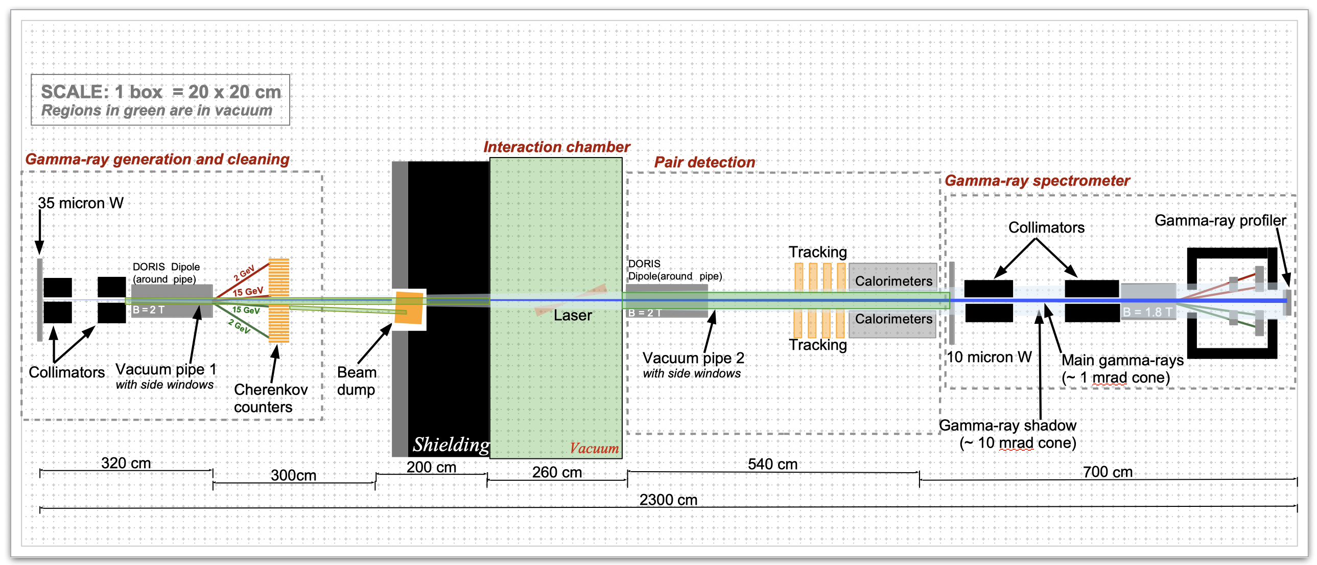
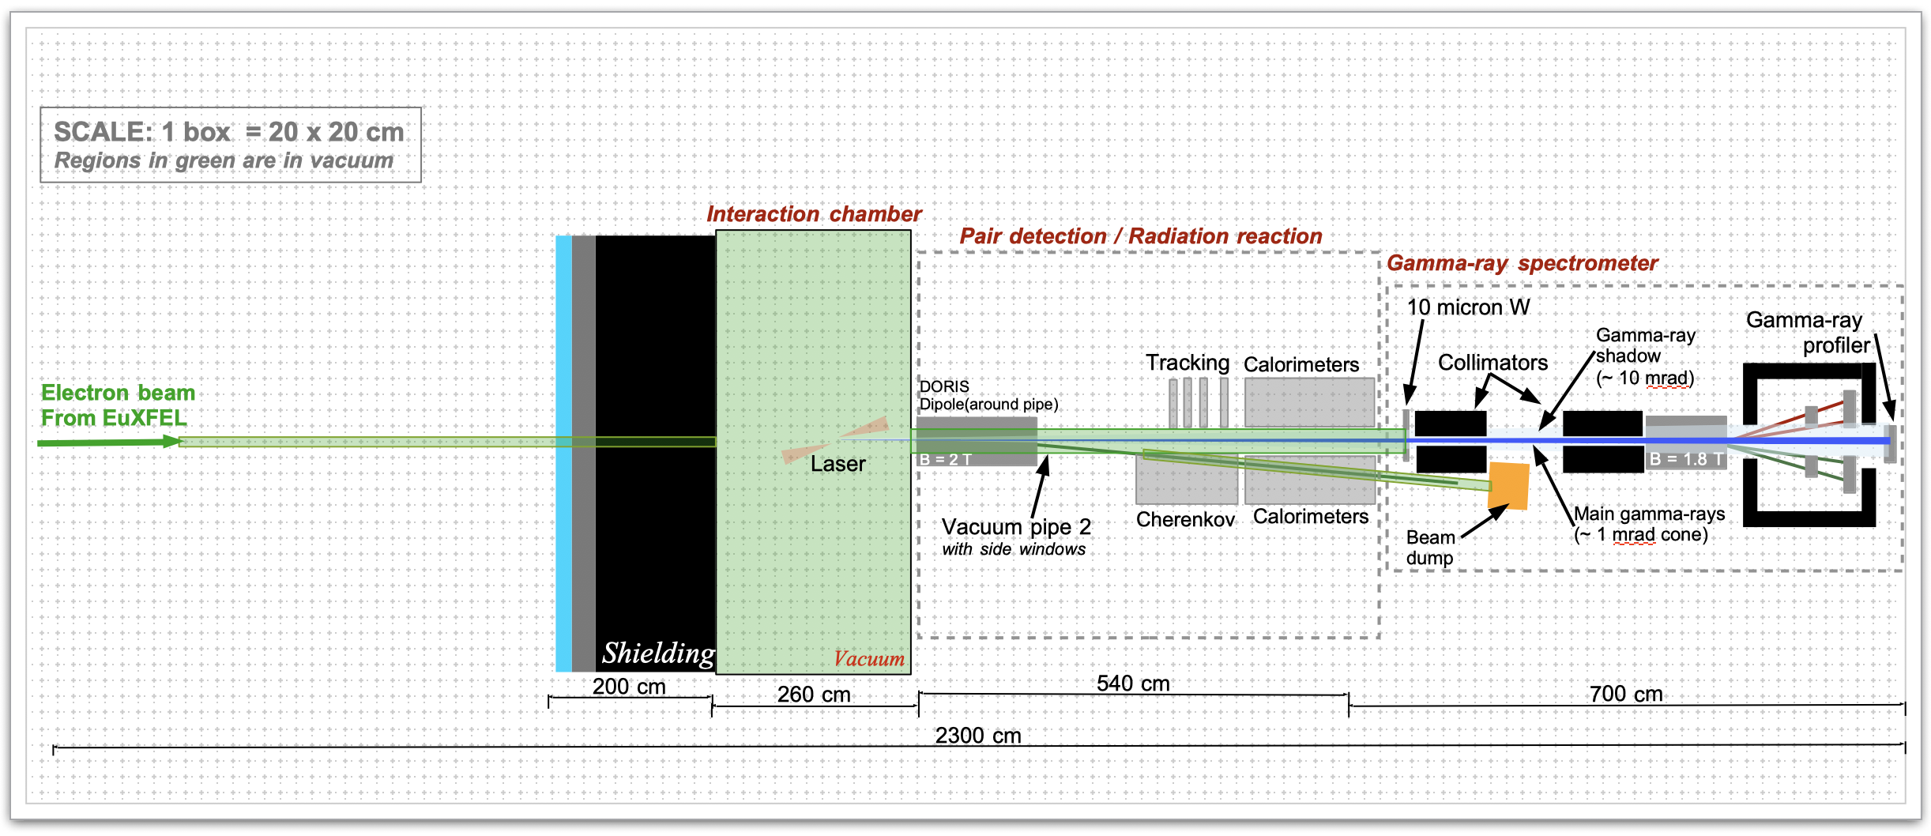
Photon+laser
Electron+laser

Slide 3
Can we come up with one unified setup?

Slide 4
Photon/electron+laser
Positron side:
The same anyway
Electron side:
Scintillator+ALPIDE+Cerenkov?
Make target
removable
Magnet turned off for
E-laser mode
Two beam dumps
Photon detection system:
The same anyway

Slide 5
Advantages
Can easily switch between the two modes
Useful to have high rate Compton process for tuning, calibration, alignment for BPPP also
Helps to tune electron/laser overlap region
Minimizes risks that things get broken during setup switch
Target being retractable is anyway a very good thing

Slide 6
Challenges
Electron detector: want tracker for BPPP process but probably not rad-hard enough for Compton process? Can it be moved by robotics? Operationally one could
start each brem-laser run with egamma setup to make sure we have good overlap and timing between electron beam and laser
once that is established: add target
once that is established: move in tracking detector
Cherenkov and scintillator too? Depends on if they are mechanically coupled also.
[and at the end of the run the reverse potentially]
Electron rates are low: how to operate Cherenkov to count the low rates?
Need two beam dumps [+photon dump]
This is probably true anyway as moving a beam dump seems a bit tough?
Are there other things that I am overlooking?

