Slide 1
ARES operation meeting
F. Burkart on behalf of the ARES shift crew
14.09.2020

Slide 2
Achievements
Beam in the EA with both TWS powered
MDI shift
MSK shift
Tools development
Issues
X1 screen collision with FC
TWS2 was not a nominal pulse settings
S1 not reachable

Slide 3
Grounding Issues
MKK and MIN analysis ongoing.
Beam jittering can be explained by leaking RF
Anyway could opportunity to check grounding of ARES
Meeting with MKK and MIN
First re-investigations by MKK

Slide 4
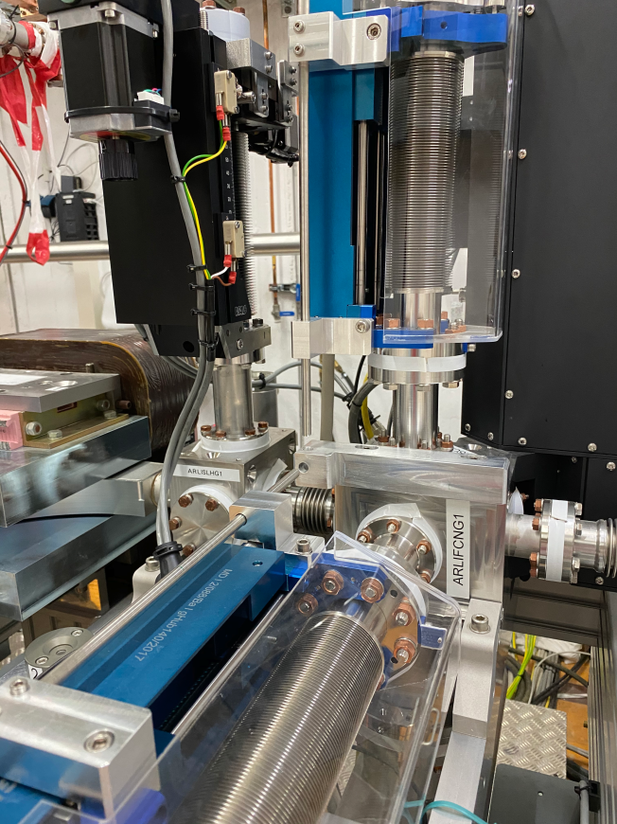
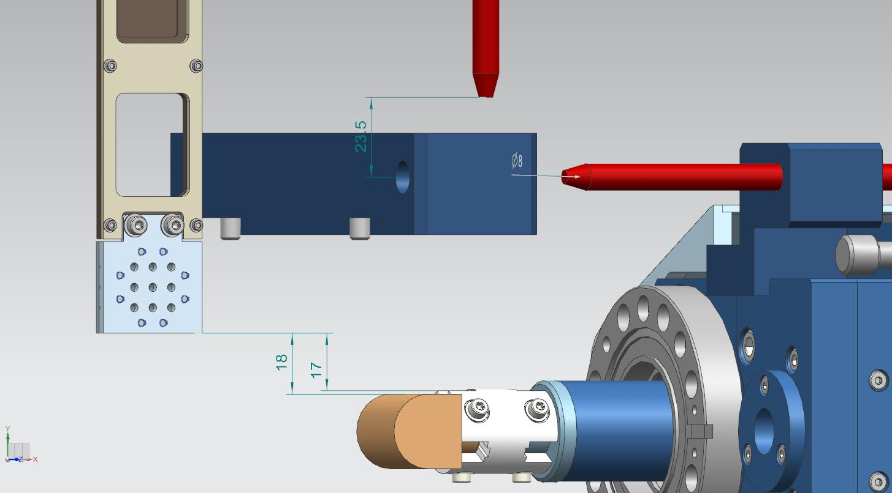
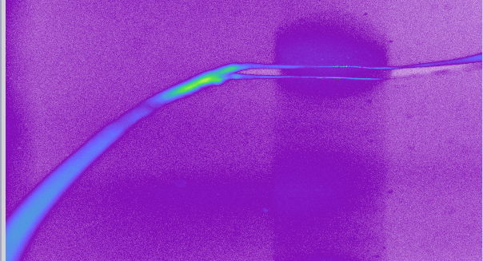
Screen – FC collision

Slide 5
Other (technical) stuff
Corrector Magnets orientation – was fixed by MKK this morning – to be checked tomorrow.
EA1 rack server finally installed.
Gun Klystron arcing – solved by reducing operating voltage and increasing amplitude.
Crane works and construction work expected – going back to BKR under discussion.

Slide 6
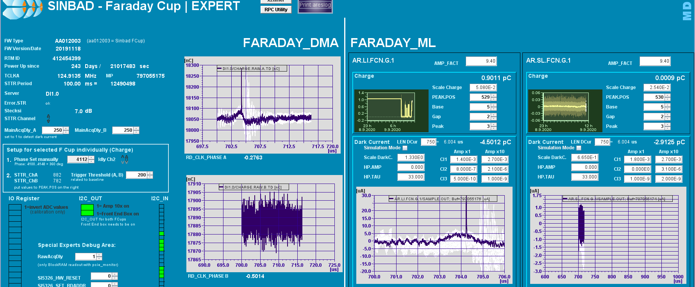
MDI shift summary
Matthias Werner, Dirk Lipka, Gero Kube, Reinhard Neumann, Norbert Wentowski, Artem Novokshonov
KURZFASSUNG: - Solenoid-Scans für DaMon und FaradayCup-Messungen wiederholt, alles ist konsistent. - FaradayCup zeigt ca. 15% weniger Ladung als DaMon. Frühere Differenz von bis zu 40% erklärbar. - Dunkelstrom-Messung mit Schirm auf später verschoben, weil Dunkelstrom aktuell zu klein ist. - Nach Entfernen des Oszilloskops sind Störungen durch TWS1-Modulator in der FaradaCup-Messung verschwunden! Das Scope kann bei Bedarf ausgebaut und an anderer Stelle verwendet werden

Slide 7
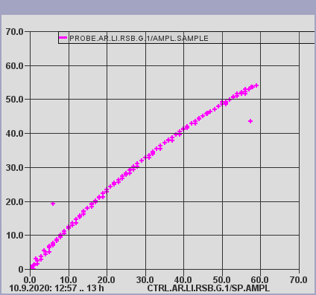
MSK shift summary
Sven Pfeiffer, Matthias Hoffmann
momentum measurement for RF-gun
9:00-10:00 FW and LLRF server update for TWS2, LLRF server update for RF-gun and TWS1
10:20-11:10 Signal adjustments for the RF-gun
additional
Displayed RF-gun pre-amplifier signal calibrated in W
TWS2 power signals after server update adjusted
Conclusion
RF-gun
SP scales now in MV/m
OVC working to compensate for non-linearities in the high power chain
TWS1 - operation as before
TWS2 - operation as before, new server with adjusted parameters
Sonst freuen wir uns auf die nächste Schicht. War echt nett heute :-) Viele Grüße, Sven

Slide 8
Plans for week 38
Data analysis
Hardware Commissioning – Screens and Magnets downstream of EA1.
Beam Measurements
Phase scan vs. Centroid
QE measurements (please inform Max!)
Emittance vs. Charge
Stability measurements

Slide 9
Schedule
Week 38
Date | Shiftleader
14.9. | MDI, MKK, MIN, FS-LA
15.9. | Hannes / Willi
16.9. | Hannes / Willi
17.9. | Frank
18.9. | Thomas

Slide 10
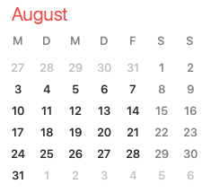

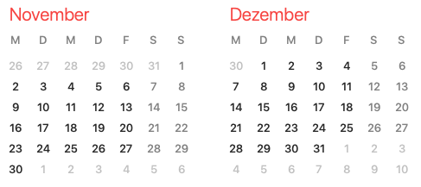
Shutdown (Monday = Maintenance day)
RF Conditioning (Gun)
Beam Commissioning (Gun section)
Beam Commissioning (Linac section + EA1)

Slide 11
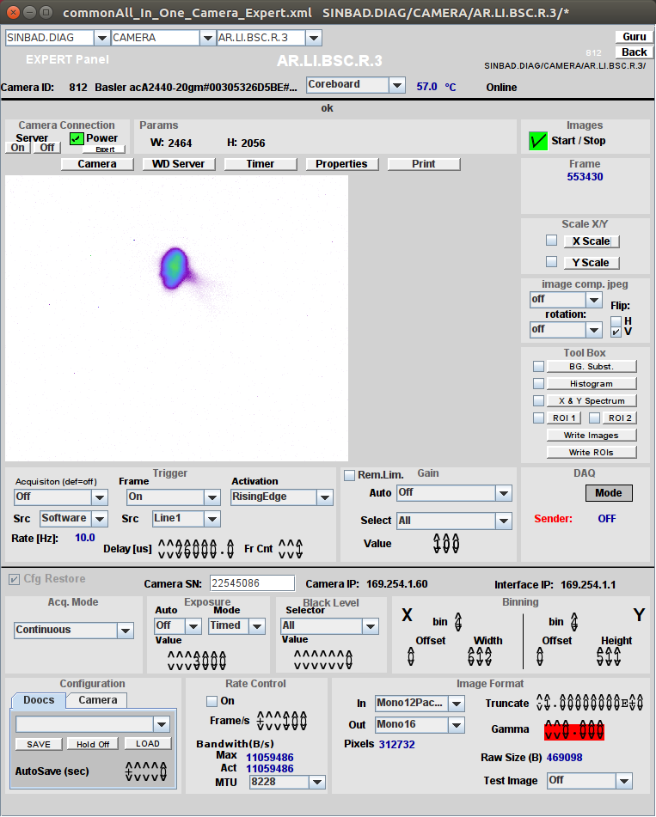
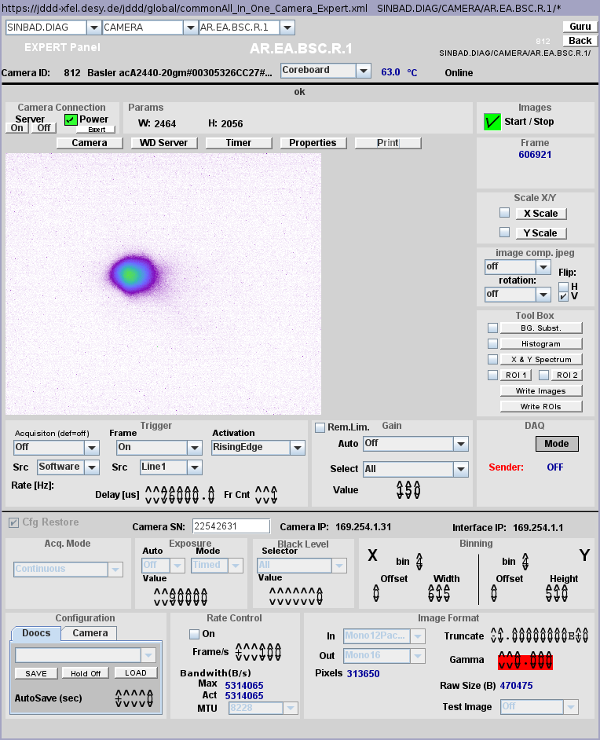
TWS1 momentum measurement on EA.R1 and LI.R3
* Momentum measured for each screen with CXG3 in the same conditions (Note: Distance screen/steerer is large enough so that the model assumptions are fulfiled for both cases).
LI.R3 → 75.51 +/- 1.38 MeV/c
EA.R1 → 76.83 +/- 1.00 MeV/c
* Results are consistent within the errorbars → LI.R3 and EA.R1 have very close (same ?) vertical calibration. It would still be good to have a calibration of all screens to avoid any doubts.

Slide 12
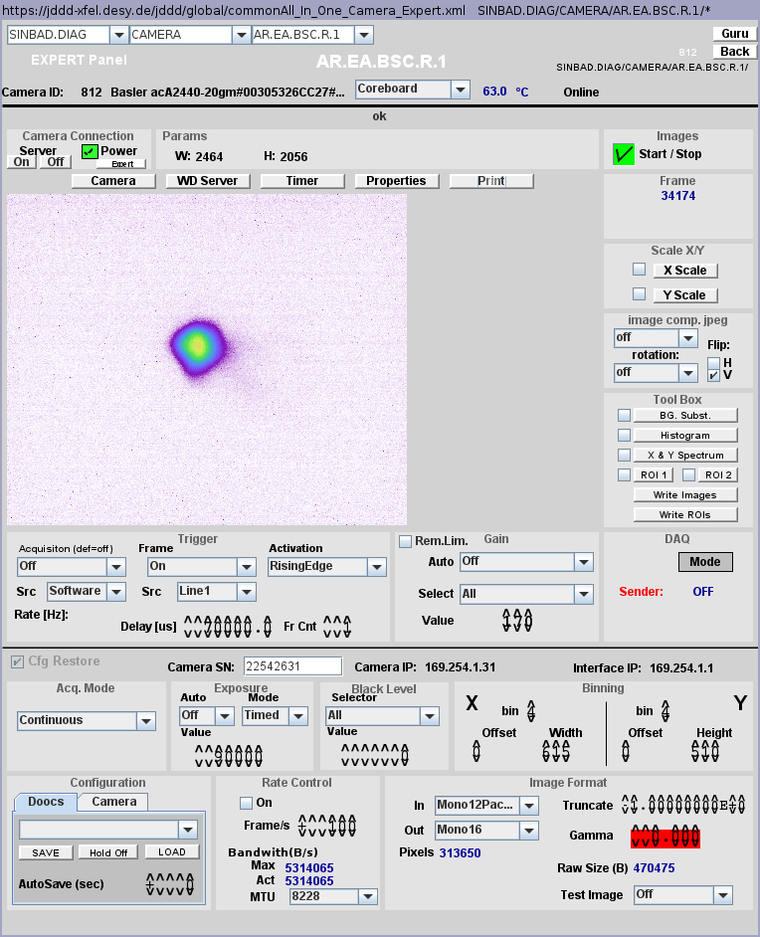
TWS1 momentum measurement with CXG3 and CXG4
* Momentum measured on EA.R1 with CXG3 and CXG4 in the same conditions (Note: Distance screen/steerer is large enough so that the model assumptions are fulfiled for both cases).
CXG3 → 76.04 +/- 0.98 MeV/c
CXG4 → 71.10 +/- 0.92 MeV/c
* Results not compatible within the errorbars → Calibration of CXG3 and CXG4 are very likely different (by around 6.5%) → Cross-calibration of all PCB steerers would be useful (especially since mounting dependent).

Slide 13
TWS2 momentum measurement
First a maximum of only 80 MeV/c (< 10 MeV/c gain) was found for 36 MW probe power.
TWS2 pulse was found to be only 0.9 μs long (vs 2 μs for TWS1) → The beam was out of the pulse and probably seeing only „remnants“ of the accelerating field → Fast conditioning up to 2 μs pulse length and 34 MW probe power (Note: Pulse shape weird compared to TWS1).
A maximum around 113 MeV/c was found, with no improvement by changing the delay of TWS2 pulse → Beam is very likely in the pulse now.
The maximum of around 42 MeV/c is not compatible with the expected accelerating field. It should be around 69 MeV/c for a probe power of 34 MW.

Slide 14
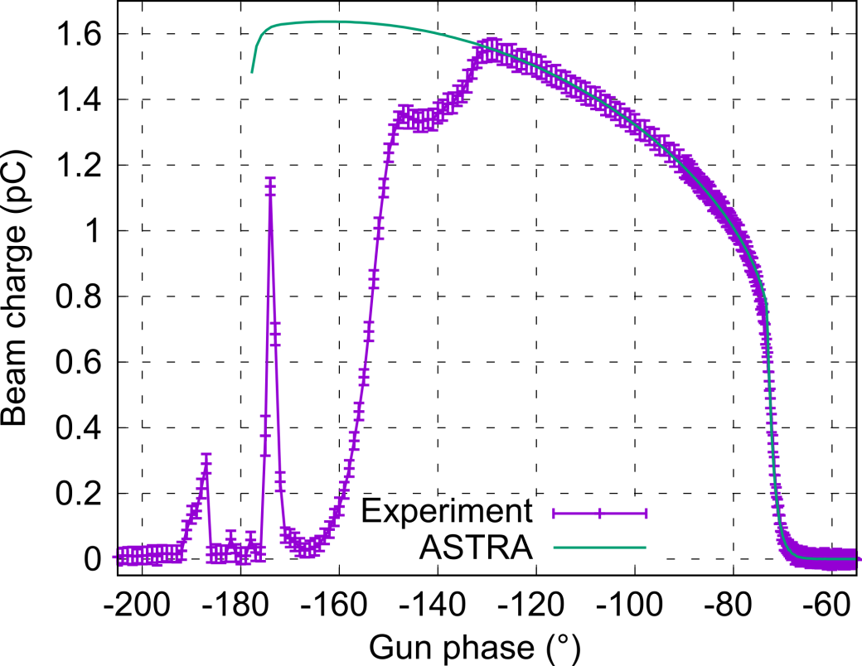
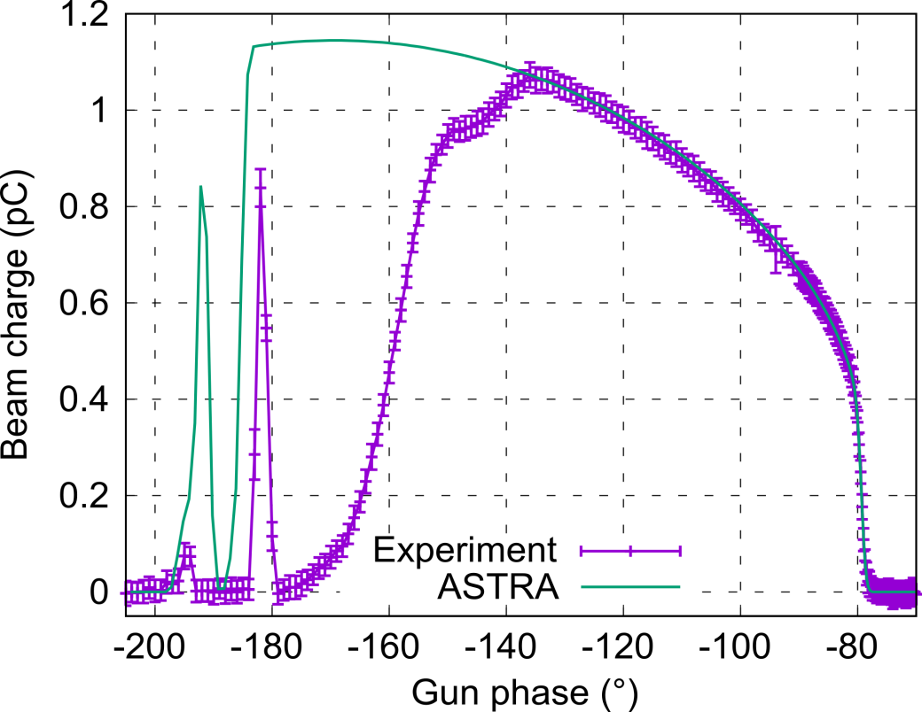
Schottky scan for Cs₂Te and Mo cathode: Status
* Simulations still ongoing to check unclear points (region of the tail and shoulder especially).
* Cs₂Te (left): Strong hint towards dominant response time of the cathode wrt laser pulse duration, with an exponential delay set to around 1.2 ps in ASTRA for the plot. Still difficulty to fit the shoulder region (under investigation).
* Mo (right): Shorter response time than Cs2Te. Not totally clear if this is only laser-induced or if there is a also an effect of a cathode response time. 550 fs rms Gaussian laser with no response time for the plot.

