Slide 1
LUXE ECAL budget
Wolfgang Lohmann

Slide 2
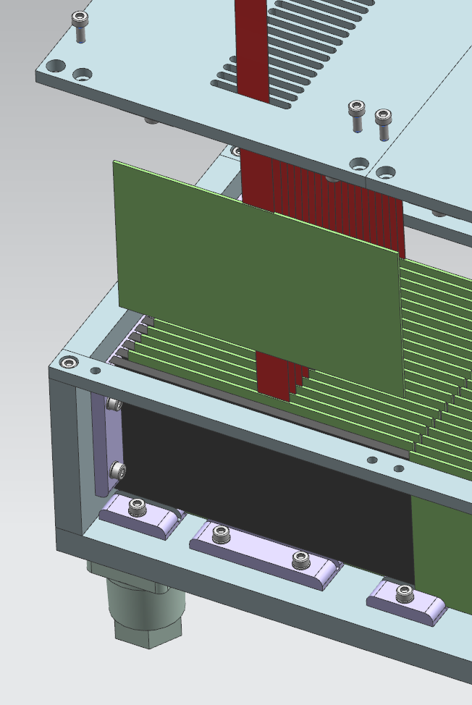
ECAL budget
ECAL structure
Silicon detector planes
Tungsten absorber plates,
55x5.5x0.35 cm³,
insertion of a detrector plane

Slide 3
ECAL budget
Detector plane with FE electronics
Full calorimeter readout modules

Slide 4
ECAL budget
The calorimeter is subdivided in 5 modules, each 10.5x5.5 cm² in area.
Each sensor has a size of 5.5 x 10.5 cm2. Tungsten plates are made of the full length of the calorimeter .
The volume of one tungsten plate is 550 x 55 x 3.5 mm³ = 105,88 cm³. With the tungsten mass density ρ= 19.3 gcm⁻³ the mass per plate amounts to 2,04 kg. For 20 plates this is 41 kg.
Assuming a price of 400 $ per plate, the total price amonts to about 8000 $, or 6800 Euro.
The cost for the production of the mechanical frame is estimated from the DESY engineers to be about 1000 Euro.
The sensor area amounts to 10.5 x 5.5 cm² = 58 cm². For one module this results to 1160 cm² and for the whole calorimeter to 5800 cm². Assuming a price about 8 Euro cm⁻², the price for one piece is 464 Euro, for one module is 9280 Euro, and for the calorimeter about 46400 Euro.
Each sensor needs two Kapton PCBs for signal transmission and HV supply. Assuming 60 Euro per piece, for one module 2400 Euro are needed, and for the calorimeter 12000 Euro.
In addition carbon fibre supports are needed. For these supports a price of 300 Euro per piece is assumed.

Slide 5
ECAL budget
The number of readout channels depends on the pad-size. Assuming 5 x 5 mm² pads, the number of channels per sensor is 231, per module 4620, and for the calorimeter 23100. Assuming for ASIC production a price of 1.5 $ per channel, the cost for ASICs is about 36000 Euro.
In addition, expenditures for ASIC prototyping, probe-cards, PCBs for FE electronics, LV and HV supplies, Crates, receiver cards and tooling are forseen.
LUXE calorimeter
Mechanics
 | number | price | total
tungsten plates | 20 | 340 | 6800
support frame | 1 | 1000 | 1000
sensor support structures (carbon etc) | 100 | 300 | 30000

Slide 6
ECAL budget
Connectivity
fan out Kapton HV | 100 | 60 | 6000
fan out Kapton, signal | 100 | 60 | 6000
Silicon sensors | 100 | 470 | 47000
Front-end ASICs
prototyping, ASICs | 50 | 1000 | 50000
channels | 24000 | 1,5 | 36000
probecard for tests | 1 | 20000 | 20000

Slide 7
ECAL budget
front-end electronics
PCB and assemply | 100 | 100 | 10000
auxiliary components |  |  | 15000
Power supplies
HV |  |  | 10000
LV |  |  | 10000
cables and connectors, patch panels |  |  | 15000
Data acquisition
Receiver cards (FPGA based) | 100 | 500 | 50000
crates | 5 | 1000 | 5000
crate computer | 5 | 1000 | 5000
racks | 1 | 2000 | 2000
Tooling |  |  | 30000
sum |  |  | 354800

Slide 8
ECAL budget
Engineering Personpower, 2 FTE years |  |  | 160000
total |  |  | 514800
The costs of the components for one Luxe ECAL amount to 354,8 k Euro. The engineering person power is estimated to be 2 FTE years, corresponding to 160 k Euro. The total budget then amounts to 514,8 k Euro.

Slide 9
Phase 0 budget
The calorimeter is subdivided in 5 modules, each 10.5x5.5 cm2 in area.
In the following a cost estimate for one module is given:
Each sensor has a size of 5.5 x 10.5 cm2. Tungsten plates are made of the same size.
The volume of one tungsten plate is 550 x 55 x 3.5 mm³ = 105,88 cm³. With the tungsten mass density ρ= 19.3 gcm⁻³ the mass per plate amounts to 2,04 kg. For 20 plates this is 41 kg.
Assuming a price of 400 $ per plate, the total price amonts to about 8000 $, or 6800 Euro.
The cost for the production of the mechanical frame is estimated from the DESY engineers to be about 1000 Euro.

Slide 10
Phase 0 budget
The sensor area amounts to 10.5 x 5.5 cm² = 58 cm². For one module this results to 1160 cm². Assuming a price about 6 $ cm⁻², the price for one piece is 350$, and for one module is 7000 $.
Each sensor needs two Kapton PCBs for signal transmission and HV supply. Assuming 60 $ per piece, for one module 2400 $.
In addition carbon fibre supports are needed. For these supports a price of 300 $ per piece is assumed.
The number of readout channels depends on the pad-size. Assuming 5 x 5 mm² pads, the number of channels per sensor is 231, and per module 4620. Assuming for ASIC production a price of 1.5 $ per channel, the cost for ASICs is about 7000 $.
In addition expenditures for ASIC prototyping, probe-cards, PCBs for FE electronics, LV and HV supplies, Crates, receiver cards and tooling are foreseen. A summary is given in the following table.

Slide 11
Phase0 budget
LUXE calorimeter
Mechanics
 | number | price | total
tungsten plates | 20 | 340 | 6800
support frames | 1 | 1000 | 1000
sensor support structures (carbon etc) | 20 | 300 | 6000
Connectivity
fan out Kapton HV | 20 | 60 | 1200
fan out Kapton, signal | 20 | 60 | 1200
Silicon sensors | 20 | 470 | 9400
Front-end ASICs
prototyping, ASICs | 50 | 1000 | 50000
channels | 5000 | 1,5 | 7500
probecard for tests | 1 | 20000 | 20000

Slide 12
Phase0 budget
front-end electronics
PCB and assemply | 20 | 100 | 2000
auxiliary components |  |  | 5000
Power supplies
HV |  |  | 5000
LV |  |  | 5000
cables and connectors, patch panels |  |  | 5000
Data acquisition
Receiver cards | 20 | 500 | 10000
crates | 1 | 1000 | 1000
crate computer | 1 | 1000 | 1000
racks | 1 | 2000 | 2000
Tooling |  |  | 20000
sum |  |  | 159100
Engineering Personpower |  |  | 80000
total |  |  | 239100
The budget for the calorimeter hardware amounts to 159,1 k Euro, including one year of personpower it amounts to 239,1 k Euro

Slide 13
Phase0, two modules instrumented
LUXE calorimeter
Mechanics
 | number | price | total
tungsten plates | 20 | 340 | 6800
support frames | 1 | 1000 | 1000
sensor support structures (carbon etc) | 40 | 300 | 12000
Connectivity
fan out Kapton HV | 40 | 60 | 2400
fan out Kapton, signal | 40 | 60 | 2400
Silicon sensors | 40 | 470 | 18800
Front-end ASICs
prototyping, ASICs | 50 | 1000 | 50000
channels | 10000 | 1,5 | 15000
probecard for tests | 1 | 20000 | 20000

Slide 14
Phase0 budget two modues instrumented
front-end electronics
PCB and assemply | 40 | 100 | 4000
auxiliary components |  |  | 5000
Power supplies
HV |  |  | 5000
LV |  |  | 5000
cables and connectors, patch panels |  |  | 5000
Data acquisition
Receiver cards | 40 | 500 | 20000
crates | 2 | 1000 | 2000
crate computer | 2 | 1000 | 2000
racks | 1 | 2000 | 2000
Tooling |  |  | 20000
sum |  |  | 198400
Engineering Personpower |  |  | 120000
total |  |  | 318400

Slide 15
ECAL budget
Still to be done:
Update for sensors (Yan)
Update for FE electronics (Marek)
Support for Ph.D.
Travel costs
Budget profile (timeline)
Contingency (20% ???)

