Slide 1
ARES operation meeting
W. Kuropka on behalf of the ARES shift crew
21.09.2020

Slide 2
Achievements
Beam at the end of the beamline!
Quadrupole commissioning started
High energy dipole commissioning started
EA1 chamber commissioning started
Tools development
Issues
X1 screen collision with FC (from last week)
Gun set-point limited to 60MV/m (in software)
Slight forward power jumps at gun
Some magnet power converter and modulator issues (including communication errors, to be investigated by MIN)

Slide 3
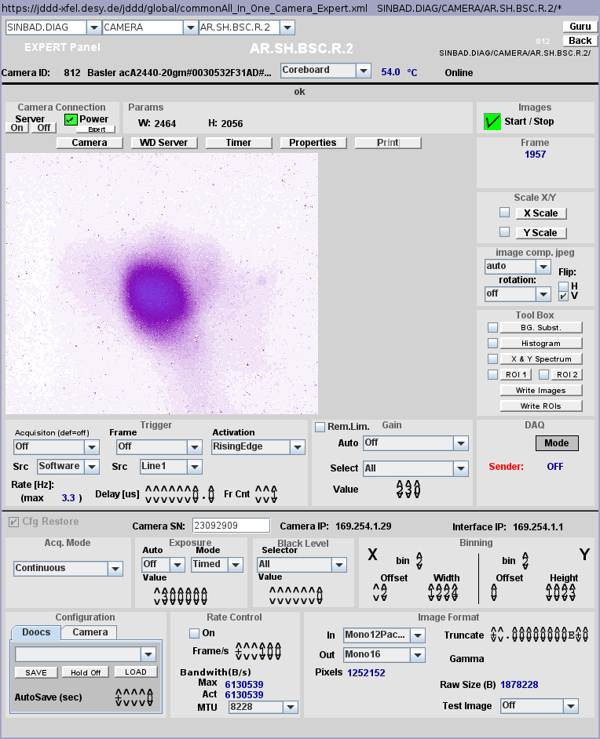
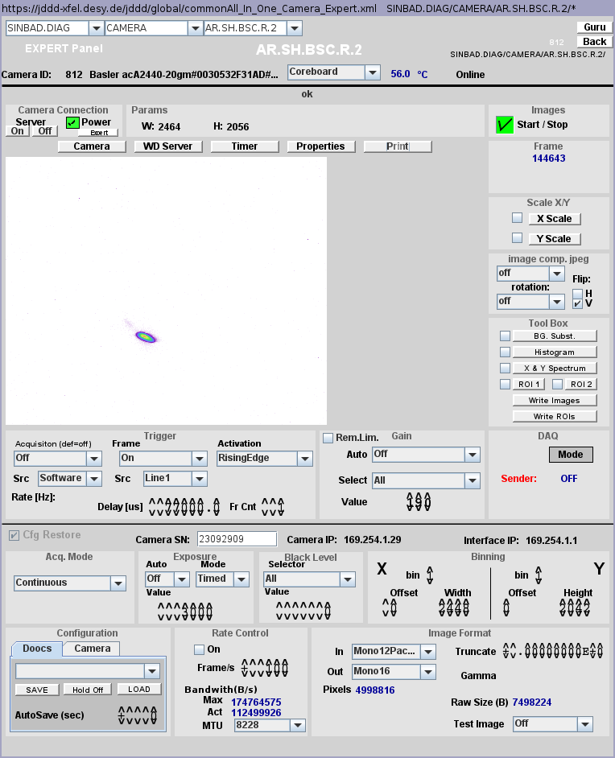
Beam at the end of the beamline!
Reproducible working point
Also with quadrupoles

Slide 4
TWS2 phase scan
Measured at set phase for TWS1
75 MeV/c input from TWS1
Forward power reading not compatible with momentum gain

Slide 5
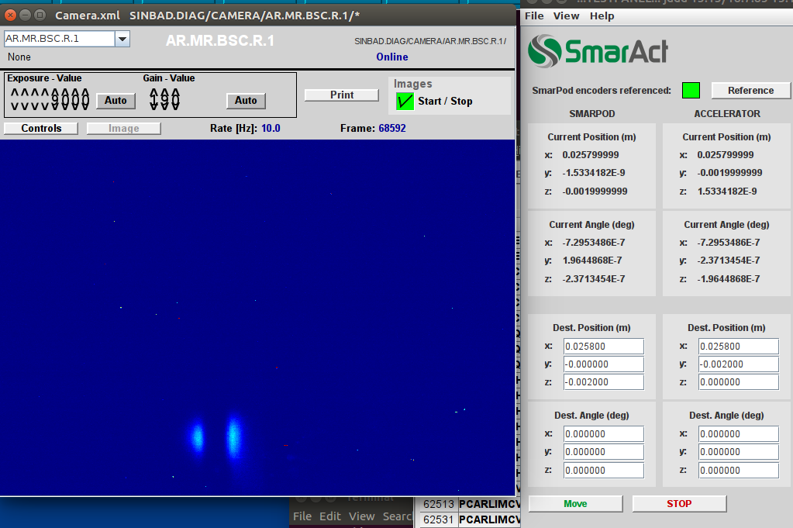
Beam at EA1 chamber
Sample holder alignment channel (0.5mm) was found swiftly
Beam centered on DLA1

Slide 6
Beam at EA1 chamber
https://ttfinfo.desy.de/SINBAD-ARESelog/show.jsp?dir=/2020/38/17.09&pos=2020-09-17T15:45:00

Slide 7
Other (technical) stuff
Corrector Magnets: Orientation checked for all magnets – a few more changes necessary
Toroid operational
Except EA.X1 all screen stations are in operation, triggered and calibrated
High energy dipole corrector coil setup and cycling procedure to be investigated.
Crane works and construction work expected – going back to BKR under discussion.

Slide 8
Plans for week 38
Data analysis
Hardware Commissioning – all quadrupole Magnets, high energy dipole
Beam Measurements
  Momentum Measurements / phase scans
  Reference files
  Phase scan vs. Centroid
  QE measurements (please inform Max!)
  Emittance vs. Charge
  Stability measurements

Slide 9
Schedule
Week 39
Date | Shiftleader
21.9. | MKK, FS-LA
22.9. | Hannes / Florian - Frank for Lasershutter
23.9. | Frank
24.9. | Florian / Willi
25.9. | Thomas

Slide 10
Schedule
Week 40
Date | Shiftleader
28.9. | tbd
29.9. | Florian / Willi
30.9. | Hannes
1.10. | Frank
2.10. | Thomas

Slide 11



Shutdown (Monday = Maintenance day)
RF Conditioning (Gun)
Beam Commissioning (Gun section)
Beam Commissioning (Linac section + EA1)

Slide 12
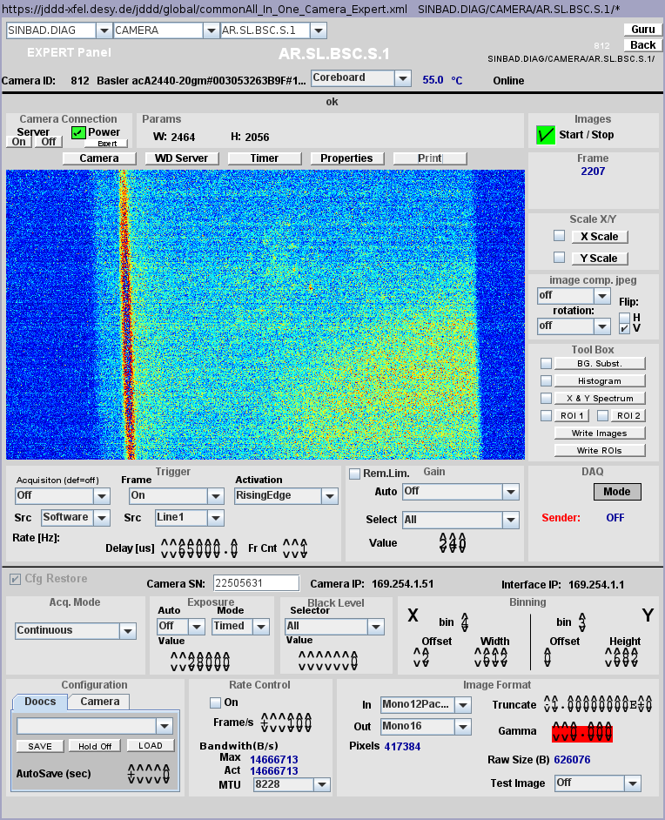
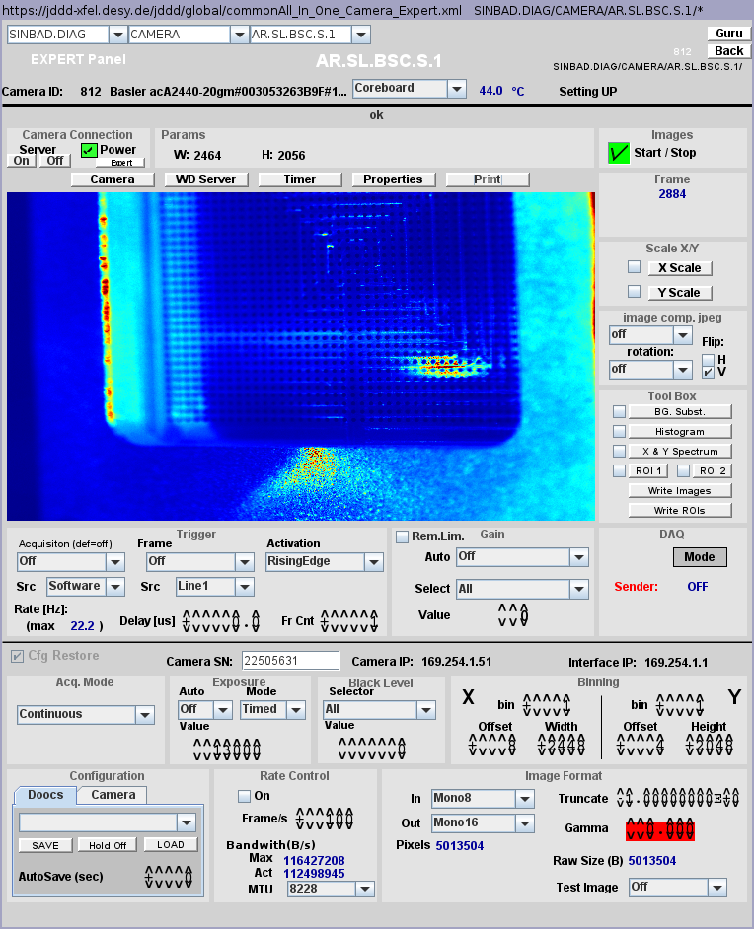
Image of the screen in S1 appears tilted
* Artem requires an image of the calibration grid to evaluate this tilt. There is one from 28.8.2020, where the calibration grid also appears tilted (good enough or should we acquire a new one ?).

Slide 13
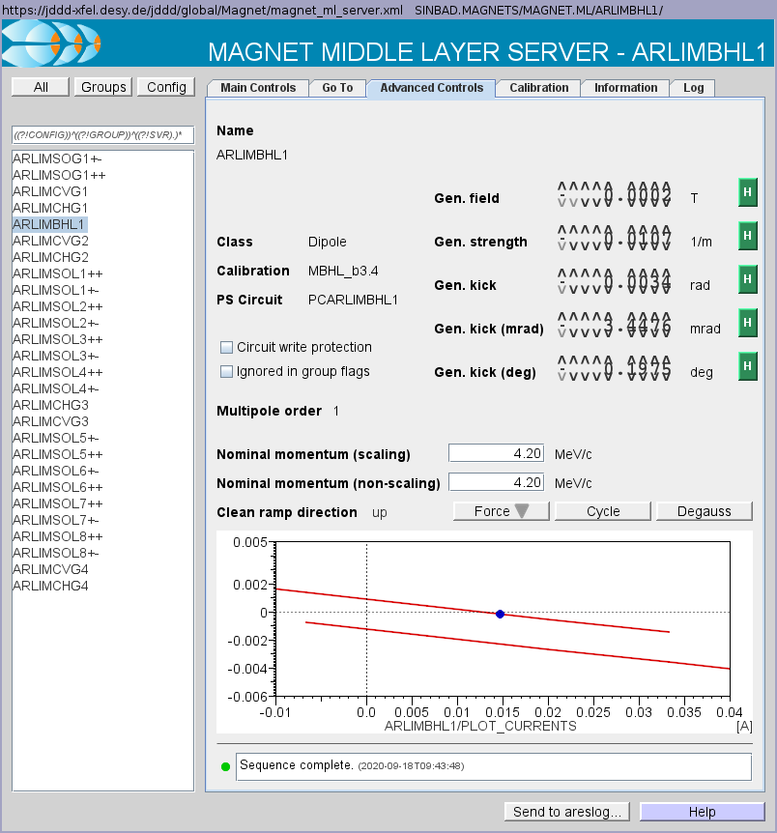
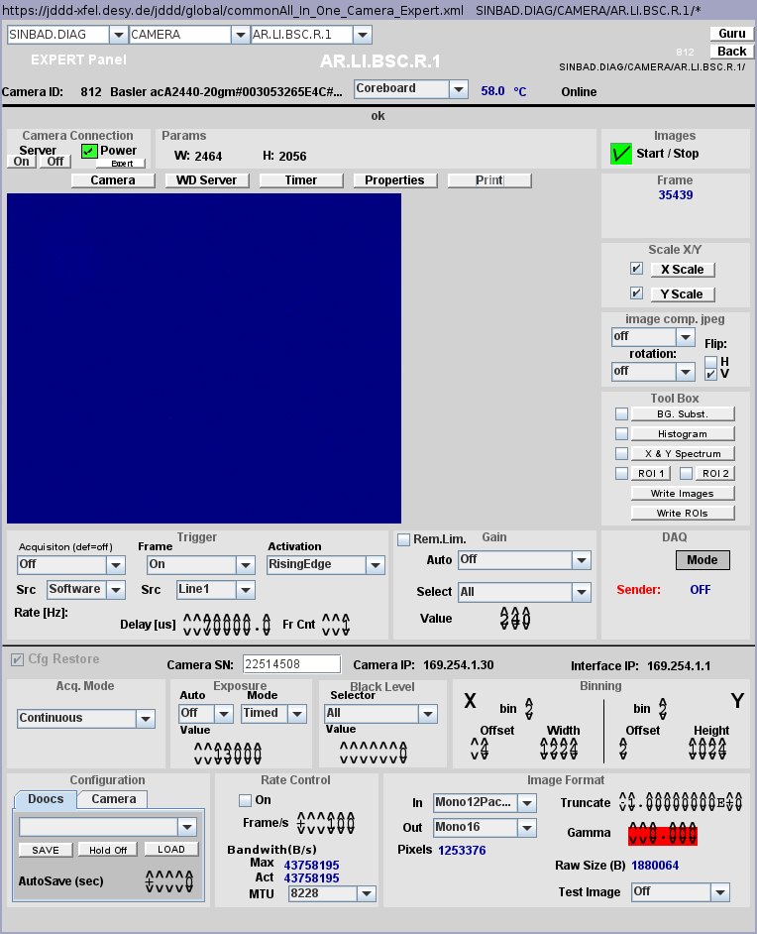

Investigation on the dipole remnant field (1/2)
* First using standard procedure: Enter 0 A as current in the main controls tab and then cycle the dipole. It goes to a current of +0.015 A on the top branch of the hysteresis curve.
Beam picture on LI.R1 (after the dipole).
CHG1 set to
0 A.
Beam picture on LI.R1 (after the dipole).
CHG1 set to
-3.3 A.
The hysteresis curve stored in the advanced controls tab shows a remnant field of -150 μT (around 3 times the earth magnetic field).

Slide 14



Investigation on the dipole remnant field (2/2)
* Then using manual procedure: Going manually (following the hysteresis) to a current of +0.0126 A on the top branch of the hysteresis curve (using Go To tab).
Beam picture on LI.R1 (after the dipole).
CHG1 set to
0 A.
Beam picture on LI.R1 (after the dipole).
CHG1 set to
-1 A.
The hysteresis curve stored in the advanced controls tab shows a remnant field of -2.5 μT.
We should keep it in mind and redo this study when all we be aligned (cathode laser and gun solenoid).

Slide 15
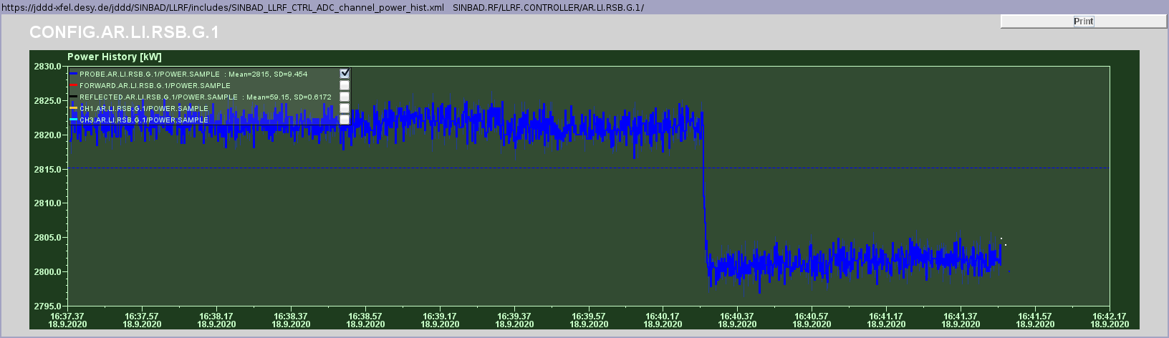
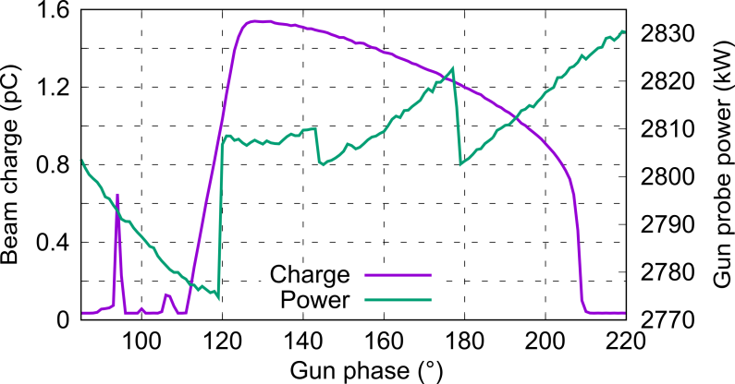
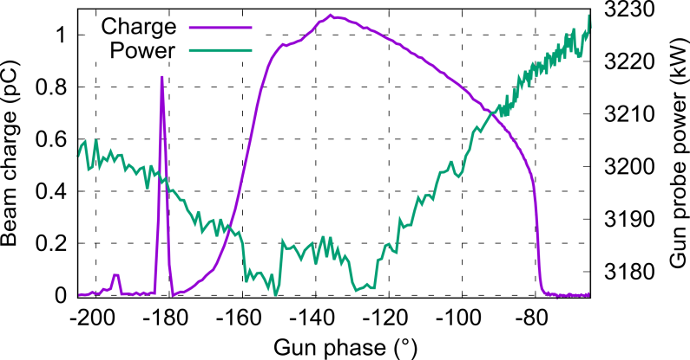
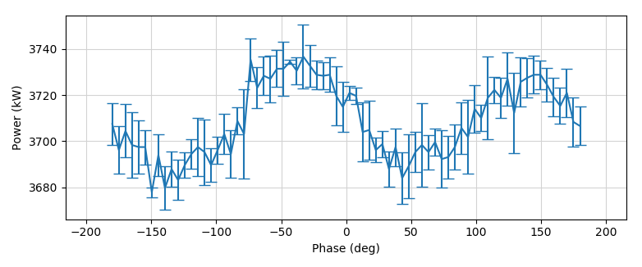
Weird behavior of gun power
* Sudden power jumps were observed when performing a phase scan and also when nothing was touched in the middle of a measurement. Amplitude was constant in Ulrich‘s tool and LLRF server.
Power drop ≈ 25 kW while nothing was touched (18/09/2020).
* The behavior with large power jumps during a phase scan (up to 35 kW at max.) was apparently not present up to recently.
Power variation during Schottky scan
(18/09/2020)
Power variation during Schottky scan
(21/08/2020)
* Modulator & water have been checked and were ok. Also no increase of reflected power.
Power variation during 360° phase scan (December 2019)

