Slide 1
LUXE ECAL budget
Wolfgang Lohmann

Slide 2
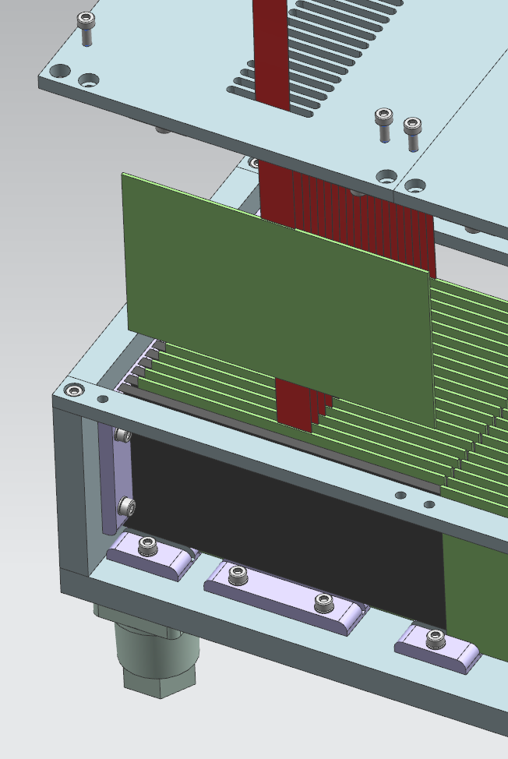
ECAL budget
ECAL structure
Silicon detector planes
Tungsten absorber plates,
55x5.5x0.35 cm³,
insertion of a detrector plane

Slide 3
ECAL budget
Detector plane with FE electronics
Full calorimeter readout modules

Slide 4
Phase 0 budget
The calorimeter is subdivided in 5 modules, each 10.5x5.5 cm2 in area.
phase0
In the following a cost estimate for one module is given:
Each sensor has a size of 5.5 x 10.5 cm2. Tungsten plates are made of the same size.
The volume of one tungsten plate is 550 x 55 x 3.5 mm³ = 105,88 cm³. With the tungsten mass density ρ= 19.3 gcm⁻³ the mass per plate amounts to 2,04 kg. For 20 plates this is 41 kg.
Assuming a price of 400 $ per plate, the total price amonts to about 8000 $, or 6800 Euro.
The cost for the production of the mechanical frame is estimated from the DESY engineers to be about 1000 Euro.

Slide 5
Phase0 budget two modues instrumented
Committments 2021 | number | price
Tungsten plates | 20 | 6800
support frame | 1 | 1000
sensor carbon support | 40 | 12000
fan out (HV and signal) | 80 | 4800
silicon sensors | 40 | 18800
ASICS, prototyping | 50 | 50000
channels | 10000 | 24000
probecard | 1 | 20000
Tooling | 1 | 20000
sum |  | 148400
Committments 2022
FE electronics
PCB and assembly | 40 | 4000
auxiliary components | 1 | 5000
HV and LV devices | 2 | 10000
connectors, PP |  | 5000
DAQ
Receiver cards | 40 | 20000
crates | 2 | 2000
crate computer | 2 | 2000
racks | 1 | 2000
sum |  | 50000
total |  | 198400
INSTALLATION WINTER 2022/23

Slide 6
Phase0 budget, two modules
expenditures in 2021
Tungsten plates | 20 | 6800
support frame | 1 | 1000
ASICS, prototyping | 50 | 50000
sensor carbon support | 40 | 12000
Sum |  | 69800
expenditures in 2022
fan out (HV and signal) | 80 | 4800
silicon sensors | 40 | 18800
ASICs channels | 10000 | 24000
probecard | 1 | 20000
Tooling | 1 | 20000
FE electronics
PCB and assembly | 40 | 4000
auxiliary components | 1 | 5000
HV and LV devices | 2 | 10000
connectors, PP |  | 5000
DAQ
Receiver cards | 40 | 20000
crates | 2 | 2000
crate computer | 2 | 2000
racks | 1 | 2000
sum |  | 128600
total |  | 198400
INSTALLATION WINTER 2022/23

Slide 7
Phase1 budget, three modules
Committments 2023/24 | number | price | total
sensor support st+5:26ructures (carbon etc) | 60 | 300 | 18000
fan out Kapton HV | 60 | 60 | 3600
fan out Kapton, signal | 60 | 60 | 3600
Silicon sensors | 60 | 470 | 28200
ASIC channels | 14000 | 2,6 | 36000
front-end electronics
PCB and assemply | 60 | 100 | 6000
auxiliary components |  |  | 10000
Power supplies
HV |  |  | 5000
LV |  |  | 5000
cables and connectors, patch panels |  |  | 10000
Data acquisition
Receiver cards | 60 | 500 | 30000
crates | 3 | 1000 | 3000
crate computer | 3 | 1000 | 3000
Tooling |  |  | 10000
sum |  |  | 156400
INSTALLATION 2026

Slide 8
Phase1 budget, three modules
Expenditures 2024/25 | number | price | total
sensor support st+5:26ructures (carbon etc) | 60 | 300 | 18000
fan out Kapton HV | 60 | 60 | 3600
fan out Kapton, signal | 60 | 60 | 3600
Silicon sensors | 60 | 470 | 28200
ASIC channels | 14000 | 2,6 | 36000
front-end electronics
PCB and assemply | 60 | 100 | 6000
auxiliary components |  |  | 10000
Power supplies
HV |  |  | 5000
LV |  |  | 5000
cables and connectors, patch panels |  |  | 10000
Data acquisition
Receiver cards | 60 | 500 | 30000
crates | 3 | 1000 | 3000
crate computer | 3 | 1000 | 3000
Tooling |  |  | 10000
sum |  |  | 156400
INSTALLATION 2026

Slide 9
ECAL budget, phase0 and phase1

Slide 10
Phase0 and phase1

