Slide 1
MTCA.4 1U CRATE The new 1U Crate by nVent SCHROFF
schroff.nvent.com
nVent Schroff
YouTube.com/nVentSCHROFF
December 02, 2020
Christian Ganninger
nVent / Schroff GmbH

Slide 2
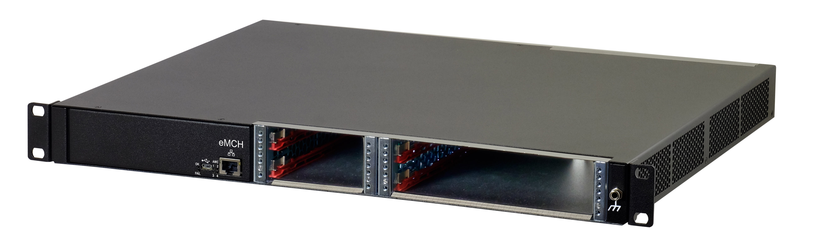
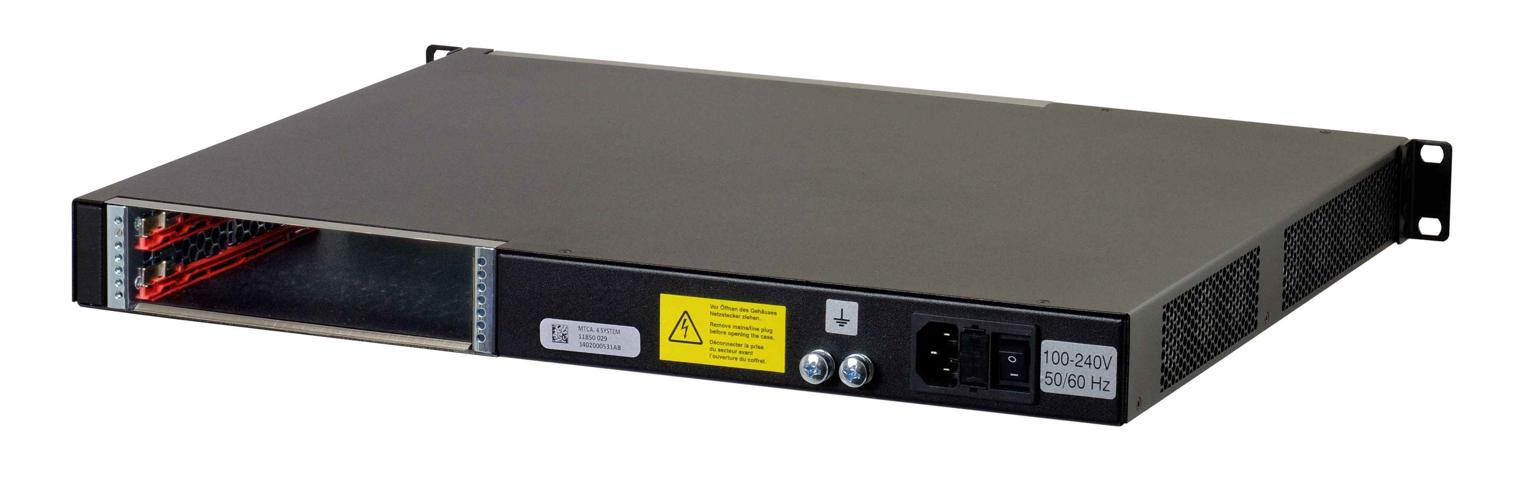
MTCA.4 1U Crate - Main Features
1 U height, 19” width, 373 mm depth
Shielded steel case, powder coated
Two Double Mid-size AMC Slots with RTM
Two Single Mid-size AMC Slots
Integrated eMCH (embedded MicroTCA Carrier Hub)
1 GbE uplink on front side
Wide range AC power input on rear side
Integrated 400 W Power Supply
Integrated side to side cooling
Power and cooling management

Slide 3
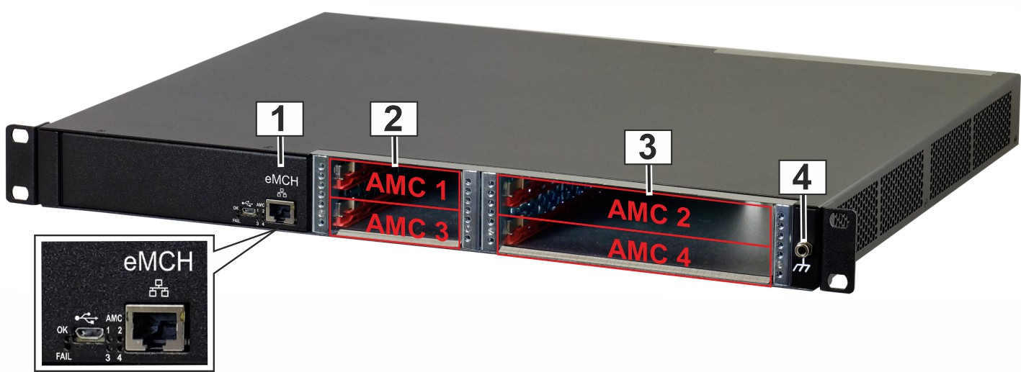
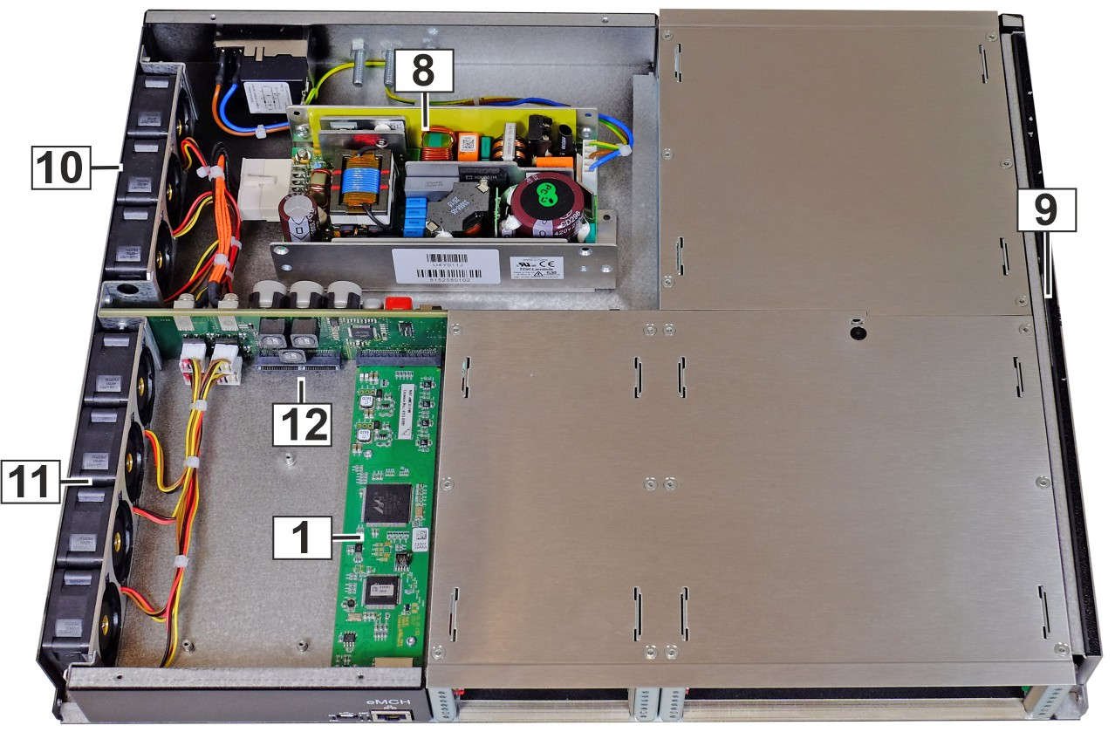
MTCA.4 1U Crate - Front, Rear and Top View
eMCH
AMC slots 1 & 3
AMC slots 2 & 4
ESD Wrist Strap Terminal (4 mm banana jack)
RTM slots
Ground Terminal (Equipotential bonding)
AC input with Mains / line switch and fuse
PSU
Air filter
Fans rear section
Fans front section
Connector for 3rd party eCLK module

Slide 4
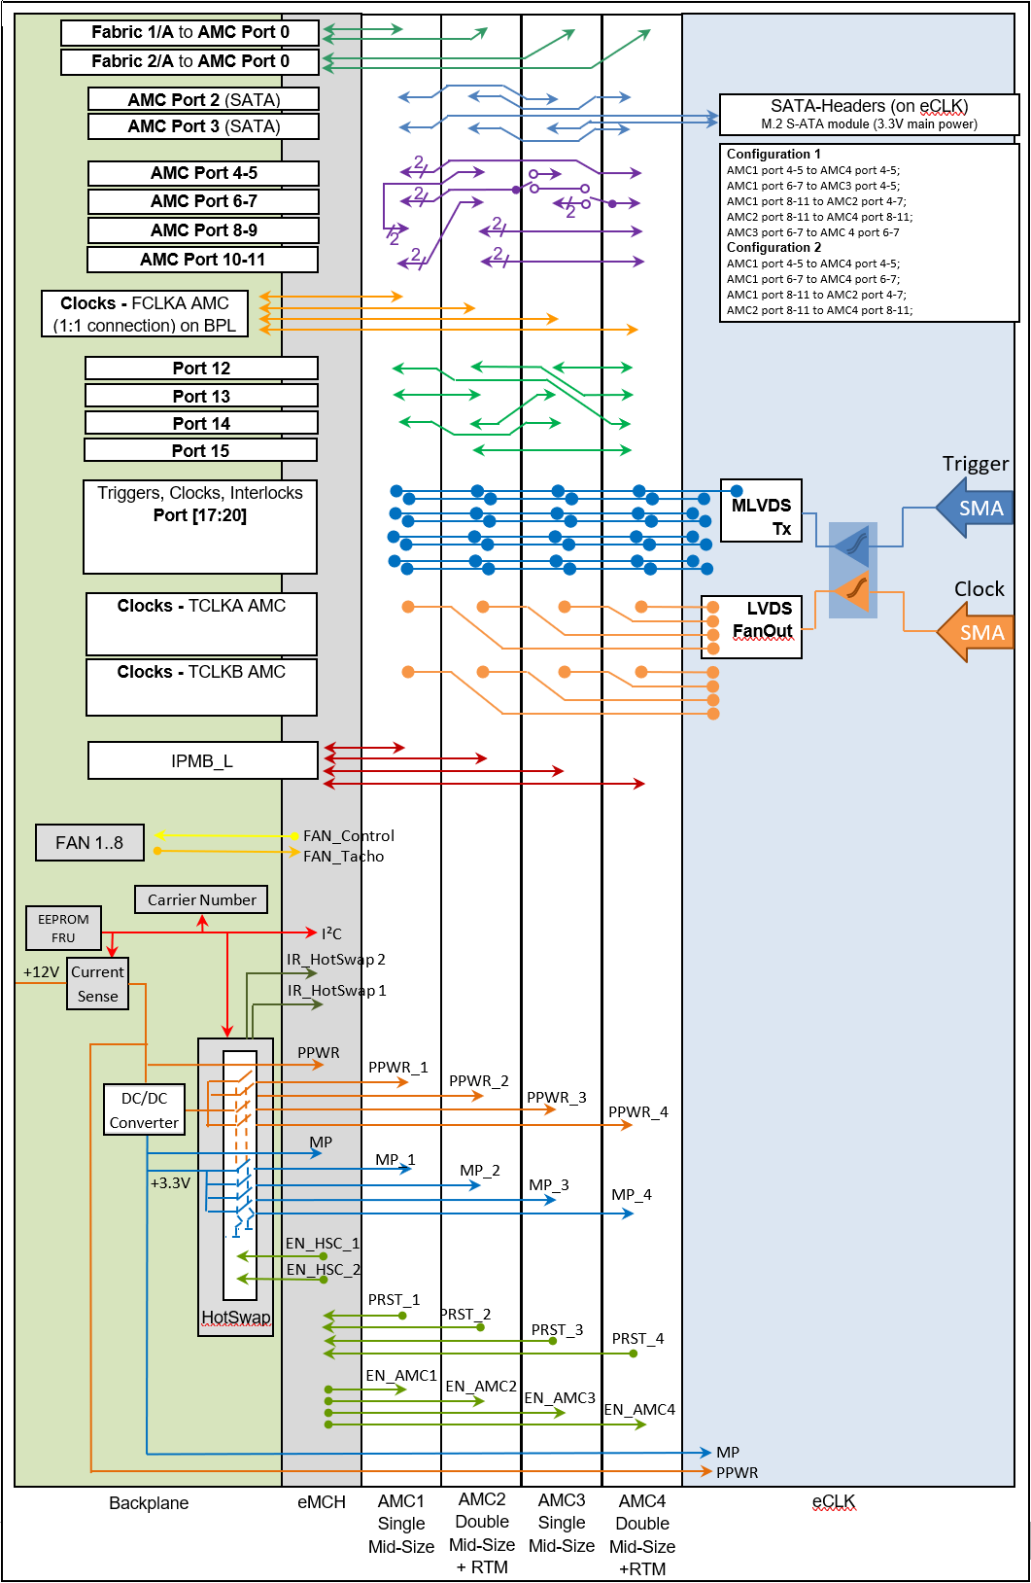
MTCA.4 1U Crate - Backplane Topology
GbE Links from MCH to all AMC Slots
Direct S-ATA / SAS connections:
AMC 1 <-> AMC 3: Port 2
AMC 2 <-> AMC 4: Port 3
AMC 1 & 3: Port 3 <-> SATA Headers on eCLK connector
Fat pipe and extended fat pipe contains 4 PCIe Gen 3 x4 MUX’s that allows the user to select through the eMCH two different fat pipe / extended fat pipe configurations
Configuration 1
AMC1 port 4-5 to AMC4 port 4-5;
AMC1 port 6-7 to AMC3 port 4-5;
AMC1 port 8-11 to AMC2 port 4-7;
AMC2 port 8-11 to AMC4 port 8-11;
AMC3 port 6-7 to AMC 4 port 6-7
FCLK for PCIe Gen3 clock generated on backplane
Configuration 2
AMC1 port 4-5 to AMC4 port 4-5;
AMC1 port 6-7 to AMC4 port 6-7;
AMC1 port 8-11 to AMC2 port 4-7;
AMC2 port 8-11 to AMC4 port 8-11

Slide 5
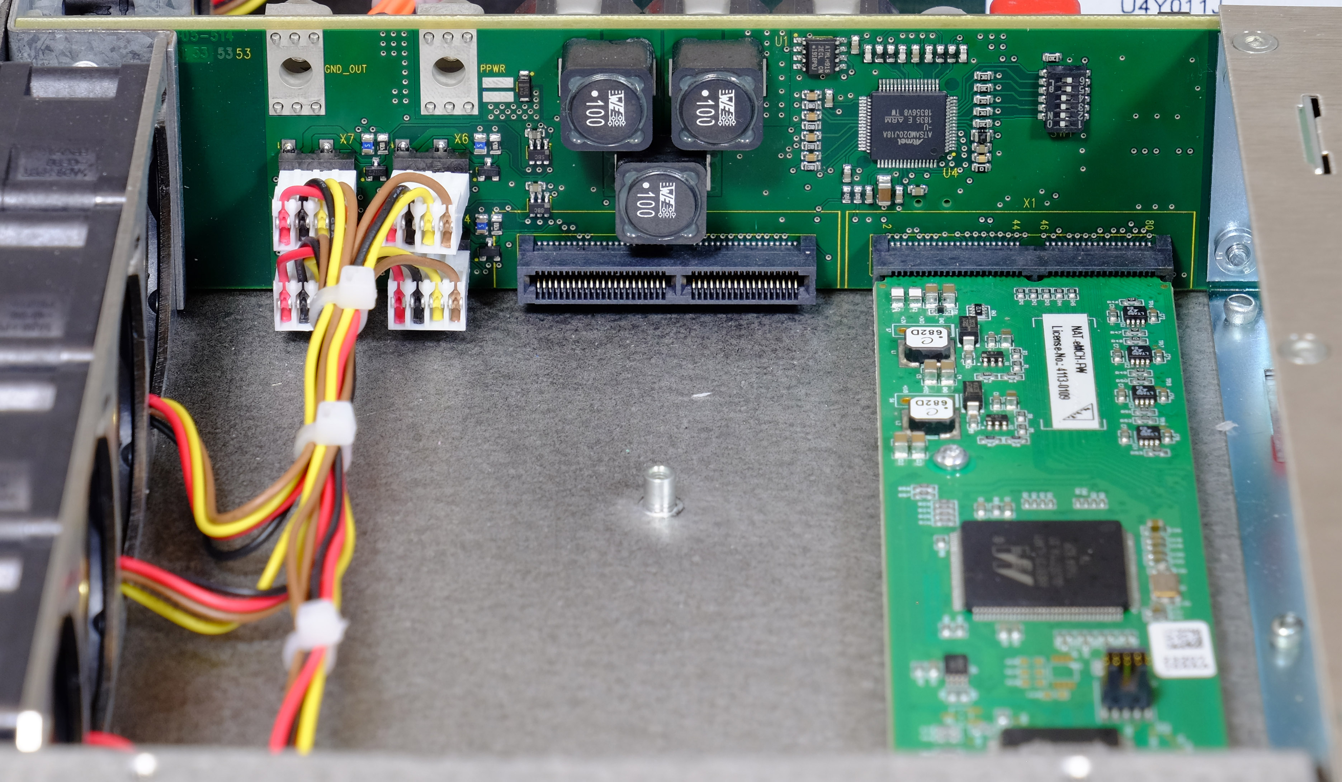
MTCA.4 1U Crate - Option for eCLK Module
The system provides a connector, stand-offs and mounting space for a third party clock module
The connector pin out is in the Crate’s User Manual
1x MP pins (3.3V / 1.5A) and 4x PP pins (12V / 6A)
Port 17 to 20 busses routed to eCLK connector
TCLK A & B routed from each AMC to the eCLK connector
Either external Clk and trigger feedthrough or internal CLK module can be realized

Slide 6
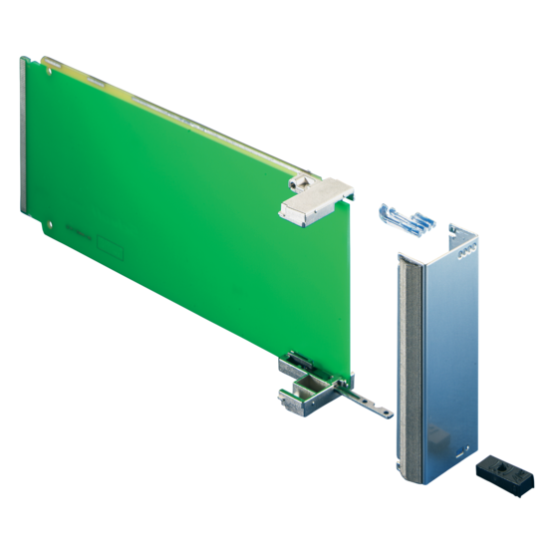
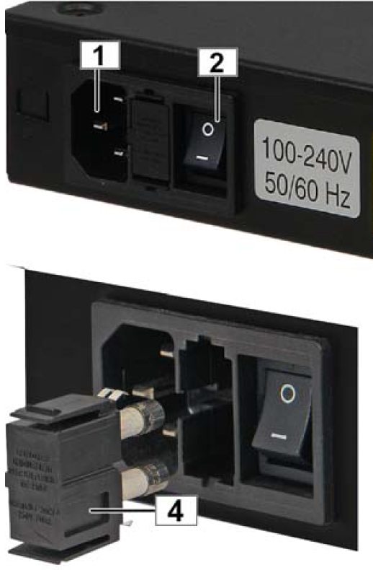
MTCA.4 1U Crate - Cooling & Power
Cooling from right to left
ATTENTION: To fit 2 Mid-size AMC’s one above the other, the AMC’s are mounted upside down (pcb on the bottom side)
Better heat dissipation from pcb (air convection)
Air flow direction is from top of the AMC module to the bottom
Air filter in the inlet section can be removed after top cover is disassembled
7x 40 mm fans located in the air outlet section
100 – 240 V AC power input with mains switch and fuse on the crate backside
Integrated 400 W open frame PSU, PP and MP switching by eMCH on the backplane

Slide 7
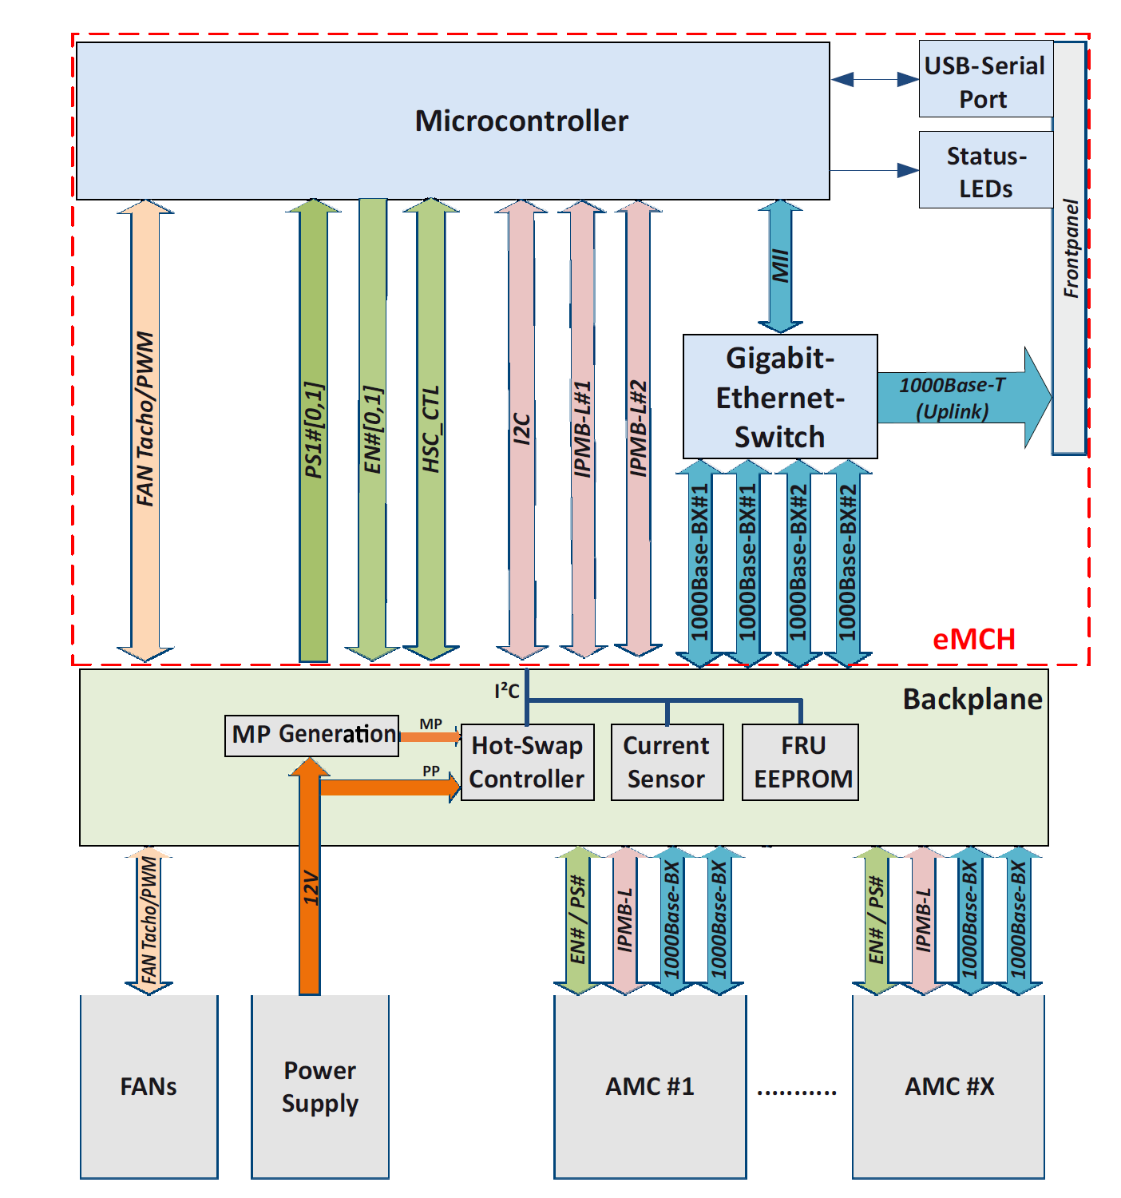
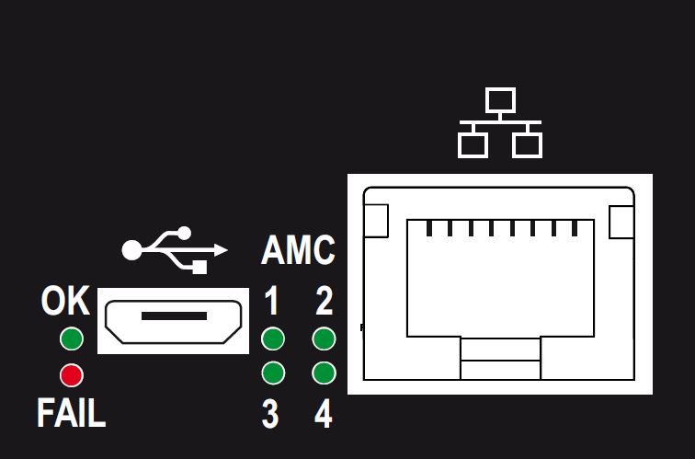
MTCA.4 1U Crate - eMCH
The eMCH provides basic MicroTCA functionality for switching and managing AMC modules
Switching and hub functionality for the system fabric gigabit ethernet (GbE)
Supports the typical hot swap management and its transition state machine (M0 to M6) for each AMC module
The embedded MCH monitors and verifies local sensor data of the chassis and installed FRU devices and supplies MicroTCA power and cooling
Remote administration can be done locally over the CLI (Command Line Interface) served by the front USB port
4 front panel status LEDs for the AMCs, and 2 LEDs (OK, FAIL) for the system’s operation status
Sockets for a RJ45 plug and a micro USB cable

Slide 8
Thank you!

