Slide 1
Application of MTCA.4 with RF Backplane to LLRF and BPM Electronics at SPring-8
H. Maesaka, H. Dewa, T. Fujita, T. Fukui, N. Hosoda,
M. Ishii, E. Iwai, M. Masaki, T. Ohshima, S. Takano,
RIKEN SPring-8 Center
Japan Synchrotron Radiataion Research Institute (JASRI)
December 2nd, 2020

Slide 2
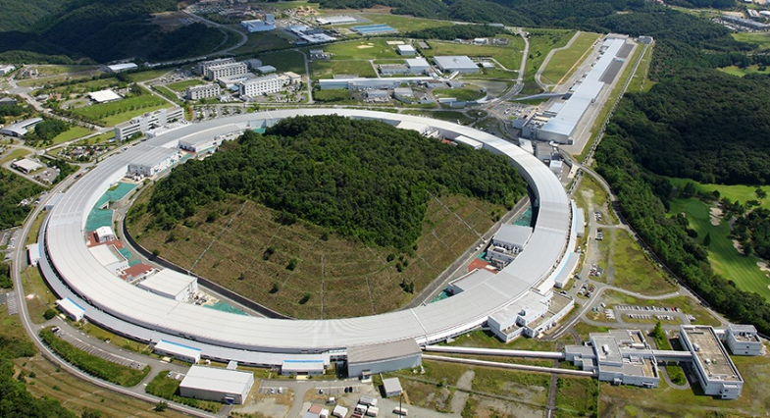
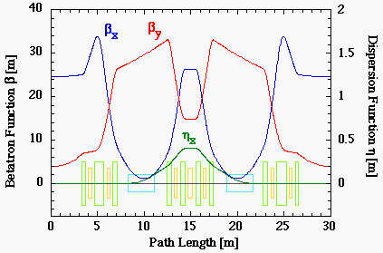
Introduction
SPring-8
  Beam Energy: 8 GeV
  Lattice: Double-bend acromat (DBA)
  Natural Emittance: 2.4 nm rad
  # of cells: 44
  User service since 1997.
  Electronics are based on NIM and VME.
SPring-8 Upgrade Project (SPring-8-II)
  Beam Energy: 6 GeV
  Lattice: 5-bend achromat (5BA)
  Natural Emittance: ~100 pm rad
  MTCA.4 for high-speed electronics.
    Low-level RF (LLRF), Beam position monitor (BPM), etc.
  We started R&D of MTCA.4 ~5 years ago and we are already upgrading these electronics.
New 3 GeV light source in Japan will also use MTCA.4 for LLRF and beam diagnostic systems.
SPring-8
SPring-8-II

Slide 3
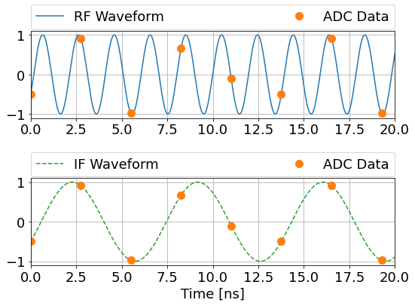
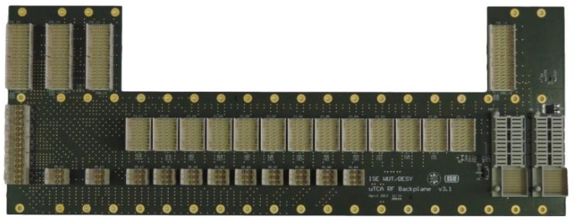
Design Concept
508.58 MHz
363.3 MSPS
LLRF and BPM electronics must detect acceleration RF signals precisely.
  Acceleration RF frequency: 508.58 MHz
Under-sampling scheme was chosen for RF detection.
  The circuit is simpler than down-conversion scheme.
  Drifts of active RF components can be reduced.
    Mixers, LO generators, etc.
  Sampling frequency (f_{S}): 363.3 MHz = 508.58 x 5 / 7
  Intermediate frequency (f_{IF}): 145.3 MHz = 508.58 x 2 / 7
  Digital down-conversion from IF to IQ baseband in the FPGA on the digitizer.
  Required resolution (10 MHz BW):
    Amplitude: 60 dBc = 1 x 10^{–3}
    Phase: 0.1 degree
MTCA.4 can be one of the best choices for the new system.
  A common digitizer AMC can be used.
  The individual RF front-end circuit for each system can be incorporated into a µRTM.
  The RF backplane provides rigid transmission lines and reduces wiring.
145.3 MHz
[ns]
LLRF Frontend
µRTM
High-speed
Digitizer AMC
LLRF Frontend
µRTM
High-speed
Digitizer AMC
LLRF Frontend
µRTM
High-speed
Digitizer AMC
Acc. RF
BPM Frontend
µRTM
High-speed
Digitizer AMC
BPM Frontend
µRTM
High-speed
Digitizer AMC
BPM
BPM Frontend
µRTM
High-speed
Digitizer AMC
RF backplane

Slide 4
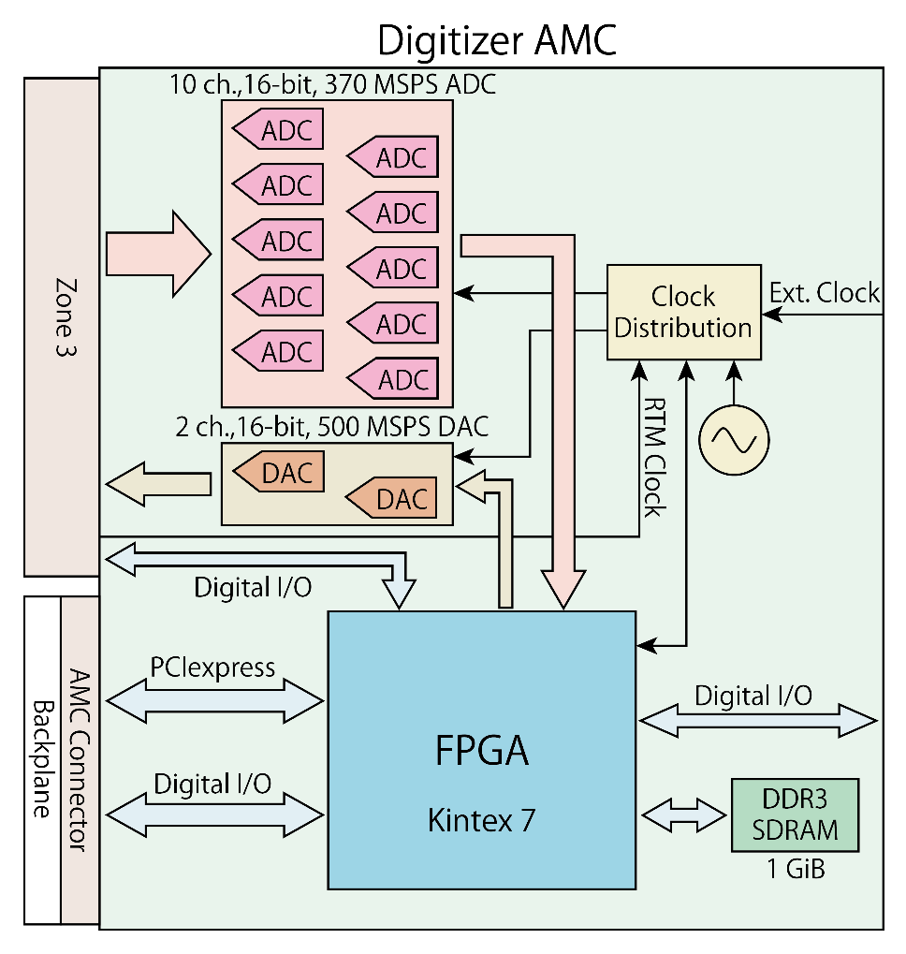
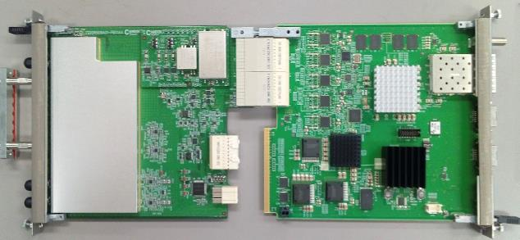
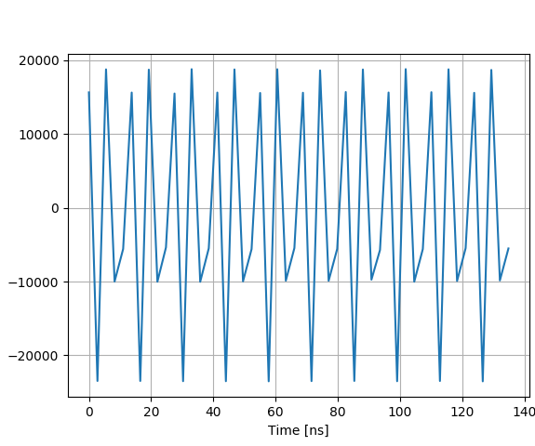
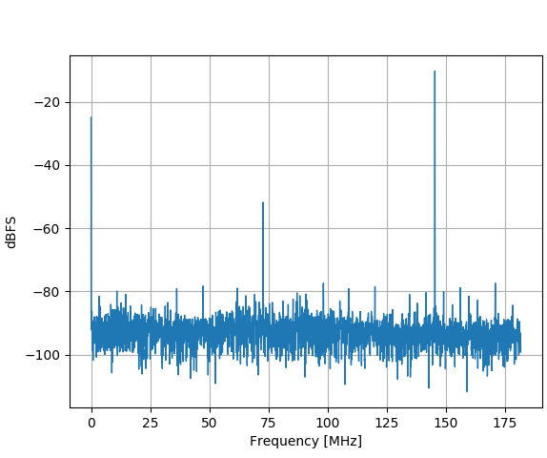
Digitizer AMC
ADC x 10 ch.
  370 MSPS max., 16-bit
  ADC16DX370
DAC x 2 ch.
  500 MSPS max., 16-bit
  AD9783
FPGA: Kintex7 (XC7K480T)
On-board RAM: DDR3-SDRAM 1 GiB
ADC performance
  Noise level (182 MHz BW):
  –69.9 dBFS (No input)
  –51.7 dBc (508.6 MHz input)
    Larger noise than ADC datasheet for 509 MHz input due to clock jitter.
  Amplitude resolution (10 MHz BW):
  –64.9 dBc ~ 5.6 x 10^{–4} (508.6 MHz)
  Phase resolution (10 MHz BW):
  0.058 deg. (508.6 MHz)
Made by Mitsubishi Elec. Tokki Systems
Raw waveform
FFT
20000
-20
10000
-40
0
dBFS
-60
-10000
508.6 MHz input
363.3 MSPS
145.3 MHz IF
-80
-20000
-100
0
20
40
60
80
100
120
[ns]
0
25
50
75
100
125
150
175
[MHz]

Slide 5
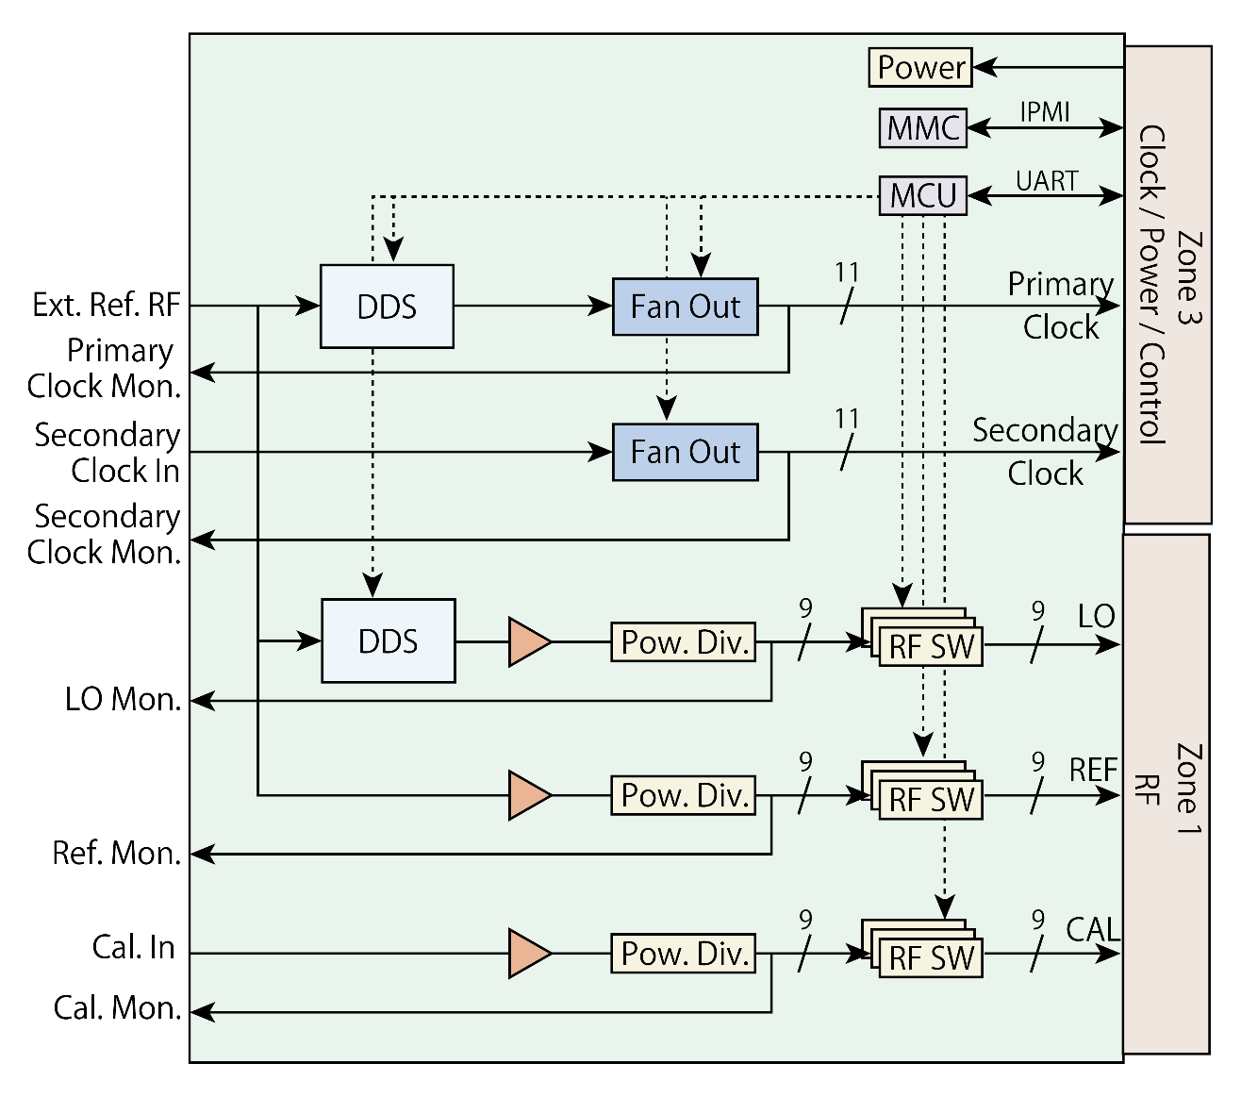
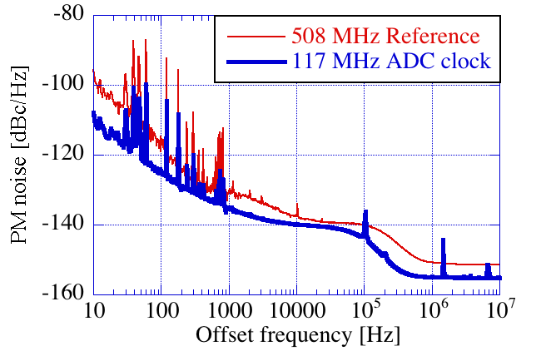
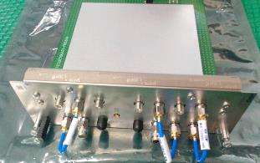
RF/Clock eRTM
RF/Clock eRTM
(extended RTM)
The primary clock and LO signal are generated by direct digital synthesizer (DDS).
  AD9914
  Up to 500 MHz.
The two clocks and three RF signals (LO, REF, and CAL) are distributed to µRTMs through the RF backplane.
  Clock: 11-way fan out
  RF: 9-way power divider
All the outputs can be turned on and off.
The DDS frequency and output switches are controlled by using UART through LVDS data lines of the RF backplane.
  Operability confirmed with NAT-MCH-RTM-BM-FPGA.
The MMC (IPMI) also works well with NAT-MCH-PHYS80 and NAT-RPM-AC600.
508.58 MHz
363.3 MHz
Phase noise data
Additive jitter is less than 100 fs.
Two-slot wide
Made by Candox Systems

Slide 6
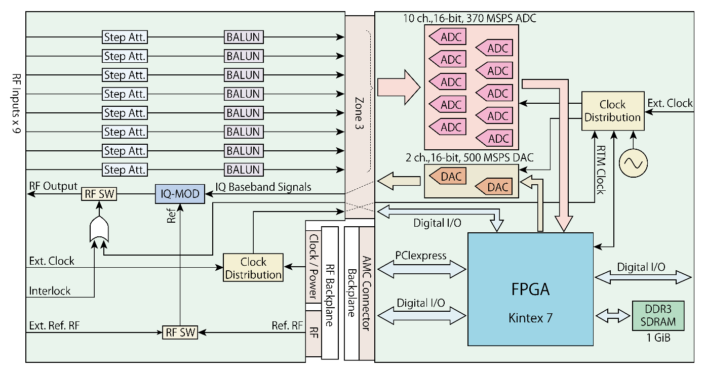
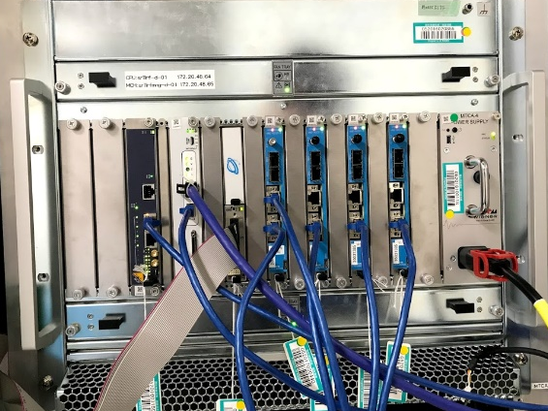
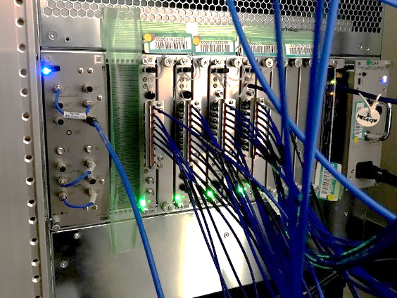
LLRF System
MTCA.4
Master oscillator
ç
CPU
Tuner FB
Ref
Clock eRTM
An acceleration RF signal is generated by an IQ vector modulator on a µRTM.
  Baseband signals are given by DACs on the digitizer.
RF signals from high-power components are directly digitized by ADCs after level adjustment by step attenuators on the µRTM.
IF data from ADCs are digitally down-converted in the FPGA.
The klystron forward signal and the vector sum of the cavity pickup signals are fed back to DAC for the stabilization of the amplitude and phase.
The RF switch is turned off when a machine protection interlock signal is detected.
  Waveforms at such an event can be recorded.
We have replaced the electronics for all the four RF stations with the MTCA.4 system.
Interlock
HV PS
Klystron
Kly Drv
SW
IQ MOD
DAC
Kly Fwd
Kly Bwd
Level adjust
ADC
Kly FB
Dummy load
Backplane
Cav Fwd x 8
Cav Bwd x 8
Level adjust
ADC
Cav Pickup x 8
Level adjust
ADC
Cav FB
Cavity
Tuner
Motor driver
RTM (RF FE)
AMC Digitizer
EtherCAT
Vacuum
Interlock
LLRF Frontend µRTM
Digitizer AMC
Front
Rear
LLRF µRTM
Made by Candox Systems

Slide 7
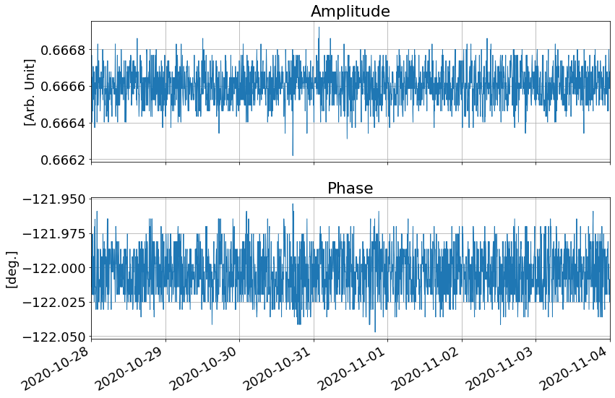
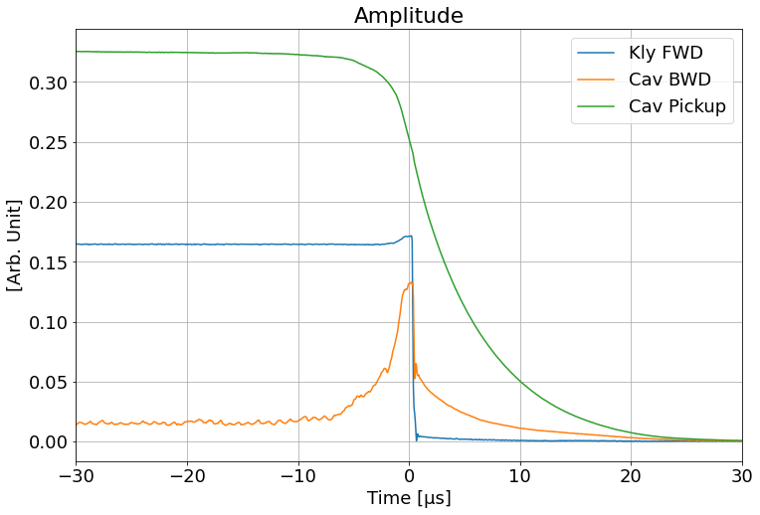
LLRF Performance
Waveform data in case of a breakdown in a cavity.
  The backward power from the cavity began to increase about 6 µs before SW off.
  This interlock was triggered by over-voltage of the cavity backward signal.
  These waveforms are quite useful for postmortem analysis.
Stability of the vector sum data
  1-week data
  Amplitude: 1.4 x 10^{–4}
  Phase: 0.017 deg.
  (within the feedback loop)
1 week

Slide 8
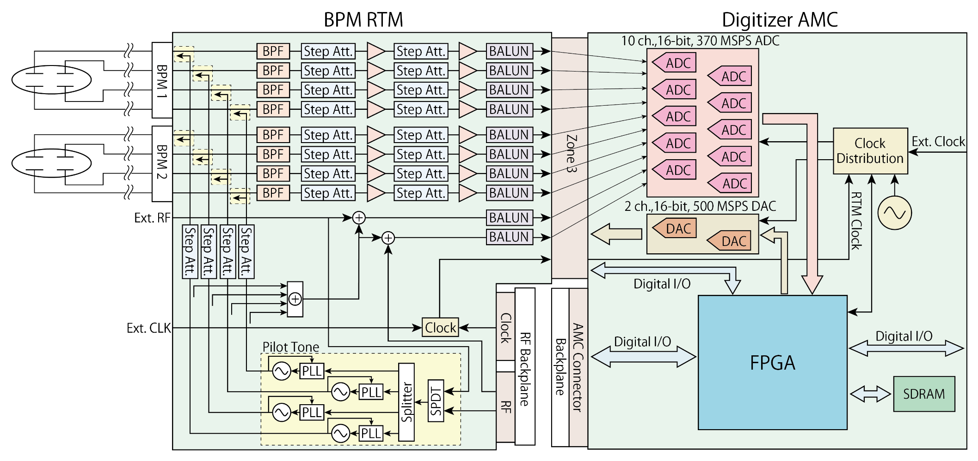
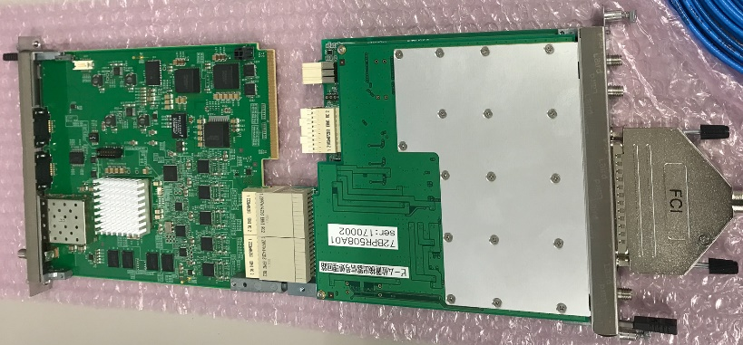
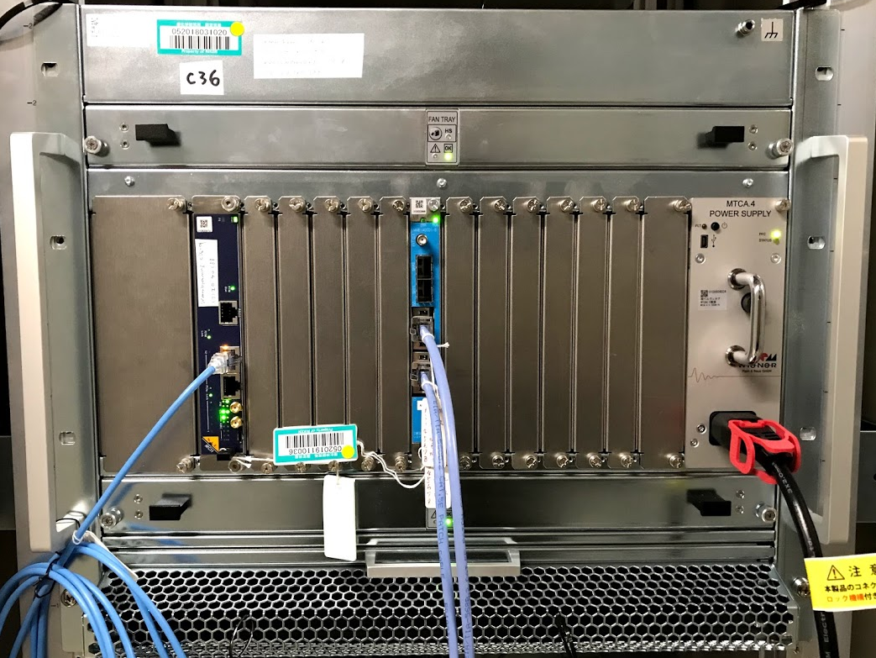
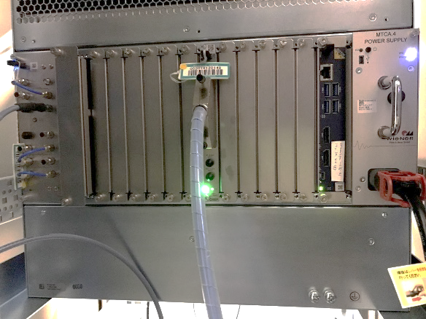
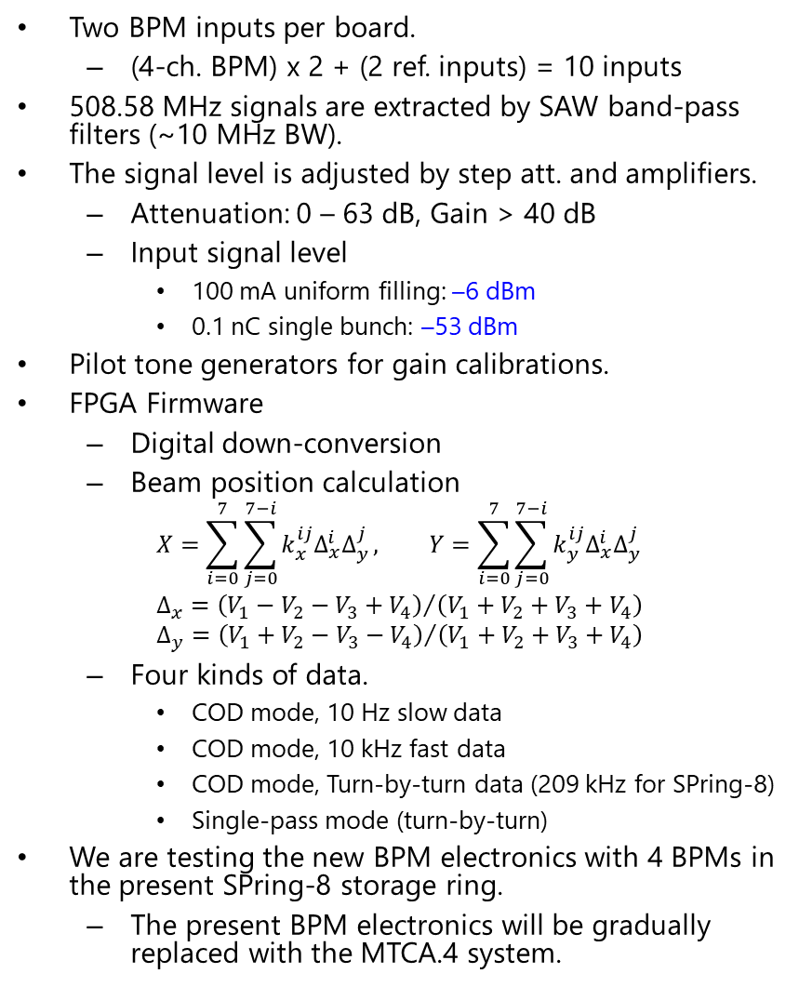
BPM Electronics
Two BPM inputs per board.
  (4-ch. BPM) x 2 + (2 ref. inputs) = 10 inputs
508.58 MHz signals are extracted by SAW band-pass filters (~10 MHz BW).
The signal level is adjusted by step att. and amplifiers.
  Attenuation: 0 – 63 dB, Gain > 40 dB
  Input signal level
    100 mA uniform filling: –6 dBm
    0.1 nC single bunch: –53 dBm
Pilot tone generators for gain calibrations.
FPGA Firmware
  Digital down-conversion
  Beam position calculation
    $$X=\sum_{i=0}^{7}{\sum_{j=0}^{7−i}{k_{x}^{ij}Δ_{x}^{i}Δ_{y}^{j}}}, Y=\sum_{i=0}^{7}{\sum_{j=0}^{7−i}{k_{y}^{ij}Δ_{x}^{i}Δ_{y}^{j}}}$$
    $$Δ_{x}={\left(V_{1}−V_{2}−V_{3}+V_{4}\right)}/{\left(V_{1}+V_{2}+V_{3}+V_{4}\right) }$$
    $$Δ_{y}={\left(V_{1}+V_{2}−V_{3}−V_{4}\right)}/{\left(V_{1}+V_{2}+V_{3}+V_{4}\right) }$$
  Four kinds of data.
    COD mode, 10 Hz slow data
    COD mode, 10 kHz fast data
    COD mode, Turn-by-turn data (209 kHz for SPring-8)
    Single-pass mode (turn-by-turn)
We are testing the new BPM electronics with 4 BPMs in the present SPring-8 storage ring.
  The present BPM electronics will be gradually replaced with the MTCA.4 system.
Made by Candox Systems
Front
Rear

Slide 9
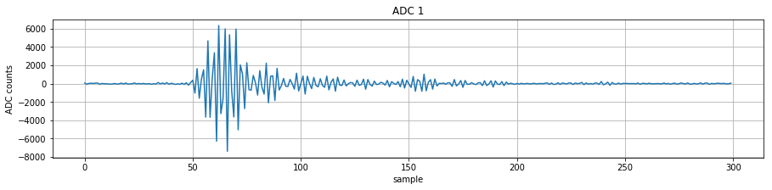
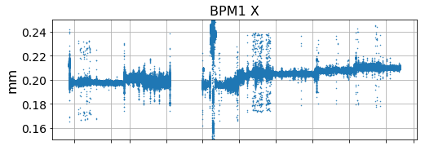
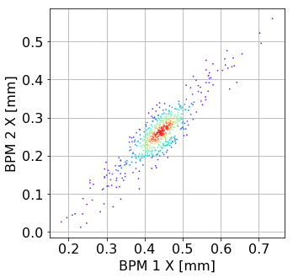
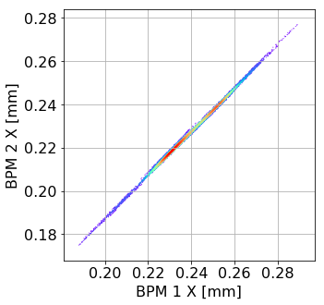
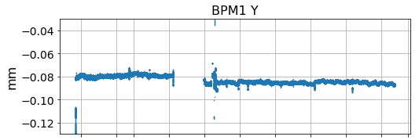
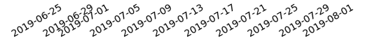
BPM Performance
Raw IF waveform (single bunch)
Long-term stability
The beam orbit was stabilized by the present BPM system.
Beam position data from the MTCA.4 system was stable within 10 µm for more than 1 month.
363 MHz clock
IF: 145 MHz
100 ns
20 µm/div.
BPM Resolution
Single pass: 22 µm (0.13 nC)
COD (fast data): 0.39 µm (30 mA, 2 kHz BW)
Filling pattern changed
Beam orbit was intentionally shaken for these measurements.
Single-pass
Horizontal
COD (10 kHz fast data)
Horizontal
20 µm/div.
Filling pattern changed
0.55 µm std.
31 µm std.
1 month
100 µm/div.
20 µm/div.

Slide 10
Summary
We have developed MTCA.4 LLRF and BPM electronics for the SPring-8 upgrade project.
  RF backplane is used for RF and clock distribution.
High-speed digitizer AMC
  370 MSPS, 16-bit, 10-ch. ADCs and 2-ch. DACs
  Under-sampling scheme to detect 508.58 MHz RF signals.
RF/Clock distribution eRTM
  DDCs for primary clock and LO generation.
  This eRTM can distribute three RF signals (LO, REF, CAL) and two clock signals.
RF Frontend µRTMs
  LLRF: 9 RF inputs with step attenuators and 1 vector modulator output.
  BPM: 2 BPM inputs with SAW filters, step attenuators, and 40 dB amplifiers.
LLRF system
  RF detection, RF generation, ALC and PLL feedbacks, etc. are working well.
  We completed the replacement of the LLRF system for all the four RF stations.
BPM electronics
  BPM calculations for single-pass and COD modes are successfully implemented.
  Sufficient position resolutions and long-term stability were confirmed.

