Slide 1
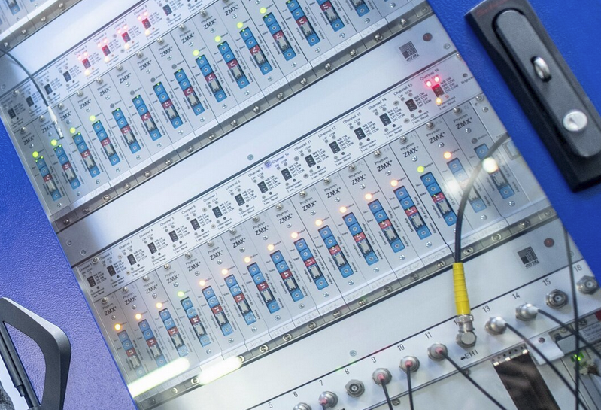


MicroTCA motion card
Nikola Radakovic

Slide 2
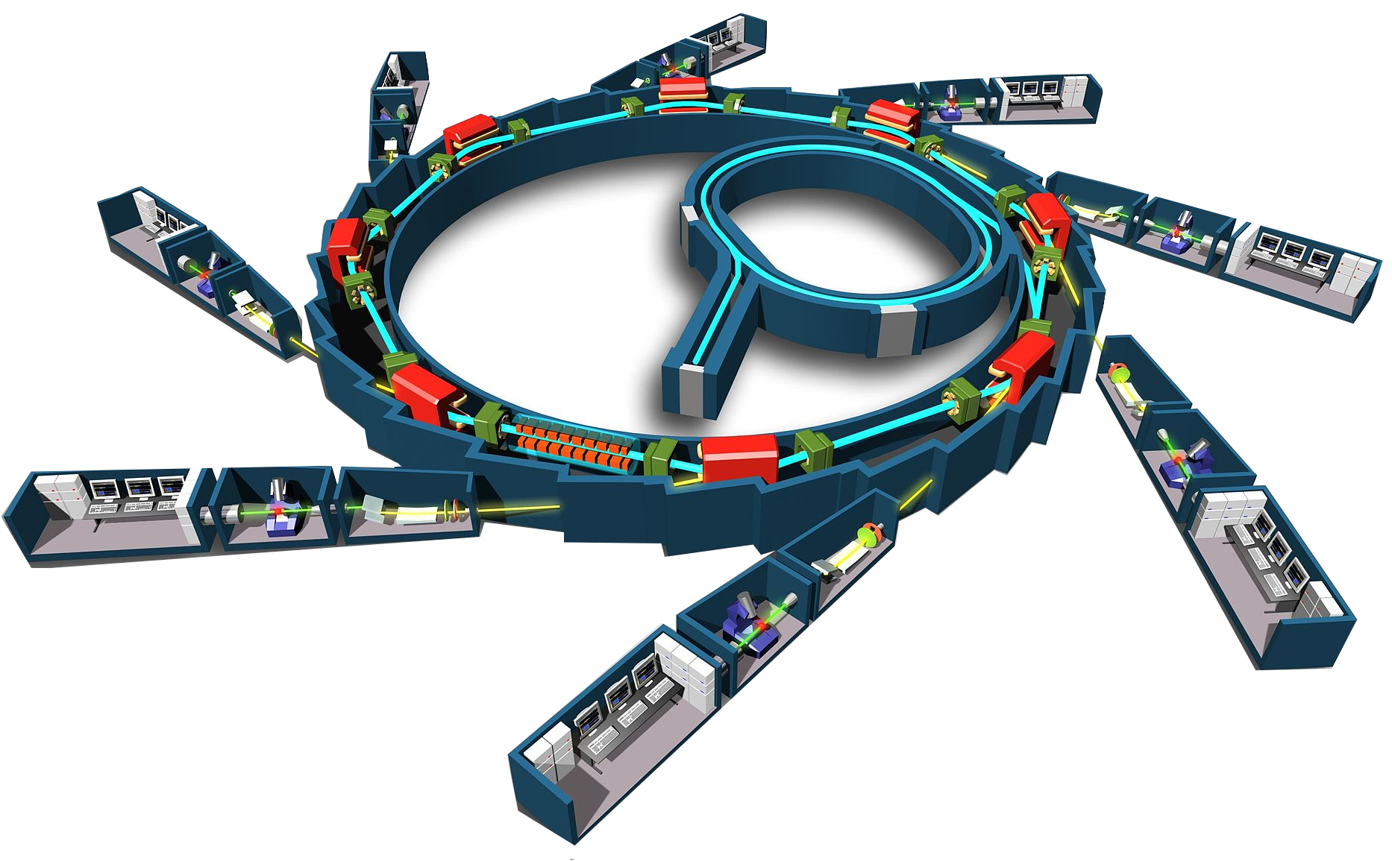
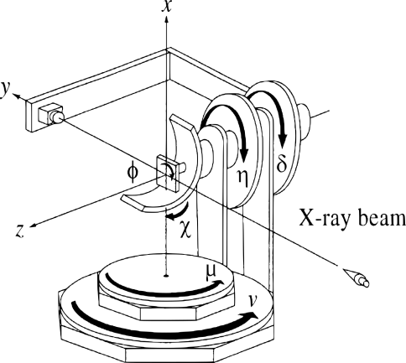
control
cabin
optics cabin
beamline
robot
diffractometer
experimental cabin

Slide 3
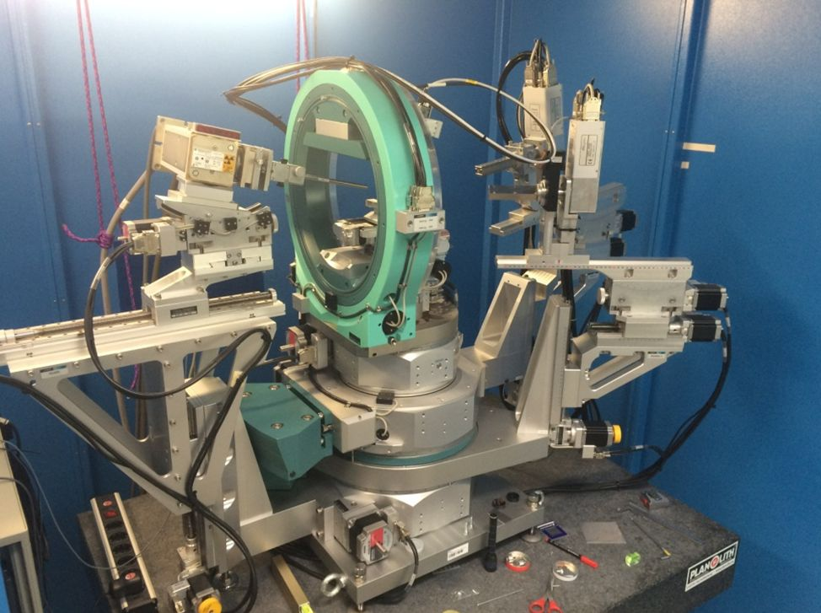
Motors
Motors

Slide 4
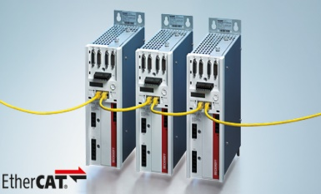
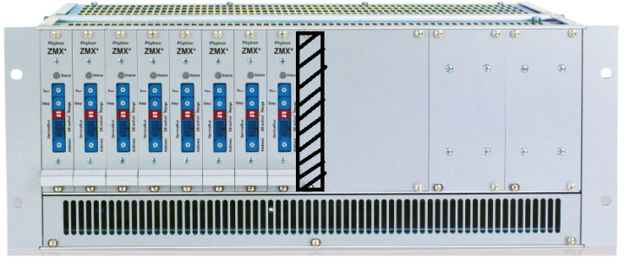
fieldbus
parallel interface

Slide 5
OBJECTIVES
Not provided by the cards that we presently use
Build a card that:
is future proof
provides high I/O count
is scalable
is distributed
supports existing DESY beamlines

Slide 6
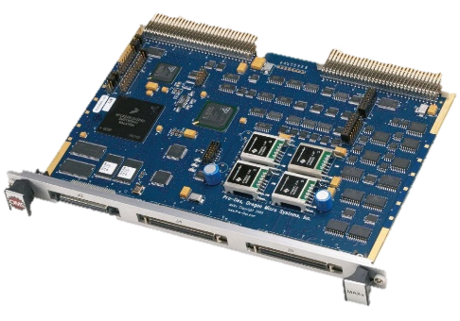
Motion Controller Card Overview
FPGA
System on Chip
In development: DAMC-MOTCTRL
MicroTCA.4 based; compatible to existing motion controllers
Stand-alone/ local/ distributed installation scheme
16 axis per card
Modern serial iterfaces and legacy parallel interfaces
Reference: OMS MAXv (VME)

Slide 7
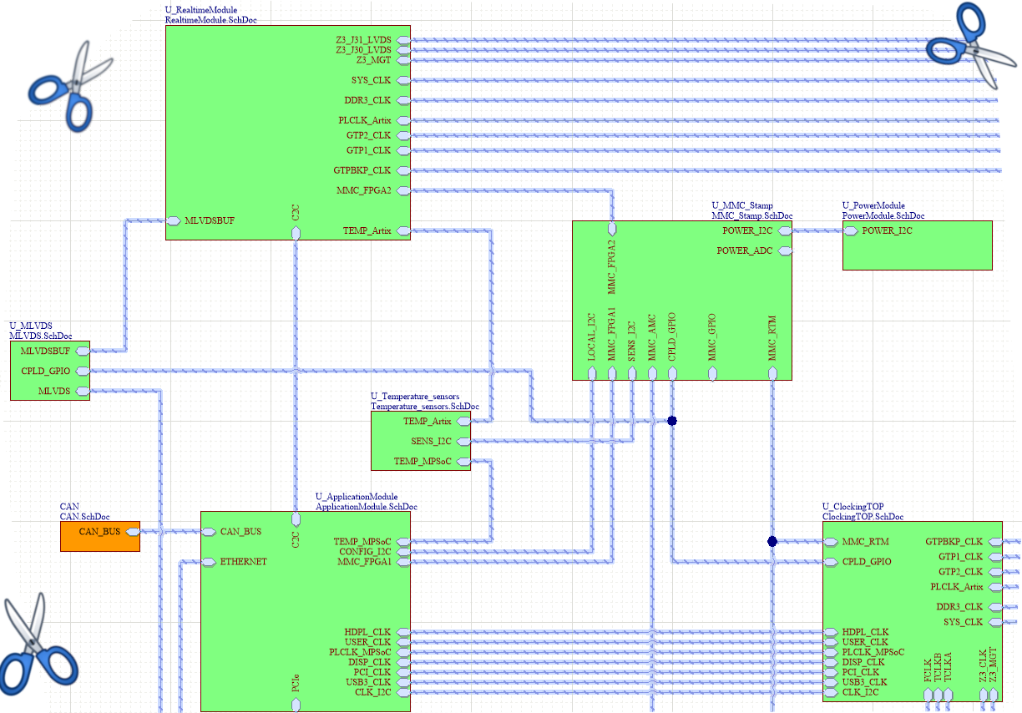

Slide 8
1. Future proof
2x 10GE ports
42x LVDS signals
3x 1GE ports
Legacy 3.3V/5V output
4x ARM53
versatile application: Display, User I/O, even booting
Micro TCA backplane
2x RPUs

Slide 9

2. High I/O count
Encoder, custom drives or fan-out board
remote access
DAQ/PLC
servos
steppers/encoders
PCIe or Low Latency Links for card-to-card communication

Slide 10
3. Scalability
Close as a ring
To other card , device

Slide 11
4. Distributed architecture
MPI ( to cluster )
MPI
MPI
DDR4
DDR4
DDR4
OpenMP
MPI
MPI
MPI
DDR4
DDR4
DDR4
MPI
OpenMP
Cluster
computing
OpenMP
Vectorization of floating-point math

Slide 12
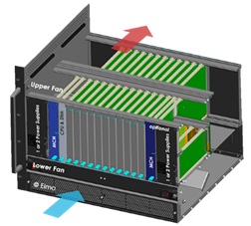
5. Compatible with existing DESY set-up
Front plane
Back plane

Slide 13
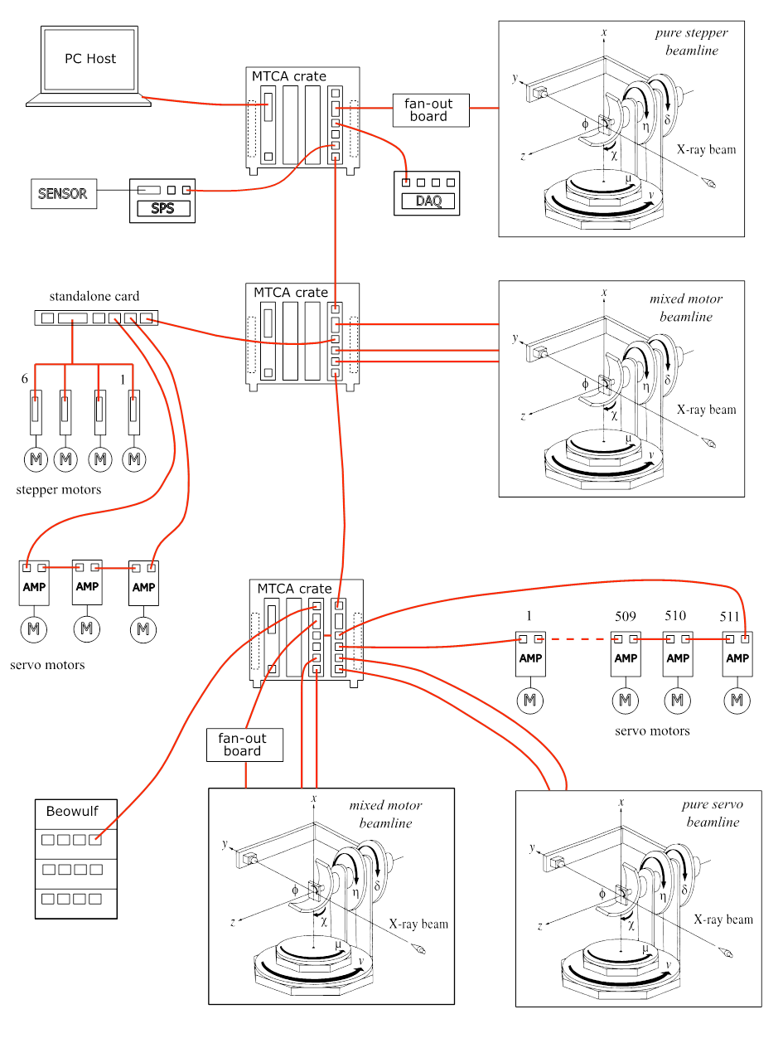
The big picture
PLC
16 motors per beamline
mixed motor topologies
Motion cards
Fieldbus point to point motors or PLCs
Cloud services: Apache Spark, Cassandra, Hadoop

Slide 14
Thank you

