Slide 1
ARES Operation Meeting
Summary of week 39
Frank Mayet, on behalf of the ARES shift crew

Slide 2
Summary
Week 39
Achievements
First measurement with the PDE
Steerer directions re-tested after re-cabling
  All correct, except ARLIMCHG2
  (to be replaced)
First QE measurement of the current Mo Cathode
Gun gradient limit increased from 60MV/m to 100MV/m
Quadrupole cycle script
Optical spectrometer @ EA1 operational (we saw the cathode laser beam in the chamber)
EA1 hexapod DOOCS server now with official DOOCS address and functional
Gun momentum vs. phase scan for different gradient settings
Working point for beam on R1 w.o. solenoid
Issues
The solenoid power supplies could not be switched on on Wednesday → Next time this happens, MKK has to exchange parts in the PS
The quadrupole PS are not precise at low currents (<10A; max=270A) and can react very slowly in this range
TWS1 phase drifts

Slide 3
First Momentum measurement with the PDE
Procedure: We first ramp to 600A, then wait and then go back to the predicted current
Gun amp: 45 MV/m
Gun power: 1.6 MW
Gun Phase: 165 deg
TWS1 Amp: 13
TWS1 Power: 30.9 MW
TWS1 Phase: -30 deg
TWS2 Amp: 12
TWS2 Power: 31.8 MW
TWS2 Phase: -100 deg
Measured momentum: 121.02 MeV/c, which is consistent with the phase scan we did on 17.09.2020, where
we measured 120 MeV/c at the same phase using the steerers(CXG4 --> MR.R1)

Slide 4
Gun – Output vector correction learnings
For precise phase scans, wait for the ampt/phase RBV to stabilize (i.e. the OVC to adapt)
  Otherwise the gun amplitude will depend on the phase (could in principle be minimized by tuning the gun temperature)
Dependence reduced!

Slide 5
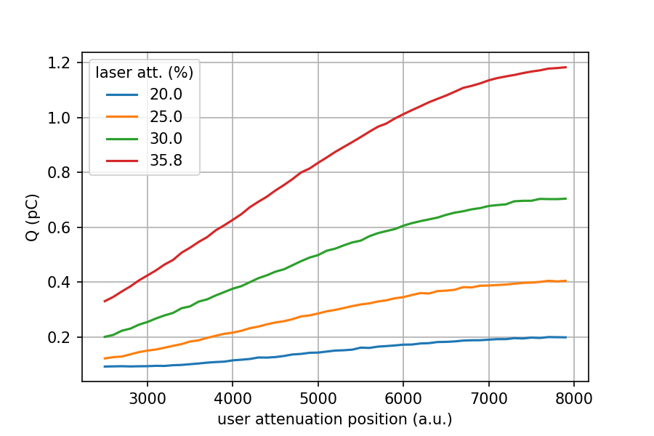
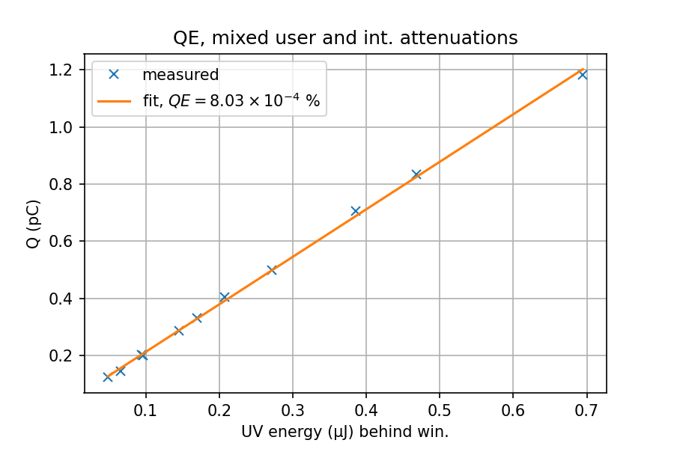
QE Measurement (Mo Cathode) – Analysis by Max K.
UV measurement: 2020.09.21, Charge scans: 2020.09.23
UV Vacuum-window coated from one side
  Reflection < 0.25%, estimated to be 0.1%; Reflection from vacuum side: 4%
User attenuator non-linear

Slide 6
Tools development
Quadrupole cycle script by Willi
EA1 Hexapod server now with official DOOCS address and jddd panel
EA1 optical spectrometer operational
Laser off
Laser on; signal @ 257nm in the EA1 chamber

Slide 7
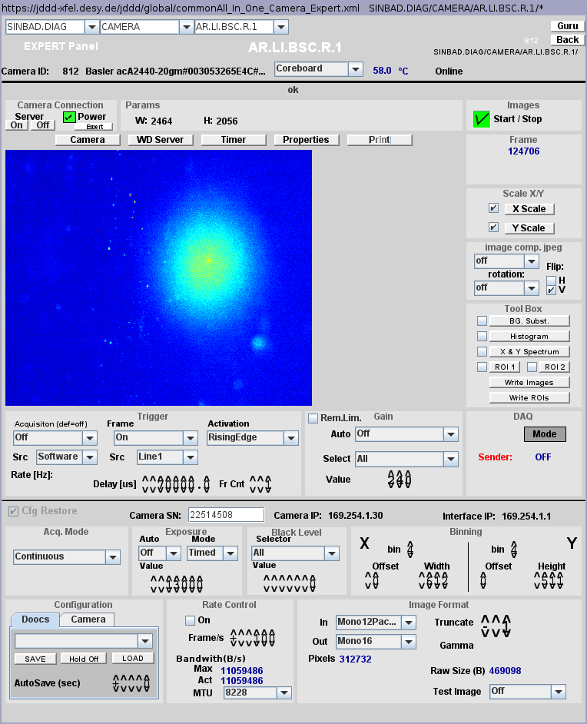
Beam found on LI.R1 with no gun solenoid
Gun solenoid set to zero current and cycled.
Gun amplitude setpoint to 65 MV/m and phase setpoint to around +68° wrt. phase of max. momentum (following ASTRA simulations).
CVG1 to +2 A and V earth magnetic field corrector to -8 A.
CHG1 to -5 A (max) and H earth magnetic field corrector to -10 A (max).
Good starting point for laser alignment (strategy to be defined though: how to handle with CXG1 and earth magnetic field corrector).
Probably better to wait for the new X1 screen (beam should be smaller for the same settings and reduced influence of dipole). But might be more dark current limited (?).

Slide 8
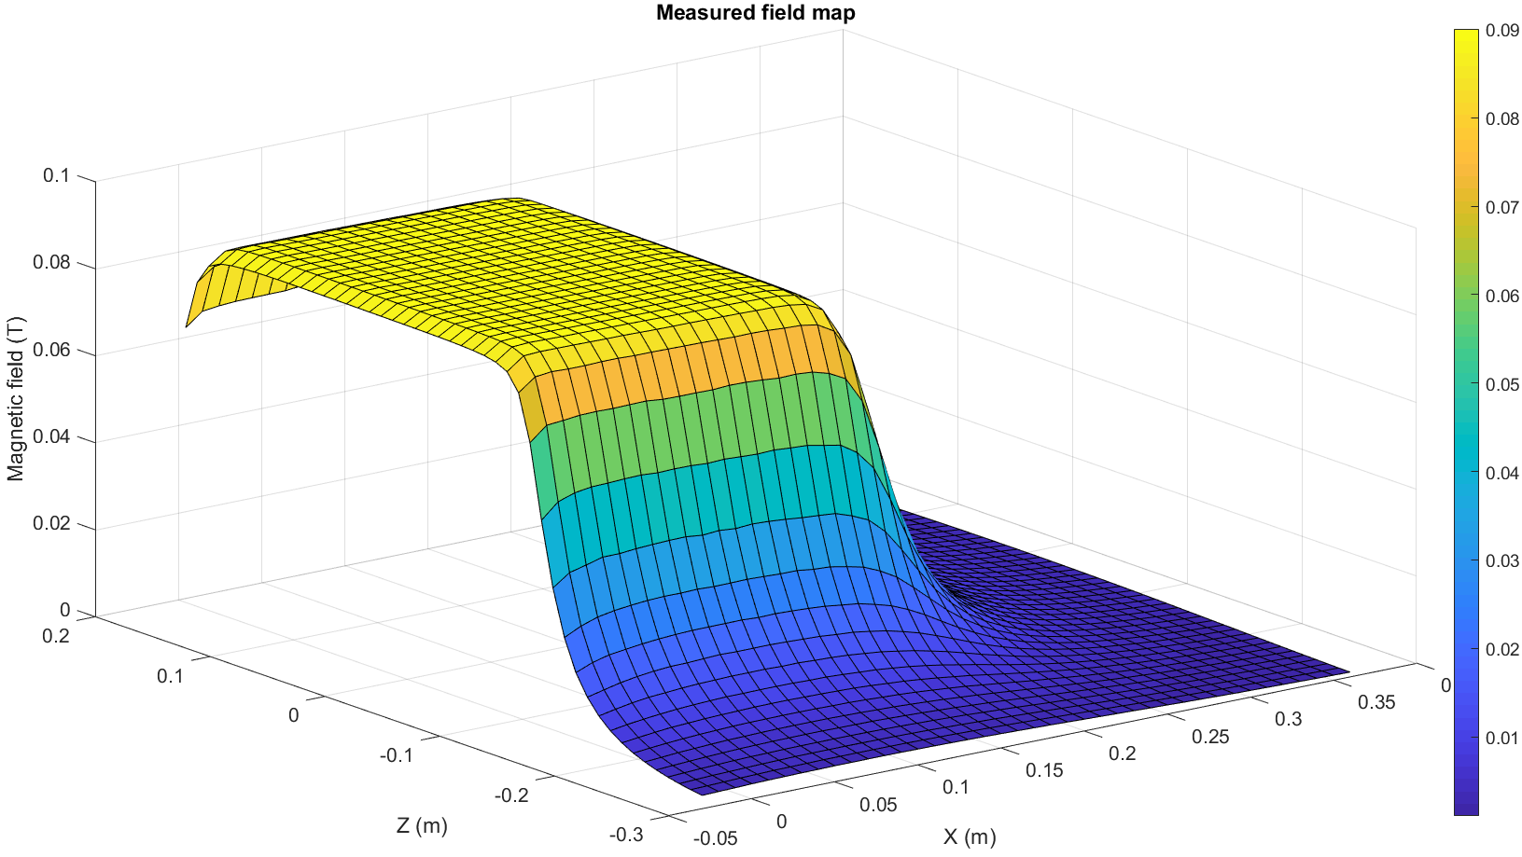
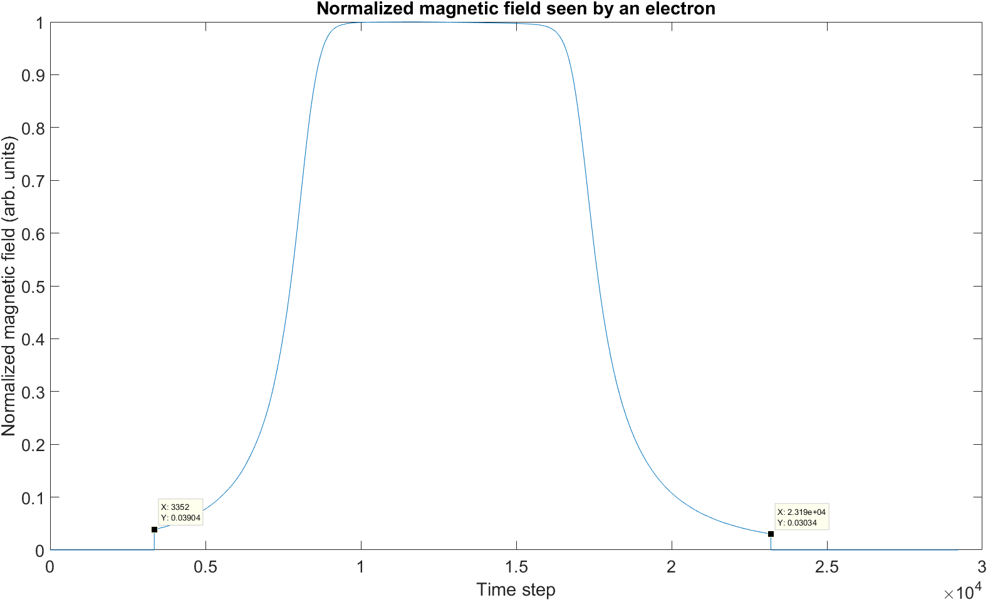
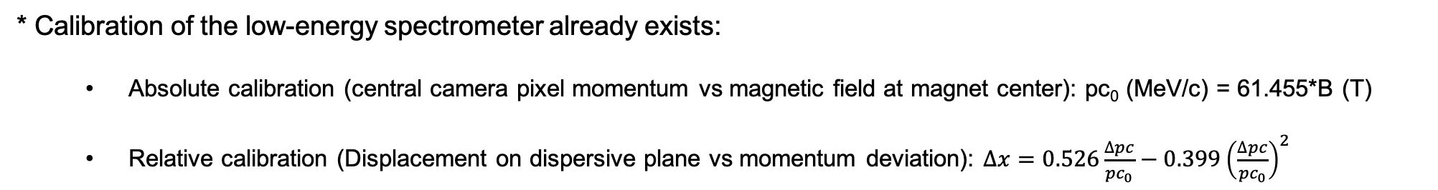
Low-energy spectrometer (re)calibration (1/2)
* Calibration of the low-energy spectrometer already exists:
  Absolute calibration (central camera pixel momentum vs magnetic field at magnet center): pc₀ (MeV/c) = 61.455*B (T)
  Relative calibration (Displacement on dispersive plane vs momentum deviation): $∆x=0.526\frac{∆pc}{{pc}_{0}}−0.399{\left(\frac{∆pc}{{pc}_{0}}\right)}^{2}$
* However, it is based on an incomplete field map (cut at 3-4% of the max.) → Not as accurate as possible.

Slide 9
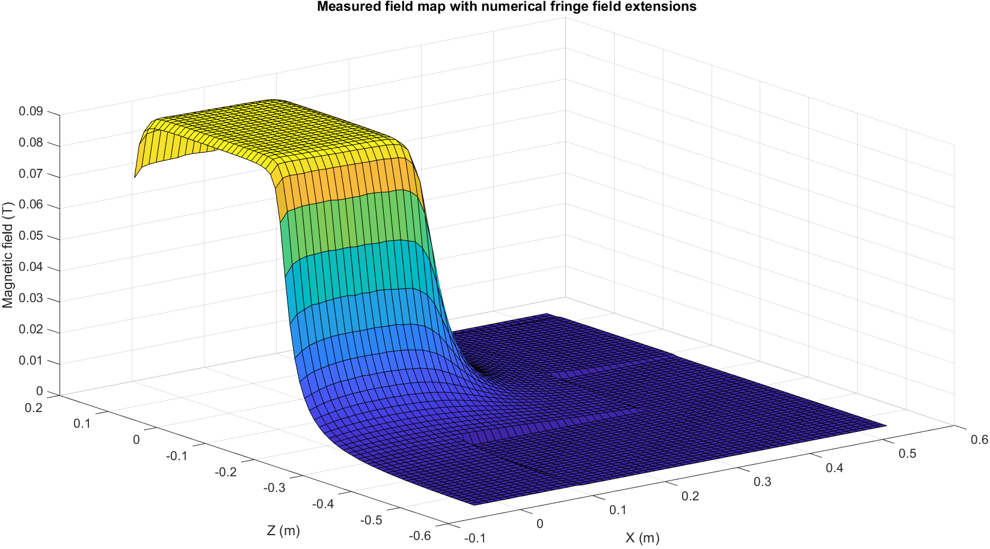
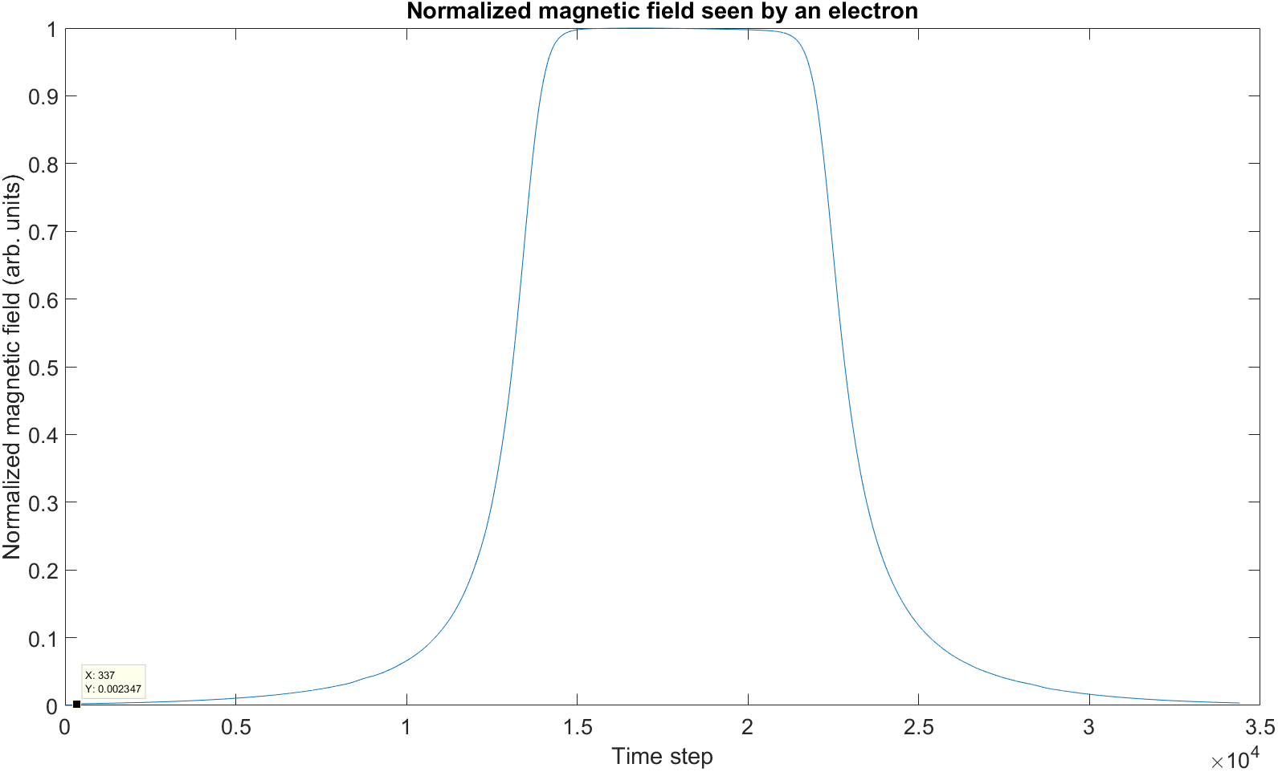
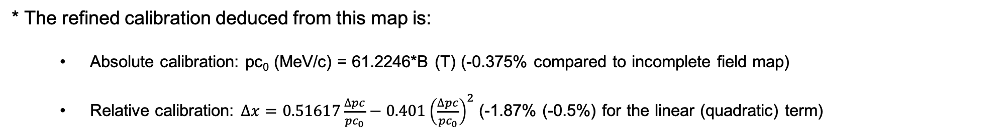
Low-energy spectrometer (re)calibration (2/2)
* Calibration performed again with a numerically completed field map (fit of the tails with sum of exponentials).
* The refined calibration deduced from this map is:
  Absolute calibration: pc₀ (MeV/c) = 61.2246*B (T) (-0.375% compared to incomplete field map)
  Relative calibration: $∆x=0.51617\frac{∆pc}{{pc}_{0}}−0.401{\left(\frac{∆pc}{{pc}_{0}}\right)}^{2}$ (-1.87% (-0.5%) for the linear (quadratic) term)

Slide 10
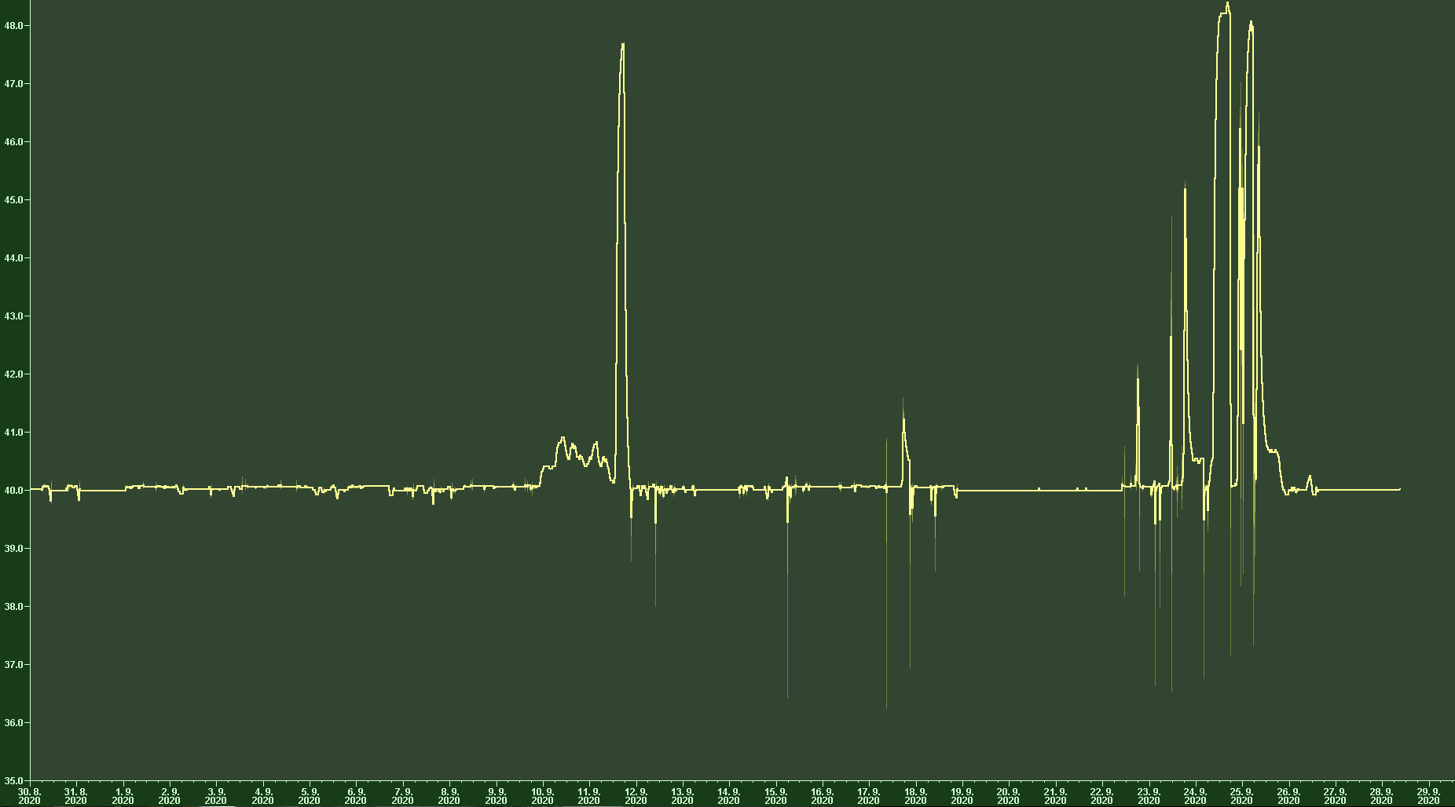
Phase shifts TWS
Water temperature drifting – MKK triggered – investigations ongoing,suspicion: faulty valve

Slide 11
MSK shift
Monday (Tunnel)
Damping element removal RF-gun
Recabling TWS2 (Forw ←→ Probe2)
Check of cables, etc
Wed (control room)
First step calibration TWS
Energy measurements needed.

Slide 12
Shutdown Planning
KW 42: MDI and MVS (clean)
KW 45: MEA (dirty)

Slide 13
Other (technical) stuff
Pandora moved downstream of EA
MKK investigating SOLL-IST difference for Quads
Check Quad-Serial Number needed for hysteresis curves
Second PCB steerer replacement triggered.
High energy dipole corrector coil setup and cycling procedure to be investigated.
  Long-term: Connection to the standard power converter (MKK)
  Short-term: power supply and installation by MEA
Corrector Magnets: Orientation corrected
Crane works and construction work expected – going back to BKR under discussion.

Slide 14
Plans for week 40
Data analysis
Hardware Commissioning – all quadrupole Magnets, high energy dipole
Beam Measurements
  Momentum Measurements / phase scans
  Reference files
  Phase scan vs. Centroid
  QE measurements (please inform Max!)
  Emittance vs. Charge
  Stability measurements

Slide 15
ARES Schedule
Week 40
Date | Shift Leader
28.9. | MDI, D3, MSK
29.9. | Florian / Willi
30.9. | MSK (morning) / Hannes
1.10. | Frank
2.10. | Thomas

Slide 16
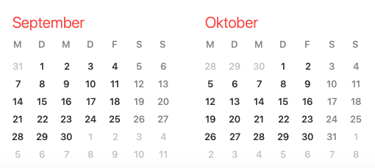
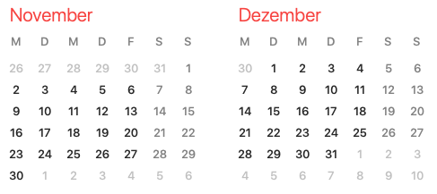
ARES Schedule
2020
Shutdown (Monday = Maintenance day)
Beam Commissioning (Linac section + EA1)
Shutdown week 42: MVS/MDI
  Collimator, X1 screen, pepper pot
Shutdown week 45: MEA
  Holes for PolariX

