Slide 1
Stridenas
Status of the Stridenas Beam Profile Monitor for Low-Charge Electron Beams
S. Jaster-Merz, F. Burkart, M. Stanitzki
Special thanks for the support from MPY-1 & FH-ATLAS, MVS and the FH E-Lab!

Slide 2
Motivation
High energy physics
Single electron detection
Stridenas
Intermediate charge
Scintillating Screens + Camera
~pC to ~nC charge range

Slide 3
Recap – Working principle of silicon sensors
Working principle: pn-junction.
Electrons interact with the sensor material and deposit energy, follows a Landau distribution for MIPs.
Production of electron-hole pairs (~80 per µm and MIP).
Charge carriers drift towards the electrodes and start the signal current.

Slide 4
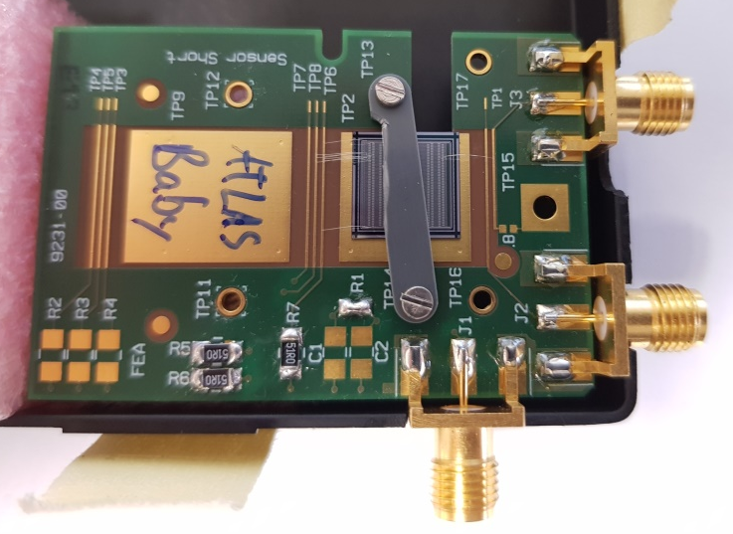
STRIDENAS Project
So far:
Sensor characterization performed.
Successfully detected single electrons.
Commissioning of readout electronics.
P
P
P
Prototype built but not functional.

Slide 5
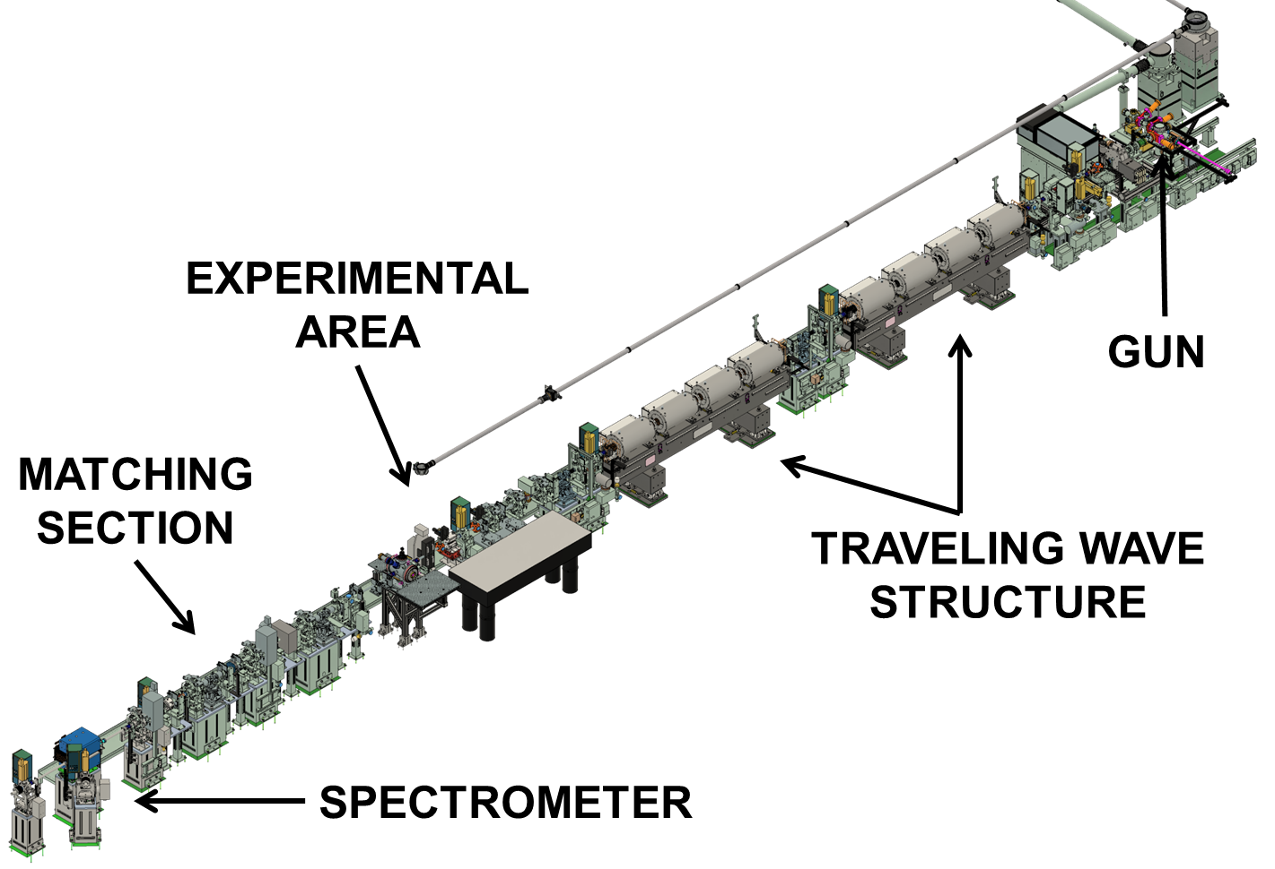
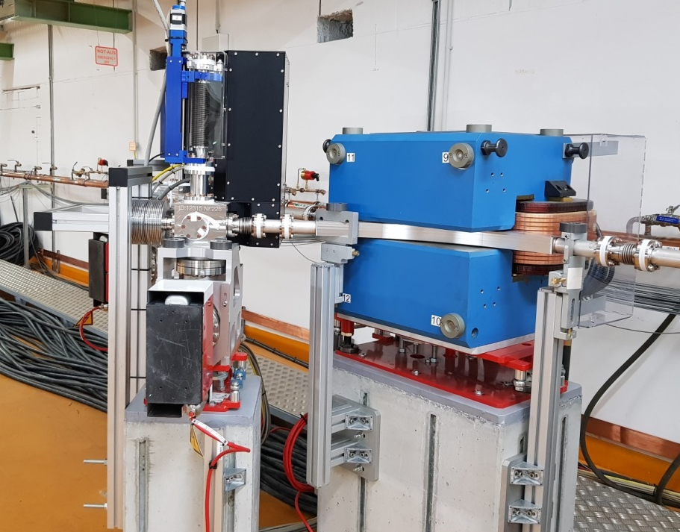
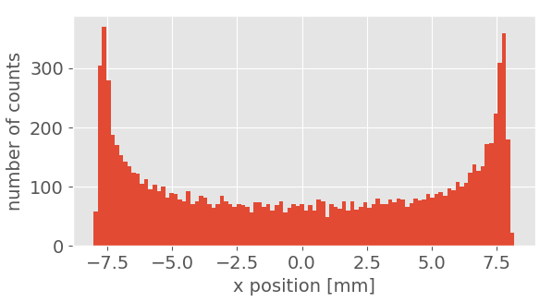
First experimental tests at ARES
Foreseen for the beginning of 2021
Experimental chamber downstream of screen station.
Vacuum window to protect the machine vacuum.
Simulation of particle matter interaction using G4 Beamline.
Matching studies to optimize resolution.
Detector characterization.

Slide 6
Matching studies
Matching to the Stridenas position
Matching from the experimental area to the detector using 4 quadrupoles.
First matching iteration using ELEGANT.
Final matching in ASTRA using the dipole field map, space charge and varying the last quadrupole.
Input particle distribution at EA1:
Parameter | Unit | Value
Energy | MeV | 52.54
Charge | pC | 1
Beta x | mm | 5
Beta y | mm | 767.7
ε_{n,x} (rms) | nm | 44.7
ε_{n,y} (rms) | nm | 44.2
Final resolution of: 10⁻⁴
Parameter | Unit | Value
σ_{x} | mm | 5.5
σ_{y} | mm | 0.1
Beta x | mm | 75.1

Slide 7
Challenge: Beam has to pass through a vacuum window
G4 Beamline simulations of 50µm thick Ti grade 5 window: Impact of drift between window and sensor
First performance tests for two possible window materials will be performed by MVS.

Slide 8
Detector characterization setup
Detectors can be easily tested
Using a Strontium-90 source (beta emitter, maximum energy of ~2.3 MeV)
Fast amplifier (40dB)
Oscilloscope for readout
And characterized
Future detector boards to be checked here before tests at ARES.
P
FH E-Lab

Slide 9
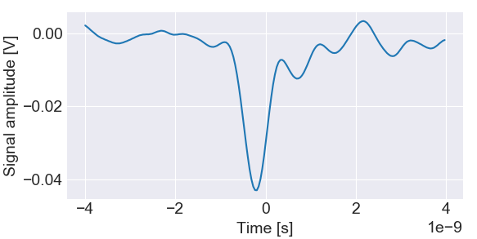
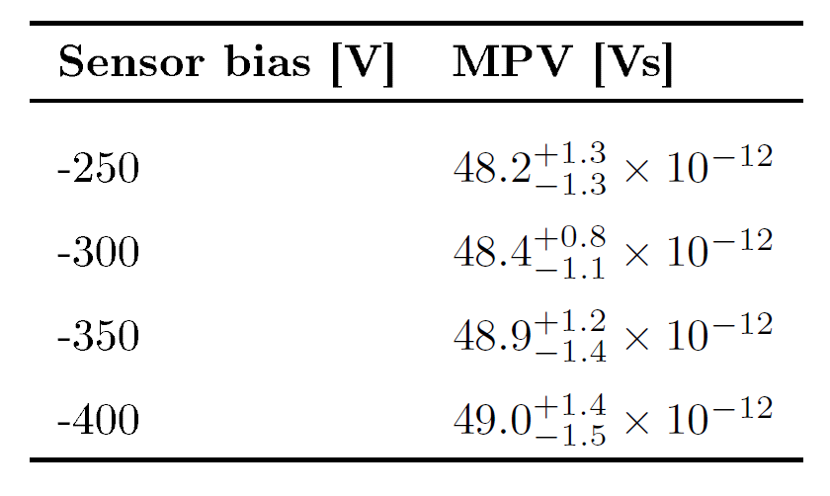
Sensor characterization using a ⁹⁰Sr source
Signal from the ⁹⁰Sr source follows a Landau distribution.
Electronics introduce Gaussian noise.
Fit data with a convolution of a Gauss and a Landau function.
Sensor is functional.
Data analysis still ongoing.

Slide 10
Conclusion and outlook
Stridenas: Novel beam profile monitor for electron beams with sub-pC charge.
First experimental tests foreseen at ARES at the beginning of next year.
Preparatory simulation studies
to optimize the spectrometer resolution.
to study particle matter interaction.
Detector characterization setup allows to
easily test detectors.
characterize detectors.
Investigate problem of old PCB, short identified
→ connect spare sensor to second PCB (less glue, less strips)
New board for new ATLAS17 sensors

Slide 12
Quadrupole strengths for matching study

