Slide 1

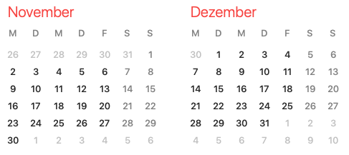
ARES operation meeting, Monday 5th October 2020
by the ARES shift crew
Shutdown (Monday = Maintenance day)
Shutdown week 42: MVS/MDI
Collimator, X1 screen, pepper pot
Shutdown week 45: MEA
Holes for PolariX
RF Conditioning (Gun)
Beam Commissioning (Gun section)
Beam Commissioning (Linac section + EA1)

Slide 2
Summary of KW40
 | Tuesday 29th September | Wednesday 30th September | Thursday 1st October | Friday 2nd October
Achievements | * First centroid vs phase scan at LI.R1 without gun solenoid * Centroid stability measurement on LI.R1 overnight | * LLRF study: Gun recalibration; TWS1 first calibration; update of servers * Centroid stability measurement on LI.R3 overnight | * ≈ Axis-parallel trajectory through TWS1 achieved * First momentum spectrum measurement with PDE + stability measurement overnight | * Study on tilting angle seen on SL.S1 * Measurement for alignment of solenoids 3 & 4 of TWS1 taken * PDE calibration test
Perturbating events | - | * Missing interlock for gun modulator during the night | - | * Camera server unstable * Cycling procedure of TWS solenoids not working (solved)
Notes | * Phase scale is still changing → Schottky scan for check at shift start is always good | - | * Possibly the camera on LI.R3 is looking out of the beamline center | * Change binning settings in camera server only after starting image display

Slide 3
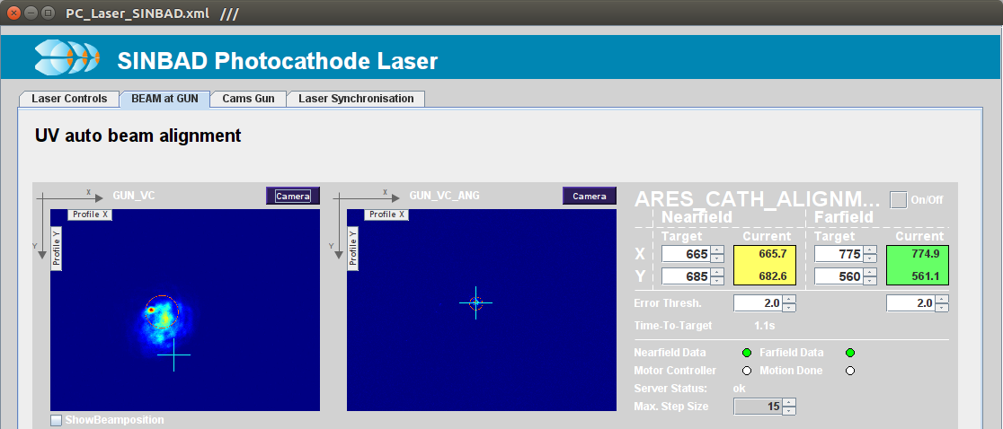
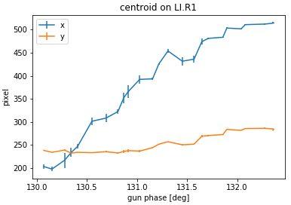
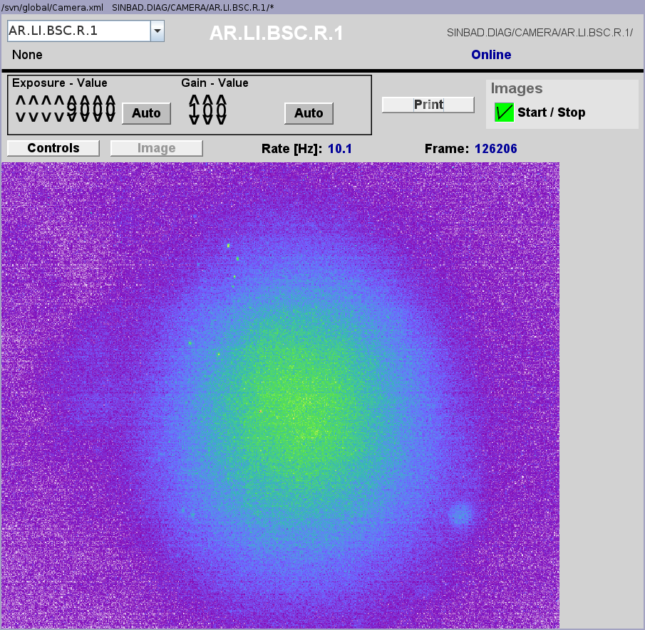
Centroid vs phase scan on LI.R1 w/o gun solenoid
Displacement much stronger in X than in Y → Main misalignment of the cathode laser is horizontal
Hard to start a correction of this without aperture and an operational X1 screen → To be continued after next week shutdown

Slide 4
MSK shift: summary
!!RF-gun * Adjusted the RF-gun probe with measurements from Thomas (changes SP by ≈ 6%) * Adjusted the probe power readings back to old value * Performed forward and reflected calibration w.r.t. the probe * phase off by -160deg. due to removal of attenuator * Power reading set back to old value * ADC dynamic range optimization * changed DCM attenuator for forward and reflected by -6dB (from 20dB to 14dB) * adjusted scaling coefficients correspondingly * max SP is 111MV/m !!TWS1 * calibrated the setpoint to MV * used the calibration from Hannes during the morning, * measured momentum 77.1MeV/c for gun+TWS1 and 2.52MeV/c for RF-gun only * assumed momentum/energy increase of 74.5MV for TWS only * detection chain calibrated without chaning the drive signal * SP of ~13.2 corresponds now to SP of 74.5MV * adjusted OVC to maintain the operating point in case of non-linearities in high power chain !!TWS2 * calibrated the setpoint roughly to MV * no momentum measurement --> assumed same condistions as for TWS1 * if this does not reflect the current operation conditions we might change it back * fine tuning might still be necessary * adjusted OVC to maintain the operating point in case of non-linearities in high power chain ``Remark: the TWS2 power readings did not change and those show still an decrease in power along the structure. Can someone simulate the TWS with RF simulation tool for change of the input and output port. It is just to exclude that the TWS is not correctly installed.``
Next shift after the shutdown week

Slide 5
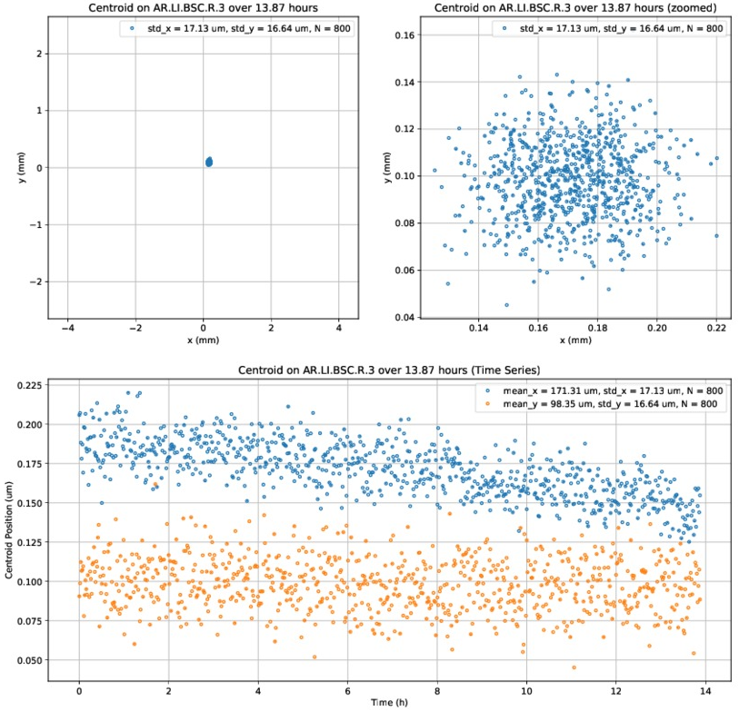
Centroid stability measurement on LI.R3 (TWS1 powered)
* Rms relative pointing stability wrt beam size is:
- 5.3% along x
- 9.5% along y
* Good result and can very likely be improved since the chosen conditions were not the most stable ones
* Centroid drift likely explained by a gun temperature drift overnight

Slide 6
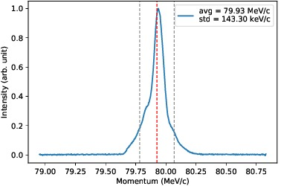
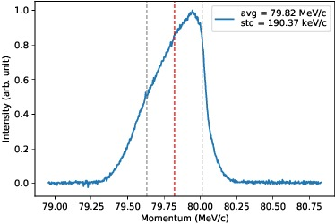
First momentum spectra measurement with PDE
* Done using calibration derived by Frank
TWS1 phase maximizing momentum gain: 0°
TWS1 phase: +5°
* Further analysis of the data by Frank is ongoing

Slide 7
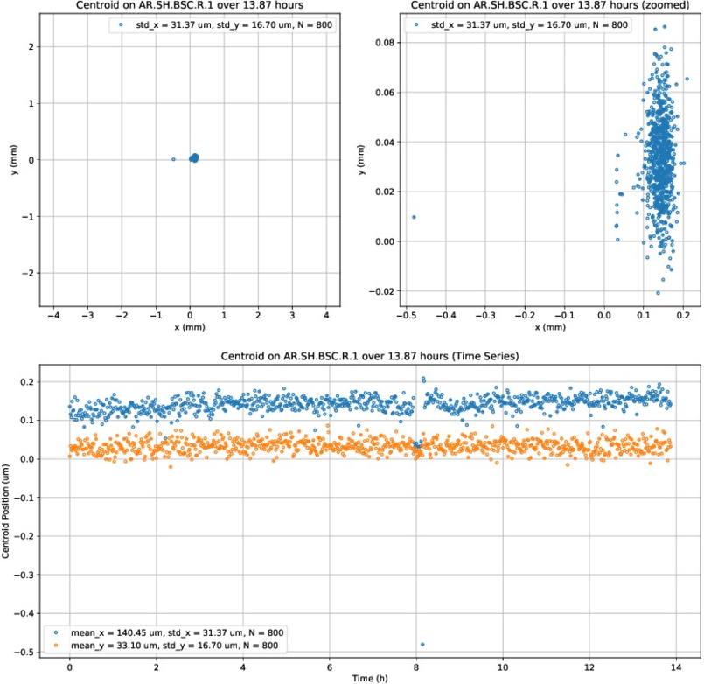
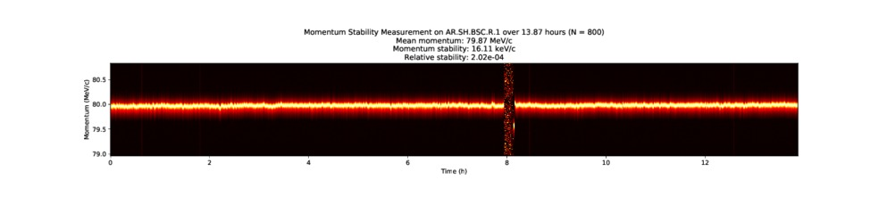
Momentum stability measurement with PDE
* Highly shifted events can be seen around 8h run time due to TWS1 waveguide vacuum interlock
* Rms relative momentum stability wrt average momentum is ~ 2*10⁻⁴, including the vacuum interlock period
* Further analysis of the data by Frank is ongoing

Slide 8
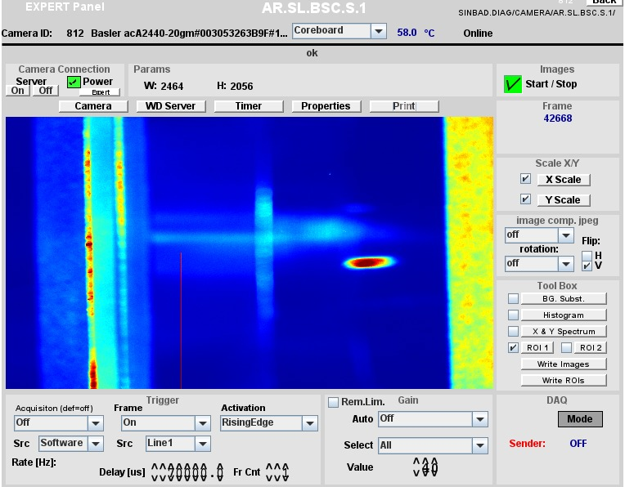
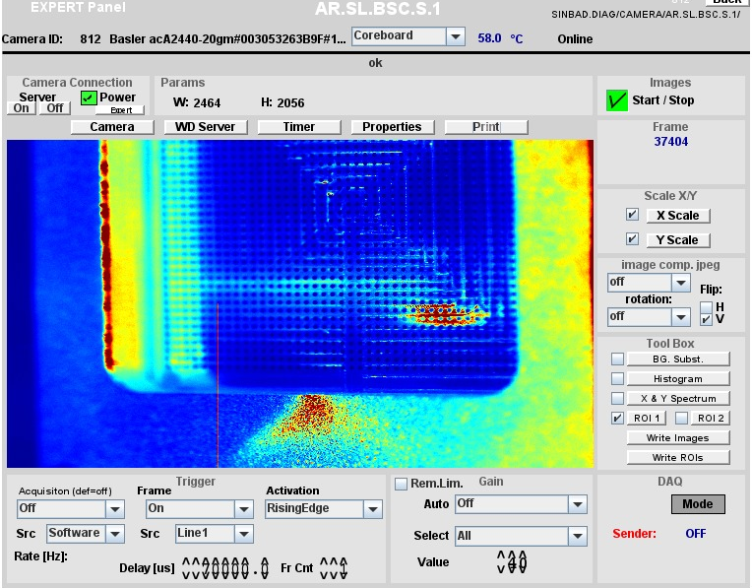
Study on tilt angle on screen SL.S1
Image of screen SL.S1 appears tilted by ≈ 1.5°
Image of calibration grid also appears tilted by ≈ 1.5°
* On the left side, the edge of the blade carrying the screen and grid is visible. When moving the blade in and out, it appears that the distance along X between the edge of the image and the edge of the blade for a fixed position in Y is not constant. This should not happen if the edge of the blade is straight and the blade moves with no angle in and out the beamline → One of these things is happening.
* Analysis of the data is ongoing to clarify if this is the only cause of the tilted image or if the camera/optics also add a contribution to this tilt.

Slide 9
Data analysis for BBA of solenoids around TWS
Momentum (MeV/c) | Solenoid |  | dX (µm) | dX_{rot} (µrad) | dY (µm) | dY_{rot} (µrad)
2.52 ± 0.03 | TWS1-Sol4 | 1st iteration | 88.5 | 844.9 | -172.9 | -1652
 |  |  | (-62.94,239.9) | -602.6,2293 | (-324.4,-21.52) | (-3099,-204)
 |  | 2nd iteration | 78.67 | 753 | -163.3 | -1563
 |  |  | (-139.6,296.9) | (-1334,2840) | (-381.5,-55.03) | (-3650,-523.7)
 |  | Average Misalignment | 83.58 | 798.95 | -168.10 | -1607.5
 | TWS1-Sol3 | 1st iteration | 164.44 | 1571 | 163.7 | 1566
 |  |  | (-290.8,619.5) | (-2780,5921) | (-291.5,618.8) | (-2784,5917)
 |  | 2nd iteration | 184.4 | 1763 | 327.4 | 3128
 |  |  | (-640,1009) | (-6116,9643) | (-497,1152) | (-4752,1101)
 |  | Average Misalignment | 174.40 | 1667 | 245.55 | 2347
Two sets of data was taken for each solenoid, by scanning the solenoid current and recording the beam positions on the screen.
Analysis of BBA of solenoids in given in table below.
Solenoid should be moved in the opposite direction in the accelerator coordinates system
This is only a first estimate. Analysis of the data is still ongoing by Sumera.

Slide 10
Other technical stuffs
Water temperature drift stability measurement – MKK4 corrects on sensor E2.BT2 – this one is stable. To be checked if we see the tunnel temperature drift on the gun.
Second PCB steerer replacement triggered – will be done by Hannes / Max.
High energy dipole corrector coil setup and cycling procedure to be investigated.
Go for proper long-term solution: Connection to the standard power converter (MKK) in the shutdown.
MKK investigating SOLL-IST difference for Quads – exchanged relays. Adjusted orange warning signs, fine-tunig after optics set-up
Crane works and construction work expected – going back to BKR under discussion.

Slide 11
Planning of shutdown weeks 42 & 45
KW 42: MDI and MVS (clean)
Pepper pot installation
X1 complete exchange
FC exchange
Collimator alignment
KW 45: MEA (dirty)
Hole drilling
Water works
MCS server updates
TEM400
TEM200
TEM150
TEM300
TEM300
TEM300
Pepper pot

Slide 12
Shift planning for KW41
Date | Shiftleader | Tasks | SSB | LSO
5.10. | Thomas | MEA – Transport MDI Screen S1(tbc) MIN (cable tests of TWS2) | Eva | Frank
6.10. | Willi | FS-LA (laser works) MKK6 (magnet current tests) | - | Andi W.
7.10. | Willi | FS-LA (laser works) MKK6 (magnet current tests) | - | Andi W.
8.10. | Hannes / Willi |  | Eva | Andi W.
9.10. | Thomas |  | Eva | Andi W.
NO ELECTRONS!!
NO ELECTRONS!!

