Slide 1
Electron Laser plots
Beate

Slide 2
Compton events

Slide 3
Electron and Photon Energy distributions

Slide 4
e- and photon rates vs xi
JETI40
photons
electrons
Rate plot not yet normalized by area: should be rescaled by overlap area to account for flux changing with w0
=> a bit non-trivial as size of electron beam 5 um, so only affects cases where w0<~5000

Slide 5
Number of photons per electron
JETI40

Slide 6
Plot by Tony: compared to MC

Slide 7
MC: xi
MC samples over range of xi values as the laser pulse has gaussian intensity distribution
In 3 dimensions
Only small fraction of events have maximal xi value
This distribution is in principle well known if we know the widths of pulses in all 3 dimensions
Physics depends on xi, i.e. cross section largest at high xi

Slide 8
Xi distributions
Max xi | Mean xi | Xi RMS
0.31 | 0.25 | 0.06
0.77 | 0.56 | 0.16
1.55 | 0.96 | 0.34
1.94 | 1.13 | 0.43
3.10 | 1.46 | 0.77
3.45 | 1.69 | 0.79
3.90 | 1.83 | 0.89
4.44 | 2.00 | 1.02
5.20 | 2.21 | 1.18
The actual xi-distribution contains the physics we want to measure
=> How can we unfold it from observed particles?

Slide 9
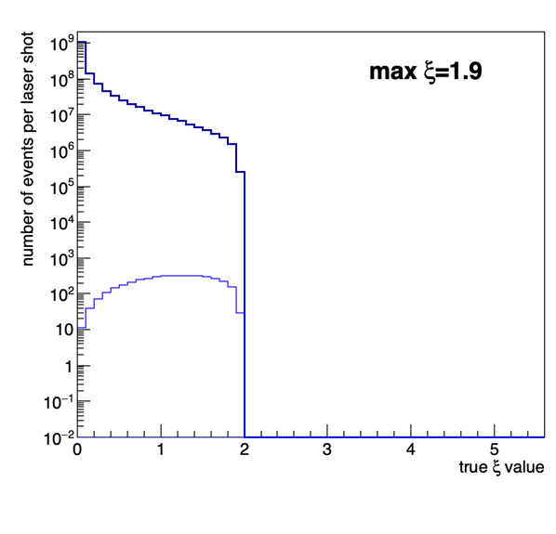
MC: xi distribution examples
All events
All events
Compton events
Compton events
Two-step trident events
Relative fraction of events that interact highest at high xi

Slide 10
Photon energy distributions
When selecting ranges of xi within file we see the moving Compton edges
Observed spectrum is superposition of all these ranges => Edges are washed out

Slide 11
Two-step trident events

Slide 12
Events in e-laser setup with pair production
Compton photon
creating pair

Slide 13
Positron rate vs nominal xi (OPPP)
~10 positrons per bunch
Crossing at high xi

Slide 14
Positron Spectrum

Slide 15
BPPP events

Slide 16
Rates of e+ in BPPP events
Why is there a factor 1.632/0.368=4.4 difference between xi=5.12 (JETI40) and xi=5.01 (phase II)?
Very important to understand: at present we expect higher numbers of events in HICS+OPPP mode than in BPPP mode…

Slide 17
Xi distribution
Looks weird

