Slide 1

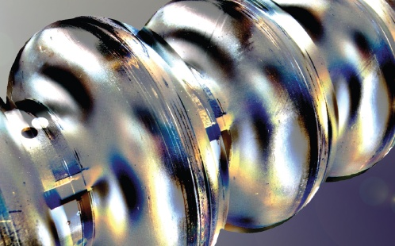


Grain boundary segregation and precipitation of carbides in heat treated Nb cavity cutouts and samples
Arti Dangwal Pandey - on behalf of SRF R&D team and Nano lab at DESY
TTC 2021, TESLA Technology Collaboration
MML
From Matter to
Materials and Life

Slide 2
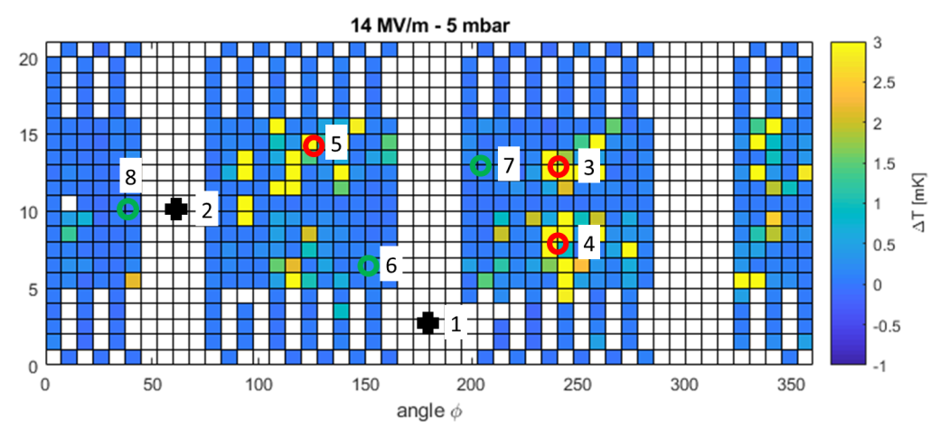
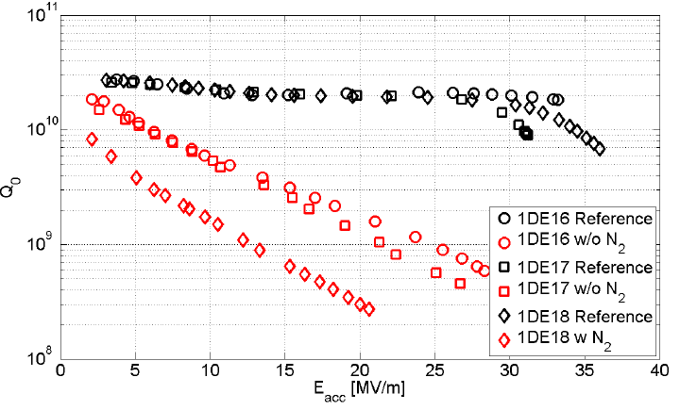
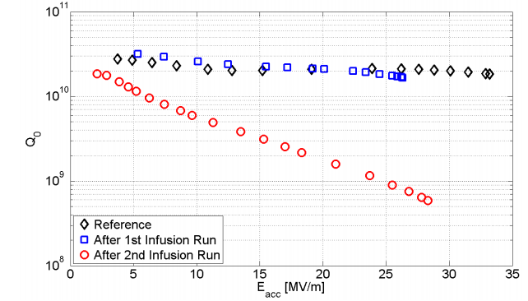
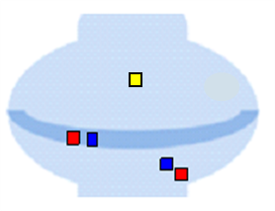
Reasons behind Q-degradation?
Infusion attempts with/ without nitrogen on fine grain Nb cavities
T-maps @ 1.5 K
800 °C /3 hrs + 120 ° C /48 hrs
1DE16
M. Wenskat et al, SUST 33, 115017 (2020)
Schmitz et al, Review of Scientific Instruments 89, 54706 (2018)
800 °C /3 hrs + EP + 120 ° C /48 hrs
+ 800 °C /3 hrs + 120 ° C /48 hrs
+ 800 °C /3 hrs + 120 ° C /48 hrs

Slide 3
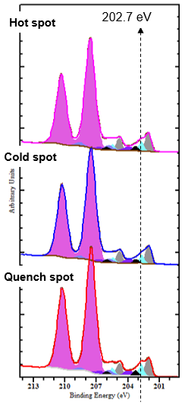
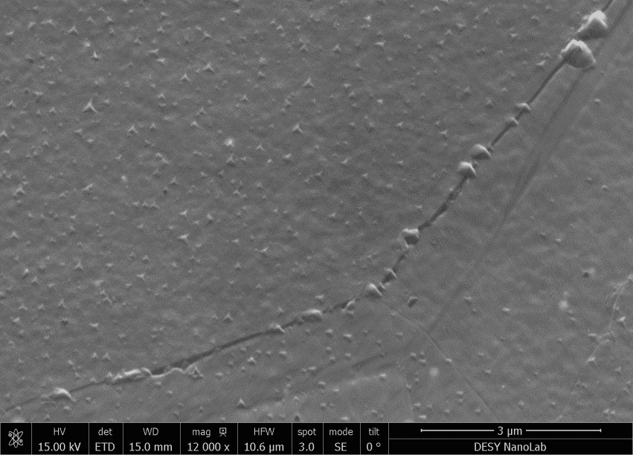
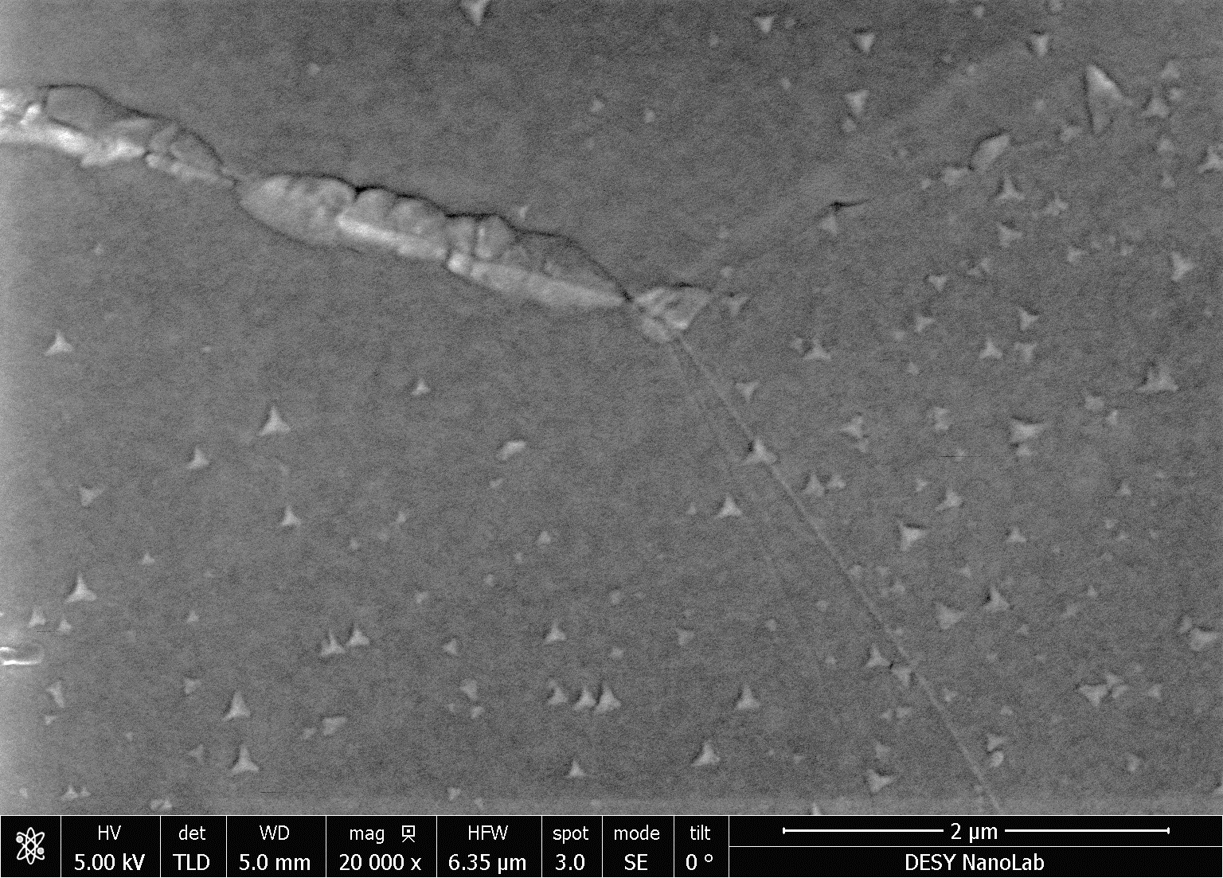
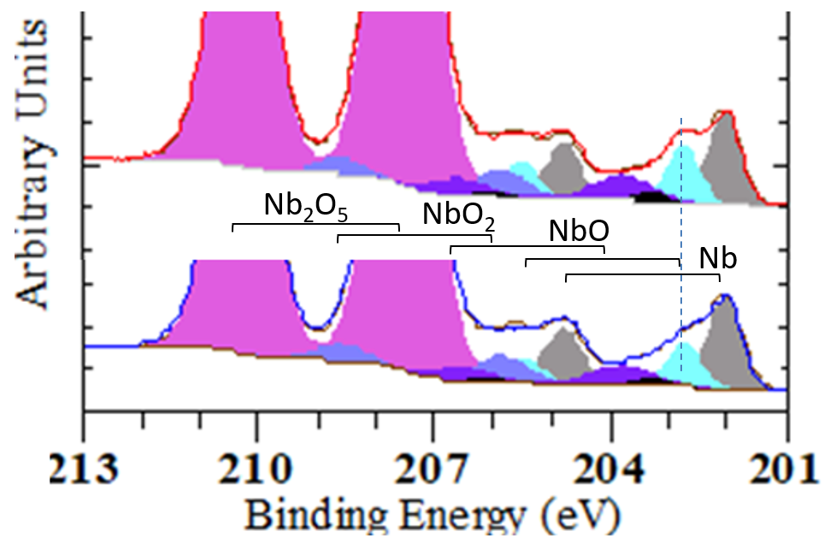
Cavity cutouts: Carbide Precipitates overall
XPS: Nb3d
SEM, X-ray photo electron Spectroscopy (XPS): Nb₂C additional phase
Cold spot
Hot spot
Increased agglomeration of precipitates at grain boundaries
Quench spot
Nb₂C
Quench spot
Cold spot

Slide 4
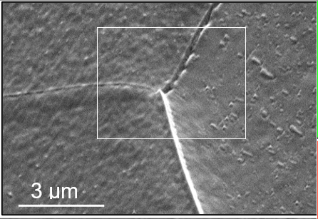
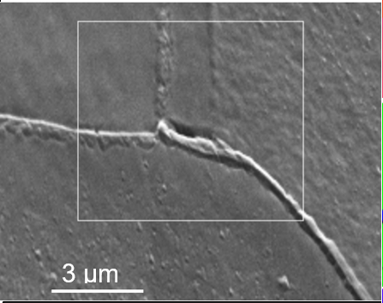
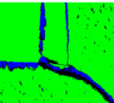
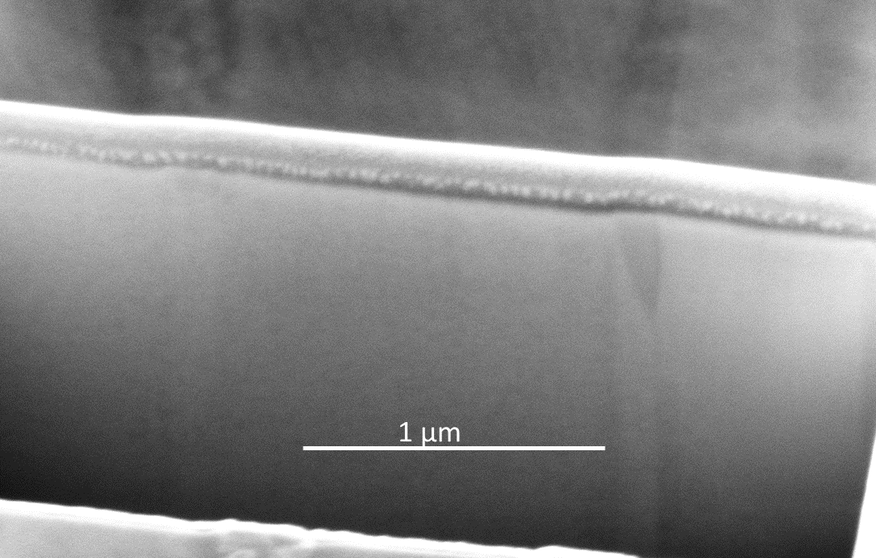
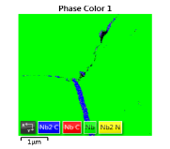




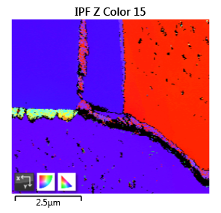
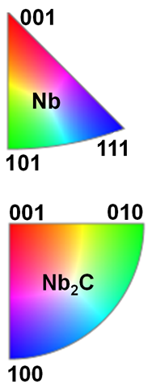
Grain boundary segregation: Nb grain decoupling
SEM, electron backscatter diffraction (EBSD), and Focused ion beam (FIB) milled cross sections
cold spots
Quench-spot
FIB Cross-section view
Pt layer
Nb Nb₂C
Nb Nb₂C
Depth of carbides into Nb >> RF penetration depth
Decouples the Nb grains within RF layer
Enormous Q-degradation as seen in granular thin films on cavities/ Ti contaminated Nb cavities
Bonin & Safa (1991) Supercond. Sci. Technol. 4 257
ANTOINE C, et al., Proceedings of the 1997 Workshop on RF Superconductivity,
Abano Terme (Padova), Italy
A. Grassellino et al., arXiv (2013), arXiv:1305.2182

Slide 5
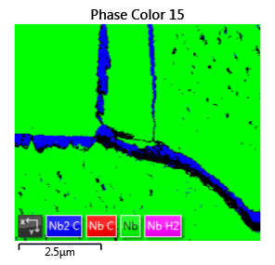
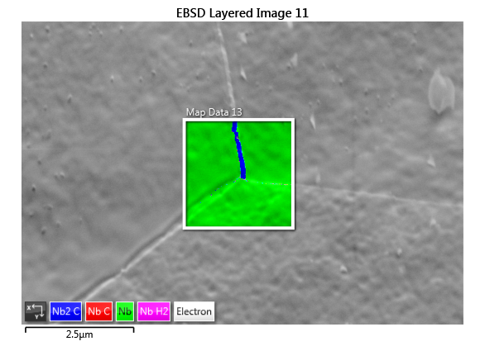
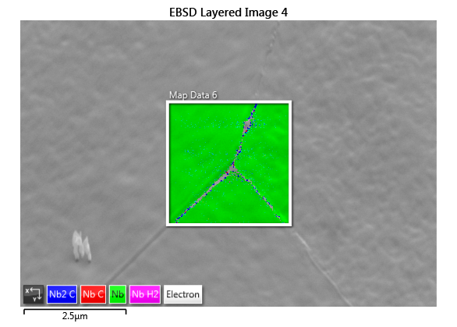
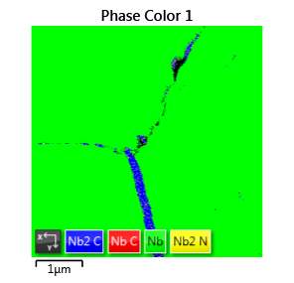
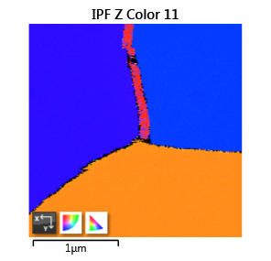
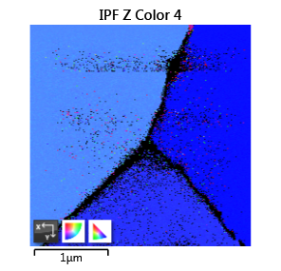
Comparison to a successful N-infusion treatment
SEM + Electron backscatter diffraction (EBSD)
(111)
(001)
Nb sample N- infused with 1DE20 at FNAL
(111)
GB Segregated carbides width
>200 nm @ cold spot; 500 nm @ quench spot
of 1DE16
~100 nm
- much less ‚C‘ segregation at few grain boundaries
Carbides were also reported by FNAL already
[A. Grassellino etal. In “Unprecedented quality factors at accelerating gradients up to 45 MVm^-1 in niobium superconducting resonators via low temperature N infusion”]
Notes:
I quote: " Further studies will be performed on the origin of these precipitates, but preliminary XRD results indicate they are niobium carbides. The origin of these carbides is currently under investigation, but it is expected to affect negatively cavity performance."

Slide 6
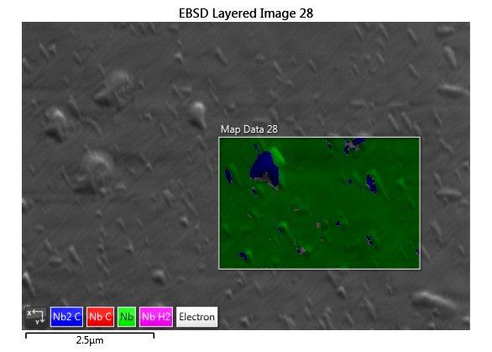
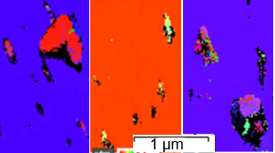
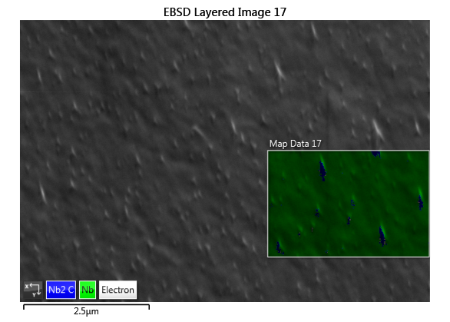
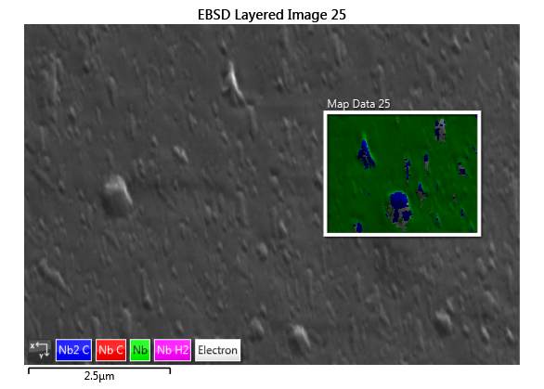
Carbide growth dependence on Nb orientation
SEM + Electron backscatter diffraction (EBSD)
Precipitates
Grain boundary segregation
Nb(111)
α-Nb₂C (orthorhombic)
Nb (bcc)
More segregation at higher index plane side
Size and shape changes with Nb grain orientation

Slide 7
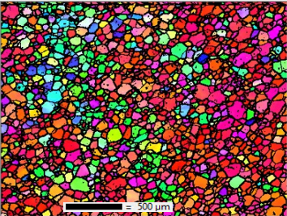
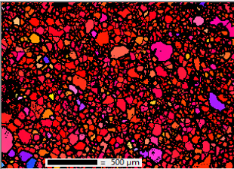
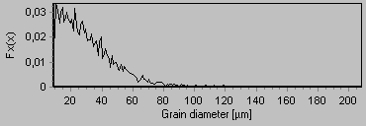
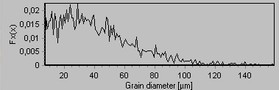
Grain-size distribution
electron back scattered diffraction (EBSD)
High Q , high E_{acc} after : 800 °C /3 hrs + 40 µm EP + 120 ° C /48 hrs
Cold spot
Quench spot
Av. size < 30 µm
Av. size ~ 40 µm

Slide 8
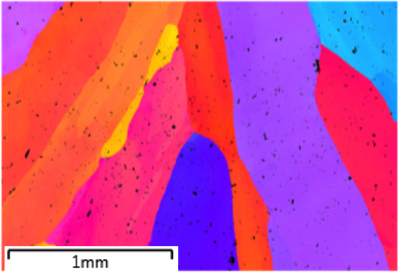
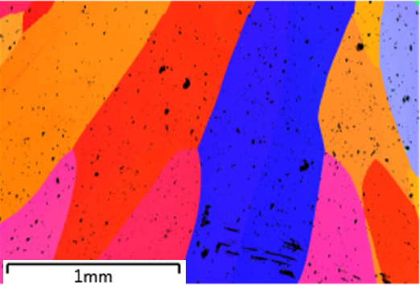
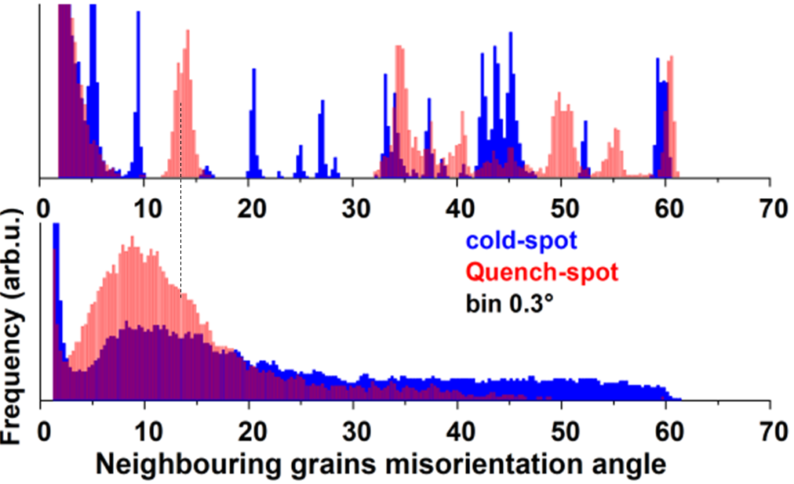
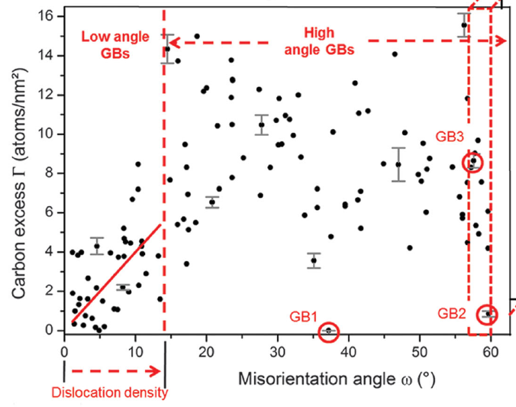
Misorientation angle (θ) distribution
Low-angle grain boundaries with high dislocation density
Low angle grain boundaries
bcc Fe – C system
Dislocation density increases with θ for low-angle grain boundaries
In quench spots: Excess of low-angle grain boundaries at higher θ (up to 14̊)

Slide 9
Summary:
Nb₂C precipitates and grain boundary segregation observed on cavity cut-outs as well as Nb samples heated up to 800 C (incl. successful N-inf)
- Dimensions decided by C content in furnace ambient and cavity surface
Q-degradations due to
  - For high ‘C’ contamination: enormous GB segregation and precipitation of carbides of large dimensions (~0.5 µm) occur. Carbides penetrating into the GBs result in to Nb grains decoupling, and hence, lead to anamolous Q-losses starting at low E_{acc}
  - Nb₂C as surface defects might result ohmic losses and hence, a quench at a reduced E_{acc}
  - Excess of low angle grain boundaries in high theta regime, with abundance of very small grains facilitates early flux penetration and hence a quench at a reduced E_{acc}

Slide 10
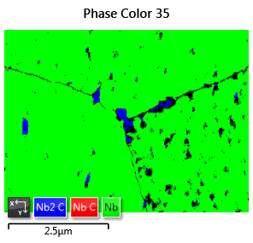
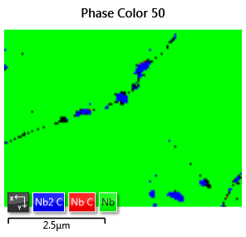
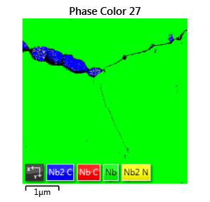
C-segregation, low angle grain boundaries => Q-degradation
C excess, Q-loss, and misorientation angles distribution
Cold spot Hot spot Quench spot
Excess of carbides at grain boundaries/ precipitates : higher losses in cavities
Excess of low-angle grain boundaries

Slide 11
Acknowledgements
Colleagues at FNALfor N-infusion of samples and cavity
HZB
BEEM (electron microscopy) group at TUHH
DESY Nanolab team and MSL/MPL group at DESY
Thank you very much for your attention!

