Slide 1
ARES Operations Meeting

Slide 2
Shutdown
Shutdown successfull finished
Screen exchanged
Pepper pot installed
Collimator and Faraday Cup exchanged.
MEA survey team marked positions for BC and TDS
2 micron laser alignment

Slide 3
Plans for week 43
RF tests
Beam restart on THU, check laser alignment on X1
Function tests (X1, Faraday Cup, Collimator, corrector coils on PDE)
Set-up PDE energy measurements
TWS1 and 2 phase scans.

Slide 4
Schedule
Week 43
Date | Shiftleader
19.10. | TWS RF tests, MEA
20.10. | Frank
21.10. | Hannes
22.10. | Willi
23.10. | Thomas

Slide 5

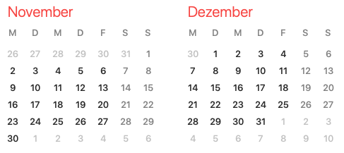
Shutdown (Monday = Maintenance day)
Beam Commissioning (Gun section)
Beam Commissioning (Linac section + EA1)

