Slide 1
ARES Operations Meeting
Week 44 / 2020
H. Dinter, on behalf of the ARES shift crew

Slide 2
Summary of week 43
 | Monday 19th | Tuesday 20th | Wednesday 21st | Thursday 22nd | Friday 23rd
Achievements | TWS RF tests X1 & Faraday cup test | Tests of FC and X1 Establish a PDE working point Teacher tour FC mover steps fixed | Collimator studies Teacher tour Cathode laser auto alignment working again CXG2 polarity check | Collimator tests Momentum measurement on SL.S1 Finding setup to get beam through TWS1 | Transport the beam as far as possible, looking at trajectory all along beamline Detailed Schottky scan TWS1 momen-tum phase scans
Difficulties | Cathode laser auto alignment stuck Faraday cup does not reach end position One magnet missing its water signal | TWS1 modulator fault Pyqtgraph based tools do not work anymore Cathode laser auto alignment stuck (motor controller not responding) |  | Several vaccum events in TWS1 and waveguides, two of them triggering vacuum interlock. Probably due to increased operation voltage of the RF station. | Camera server died

Slide 3
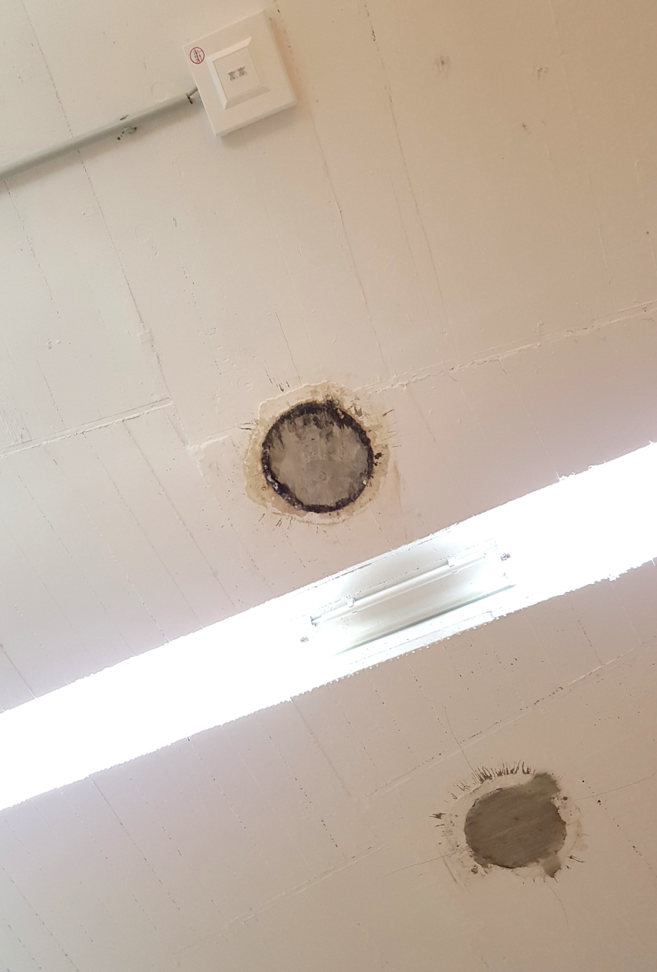
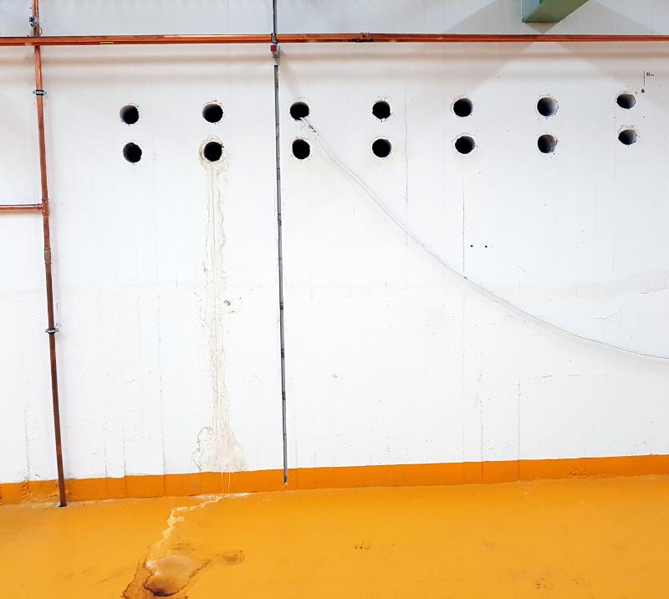
Water in the tunnel

Slide 4
Technical issues
Sparking in the TWS1 modulator at 2900 V, was reset locally and re-started with 2800 V.
Some vacuum events in the TWS1 waveguides.
Investigations ongoing concerning TWS1 FW/probe1 power.

Slide 5
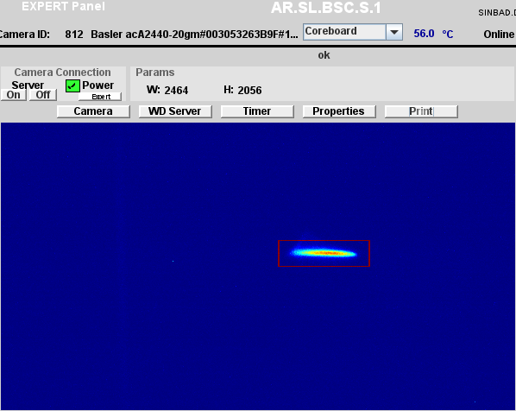
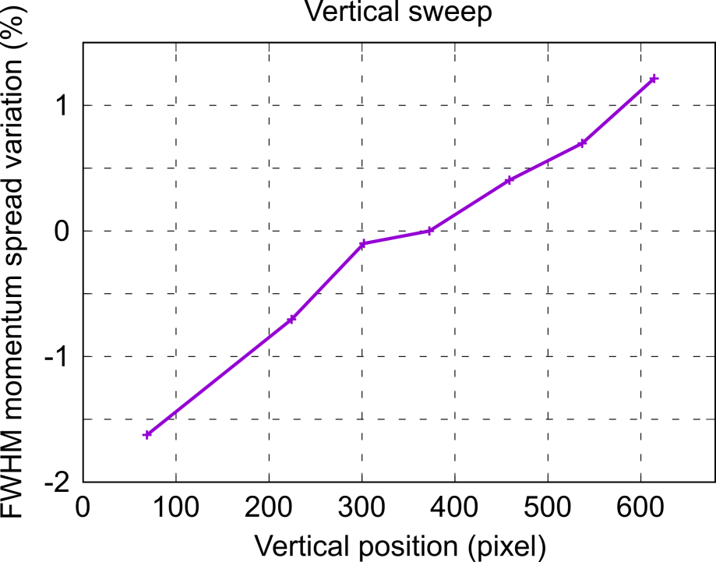
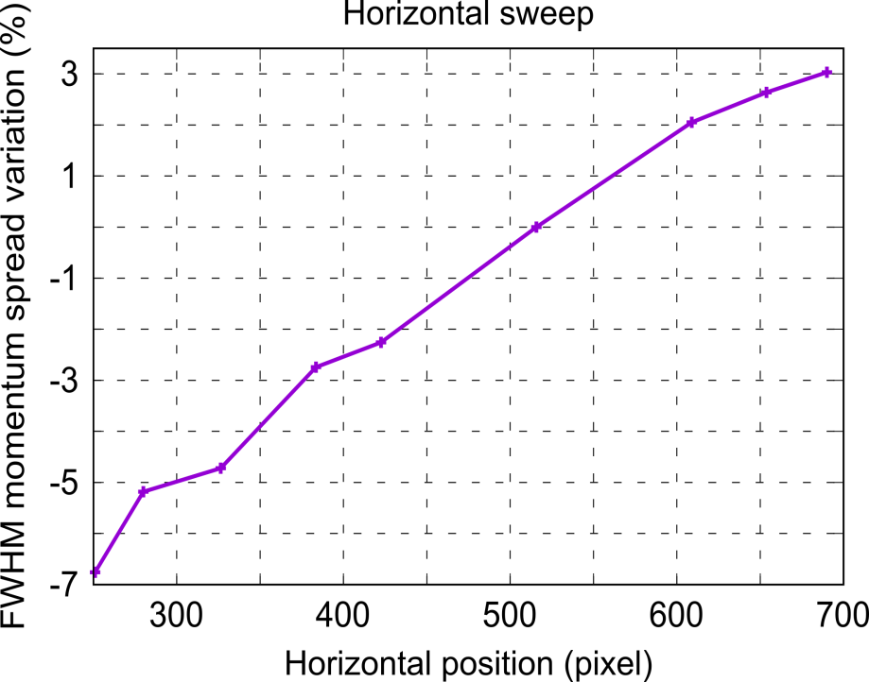
Characterization of SL.S1 screen
Sweep the beam vertically (change CVG1) and horizontally (change Idip.) wrt reference position and measure momentum (spread) variation.
CVG1 ↑
Idip. ↑
Idip. ↓
CVG1 ↓
Average momentum value shows a max. deviation of ≈ 0.1% wrt reference → Not significant.
Rms (FWHM) momentum spread shows a max. deviation of ≈ 1.3 (1.6) % wrt reference for a vertical sweep → Not so critical.
Rms (FWHM) momentum spread shows a max. deviation of ≈ 4.5 (6.7) % wrt reference for an horizontal sweep → More significant → ROI cannot be increased too much without losing accuracy.

Slide 6
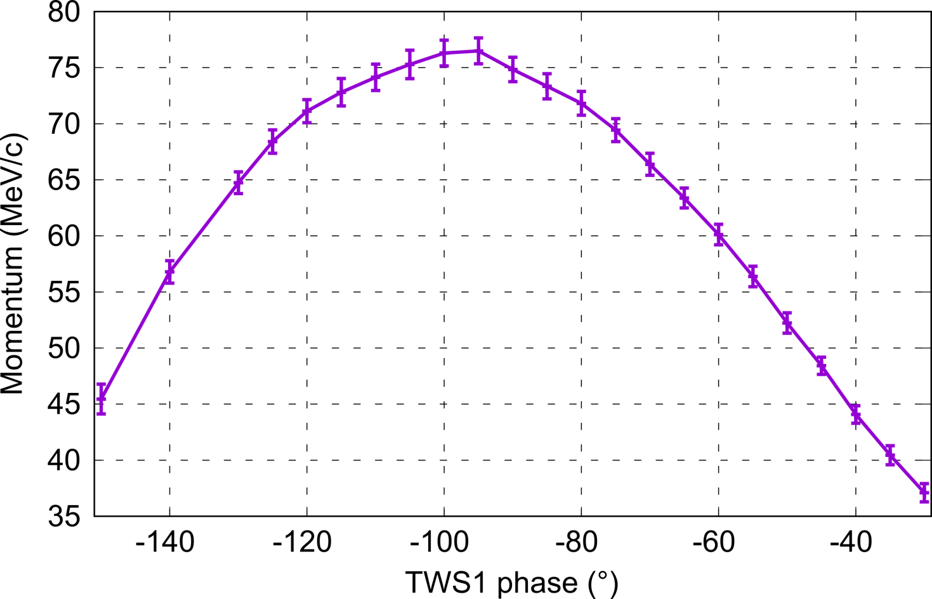
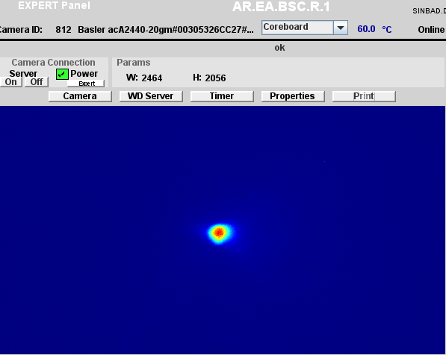
TWS1 momentum measurement (1/3)
Conditions: Initial momentum of 3.403 MeV/c; Amplitude SP 95 for TWS1 → 39.55 (47.64) MW fwd (probe) power.
Measurement performed on EA.R1 screen varying CVG4 current.
Beam on EA.R1 screen for max. momentum
Max. momentum measured to 76.490 +/- 1.154 MeV/c at phase -95°. A measurement with CVG3 in the same conditions gives 77.256 +/- 1.028 MeV/c (factor of 1.01) → Fully consistent.
But, for such a low initial momentum there are two peaks → Is it the real maximum ?

Slide 7
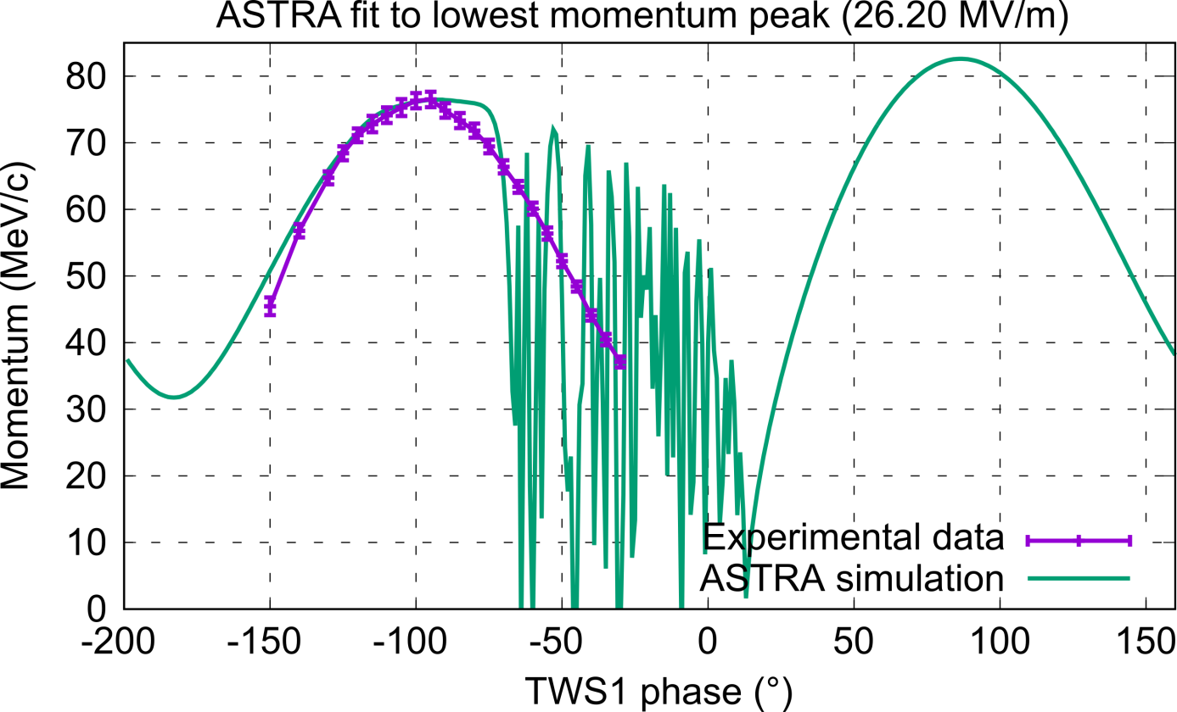
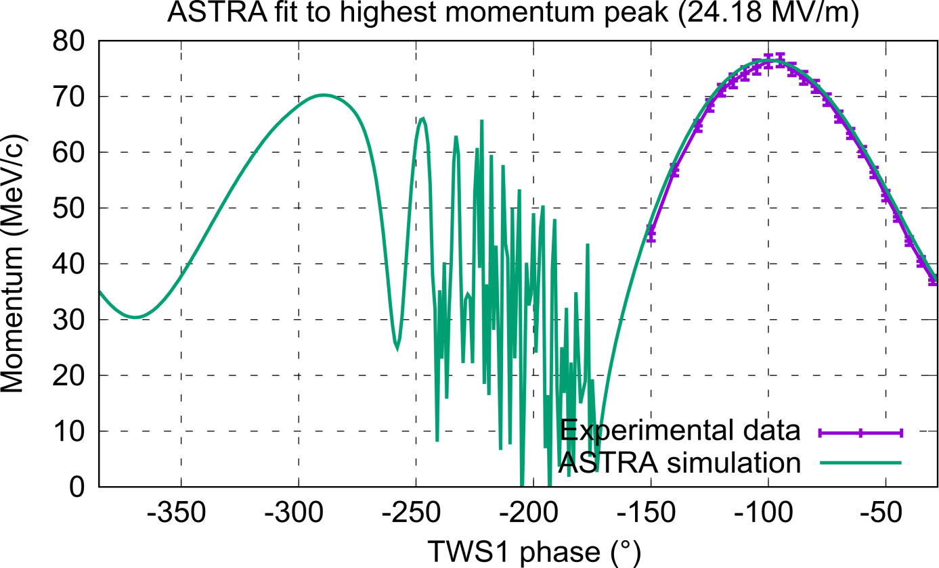
TWS1 momentum measurement (2/3)
ASTRA simulations show that to reach 76.49 (77.26) MeV/c requires an average gradient in TWS1 around 24.18 (24.43) MV/m if the highest momentum peak has been measured and around 26.20 (26.45) MV/m if the lowest momentum peak has been measured → Hint towards the first case.
Trying to fit each case with an ASTRA simulation (single particle at 3.403 MeV/c) clearly favors the first case and strongly indicates that the real maximum has been measured.
We likely have an average gradient ≈ 24.2 (24.4) MV/m in TWS1 at amplitude SP 95. From design, 41 MW → 25.5 MV/m. From square-root scaling, 24.3 MV/m → 37.23 MW. Not 100% consistent with readings. Need measurement with PDE to refine.

Slide 8
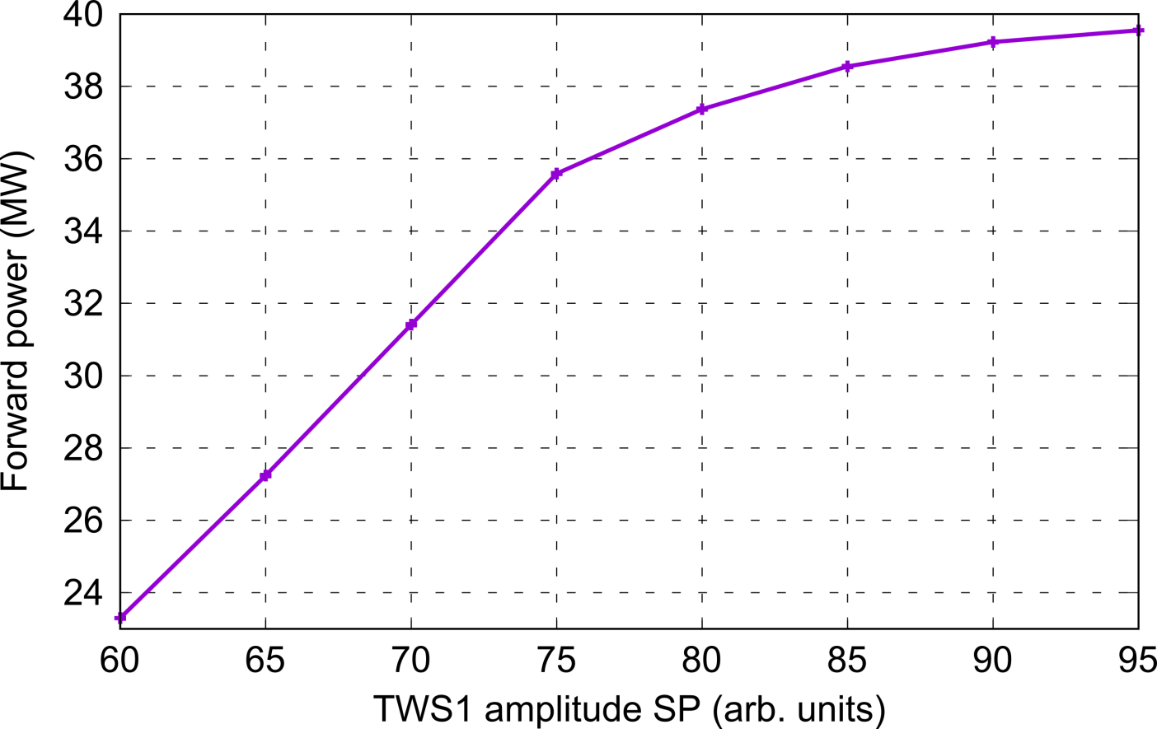
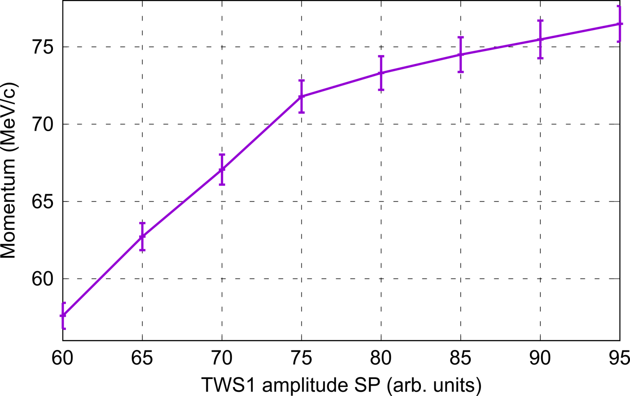
TWS1 momentum measurement (3/3)
Measurement of momentum has been performed at phase -95° as a function of TWS1 amplitude SP. Analysis ongoing.

Slide 9
Plans for week 44
Function tests (corrector coils on PDE)
Set-up PDE energy measurements
TWS1 and 2 phase scans.
Laser Alignment (?)

Slide 10
Schedule
Week 44
Date | Shiftleader
26.10. | BAU, MEA, FS-LA
27.10. | Hannes
28.10. | Frank
29.10. | Willi
30.10. | Thomas

Slide 11


Shutdown (Monday = Maintenance day)
Beam Commissioning (Gun section)
Beam Commissioning (Linac section + EA1)

