Slide 1
ARES Operations Meeting
Week 45 / 2020
F. Burkart, on behalf of the ARES shift crew

Slide 2
Shutdown work
Holes for MIN cables (TDS)
Holes for support structures (BC and TDS)
Cable pulling (FS-LA)
Cathode box installation
Screen gluing (ongoing) → baking out → MVS preparation
Discussions extension rackroom AC.
SSB check
MSK synchronization upgrade for PC laser – test this afternoon (and tomorrow morning)

Slide 3
Technical issues
Screen X1 calibrated.
“The calibration was off (2.5 to 2.7 um in y) about 8 %.” Artem
“I applied the updated calibration from Artem on the data taken last Friday for CVG1 on LI.X1. It gives a momentum of 3.34 +/- 0.05 MeV/c (against 3.41 MeV/c for the spectrometer). Discrepancy is now 2% and therefore totally reasonable. To be confirmed next week.” Thomas

Slide 4
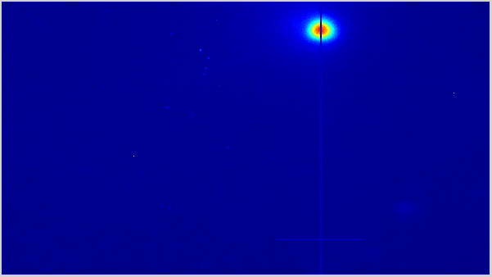
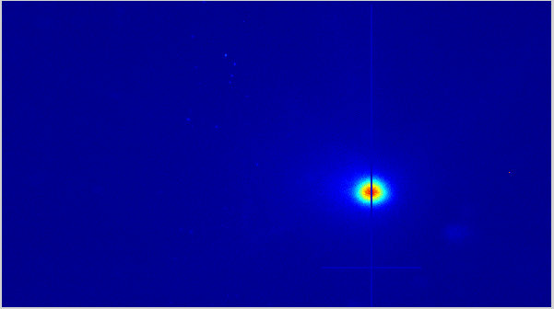
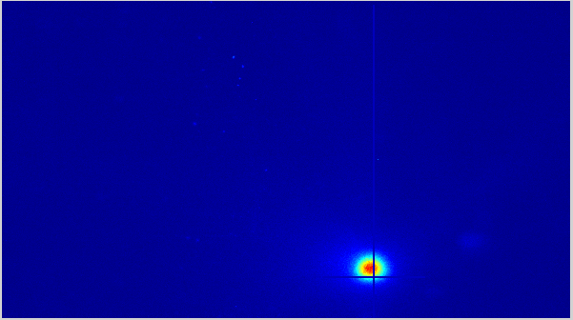
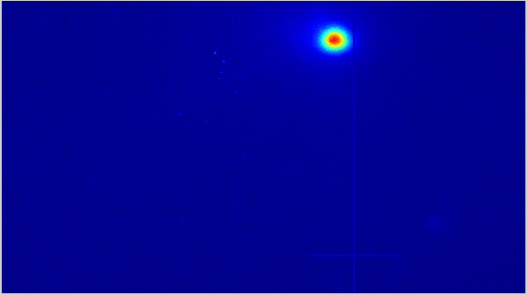
Coupling of PCB steerer in gun region
Study the coupling between horizontal and vertical deflections for the two PCB steerers in the gun region. Only gun solenoid and the studied steerer (CVG1 or CVG2) were powered (all other magnets to zero). Images taken on LI.R1.
CVG1 (left side plots): 63 μm horizontal displacement for 4146 μm vertical displacement → ≈ 1.5% coupling.
CVG2 (right side plots): 347 μm horizontal displacement for 2764 μm vertical displacement → ≈ 12.6% coupling.
CVG1: +1 A → -2 A
CVG2: -5 A → +4 A

Slide 5
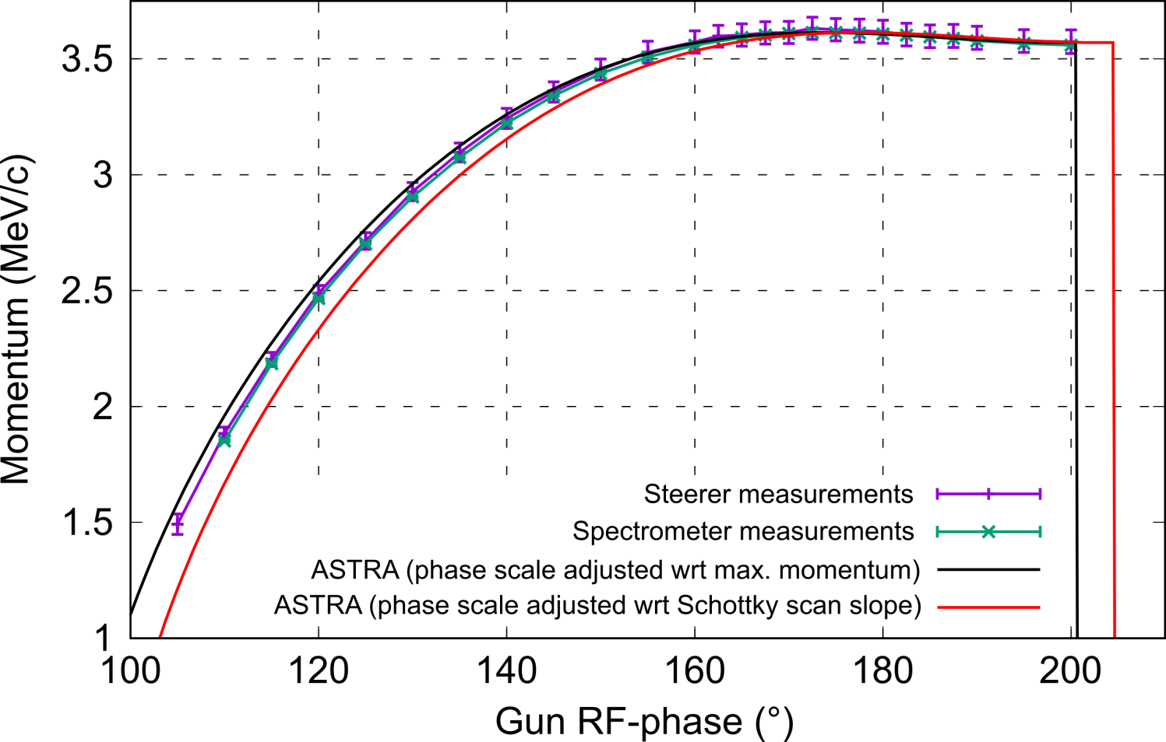
Gun momentum phase scan (1/2)
Fit the experimental gun momentum phase scan with ASTRA. Measurements acquired with the low-energy spectrometer and CVG1 on LI.R1. Gun RF-phase between experiment and ASTRA adjusted in two different ways: same position of the max. momentum or same position of the rising slope of the Schottky scan (should in principle give the same thing).
None of the options fit the experimental results well and they are not giving the same thing → Problem.

Slide 6
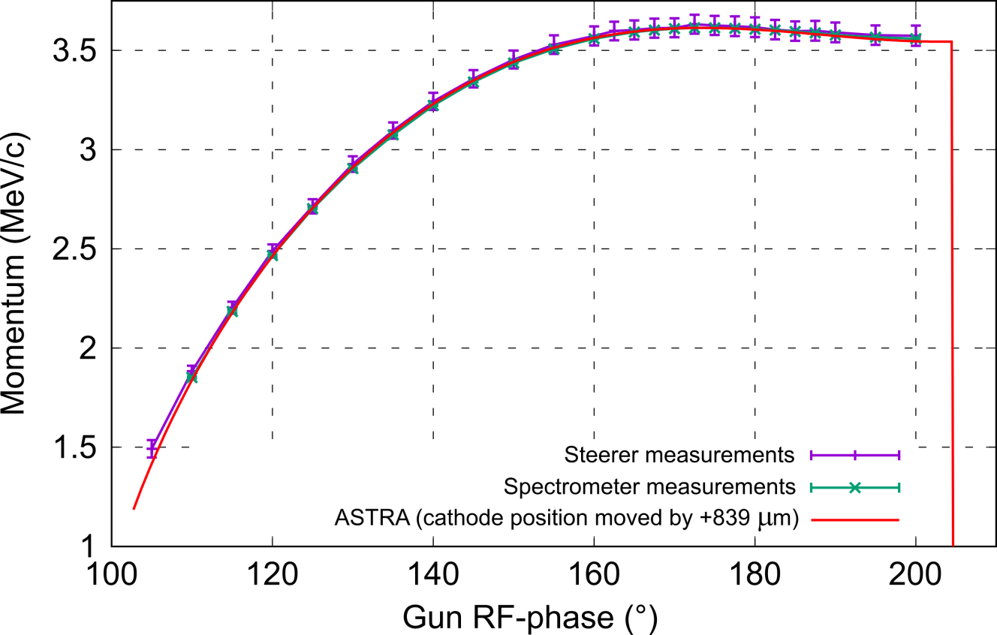
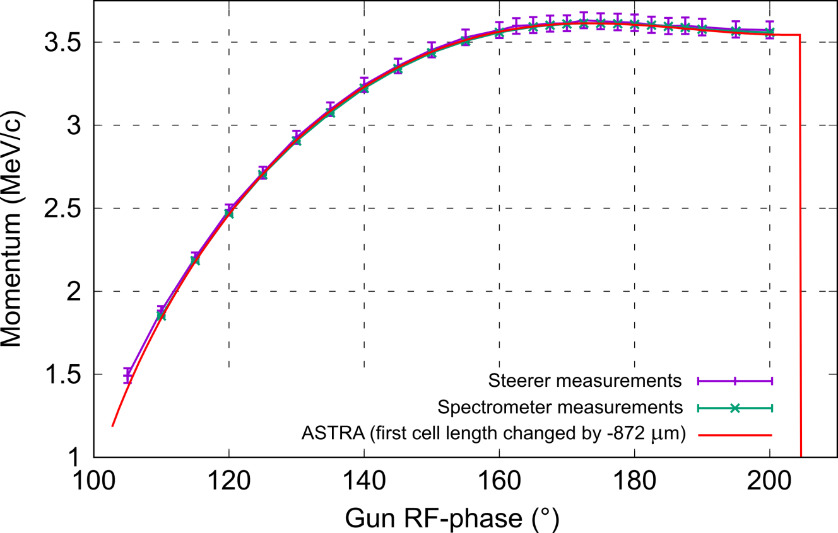
Gun momentum phase scan (2/2)
This could be explained if the gun field profile used in ASTRA is incorrect (e. g. if the cathode position is shifted). ASTRA simulations have been conducted to find for which cathode position the two methods of phase adjustment (max. momentum and Schottky scan rising slope) give the same thing. 2 options considered to modify the gun field profile: simply cut it or compress the length of the first cell.
Simulations are consistent and agree much better with the measurements when a shift of the cathode position is considered. This shift would be between 840 μm and 870 μm (depending on the way the field profile is affected).

Slide 7
Plans for week 46
Insert new cathode
Align laser
Beam characterization gun area

Slide 8
Plans for week 46 - SINBAD
Crane works… Construction side – be carefull.
KALDERA concrete construction work will (maybe) start this year.
Test of SINBAD Hall ventilation (WED – 10.30)

Slide 9
Schedule
Week 46
Date | Shiftleader
9.11. | MVS
10.11. | Florian, Hannes, Willi
11.11. | Frank
12.11. | Willi
13.11. | Thomas

Slide 10
Schedule
Week 47
Date | Shiftleader
16.11. | No shutdown
17.11. | Hannes – MVS at EA1 - screen exchange
18.11. | Frank
19.11. | Willi
20.11. | Thomas

Slide 11


Shutdown (Monday = Maintenance day)
Beam Commissioning (Gun section)
Beam Commissioning (Linac section + EA1)

