Slide 1
ARES Operations Meeting
Week 46 / 2020
W. Kuropka, on behalf of the ARES shift crew

Slide 2
Report from last week
Restart after week long shut down
Dark charge measurements with Molybdaenium cathode (“old”)
Taking emittance data with “old” cathode
TWS2 conditioning
Momentum vs. gun phase measurements with “old” cathode
Cathode exchange → CsTe inserted
Careful gun ramp up
Cathode laser alignment
Dark current characterization
Photo charge measurement
Momentum vs. gun phase measurement with “new” cathode

Slide 3
Technical issues
Console work stations are really slow
Few magnet hickups

Slide 4
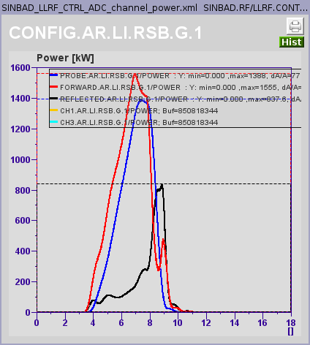
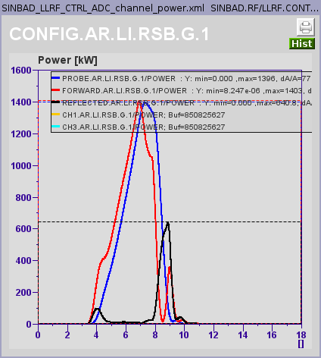
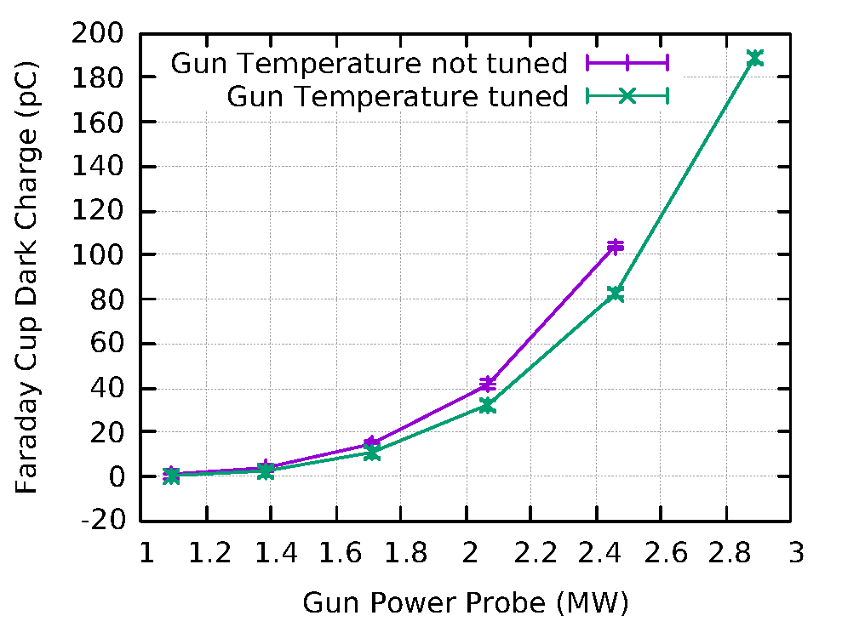
Gun Water Temperature Tuning & Dark Charge Measurements
Shift on 2020-11-10
Gun SP = 45 MV/m
Gun Solenoid adjusted at each data point in order to focus the entire dark charge into the Faraday cup
Temperature SP = 42.88°C
Temperature SP = 46.00°C

Slide 5
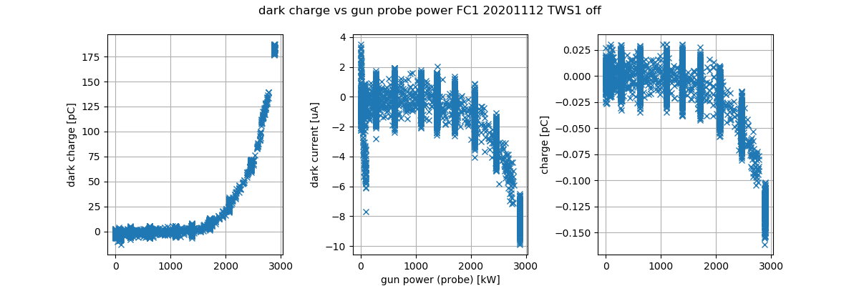
Dark charge during ramp up, CsTe cathode
Data taken during gun ramp up after cathode exchange

Slide 6
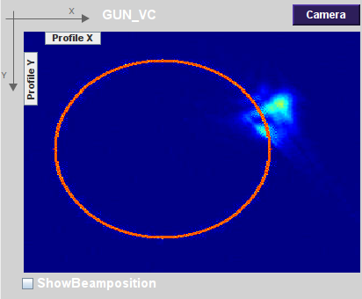
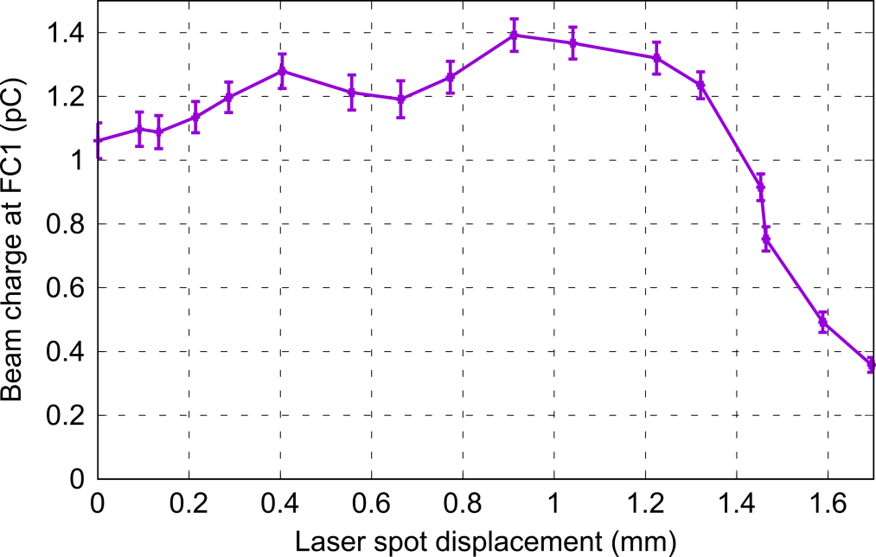
Laser alignment using gun coupling antenna
Coupling antenna has a 7 mm radius and is before the influence of solenoid field → Act as a potential collimator and is maybe useable to align the laser on the cathode.
A clear decrease of the charge is visible starting at around 1.3-1.4 mm of laser spot displacement (assuming camera image has a 5.5*5.5 μm² pixel size). A second point on the other side would allow drawing a circle from which the center should be close to the cathode center.
This could be an additional method to the centroid vs phase scan to align the laser in the gun, but it is impractical with the mirrors we currently have to move the laser spot → New mirrors will definitely help.
Can also be cross-checked with ASTRA simulations (to be done).
Experimental measurement
Initial laser position

Slide 7
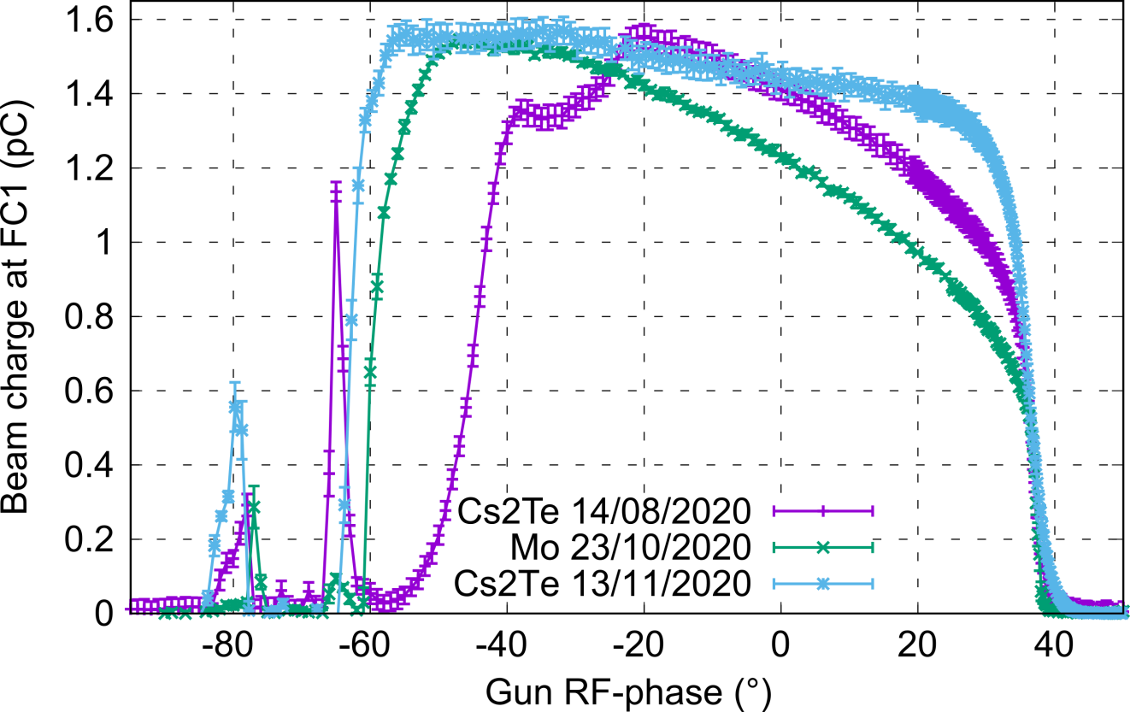
Schottky scan
Detailed Schottky scan has been acquired and compared with ones taken from the previous Mo and Cs2Te cathodes.
For similar charge level and gun setpoint (≈ 65 MV/m), the new cathode is exhibiting a significantly different behavior compared to the previous ones, namely the Schottky effect is significantly reduced and scan is close to a square.
Analysis with Matlab fitting tool and ASTRA will follow to determine the emission process (response time) from this new Cs2Te cathode.

Slide 8
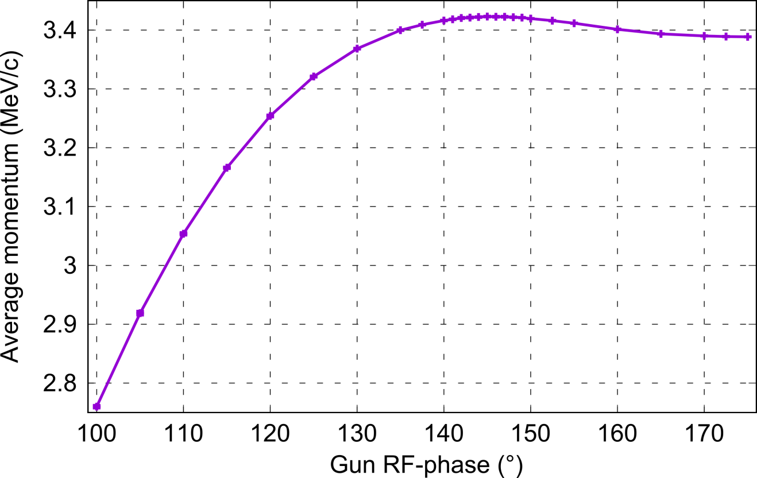
Gun momentum phase scan
Detailed gun momentum phase scan has been acquired.
The max momentum of 3.4229 MeV/c is consistent with the measurement with CVG1 on LI.R1 at the same phase (3.4267 +/- 0.0474 MeV/c) as expected.
Comparison with ASTRA simulation will follow to check if the field profile used in ASTRA is able to reproduce what we measure or not.

Slide 9
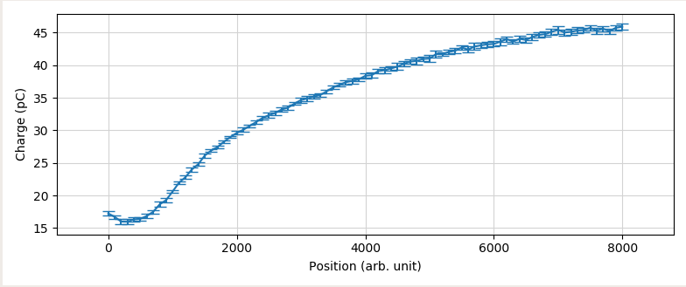
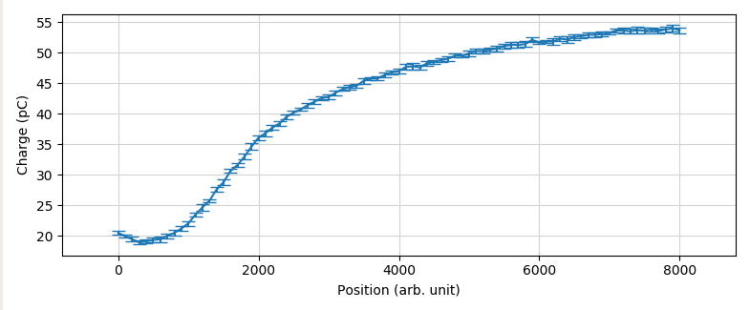
Charge measurements
Charge measurement as a function of laser intensity have been performed (could be used for QE measurement after asking Caterina how to convert the points into laser pulse energy).
Attenuator on the remote desktop user app fixed to several values (plots are for 50%, the max. I used) and user attenuator position has been scanned.
Max. charge phase helps compared to max. momentum phase (17% more charge) but beam properties worse.
Charge emitted is saturating (space-charge forces) → Unlikely to reach 100 pC with these settings (Gun SP 65 MV/m & 320 μm Ø aperture).
Two solutions: Increase the gun setpoint and/or use a larger aperture for the cathode laser.
Max. momentum phase
Max. charge phase

Slide 10
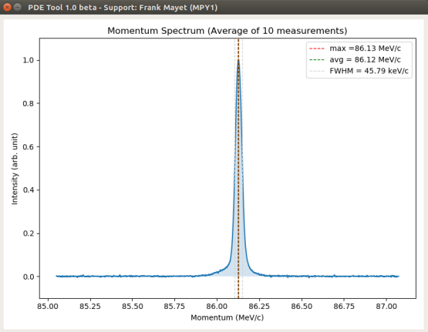
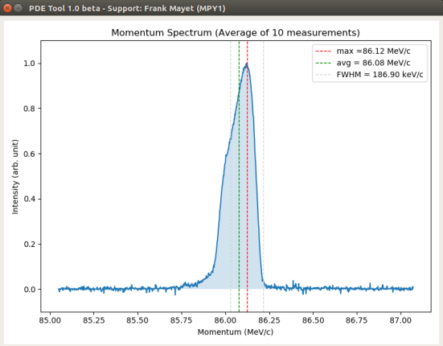
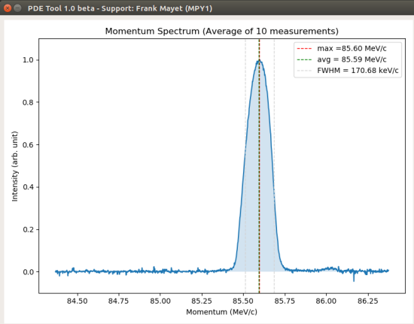
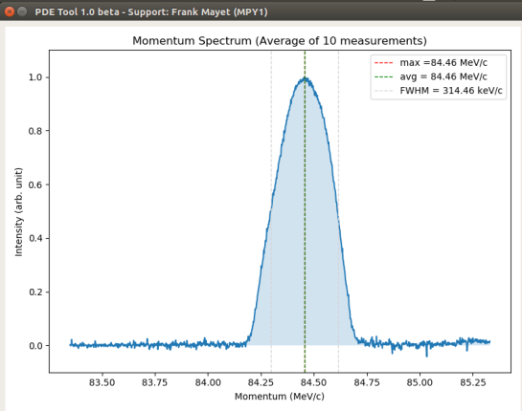
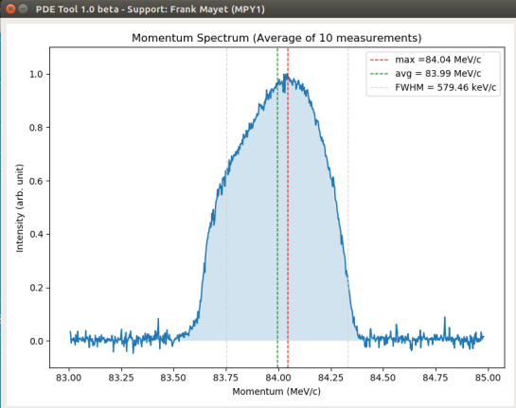
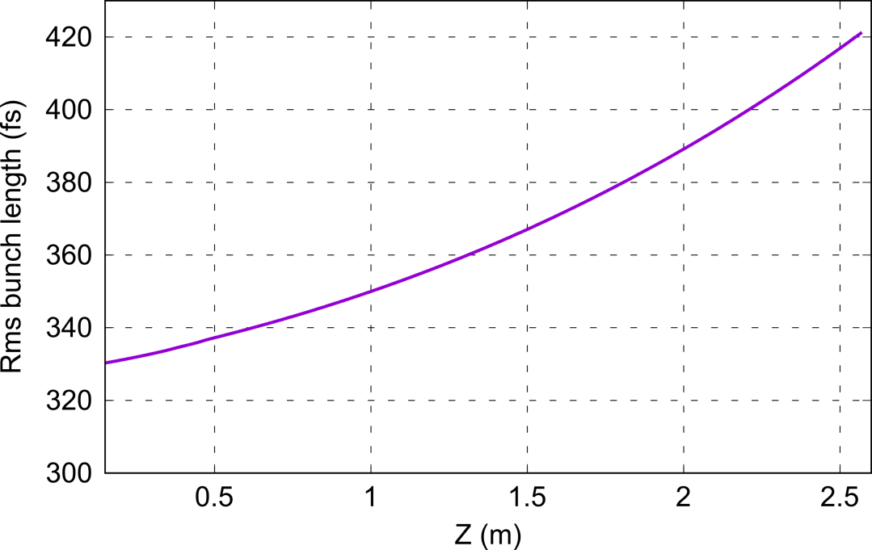
First estimation of bunch length in gun region
Momentum spectra acquired with PDE and Frank‘s live tool on 30/10/2020 (still Mo cathode) for different phases of TWS1 (TWS2 off) all other conditions remaining the same.
Applying 3-phase method with simplified model of TWS1 (sinusoidal field with amplitude equal to the average accelerating gradient) + no phase slippage included predicts an rms bunch length of 410 fs at TWS1 entrance (close to ASTRA).
Still preliminary (ASTRA conditions and model conditions have to be further evaluated) but encouraging.
Could probably use this method to diagnose an ≈ 100 fs rms beam out of TWS1 (VB) with TWS2.
ASTRA simulation
Bunch length evolution from gun exit to TWS1 entrance

Slide 11
Plans for week 47
beam characterization in gun region with new cathode
TWS 2 conditioning

Slide 12
Plans for week 47 - SINBAD
Crane works… Construction side – be carefull.
KALDERA concrete construction work will (maybe) start this year.

Slide 13
Schedule
Week 47
Date | Shiftleader
16.11. | TWS2 operation, preparation for EA1 opening on Tuesday
17.11. | Install high presission YAG screen at EA1, Hannes
18.11. | Frank
19.11. | Willi
20.11. | Thomas

Slide 14
Schedule
Week 48
Date | Shiftleader
23.11. | Tunnel open
24.11. | Hannes
24.11. | Frank
25.11. | Willi
26.11. | Thomas

Slide 15


Shutdown (Monday = Maintenance day)
Beam Commissioning (Gun section)
Beam Commissioning (Linac section + EA1)

