Slide 1
Towards coherent ultrafast spectroscopy
at IR-FELs
S. Kovalev, I. Ilyakov, A. Ponomaryov, J.-C. Deinert, J.M. Klopf, A. Pashkin, S. Winnerl, P. Evtushenko
Notes:
1
jmk: Corrected my name.

Slide 2
Introduction:
Background:
Accelerator-based sources can provide unique parameters of radiation
that is important both for fundamental research and applications.
A big interest on THz/IR range is attributed to selective ground state
excitation, THz nonlinearities, coherent phase control etc.
Problem: conventional techniques to study field-induced effects (time-
resolved techniques) often not working, require adaptations
Pulse-resolved detection as a way to overcome various accelerator instabilities,
but tested only for superradiant (CEP stable) sources.
Motivation:
FEL can provide tunable radiation with extreme spectral brightness → ideal for selective excitation.
FEL oscillators are not CEP stable, so new techniques are needed to determine the phase of each pulse at the high repetition rate.
Important for FEL-seeded superradiant accelerator based sources (such as DALI) in planning
Up to now: no results on coherent spectroscopy using CEP-unstable sources.
Here, we demonstrate: the CEP-instability problem can be solved by phase-resolved detection, and coherent spectroscopy can be employed at IR-FELs
Notes:
This is a lot of text, I tried to shorten it a little bit without removing any information.
jmk: I actually added more text because I didn‘t think the lack of CEP stability for the FEL was made clear.
2

Slide 3
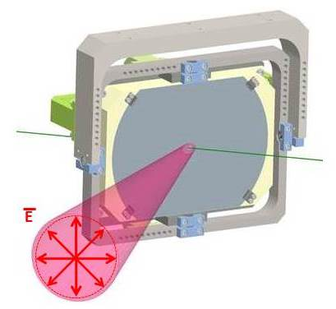
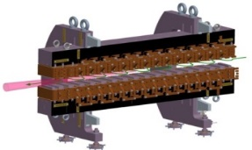
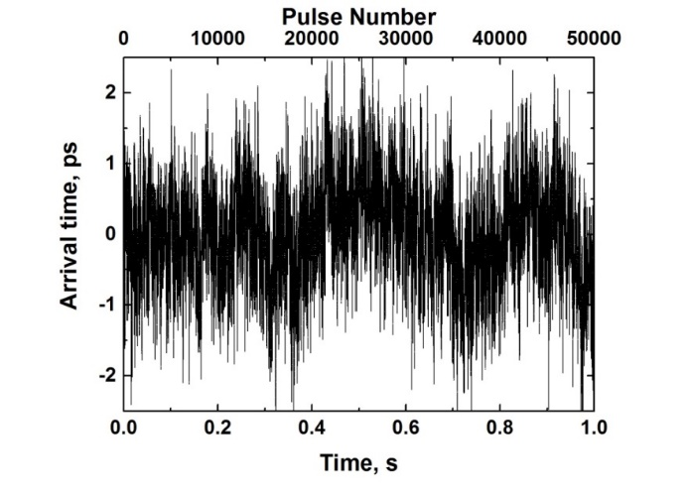
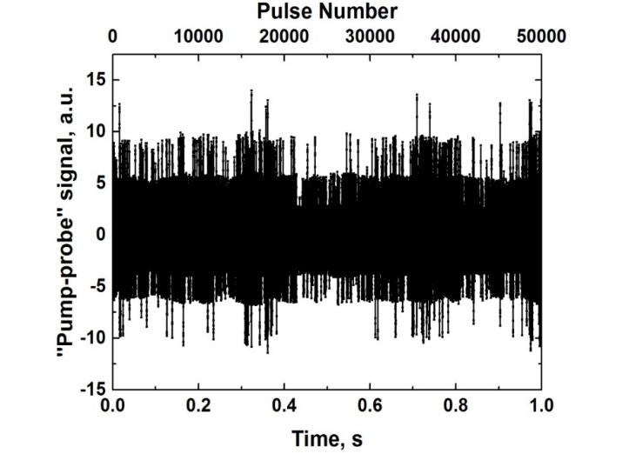
Pulse-resolved detection concept:
fs laser system
Time-resolved
experiments
Characterization:
Jitter, amplitude, spectrum
CDR source
undulator
Notes:
jmk: I swapped the position of the two plots so that they are under their respective sources…at least that’s my understanding of the plots.

Slide 4
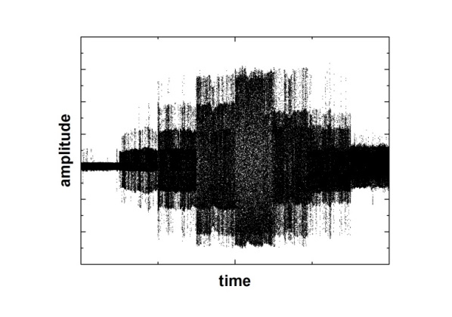
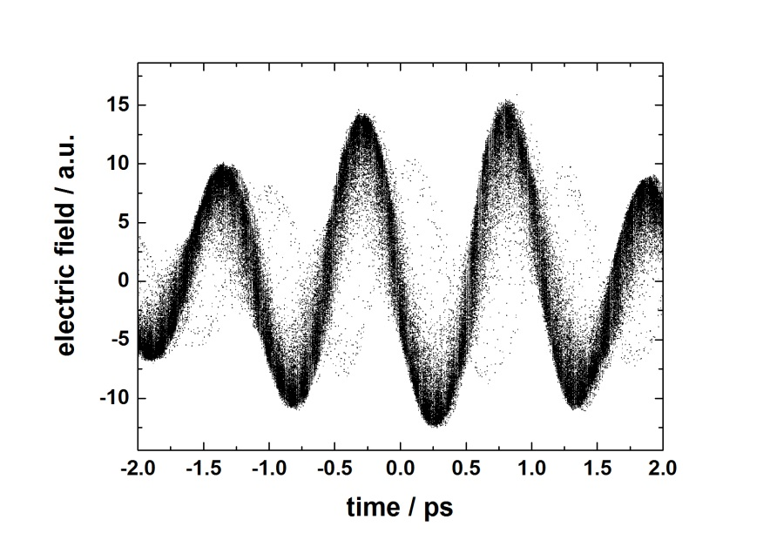
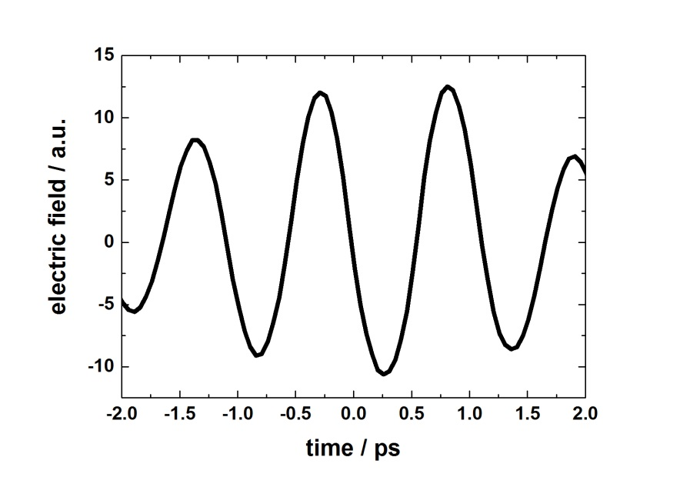
Pulse-resolved detection concept:
fs laser system
Time-resolved
experiments
Characterization:
Jitter, amplitude, spectrum
CDR source
undulator
Notes:
jmk: Swapped the plots to match the change I made in the previous slide.

Slide 5
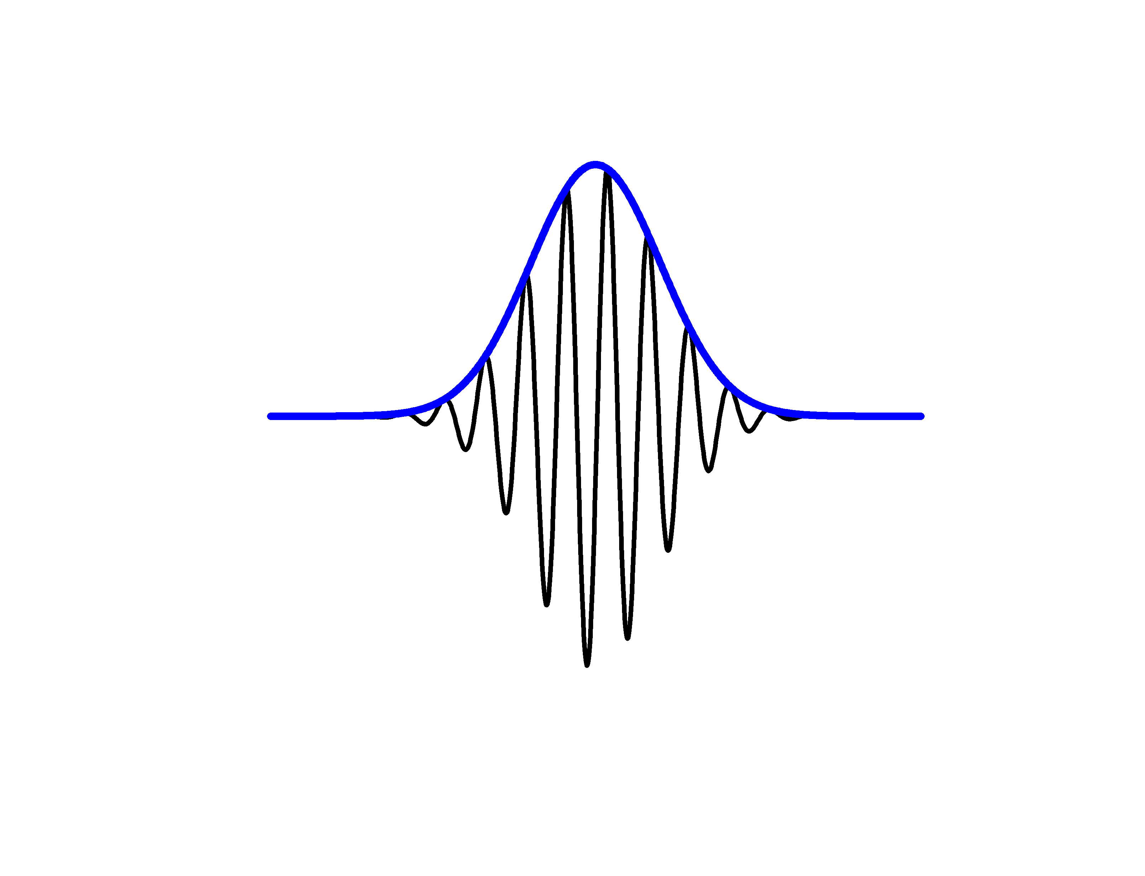

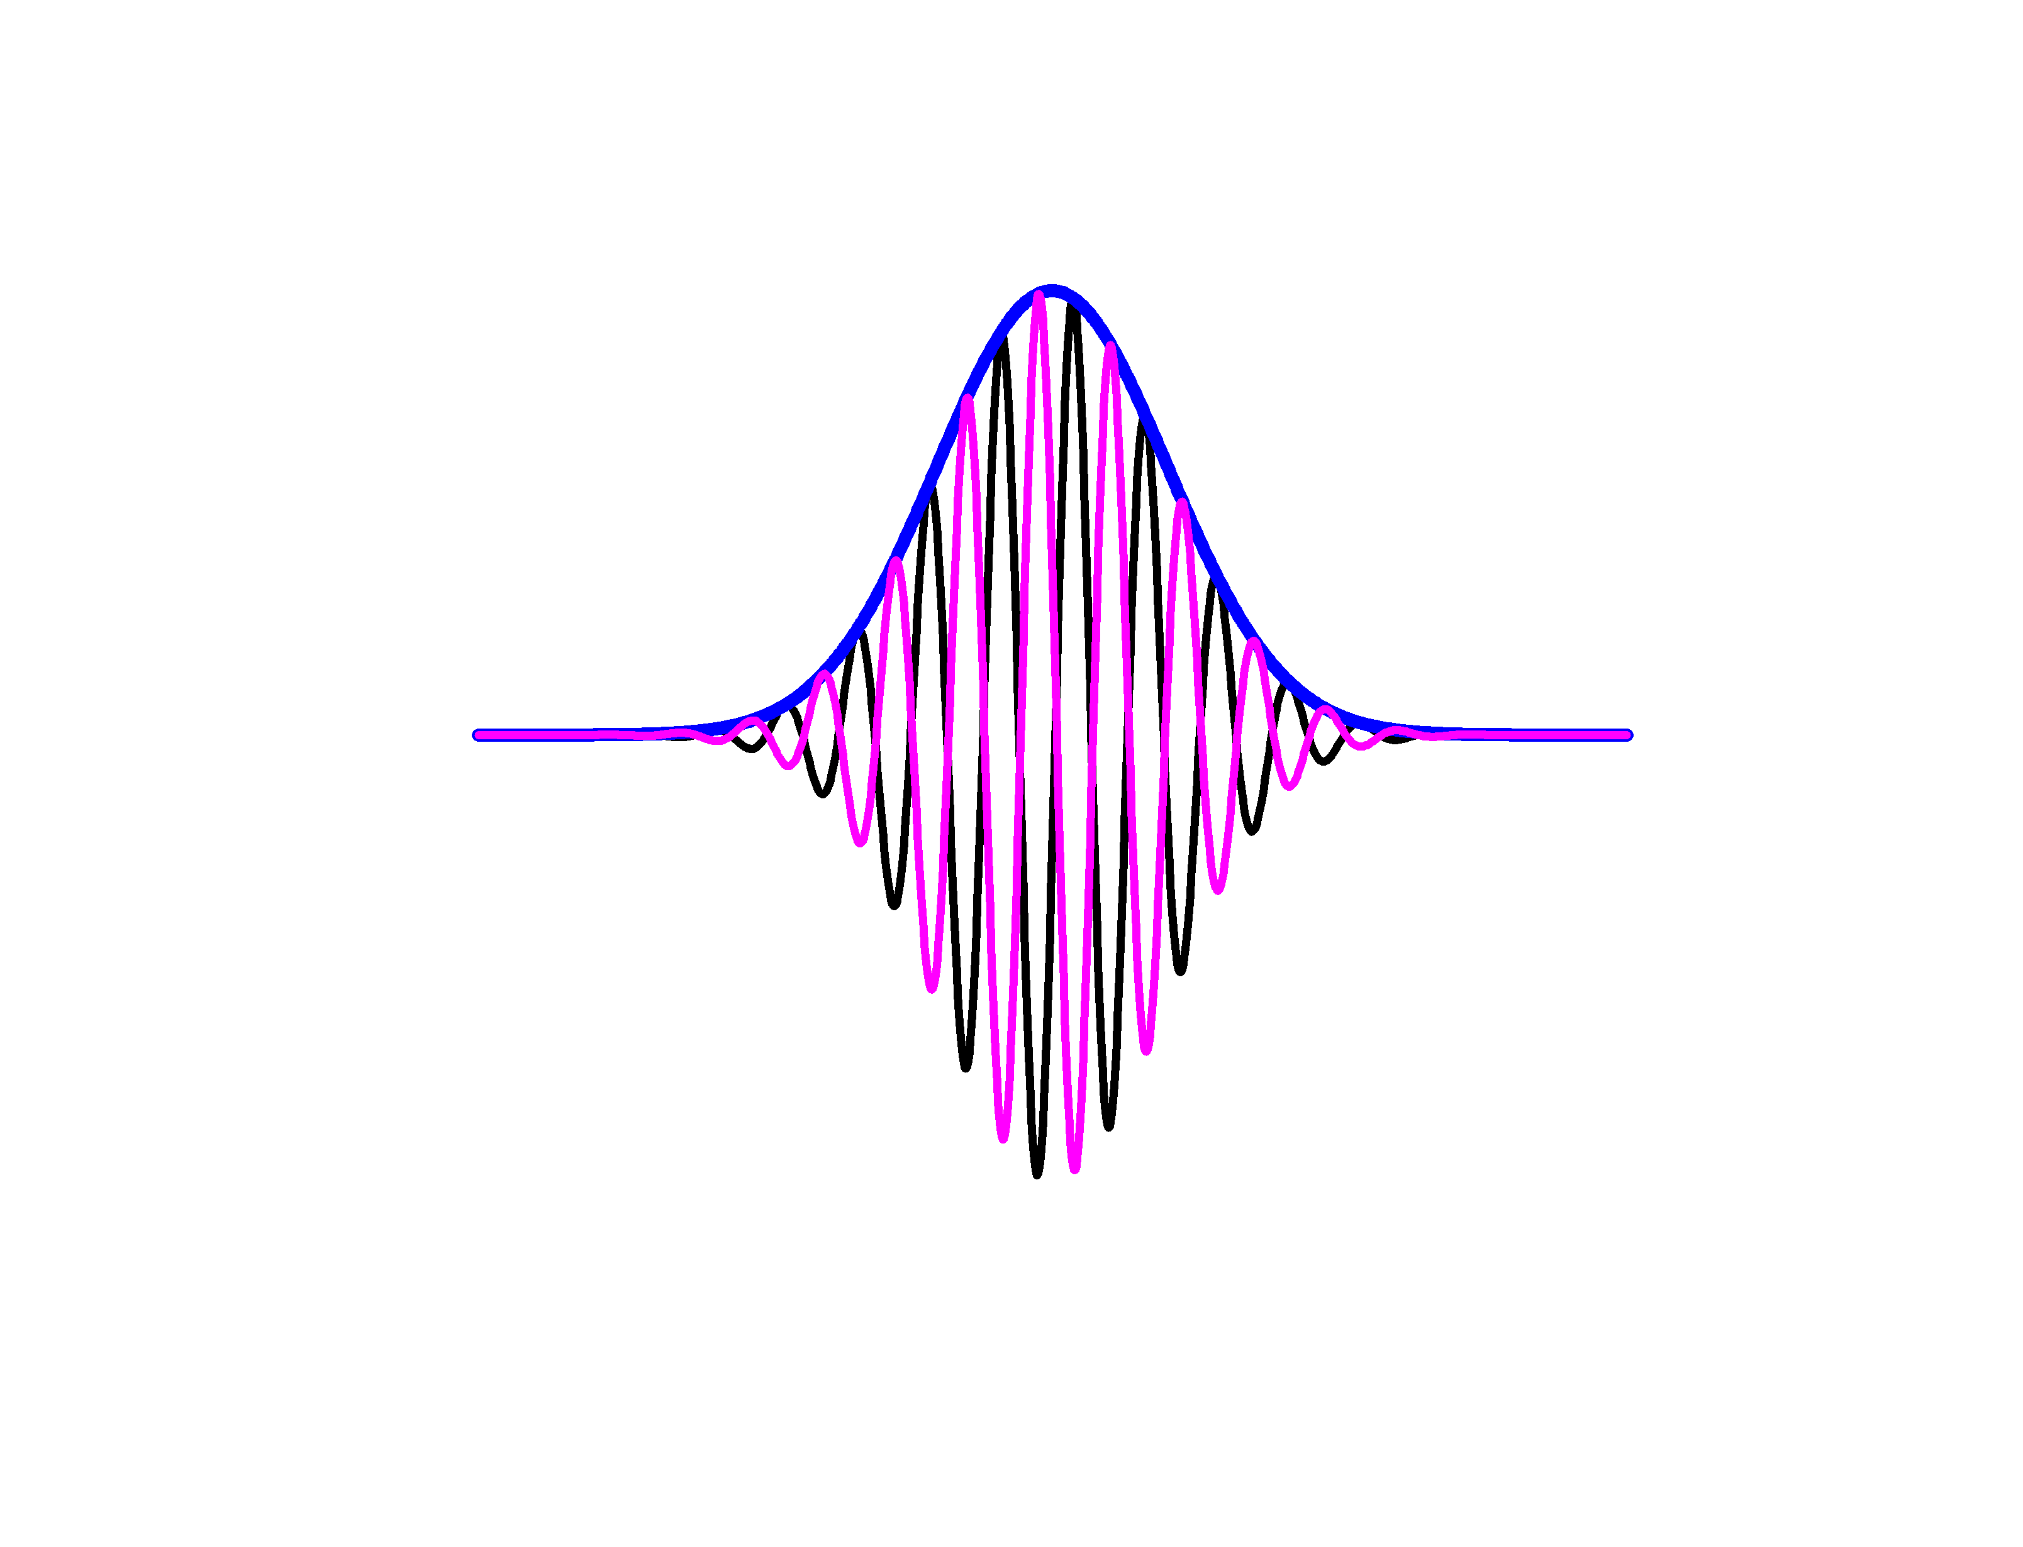
CEP fluctuation problem at FEL oscillators:
Pulse-resolved detection:
CEP stable sources
CEP unstable sources
Timing jitter is the most critical parameter
Phase is the most critical parameter

Slide 6
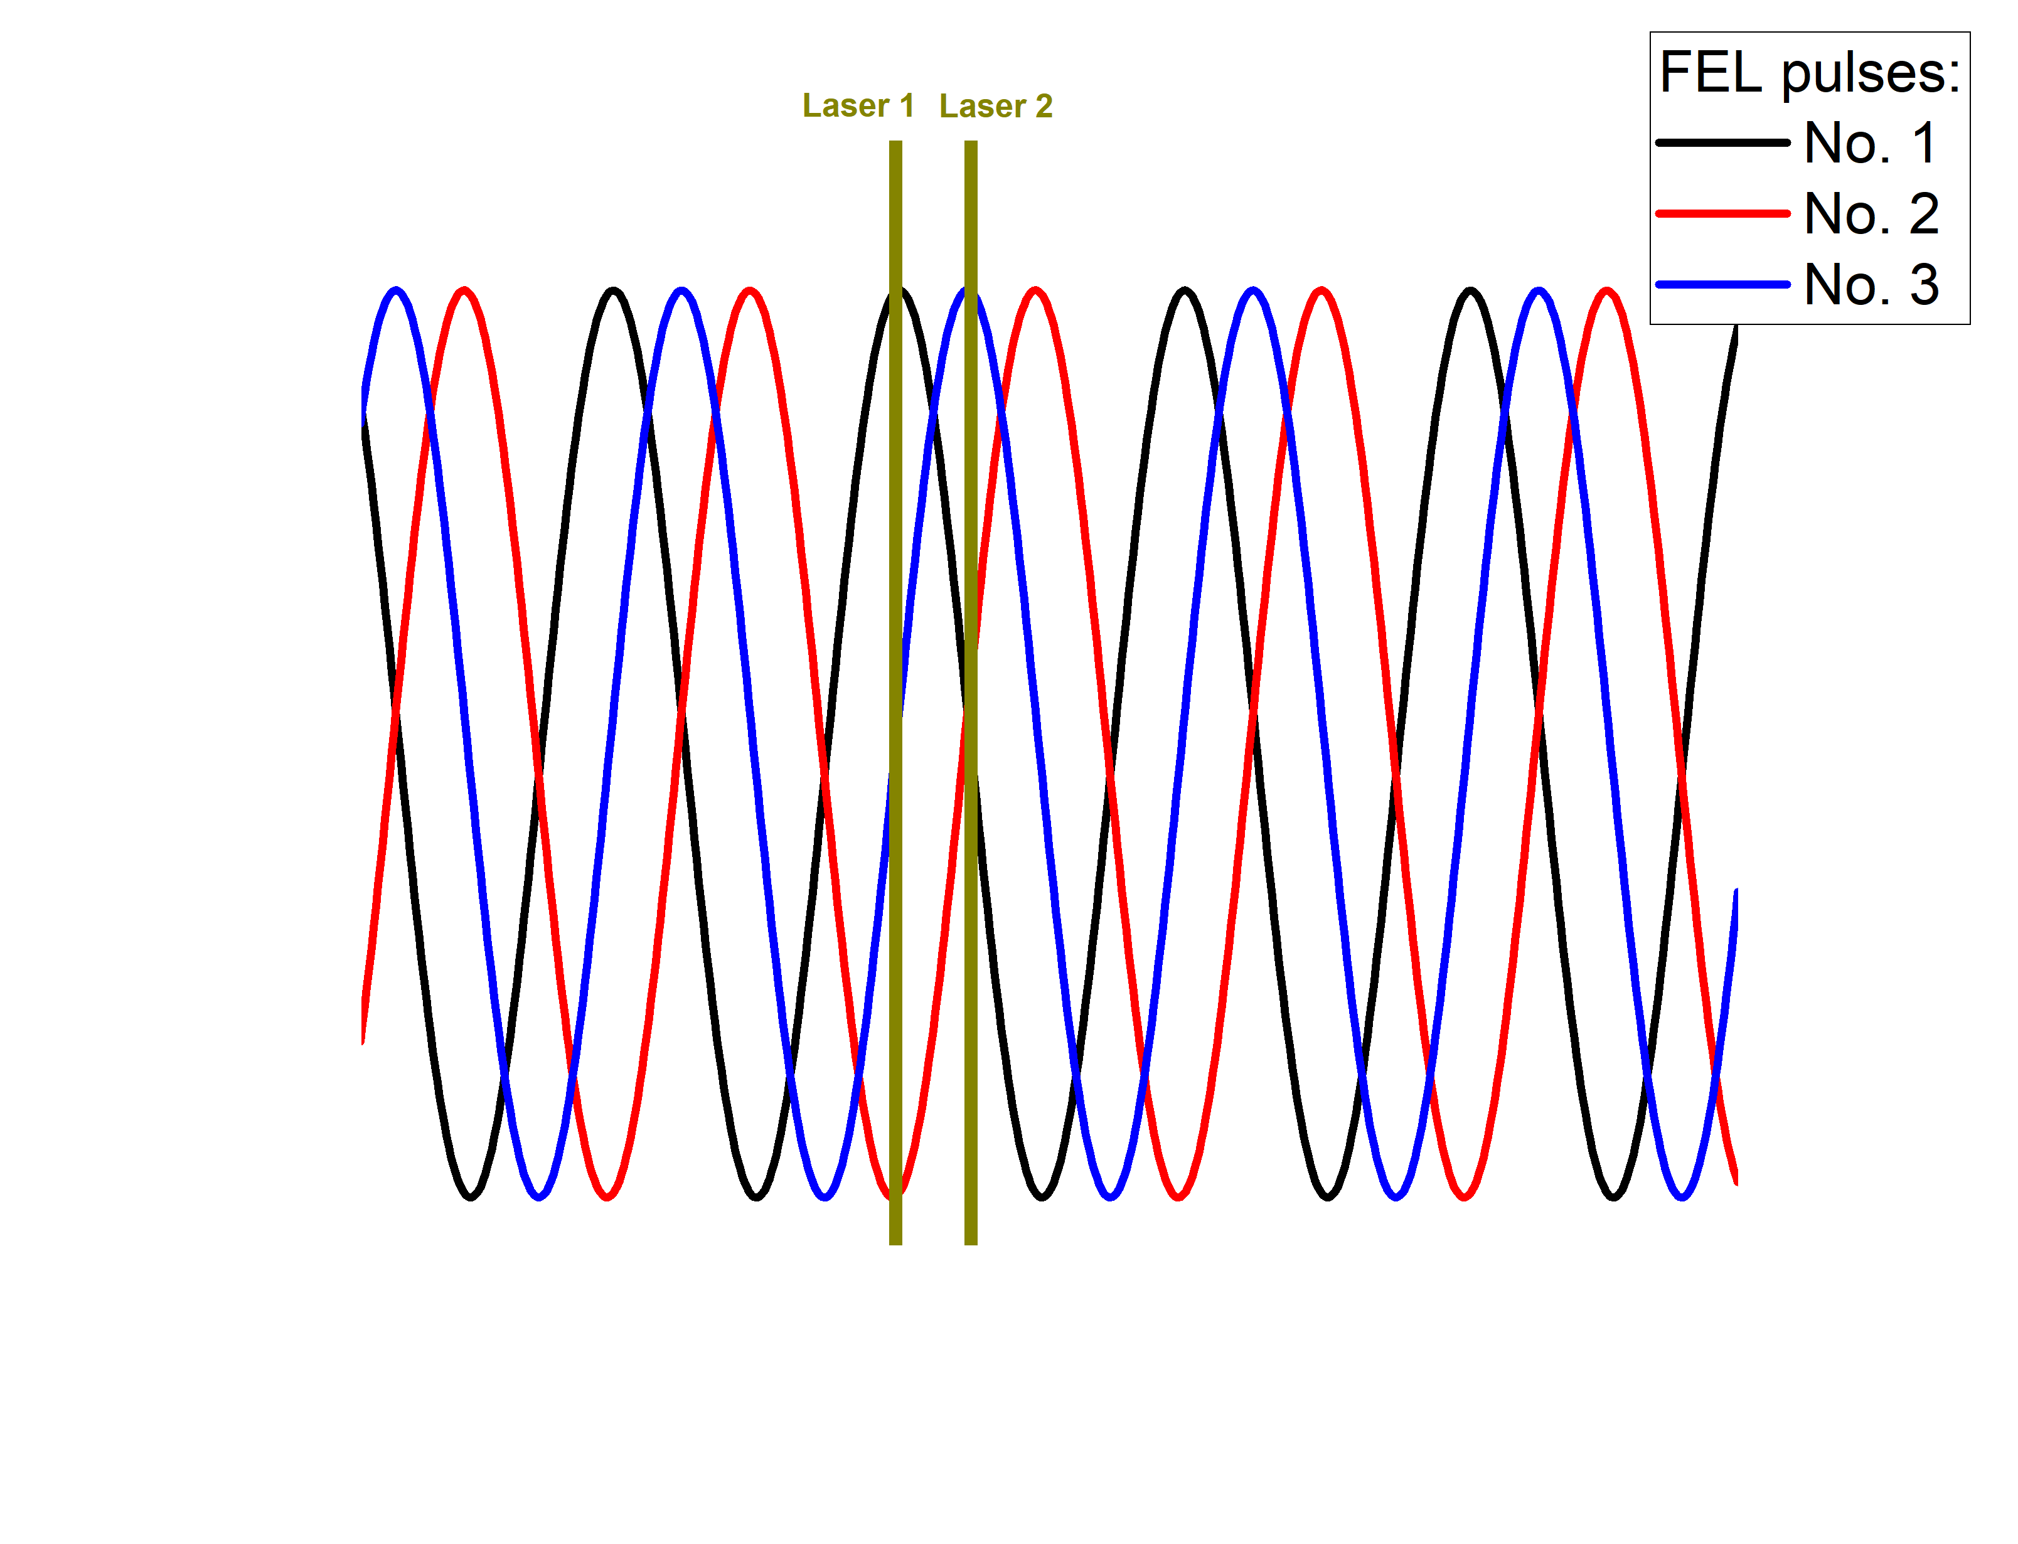
Phase-resolved detection concept:
Solution: measure the FEL phase for each shot and correlate it with experiment.
Challenges:
High repetition rate (13 MHz);
Narrow bandwidth;
Spectral decoding cannot be applied;
FEL phase can be determined
by using two laser pulses;
Or by measuring electric field and
its derivative with a single pulse.

Slide 7
Experimental setup:
Notes:
A little more information text would be helpful.
7

Slide 8
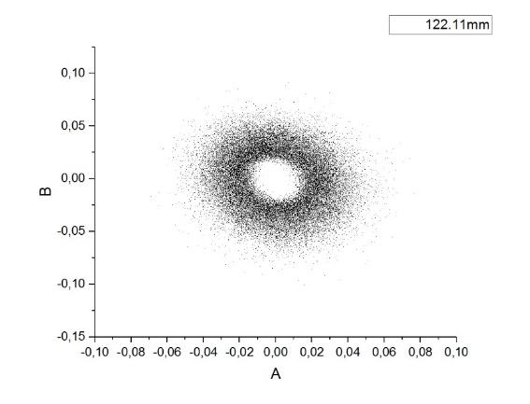
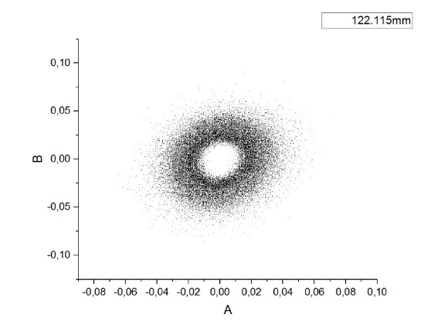
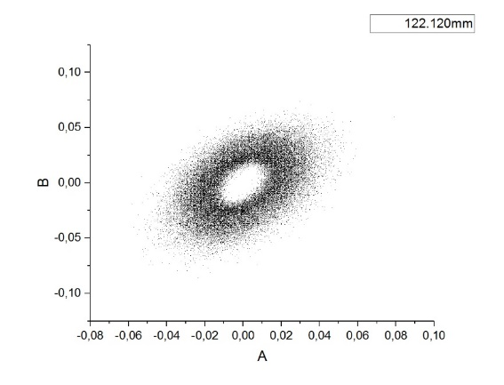
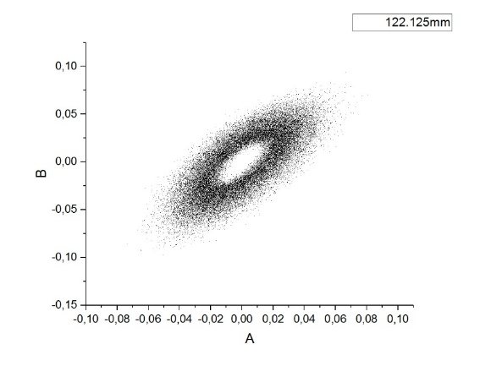
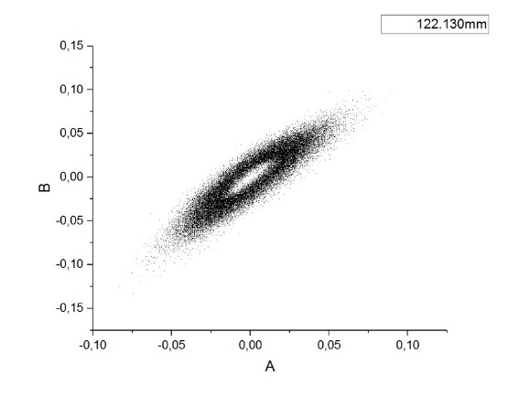

Results: phase determination
When two lasers are separated by quarter wavelength the phase can be determined
Notes:
Plots and labels should be a bit bigger and you need proper axis labels. The text is not fully clear, do you mean „When two laser pulses are separated in time by less than a quarter wavelength...“?
jmk: I don‘t understand what is being changed from plot to plot to cause the change in the symmetry of the plots. Also, I agree that the labels and legends need to be larger and meaningful. I understand these to be basically polar plots, i.e. (E*cosθ, E*sinθ). Is that correct? If so, perhaps it can be plotted like the plot I have added in the next slide.
8

Slide 9
Results: phase determination
Polar Plot of the FEL phase
(40000 pulses)
phase
filter
Notes:
9

Slide 10
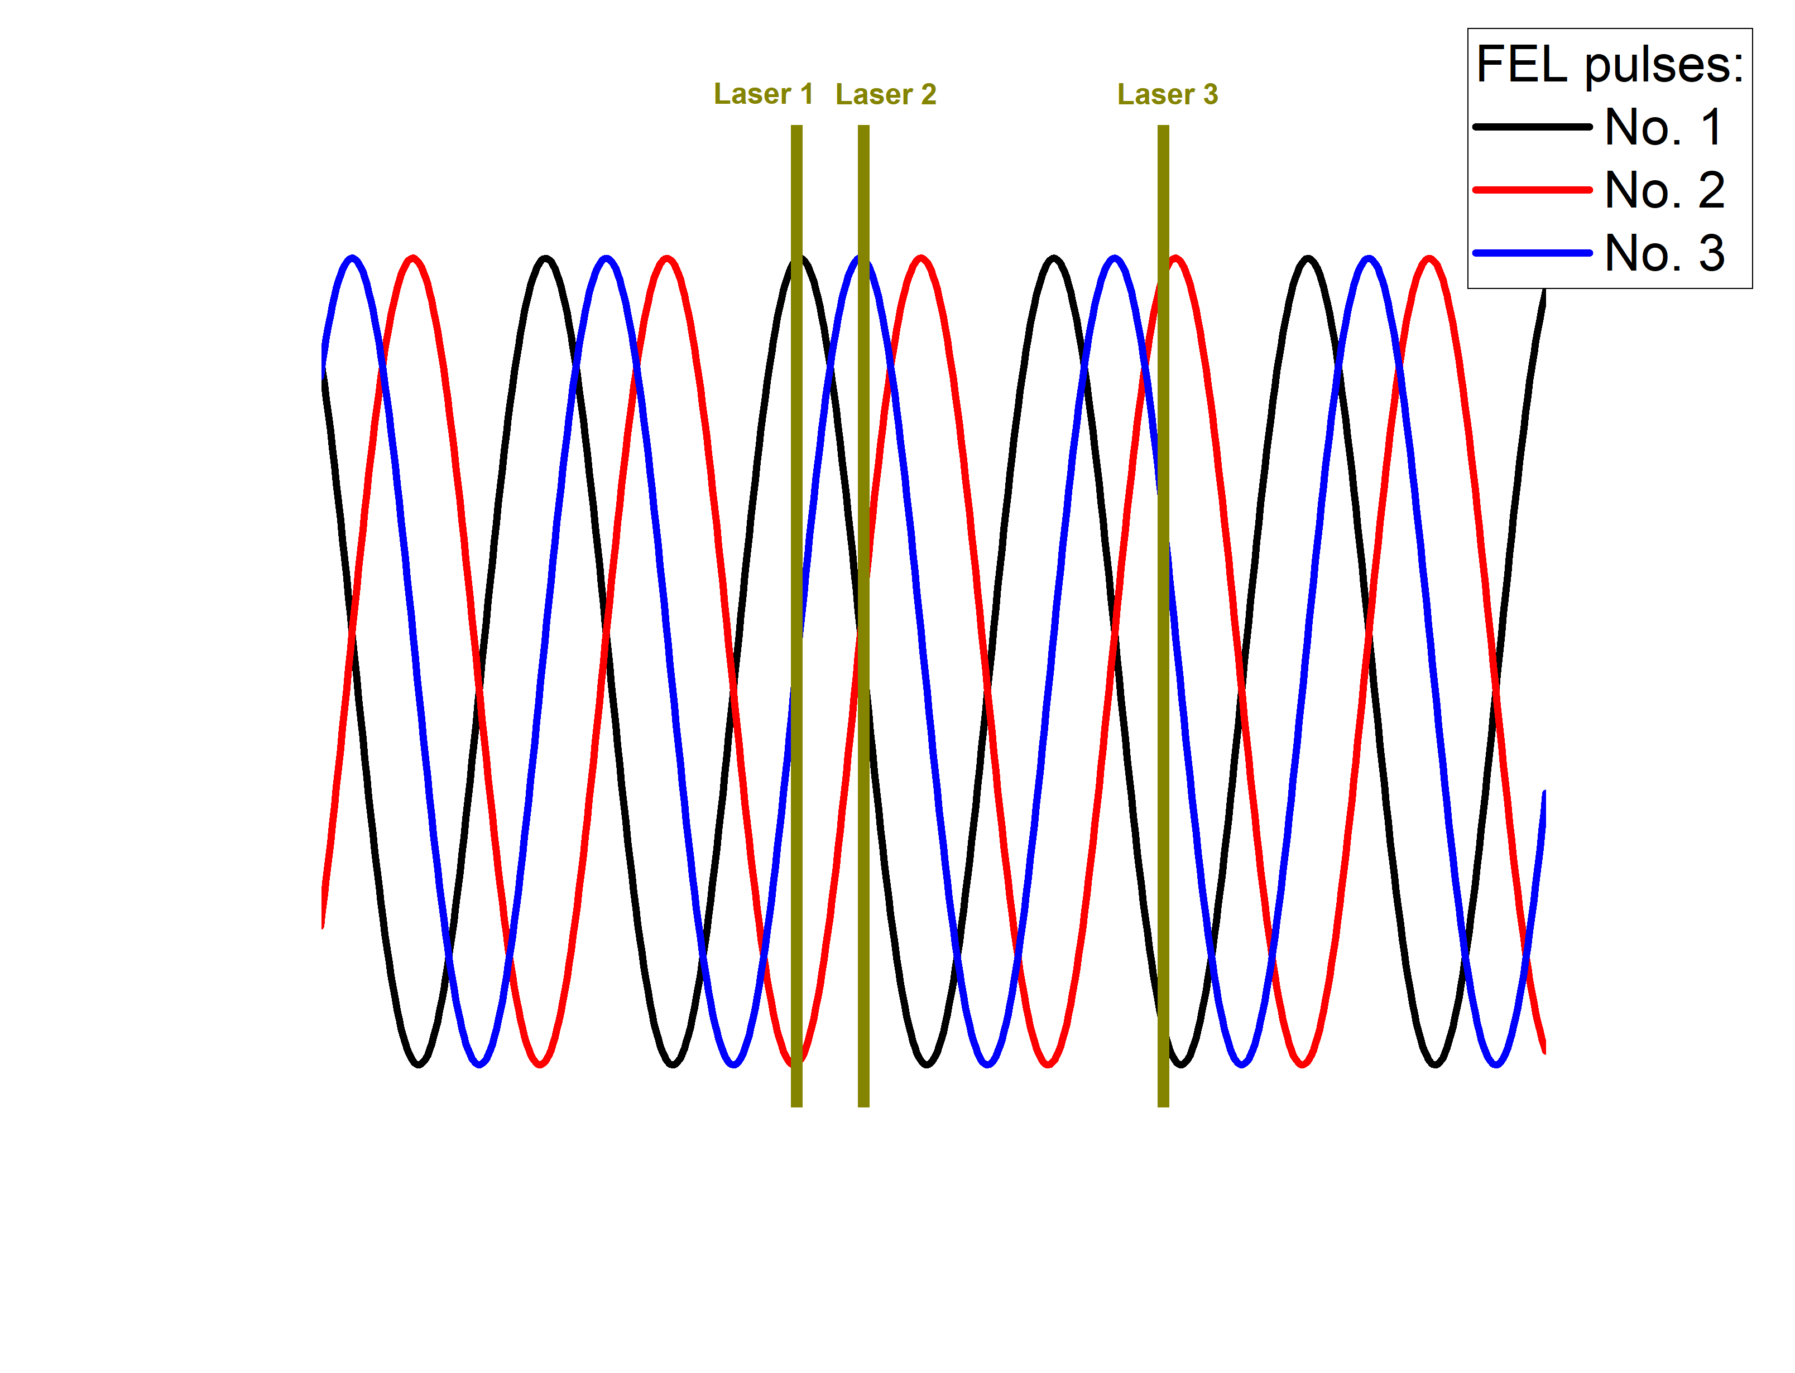
Results:
Laser 1 and 2 are fixed
Laser 3 is scanning
Electro-optic sampling
Using standart detection: all phases
Using phase filter
Notes:
Plot labels are too small. What are laser 1, 2, 3? They do not appear in the plot before.
jmk: Perhaps add a label for Laser 1, Laser 2, and Laser 3 on slide 7.
10

Slide 11
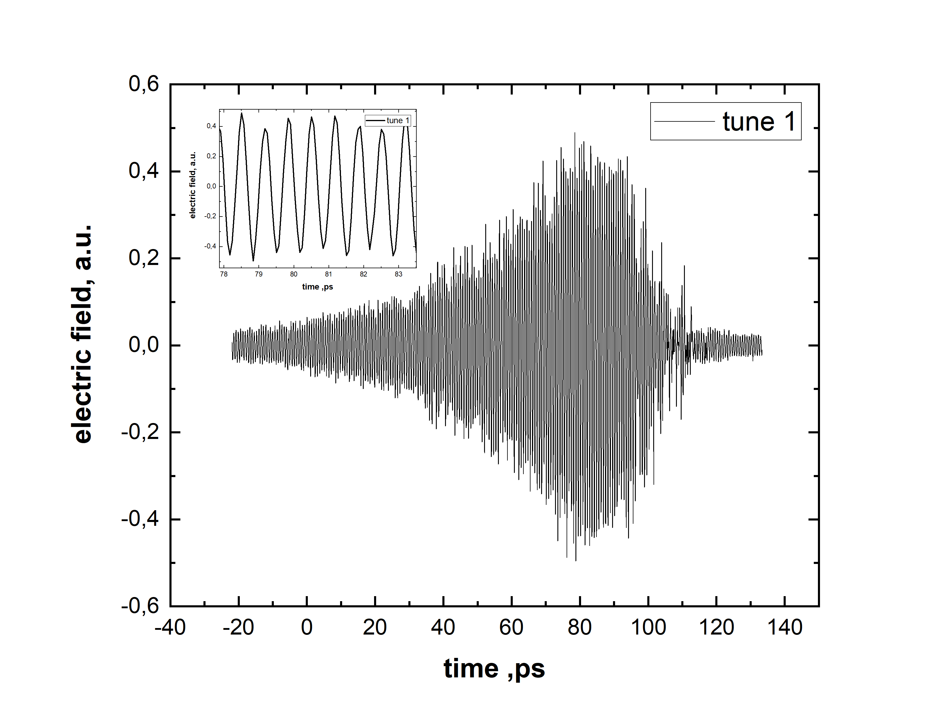
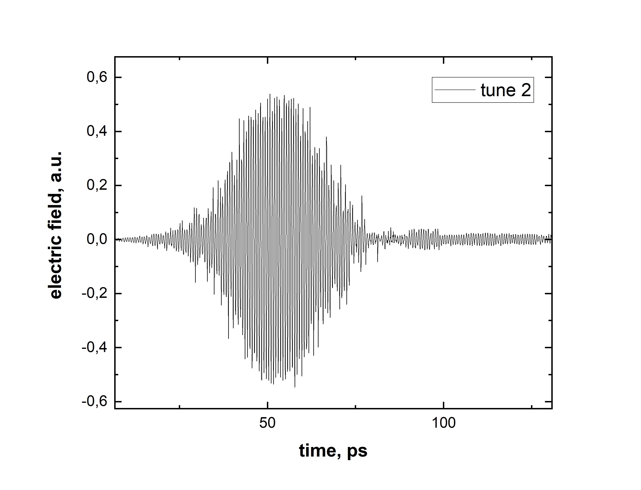
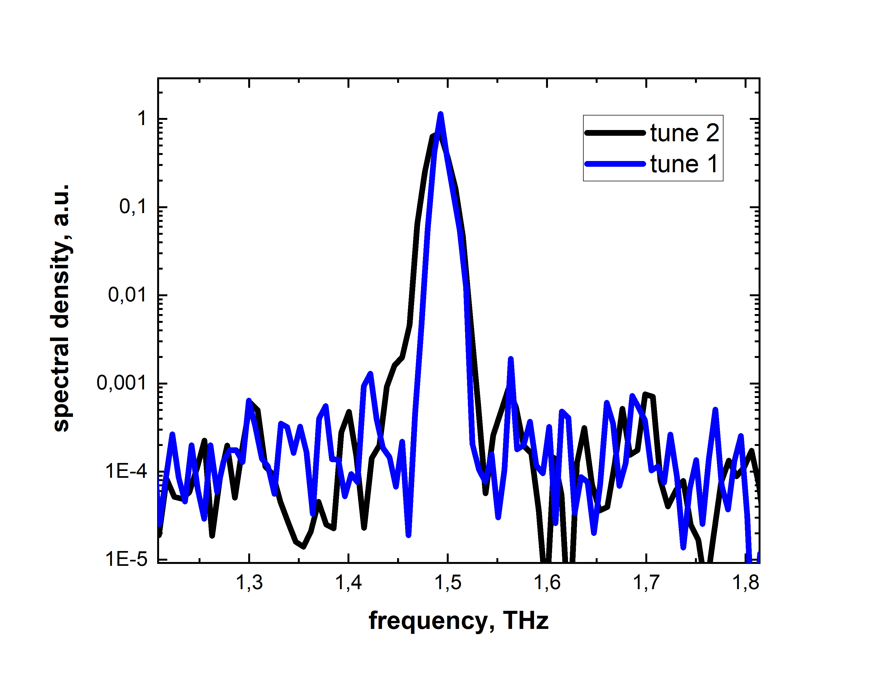
Results:
Notes:
Inset is too small. Maybe add just a little bit of text with the take home message.
jmk: This is very nice, but some text is needed and the two time-domain plots need to have the same X-scales and tick spacing. It should then be very clear that tune 2 provides a shorter pulse, which is also manifest in the wider spectral bandwidth in the frequency-domain plot.
11

Slide 12
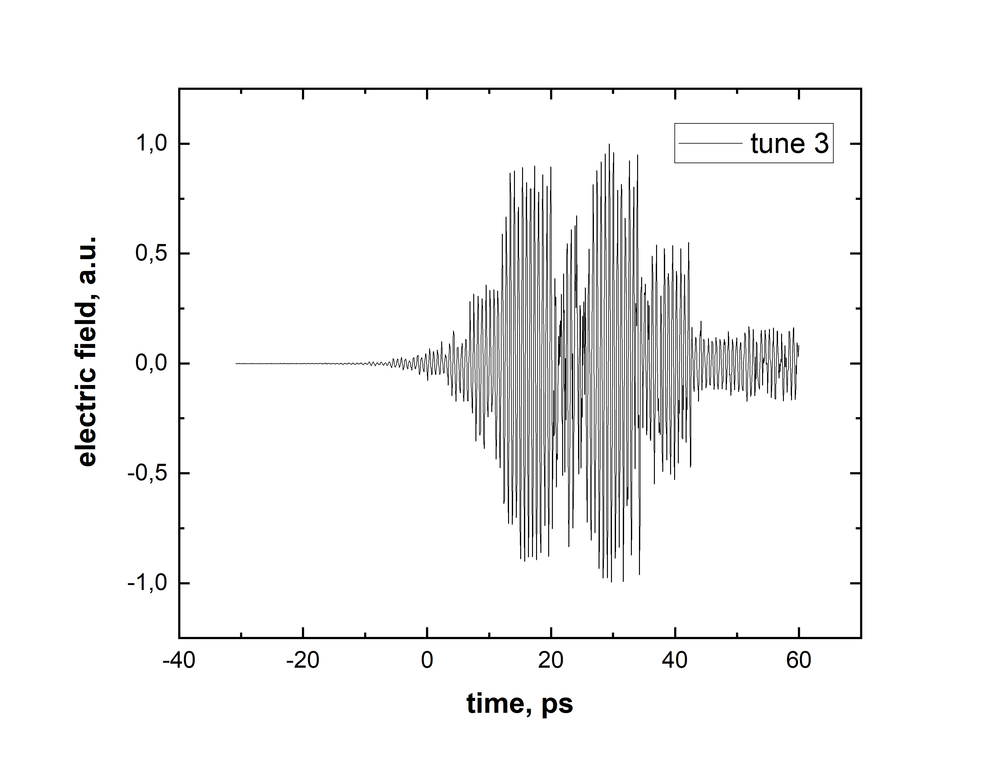
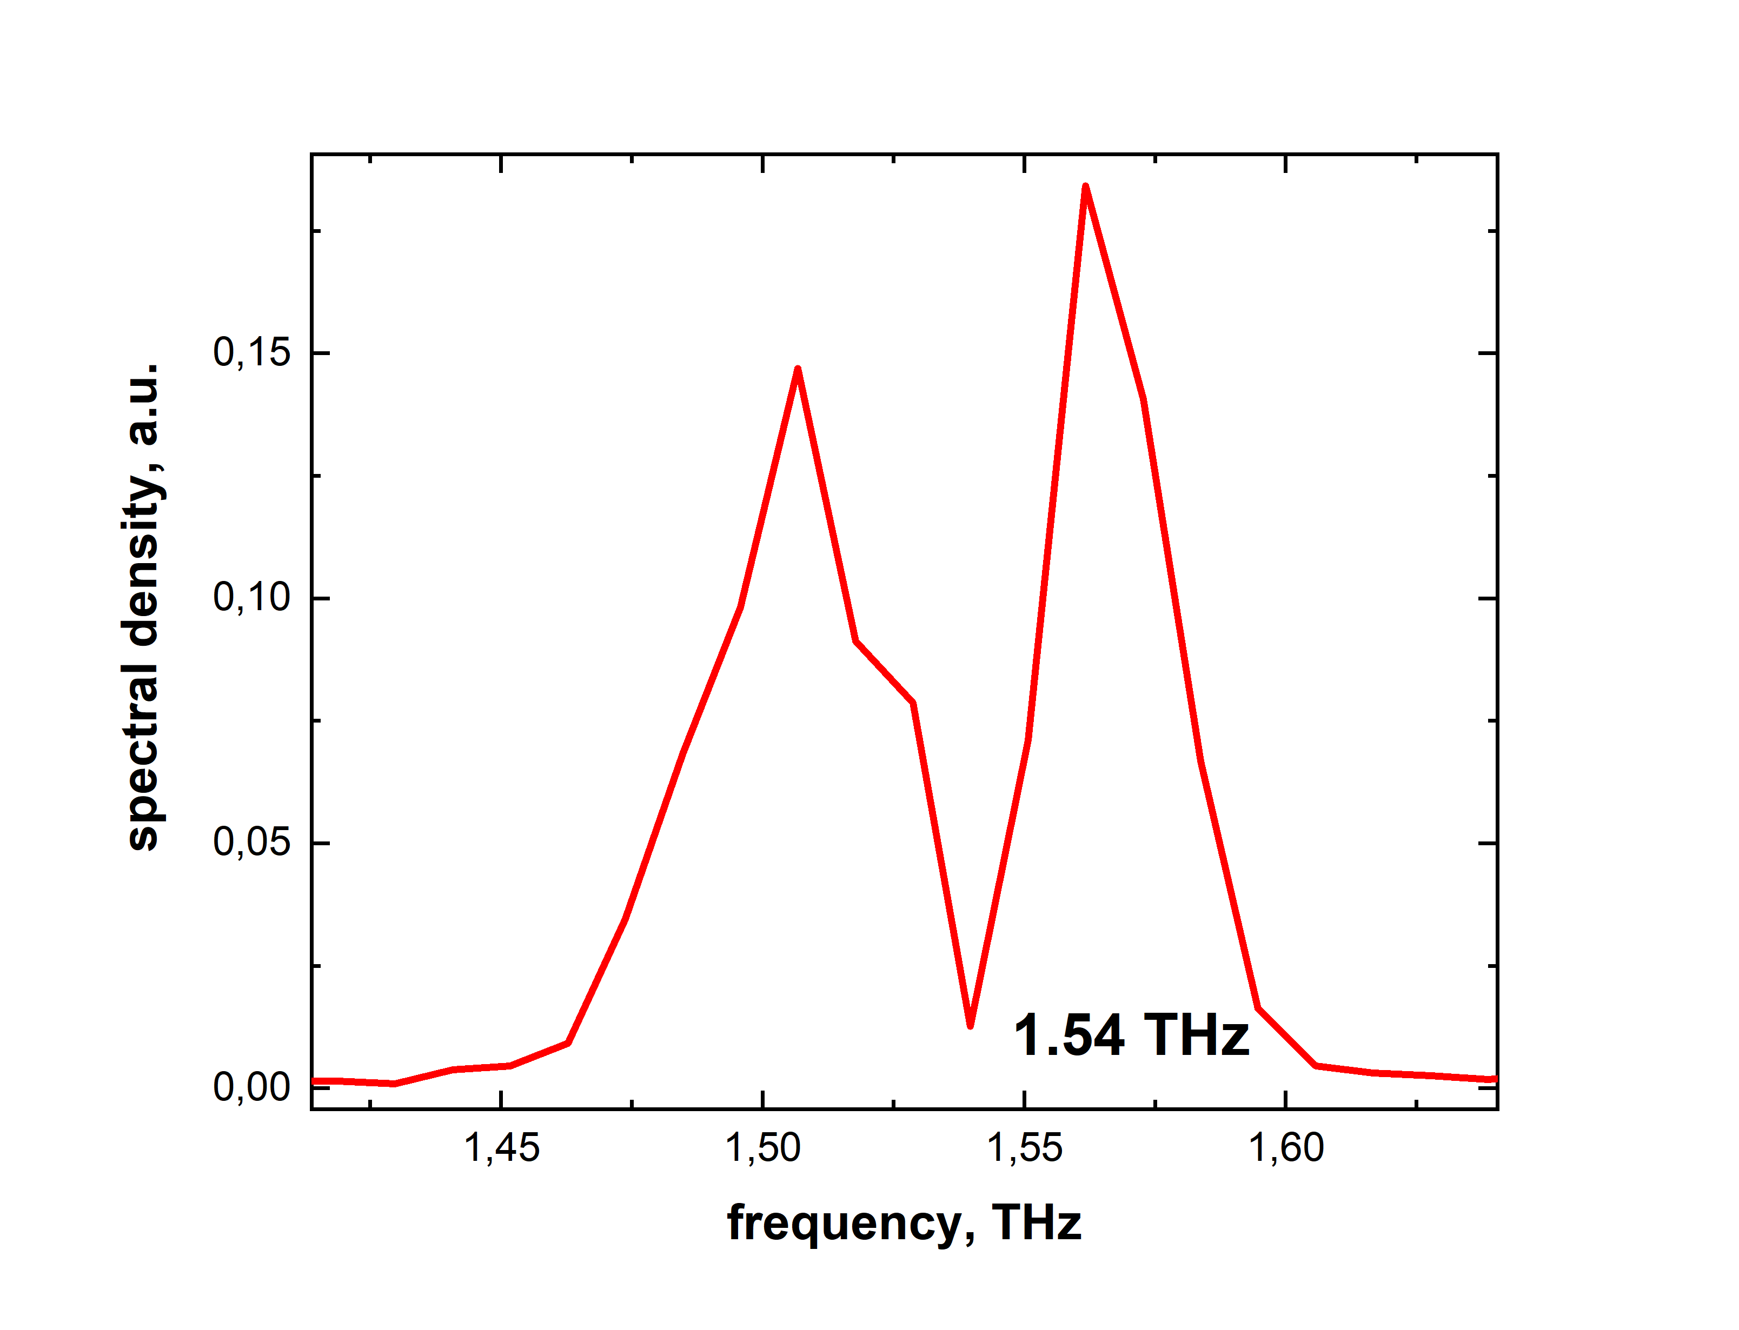
Results:
Dip in the frequency corresponds to water absoprtion line (1.542 THz)

Slide 13
Conclusion:
Pulse-resolved detection can be applied to CEP-unstable sources,
such as IR-FEL oscillators or others.
Using phase compensation / filtering, coherent spectroscopy
is feasible, e.g. field driven dynamics can be observed.
Opens new research area for accelerator-based sources
Next steps:
Timing jitter monitoring / compensation;
Organic EO crystals to cover 10 THz range;
Benchmarking other schemes, as this was just the first attempt

Slide 14



Thank you for your attention.

