Slide 1
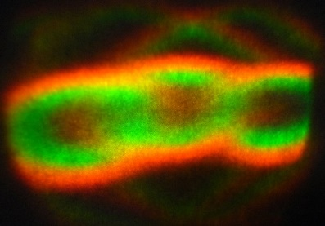
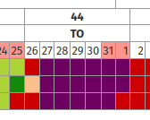
Two Orbit – first scheduled week of user operation
Markus Ries, Paul Goslawski,
Terry Atkinson, Thomas Birke, Ji-Gwang Hwang, Marten Koopmans, Meghan McAteer, Günter Rehm, Ed Rial, Andreas Schälicke, Gregor Schiwietz, Tom Struppert et al.
BESSY II machine group

Slide 2

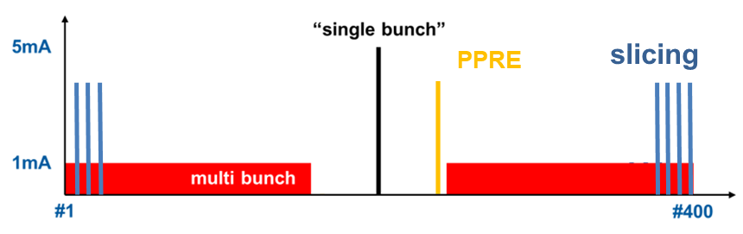
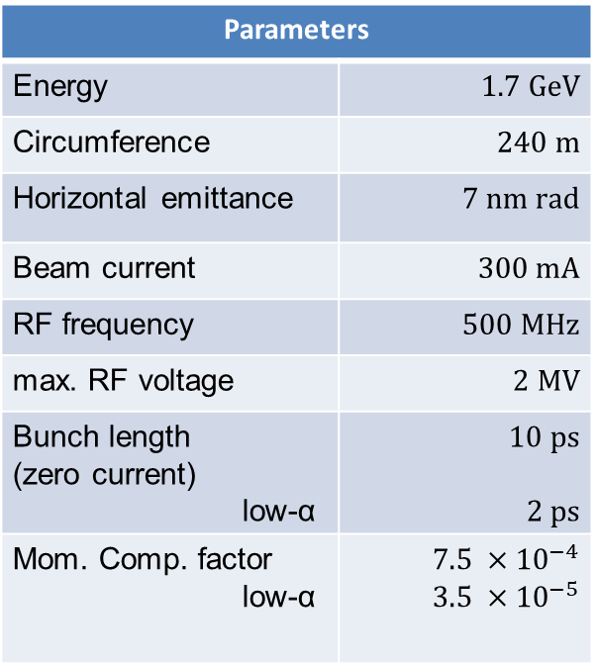
BESSY II
Parameters
Energy | $$1.7 GeV$$
Circumference | $$240 m$$
Horizontal emittance | $$7 nm rad$$
Beam current | $$300 mA$$
RF frequency | $$500 MHz$$
max. RF voltage | $$2 MV$$
Bunch length (zero current) low-α | $$10 ps$$ $$2 ps$$
Mom. Comp. factor low-α | $$7.5 ×{10}^{−4}$$ $$3.5 ×{10}^{−5}$$
in user operation since 1998
diverse user community
offering short x-ray pulses and timing

Slide 3
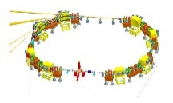
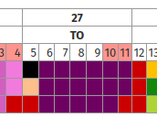
The idea – Transverse resonance island buckets (TRIBs)
MLS
first observation
development of techniques and basic understanding
  nonlinear dynamics
  resonant population
  Single island population with nonlinear resonant kicking
proof of principle user operation
BESSY II
TopUp as additional
challenge
2018:
User test week
2019:
MHz-XMCD demo
2020:
scheduled user operation
2021:
scheduled user operation

Slide 4
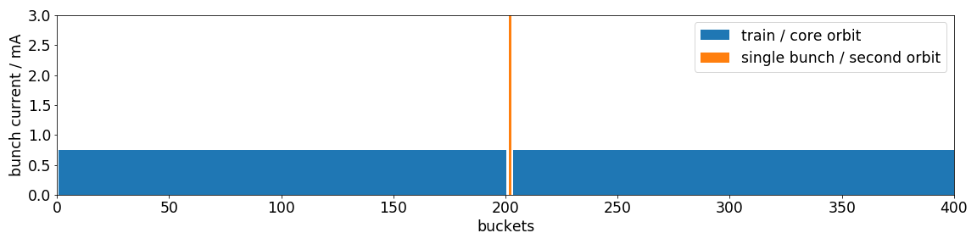
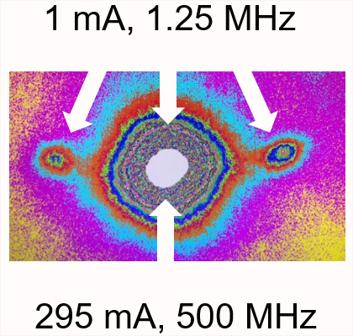
Scheduled TRIBs user operation week
steady operation for the full week
separation tweaked towards horizontal plane
all IDs usable (except U17 → MPS)
no slicing (no efforts in this direction at the moment)

Slide 5
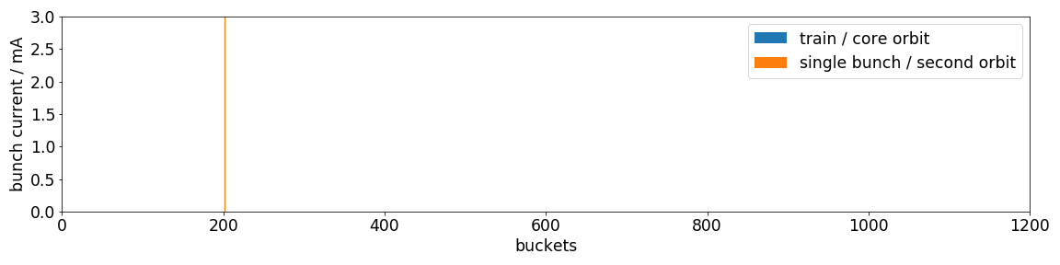
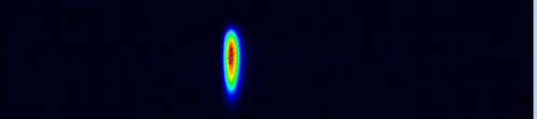
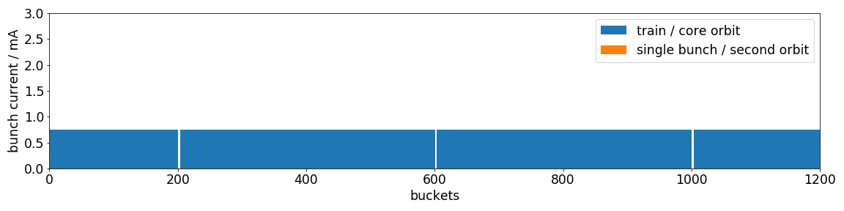
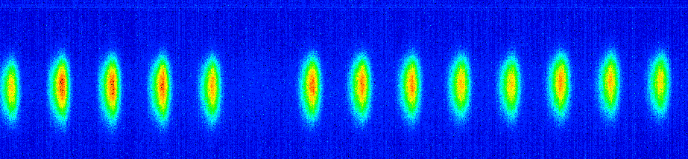
What filling pattern was offered?
single island perspective
core beam perspective
800 ns
5

Slide 6
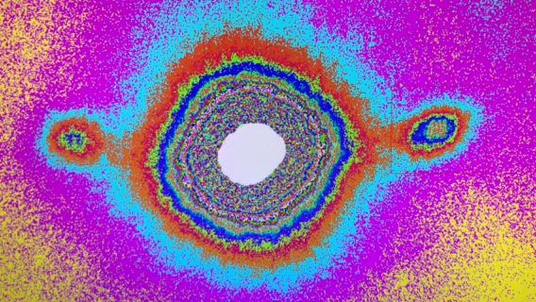
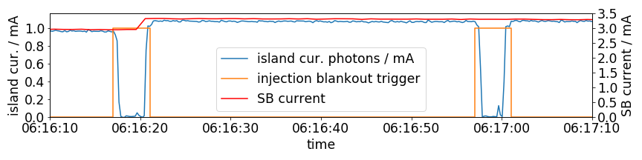
Injection concept
island charge collapsed to core bucket for the injection process
nonlinear resonant clearing of the train to avoid diffusion to island buckets
resonant nonlinear & dipole repopulation of filled island buckets
blank-out signal of 4s (control system based)
3 mA, 0.42 MHz
295 mA, 500 MHz

Slide 7
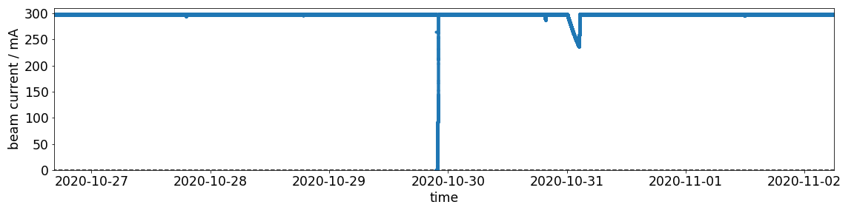
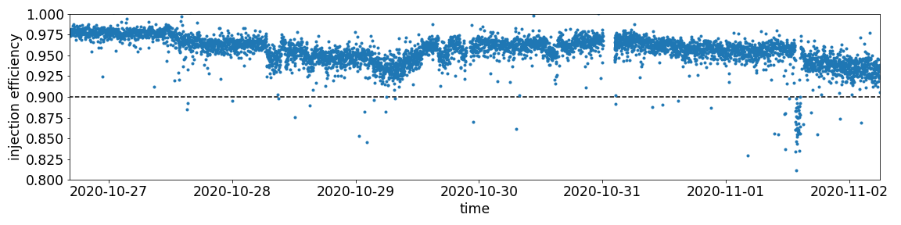
Operation perfomance
availability > 99%
(non-TRIBs related outages)
around 6000 shots, not a single miss
> 95 % average injection efficiency

Slide 8
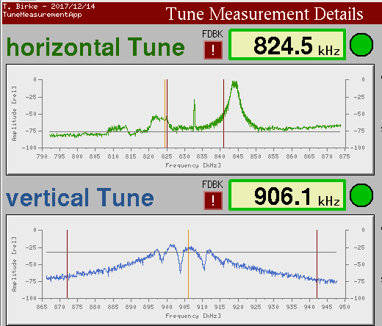
General machine setup parameters
parameter | value | Unit
beam current | 300 | mA
island current | 3 | mA
Hor. Tune (core / island) | 17.660 / 17.681
Vert. tune. (core / island) | 6.728 / 6.730
coupling | ~1%
chromaticity (hor/ver) | 0.3 / 3.2
bunch by bunch feedback | X/Y/Z ON
fast orbit feedback | running
tune feedback | Slow (6s), core only

Slide 9
lessons learnt
it works!
there is potential for improvement
required injection efficiency achieved
resonant repopulation works reliable and has not yet reached speed limits
high electron population purity achieved and maintained (> 1000)
no issues with ions observed
phase tracking of core tune & feedback works
effects of IDs on island beam are smaller than expected but need to be taken care of at smallest gaps (SB user disturbed)
  U49D4 → island orbit / potential well / diffusion rates
  UE52 → injection efficiency

Slide 10
Open challenges
beam position not easily determined…
requires bunch resolved measurement as well as single-island population
CPMU17 – locked for machine protection considerations
effect of gap & shifts visible, crucial to be improved for selected (old) IDs
test harmonic sextupole feedforward tables
Users have to get used to this mode of operation (as we have to)
  Normalization
  Different rep rate “rhythm”

Slide 11
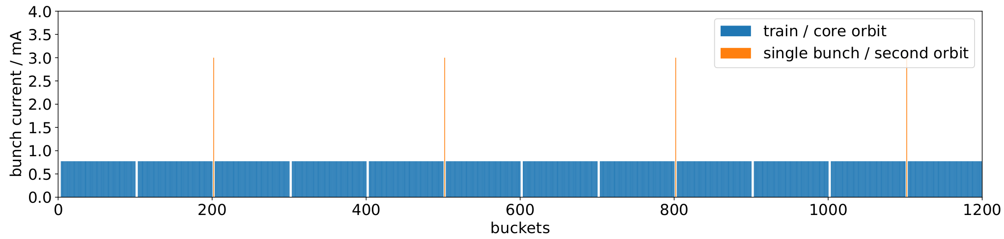
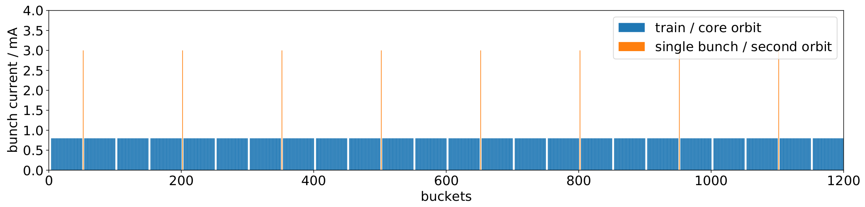
Proposed filling patterns for TwoOrbit operation
3mA
@
1.67MHz
=
4mA/800ns
600 ns
3 mA
@
3.33MHz
= 8mA/800ns
300 ns

Slide 12
Summary
machine point of view: TRIBs user operation successful!
close to established quality, more improvements seems to be in reach
next week: CW27 2021
coupling / vertical displacement of islands reduced in a first step
IDs: feedforward tables to be optimized, harm. sextupole feedforward to be done
Speed up injection process → sub second, hardware blank out trigger
Investigation of dedicated operation modes exploiting new beam qualities
  TRIBs MHz XMCD
  TRIBs two color
machine protection remains an issue
from our experience many things get easier with higher energy and smaller emittance…

Slide 13
ACKNOWLEDGEMENT
Michael Abo-Bakr, Wolfgang Anders, Felix Andreas, Terry Atkinson, Yvonne Bergmann, Thomas Birke, Daniel Böhlick, Anne Bundels, Markus Bürger, Rober Burneleit, Emanuel Cambas, Mathias Diehn, Marc Dirsat, Olaf Dreßler, Michael Edling, Silvio Ehlert, Dan Eichel, Volker Dürr, Pablo Echevarria, Fjodor Falkenstern, Jörg Feikes, Nadine Fischer, Roland Fleischhauer, Andre Frahm, Benjamin Franksen, Sabine Giray, Holger Glass, Hans-Walter Glock, Felix Glöckner, Anny Gora, Rainer Görgen, Paul Goslawski, Mario Haucke, Jochen Heinrich, Svenja Heling, Andreas Heugel, Harry Hoffmann, Falk Hoffmann, Karsten Holldack, Holger Huck, Ji-Gwang Hwang, Andreas Jankowiak, Christian Jung, Christian Kalus, Jens Knobloch, Jörg Kolbe, Marten Koopmans, Bernhard Kuner, Jens Kuszynski, Victoria Laux, Nicole Leuschner, Ji Li, Klaus Ludwig, Michael Markert, Aleksandr Matveenko, Meghan McAteer, Tom Mertens, Gert Meyer, Gregor Mielczareck, Ingo Müller, Roland Müller, Christian Nass, Klaus Ott, Fabian Pflocksch, Lutz Pichl, Henry Plötz, Markus Ries, Daniel Romeo, Stefan Rotterdam, Roswitha Schabardin, Andreas Schälicke, Tobias Schneegans, Günter Schindhelm, Ines Seiler, Gregor Schiwietz, Bernhard Schriefer, Thomas Schröter, Michael Schuster, Dirk Schüler, Hannes Stein, Tom Struppert, Ervis Suljoti, Yegor Tamashevich, Michael Ulrich, Stefan Wiese, Daniel Wolk, Antje Vollmer, Sven Wrede, Nora Wunderer … and many more

Slide 14
THANK YOU FOR YOUR ATTENTION

Slide 15
Backup

Slide 16
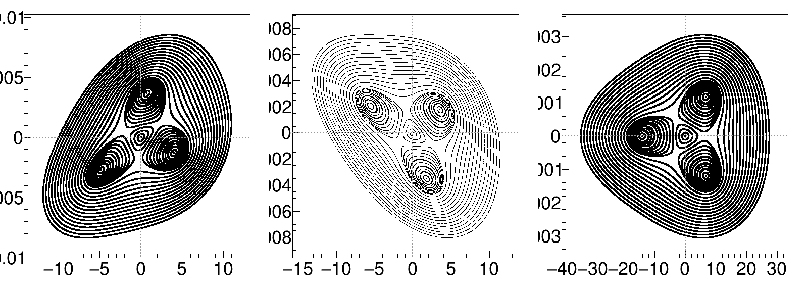
Nonlinear resonant kicking to populate a single island
x’
x’
x
x
k

Slide 17
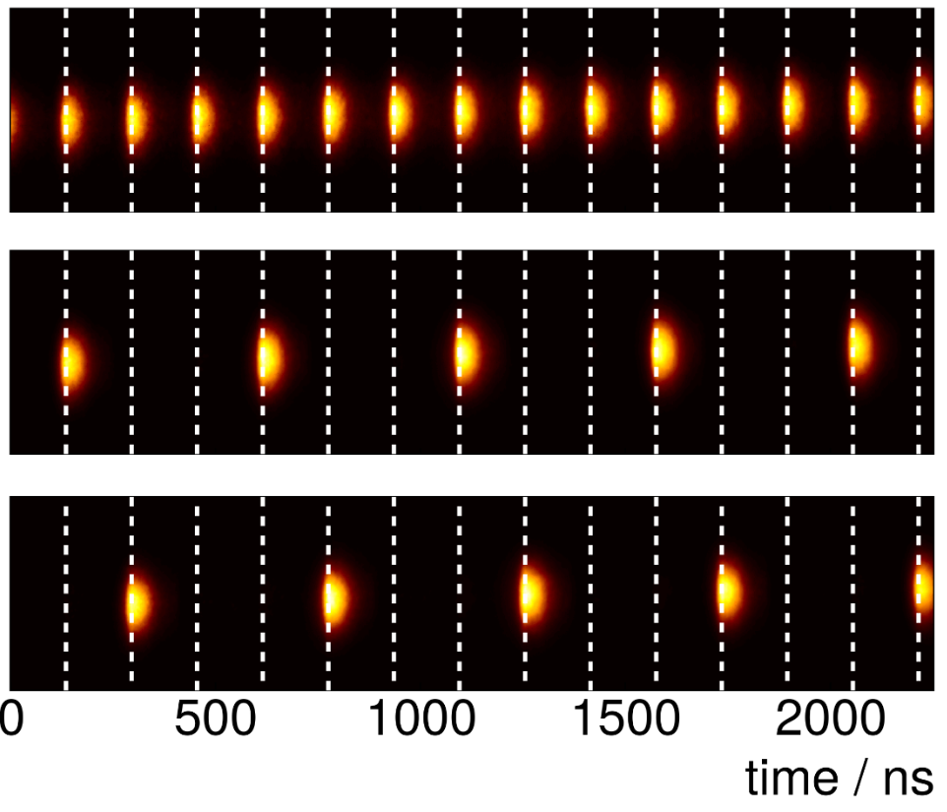
Nonlinear resonant kicking to populate a single island
streak measurement
(aperture used to exclusivley select photons from a single island)
How to populate a single island?
→ Nonlinear kicking (half a stripline kicker)
kick-kick-pause or kick-pause-pause scheme depending on phase space rot.
top: equally populated islands
mid/bot: single island populated
17

Slide 18
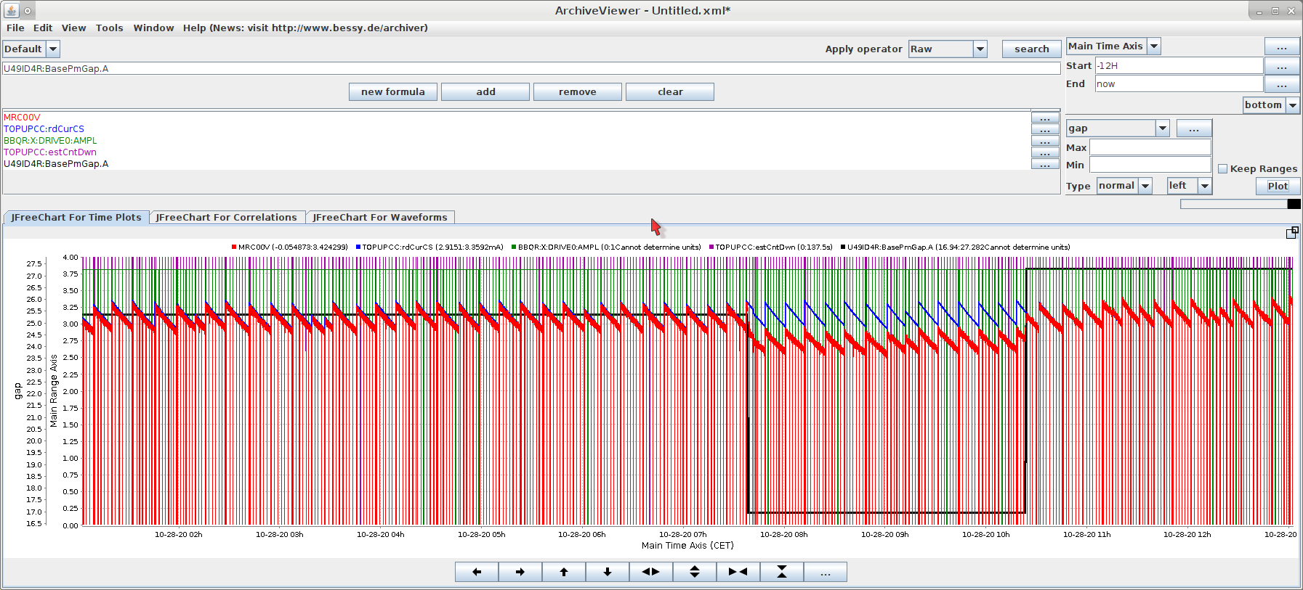
Open challenges & lessons learnt

Slide 19
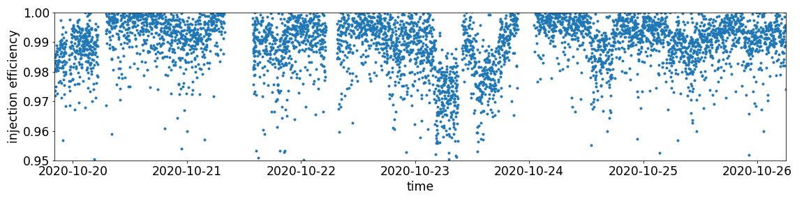
Side effects…
the standarduser week before the first scheduled TwoOrbit week had the best injection efficiency ever recorded… 98.5%

Slide 20
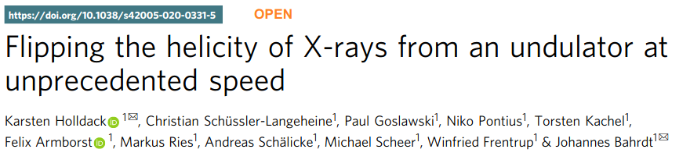
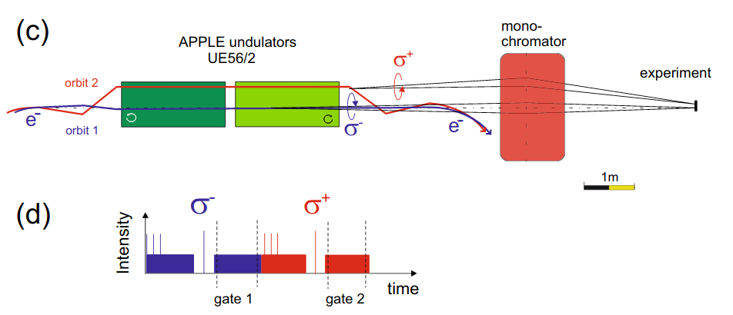
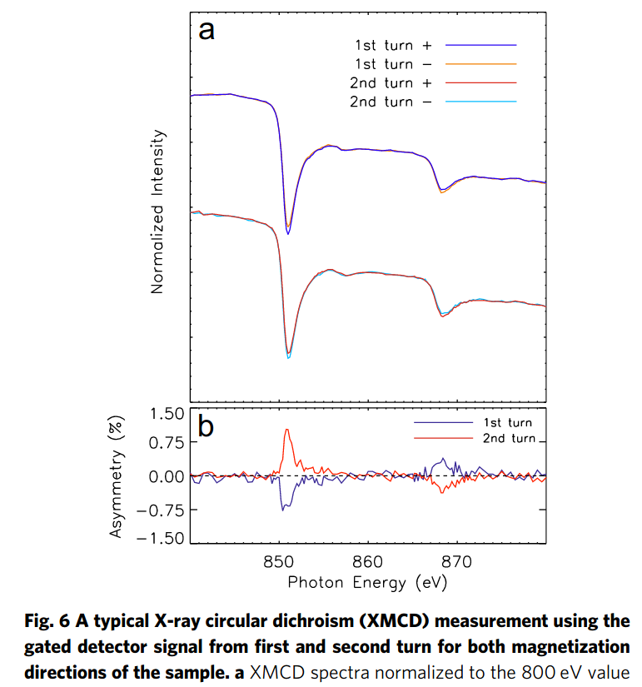
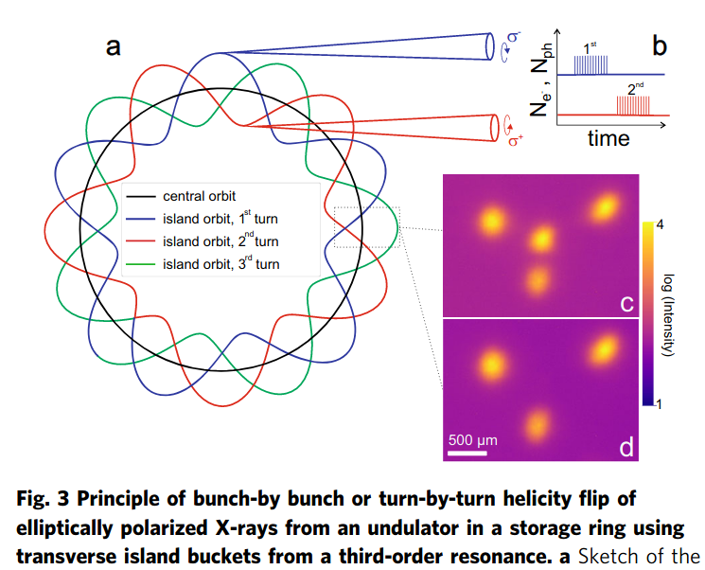
TRIBS as an enabler for new methods: MHZ-XMCD
2 full days spent in July 2019 for a pioneering
experiment at UE56/2
XMCD detection used as probe to detect
turn-by-turn helicity reversal of circular X-rays
tricky combination of stable TRIBs settings
in machine and UE56/2 twin undulator
at special setting
first two TRIBs orbits accepted by beamline
20

Slide 21
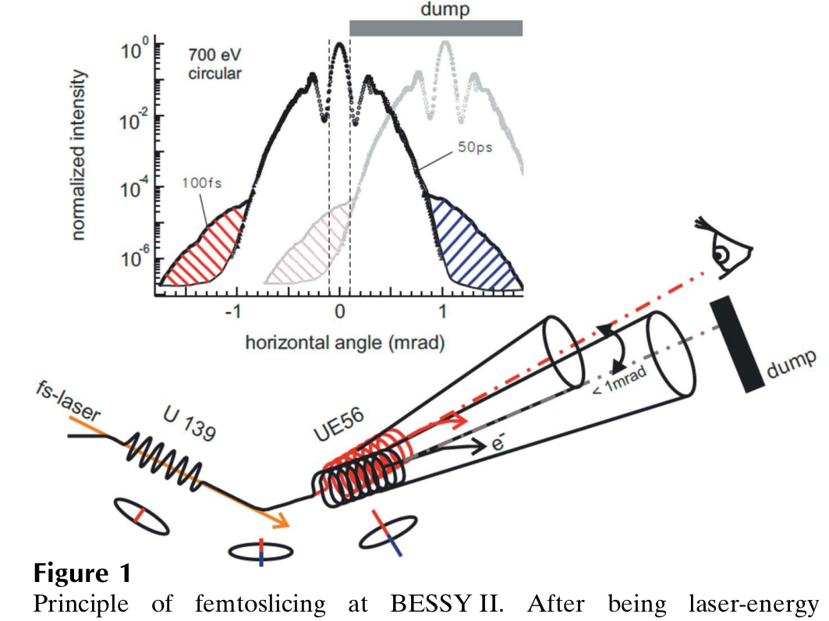
more slicing bunches (3→7) implemented for user operation
FemtoSpeX: a versatile optical pump–soft X-ray probe facility with 100 fs X-ray pulses of variable polarization
K. Holldack et al., J. Synchrotron Rad. (2014). 21, 1090–1104
rep. rate limited to 6kHz by laser
S/N dominated by halo-dynamics
bunch number increased from 3 to 7
bunch current decreased from 4 mA to 3 mA

