Slide 1




Status, Highlights and Outlook
Accelerator Research and Development
Subtopic 2
Peter Spiller, GSI
Anke-Susanne Müller, KIT
February 1st, 2021
7th Annual MT Meeting
Online

Slide 2
ST2 Outlook POF III > POF IV
POF III : Concepts and Technologies for Hadron Accelerators
POF IV : New Concepts and Prototypes for Maximizing the Performance of Hadron- and Electron Accelerators
Speakers:
Peter Spiller (GSI) and Anke-Susanne Müller (KIT)
Focus: Concepts, Technology and Rf Accelerators
Structure/Content:
Intensity
Quality
Efficiency
Technology
Energy Efficiency

Slide 3

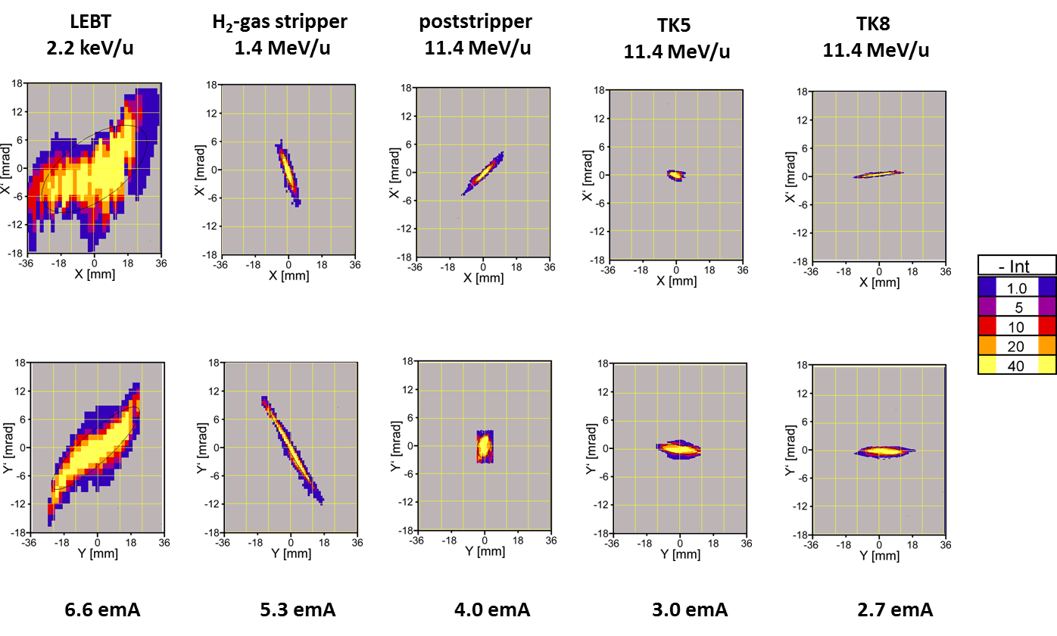
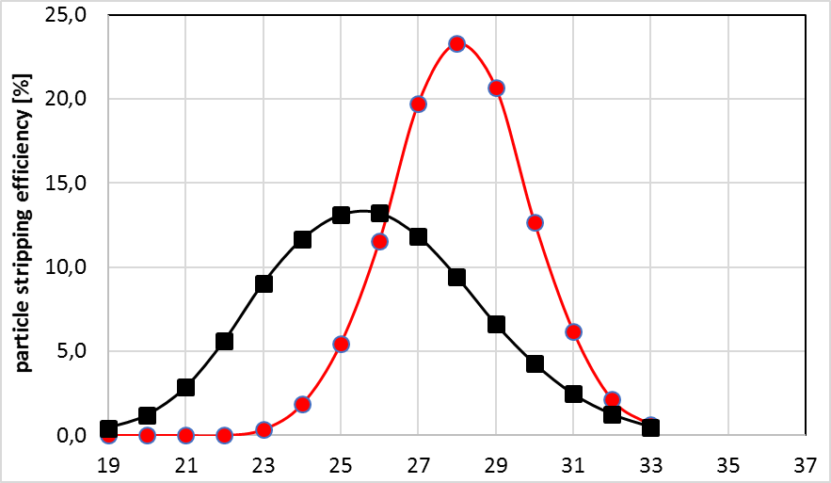
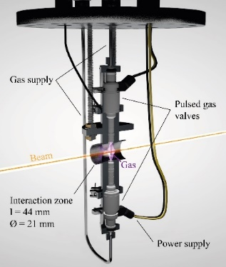
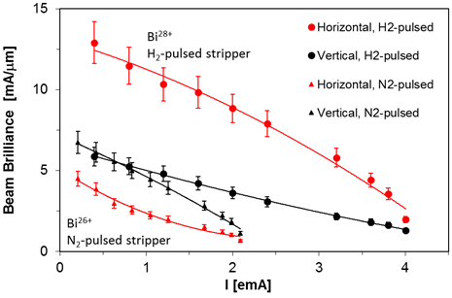
ST2 –
High Current Heavy Ion Injector Linac
Pulsed Hydrogen Gas Stripper for UNILAC
1.4 MeV/u gas stripper:
pulsed H₂-target vs. N₂-gas jet
Heavy ion beam studies: Bi⁴⁺ => Bi²⁸⁺
Goal:
worldwide unique heavy ion intensities
15 emA U²⁸⁺
H₂-pulsed
N₂-gas jet
+75%
W. Barth et al 2020 JINST 15 T12012
https://doi.org/10.1088/1748-0221/15/12/T12012
All ions
  Increased average charge
  less Rf power
  higher SIS18 energy
Heavy ions (U, Bi):
  more narrow distribution
  increased efficiency
  higher beam intensity
Heavy ion beam brilliance studies
FAIR: 15mA/μm
P. Scharrer et al., Proc. LINAC16, TUOP03
    Energy Efficiency: The energy saving during operation of the UNILAC by the pulsed gas stripper is up to 20% !

Slide 4
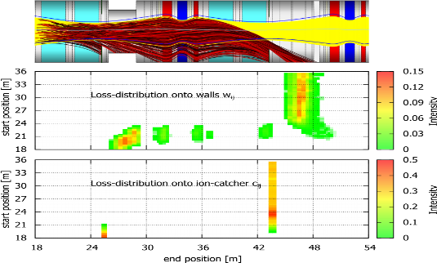
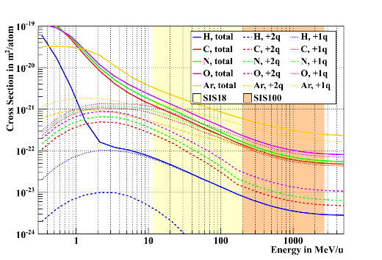
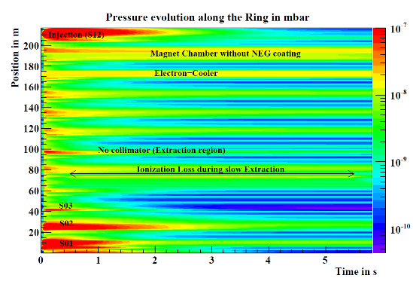
ST2 –
Ultimate Heavy Ion Intensities in Synchrotrons
StrahlSIM Code
Developed by GSI for simulations on the FAIR synchrotron operation with low charge state heavy ions
„Self-consistent“ simulations for spatial and temporal pressure and loss evolution:
Ion optic layout (linear)
Cross sections for prejectile-target combinations (e-capture, e-loss, multiple)
Maschine cycle and energy dependence of cross sections
Ion induced desorption yields considering low desorption surfaces
Conventional UHV system (incl. outgasing, conduction and pumping)
Special UHV systems, e.g. NEG surfaces including saturation
Cryopumping and transitions from room temperature
Beam loss distribution by charge exchange
Cross sections for charge exchange
Residual gas pressure as a function of time and space

Slide 5
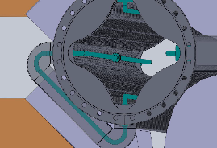
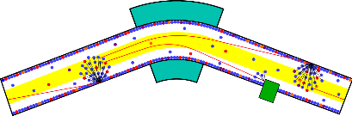
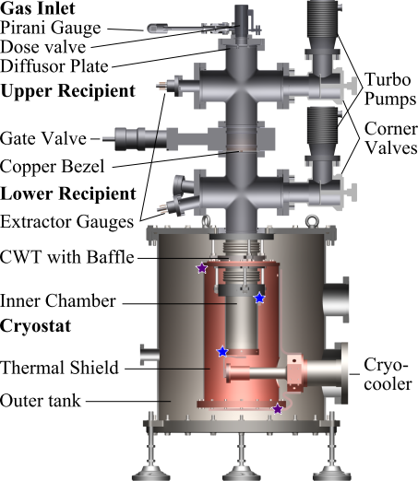
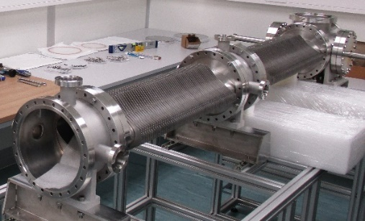
ST2 –
Ultimate Heavy Ion Intensities in Synchrotrons
Stabilization of Dynamic Vacuum in Room Temperatur Synchrotrons
Application of Cryopumping in Room-Temperatur Synchrotrons
Cryo-Teststand
(Phd thesis S. Aumüller)
Dipole
Ionization
Loss
Capture Loss
Investigation of properties of cryopumping
(Phd thesis F. Chill)
Cryogenic Inserts in Ion Catcher System
Cryogenic Inserts in Thin Wall Quadrupole Chamber

Slide 6
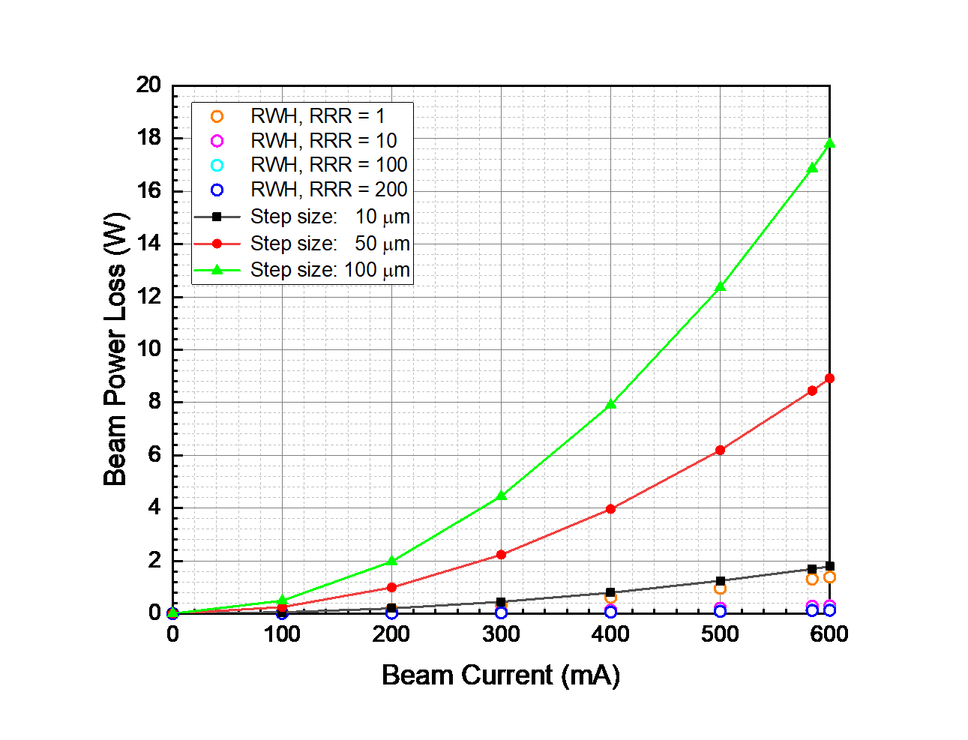
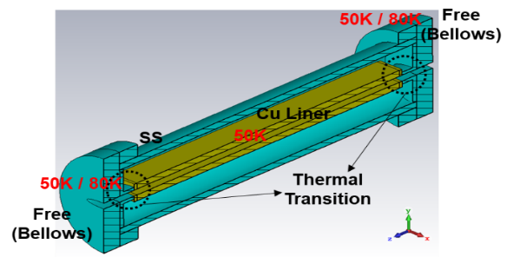

EuroCirCol - FCC H2020 Project: BESTEX setup
ST2 –
Advanced Beam Pipe Studies for HE Colliders
Beam Heat Load Studies for LHC and Beyond
■ COLDDIAG (cold vacuum chamber for beam heat load diagnostics) refurbishment for deeper beam heat-load studies
- Design, manufacture, & testing of a new thermal
transition for 50-K cold-bore operation
- Feasibility studies at accelerator facilities
Advance Beam Screen
Installation of new beam screen: Cu surface with saw tooth shape and laser ablation treatment for reduction of SEY.
Setup upgrade: nitrogen cooling and reduction of glancing angle for similar conditions to FCC-hh
New measurements at RT and 77K
Experimental results are representative for the planned machine vacuum system: photo-stimulated desorption molecular desorption rate can be reduced

Slide 7
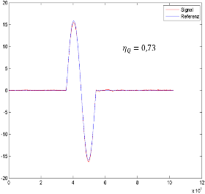
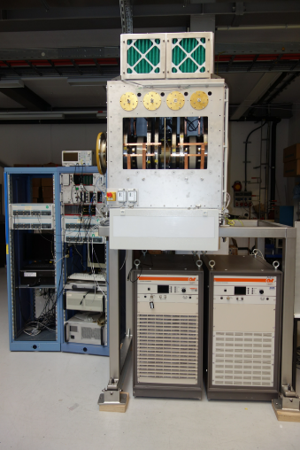
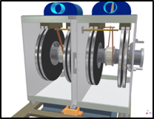
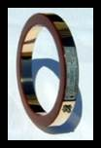


Broad Band MA-Loaded Cavities
ST2 –
Broad Band Cavity Systems including Low Level Electronics suitable for the generation of a barrier bucke or longitudinal feed-back
Concept of Bunch-by-Bunch Longitudinal Feedback System
De-Multiplexing of beam current signal in up to 10 bunch channels
Processing of bunch information (phase, amplitude) and calculation
of individual correction signals
Multiplexing of all bunch corrections into one kicker correction signal
Generation of a single harmonic oscillation (1kV_{p})
beam
R&D-Study by company Aurion
Signal Processing
DeMUX
MUX
Oil-cooled MA stack
coop. TU Darmstadt
MA test cavity

Slide 8
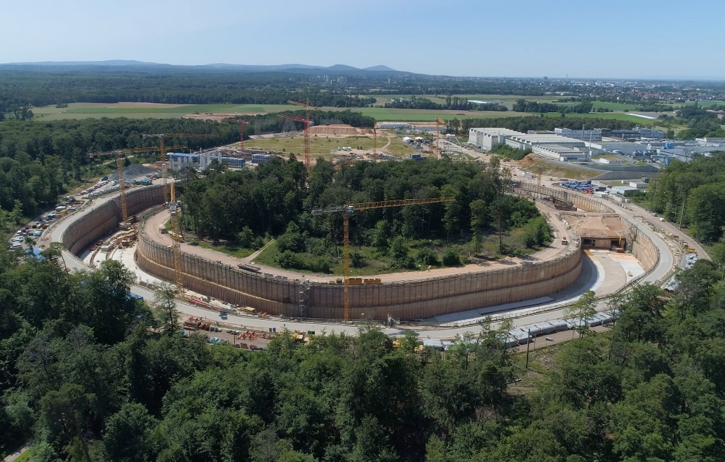
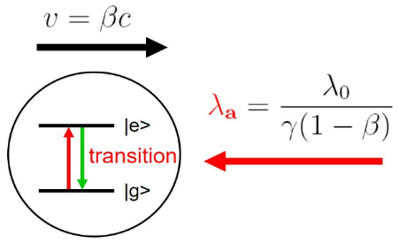
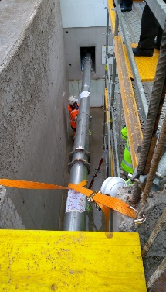
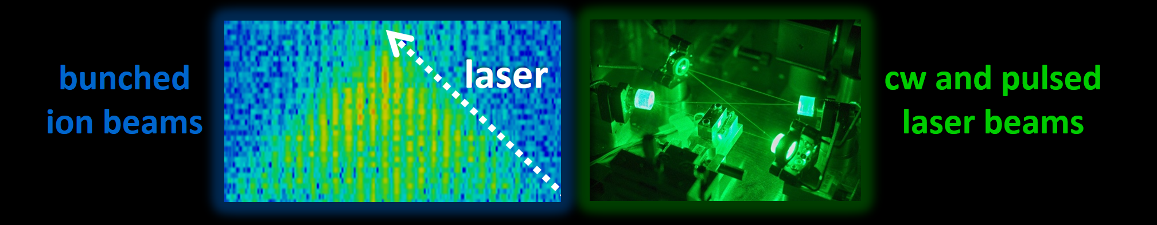
ST2 –
Laser Cooling of Relativistiv Heavy Ions
SIS100 will be the first user synchrotron equiped with a „laser cooler“ world wide.
Laser-cooled relativistic heavy-ion beams (γ up to 13 for Z = 10 - 60)
Only cooling method at relativistic energies (dp/p<10⁻⁷)
Extraction of very cold and very short ultra-relativistic ion bunches
Major highlights:
Installation of the laser beamline in SIS100 tunnel
Net cooling force in the direction of the laser light (longitudinal).
Visiting Scientist Fellowship for Associated Professors of Chinese Academy of Science for D. Winters
Laser and Particle Beams Young Scientist Award for S. Klammes
talk: S. Klammes

Slide 9

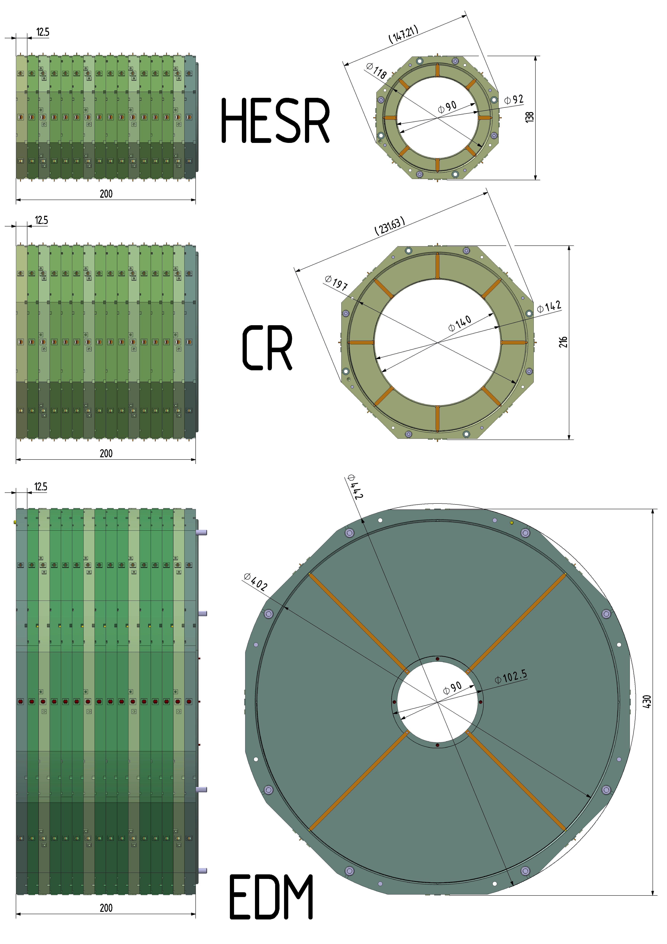
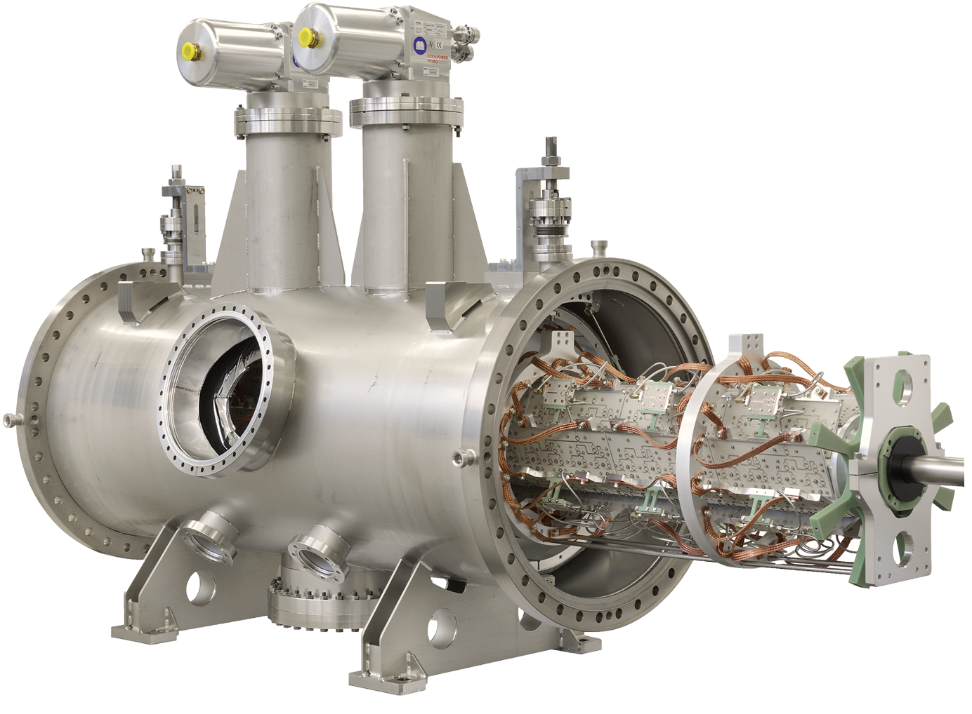
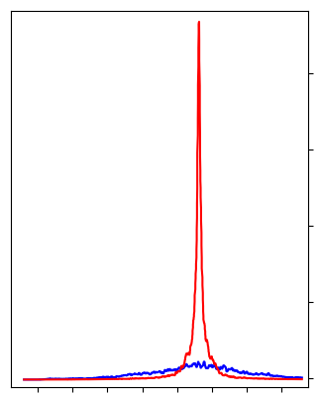
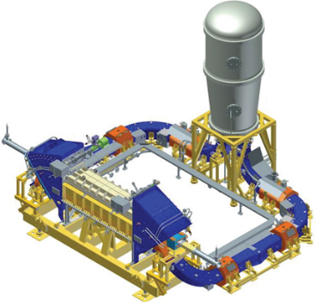
Advanced Stochastic and Electron Cooling
ST2 –
Stochastic cooling with slot-ring couplers
Highest brilliances
stochastic transverse precooling + e-cooling
R&D objectives:
advancing slot ring couplers in terms of aperture limitation, frequency range and resonant design
self-adjusting stochastic cooling
cooling structures for counter rotating beams for weak focusing lattice
e-cooling modeling
  Cooler hardware
  Cooling process
  Compensation schemes
parallel stoco+ecool+target, beam
HESR Pick-up
2438175
2438250
2438350
Successfully tested with PANDA cluster target at COSY
f / MHz
Successful electron cooling
down to dp/p = 3.85∙10⁻⁵
I_{e} = 0.6 A, with barrier bucket
2 MV e-cooler (4 GeV)

Slide 10
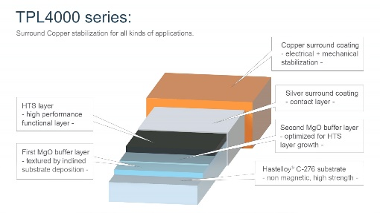
ST2 –
Fast Ramped Superconducting Magnets
Cold test of fast ramped cosθ dipole magnet
GSI continues with developing world wide unique expertise in fast ramped superconducting magnets.
A full size SIS300 dipole magnet has been developed. The main goal was minimizing the AC loss in the coil by means of a special low loss Rutherford cable.
The cold mass of the full size SIS300 dipole magnet has been cold tested in a vertical bath cryostat at INFN Milano. A ramp rate of 1 T/s could be reached, which compares to 50 mT/s of usual s.c. magnets with standard Rutherford cable.
In 2020 the assembled magnet has been send to ILK for preparing a cold test of the full magnet (picture left).
Set-up of full size SIS300 dipole magnet at test stand at ILK
HTS Nuclotron Cable
In preparation of the EU funded program IFAST, GSI has set-up a collaboration between IEE Bratislava, ILK Dresden and University Twente on the development of an high current, wide temperature range, energy efficient ReBCO-HTS based Nuclotron cable and prototyping of a fast ramped magnet. Potential applications for energy technologies, e.g. s.c. energy storage will be studied.
Recent progress in advanved manfacturing techniques (higher cirtical currents, advanced doping) of commercial HTS tapes may enable higher field magnets.
So far, fast ramped s.c. accelerator magnets have been build based on two types of cable: a) Nuclotron cable or b) low-loss Rutherford cable.
GSI is going to further develop the Nuclotron cable by replacing the NbTi strands by an HTS tape.
Notes:
Wir haben die Saugeigenschaften von kryogenen Oberflächen bzgl. Wasserstoff vermessen (soujourn time, sticking coefficient).
Erstaunlicherweise gibt es dazu keine vollständige Daten in der Literatur.
Die Daten haben wir in unser STRAHLSIM Programm eingebaut (weltweit einziges Programm zur Berechnung des dynamischen Vakuums und Umladungsverluste).
Damit haben wir dann die Umladungsverluste (Ionization) im SIS100 berechnet (rechts unten). Vier x Injektion und dann kurze Beschleunigung. Die Schräge auf den Intensitätsplots sind Umladungen.
Darüber hinaus haben wir das Sättigungsverhalten der kryogegen Oberflächen berechnet

Slide 11
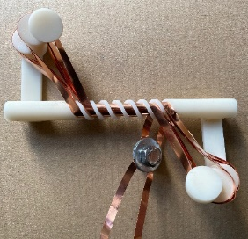
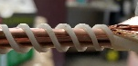


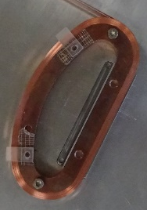
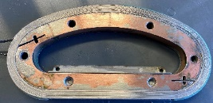
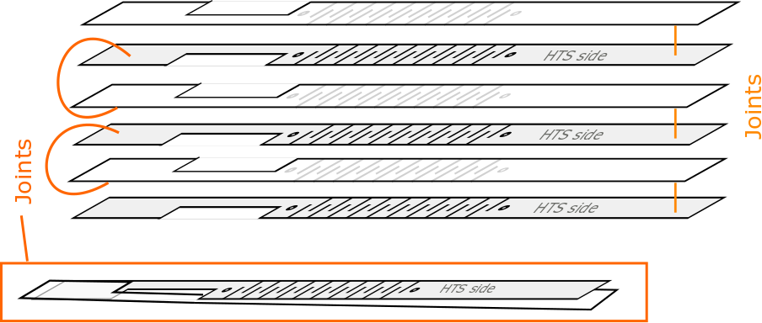
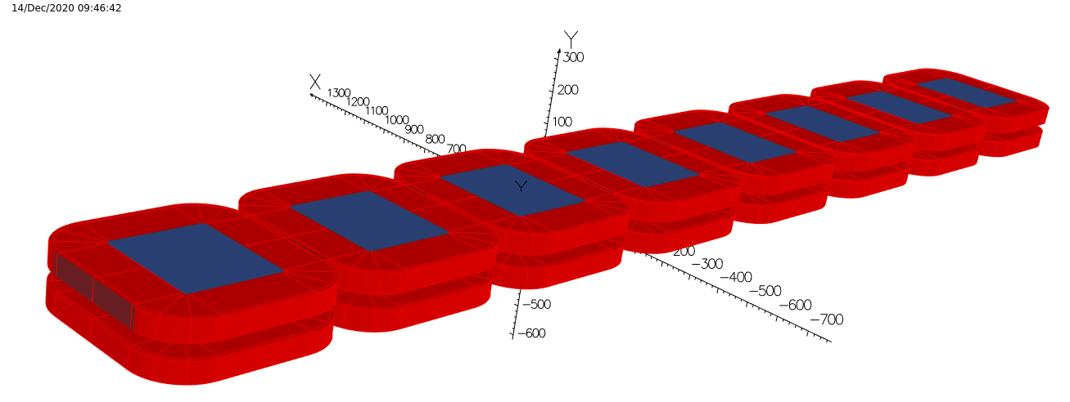
ST2 –
New S.C. Undulator Concepts and Technologies
Helical undulator
Application of HTS in form of coated REBCO tape conductors to undulators and wigglers allow reaching higher magnetic fields and larger operating margins.
Undulator Prototype coils, horizontal and vertical racetracks as well as a helical design, are being designed and their performance will be evaluated to make a final design choice for a five period short model.
Vertical & horizontal racetrack undulator
Structured HTS -undulator (HTSU)
Field generation by alternating stacks of meander
structured HTS tapes
Tapes are structured with a Laser:
Superconducting undulators as THz afterburners for EU XFEL)
Investigation of parameter range
Very long period length
High fields
Coil model with iron poles high fields for parameter studies

Slide 12
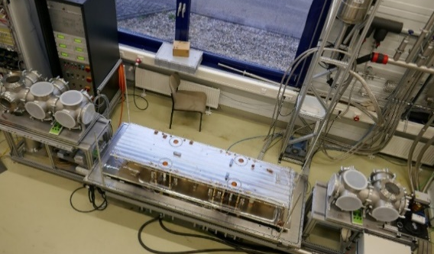
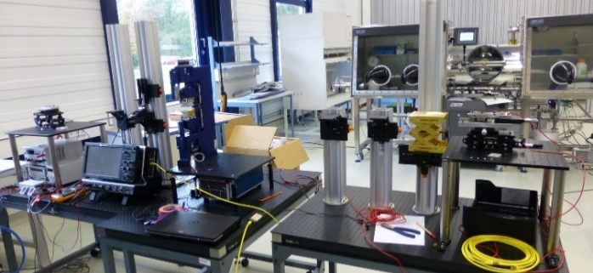
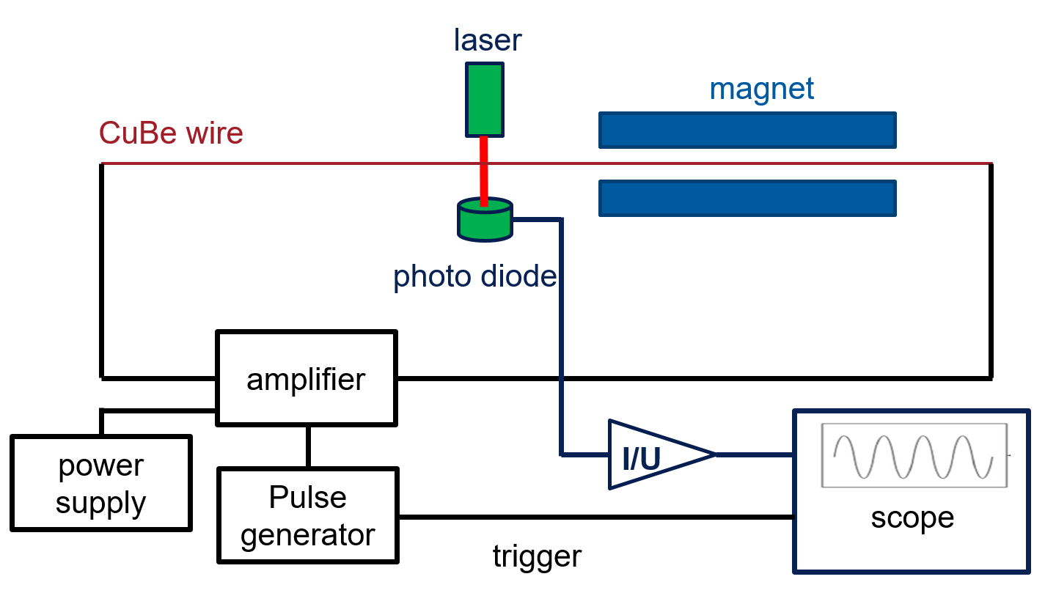
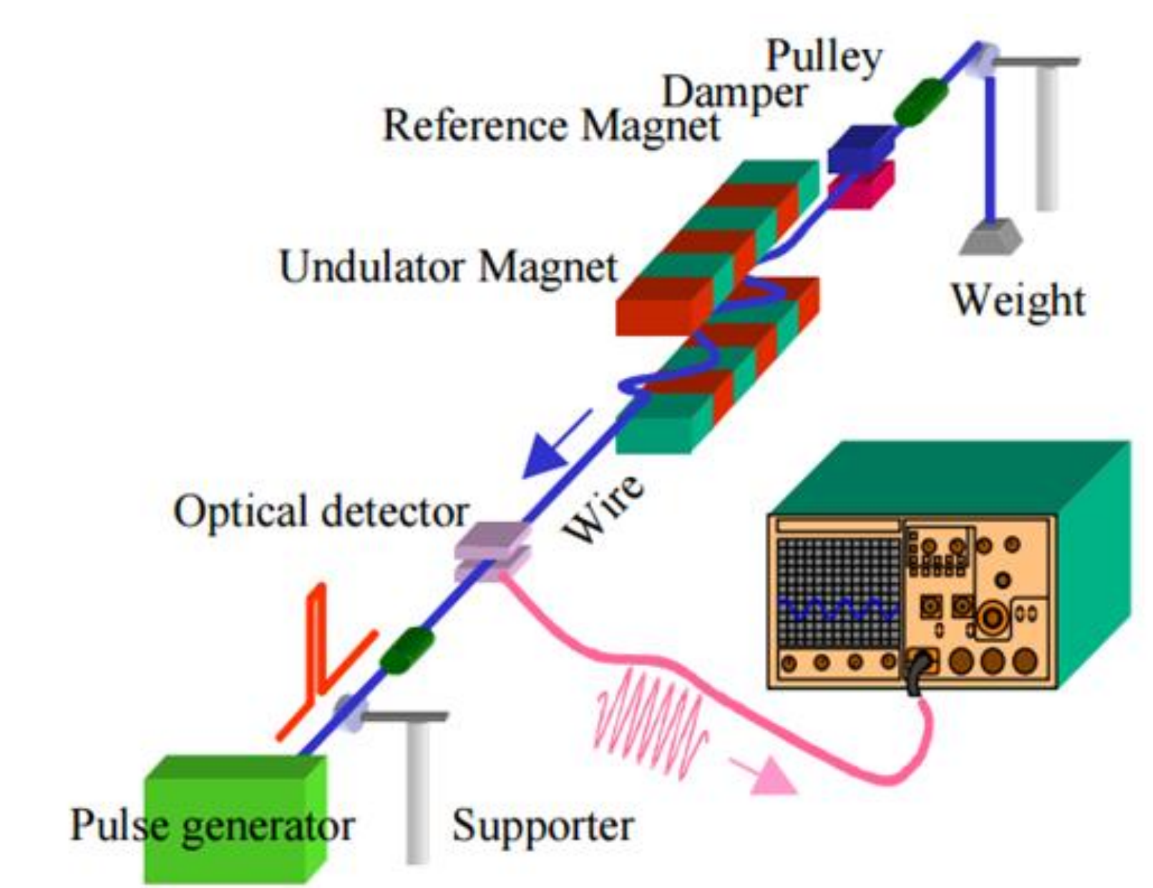
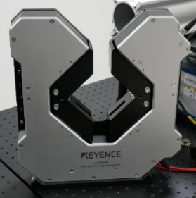
S.C. Undulator Test Infrastructure
ST2 –
SCU magnetic field characterization facility (Caspar II)
For optimizing coherence and energy transfer between electron and light,
accurate characterization of the local magnetic field and the field integrals of superconducting undulator- and wiggler coils up to a length of 1.8 m.
Coil training in conduction cooled environment.
Stability tests.
Local field measurements with Hall samples (incl. roll off).
Field integral measurements and minimization with correctors.
New magnetic measurement systems
pulsed wire set up
  ultra fast
  where hall probe is inaccessible
  spatially resolved measurements of magnetic structures
  → goal: characterisation of superconducting coils
constant current set up
  goal: high precision measurement of 1st and 2nd field integral
  to be implemented in pulsed wire system
  new 2D ultrafast (16kHz)
  high precision (x,y < 2 µm) laser system under commissioning

Slide 13

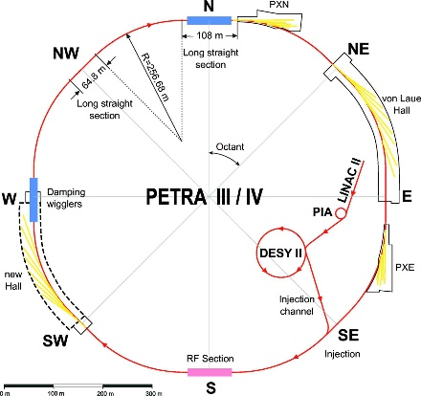
R&D towards PETRA IV
ST2 –
PETRA IV R&D
PETRA IV design is based on proven concepts. Some R&D is however necessary to open the possibilities of improving energy efficiency, better beam stability, new operation modalities etc.
Low-medium-risk R&D and test activities:
  Development of modern feedback and beam stabilization concepts
  Permanent magnet developments (in collaboration with ESRF, Daresbury)
  Improving BPM resolution (10-20 μm resp. 100 nm) of the Libera system
A portfolio of beam tests at PETRA III being established. A dedicated test beamline foreseen.
PETRA IV injector R&D
Linac studies
Experiments at the ARES linac (S-Band) will be performed.
Generation of high charge bunches and studies on laser pulse doubling.
High-charge photoinjector R&D at SINBAD

Slide 14
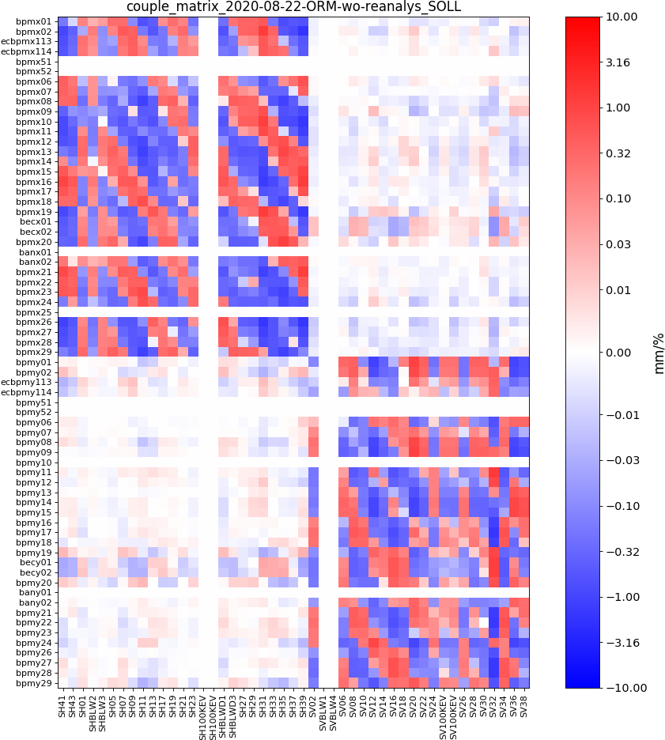
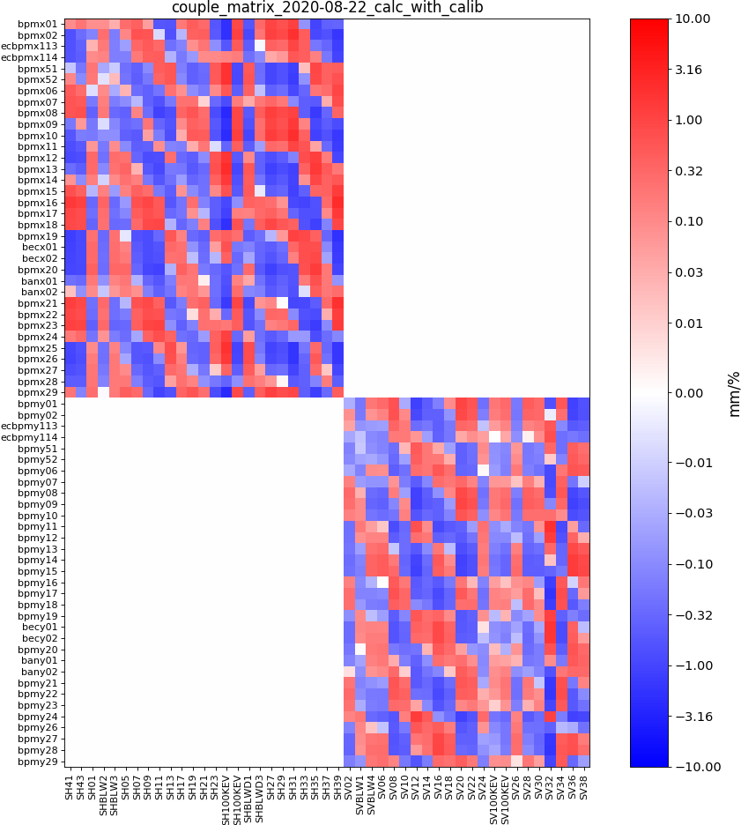
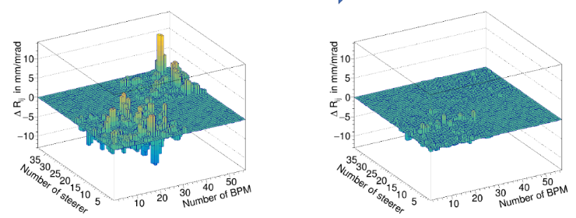
ST2 –
Advanced Beam Control
Partnership GSI/FAIR (SYS) and Communication Engineering Lab CEL@KIT, Karlsruhe (Helmholtz)
- new collaboration on RF signal processing in particular those based on distributed Software-Defined-Radios (SDRs)
- SDRs are used at GSI/FAIR for continuous monitoring of wide-band Schottky and RF cavity signals that in turn are used by our beam-based systems to tune and improve the FAIR beam parameters
- keywords: distributed ns-level synchronisation of wide-band (>100 kHz -> 4 GHz) multiple-input-multiple-output (MIMO) data acquisition and processing systems.
FZJ/GSI: Test of machine learning algorithms at COSY
in the scope of Helmholtz AI Consulting
CosyMMOpt – better measurement and model matching with genetic algorithms (GA) and particle swarm optimization (PSO)
MALIA - injection optimization for COSY and SIS 18 with reinforcement learning and transfer learning
Application of machine learning in BI: e.g. reconstruction of space charge distorted beam profiles from IPM monitors
find correlations in spin tune data and COSY settings
measured vs modelled ORM for CosyMMOpt
DESY: Petra IV High-risk R&D and test activities
  Machine Learning for autonomous accelerator
LOCO

Slide 15
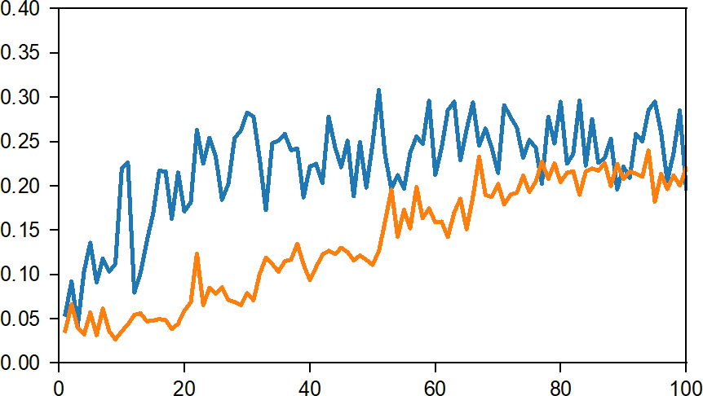
ST2 –
Advanced Beam Control
Operation experience with bayesian optimization
Bayesian Optimization is used in applied machine learning to tune the hyperparameters of a given well-performing model on a validation dataset.
Improve the injection rate from the booster to the storage ring
Manual trial-and-error tuning is time consuming, depends on the operator’s experience, and can easily get stuck in local optima
Implemented Bayesian optimization (BO) with Gaussian Processes (GP) for the beam injection tuning at KARA
Achieved efficient optimization for 9 tuning parameters
BO outperforms Nelder-Mead (NM) and manual tuning (factor 2)
Injection tuning half-automated
Contextual BO using current as context variable
Injection Efficiency
GP-UCB
Nelder-Mead
Evaluation Cycles
Benchmark BO against NM algorithm
See also ST2 Highlight Talk by A. Santamaria Garcia
Courtesy: C. Xu, KIT
Notes:
Progress since MT annual meeting 2020-06: contextual optimization with the goal to incorporate temperature information (sensors are to be purchased/installed next year). Paper in preparation.

Slide 16
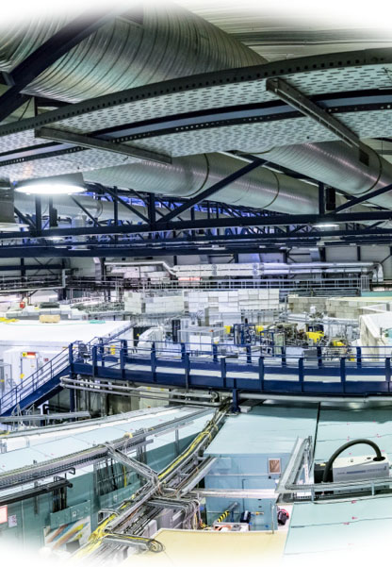
R&D for energy efficient accelerators
ST2 in POFIV
ARD Recommendation: add a milestone on energy efficient R&D for future technical infrastructures and accelerator projects
Flexible load management and optimization employing AI methods
Dynamic coordination with network operators
Hybrid magnets and energy efficient magnet technologies
Energy-efficient RF and cryogenics
Qualification of new procedures & components at ARD test facilities
Application of accelerator technologies in energy systems
Cooperation across Helmholtz: Innovation Pool project InnovEEA
(GSI, HZB, and DESY and KIT)
Participation in EU-IFAST “Sustainable Concepts for Accelerator driven Research Infrastructures”
See presentation by S. Grohmann

