Slide 1





Development of a next generation CMOS MAPS for CBM and beyond
in collaboration with:
PD Dr. Michael Deveaux
on behalf of the MIMOSIS-team.

Slide 2
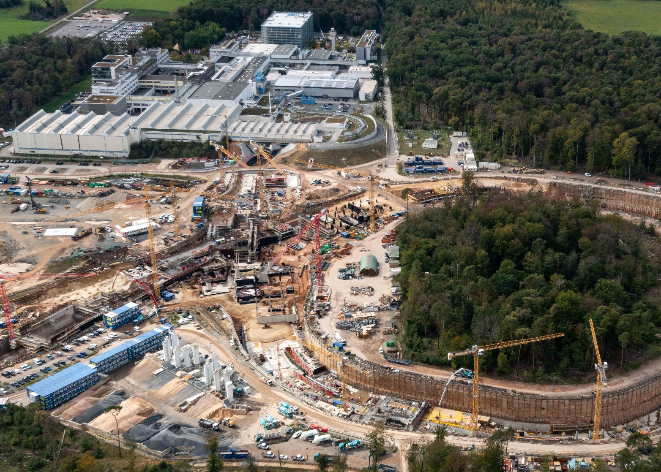
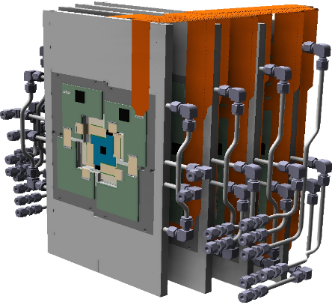
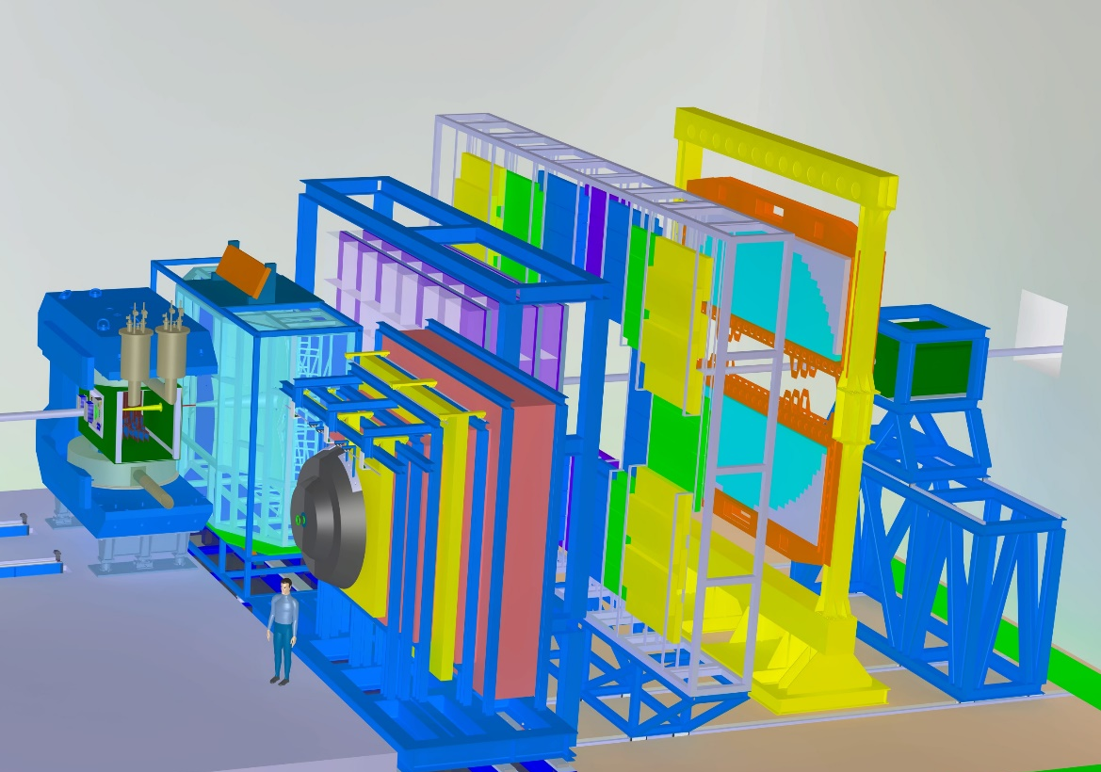
Initial motivation: CBM
CBM
MVD

Slide 3
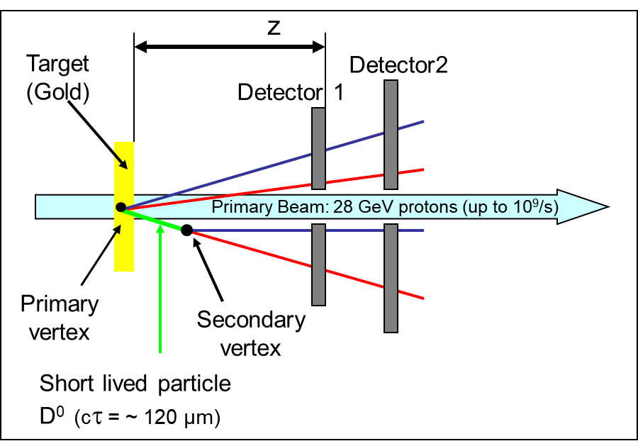
The CBM-MVD, motivation of requirements
Limited detector precision spoils vertex precision.
  Needs <5µm.

Slide 4
The CBM-MVD, motivation of requirements
Limited detector resolution spoils vertex resolution.
  Needs <5µm.
Multiple coulomb scattering must be reduced.
  Needs x< 0.3% X_{0.}
  Detector in vacuum.
  Low power <100mW/cm²
Collision rate:
  10⁵ Au+Au/s (11 AGeV)
  10⁷ p+Au/s (30 GeV)
  Need high rate capability
 | CBM requirement
Spatial precision | <5 µm
Low power | <100 mW/cm²
Material budget (per station) | 0.3% X₀
Calls for CMOS
MAPS

Slide 5
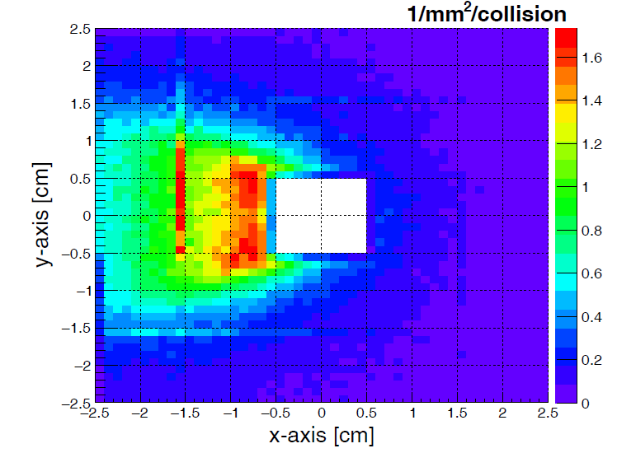
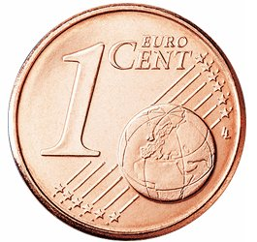
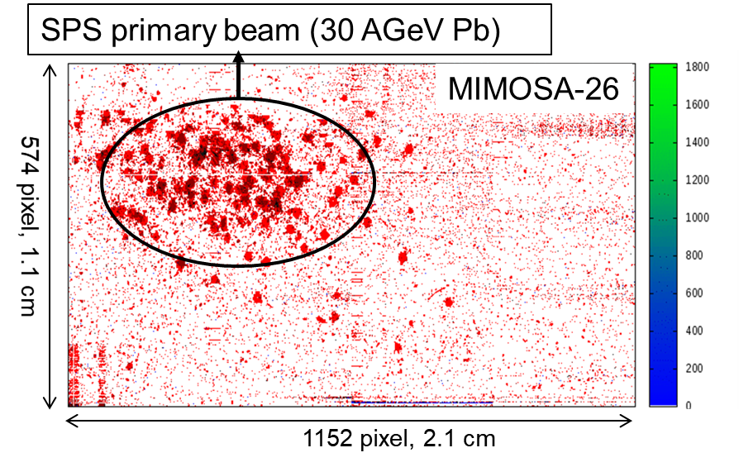

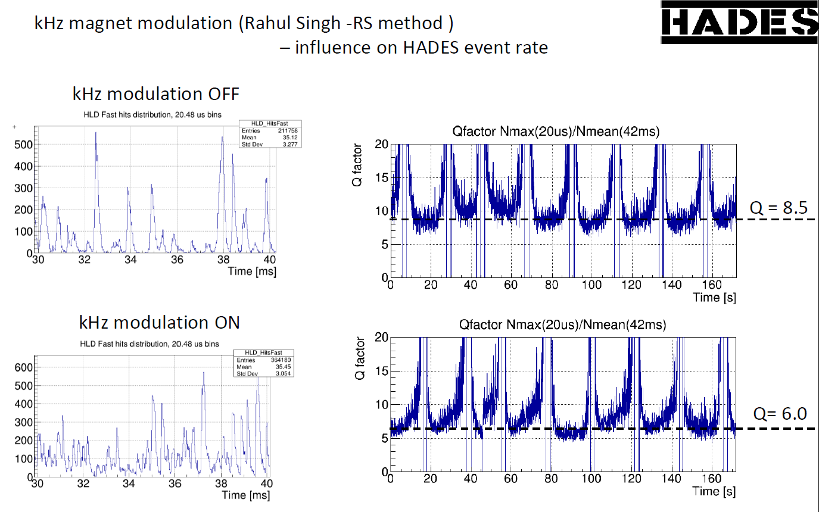

Additional requirements: Beam and occupancies
Curtesy
Size of MIMOSIS-1
Q.Li, private communication
Beam hole:
11 mm
Courtesy
Double counting in simulation (simulated sensor overlap)
Occupancy very inhomogenious.
Strong beam fluctuations expected.
Beam halo ion impacts expected.
Beam intensity - SIS18
J.Pietraszko, private communication
CBM requirements (cont.)
Rate capability mean (peak) | 20 (80) MHz/cm²
Ion tolerance (10 AGeV Au) | 1 kHz/cm²

Slide 6
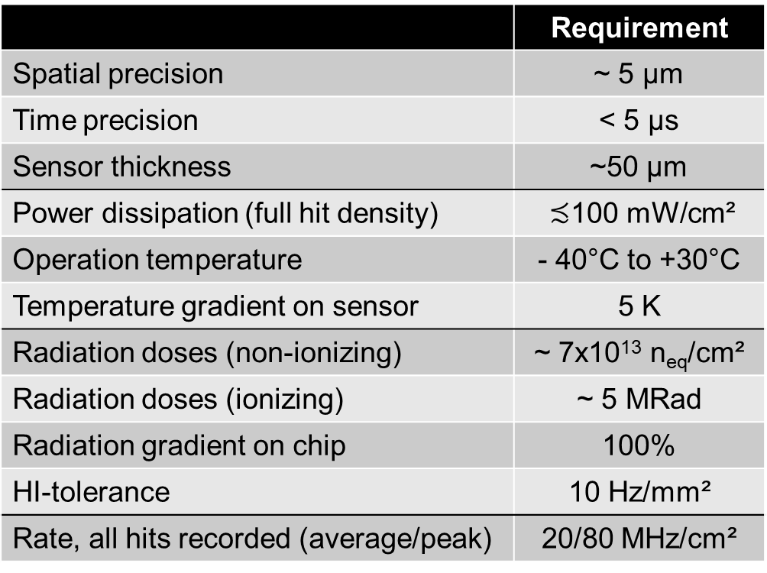
Assumption:
Sensor has to withstand 5x10⁶s at 100 kHz Au+Au or 10 MHz p-A.
All numbers hold for the most illuminated 1mm² of the MVD.
 | Requirement
Spatial precision | ~ 5 µm
Time precision | < 5 µs
Sensor thickness | ~50 µm
Power dissipation (full hit density) | $≾$100 mW/cm²
Operation temperature | - 40°C to +30°C
Temperature gradient on sensor | 5 K
Radiation doses (non-ionizing) | ~ 7x10¹³ n_{eq}/cm²
Radiation doses (ionizing) | ~ 5 MRad
Radiation gradient on chip | 100%
HI-tolerance | 10 Hz/mm²
Rate, all hits recorded (average/peak) | 20/80 MHz/cm²
approx.

Slide 7
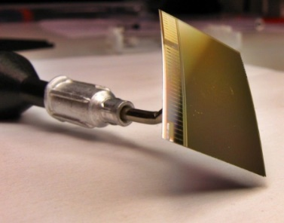

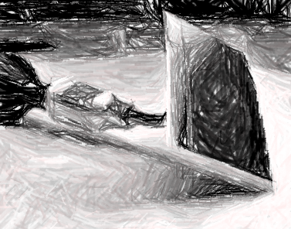

R&D strategy
Depleted MAPS
Rad. hard. >10x ?
In collaboration with:
MIMOSA-26
On-pixel discrimination.
Speed-up x20
Low power x0.2
CBM specific:
Beam halo tolerance
~80 MHz/cm² rate
Beam fluctutation
In collaboration with:
MIMOSIS

Slide 8
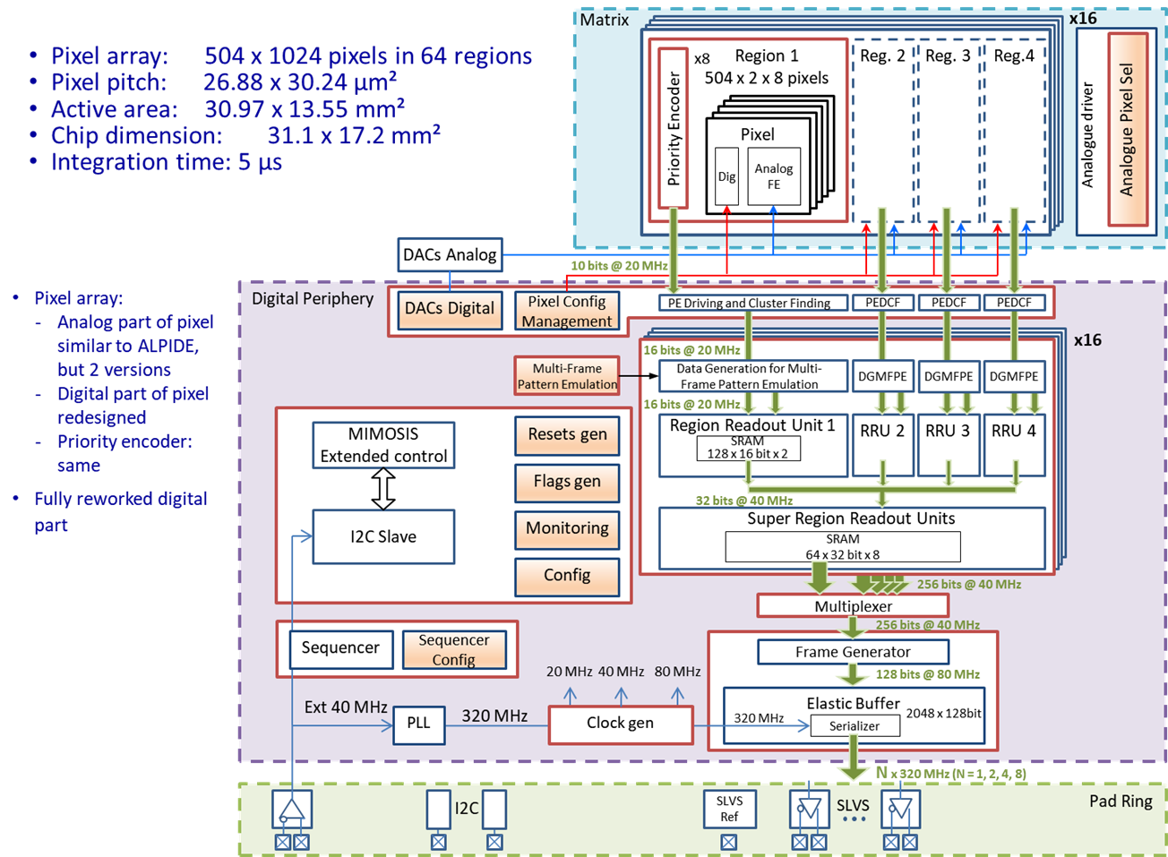
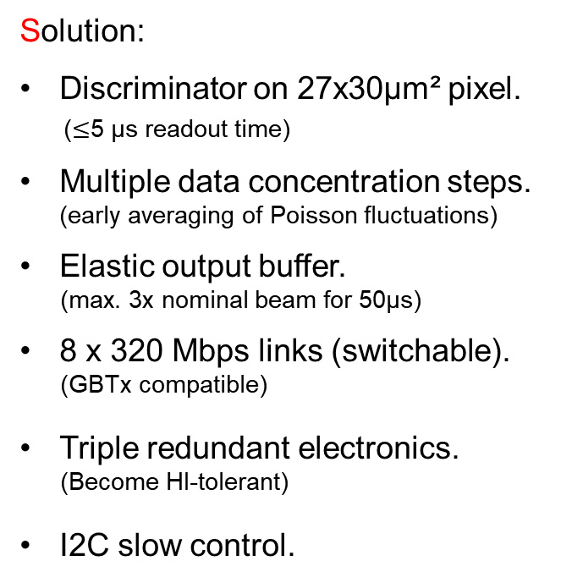
R&D strategy
Sensor must handle 100kHz Au+Au
Sensor must handle occupancy
gradients in space.
Size of MIMOSIS-1
Sensor must handle beam
fluctuations in time.
Solution:
Discriminator on 27x30µm² pixel.
($≤$5 µs readout time)
Multiple data concentration steps. (early averaging of Poisson fluctuations)
Elastic output buffer.
(max. 3x nominal beam for 50µs)
8 x 320 Mbps links (switchable).
(GBTx compatible)
Triple redundant electronics.
(Become HI-tolerant)
I2C slow control.
MIMOSIS block diagram

Slide 9

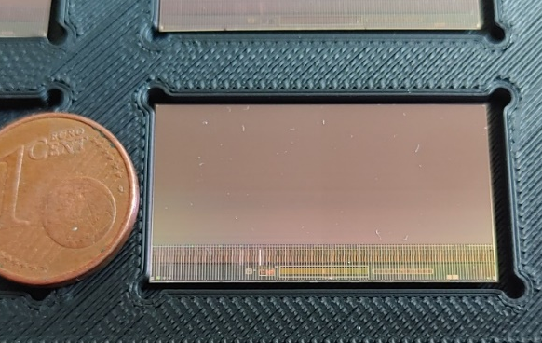
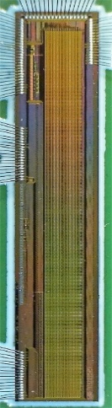
MIMOSIS – R&D schedule
MIMOSIS-0 (2018)
Demonstrate pixel concept.
Demonstrate readout concept.
MIMOSIS-1 (2020)
Add buffer structure.
In beam tests.
SEE hardening 1/2
MIMOSIS-0
MIMOSIS-1
We are here
MIMOSIS-2 (2021e)
On-chip pixel grouping.
Final pixels.
SEE hardening 2/2
All submissions:
Additional CE18 test structures
to study specific design questions.
MIMOSIS-3 (End 2022e)
Final sensor

Slide 10
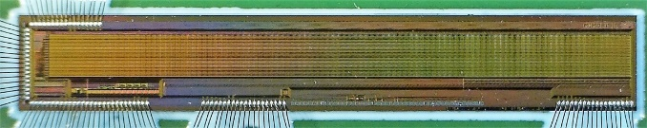
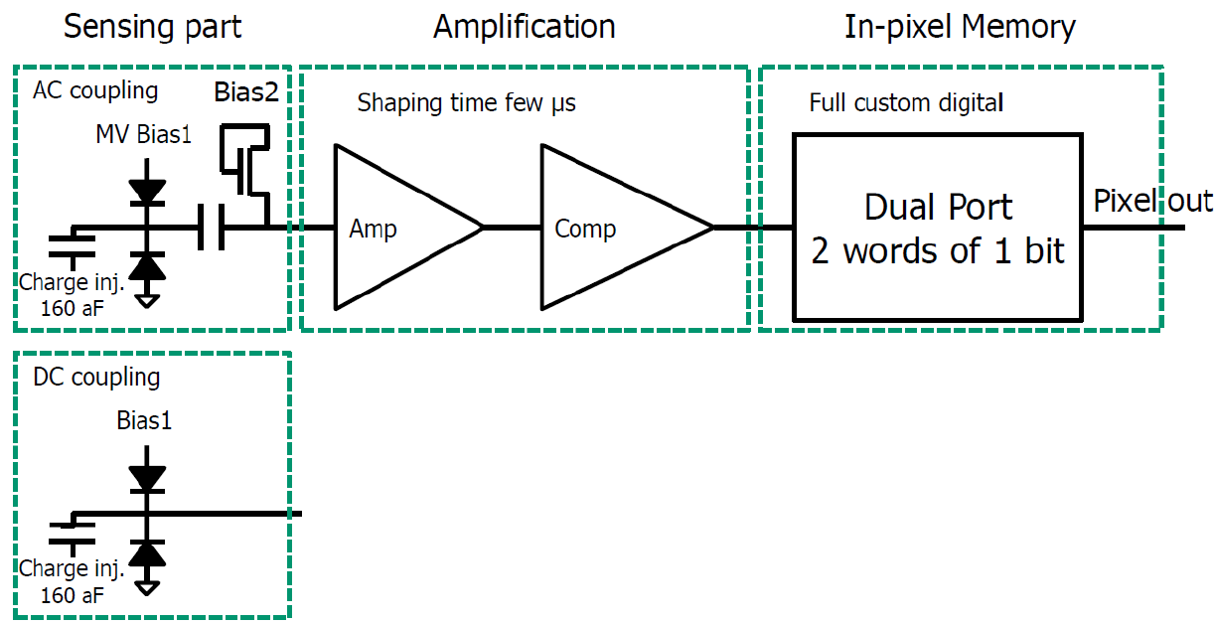
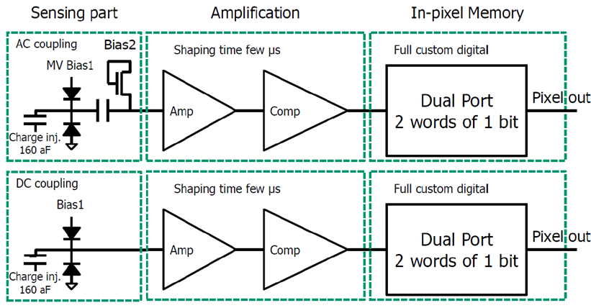
First Prototype: MIMOSIS-0
MIMOSIS-0
32 columns of 504 pixels.
Priority encoder (data driven).
Up to 40V depletion voltage.
No data buffers yet.
1 mm
MIMOSIS-0
DC-pixel
(Inspired by ALPIDE)
Pulse injection
AC-pixel
up to 40V HV top bias
Back bias possible.
P-Well bias (ALPIDE) possible
Decoupling capacitor

Slide 11
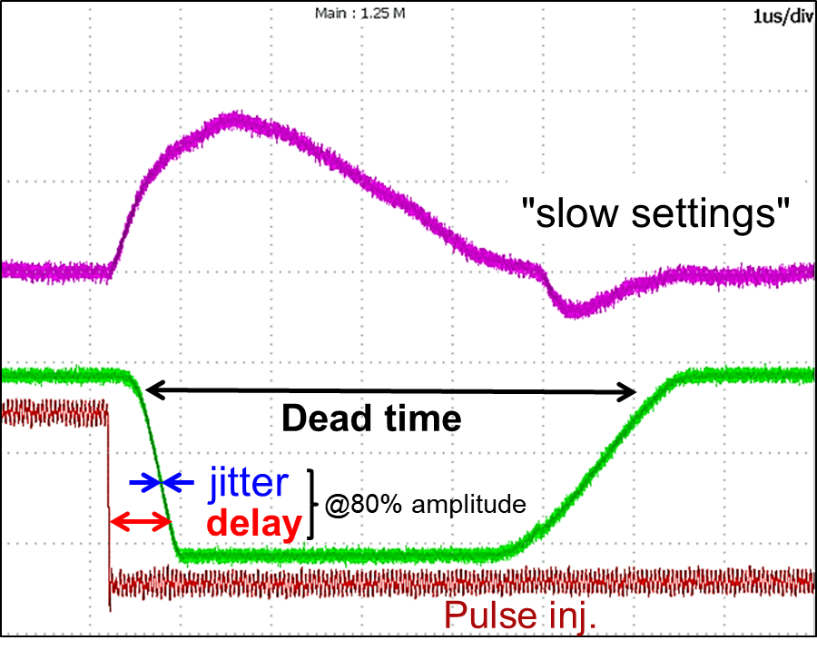
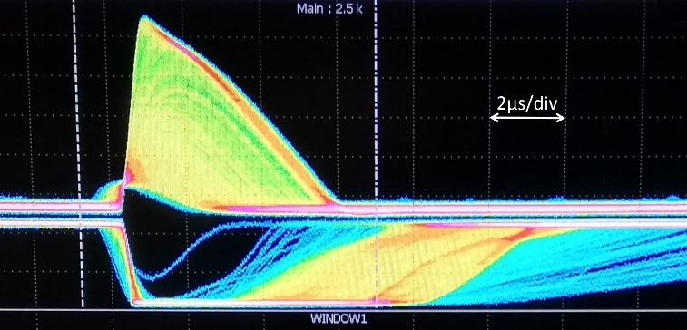
MIMOSIS-0: Pulse tests
Pulse injection
Signal
M.I.P ~850e (MPW 25µm epi)
~850e
⁵⁵Fe (1640 e)
Rather small time walk & jitter

Slide 12
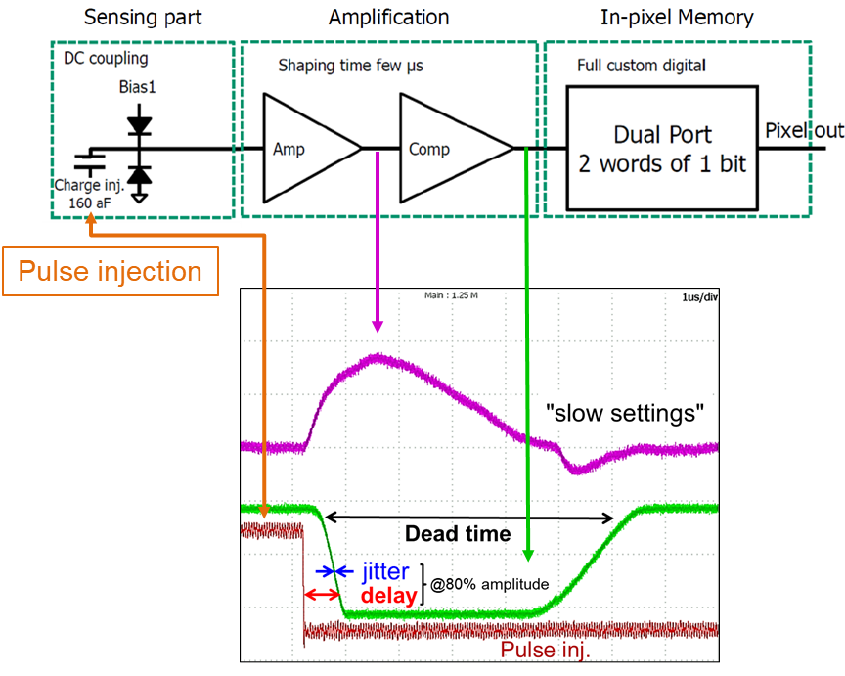
MIMOSIS-0: Pulse tests
(individual pixel)
400
After optimizing trim voltages:
Time walk + jitter < 1µs, pixel busy (analog) ~3µs.
AC pixel (not shown) 30% slower than DC pixel
Might reach time accuracy < 1µs (target frame readout time 5µs)

Slide 13
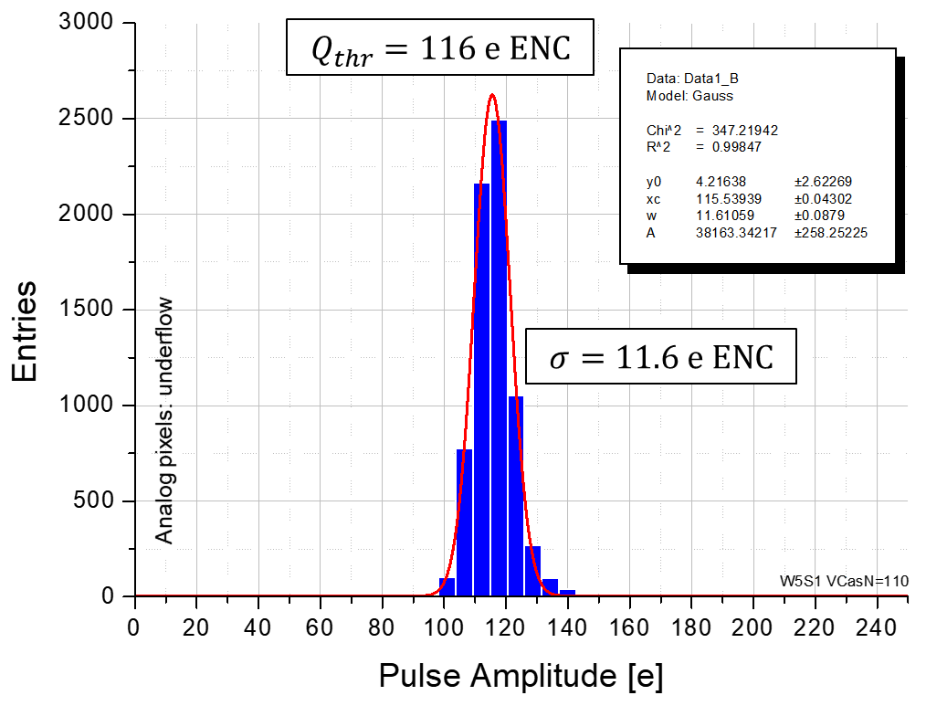
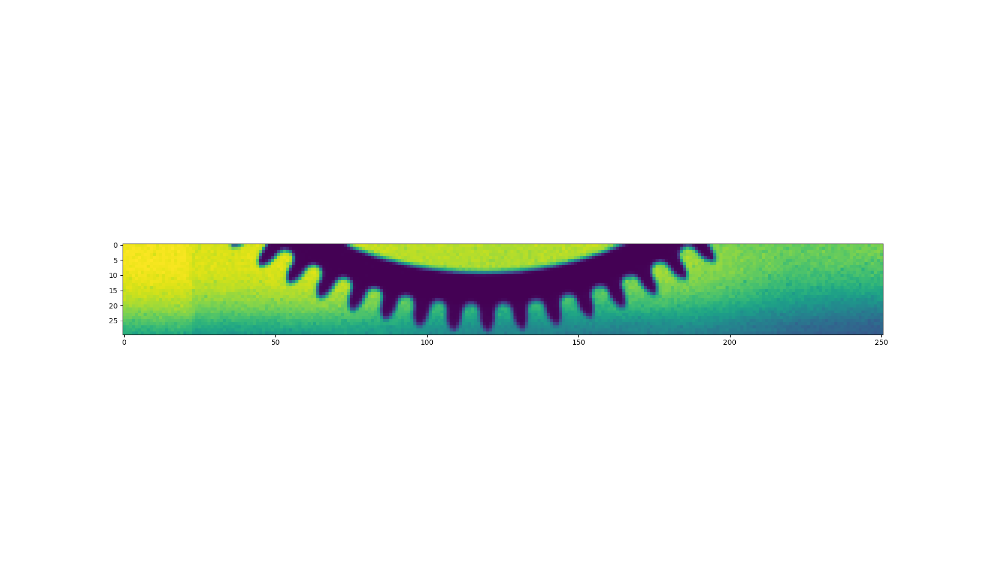
First Prototype: MIMOSIS-0
1 mm
Signal: 850e MPV
Computed estimate.
M.I.P. 25µm-epi.
No charge sharing.
Test with test-pulse:
FPN < 12 e ENC, temporal noise <<6 e ENC
Threshold ~120 e (Threshold/Noise = 8)
Very uniform response.
^{X-ray}

Slide 14
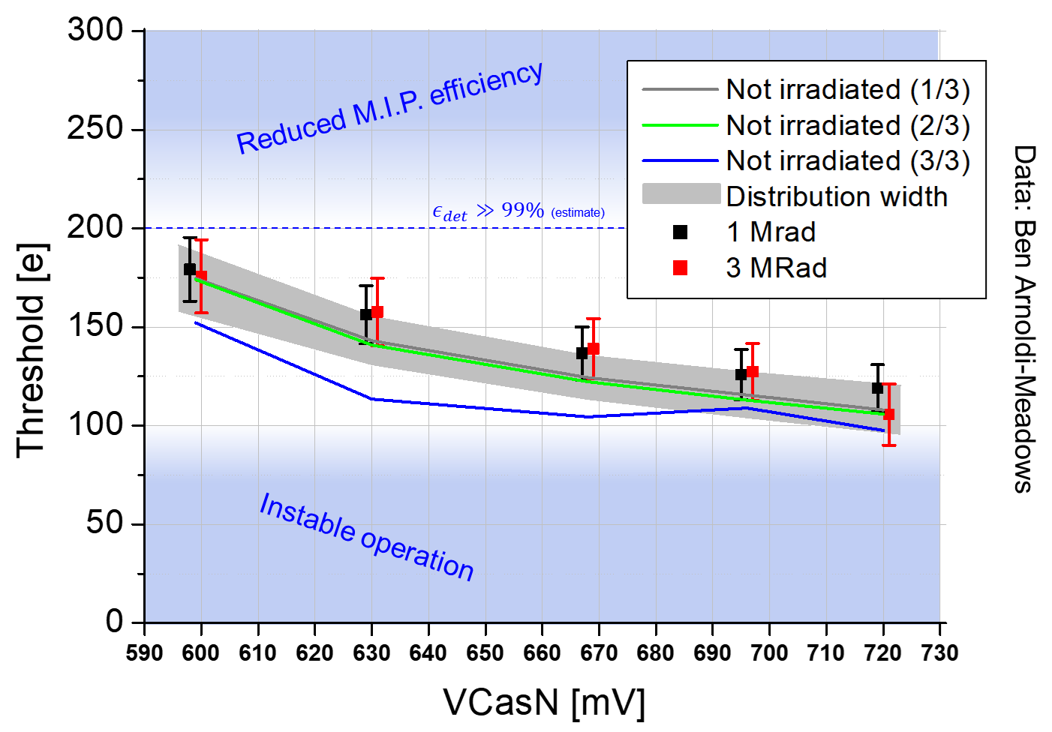
Results: MIMOSIS-0
B. Arnoldi-Meadows, CBM progress report 2019
Manipulation error?
Room temperature
Rad tolerance > 3 MRad (after 1 year room temperature annealing)
Handling dose gradients appears feasible.

Slide 15
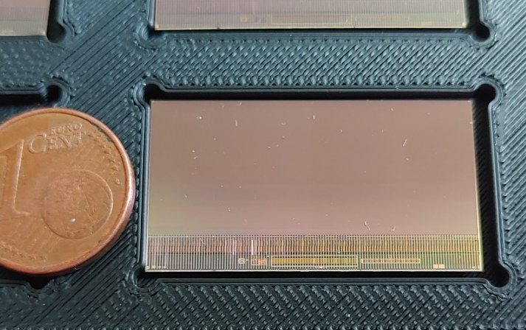
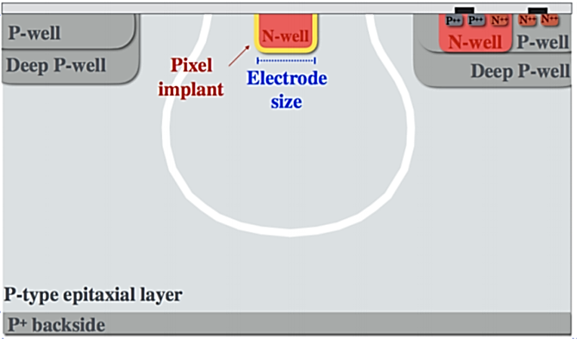
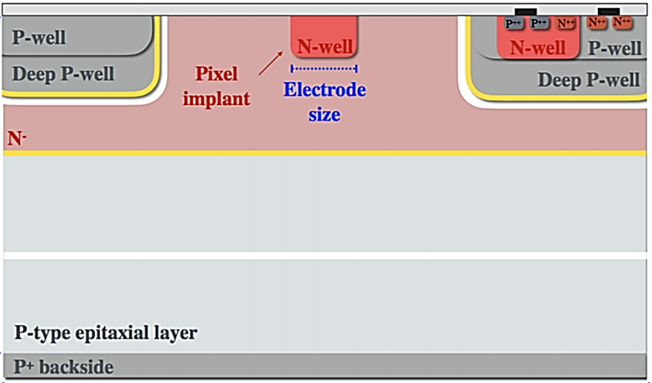
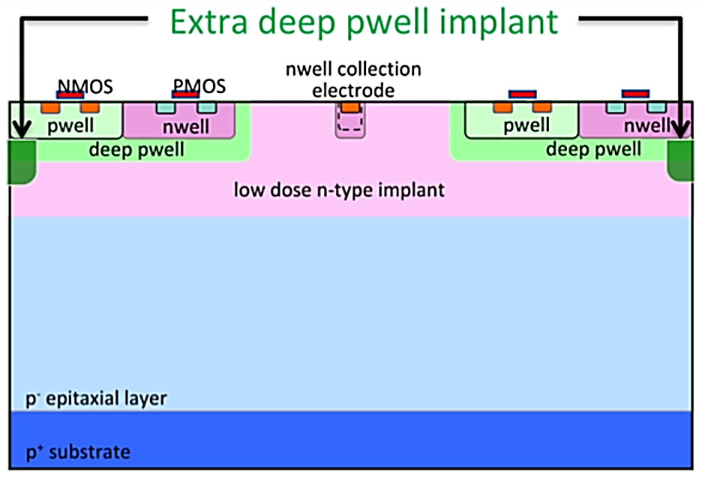
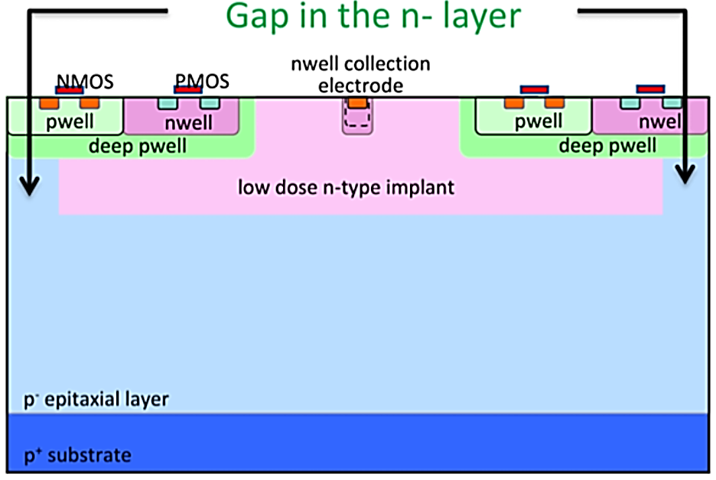
MIMOSIS – 1 : 1st full size sensor
MIMOSIS-1, 60µm thick
MIMOSIS-1, 60µm thick
W. Snoeys et al., DOI: 10.1016/j.nima.2017.07.046
H. Pernegger et al., https://doi.org/10.1016/j.nima.2018.07.043
M. Munkeret al., DOI: 10.1016/j.nima.2019.02.049
M. Dyndal et al.,10.1088/1748-0221/15/02/p02005
 | MIMOSIS-1 goal
Time precision | < 5 µs
Pixel | 1024 x 504
Pixel size | 27 x 30µm²
Pixel variants | 2 x AC – 2 x DC
Epi layers | 6 options (4 relevant)
HI tolerance | Hardened
3 x

Slide 16
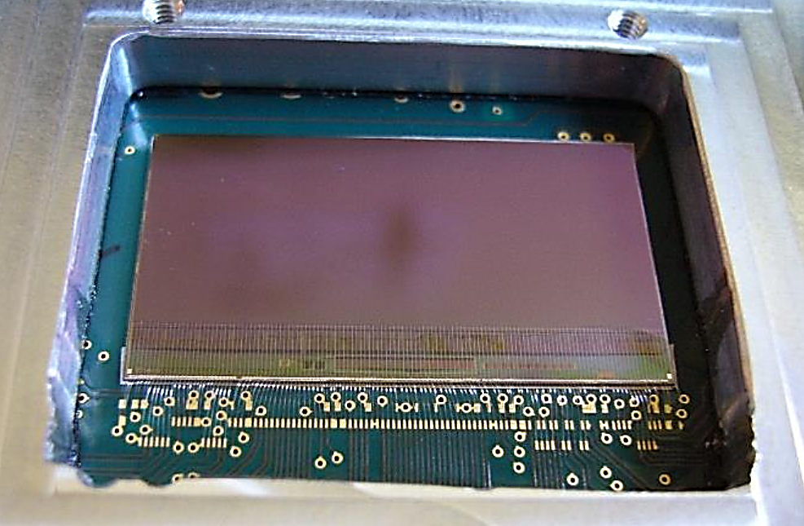
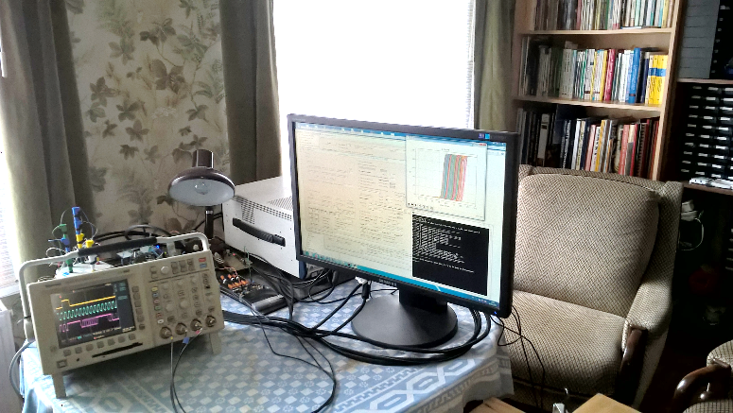
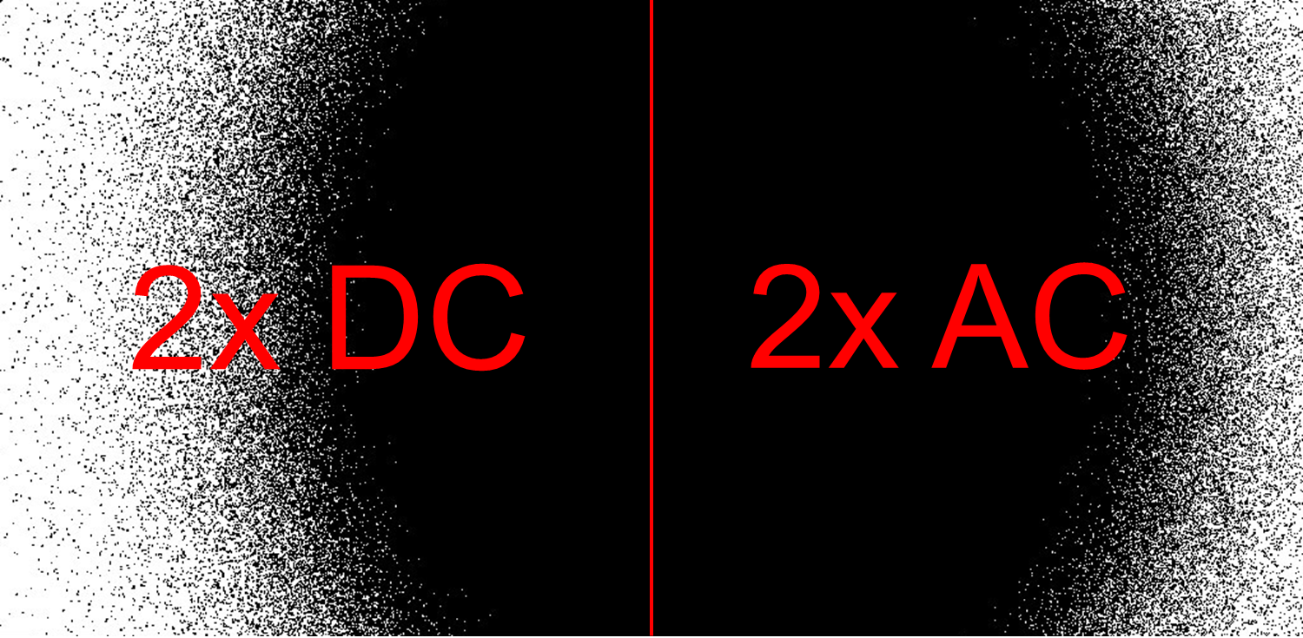
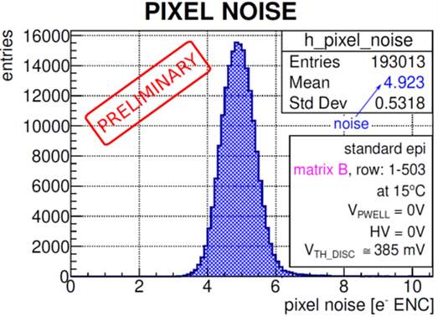
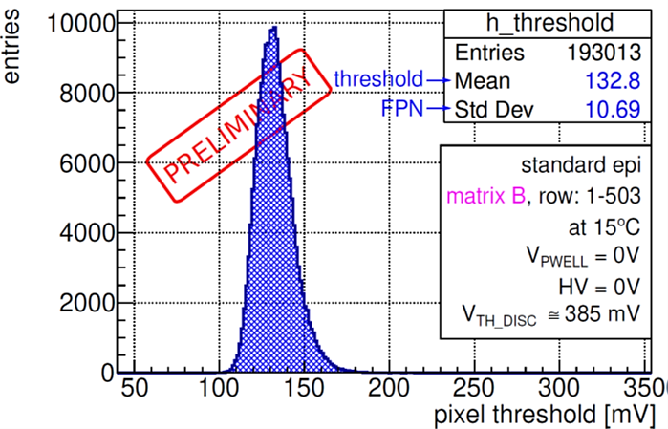
MIMOSIS – 1 : 1st full size sensor
MIMOSIS-1 test system
(Lockdown edition)
Response to ⁵⁵Fe
MIMOSIS-1, 60µm thick
Fixed Pattern Noise: 9 - 17 e ENC
Thermal noise: 3 - 5 e ENC
First results look promising – stay tuned.

Slide 17



Summary and conclusion
MIMOSIS is a CMOS MAPS
Highest spatial precision.
Low power (<<100 mW/cm²).
<5 µs time precision.
Advanced radiation tolerance.
20/80 MHz/cm² recorded rate (average/peak).
The MIMOSIS-1, first full size sensor is being tested
Confident to match design goals.
GSI joined R&D aiming for future trackers (CBM-MVD, FAIR upgrade).
MIMOSIS will be made available to interested partners.
J. Baudot, G. Bertolone, A. Besson, R. Bugiel, S. Bugiel, Z. El Bitar, G. Claus, C. Colledani, A. Dorokhov, G. Doziere, M. Goffe, A. Himmi, C. Hu, K. Jaaskelainen, F. Morel, H. Pham, M. Specht, I. Valin, M. Winter, Y. Zhao
B. Arnoldi-Meadows, B. Linnik, P. Klaus, M. Koziel, Q. Li, J. Michel, C. Müntz, Q.Yang, P. Sitzmann, J. Stroth
H. Darwish, M. Deveaux, C.J. Schmidt

Slide 18
Backup

Slide 19
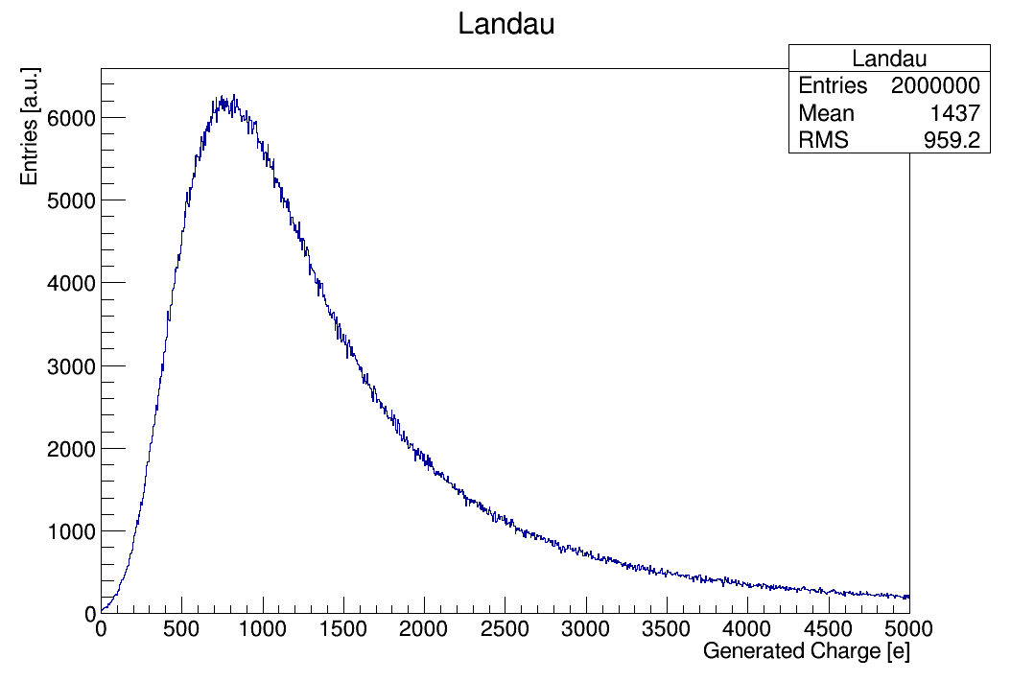
Signal estimate
Assumptions:
25µm expitaxial layer, minimum ionizing particle
Deep substrate does not contribute (pessimist)
Marginal charge sharing (fully depleted pixel)
Data : H. Bichsel, Rev. Mod. Phys.,Vol. 60 (1988), No. 3, P-663 699
MIMOSIS-0 threshold
Target:
Mean value: 1430e
FWHM: 1158e
Corresponding ROOT-Landau:
Landau (MPW,sigma) => Landau(850,293)
=> MPW=850

Slide 20
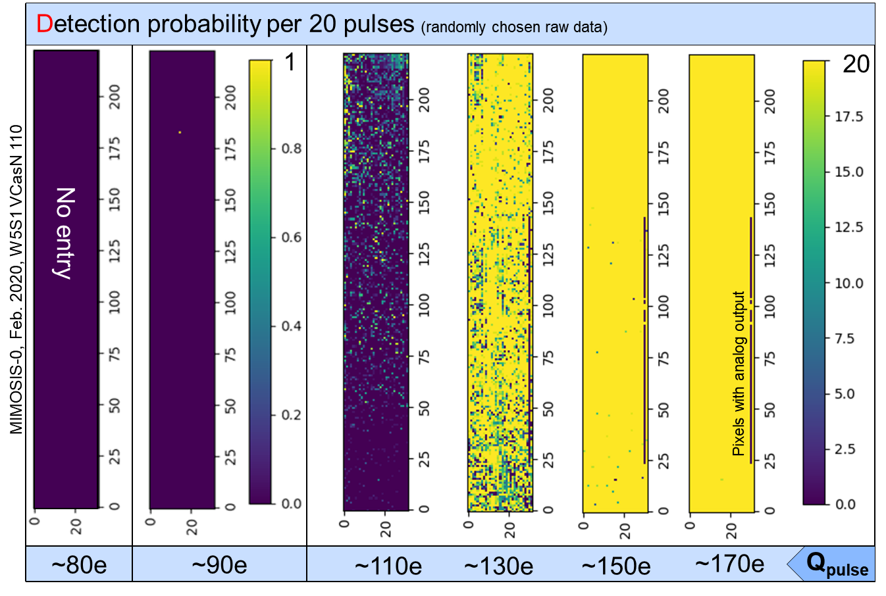
MIMOSIS-0 Threshold scan

Slide 21
Integration concept of the MVD
r_{out}
Beam
hole
CBM acceptance
Outside acceptance
Vacuum operation requires actively cooled device.
Use cooling support from diamond to move heat out of acceptance
Put heat sink and FEE outside acceptance

Slide 22
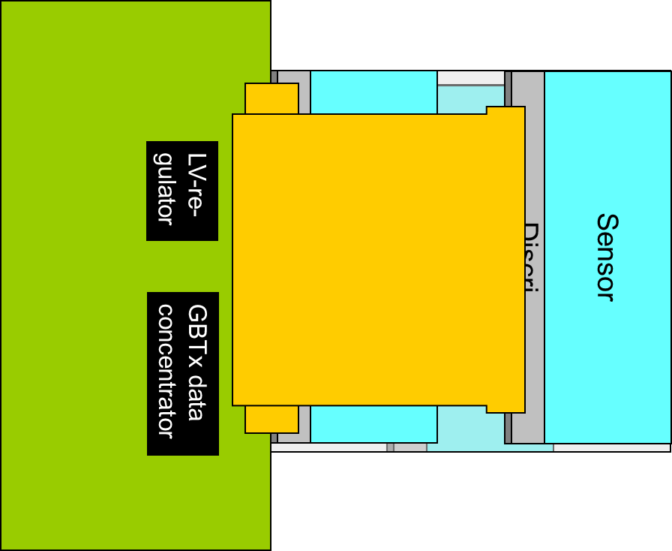
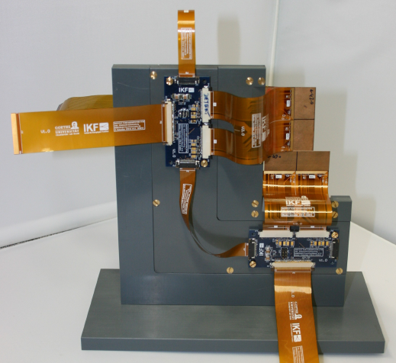
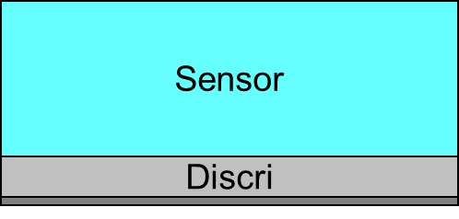
Integration concept of the MVD
Sensor
Discri
Sensor
Discri
MVD Prototype (mock up)
LV-re-
gulator
GBTx data
concentrator
M. Deveaux
22

