Slide 1
Reducing the impact of radioactivity on quantum circuits in a deep-underground facility
Francesco Valenti, Laura Cardani et al.
arXiv:2005.02286 (submitted to Nature Communications)
500 mt

Slide 2
Superconducting quantum circuits
• Supercurrent carriers: Cooper pairs (CP), e⁻ bound by phonons with binding energy Δ
e⁻ --- e⁻ + 2Δ = 2 QP (quasiparticles)

Slide 3
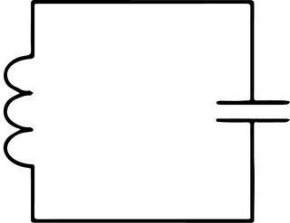
Superconducting quantum circuits
• Supercurrent carriers: Cooper pairs (CP), e⁻ bound by phonons with binding energy Δ
e⁻ --- e⁻ + 2Δ = 2 QP (quasiparticles)
• Simplest circuit: LC resonator
This work:
Inductive loss ≫ capacitive loss
C
L
R_{QP}

Slide 4
Superconducting quantum circuits
• Supercurrent carriers: Cooper pairs (CP), e⁻ bound by phonons with binding energy Δ
e⁻ --- e⁻ + 2Δ = 2 QP (quasiparticles)
• Simplest circuit: LC resonator
This work:
Inductive loss ≫ capacitive loss
C
L
Q_{i}⁻¹ = ω₀R_{QP}C
R_{QP}

Slide 5
Superconducting quantum circuits
• Supercurrent carriers: Cooper pairs (CP), e⁻ bound by phonons with binding energy Δ
e⁻ --- e⁻ + 2Δ = 2 QP (quasiparticles)
• Simplest circuit: LC resonator
This work:
Inductive loss ≫ capacitive loss
C
L
Q_{i}⁻¹ = ω₀R_{QP}C
R_{QP}
L≈L_{kinetic} (N_{QP})
⇒ ω₀⁻² = L(N_{QP})C

Slide 6
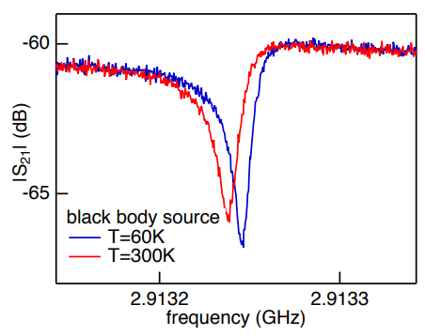
Quasiparticles in SC circuits
• Static effect: Q_{i} decreases (f₀ shifts)
Fingerprint: Q_{i}
Lévy-Bertrand et al., arXiv:2010.03845
Higher blackbody T: more broken CPs
⬄ more QPs

Slide 7
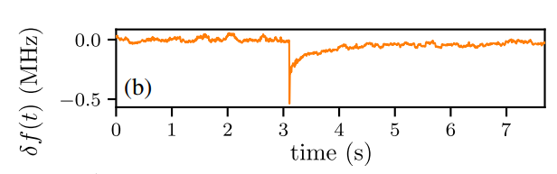
Quasiparticles in SC circuits
• Static effect: Q_{i} decreases (f₀ shifts)
Fingerprint: Q_{i}
Lévy-Bertrand et al., arXiv:2010.03845
Higher blackbody T: more broken CPs
⬄ more QPs
• Dynamic effect: f₀ jitters, or even drops
Fingerprints:
Drop count
(coarse)
Jitter spectrum
(fine)
Grünhaupt et al., PRL 121, 117001 (2018)

Slide 8
QPs: where from?
• T_{c}~1 K, T of operation ~10 mK ➔ NOT thermal!

Slide 9
QPs: where from?
• T_{c}~1 K, T of operation ~10 mK ➔ NOT thermal!
• Possible source:
radiation generating phonons in the substrate
substrate
hν ≫ 2Δ
C
L
«QP burst»

Slide 10
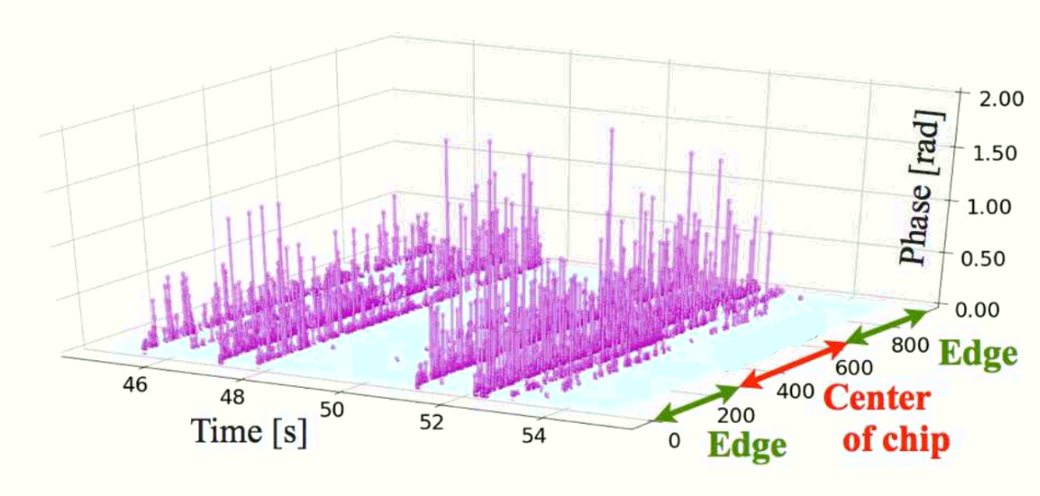
QPs: where from?
• T_{c}~1 K, T of operation ~10 mK ➔ NOT thermal!
• Possible source:
radiation generating phonons in the substrate
substrate
hν ≫ 2Δ
Adapted from:
Karatsu et al., APL 114,032601 (2019)
C
L
Resonator #
«QP burst»
• Implies time-correlated drops for same-chip resonators

Slide 11
QP abatement
substrate
hν ≫ 2Δ
C
L
«QP burst»

Slide 12
QP abatement
Reducing phonons:
-Karatsu et al., APL 114,032601 (2019)
-Valenti et al.,
PRApp 11,054087 (2019).
-Valenti, Henriques et al.,
APL 115,212601 (2019).
substrate
hν ≫ 2Δ
C
L
«QP burst»

Slide 13
QP abatement
Reducing phonons:
-Karatsu et al., APL 114,032601 (2019)
-Valenti et al.,
PRApp 11,054087 (2019).
-Valenti, Henriques et al.,
APL 115,212601 (2019).
substrate
hν ≫ 2Δ
C
L
«QP burst»
Reducing radiation:
This work!

Slide 14
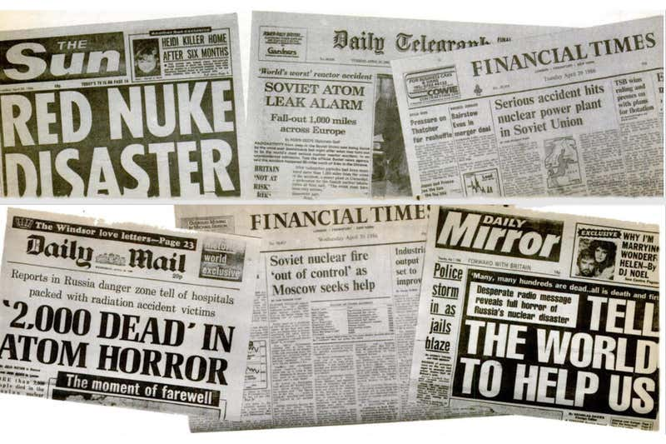
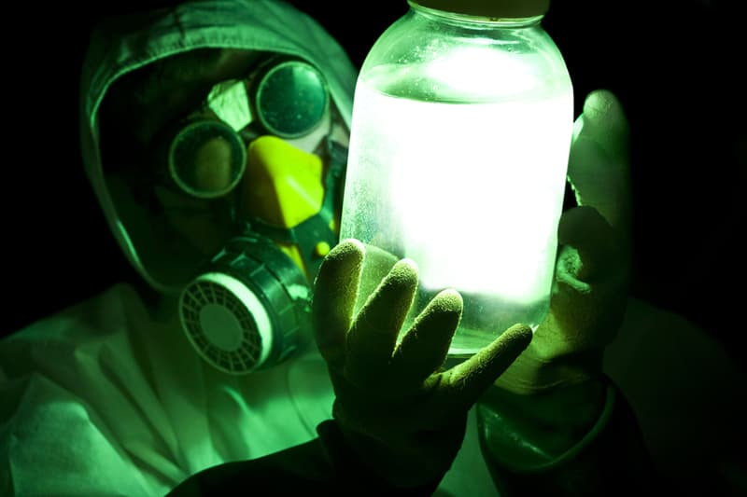
Radiation: where from?
• What I thought «radioactive contamination» looks like:

Slide 15
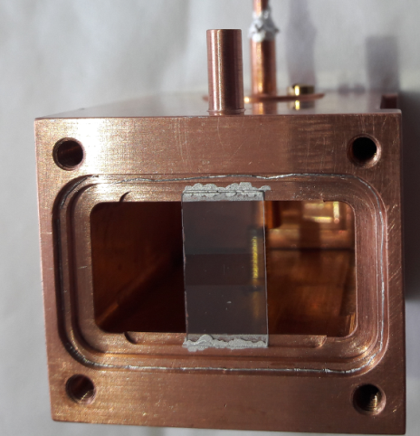
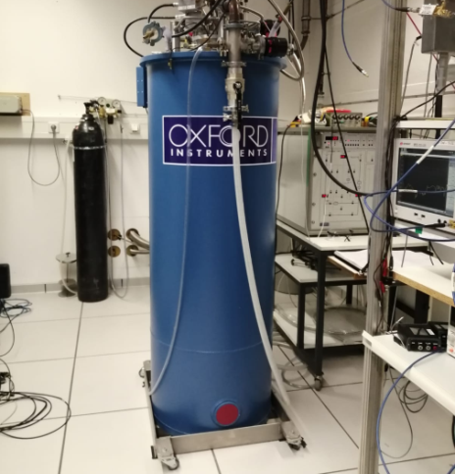
Radiation: where from?
• What I thought «radioactive contamination» looks like:
• What it also looks like:
Solder
Unshielded
cryostat
Unetched
copper
(In an above ground lab)
Silver paste
«Near sources»
«Far sources»

Slide 16
Radiation: where from?
• What I thought «radioactive contamination» looks like:
• What it also looks like:
Solder
Unshielded
cryostat
Unetched
copper
(In an above ground lab)
Silver paste
«Near sources»
«Far sources»

Slide 17
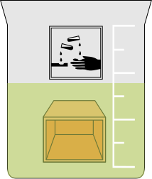
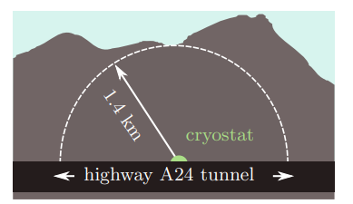
How to protect from…
Near sources:
Acid cleaning
Far sources:
Deep-undeground facility
Laboratori Nazionali del Gran Sasso, Italy

Slide 18

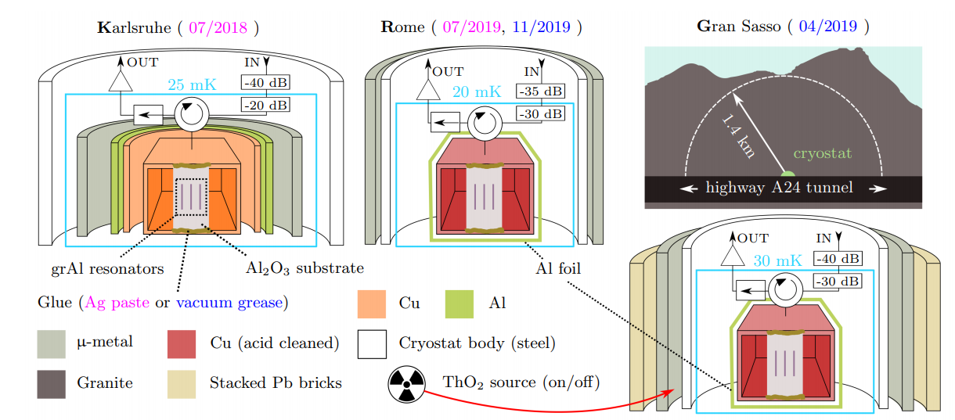
Radiation abatement: setups
Far sources
abatement

Slide 19
Radiation abatement: setups
Near sources
abatement
Far sources
abatement

Slide 20
Radiation abatement: setups
Near sources
abatement
Near and far sources
abatement

Slide 21
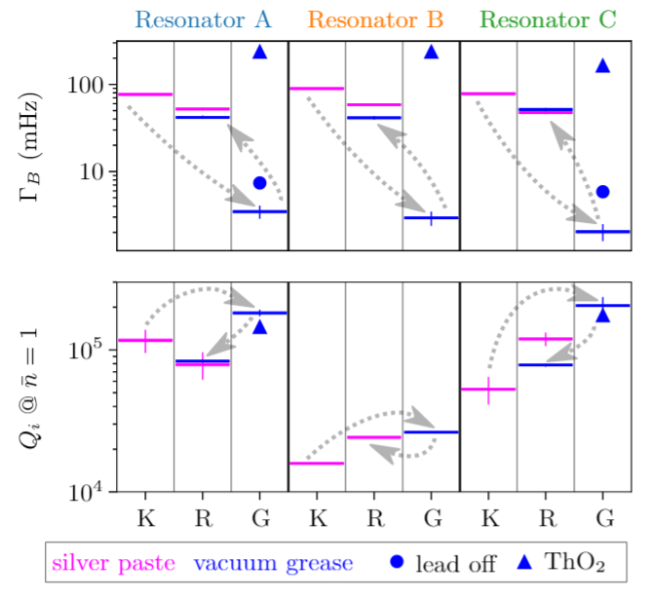

Radiation abatement: results
K : control
R : cleaned
G : cleaned and shielded
Arrows: chronology
QP burst rate (mHz)
Internal quality factor at single photon

Slide 22
Radiation abatement: results
K : control
R : cleaned
G : cleaned and shielded
Arrows: chronology
QP burst rate (mHz)
Internal quality factor at single photon

Slide 23
Radiation abatement: results
QP burst rate (mHz)
Internal quality factor at single photon

Slide 24
Summary
Superconducting circuits degraded by quasiparticles
Radioactivity is a source of quasiparticles
Radioactivity abatement improves the performance of superconducting circuits

Slide 25
Thank you for your attention!

