Slide 1


T. Dritschler, M. Caselle, L. Ardila, S. Chilingaryan,
A. Ebersoldt, J. Hurst, N. Karcher, A. Kopmann, O. Sander, T. Stockmann^{(*)}
(Commercial) DMA technologies to realize a flexible DAQ system for Tera-Scale experiments
Karlsruhe Institute of Technology (KIT)
^{(*)}Forschungszentrum Jülich
Notes:
<Foliennummer>

Slide 2
Challenges for modern DAQ Systems
Complex data paths and heterogeneous architectures
Readout
Event building
Processing
Storage
PCIe?
Ethernet?
Detector
Optical
Links?
InfiniBand?
ASICs?
FPGAs?
CPUs?
GPUs?
Advancements in Detector Technologies lead to highly complex DAQ systems
This complexity results in heterogeneous systems with many different components

Slide 3
Challenges for modern DAQ Systems
Complex data paths and heterogeneous architectures
Readout
Event building
Processing
Storage
Detector
Development and maintenance of complex DAQ systems is expensive and time consuming
Using commercially available standards and „off-the-shelves“ components might mitigate these efforts
Can we design scalable and maintainable DAQ using mostly commercial components?

Slide 4
Data transfer inside of conventional computing systems
CPU involvement in data movement
Kernel Space
Application Space
System Bus
Buffer

Slide 5
Data transfer inside of conventional computing systems
CPU involvement in data movement
Data arrives and is placed in device buffer
Kernel Space
Application Space
CPU Fetches data from buffer
Place
System Bus
Place
Place
Place
Fetch
CPU Places data into Driver memory
Fetch
Fetch
Fetch
Buffer
Data
Data
CPU Fetches data from Driver
Repeat for each Data!
CPU Places data into application space

Slide 6
Direct Memory Access (DMA) enabled data transfer
Freeing up CPU and reducing copy efforts
CPU „reserves“ memory in application space (Pinning)
Kernel Space
Application Space
CPU configures the device’s DMA engine, effectively „Mapping“ the pinned memory to the device
System Bus
Pin
Map
Data
To Network
DMA
Engine
Configure
Data arrives and is placed right into destination memory
Enables microsecond latencies
at full interconnect bandwidth!

Slide 7
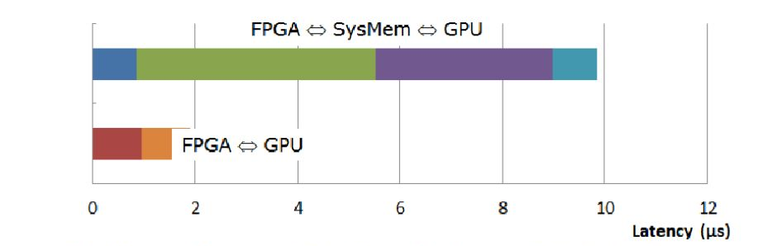
RDMA enabled GPGPU computing
Efficient use of GPUs for On-Line and In-Line data processing
DMA is possible for GPU memory as well
Analogous to main memory DMA
Pin → Map → Place
Significantly reduces latency!
System Bus
IO Device
DMA
Engine
Data
IO

Slide 8
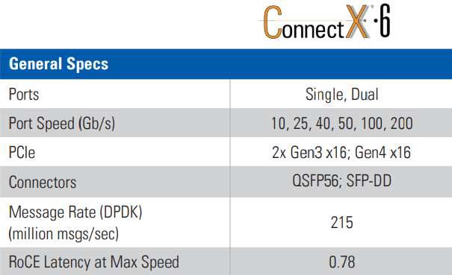
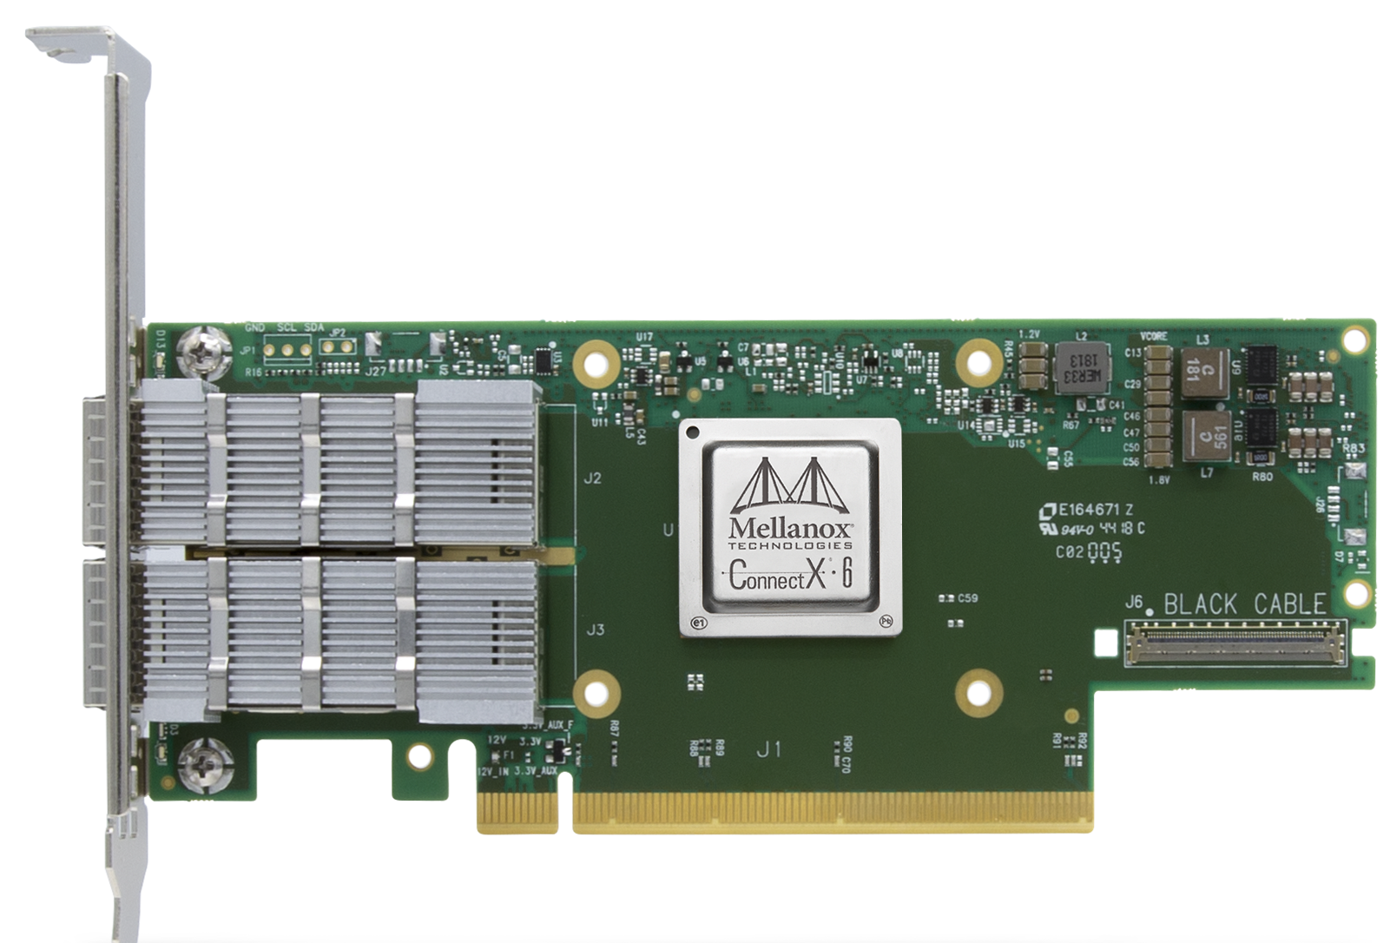
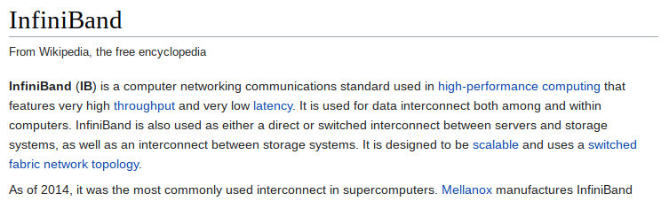
InfiniBand, the ‚de facto‘ standard for RDMA
Commercial High-Speed, Low-Latency data transfer
Support both: InfiniBand AND Ethernet!
© Mellanox
[...]

Slide 9
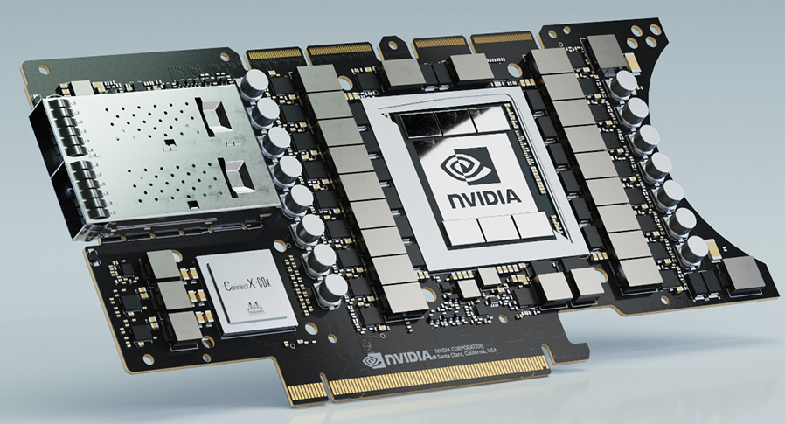
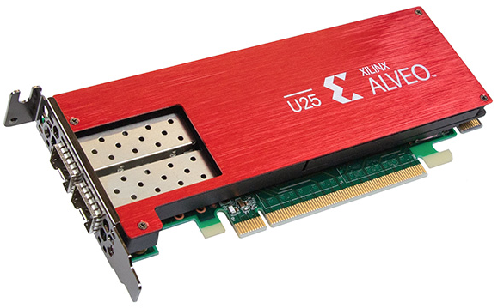
Next generation RDMA capable computing accelerators
Closing the gap between networking and computing
Nvidia EGX A100:
Ampere GPGPU,
200Gbps Network,
Ethernet + InfiniBand
Commercially available components
Software Programmable
Low development effort
Easy to upgrade to newer generations, once they become available
(R)DMA Capable
Optimized for Machine Learning and AI applications!
© Nvidia
Xilinx ALVEO SmartNIC:
Up to 1.1M LUTs
Up to 100Gbps Ethernet
© Xilinx

Slide 10
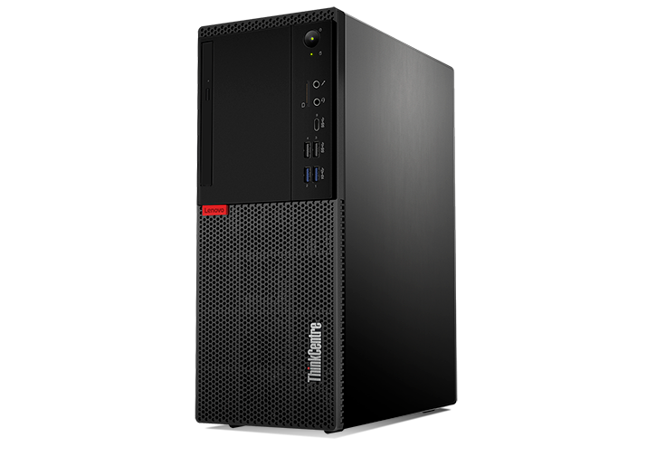
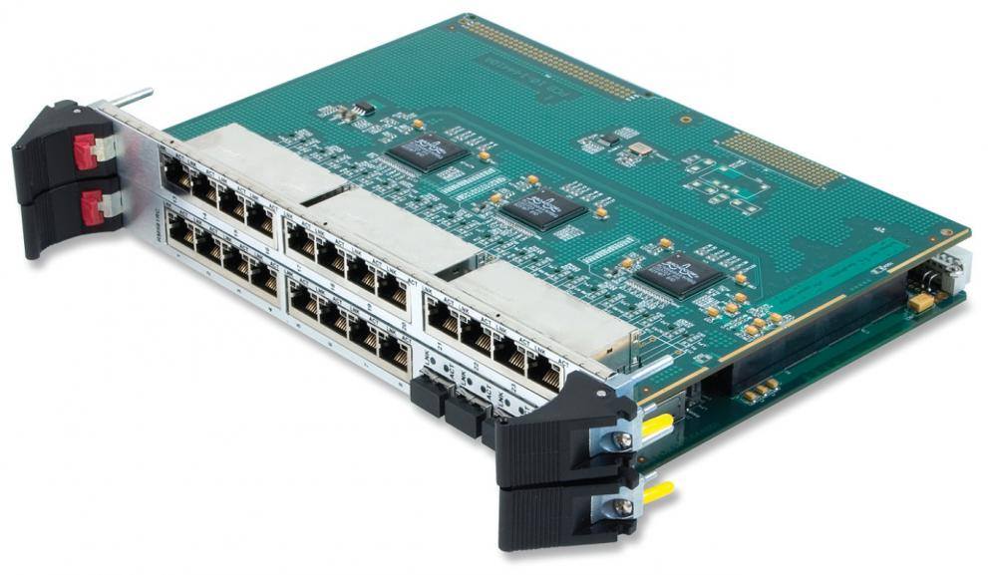
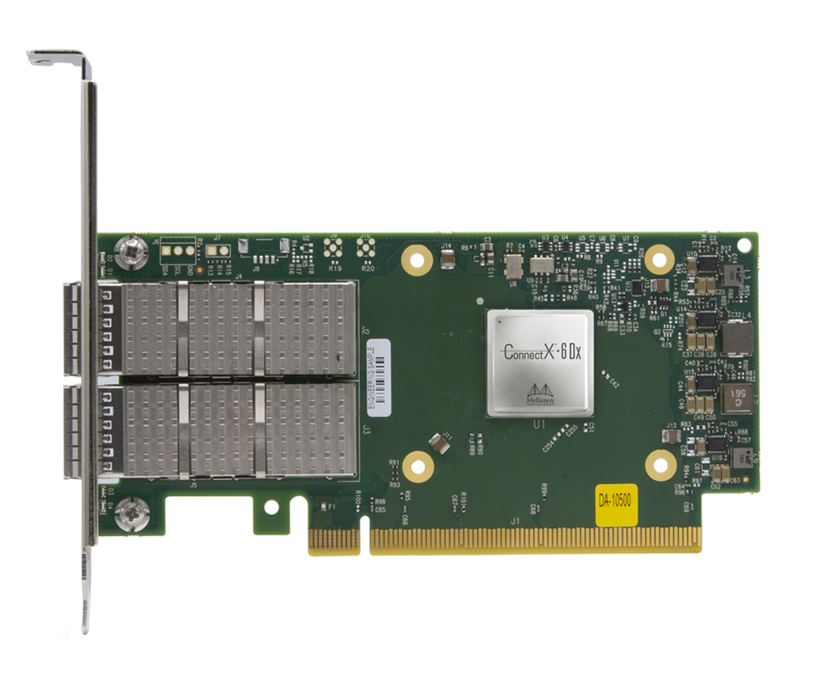
Communication between heterogeneous components
One protocol for all the most common components?
Ethernet is one of the most common commercially available interconnects
Network Infrastructure
PC / CPU
GPU
FPGA
Ethernet ✓
Ethernet ✓
Ethernet ✓
Ethernet ✓
Is there a way to benefit from RDMA using Ethernet?

Slide 11
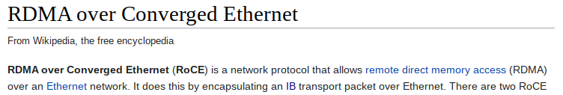
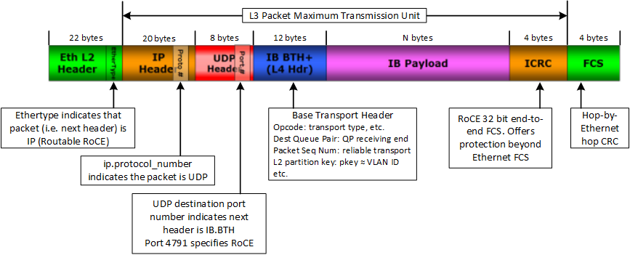
RoCE (RDMA over Converged Ethernet)
Enabling RDMA benefits for conventional Ethernet networks
RoCE uses UDP packets and encapsulates InfiniBand “instructions” into the UDP payload
Soft- and Hardware implementations available!

Slide 12

KIRO: KIT RDMA Programming Library
Integrating RMDA capabilities into software
Works for both: InfiniBand and RoCE!
© Mellanox
KIRO Server/Client:
Unidirectional data transfer from Server to Client (Clients “Pull” from Server)
Fixed-Size memory segment
Supports multiple connected clients per server
KIRO Messenger (Beta):
Layers bi-directional point-to-point messaging on top of KIRO
Messengers can connect to multiple peers
Fully RDMA enabled arbitrary sized memory exchange (“Push” and “Pull”)
Clone it on Github!
https://github.com/ufo-kit/kiro

Slide 13
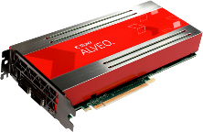

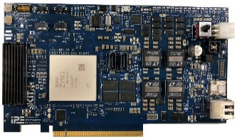
Novel DAQ architecture using commercial HPC Components
High-performance distributed ML for physics experiments
Versatile DAQ optimized for detector and AI applications
High-performance ML inference on modern programmable hardware platforms
Novel heterogeneous FPGA/GPU architecture based on emerging Ethernet protocols
On-line data path (by commercial devices)
Detectors
Modular readout
FPGA
AI
ETH
HPC
…
Ethernet fabrics
(hundreds Gb/s)
GPUs
FPGA
AI
Ethernet
Alveo
…
ETH
AI
AI
…
FPGA
AI
AI
…
ETH
HighFlex
Fast Feedback

Slide 14
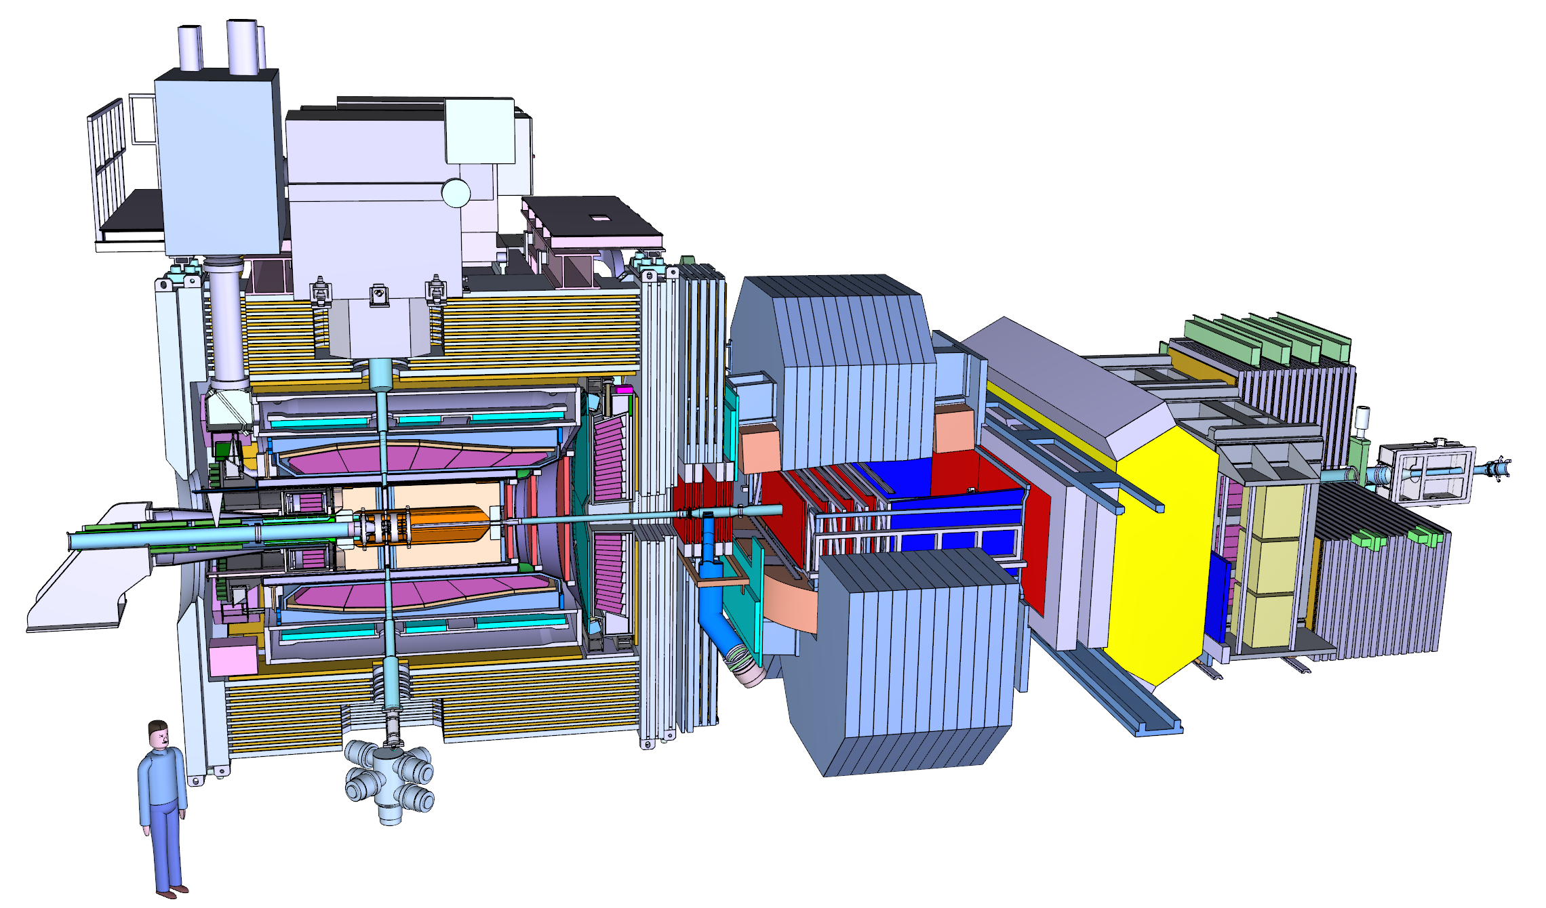

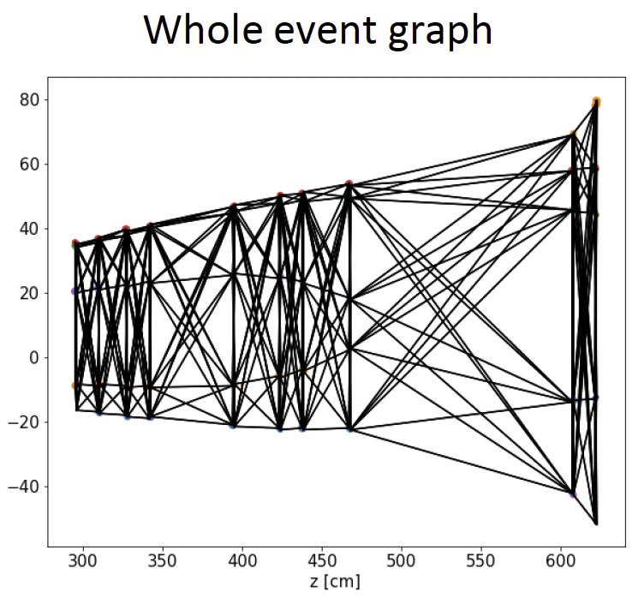
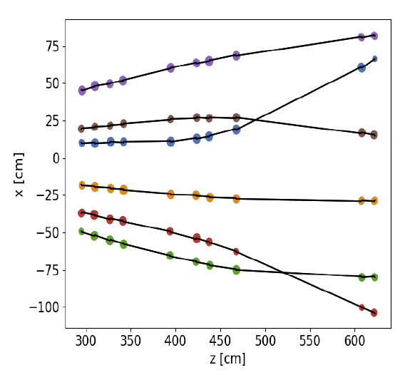
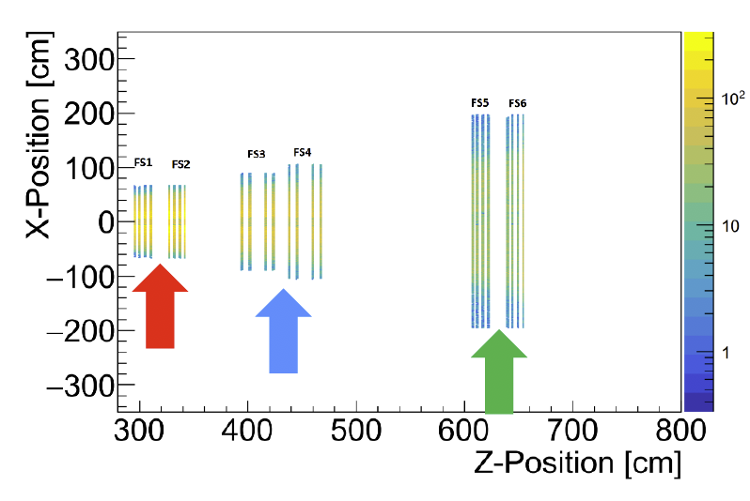
Machine Learning Application Example
PANDA Tracking and Event Selector
Graph Neural Network
Connection of all hits from one layer with all hits in next layer
Forward Tracking Stations
1 & 2, 3 & 4, 5
3&4 inside 2 Tm dipole field
Most probable connections survive
6 charged tracks
In Total:
Track finding efficiency 96%
Waleed Esmail

Slide 15
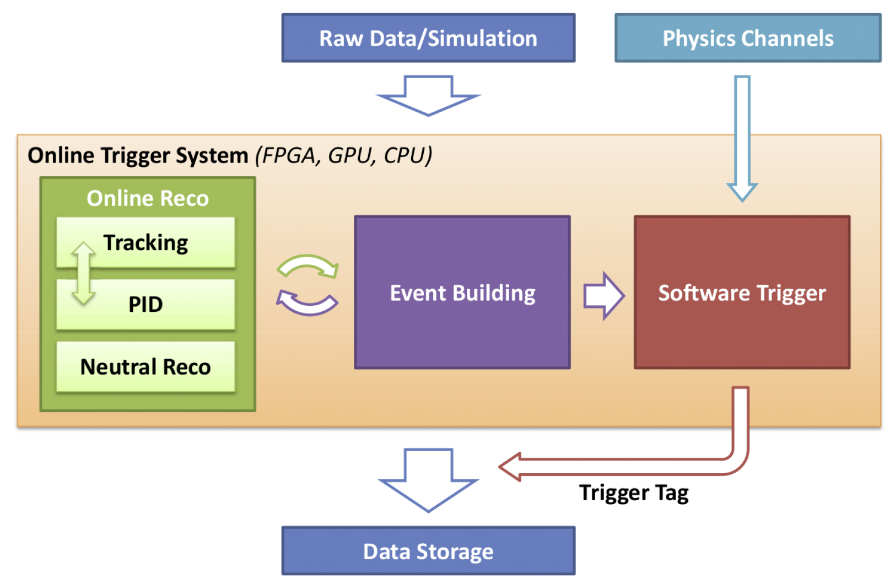
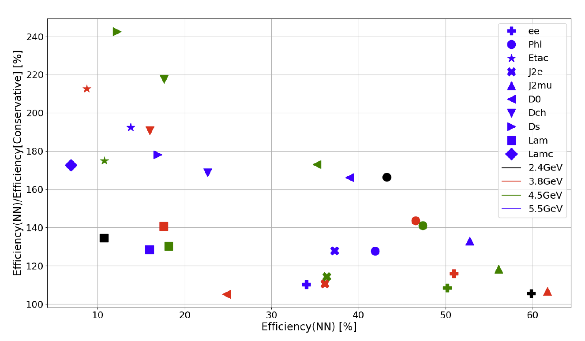
Machine Learning Application Example
PANDA Tracking and Event Selector
PANDA online event selector
Efficiency improvement for different physics channels
CNN vs. Classical method
Best network: CNN
Software trigger selects physical interesting channels from background for data storage
100%
Heterogeneous system
Unifiable communication
Proposed for PANDA DAQ
All data points above 100% efficiency vs. conventional approach → Indicates Neural Network performs better accross all metrics
Peiyong Jiang

Slide 16
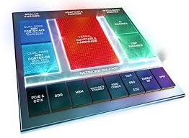
Heterogeneous FPGA – GPU architecture for beam physics
High-performance distributed ML for physics experiments
Versatile DAQ optimized for detector and AI applications
High-performance ML inference on modern programmable hardware platforms
Novel heterogeneous FPGA/GPU architecture based on emerging Ethernet protocols
Detectors
On-line data path (by commercial devices)
Beam diagnostics
Modular readout
KAPTURE
FPGA
AI
ETH
…
HPC
Ethernet
GPUs
FPGA
AI
ETH
Alveo
Synchrotron
Accelerator
…
Ethernet fabrics
(hundreds Gb/s)
…
AI
AI
FPGA
AI
ETH
AI
…
HighFlex
KALYPSO
Fast Feedback

Slide 17
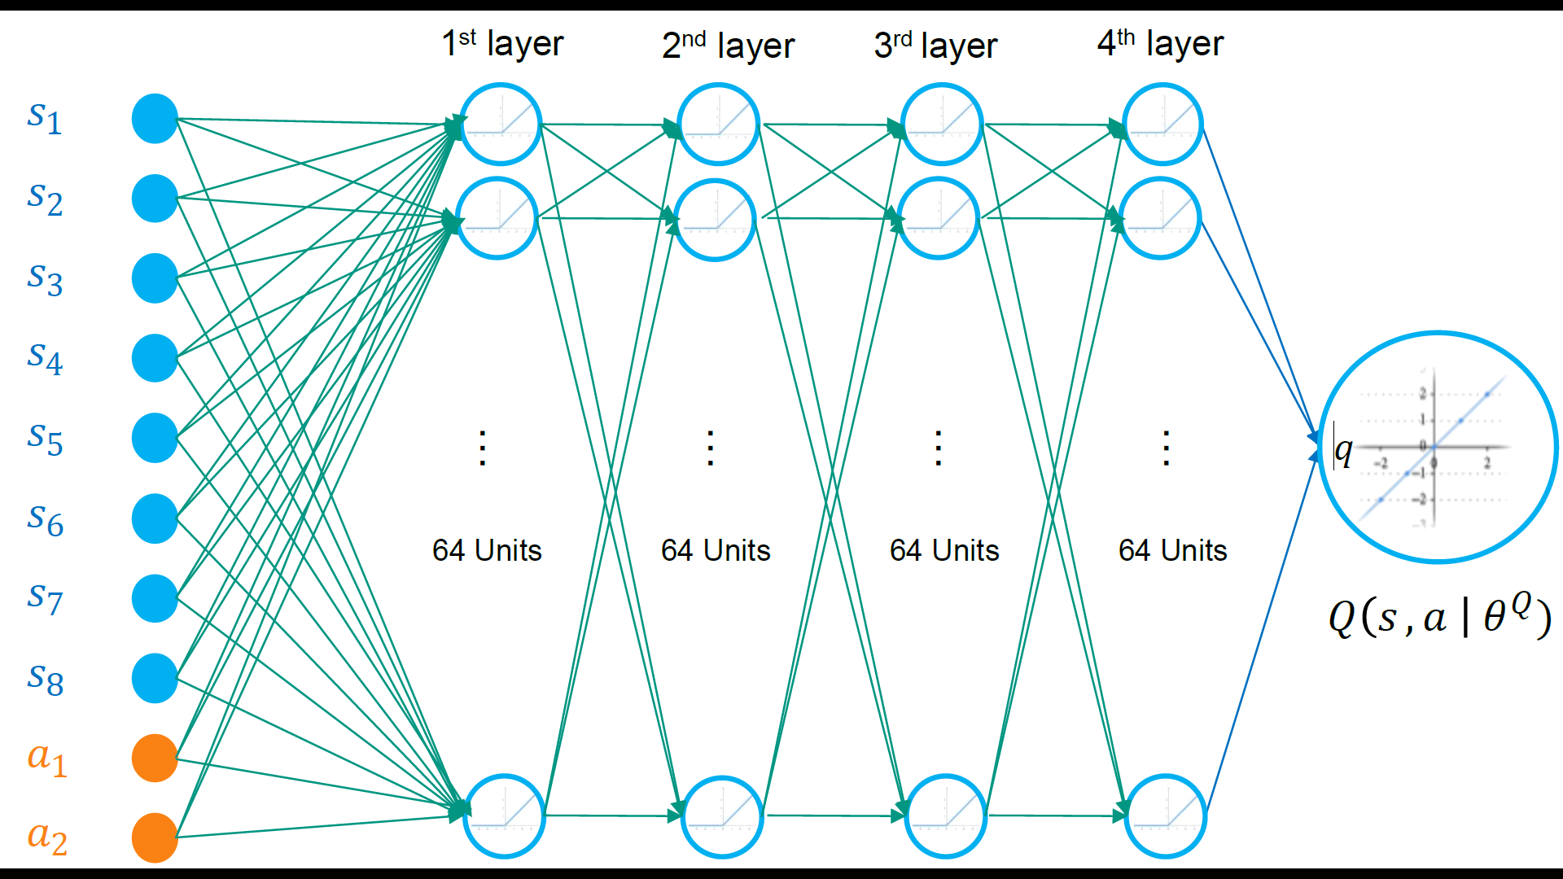
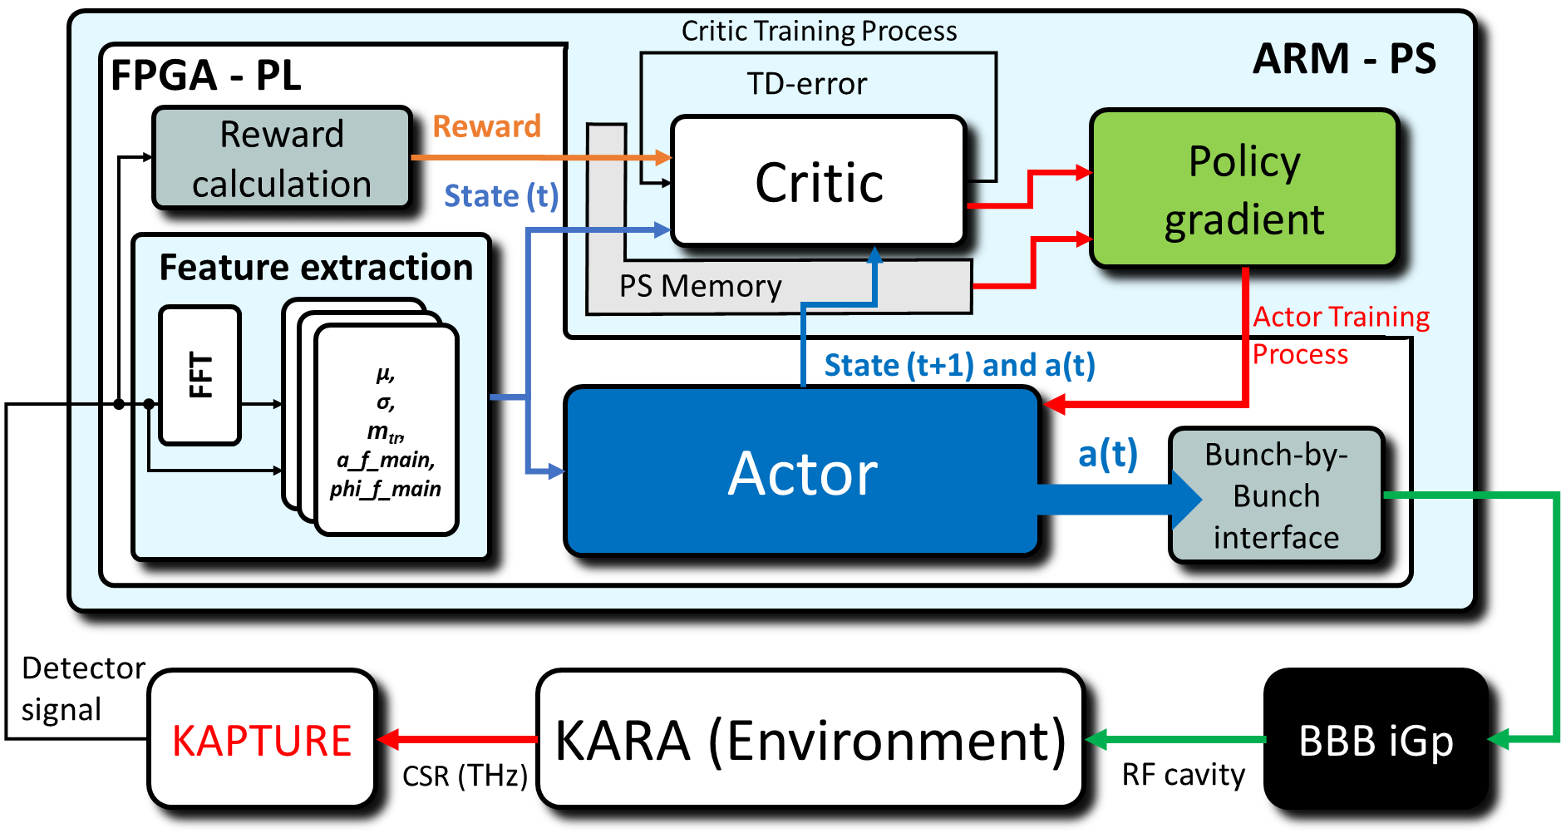
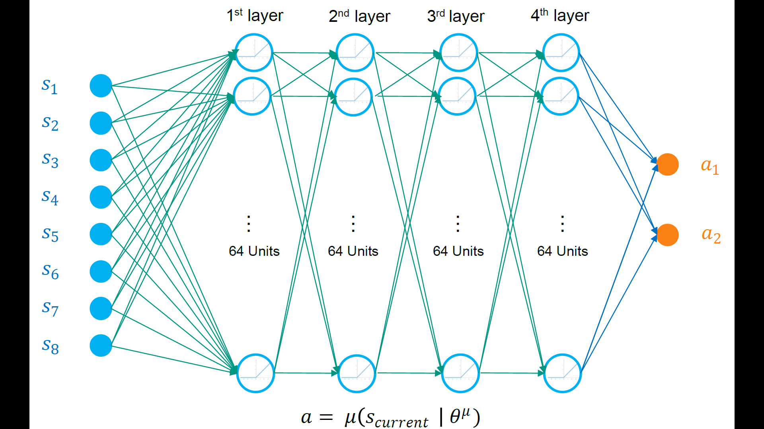
As seen in: „Accelerated Deep Reinforcement Learning for Fast Feedback of Beam Dynamics at KARA“ A. Ebersoldt
Hardware implementation
Reinforcement Learning on modern programable device
Deep Deterministic Policy Gradient (DDPG)
Critic
Critic neural network and the policy gradient are implemented as bare-metal application on ARM processor
Actor
Actor consists of four fully-connected dense layers, each layer consists of 64 neurons using a rectified linear unit (ReLU) as activation function in FPGA

Slide 18
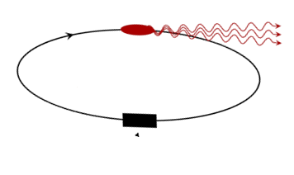
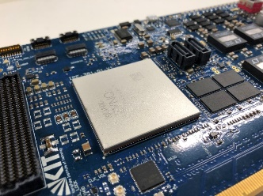
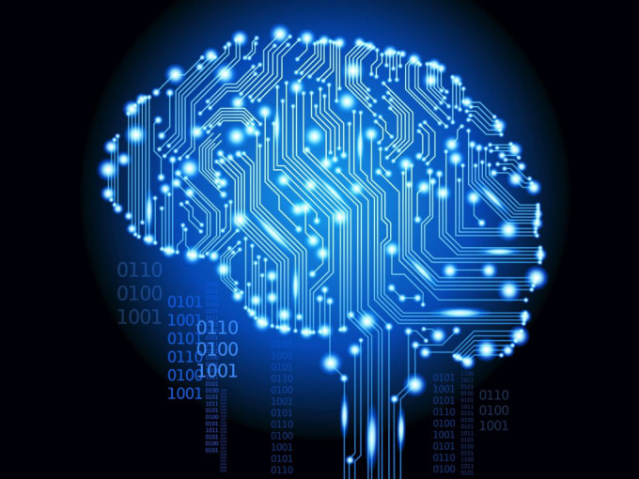
Control of the complex beam with ML
A. Ebersoldt
Machine Learning toward Autonomous Accelerators
THz detector
Closed feedback loop at KARA:
    Detection of signals with THz detectors and KAPTURE @ 500 MPulse/s
    Data processed by Reinforcement Learning on FPGA
    FPGA action as special RF signal modulation is sent to the kicker cavity
  Goal: total latency of control feedback loop << 1 ms
Target applications: KARA, FLUTE, ARES and more
Status: first beam control on FPGA developed within AMALEA → will continue in ACCLAIM (Helmholtz Innovation fund)
KAPTURE
RF System
Ethernet
Feedback
action
HighFlex card
AI deployed in the FPGA
MicroTCA

Slide 19
Application: RoCE in FPGA for the ECHo experiment
ECHo Experiment to measure the Neutrino mass
|a|
RF
Conversion
Digital
Storage / Backend
Up-conversion
4 … 8 GHz
Baseband frequency
comb generation
$f_{1}$
…
$f$
2
1
$f_{2}$
$f_{9}$
DAC
FPGA
Server
3
~
ADC
|a|
Down-conversion
±400 MHz
Digitization &
signal processing
4
5
$f_{1}$
…
$f$
$f_{2}$
$f_{9}$
Jonas Hurst, Nick Karcher, Oliver Sander

Slide 20
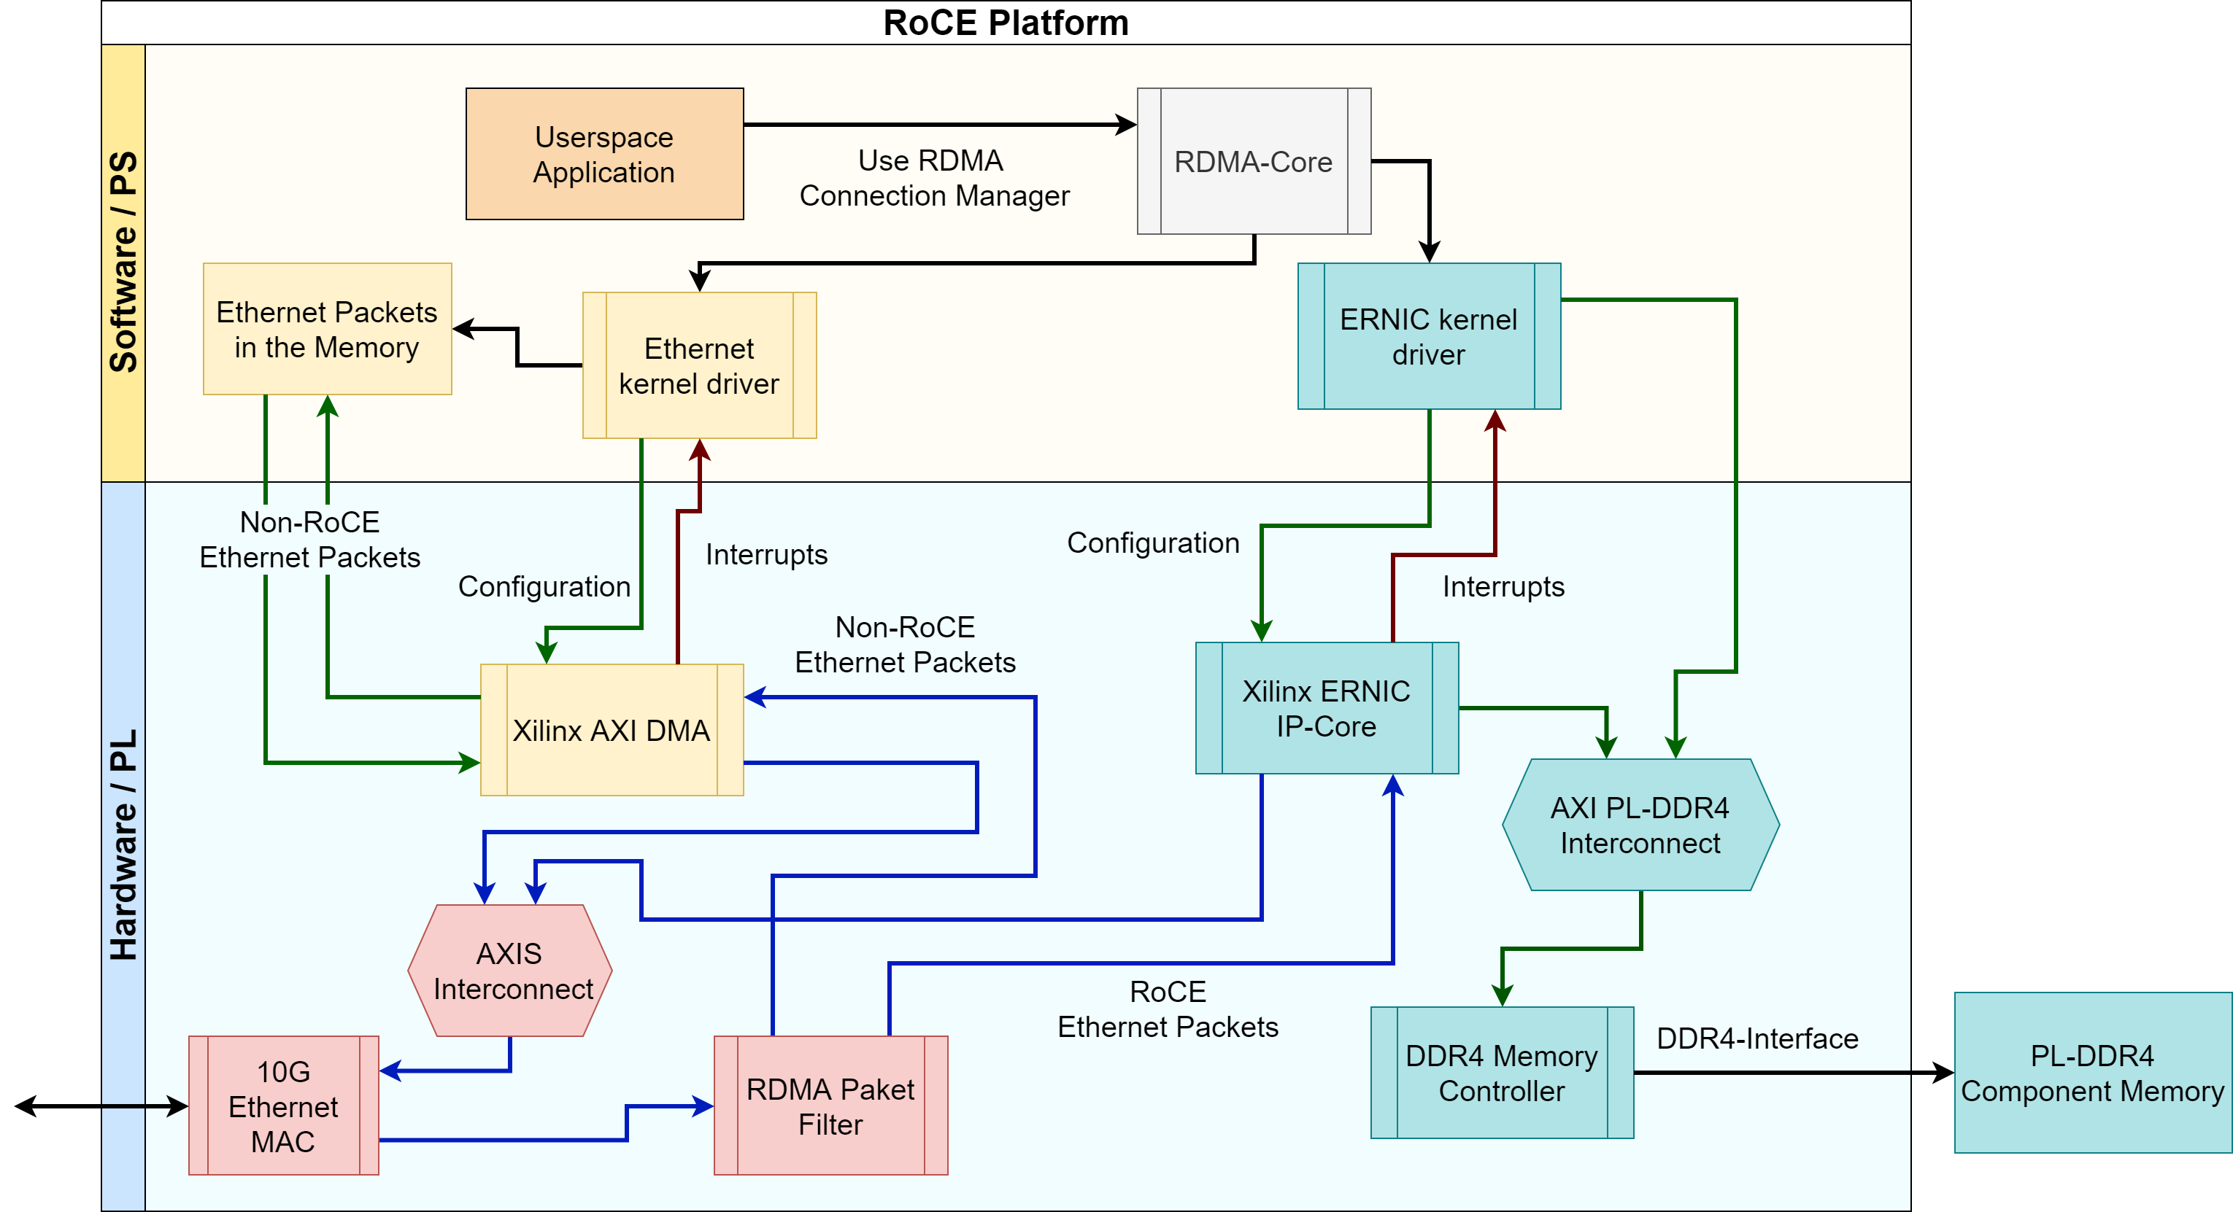
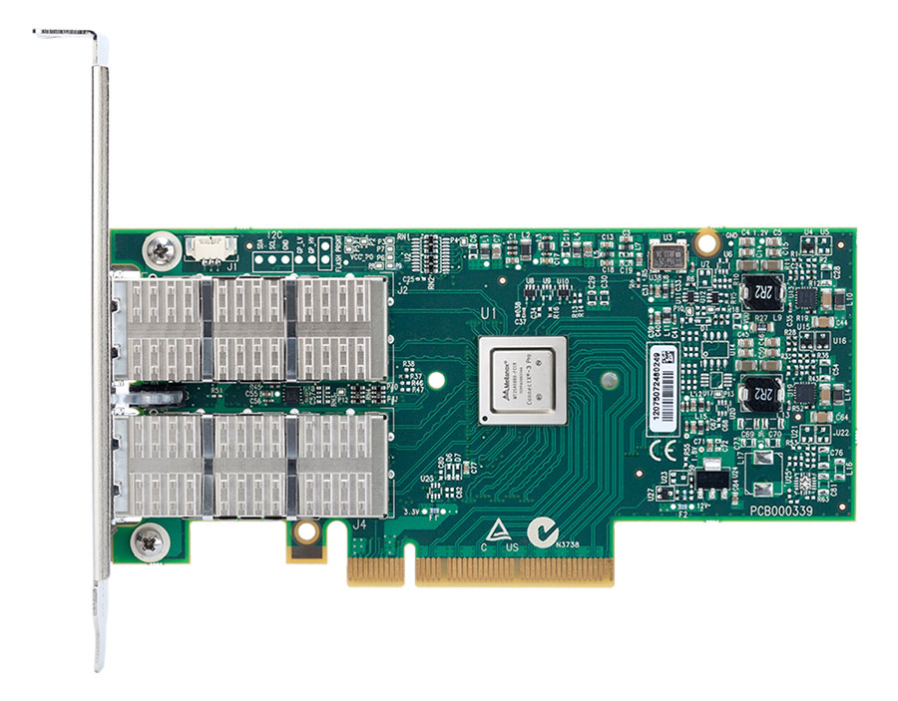
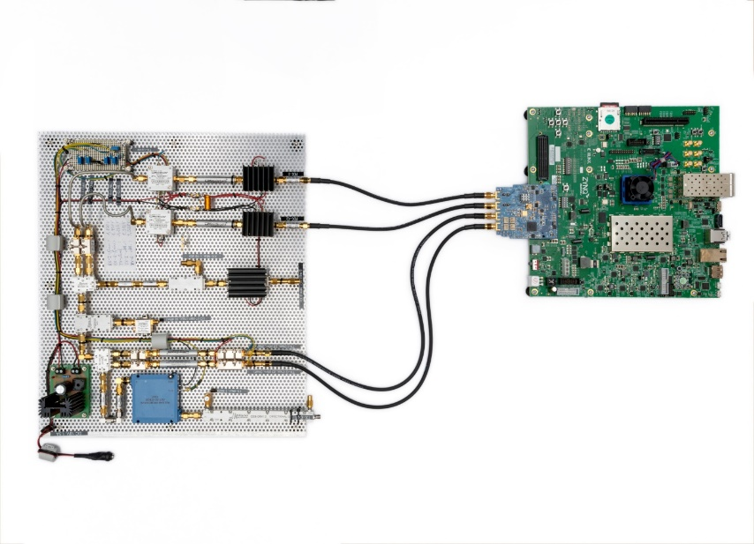
Application: RoCE in FPGA for the ECHo experiment
Xilinx ERNIC IP Core implementation and integration
KIRO
RoCE
Xilinx Zynq US+
(64bit ARM + FPGA)
Development Board
Master Thesis: „Entwicklung eines breitbandigen Datentransfers (DMA) für die Messdatenakquise“ (Jonas Hurst, Nick Karcher, Oliver Sander)

Slide 21
Conclusion
Application of industrial RDMA standards for modern DAQ
Drawbacks:
Integration into existing infrastructure requires (complex) retooling
Difficult to deploy and operate from within virtualized software environments
Full performance can only be reached when using dedicated networking hardware
Benefits:
Computing Accelerator integration → Full support for HPC and on-line processing
Readily available Hard- and Software → Drastically reduces development efforts
Single, commercial components → Easy maintenance and easy upgrades to newer versions
Highly versatile → Unify communication between all components: CPU, GPU, FPGA

