Slide 1
Compare and new files by Tony: e-laser JETI40
Beate, 24.11.2020

Slide 2
Introduction
Comparing new files called “e_laser_provisional_more_accurate_HICS” to old files called “elaser”.
Files taken from directory /nfs/dust/luxe/group/MCProduction/Signal/uncompressed/IPstrong_V1.1.00/JETI40/
Analyses based on stdhep files
definition of output changed somehow between the two and so am not 100% this is an apples to apples comparison

Slide 3
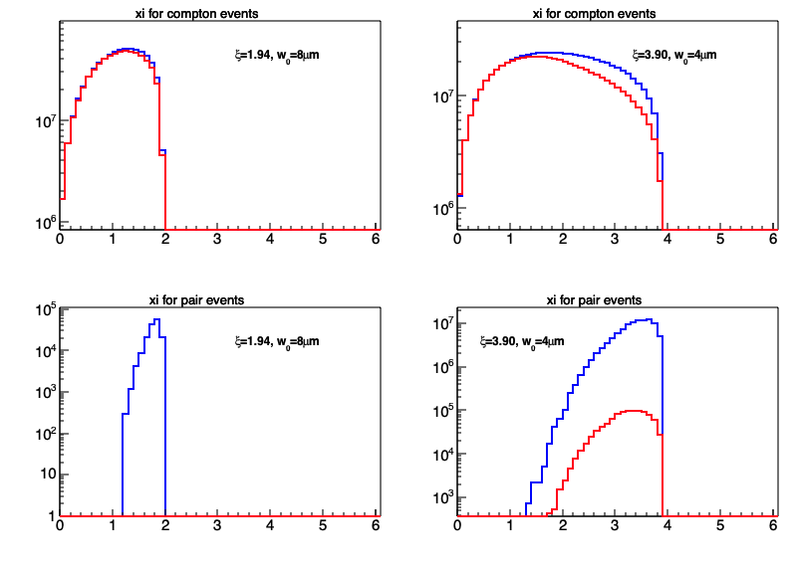
Xi distributions
Blue: new
Red: old

Slide 4
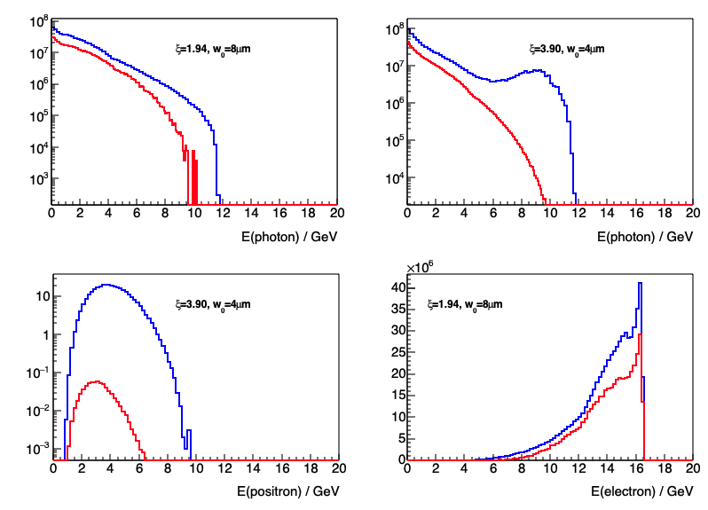
Energy distributions
New peak here!?
Blue: new
Red: old

Slide 5
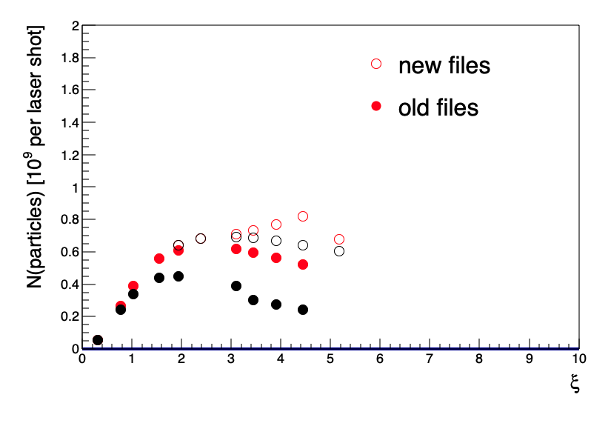
Number of photons and electrons
A bit weird

Slide 6
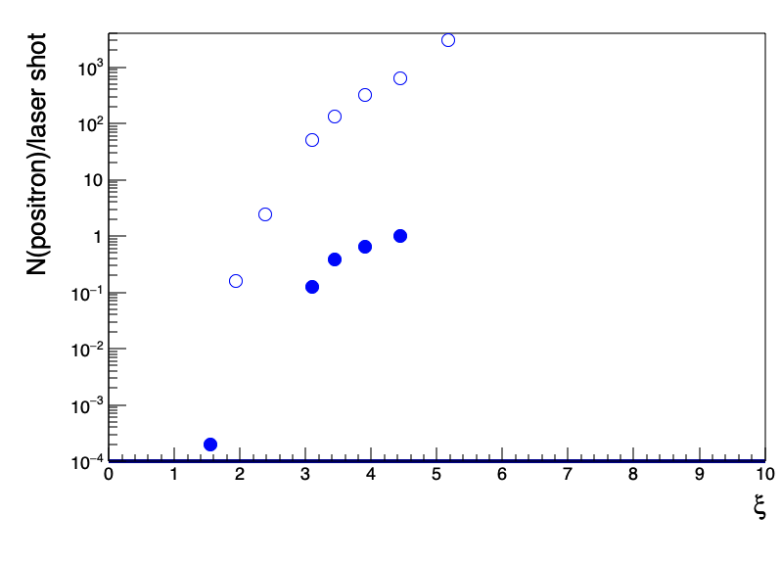
Number of positrons
Factor 1000 larger!!!

