Slide 1
Readout of ECAL
Wolfgang Lohmann

Slide 2
Readout of ECAL
In the last LUXE meeting the proposal was made to move the backend electronics to the surface hall
The cable length from the surface hall to the experiment is estimated to about 60 m
Surface hall
~60 m
experiment

Slide 3
Readout of ECAL
What we would like to put in the ??
Surface hall
DAQ computer
LV power
HV power
Slow control

Slide 4
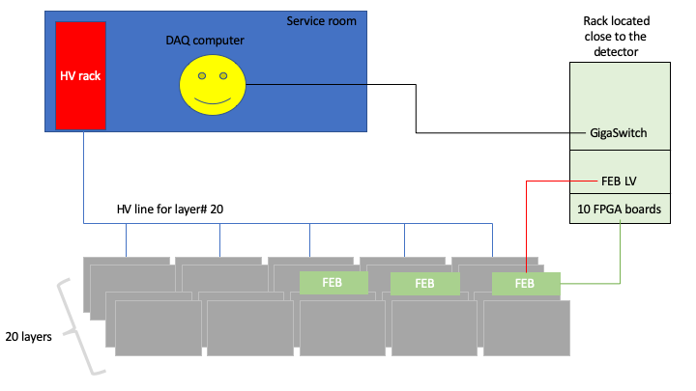
Readout of ECAL
Ethernet connection to the DAQ computer
60 m ??
Proposal made by Yan
In a crate near the detector (5m?)
On top of the ECAL frame

Slide 5
Readout of ECAL
HV (and LV) cables for the FEBs
60 m
In a crate near the detector (5m?)
On top of the ECAL frame

Slide 6
Readout of ECAL
What are the implications:
Ethernet ?
Power cables ???
Others ?

