Slide 1
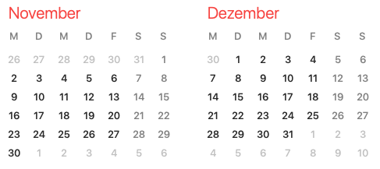
ARES Operation Meeting
Restart: 7.1.2021
Summary of week 48
Frank Mayet, on behalf of the ARES shift crew
Shutdown (Monday = Maintenance day)
ACHIP beam time
Beam Commissioning (Linac section + EA1)

Slide 2
Summary
Week 48
 | Monday 23rd November | Tuesday 24th November | Wednesday 25th November | Thursday 26th November | Friday 27th November
Achievements | Update of the PDE tool (can now record reference spectrum) Successfully tested 2/3 DOOCS servers for the 2µm laser table setup | FS-LA measured laser power in the tunnel after re-alignment of the PHAROS beamline Dark charge measurement during clean gun ramp-up to 75 MV/m Found working point for laser spot alignment | Took emittance data for 5pC at 3.46 MeV/c Cross-check FC1 and DaMon charge readings → Same values Systematic laser spot alignment w/o magnets → Found a setting where the beam does not move with phase / solenoid strength The vacuum in EA1 reached safe levels | MSK shift → Gun OVC and feedback tests Collimator studies SOG1 alignment data taken | OVC update by MSK QE measurements at 75 MV/m Transmission up to LI.R3 with TWS1 powered (first time after EA1 work)
Difficulties |  |  | Two power drops in the gun over night The LI.X1 screen is again quite dirty (small spots) SOG1 could not be cycled without adjusting limits (would not reach min/max) DOOCS camera server problems (.bmp saving) | A lot of small scratches visible on the SL.S1 screen | LI.X1 camera server frozen
Notes |  | The object on LI.X1 still at the same position and with the same orientation | The object on LI.X1 moved and rotated twice MDI (Artem) thinks the object on LI.X1 might be a statically charged piece of debris |  | The new (LLRF-defined) maximum gradient in the gun is now 90 MV/m

Slide 3
Tools
23.11.2020
Thorlabs equipment on the EA1 laser table almost fully integrated into DOOCS (piezo mirror mounts will be tested today)
DOOCS addresses ready!
…we need an EA1 laser table cockpit…
PDE tool can now take reference spectra → Useful for the ACHIP experiments

Slide 4
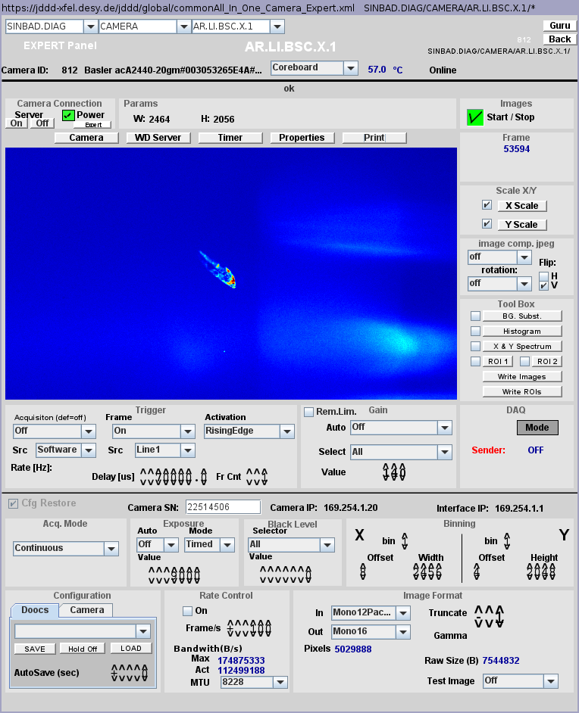

Damage (?) on X1
MDI investigating – no risk for ARES
Unknown Moving Object

Slide 5
Cathode Laser Spot Alignment
25.11.2020
Beam on LI.X1 without using magnets (in the beginning we had to use CVG1)
Iteratively aligned the laser spot using the FS-LA auto-alignment tool and recording the beam centroid vs gun phase
We found a setting where the beam at 65 MV/m does not move significantly with the phase on LI.X1 at phases around 80 deg (low momentum!). But: here the steerers need to be used (→ Earth magnetic field?).
We then tried to use the solenoid at a gun phase of 155deg (max momentum gain). We where able to focus the beam on both X1 and R1 without using steerers. The beam did not move significantly when changing the solenoid strength. The beam also did not move significantly when changing the phase; only the focusing was affected. The beam however appears on different positions on X1 / R1 (different field of view of the cameras?)
Also: Laser optics cleaned by FS-LA.
Laser spot in better shape.

Slide 6
Cathode Laser Spot Alignment
25.11.2020

Slide 7
Cathode Laser Spot Alignment
25.11.2020

Slide 8
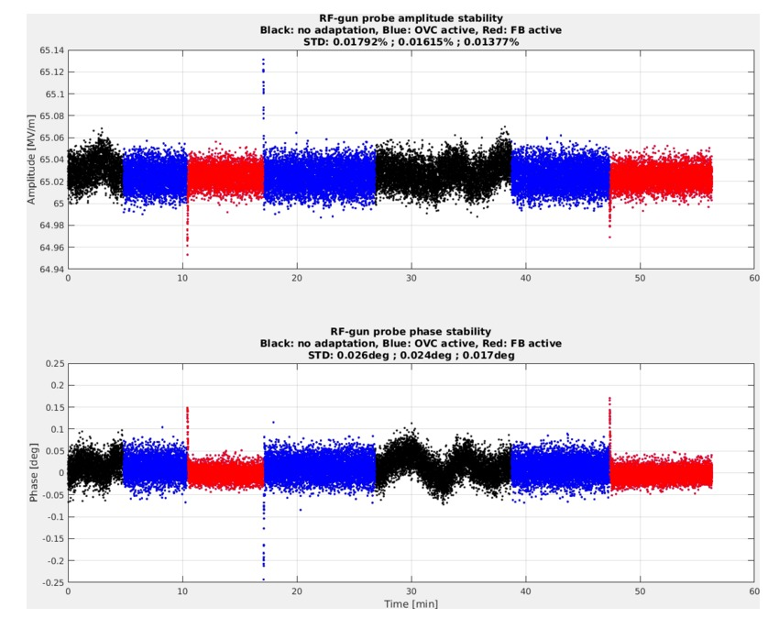
MSK Shift
26.11.2020
Full summary can be found in the logbook
Next Friday:
MSK shift to calibrate TWS2
Pre-requisite: Beam clean through the linac

Slide 9
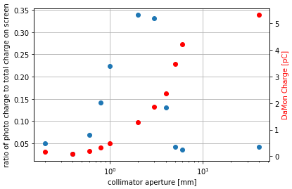
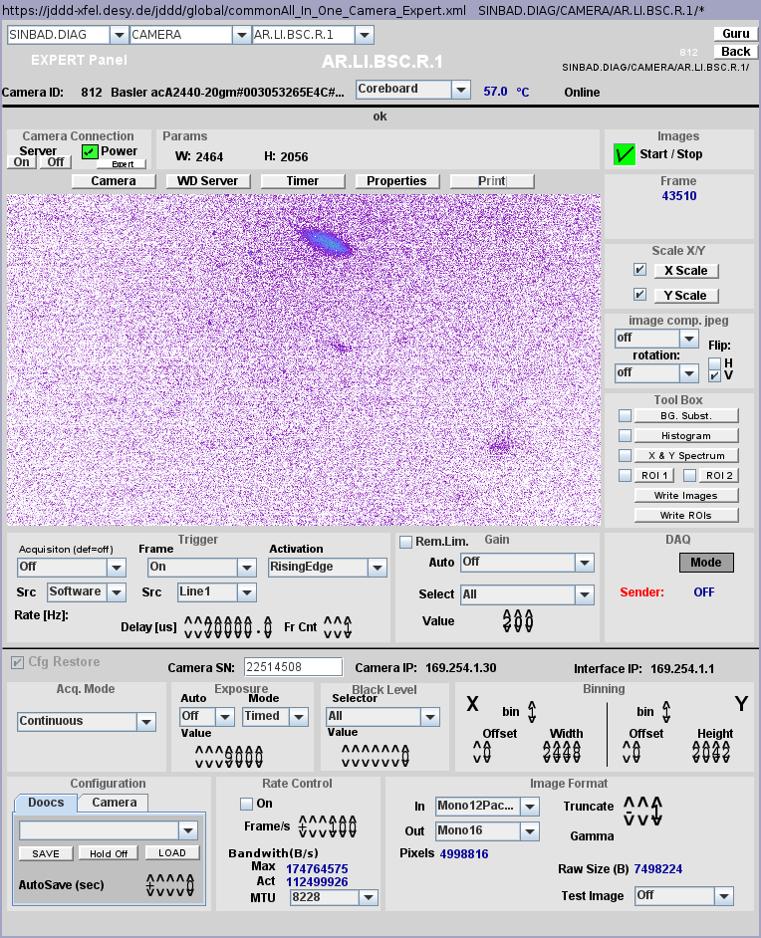
Collimator Studies
26.11.2020
Charge transmission through collimator
Beam on LI.R1 with 0.2mm aperture

Slide 10
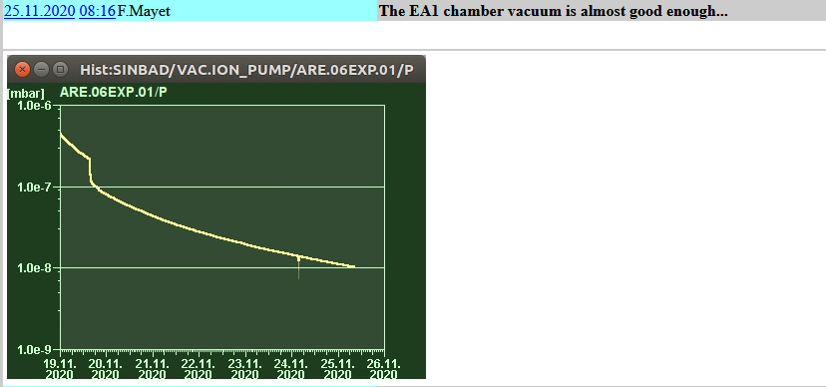
Installation of the YAG-Screen into the EA1 Chamber
Lessons learned…
Schedule:
Afternoon before: start to vent the sector (MVS), table preparation (MPY1)
Morning: table move (MEA)
Morning/afternoon: chamber activity (MVS, MPY1)
Late afternoon: table move (MEA)
Pump stand till next day lunch time.
Pump down duration: couple of days.
Following Monday: optics on table check
After 1 week

Slide 11
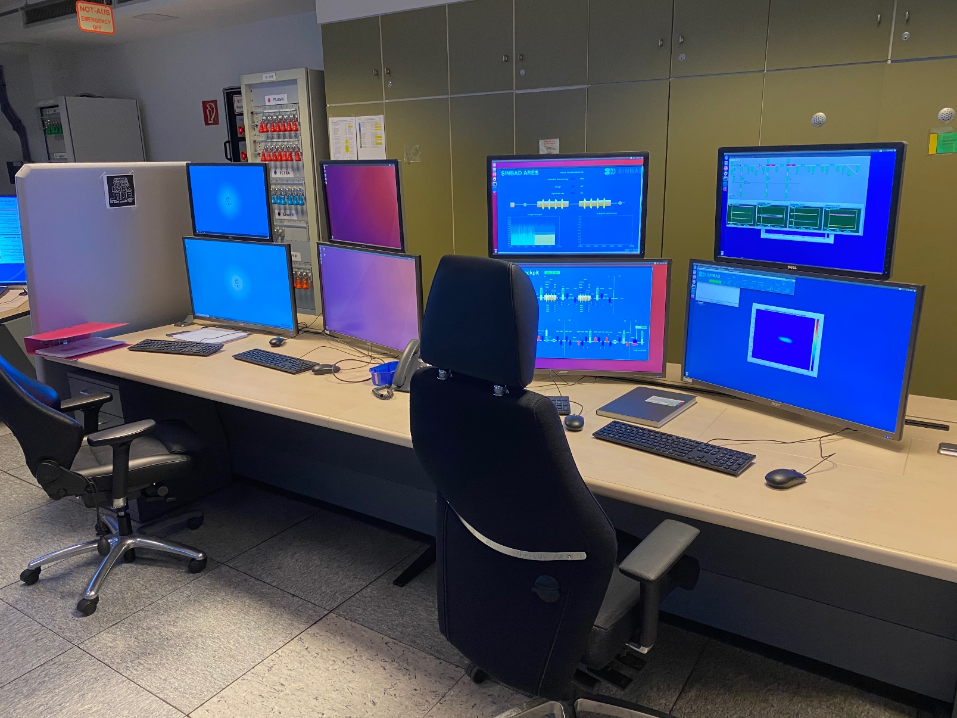
BKR
We are back…
All „guests“ have to sign the attendance list!
The shift leader can be identified through the logbook and does not need to sign in here
No hand-shaking, keep the distance – 1.5m!!
2 people w/o masks is ok (with distance) if there are more then 2 people wear a mask!
Please disinfect the keyboards, mouse, chairs and telephone after the shift.

Slide 12
Next Steps
Align Laser ü
Re-check solenoid alignment at gun – data taken
Last items of gun diagnostics:
- dark current curve from 0 to 75 MV/m – data taken
- Max. charge measurement curve with 75 MV/m
- QE of cathode – data taken
- re-measure emittance
- check FC vs. Damon and Toroid
- Collimator setup – first alignment done
Beam through the Linac at 100 MeV (setpoint for ACHIP)
Over night stability measurements: FC(dark current), position on X1, Momentum stability at Gun.

Slide 13
ARES Schedule
Week 49
Date | Shift Leader
30.11. | MEA, MDI, FS-LA, CFEL
1.12. | Hannes
2.12. | Thomas / Hannes
3.12. | Thomas / Florian
4.12. | MSK

Slide 14
ARES Schedule
Restart: 7.1.2021
Shutdown (Monday = Maintenance day)
ACHIP beam time
Beam Commissioning (Linac section + EA1)

