Slide 1
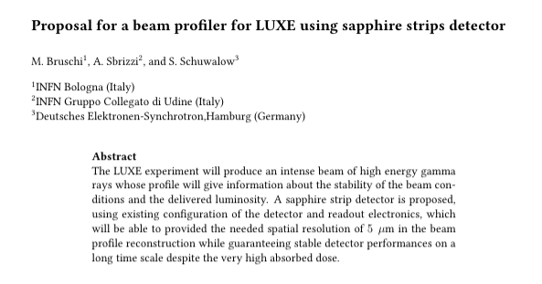

Slide 2
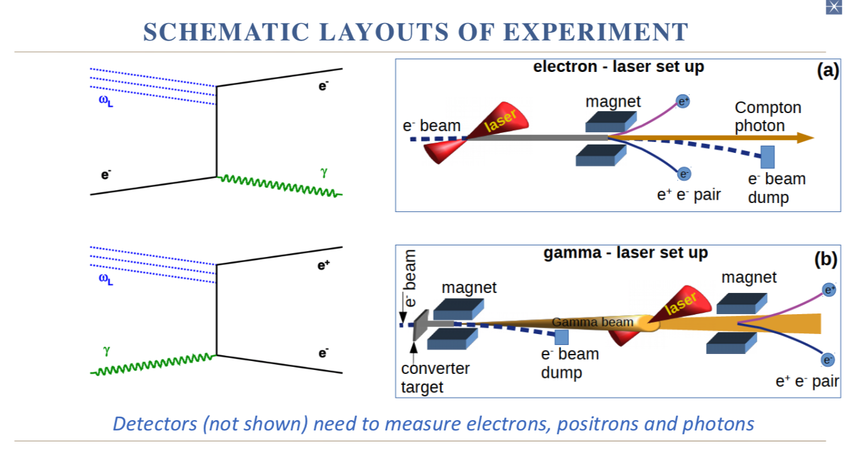
LUXE experimental setup
QED theory prediction deviation of vacuum behavior in presence of a strong external field
Using the XFEL electron beam and the state-of-art laser technology (O(TW)), intensity of the order of Schwinger limit (~1.3E18 V/m) are reached (electron-positron pair creation in vacuum)

Slide 3
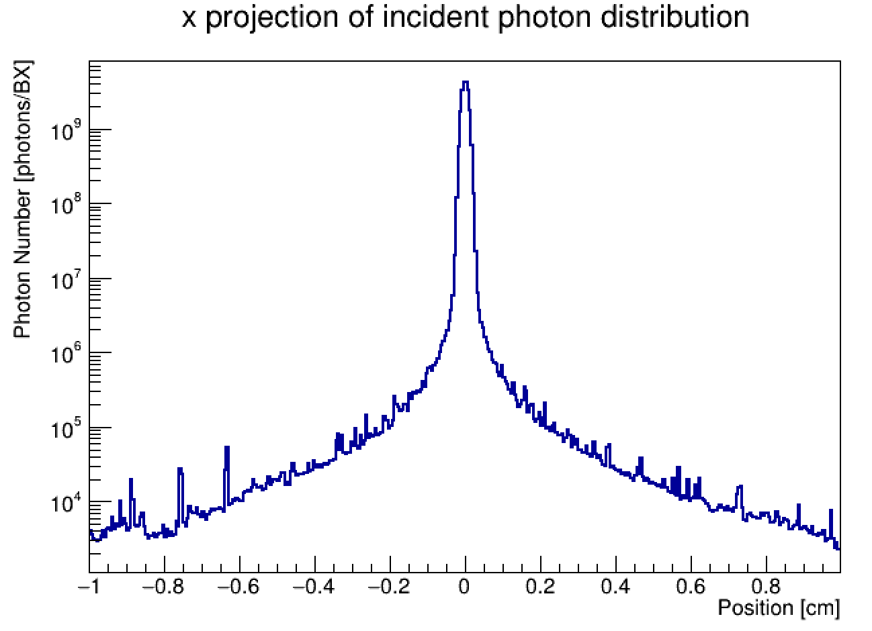
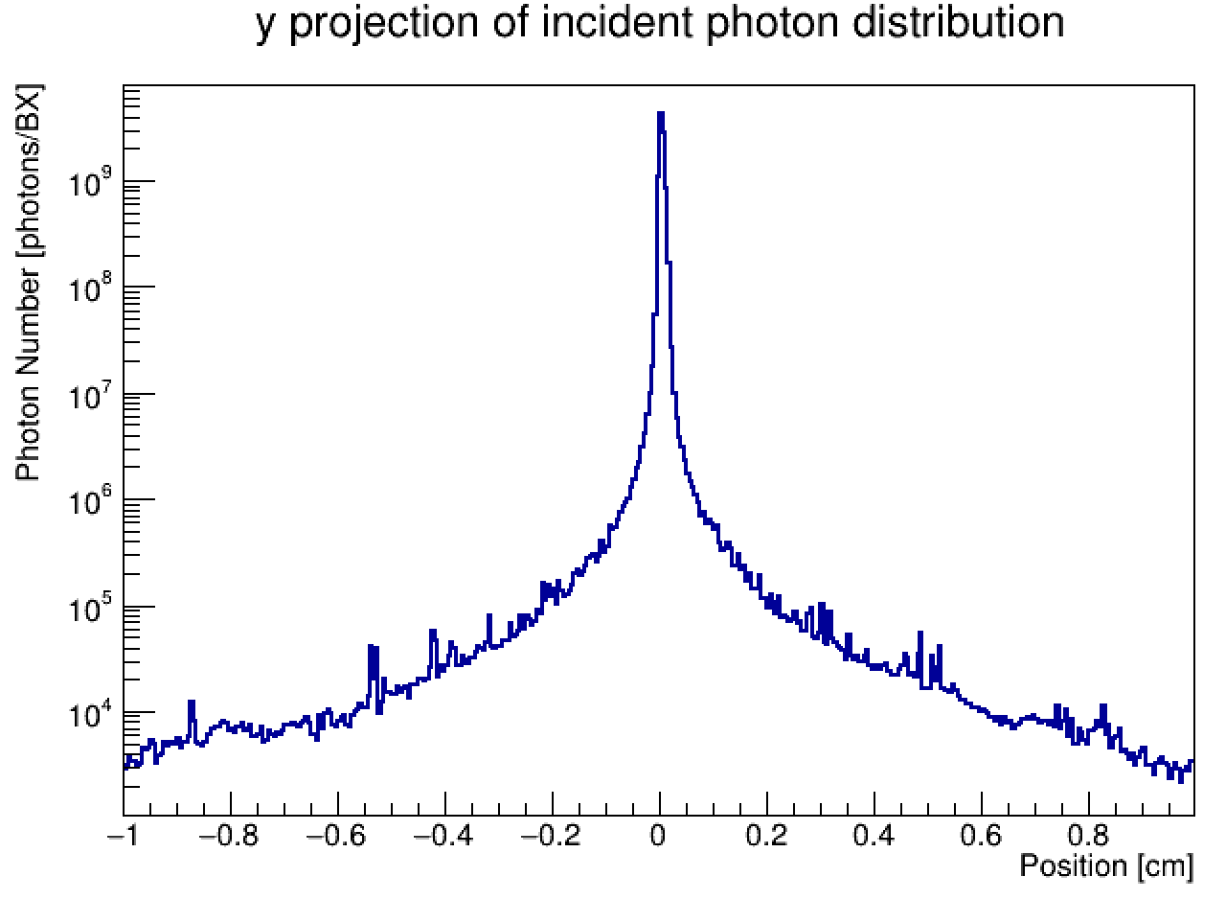
Beam profiler
Thanks: K. Fleck, G. Sarri
The beam profiler has the purpose to reconstruct the high intensity photons beam profile with a precision of 5μm
The most intense beam has φ∼1E9 photons/BX in the electron-laser setup
Many details of the project are missing
Why 5μm precision needed?
How will the luminosity will be determined?
Where the profiler will be placed ? (The meters of air crossed by the beam have not negligible radiation length wrt to the detector one) → beam widening
In any case a baseline detector can be proposed with the present knowledge of the beam conditions
σ_{x}~100μm
σ_{y}~50μm

Slide 4
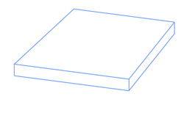
Proposed detector
0.01 cm
Beam profile contained in a 2x2 cm² detector
Extremely high dose suggests to use two detectors with strips placed orthogonally each other
High particle density can be dealt only with analog readout of the strips and center of gravity algorithm to reconstruct the beam profile position
Strips with 100 μm pitch seems to be a reasonable compromise to reach the target precision (5 μm) using a reasonable number of readout channels (400)
Since the absorbed dose depends on the detector thickness and there is no problem with signal strength, the detector should be quite thin, let’s say dz=100 μm.
2 cm
Photon beam
2 cm
0.01 cm
200+200 readout channels
Chosen Material: Sapphire

Slide 5
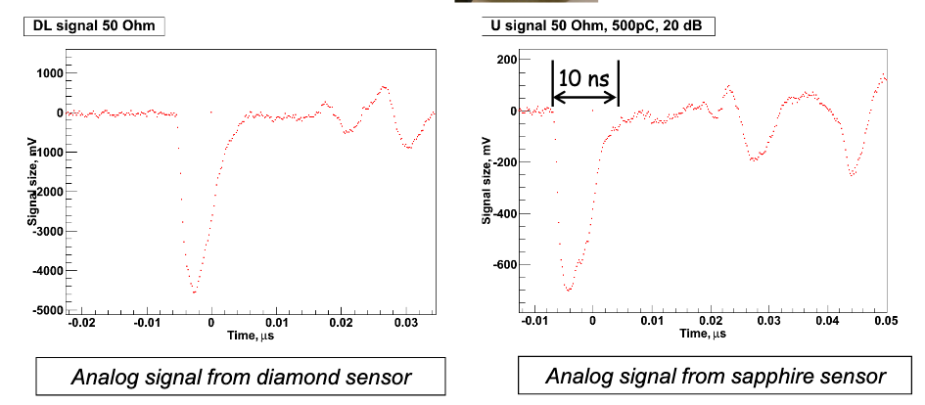
Why Sapphire?
Sapphire is Al₂O₃
S. Schuwalow et al.: Investigation of a direction sensitive sapphire detector stack at the 5 GeV electron beam at DESY-II / JINST 10 P08008
Comparison with diamond:
☺ Higher radiation resistance: ~ 10 MGy
☺ Leakage current does not increase with dose
☹ Higher eh creation energy
☹ Lower collection efficiency (~10%)
☺ Fast response (low electron mobility compensated by reduced distance travelled by electrons)
☺ Low Cost: 1euro/cm² (compared to diamond 3000 euro/cm²)

Slide 6

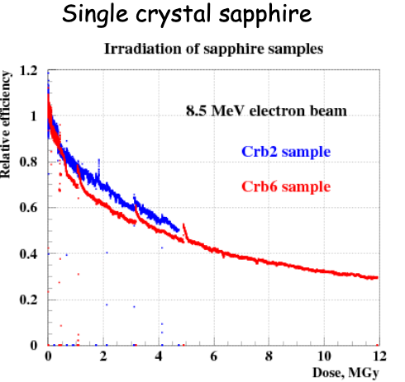
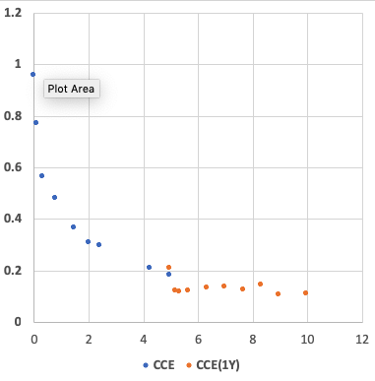
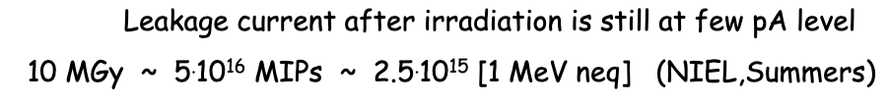
Sapphire Radiation Hardness
Relative Efficiency
Dose, MGy

Slide 7
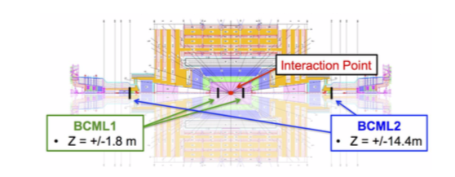
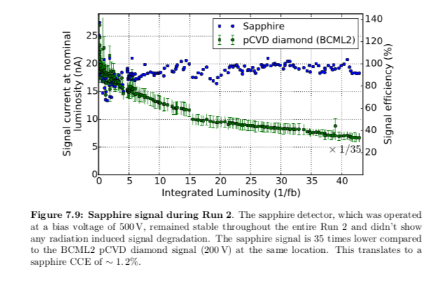
Tests on sapphire detectors
Intensive beam tests for FLASH and XFEL (electron beams)
Sapphire detectors have been intensively tested as beam halo and beam loss monitors at the Large Hadron Collider (CMS)
A sapphire version of BCM has been intensively tested during RUN2 (BCML2 sapphire) and the performances can be compared with BCML2 pCVD diamond version
Improved version (increased signal strength) of sapphire detector planned also for HL-LHC
CERN-THESIS-2017-071

Slide 8
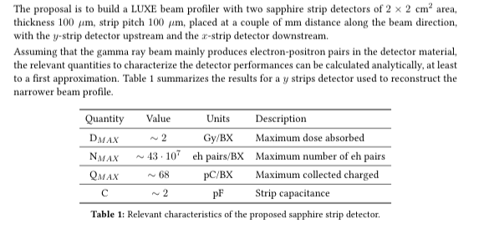
Detector Performances
Assuming 10 MGy , lifetime ~ 60 days (can be improved, see next slide)
COG Algorithm
25 μm on the single BX
5 μm on 25 BX
Readout energy resolution R < 30% needed
Point of attention
Detector Thickness: 0.14% Xo
1m of air : 0.33% Xo

Slide 9
Adding sub-millimetric movement to the detector
100 μm
radiation damage of Sapphire leads only to the lost of charge collection efficiency
the leakage current stays negligible (~pA)
Displace detector along strips, for instance, by ~0.1 mm every 10 days
Piezo motors (micrometric steps) are widely used
Factor 100 in lifetime achieved!
Method does not work with Silicon (too high leakage current when high dose is absorbed)

Slide 10
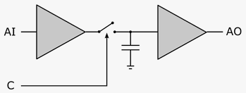
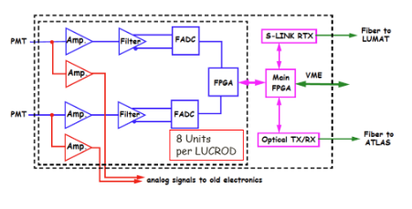
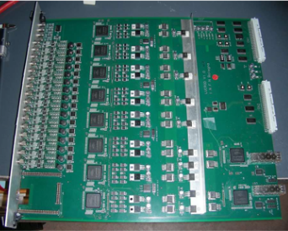
Readout Electronics
Can be rather straightforward
Plenty of signal: ~60 pC/BX (peak)
Low rate: 1 Hz
Signals transmitted to “counting room” via cat 5 cables
Plugged into a card (LUBPRO, to be designed):
Array of Sample-and-Hold capacitors
Control logic for switching and multiplexing the outputs to a readout card
10 RJ45 inputs 1 analog output
Read-out card. One possible option
ATLAS LUCID LUCROD (existing)
Array of 16 FADC 12 bit dynamic range
10 LUBPRO and 1 LUCROD will be necessary to readout the entire beam profiler
One could also think to develop a unique readout card for the run and use LUCROD for test
Sample/Hold
LUCROD CARD

Slide 11
Dynamic Range
The LUCROD board installed for LUCID has noise at level of 1 ADC count ~ 0.350 mV, and 12 bit dynamic range
Leakage current (O(pA)) << I(signal) ~ 13 mA
An effective dynamic range of 10-11 bits should be possible
A MC simulation is necessary to check if this is enough for reconstructing the beam profile
If not, one could think to different gain factors (LUCROD allows up to x 16 )

Slide 12
Next Steps
A MC simulation with realistic beam conditions and detector geometry is needed to confirm the parameters calculated to propose the detector
Test beam at DESY/XFEL for validation
Detector could be available in 6 months
No LUBPRO needed for the tests, only one LUCROD (16 channels, available)
After validation, start
LUBPRO design, production (estimate one year)
Movable support mechanics design, production (estimate one year)

Slide 13
Costs, resources
Costs (first estimate): ~ 100 keuro
Detector ~ 5 keuro
LUCROD ~ 15 keuro
LUBPRO ~ 5 keuro
Cables ~ 4 keuro
Infrastructures (movable plane plus piezo motors and control, high voltage and crate for the readout) ~ 70 keuro
The following group are interested
DESY
INFN Bologna, Padova
University of Tomsk
+ .....

Slide 14
Conclusions
A proposal for the LUXE beam profile has been submitted based on the presently available information
Despite the harsh radiation environment in which the detector will operate and the very good stability needed to achieve the target spatial resolution in the beam profile reconstruction, there is confidence that the proposed version will perform according to the specs
Advantages of the proposed detector
Very high radiation resistance
All the main technologies both in the detector side and readout side are either available or easily achievable
A prototype to be tested on beam can be available in a time scale of 6 months
Costs are contained

Slide 15
Backup slides

