Slide 1
Plasma-Based and Laser Accelerators for High-Energy Physics
Ralph Assmann, DESY and INFN
Edda Gschwendtner, CERN
EPS-HEP2021, Virtual at Hamburg, DESY, 26 – 30 July 2021
30 July 2021

Slide 2
Follow-Up to European Strategy Particle Physics
Expert Panel “High Gradient: Plasma and Laser Accelerators”
Follow-up Panel to Europ. Strategy for Particle Physics
Panel proposes roadmap for use in Particle Physcis
Panel members:
Chair: Ralph Assmann (DESY/INFN)
Deputy Chair: Edda Gschwendtner (CERN)
Kevin Cassou (IN2P3/IJCLab), Sebastien Corde (IP Paris), Laura Corner ( Liverpool), Brigitte Cros (CNRS UPSay), Massimo Ferarrio (INFN), Simon Hooker (Oxford), Rasmus Ischebeck (PSI), Andrea Latina (CERN), Olle Lundh (Lund), Patric Muggli (MPI Munich), Phi Nghiem (CEA/IRFU), Jens Osterhoff (DESY), Tor Raubenheimer (SLAC), Arnd Specka (IN2PR/LLR), Jorge Vieira (IST), Matthew Wing (UCL).
Panel associated members:
Cameron Geddes (LBNL), Mark Hogan (SLAC)), Wei Lu (Tsinghua U.) , Pietro Musumeci (UCLA)
Mandate:
Develop a long-term roadmap for the next 30 years towards a HEP collider or other HEP applications.
Develop milestones for the next 10 years taking explicitly into account the plans and needs in related scientific fields as well as the capabilities and interests of the stakeholders.
Establish key R&D needs matched to the existing and planned R&D facilities.
Give options and scenarios for European activity level and investment.
Define deliverables until the next European strategy process in 2026, which allow deciding on the continuation of this R&D line for HEP.
Elaborate consultation process with 231 registered participants, 3 townhall meetings, > 60 talks and inputs.
Due to limited time: Talk just giving a quick look

Slide 3
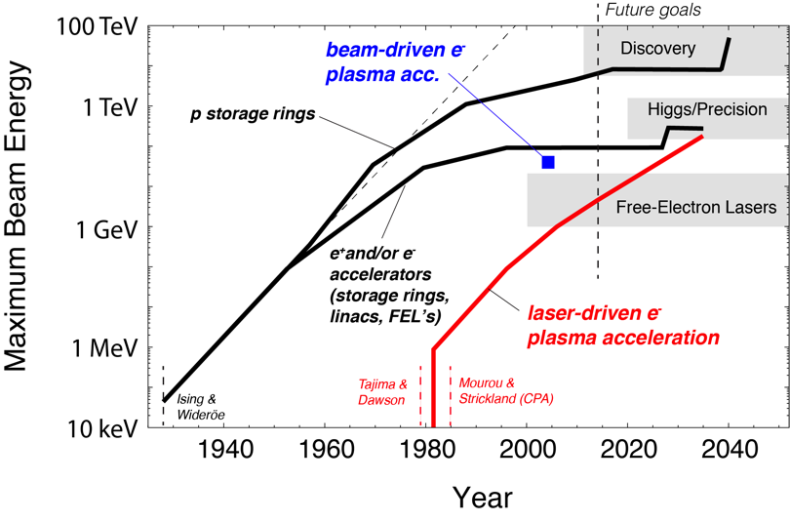

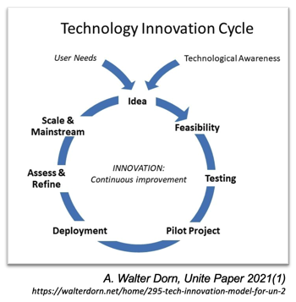
Plasma and Laser Accelerators: New Livingston Curve
Nobel prize Physics 2013 Englert/Higgs
Examples of new ideas and solutions: RF, AG focusing, beta squeeze, stochastic cooling, polarized beams, super-conducting magnets/RF, advanced materials for vacuum/collimators, plasma / laser accelerators, …
Particle physics in the driver seat for most of those developments
Nobel prize Physics 2018
Accelerators are in a continuous technology innovation cycle to be successful:

Slide 4
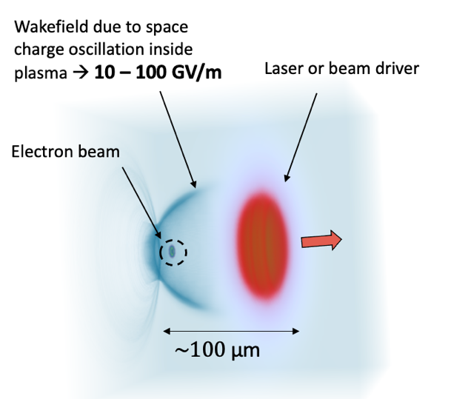

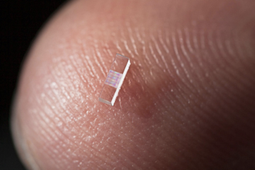
Plasma and Laser Accelerator Principle
Damage limits for metallic walls in RF cavities limit accelerating fields→ replace metal with plasmas or dielectric materials → advance into the many GV/m regime → shorter acc. lengths → reduced cost?
Lasers or THz pulses or e- beams drive dielectric structures (e.g. Silicium)
“Accelerator on a Chip” grant Moore foundation: Stanford, SLAC, University Erlangen, DESY, University Hamburg, PSI, EPFL, University Darmstadt, CST, UCLA
AXSIS ERC Synergy Grant: DESY, Arizona SU
Illustration from EuPRAXIA, A. Ferran Pousa et al
Options for driving plasma and dielectric structures (no klystrons at those frequencies):
Lasers: Industrially available, steep progress, path to low cost
Limited energy per drive pulse (up to 50 J)
e- bunch: Short bunches (need μm) available, need long RF accelerator
More energy per drive pulse (up to 500 J)
p+ bunch: Only long (inefficient) bunches, need very long RF accelerator
Maximum energy per drive pulse (up to 100,000 J)
Tajima & Dawson 1979

Slide 5
Shrinking the Size of Particle Physics Facility
RF Accelerators
> 30,000 operational – many serve for Health
30 million Volt per meter
RF: 90 years of success story for society
400 m
Added value
new Research Infrastructures due to compactness and cost-efficiency
bringing new capabilities to science, institutes, hospitals, universities, industry, developing countries.
60* m
Plasma Accelerators
first user facility to be realized
100,000 million Volt per meter
5 GeV
example
*realistic design including all required infrastructure for powering, shielding, …
Can we shrink the Linear Collider, provide e⁻ and e⁺ beams in the TeV energy regime and produce > 10³⁴ cm⁻² s⁻¹ luminosity?

Slide 6
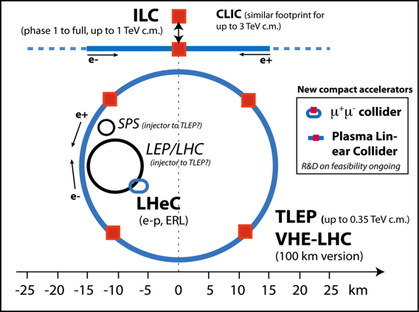
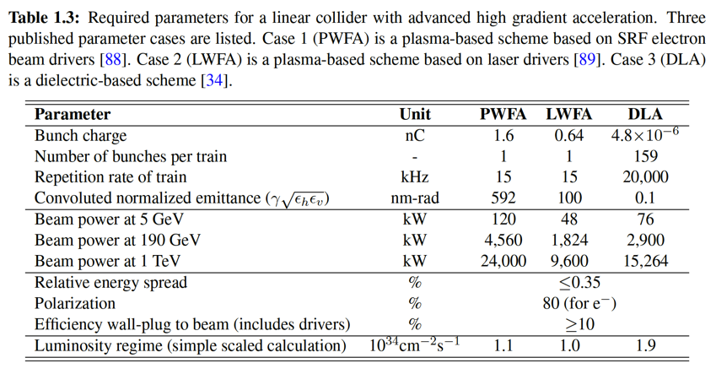
Can we shrink the Linear Collider? provide e⁻ and e⁺ beams in the TeV energy regime and produce > 10³⁴ cm⁻² s⁻¹ luminosity
TDR’s
published
FCC
Future Circular Collider
100 km, e+e-, pp
Technical design to be done
TDR to be
worked out
from expert panel interim report
No fundamental show-stopper but a lot of R&D still required.
There can be very interesting and useful interim steps (non-linear QED, fixed target, dark matter, …)
Devil is in the details! Answer requires detailed simulation, calculations, R&D, designs and tests!
How and when can we arrive at readiness for for high energy particle physics, e.g. a TeV collider?

Slide 7
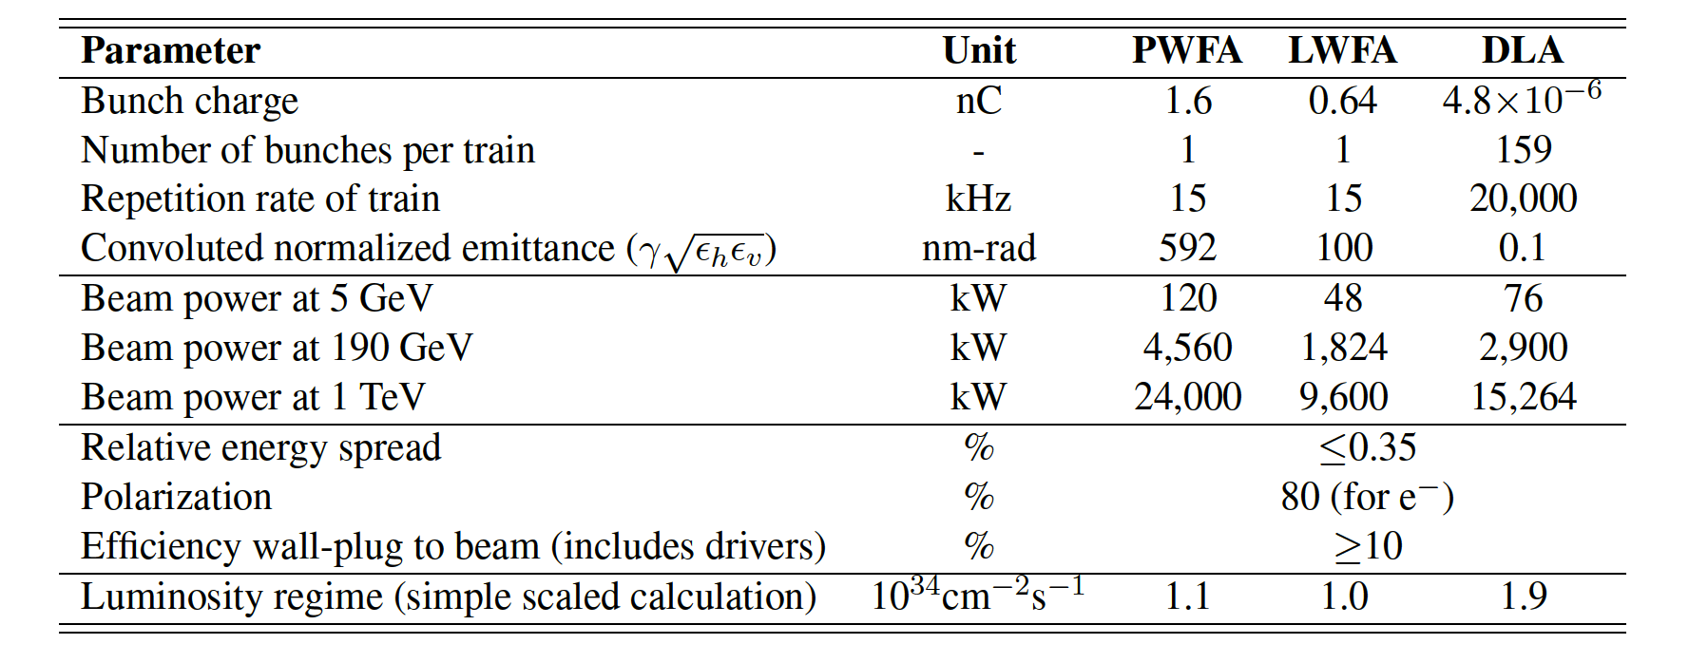
Can we shrink the Linear Collider? provide e⁻ and e⁺ beams in the TeV energy regime and produce > 10³⁴ cm⁻² s⁻¹ luminosity
How and when can we arrive at readiness for for high energy particle physics?
from expert panel interim report

Slide 8
Input to Expert Panel
#2
#3
Speaker | Institute | Country | Title
Paolo Tomassini | CNR-INO | Italy | Ultra-low emittance round beams with multi-pulse ionization injection schemes
Markus Büscher | FZJ | Germany | Polarized particle beams from laser-plasma accelerators
Max LaBerge | University of Texas at Austin | USA | Coherent transition radiation-based emittance diagnostics
Rafal Zgadzaj | University of Texas at Austin | USA | Optical probe of energy dissipation from e-beam driven plasma wakes
Christopher Doss | University of Colorado Boulder | USA | Strong electron beam focusing with passive, underdense plasma lenses
Tong Zhou | LBNL | USA | Coherent combination of high-power fiber lasers for laser-plasma-based collider applications
Franck Falcoz | Amplitude Technologies | France | Roadmap for high average power ultrashort laser
Andreas Maier | DESY | Germany | High average power laser-plasma acceleration
Roman Walczak | University of Oxford | UK | MP-LWFA to improve LPA repetition rate and efficiency / European Network for Novel Acceleraetors (EuroNNAc)
Leonida Antonio Gizzi | CNR-INO | Italy | Towards PW scale laser driver with 100 Hz / Update on the design of a kHz-KW laser driver for plasma acceleration
Simon Hooker | University of Oxford | UK | Low-loss, metre-scale plasma channels for high-repetition rate plasma accelerators
Wim Leemans | DESY | Germany | Strategy for enabling plasma-based accelerators to drive first particle-physics applications
Antonio Falone | LNF/INFN | Italy | EuPRAXIA - Proposal for a distributed research facility towards the realization of a FEL plasma based accelerator, organization, current status and outlook
Claudio Emma | SLAC | USA | Light-source applications of advanced accelerators
Sebastien Meuren | SLAC | USA | Exploring the fully no-perturbative regime of QED at a Future Linear Collider
Spencer Gessner | SLAC | USA | Towards an integrated design study for a Plasma Linear Collider / Positron plasma wakefield acceleration research at FACET-II
Mark Hogan | SLAC | USA | Plasma wakefield acceleration at FACET-II / GARD beam test facilities in the US
Richard d’Arcy | DESY | Germany | High-average power beam driven plasma acceleration
Cedric Thaury | LOA, CNRS | France | Increase of the energy gain in a laser-plasma accelerator stage
Enrica Chiadroni | LNF/INFN | Italy | High beam quality R&D at SPARC_LAB
Carl Lindstroem | DESY | Germany | Staging of plasma accelerators for high-energy, stability and beam quality
Carlo Benedetti | LBNL | USA | Ion motion, hosing suppression and beam quality preservation in plasma-based accelerators
Phi Nghiem | CEA | France | EuPRAXIA solutions and plans for a plasma-based accelerator with high beam quality
Speaker | Institute | Country | Title
Edward Snedden | STFC Daresbury | UK | High gradient acceleration at the CLARA Test Facility
Allen Caldwell | MPI for Physics Munich | Germany | Particle Physics possibilities with AWAKE-like technology
Massimo Ferrario | LNF/INFN | Italy | High quality beam-driven plasma acceleration and FEL
Moana Pittman | IJCLab, CNRS | France | High intensity laser facility for High gradient accelerator development
Robert Rossmanith |  | Germany | Preferred machine for testing a laser plasma accelerator at CERN: CERN eSPS
Wei Lu | Tsinghua University | China | CEPC high energy plasma injector and PWFA driven coherent light source based on SXFEL facility
Francois Lemery | DESY | Germany | SRF-based collinear beam-driven acceleration for a future TeV collider
Florian Burkart | DESY | Germany | 150 MeV S-Band injector linac with high stability and ultra-short electron bunches¶
Guoxing Xia | University of Manchester | UK | Plasma beam dump and its implementation in future colliders
Fahim Habib | Strathclyde University | UK | Plasma photocathode HEP R&D
Viacheslav Kubytskyi | IJCLab, CNRS | France | Plasma target development for PALLAS project
Alban Sublet | CERN | CERN | AWAKE scalable plasma sources R&D at CERN
Thomas Heinemann | Strathclyde University | UK | Hybrid plasma wakefield accelerators as test-beds for HEP building blocks
Christelle Bruni | IJCLab, CNRS | France | High peak current electron beam transport and diagnostics
Jerome Faure | LOA, CNRS | France | High repetition rate laser-plasma acceleration
Maxence Thevenet | DESY | Germany | Multi-physics simulations and plasma accelerators
Arnaud Beck | LLR, CNRS | France | The importance of software engineering for PIC simulations
Ricardo Fonseca | IST Lisbon | Portugal | OSIRIS 2030: Strategy for future plasma-based acceleration modeling
Jean-Luc Vay | LBNL | USA | Open-source simulation ecosystem for laptop to Exascale modeling of high-gradient accelerators
Denys Bondar | Kharkiv Institute Physics and Technology | Ukraine | Some Aspects of Laser Wakefield Acceleration of Self-injected Electron Bunch in a Metallic-Density Electron Plasma
Gianluca Sarri | Queen's University Belfast | UK | Plasma-based positron sources R&D: current status and next steps
Giuseppe Torrisi | INFN | Italy | CW collinear hollow-core scheme for Dielectric Laser Accelerators (DLAs)
Frank Mayet, Willi Kuropka | DESY | Germany | Dielectric Structures as Diagnostics and Beam Manipulation Devices
Joel England | SLAC | USA | Structure-Based Laser-Driven Accelerators
Guillaume Martinet | IPN Orsay | France | Dielectric wave guide for short electron beam acceleration and compression at THz frequencies
Steven Patrick Jamison | Lancaster University | UK | mm-wave and THz acceleration
See https://indico.cern.ch/event/1041900/
and https://indico.cern.ch/event/1040116/
#1
Speaker | Institute | Country | Title
Dave Newbold | STFC Rutherford | UK | Particle Physics Strategy and Accelerator R&D
Ralph Assmann, Edda Geschwendtner | DESY, INFN, CERN | Germany, Italy, CERN | Introduction to the Expert Panel on High-Gradient Acceleration (Plasma/Laser)
Andrea Latina | CERN | CERN | Linear Colliders - Plans and Advanced Accelerators Opportunities
Frank Zimmermann | CERN | CERN | Circular Collider - Plans and Advanced Accelerator Opportunities
Matthew Wing | University College London | UK | First Physics Experiments with Advanced Accelerator Concepts
Beate Heinemann | DESY | Germany | Electron-Photon Based HEP Experiments - Plans and Advanced Accelerator Opportunities
Daniel Schulte | CERN | CERN | Target Parameters for Typical HEP Relevant Beams
Erik Adli | University of Oslo | Norway | Collider Concepts with Plasma: Where to Go and Required Features for e+/e-, gg, fixed target,...
Carl Schroeder | LBNL | USA | Laser-Driven Plasma Wakefield Accelerators
Jens Osterhoff | DESY | Germany | Beam-Driven Plasma Wakefied Accelerators
Rasmus Ischebeck | PSI | Switzer- land | Dielectrics Accelerators and Other Advanced Concepts
Jorge Vieira | IST Lisbon | Portugal | Theory and Simulations
Pietro Musumeci | UCLA | USA | Snowmass Frontier on Advanced Accelerators (AF6 Coordinator)
Panel organized 3 Townhall Meetings for input on relevant activities→ 230 participants in consultation process

Slide 9
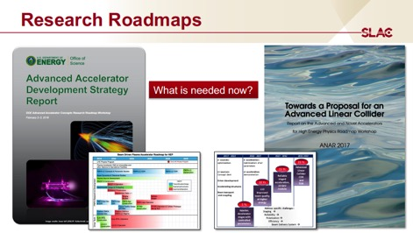

Slide 10
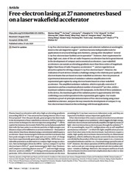

Slide 11
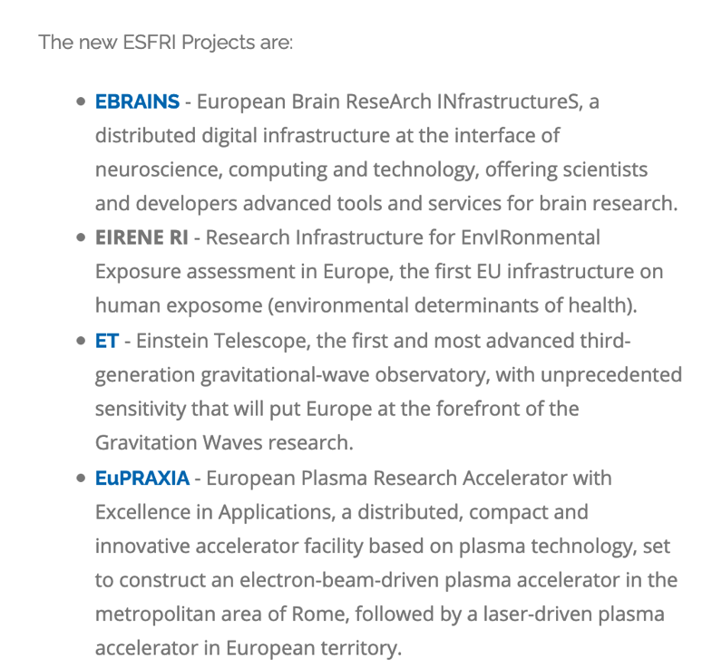

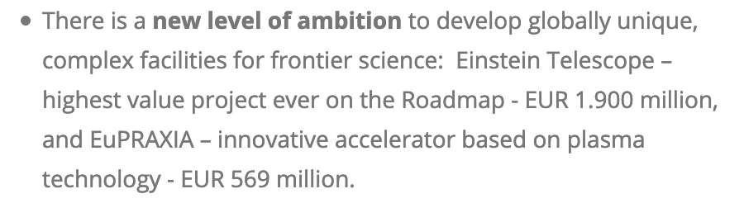
Press Release ESFRI 30.6.21
https://www.esfri.eu/latest-esfri-news/new-ris-roadmap-2021

Slide 12
Main Challenges for Particle Physics Use Reviewed
Electron beam with collider quality
1-100 GV/m acceleration, 15000 nC/s charge delivered, sub-micron transverse emittances,
10⁻⁴ rel. energy spread, spin polarization.
Deliverables: on injectors, numerical simulations, repetition rate, efficiency, beam loading, emittance preservation, energy spread control, polarization, staging, … were proposed.
Conceptual design very compact collider
with physics case, self-consistent machine parameter set, realistic assessment of feasibility issues, performance, size and cost.
Deliverables on a coordinated international design study, including beam delivery, luminosity and interaction region design were proposed.
Goal 1
Intermediate steps towards a particle physics collider and synergy
with progress in photon science and lower energy applications.
Deliverables for intermediate implementation steps were proposed.
Solution for positron acceleration
with parameters similar to electron bunches.
Deliverables: on numerical simulations, proof-of-principle experiments were proposed.
Goal 2

Slide 17
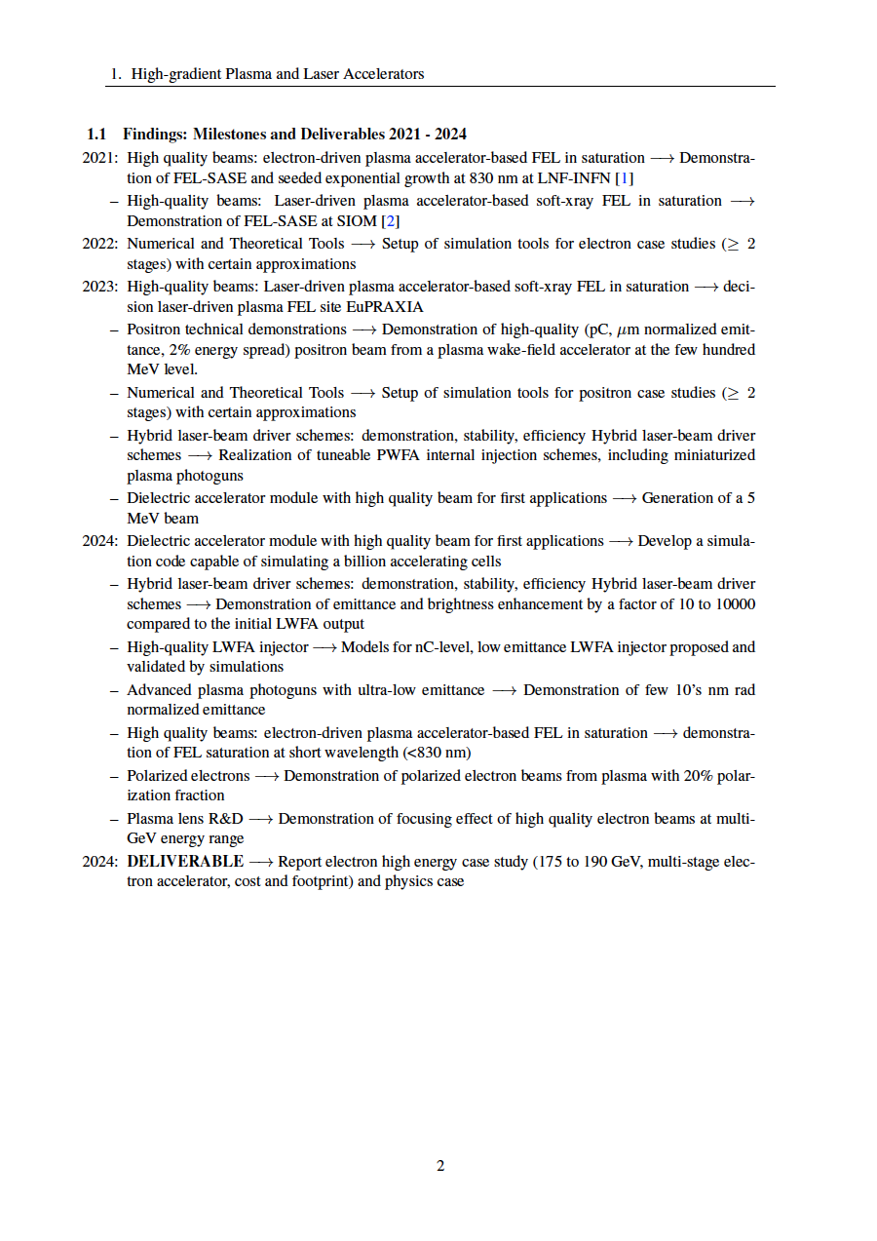
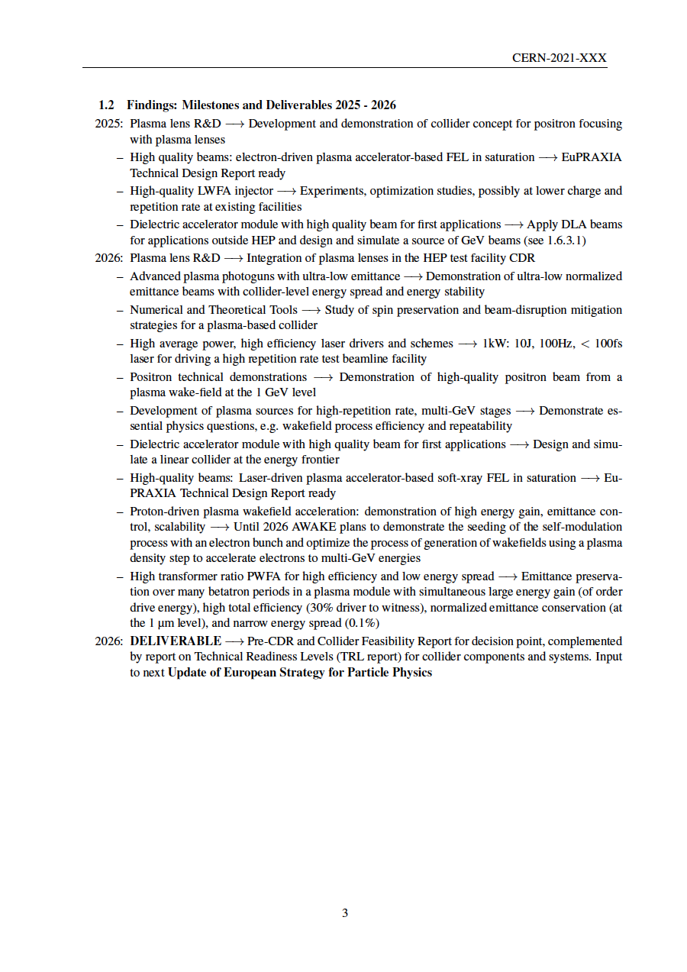
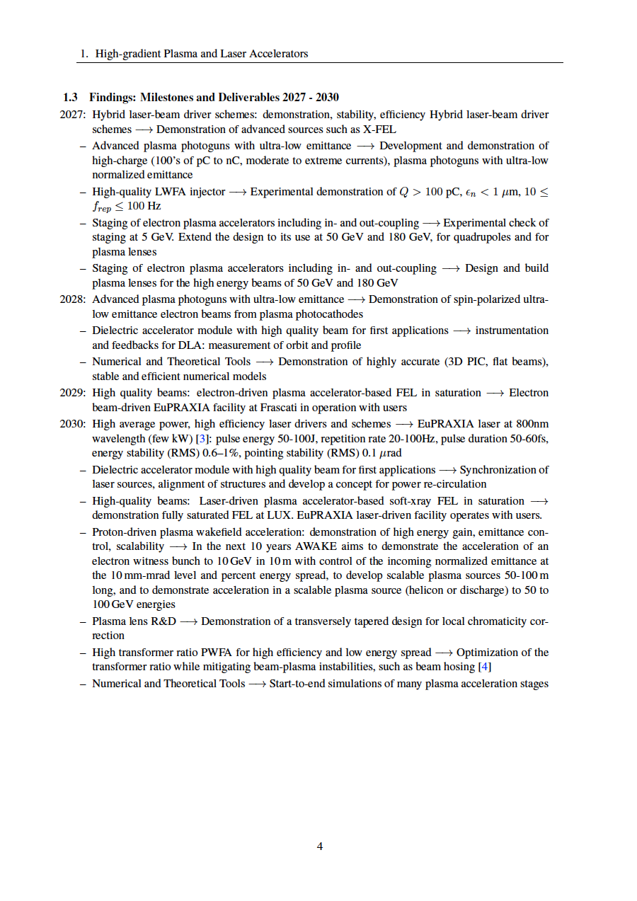
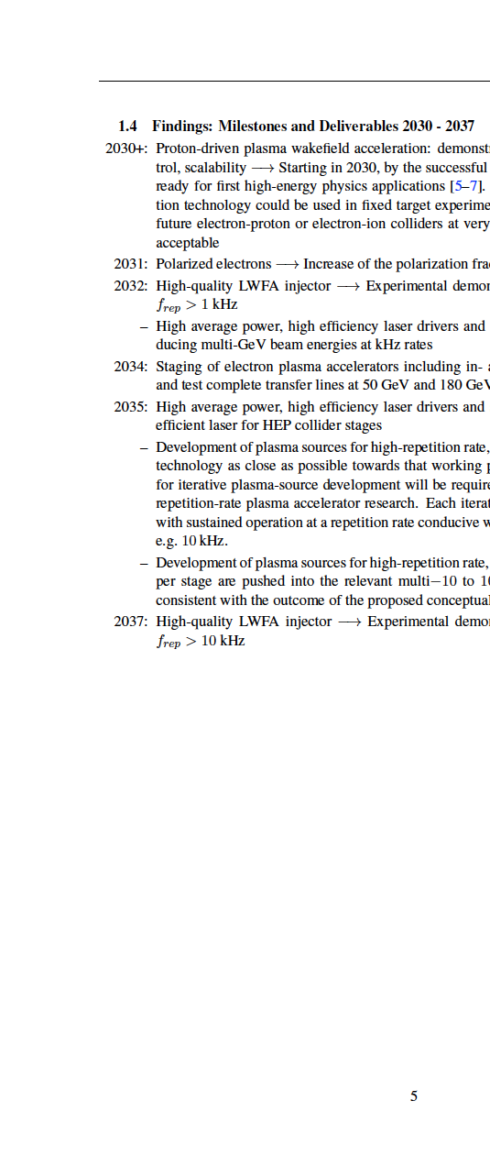
Input and findings: 56 proposed milestones and deliverables for R&D until 2037. To be discussed further and prioritized in next step of the roadmap process.

Slide 19
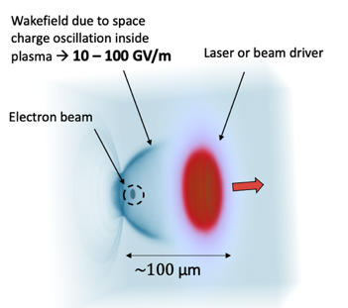
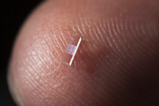
Conclusion
RF accelerators are drivers of excellence!
We have a new technology with 1 – 100 GV/m:
  Establishing compact e- beam research infrastructure in GeV regime, proposed by 50 institutes, 100’s scientists, on ESFRI roadmap (EuPRAXIA) + national projects.
Use of this technology for High Energy Physics:
  Many challenges to be solved for very compact colliders → not at all easy but no fundamental showstopper.
  Start stringent, coordinated innovation cycle for develo-ping new HEP discovery reach (feasibility → interme-diate facility → collider) with all its risks and benefits…
Final roadmap will describe detailed challenges, milestones and required support!
Draft
under discussion
Illustration from EuPRAXIA, A. Ferran Pousa et al
Tajima & Dawson 1979

Slide 20
Thank you for your attention!
Comments and suggestions very welcome and needed to prepare the best possible report
ralph.assmann@desy.de
edda.gschwendtner@cern.ch
Or send it to the expert panel:
expertpanel-plasmalaser-townhall@cern.ch

