Slide 1

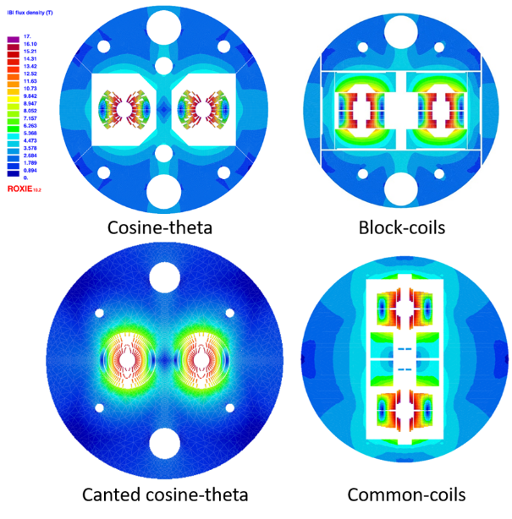

Accelerator R&D Roadmap
Status and Perspectives of High-Field Magnets R&D for Particle Physics
Pierre Vedrine
on behalf of HFM Expert Panel,
Luis García-Tabarés , Bernhard Auchmann, Amalia Ballarino, Bertrand Baudouy, Luca Bottura, Philippe Fazilleau, Matthias Noe, Soren Prestemon, Etienne Rochepault, Lucio Rossi, Carmine Senatore, Ben Shepherd
EPS-HEP Conference, 30 July 2021

Slide 2
Outline
Motivation and Goals
Panel activities
State of the art – Initial findings
R&D plans
Conclusions
EPS-HEP Conference, 30 July 2021

Slide 3
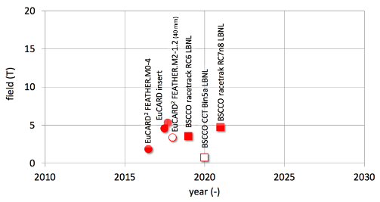
Motivation (1/2)
High Field Magnets (HFM) are among the key technologies that will enable the search for new physics at the energy frontier.
Approved projects (HL-LHC) and studies for future circular machines (FCC, SppC) call for the development of superconducting magnets that produce fields beyond those attained in the LHC .
Progress in highest field attained in European and international programs (EU-FP6 CARE , EU-FP7 EuCARD, EuCARD2, HL-LHC , ARIES, on-going I-FAST, HFM & US-DOE programs)
EPS-HEP Conference, 30 July 2021

Slide 4
Motivation (2/2)
Lead times for the development of high-field magnets are long, with a typical duration in excess of a decade. It is hence important to pursue R&D in parallel with scoping studies of new accelerators.
The development of high field magnets naturally spans over many fields of science and requires a broad mix of competencies, implying a research team assembled as a collaboration ranging from academia to industry.
The development of novel SC magnet technology at the high field frontier requires specific infrastructure, often of large size.
An important matter underlying the above considerations is that of cost. In this respect we have to consider not only the construction cost of magnets, but also the cost of the R&D itself.
One such program will have to be of collaborative nature, with strong partnership among national laboratories, universities and industry.
These considerations point to the need of a sustained and inclusive R&D program for high-field superconducting accelerator magnets as a crucial element for the future of HEP, as underlined by the strong recommendation emitted by the European Strategy Group 2020
EPS-HEP Conference, 30 July 2021

Slide 5
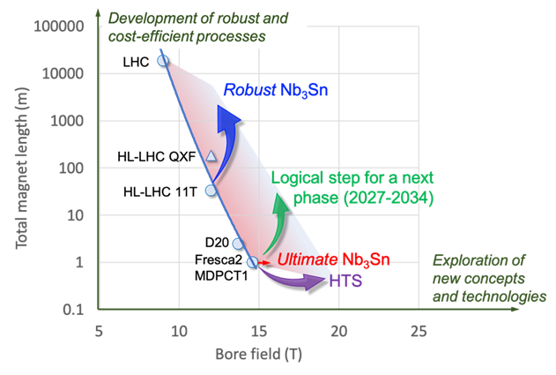
Goals of a High Field Magnets R&D Program
Demonstrate Nb₃Sn magnet technology for large scale deployment, pushing it to its practical limits, both in terms of maximum performance as well as production scale
  Demonstrate Nb₃Sn full potential in terms of ultimate performance (towards 16 T)
  Develop Nb₃Sn magnet technology for collider-scale production, through robust design, industrial manufacturing processes and cost reduction (benchmark 12 T)
Demonstrate suitability of HTS for accelerator magnet applications, providing a proof-of-principle of HTS magnet technology beyond the reach of Nb₃Sn (towards 20 T)
Other key parameters:
  Cost of Magnets & R&D
  Timeline of a realistic development
EPS-HEP Conference, 30 July 2021

Slide 6
Panel Activities
HFM Expert Panel held about ten meetings to date. All meetings are collected under an indico category (material presented and minutes)
- Two open international workshops were organized and held virtually. Details on the workshops can be found at:
“HFM State-of-the-Art” (SoftA workshop) took place April 14-16, 2021: https://indico.cern.ch/event/1012691/
“HFM Roadmap Preparation” (RoaP workshop) took place June 1&3, 2021: https://indico.cern.ch/event/1032199/
The proceedings of the workshops constitute the main body of the wide and open consultation of the community demanded by the LDG. A report is in preparation, based on the executive summaries provided by all contributors.
Open consultation process is now completed. We expect to have 4…6 more meetings of the Expert Panel in the coming 3 months to define the prioritized roadmap.
A panel-only workshop is planned for Roadmap Implementation (RoaI) on September 15-16, 2021, with the goal of consolidating the 30-page final report and proposed HFM prioritized roadmap for November 2021.
EPS-HEP Conference, 30 July 2021

Slide 7
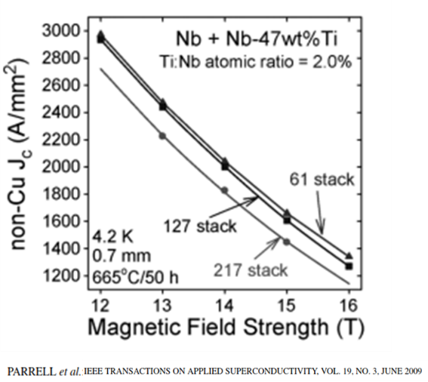
State of the Art - Initial findings - 1
Conductors – Nb3Sn
Nb3Sn is reaching the upper limit of performance.
Advances in composition and architecture need to be consolidated (laboratory), and made practical for large-scale production (industry), including considerations on all performance parameters (mechanics, magnetization – laboratory; homogeneity, unit length, cost – industry).
Conductors – HTS
Spectacular electrical performance of HTS tapes, the challenge is now to combine critical current with mechanical and protection properties.
High temperature operation (20 to 65 K) is an interesting option also driven for other fields (fusion and power machinery).
Industry drive for high-field performance is independent of HEP (cost of HTS will decrease because of substantial investment from fusion and power applications).
EPS-HEP Conference, 30 July 2021

Slide 8
State of the Art - Initial findings - 2
Magnets Nb3Sn
Length effects and electro-thermo-mechanics of Nb3Sn magnets are a crucial issue (11T experience). R&D should be based on a combination of models and real length prototypes.
An initial tentative to identify suitable design options for the various field levels targeted:
2-layer cos-theta suitable up to 12 T
4-layers cos-theta or blocks for the 14-16 T range
Common coils to resolve the issue of the end (to be demonstrated)
CCT or other stress managed concept beyond 15-16 T
A decision on a feasible, cost-effective and practical operating field
will be one of the main outcomes of the development work
planned in the coming years.
Industry would welcome early involvement in the R&D phase, participating in the whole process to gain early experience on a potential manufacturing phase and decrease risk.
EPS-HEP Conference, 30 July 2021

Slide 9
State of the Art - Initial findings - 3
HTS Magnets
Non Insulated/Partial/Controlled Insulated conductors may be a tool to explore the technology on small scale, in order to face obvious challenges (long time constants, mechanics with ill-defined current flow), as the predictability of the transverse resistance in the conductor is an issue.
We need a focused study on what is the best HTS cable configuration for magnet applications , targeted at magnet construction (winding of the ends) and operation (transposition)
Field quality is a declared issue, but this should be revisited, possibly transferring a part of the challenges to beam dynamics, diagnostics and controls.
Associated Technologies
Programs for Characterization and development of insulation systems, development of advanced diagnostics and material analysis and multiscale and multi-physics modelling should be supported in priority
A prioritized program for the Upgrade of test infrastructure shall be defined to accompany the needs for high field characterization of conductors and cables, and fast turnaround on magnet sub-scale and full-scale demonstrators and models.
Thermal management of high field magnets (both internal, heat transfer to coolant, and external, heat transfer to cryoplant) will require new engineering solutions that need to be integrated from the start.
EPS-HEP Conference, 30 July 2021

Slide 10
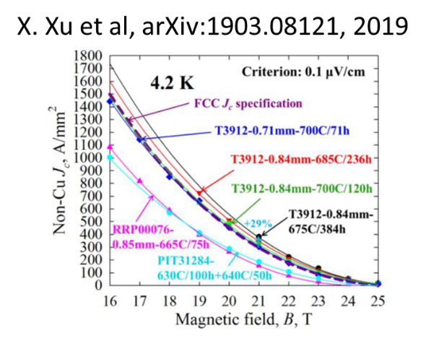
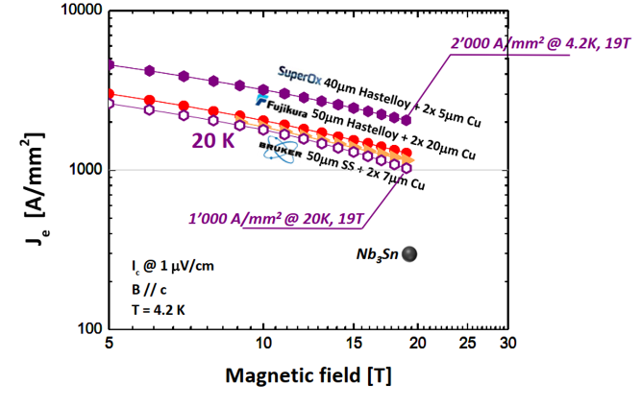

HFM R&D plans related to superconductors
Nb₃Sn Conductor
  Advance performance of Nb3Sn wires beyond present state-of-the-art, with a target 1500 A/mm2 at 16 T (mechanical properties, magnetization & stability, cost…).
  Develop cables with high engineering current density, J_{E} ≈ 600 A/mm², appropriate to yield a compact and efficient coil design.
  Increase the number of qualified manufacturers of HEP-class Nb3Sn conductor and make the material less expensive in view of a demonstration of production scale-up.
HTS Conductor
  Focus is on REBCO (exploit complementarity with US-MDP for Bi-2212)
  Achieve controlled, homogeneous and reproducible geometrical and electro-mechanical properties along the full length,
  Industrialize production to assure feasibility of long - 1 km target – unit lengths and reduce the cost to make future large-scale applications affordable.
  Develop, qualify and identify the type of cable suitable for accelerator quality magnets (stack, CORC, Roebel, novel concepts);
  Study electrical insulation and suitable impregnation processes;
EPS-HEP Conference, 30 July 2021

Slide 11
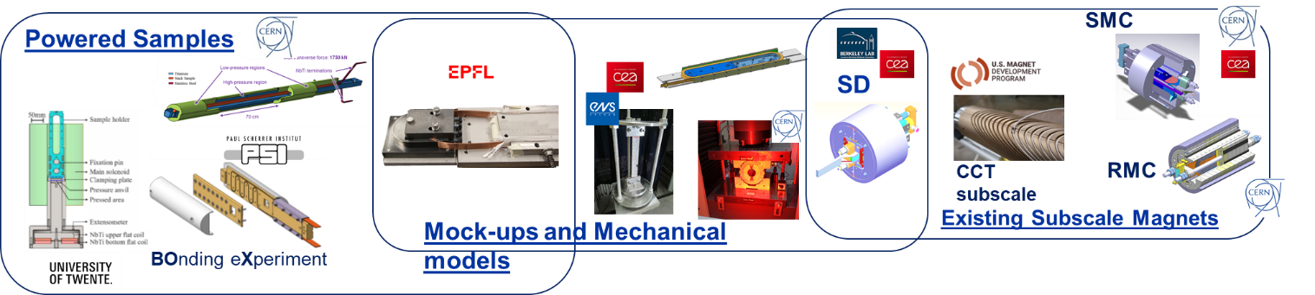
HFM R&D plans related to Nb₃Sn magnets
Develop robust (12 T target) and ultimate (towards 16 T) field designs in parallel to samples and subscales in an agile mode that incorporates insights from previous steps.
Develop Nb3Sn magnet technology for robust and scalable manufacturing for long magnets and promotion of automation and innovations leading to simplified manufacturing processes,
Test new technologies at smallest possible scale using short model or other small-scale test facilities in this context at the earliest possible moment
Complete the knowledge of material parameters and proper implementation of coil and other materials as well as interfaces in 3D models
EPS-HEP Conference, 30 July 2021

Slide 12
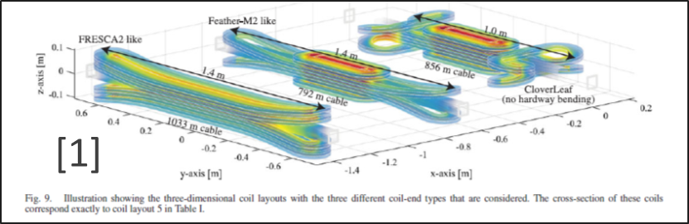
HFM R&D plans related to HTS magnets
  Manufacture and test sub-scale and insert coils as a “R&D vehicle” and demonstration of operation beyond the reach of Nb₃Sn.
  Explore the ‘controlled-insulation’ scheme for HTS coil by testing coils with reasonable current and test it with requirements for accelerators.
  Optimize the shape design to reduce wrong field components (//c).
  Study the end design options (cloverleaf, CCT,…) to mitigate the complexity of tape ratio aspect and hard way bending
  Explore and model the screening currents effects (magnetization and temporal stability) and ways to decrease/remove these effects (overshoot/vortex shaking/temperature increase)
  Explore the possibility of intermediate temperature range (10-20 K) and dry magnet (conduction cooled).
EPS-HEP Conference, 30 July 2021

Slide 13
HFM R&D plans related to Cross-cutting Technology
Materials, Cryogenics and Modelling
  Develop and characterize materials and composites relevant to HFM
  Develop new engineering solutions for thermal management of high field magnets
  Consolidate the modelling tools to complement short model magnets.
HFM Magnet Protection
  Explore alternative detection methods (more difficult for HTS than for LTS) including new quench diagnostics
  Explore alternative protection methods (LTS and HTS have high energy density) to make them faster and more efficient.
HFM Production infrastructure
  Develop at the partners’ laboratories, dedicated infrastructure suitable for HFM R&D, at the start.
  Construction of full-scale prototypes, also engaging industry, is needed in early phases of the activity.
HFM Test Infrastructure and Instrumentation
  Review existing diagnostic, instrumentation and test infrastructure as required by HFM R&D, and establish future needs.
  Coordinate instrumentation and test infrastructure development and upgrades and facilitate sharing of test resources within the scope of HFM R&D.
HFM Applications to Science and Society
  Evaluate and foster the scientific and societal impact of the HFM R&D, maintaining a tight connection with the HFM stakeholders.
EPS-HEP Conference, 30 July 2021

Slide 14
Conclusions
The HFM roadmap process is progressing well, taking into account the needs of the high energy physics community for future colliders.
The first R&D plans are emerging and will soon be translated into prioritized roadmaps, proposed demonstrators, and engagement scenarios.
The impact of HFM magnet development on the industrial ecosystem, on the training and education of future generations of magnet builders, and on the sustainability of the technologies developed will also be explored.
The challenge for the next 5 to 10 years is considerable, but HFM community is ready to respond.
EPS-HEP Conference, 30 July 2021

