Slide 1

ARES Operation Meeting
Summary of week 49
Restart: 11.1.2021
Willi Kuropka, on behalf of the ARES shift crew
Shutdown (Monday = Maintenance day)
ACHIP beam time
Beam Commissioning (Linac section + EA1)

Slide 2
Summary
Week 49
 | Monday 30rd November | Tuesday 1st December | Wed. 2nd December | Thursday 3rd December | Friday 4th December
Achievements | Laser equipment of EA laser table integrated into doocs | Phase/momentum scans for TWS1 and 2 | TWS1 and 2 phase scans for bunch length estimate | Check on Ho:YLF and cathode laser timing by Huseyin and Caterina Testing beam diagnostic equipment in EA chamber Beam detected on EA.A1 | MSK shift, TWS1 and 2 calibrated, ADC settings adjusted Investigation of DaMon signal for the “double beam” More tests on EA chamber optical spectrometer
Difficulties |  | Vacuum valve did not respond for some time EA.R1 screen also has “dirt” on it | Camera server one has frequent hiccups that prolong data taking (Maximum measurable momentum of the PDE is 158MeV/c) Some LLRF ADC overflow | Did not see signal from optical spectrometer, yet | Camera server one has frequent hiccups that prolong data taking
Notes |  |  | There appears to be a secondary beam in the machine |  | Secondary beam might occure due to cathode laser pulse picker issue

Slide 3
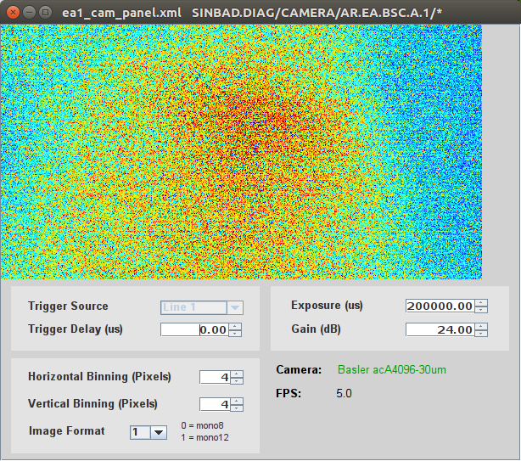
Beam at EA.A1 in the chamber
xrms = 61um (estimate...)

Slide 4
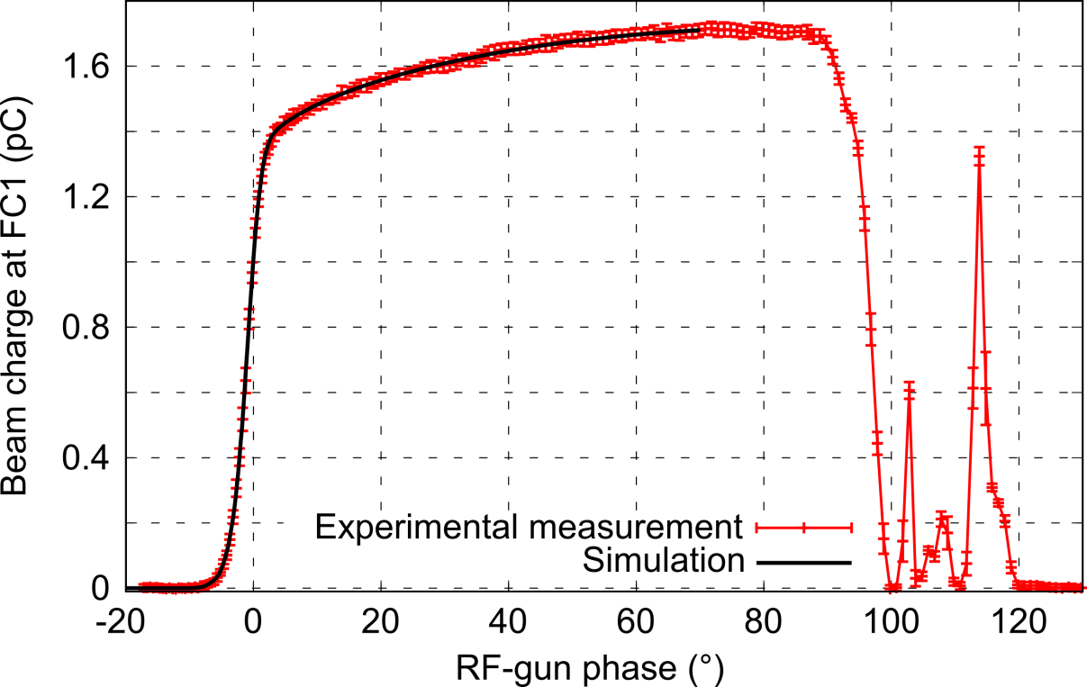
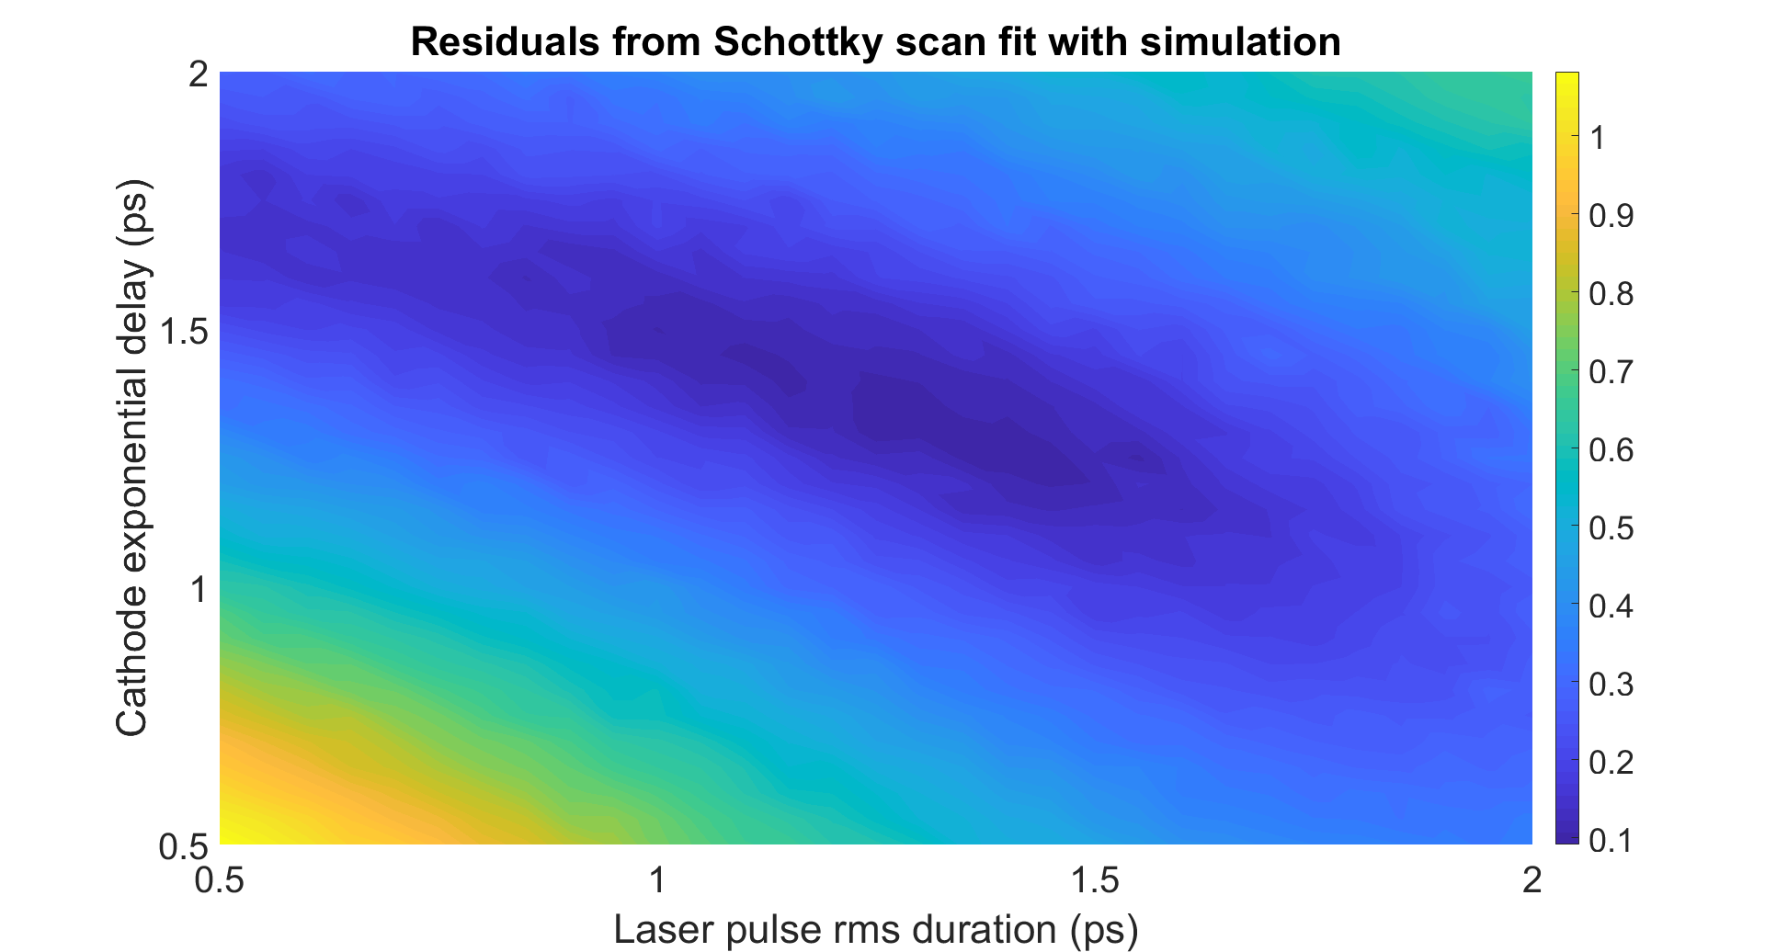
Schottky scan after laser alignment
Measurement performed (26/11/2020) after laser alignment on the new Cs₂Te cathode (Gun SP 65 MV/m).
Mo cathode (23/10/2020)
Cs2Te cathode (14/08/2020)
Native charge | 1.253 pC
Max. Charge | 1.716 pC
Laser pulse | 1.35 ps rms
Cathode delay | 1.27 ps
Native charge | 0.447 pC
Max. Charge | 1.547 pC
Laser pulse | 0.546 ps rms
Cathode delay | ≈ 0 ps
Native charge | 0.602 pC
Max. Charge | 1.555 pC
Laser pulse | 0.546 ps rms
Cathode delay | 1.38 ps
Schottky contribution massively reduced and laser pulse duration seems to have changed (increased).

Slide 5
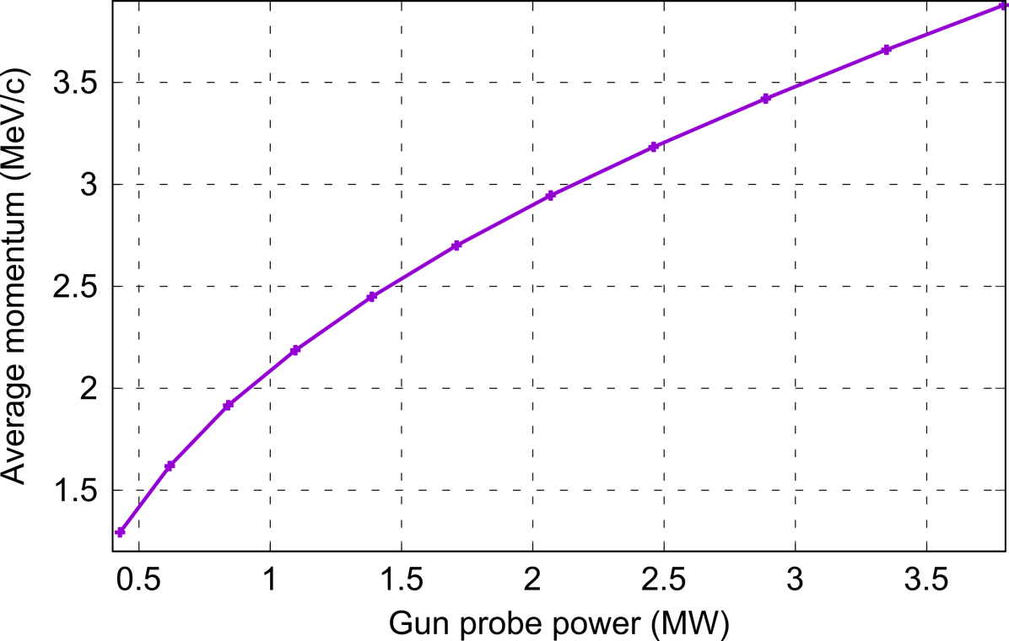
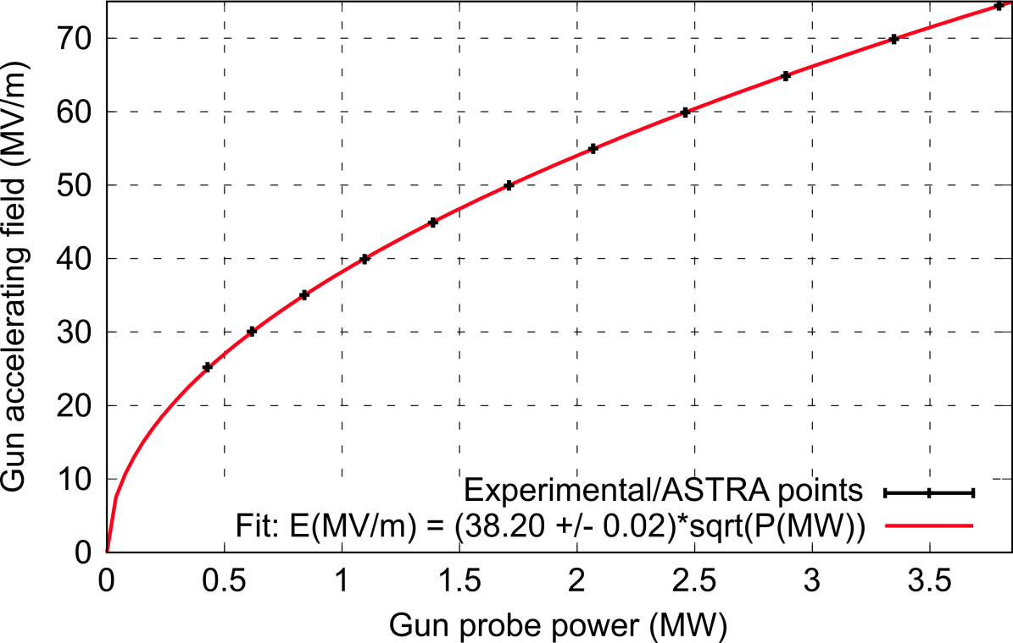
Gun max. momentum vs power
Measurement performed (20/11/2020) before laser alignment on the new Cs₂Te cathode.
Single e⁻ ASTRA simulation
Gun shunt impedance determined to 38.20 +/- 0.02. Very close to the 37.92 +/- 0.06 determined with the Mo cathode using a collection of measurements.
Confirmed to be much lower than the previous gun (47.67).

Slide 6
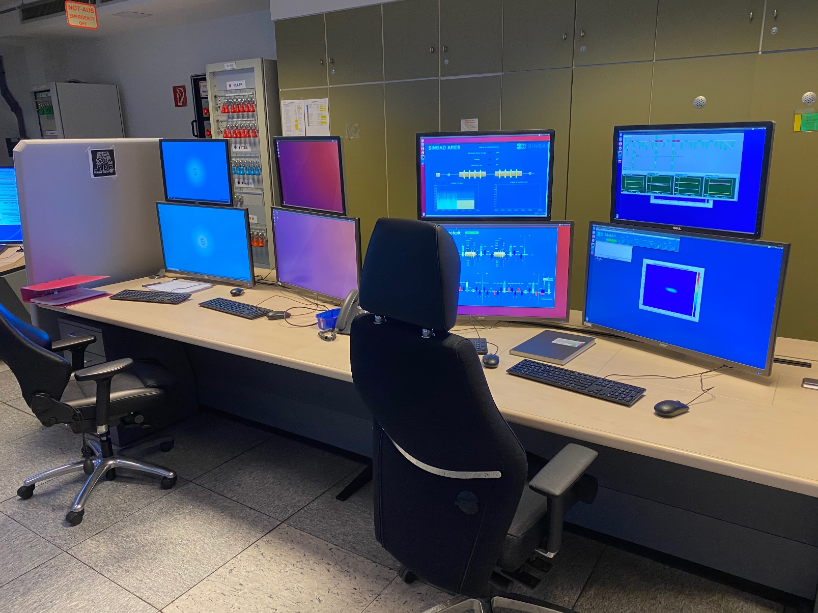
BKR – we are back…
It is soo quiet…
All „guests“ have to sign the attendance list!
The shift leader can be identified through the logbook and does not need to sign in here
No hand-shaking, keep the distance – 1.5m!!
2 people w.o. masks is ok (with distance) if there are more then 2 people wear a mask!
Please disinfect the keyboards, mouse, chairs and telefon after the shift.

Slide 7
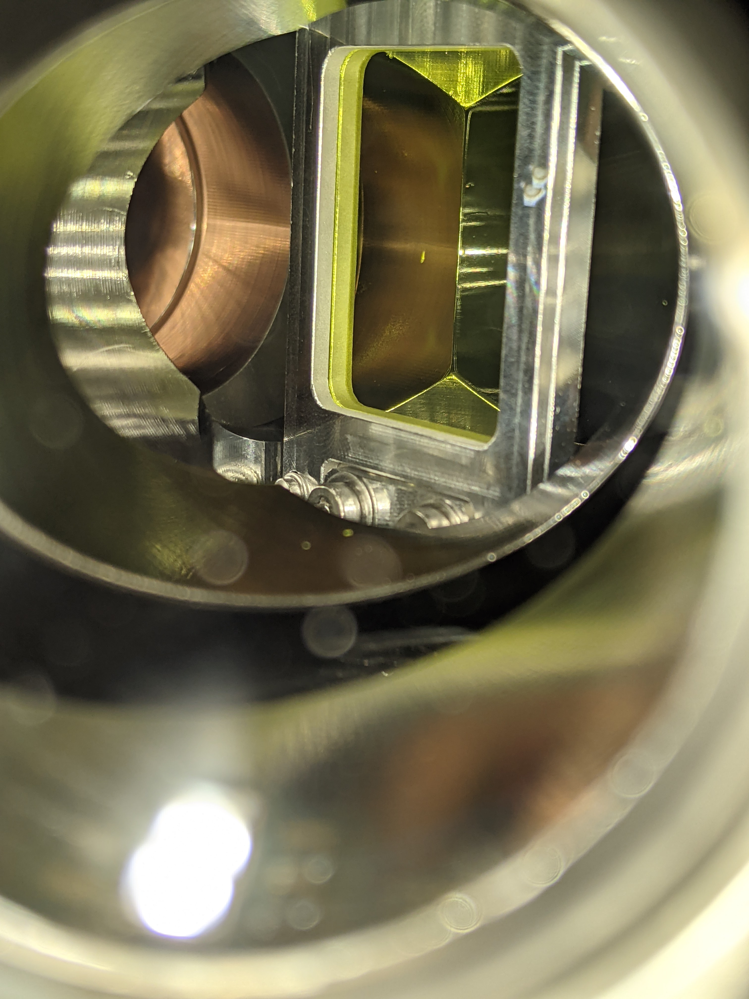
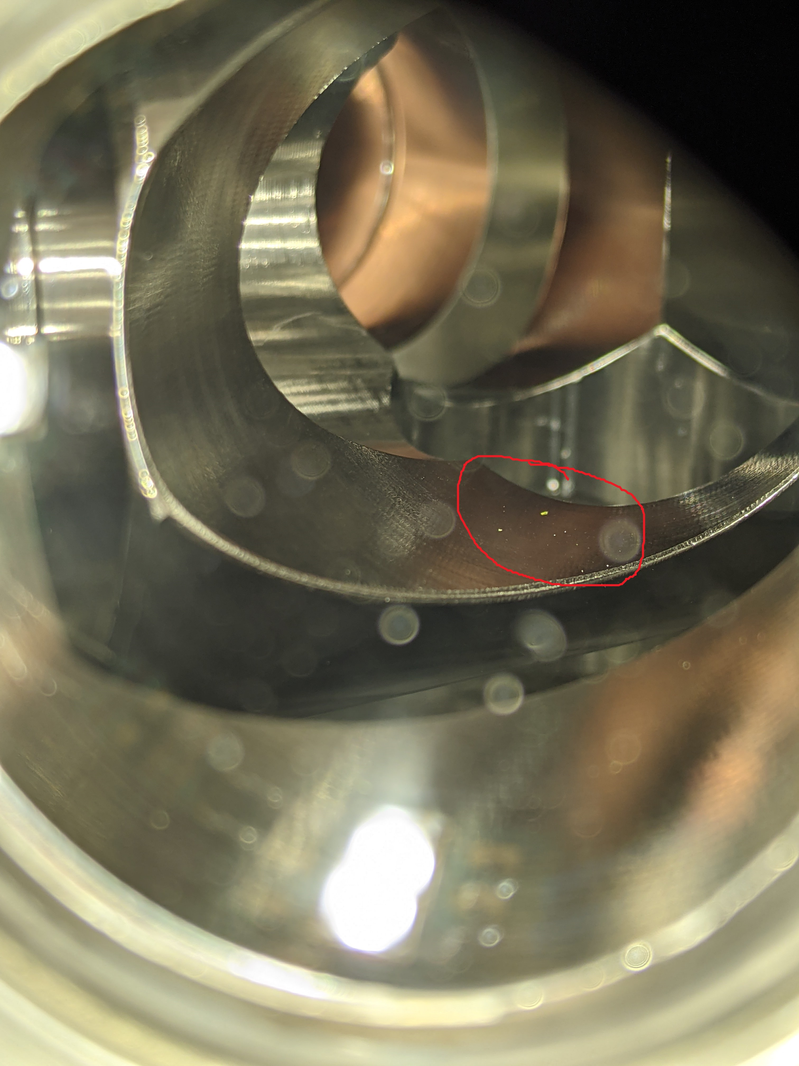
Technical issues
X1 screen object
MVS will do some clean-up.
Date to be defined.

Slide 8
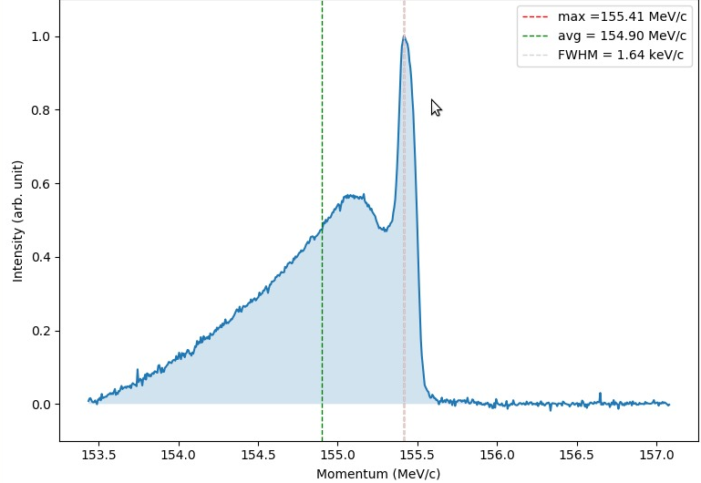
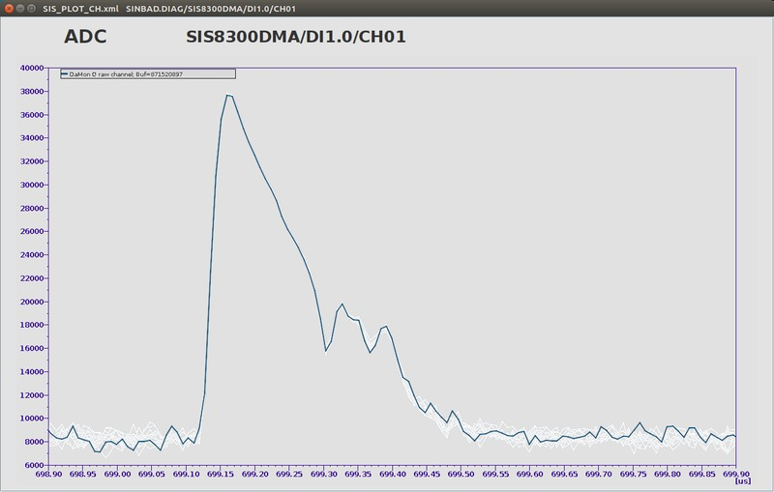
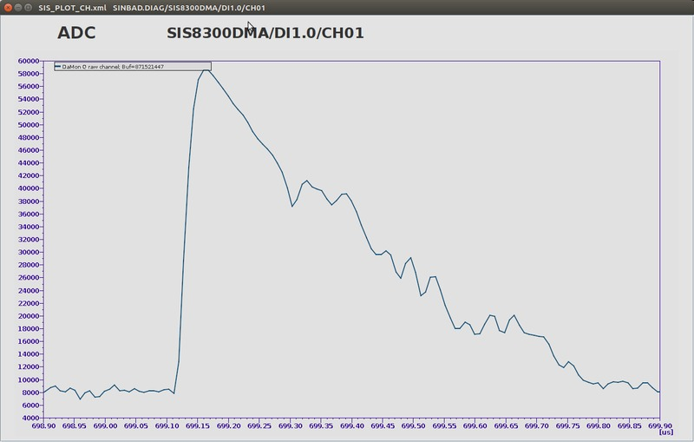
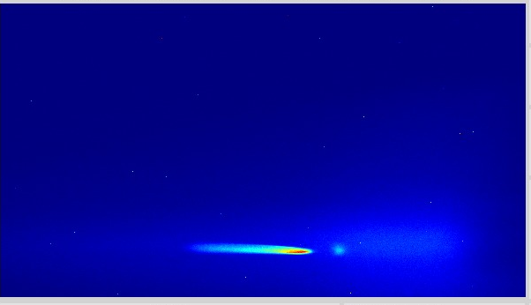
Double peak on the spectrometer
PDE spectrum R1 with laser aperture
DAMON with laser aperture
FS-LA assumes pulse picking issues.
Analysis ongoing.
DAMON without laser aperture
PDE Screen R1 with laser aperture

Slide 9
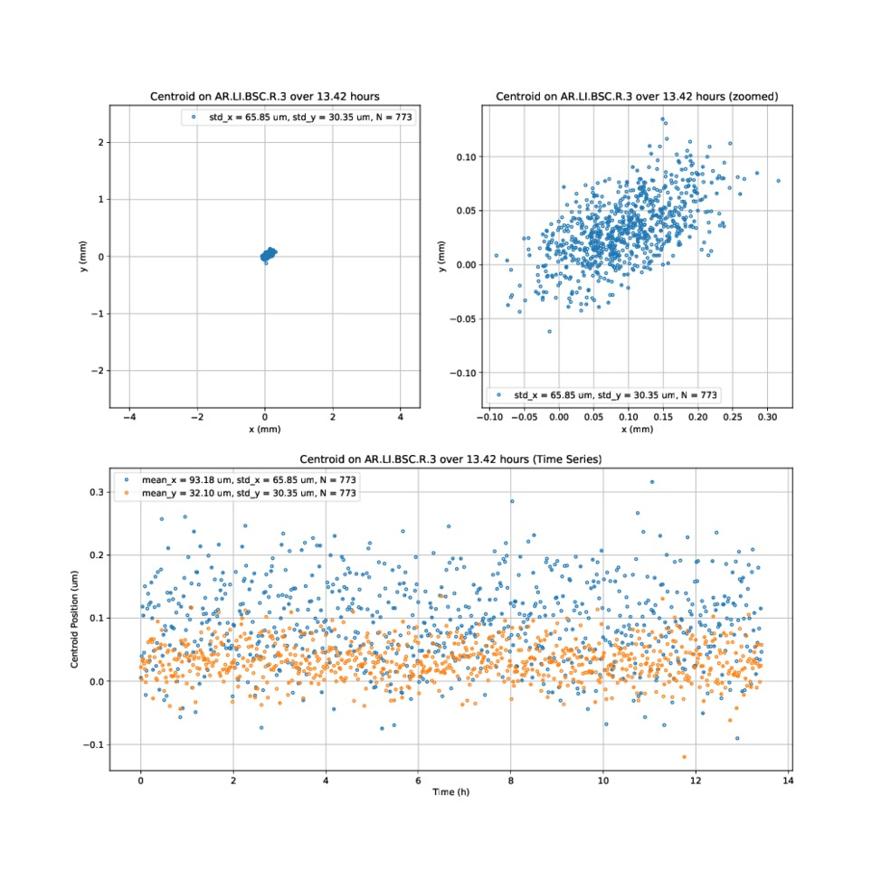
Stability
(mm)

Slide 10
Next steps
Align Laser ü
Re-check solenoid alignment at gun – üdata analyzed
Last items of gun diagnostics: - dark current curve from 0 to 75 MV/m ü - Max. charge measurement curve with 75 MV/m - QE of cathode – ü data analyzed - re-measure emittance - check FC vs. Damon and Toroid ü - Collimator setup ü
Beam through the Linac at 100 MeV (setpoint for ACHIP)
Over night stability measurements: FC(dark current), position on X1, Momentum stability at Gun.

Slide 11
Schedule
Week 50
Date | Shiftleader
7.12. | MEA – safety walk, FS-LA, CFEL
8.12. | Hannes
9.12. | Willi/Frank
10.12. | Willi/Frank
11.12. | Thomas

Slide 12
ARES Schedule
Restart: 11.1.2021
Shutdown (Monday = Maintenance day)
ACHIP beam time
Beam Commissioning (Linac section + EA1)

