Slide 1
ARES Operations Meeting
Week 50 / 2020
W. Kuropka, on behalf of the ARES shift crew and ACHIP@SINBAD

Slide 2
Report from last week, first ACHIP run
Monday: Transmission of the 2um laser through the EA chamber
Tuesday: set up working point for electron transmission through DLA, and radiation detection
Wednesday: still setup for transmission, got the beam on chamber YAG screen
Thursday: beam easy to find on EA.A1, trying to decrease spotsize, additional camera installed at chamber view port, big thanks to Olaf and MEA
Friday: observe the glowing DLA via the viewport camera
Weekend: long term stability measurement using the PDE

Slide 3
Experimental issues
Secondary beam, we still do not know where it is coming from, pulse picking is not the problem
Large energy spread due to secondary beam, focus of the main beam is impossible to find
Missalignment of the EA quads also adds dispersion
Could not detect radiation from the DLA using optical spectrometer, but is visible on the observation camera
Alignment channels in the sample holder are too easy to find…smaller channels would be great
finally…optical fiber of the spectrometer is in the beam path for some hexapod positions

Slide 4
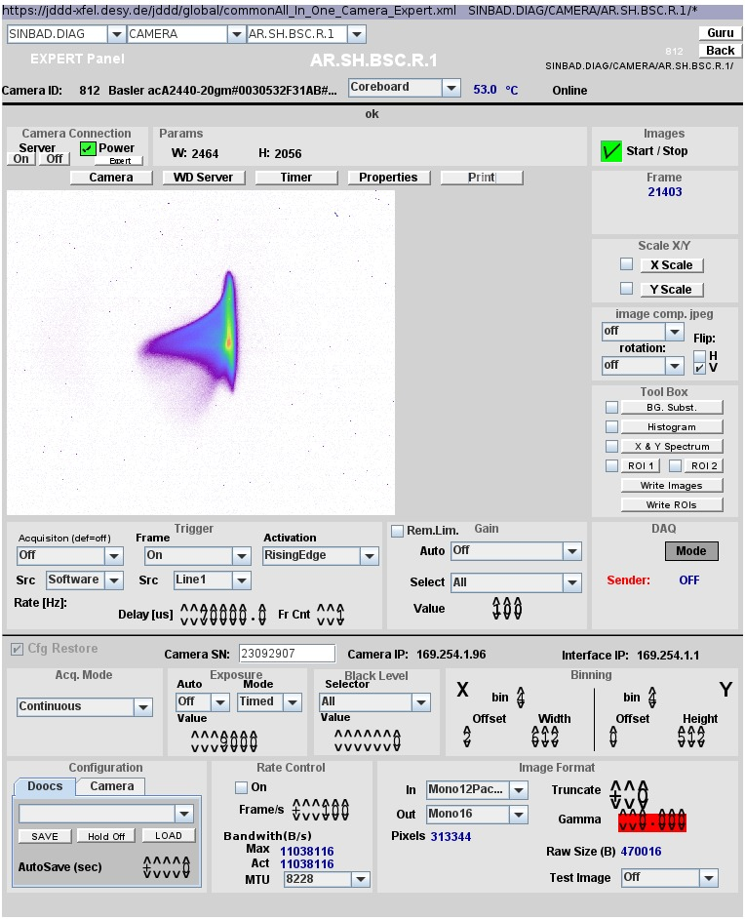
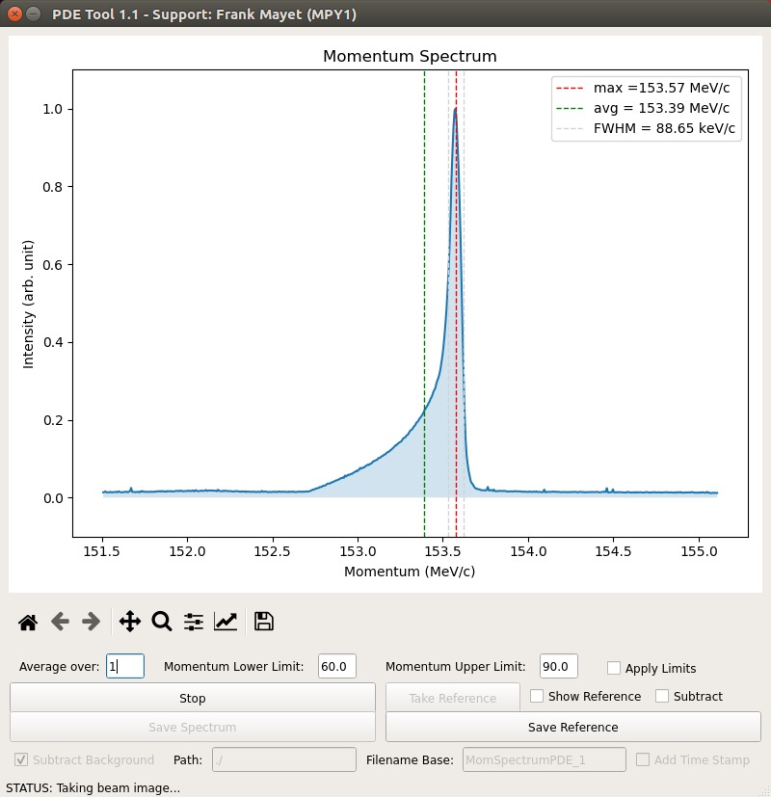
Experimental issues 1 – secondary beam

Slide 5
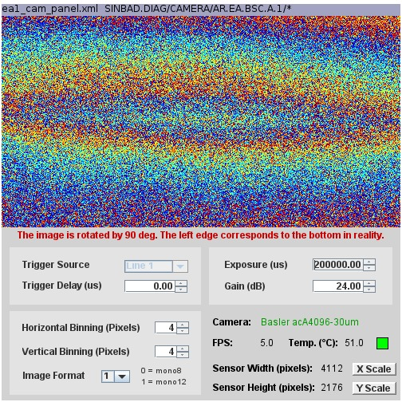
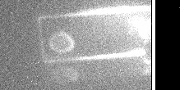
Experimental issues 2 – EA.A1
observation camera
Horizontal beam size: ~58 um, rms

Slide 6
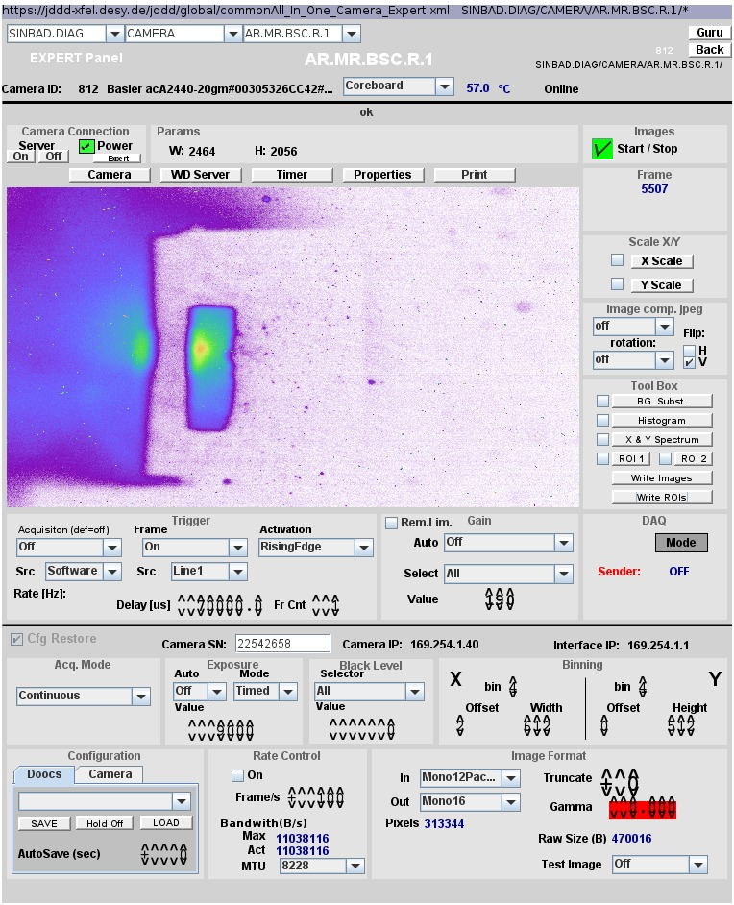
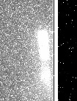
Experimental issues 3 – EA chamber spectrometer
observation camera
shadow of the sample holder and DLA

Slide 7
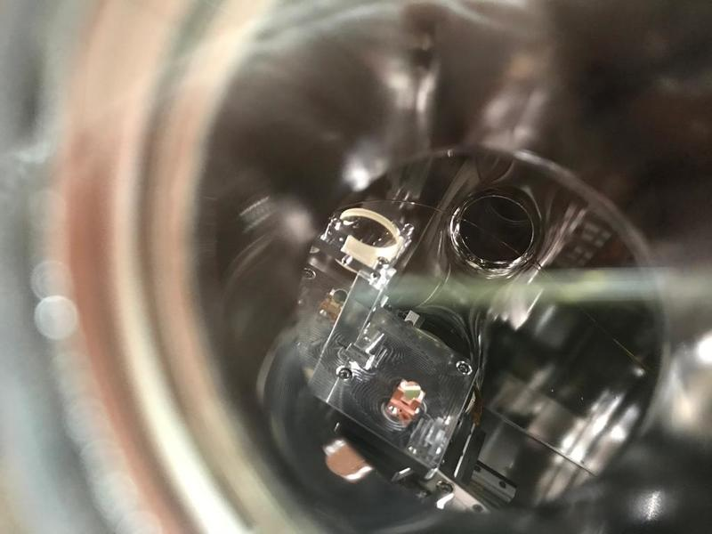
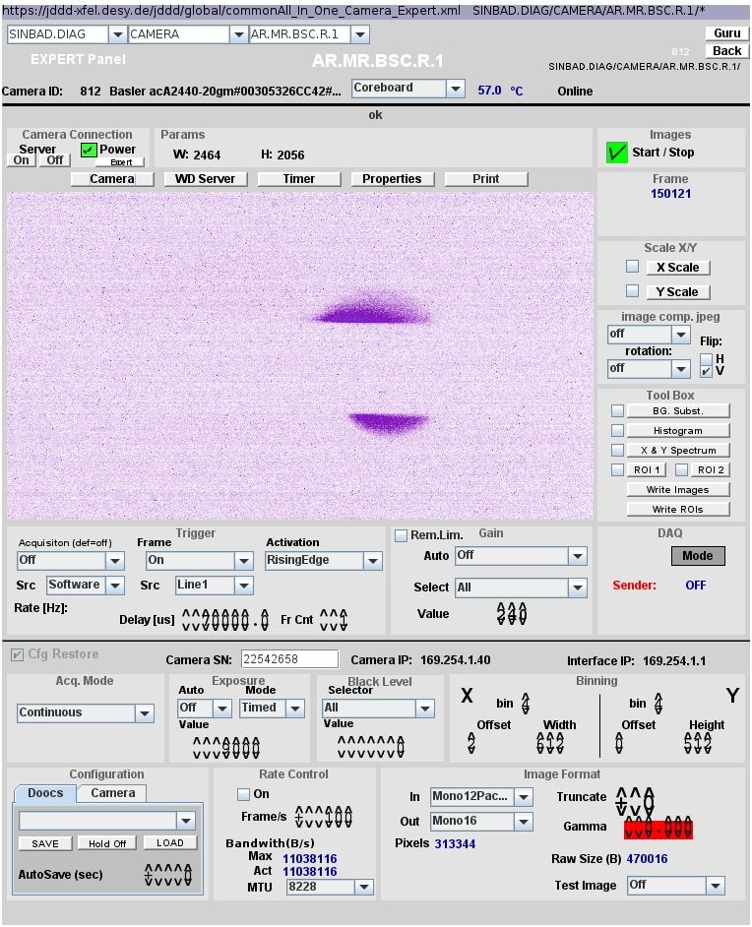
Experimental issues 4 – EA chamber fiber
observation camera
shadow of the fiber

Slide 8
Lots of lessons learned!
2um laser setup
2um laser timing synchronization
electron beam setup
Observation camera at EA chamber
YAG screen at EA chamber
Tools for accelerator and chamber diagnostic control

Slide 9
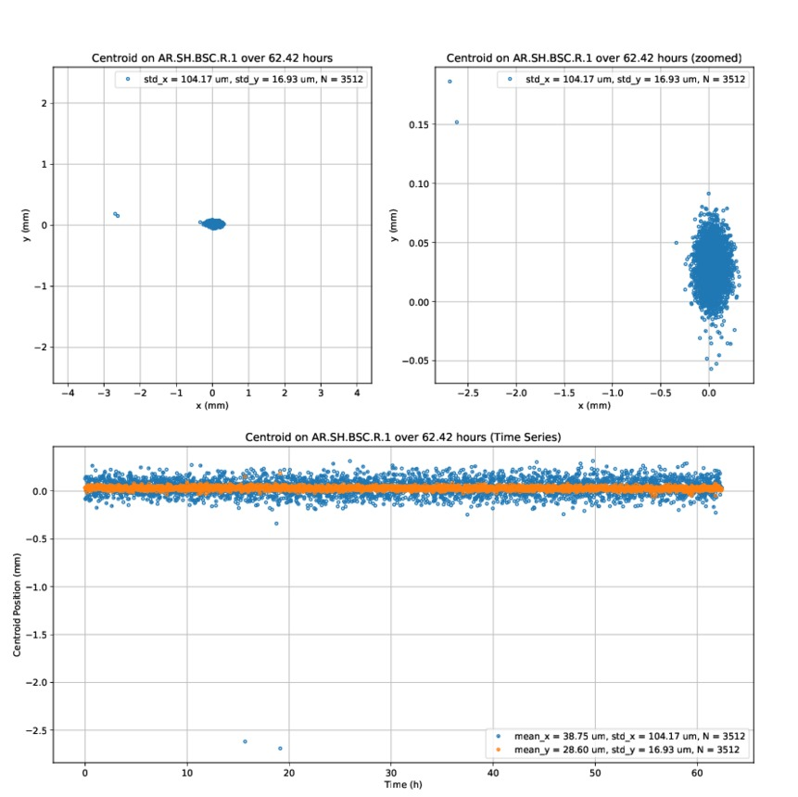
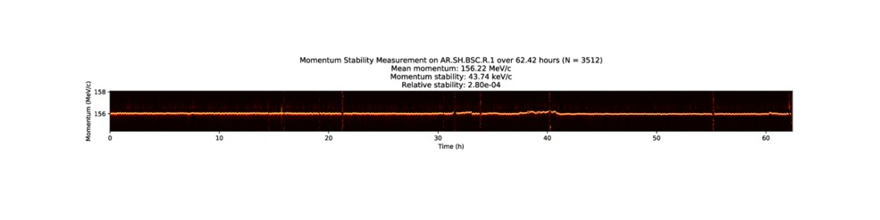
Longterm stability measurement over the weekend

Slide 10
Technical issues
Few magnet hickups
few vacuum events

Slide 11
Plans for week 51
Cathode laser investigation by FS-LA
investigation of EA quad triplet alignment

Slide 12
Schedule
Week 51
Date | Shiftleader
14.12. | Florian
15.12. | Thomas
16.12. | Willi
17.12. | Hannes/Willi
18.12. | Thomas/Hannes

