Slide 1
Driving the paradigm shift towards Open Science: FAIR data
Carlos Casorrán & Kostas Repanas
European Commission
Directorate-General for Research and Innovation
Open Science unit
RDA Deutschland Tagung 2021
Feb 25th, 2021

Slide 2
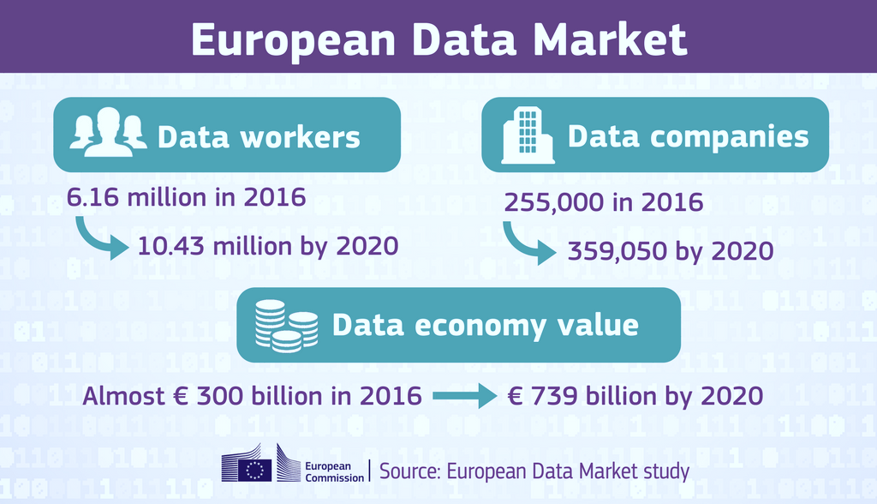
Data
Data is the main asset of the digital economy
Poor data management incurs an opportunity cost in the billions of euros
Data production continues to grow exponentially→ from 33 zettabytes in 2018 to 175 zettabytes in 2025
Research/Science is one of the main data producing/consuming domains

Slide 3
Open Science for us at the EC
Open Science means sharing knowledge and tools as early as possible, not only between researchers and between disciplines, but also with society at large.
Open Science improves the quality, efficiency and creativity of research and the trust by society in science. In particular, OS is beneficial for science, scientists and funders, e.g.:
The Commission acts as policy maker (propose legislation and encourage MS), a funder (we set requirements to our projects) and a capacity builder (we fund ‘enabling’ projects).
tackles the reproducibility crisis;
faster response to societal challenges e.g. Coronavirus, Ebola;
access to and sharing results yields higher impact through collaborations;
generates new research findings and decreases inequalities;
large opportunity costs of non-FAIR data—€10.2bn/year (source: Cost-benefit analysis of FAIR research data, 2017).
Notes:
The difficulty is that you have to provide the right rewards and incentives for open science at all levels, so you have to do it first and foremost at the institutional level, e.g. the level of each university, you have to do it at the funders level, you have to do it at the national and regional level, and also at the EU level. So the more we address what needs to be done to change researcher behaviour the more we need to engage with a broader and broader range of stakeholders if we want to be effective.

Slide 4
Horizon 2020 & Horizon Europe
Horizon 2020: ~ €80bn
Horizon Europe: ~€95.5bn
The Commission invests heavily in Research and Innovation.
Over 30000 H2020 projects—Projects produce research outputs, data, deliverables, etc.
It becomes increasingly important to make the best possible use of previous work.

Slide 5
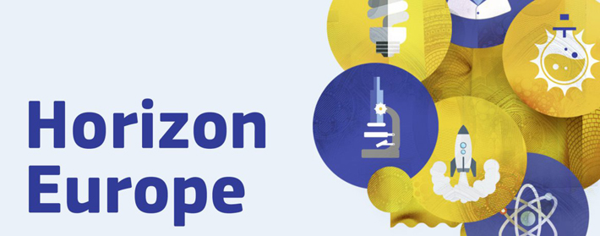
Evolution of our policies across the FPs
Planned under Horizon Europe (2021):
Open Science (OA, RDM, Cit. Eng., etc.) embedded throughout the FP. OS to play a role in the:
Evaluation of proposals (methodology)
Grant Agreement
Reporting—during the project’s lifetime
Strengthening of the obligations with respect to open access and focus on responsible RDM in line with FAIR
FP7
OA Pilot
Deposit and open access
H2020
OA Mandatory
Deposit and open access
& ORD/DMP Pilot
H2020
OA Mandatory
Deposit and open access
& ORD/DMP by default
(exceptions)
2017
2014
2008

Slide 6
Research data under Horizon Europe
The governing principle will be to manage research data responsibly, in line with FAIR, and for data to be “as open as possible and as closed as necessary”. We are likely to see the following:
At proposal stage, beneficiaries will be evaluated on preliminary RDM considerations
All projects that generate/collect/re-use research data will have to establish and regularly update a Data Management Plan (living document)
Beneficiaries will have to deposit data in a repository and link their data to publications they underpin, if applicable
Valid repositories will be those that provide PIDs for the data and ensure rich metadata in line with FAIR.
For some actions, an additional obligation to deposit in a repository that is federated under EOSC.
Beneficiaries to ensure open access ASAP under CC BY or CC0 licences (or equivalent), unless exceptions apply (duly justified in the DMP)
Notes:
The difficulty is that you have to provide the right rewards and incentives for open science at all levels, so you have to do it first and foremost at the institutional level, e.g. the level of each university, you have to do it at the funders level, you have to do it at the national and regional level, and also at the EU level. So the more we address what needs to be done to change researcher behaviour the more we need to engage with a broader and broader range of stakeholders if we want to be effective.

Slide 7
Other research outputs under Horizon Europe
Data is not the only research output that should be managed → digital: Software, algorithms, protocols, workflows, models, and physical: reagents, antibodies, hardware, etc. all need to be properly managed:
We would like to see other research outputs also described in the DMP.
There will be a strong encouragement for beneficiaries to deposit and provide open access via a repository to these outputs, unless legitimate interests or constraints apply.
Research outputs, either digital or physical, should also be findable, interoperable, accessible and re-usable → We need a better understanding of
What FAIR means for digital objects, other than data (e.g. software).
Notes:
The difficulty is that you have to provide the right rewards and incentives for open science at all levels, so you have to do it first and foremost at the institutional level, e.g. the level of each university, you have to do it at the funders level, you have to do it at the national and regional level, and also at the EU level. So the more we address what needs to be done to change researcher behaviour the more we need to engage with a broader and broader range of stakeholders if we want to be effective.

Slide 8
Trusted repositories under Horizon Europe
Trusted repositories are either certified repositories (e.g. CoreTrustSeal, nestor Seal DIN31644, ISO16363) and/or disciplinary/domain repositories that are commonly used/endorsed by the research communities (e.g. ELIXIR deposition databases).
General-purpose repositories and institutional repositories are, in general, also acceptable.
Trusted repositories share essential properties:
Mechanisms to ensure integrity and authenticity of contents.
Offer clear information about their policies/services.
Provide broad, and ideally open access to content (consistent with legal and ethical constraints).
Assign PIDs, ask for detailed metadata in a standardized (e.g. Dublin Core) and machine-readable way.
Ensure mid- and long-term preservation of contents, expert curation, quality assurance.
Meet national and/or international security criteria
Notes:
The difficulty is that you have to provide the right rewards and incentives for open science at all levels, so you have to do it first and foremost at the institutional level, e.g. the level of each university, you have to do it at the funders level, you have to do it at the national and regional level, and also at the EU level. So the more we address what needs to be done to change researcher behaviour the more we need to engage with a broader and broader range of stakeholders if we want to be effective.

Slide 9
Key documents
Important to align data management practices and have a common understanding among various funders.
The Model Grant Agreement
The Annotated Model Grant Agreement
Guidelines for proposers
DMP:
Preliminary RDM considerations included in the HE proposal forms
Now defining templates/common elements for HE respecting e.g. the core elements from the SE guidance
In addition, the SE DMP evaluation rubric is a valuable resource for researchers, but also for reviewers of DMPs at various stages of the data lifecycle
Notes:
The difficulty is that you have to provide the right rewards and incentives for open science at all levels, so you have to do it first and foremost at the institutional level, e.g. the level of each university, you have to do it at the funders level, you have to do it at the national and regional level, and also at the EU level. So the more we address what needs to be done to change researcher behaviour the more we need to engage with a broader and broader range of stakeholders if we want to be effective.

Slide 10
FAIR is great. What’s next?
There is increased familiarity across the board with the FAIR principles, and a firm conviction about the positive impact of FAIR on e.g. enhancing the transparency & quality of the scientific practice, enhanced productivity, etc.
There’s a need to mainstream FAIR practices across the scientific community. Funders across Europe and beyond are incorporating the FAIR principles into their policies & requirements.
Stumbling block: scarcity of comprehensive and comparable evaluation mechanisms/metrics for what have up to now been abstract or imprecisely defined requirements.
A number of initiatives are filling this gap:
RDA WG on the FAIR Data Maturity Model
The FAIRware initiative

Slide 11
FAIR Data Maturity Model
The FDMM WG has delivered a set of indicators (Lego building blocks of FAIRness), priorities on these indicators (taking into account different readiness levels across communities), and guidelines (explaining in detail what each indicator is about, and how it can be satisfied).
The outputs of the WG are the foundation on which FAIR assessment/evaluation methodologies can be built with two important purposes:
Self-assessment: To allow researchers to gauge the FAIR maturity of their research outputs and how to progressively improve against clear targets.
Evaluation: To allow funders to monitor compliance against set requirements

Slide 12
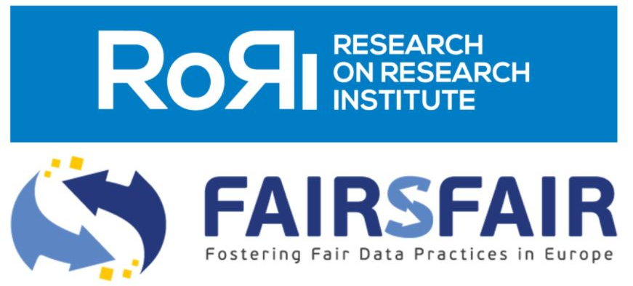
The FAIRware initiative
This is an effort led by RoRI (Research on Research Institute) supported by funders across the UK, Europe and Canada.
The goal is to develop new open source software tools and systems to mainstream uptake of the FAIR principles (e.g. including automatic FAIRness evaluation tools).
Involvement of H2020 project FAIRsFAIR
FAIRsFAIR is a Coordination and Support Action funded by the EC aiming at the mainstreaming of the FAIR principles across communities. It is developing and implementing global standards for FAIR certification of repositories, and linked to ongoing EOSC efforts.
Its involvement in this initiative ensures a significant pool of existing knowledge on which to continue building, and prevents related activities from happening in isolation.

Slide 13
FAIR and data sharing against the Sars-CoV-2
This effort represents a practical use case of FAIR data in action.
The European Commission launched on 20 April the European COVID-19 Data Platform together with EMBL-EBI, ELIXIR, and other partners, and with the support of MS.
The Platform is a international thematic priority pilot to realise the EOSC vision and to showcase the added value of FAIR data sharing to advance science and benefit researchers
It responds to the need to capitalise on the quick and wide sharing, re-use, processing of and access to research data and metadata on the SARS-CoV-2, and the related COVID-19 disease.
A very strong focus is placed on ensuring that data and metadata on this Platform are as open and as FAIR as possible.
Crucial lesson: Researchers need quick and unrestricted access to multiple data sources to accelerate their research. FAIR data is an essential component in this.

Slide 14
FAIR and data sharing, modelling and processing
In addition to the platform, the Commission promotes FAIR and data sharing through:
The drafting of detailed guidelines on open access to publications and data for Horizon 2020 projects, encouraging beneficiaries to go beyond their contractual obligations
The guidelines share best practices on FAIR, open access, data management plans, and also provide links to standards, relevant repositories, and an overview of ongoing data-related efforts under the umbrella of EOSC
The Research Data Alliance (RDA) quickly responded to our request and set up a COVID-19 Working Group to deliver detailed guidelines on data sharing under a health emergency

Slide 15
How do we move forward?
FAIR data are an essential component in Open Science policies to use the wealth in data to generate new and impactful research and tackle the reproducibility crisis
As a funder, the European Commission, will impose requirements on all Horizon Europe projects with respect to publications, data, and other research outputs
Specifically, with respect to data, the focus will be on responsible research data management in line with the FAIR principles
The community-backed work developed under the FDMM WG, and new work on the FAIRware initiative are key steps towards evaluation / assessment mechanisms of FAIRness
FAIR is a journey; Assessment of FAIRness, either by funders, or supported by repositories, will not punish beneficiaries, but educate and raise awareness, leading to increased data re-use.

Slide 16
Keep in touch
ec.europa.eu/
europeancommission
europa.eu/
@EuropeanCommission
@EU_Commission
EUTube
@EuropeanCommission
EU Spotify
European Commission
Notes:
Delete/update as appropriate

Slide 17
Thank you
© European Union 2020
Unless otherwise noted the reuse of this presentation is authorised under the CC BY 4.0 license. For any use or reproduction of elements that are not owned by the EU, permission may need to be sought directly from the respective right holders.
Notes:
Update/add/delete parts of the copy right notice where appropriate.
More information: https://myintracomm.ec.europa.eu/corp/intellectual-property/Documents/2019_Reuse-guidelines%28CC-BY%29.pdf

