Slide 1
Magnetic design and manufacturing challenges of SCU with horizontal racetrack geometries
Nikolay Mezentsev
Budker Institute of Nuclear Physics
Novosibirsk, Russia

Slide 2
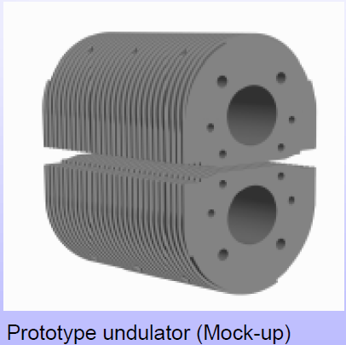
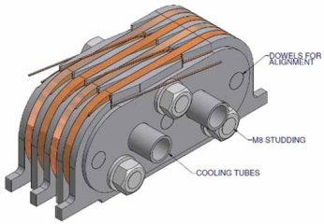
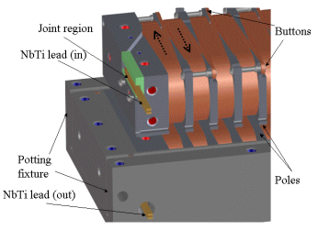
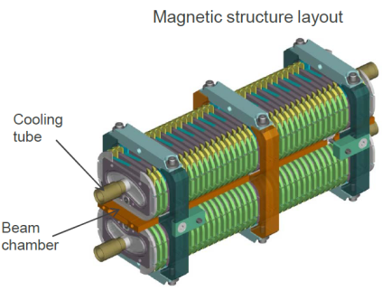
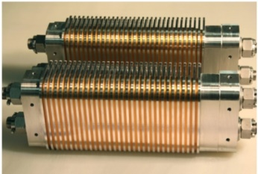




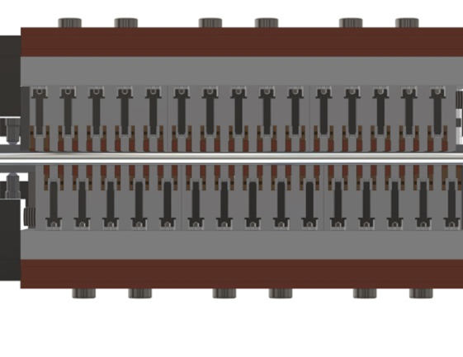
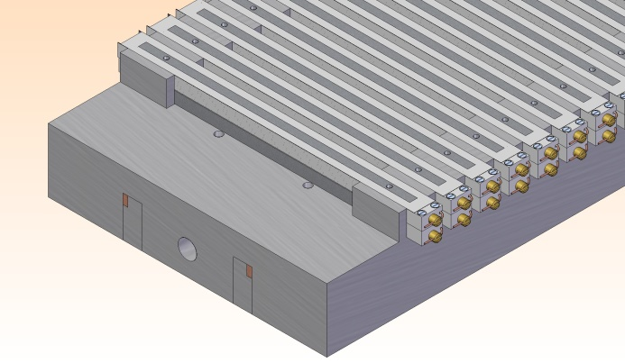
Superconducting undulators
Vertical racetrack coils
LBNL
Horizontal racetrack coils (Budker INP)

Slide 3
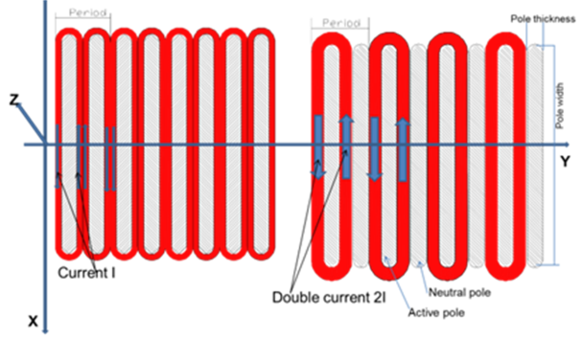
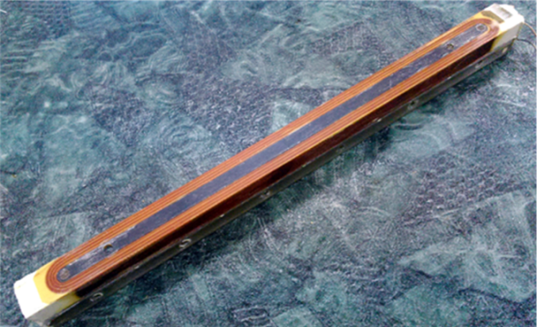
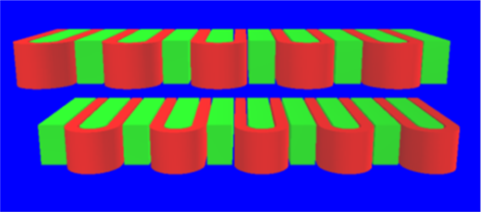
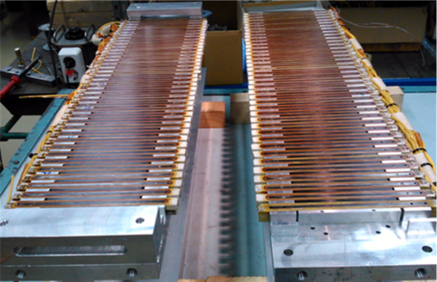
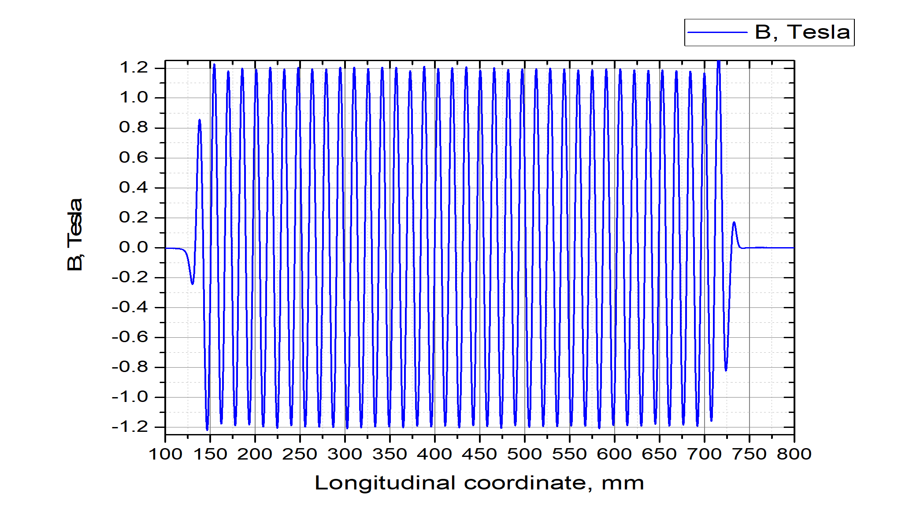
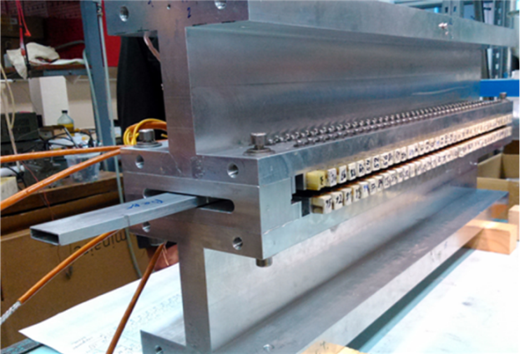
Superconducting undulator with neutral poles (prototype)
On the left - a standard set of poles with windings, on the right – set of active poles separated by neutral poles.
Period – 15.6 мм
Pole gap - 8 мм
Field - 1.2 Тесла
SC wire NbTi/Cu – 0.5 мм
Superconducting active pole
Placement of the upper and lower halves of the undulator. The lower half of the shifted relatively the upper by half period.
Assembly of top and bottom parts of the undulator
Longitudinal field distribution in the undulator prototype
Assembled undulator prototype

Slide 4
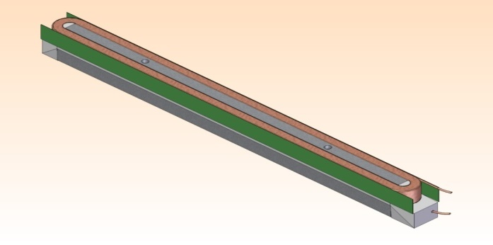
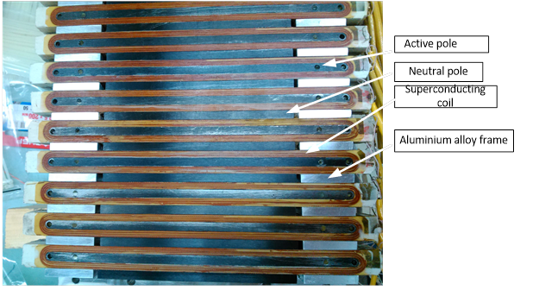
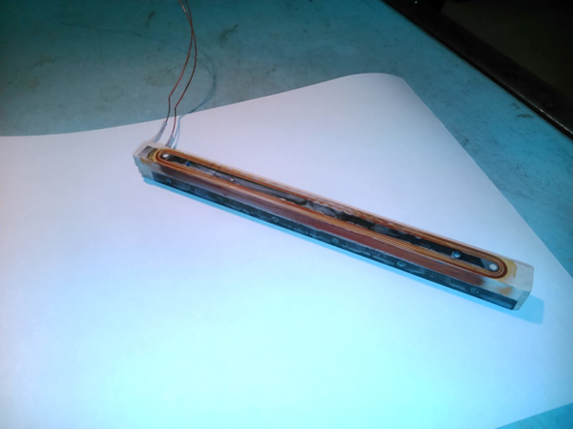
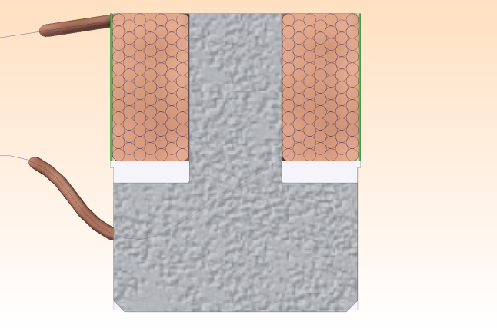
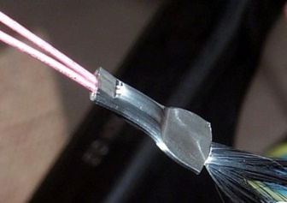
Key element of the undulator
Active pole (drawing)
Motivation of horizontal racetrack coils (HRC)
Easy to control winding accuracy
Easy to control interturn and interlayer contacts
Mass production of identical poles
Possibility of replacing "weak" poles after quench training
Many splices – is no problem with coils heating
Active pole (photo)
SC wire connection with “cold welding” method
R~ 10^-10 --- 10^-13 Ohm
Crosssection of active pole)

Slide 5
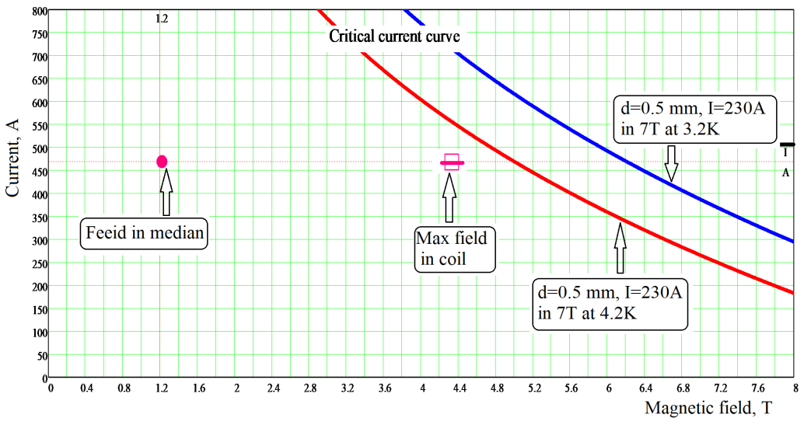
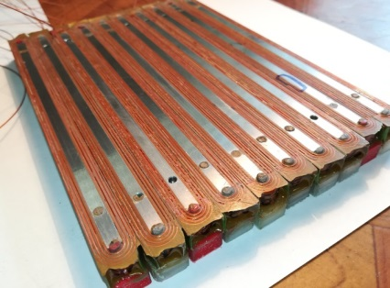
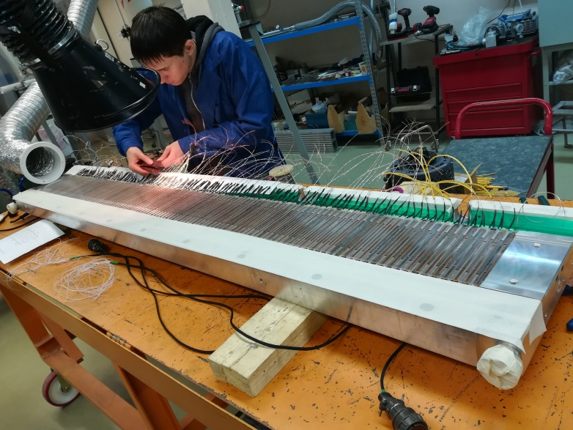
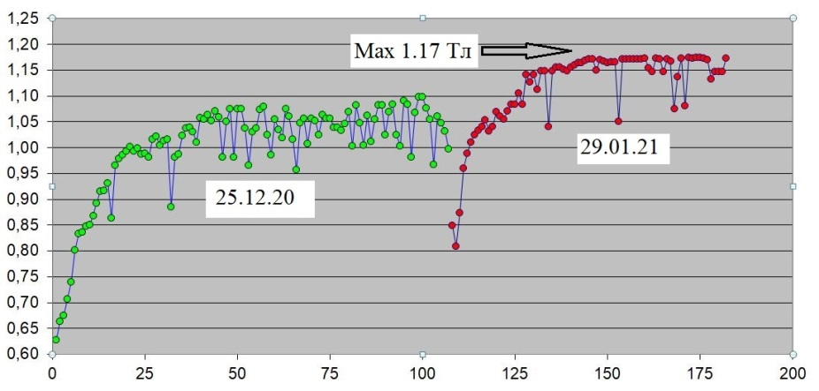
Superconducting undulator full size
Magnetic system
Main parameters:
Magnetic field, T | 1.2
Period, mm | 15.6
Magnetic gap, mm | 8
Period number | 119
Magnetic length, mm | ~2000
Current,A | 450
SC wire diameter, mm | 0.55
Turn number in layer | 12/11
Layer number | 7
Width of coil, mm | 146
SC wire critical current 7T | 250
Ratio Cu/NbTi | 0.42
Operating point position relative to SC wire critical curve (1.2 T at median) for 4.2 and 3.2 K
Quench training 119-period undulator in bath cryostat

Slide 6
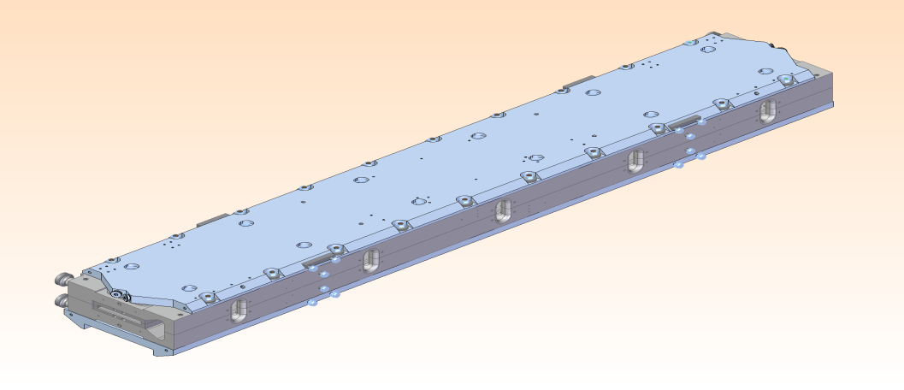
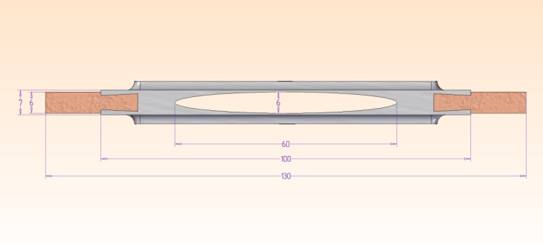
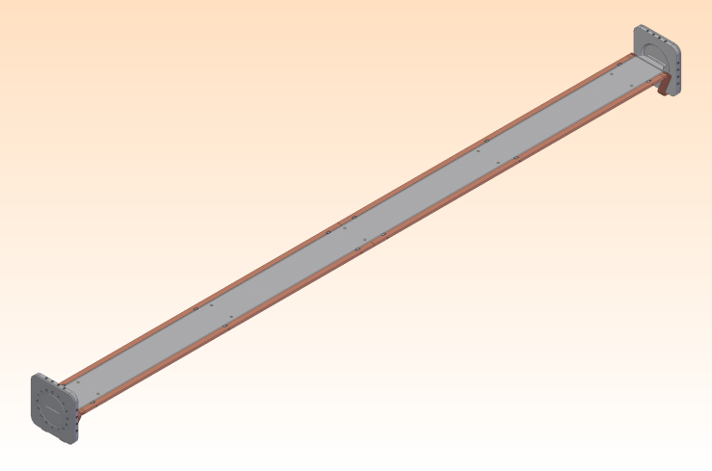
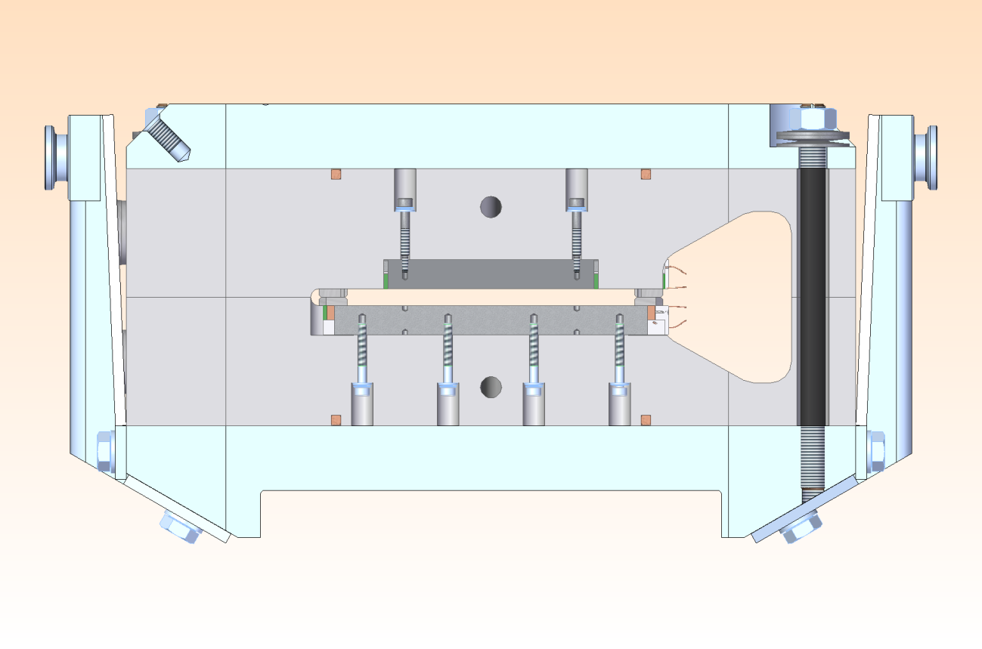
Undulator with period 15.6 mm
Assembled undulator
Beam vacuum chamber (cross section)
Beam vacuum chamber
Assembled undulator (cross section)
Stainless steel case
Main parameters:
λ = 15.6 mm
Pole gap=8 mm
Vertical aperture for beam=6 mm
Max.field = 1.15T(4.2K)- 1.2T (<3.6K)
Period number = 120
Neutral pole
Active pole
Aluminum alloy case

Slide 7
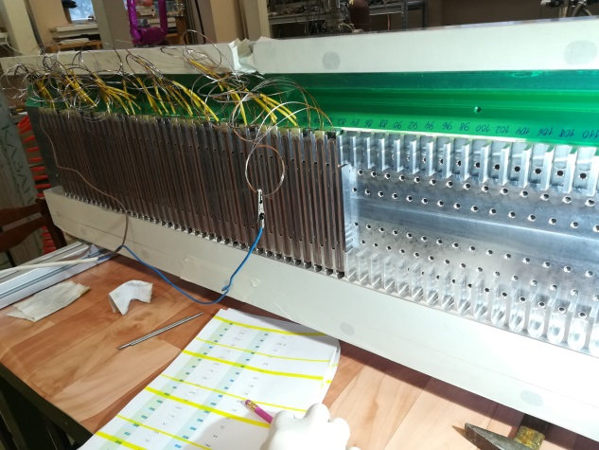
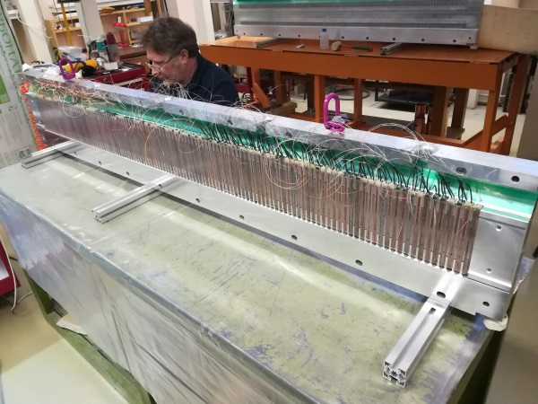
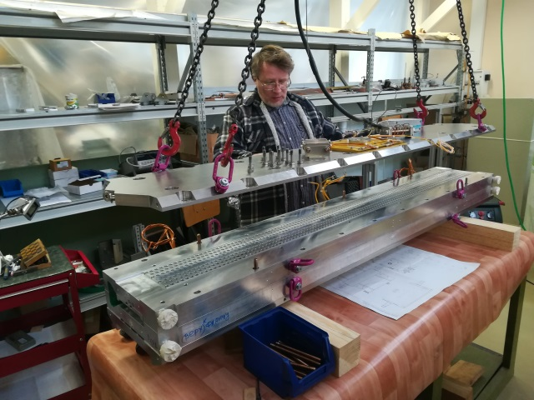
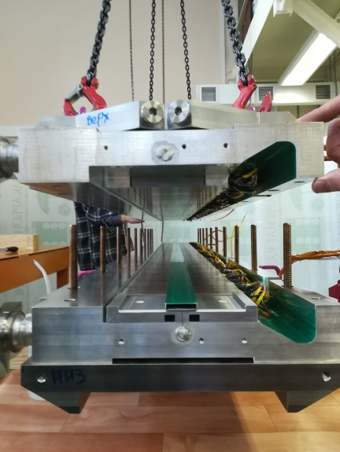
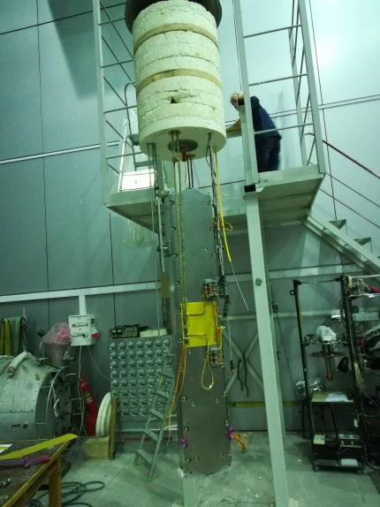
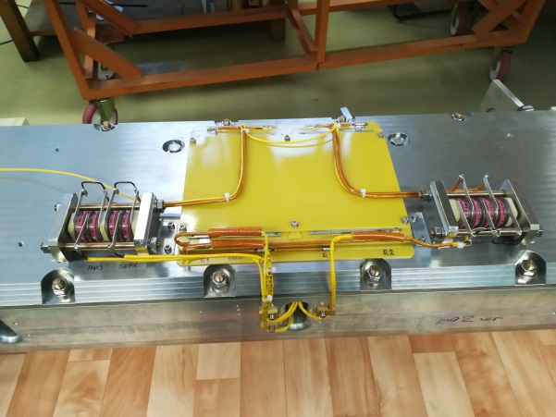
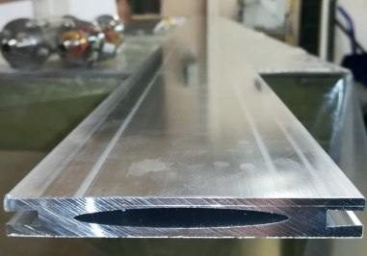
Stages of superconducting undulator assembly
AL 6063 vacuum chamber
Quench protection system
Test magnet in bath cryostat

Slide 8
Magnetic field measurements results
Magnetic field measurements results with Hall probes at field level Bz=1.16T, step=0.2mm
Half period variation along the undulator (mean period = 7.787 mm)
Orbit angle deviation in the undulator E=3 GeV

Slide 9
Local phase error behavior along the undulator
RMS phase error= 2.07 degree

Slide 10
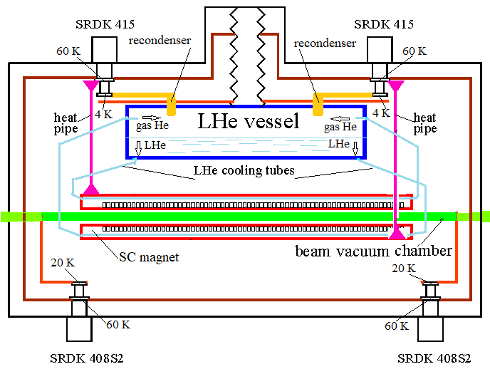
Schematic view of the cryogenic indirect cooling system of the SC undulator

Slide 11
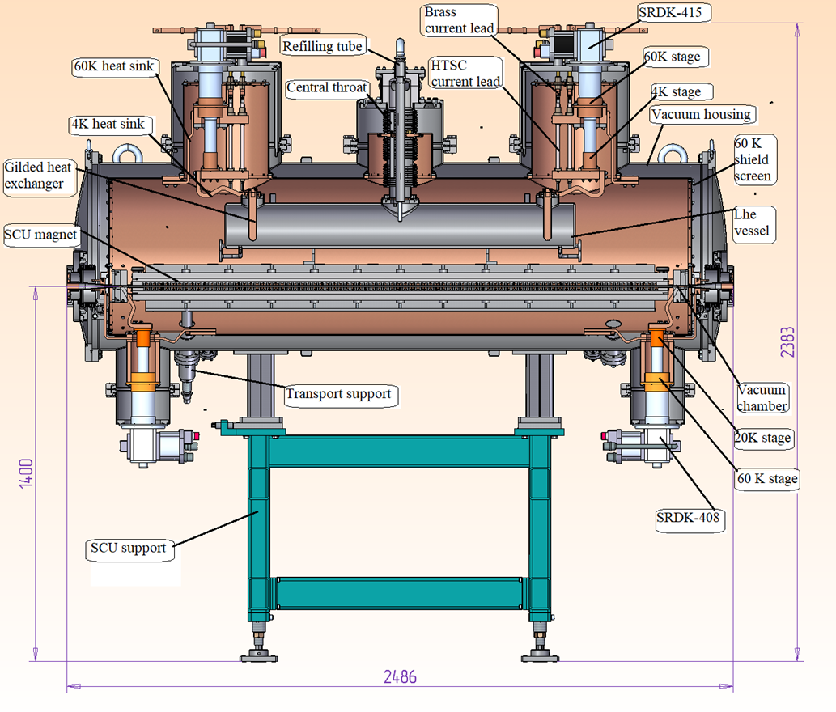
Cross section of the cryogenic indirect cooling system of the SC undulator

Slide 12
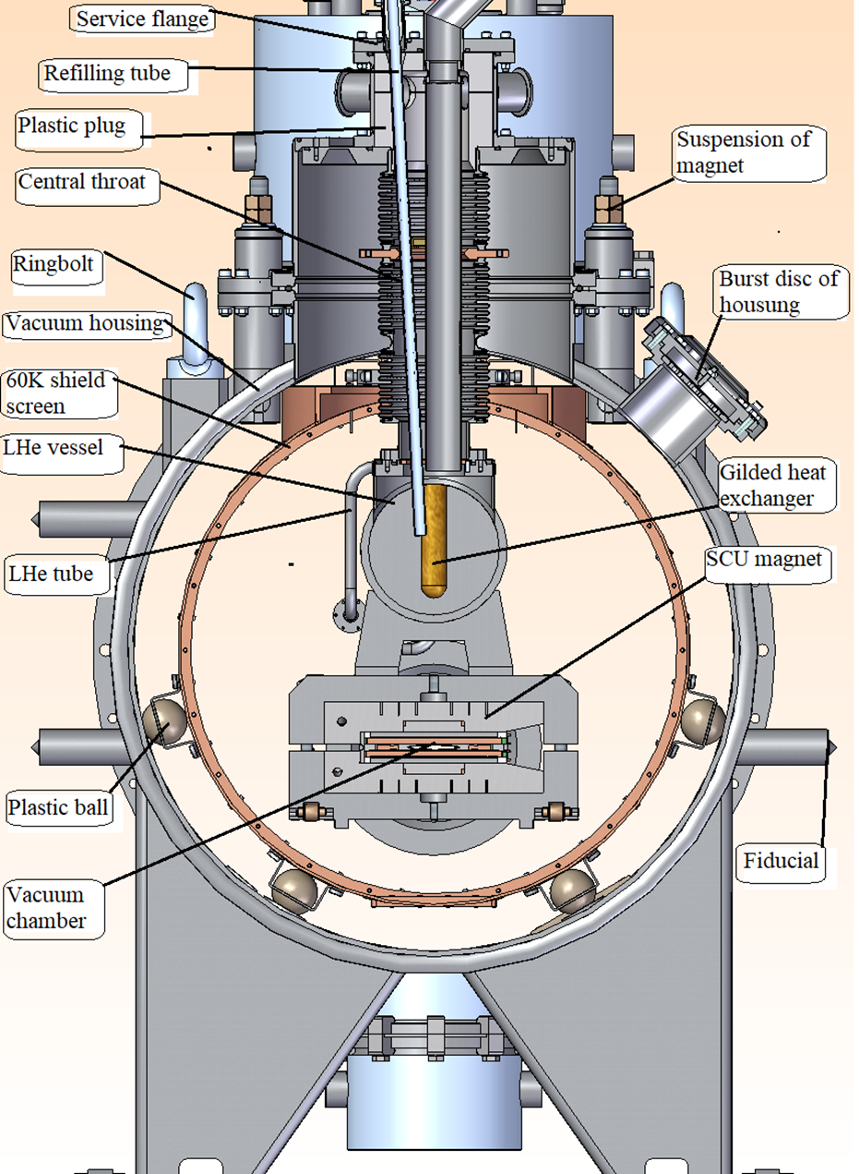
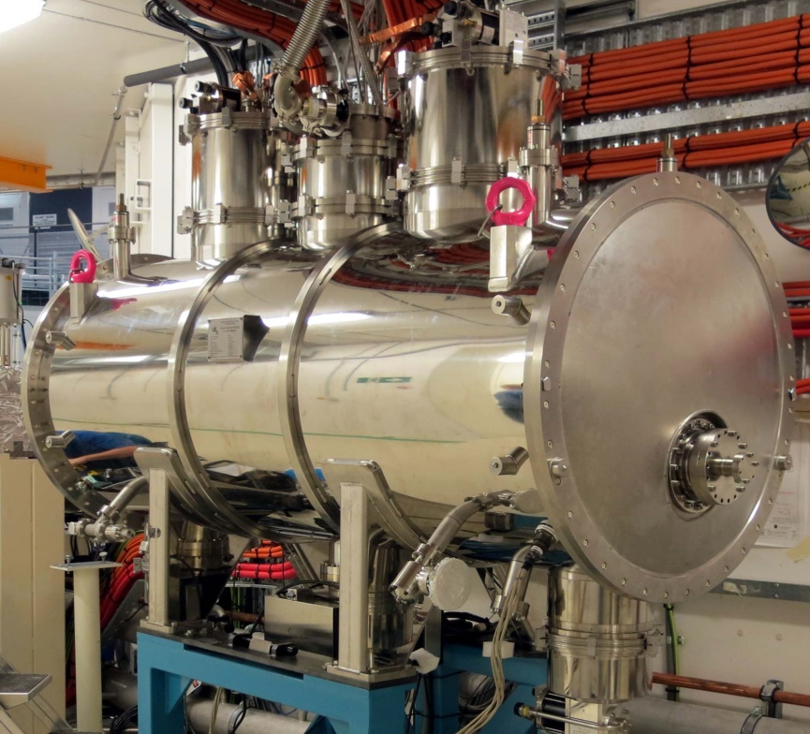
Cross section of the cryogenic indirect cooling system of the SC undulator

Slide 13
Other types of SCU undulators using the horizontal racetrack coils as a key element

Slide 14
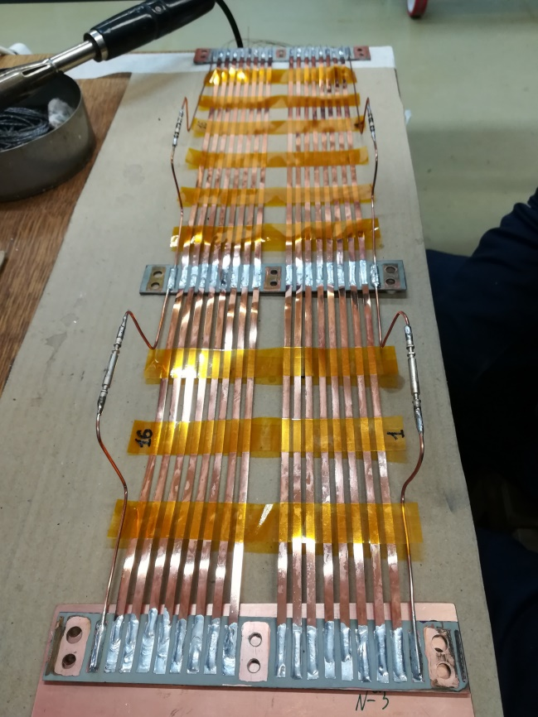
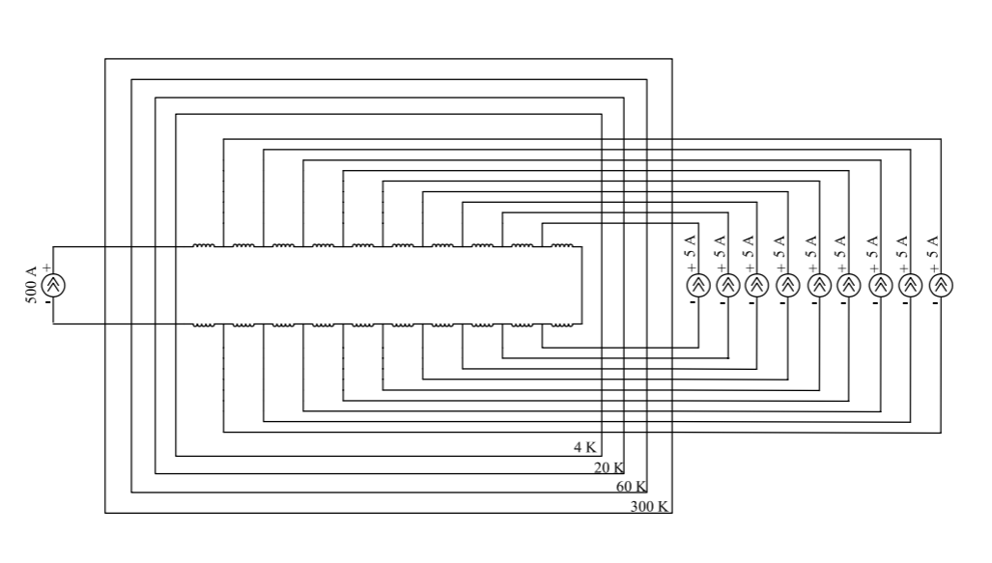
  Superconducting Undulator with tunable peak width (SCUTPW)
Changing the field in the longitudinal direction by means of shunt correction of current in groups of poles makes it possible to regulate the width of peaks in the radiation spectrum
HTSC current leads for connecting additional current sources to the windings of the undulator
Diagram for connecting additional power sources to create a variable field in the undulator groups in the longitudinal direction

Slide 15
  Superconducting Undulator with tunable peak width (SCUTPW)
Magnetic field distribution in the undulator with shunt connection s of additional currents of 5 amperes in the mode of increasing currents in 8 poles groups.
Spectrum in region 0-40keV
Spectrum in region 10-20keV
Spectrum in region 20-35keV

Slide 16
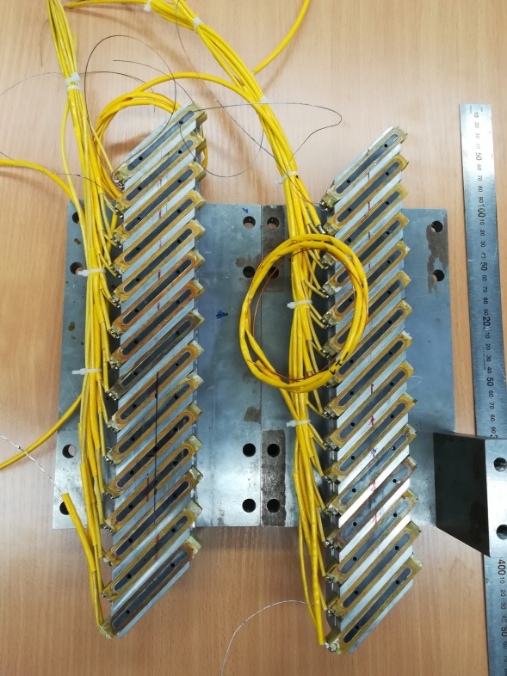
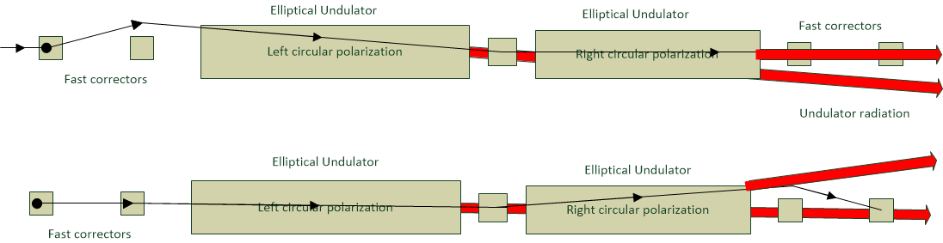
  Superconducting Elliptical undulator (SCEU)
Nominal magnetic field Bz, Tesla | 1.
Nominal magnetic field Bx, Tesla | 0.7
Period, mm | ~22
Phase error, grad | <3
Vertical/horizontal beam aperture, mm | 6/60
Pole gap, mm | 8
Period number | 44
Magnet length, mm | ~2200
Flange to flange distance, mm | ~2840
Radiated power (I=0.4 A, E=3 GeV), kW | ~5
Two halves of elliptical undulator
prototype assembled with standard undulator poles inclined on 45 degree
Scheme for fast switching of circular polarization
Cryostat

Slide 17
  Superconducting Elliptical undulator (SCEU)
Polarization
Spectrum at zero angle

Slide 18
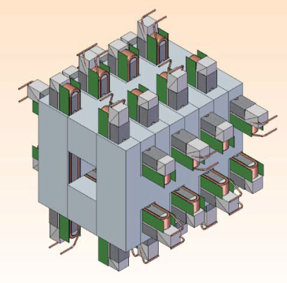
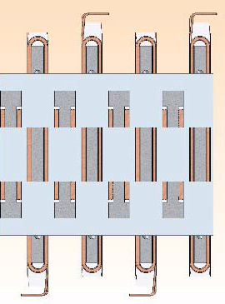
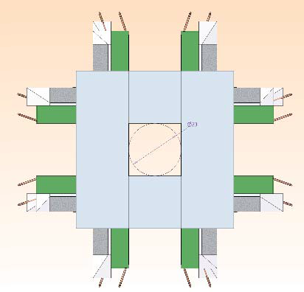
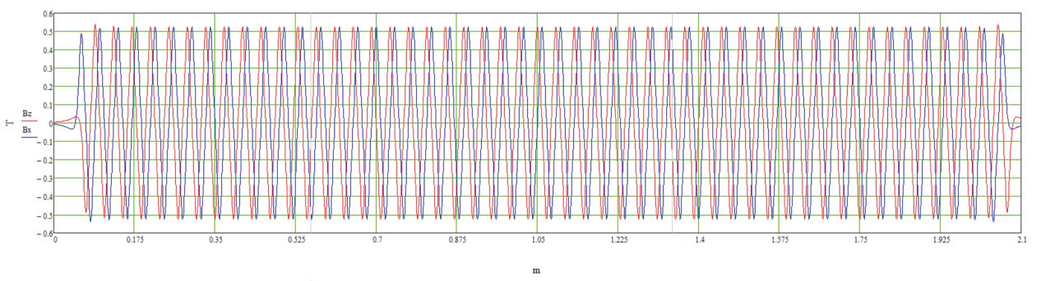
Superconducting undulator with variable radiation polarization :
A design of a superconducting polarization-variable undulator which is two planar undulators, rotated by 90 degrees and inserted into each other is proposed,.
Each undulator is powered by an independent current source, which allows you to create a magnetic field of different configuration to create linear or circular polarizations of radiation.
Parameters
Nominal vertical field, T | -0.6 - +0.6
Nominal horizontal field, T | -0.6 - +0.6
Period, mm | 40
Vertical/horizontal aperture, mm | 16/16
Pole gap, mm | 20
Period number | 50
Magnetic length, mm | 2200
Magnetic field Bz/Bx distribution of 50 - period spiral undulator.

Slide 19
  Superconducting Undulator with variable field configuration (SCUVFC)
Undulator with vertical
Linear polarization
Bx=0.5 Tesla, Bz=0
Spiral undulator with
changeable helicity
Bx=0.5 Tesla, Bz=0.5Tesla
Undulator with horizontal
Linear polarization
Bx=0, Bz=0.5 Tesla
Spectrum at zero angle
Spectrum at zero angle
Spectrum at zero angle
Polarization

Slide 20
Resume
The experience gained over the past 40 years will be used in the production of wigglers magnetic structures and cryostats.
Over the past 2 years a model of a superconducting undulator with a horizontal racetrack and short period with a phase error of less than 3 degrees has been developed and successfully tested.
Cryostats for superconducting magnets with indirect cooling using cryocoolers down to 3K temperature have been developed and implemented.

Slide 21
Thanks for your attention

