Slide 1
ARES Operation Meeting
Summary of week 3
Willi Kuropka, on behalf of the ARES shift crew

Slide 2
Summary
Week 2
 | Monday 11th January | Tuesday 12th December | Wed. 13th December | Thursday 14th December | Friday 15th December
Achievements/Overview |  | Start-up Investigation if laser position on cathode has an influence on secondary beam | Establish beam up to dipole spectrometer Investigate spectrum of the beam | Investigate secondary beam Quad scans FC and DaMon signals | QE measurement Velocity bunching working point
Difficulties |  |  | Magnet power supply problems
Notes

Slide 3
Summary
Week 3
 | Monday 18th January | Tuesday 19th December | Wed. 20th December | Thursday 21st December | Friday 22nd December
Achievements/Overview | Cathode laser investigation (secondary pulse) Alignment of additional larger apertures | Investigate secondary beam | Investigate secondary beam Also on the cathode laser | Investigate secondary beam Gun solenoid moved TWS1 SOL4 moved Changed cathode laser pulse length | Investigate influence on beam of different laser pulse lengths Gun solenoid realigned
Difficulties | No pre- or post-pulse measured with fast photodiode | Faraday cup configuration | Magnet power supply problems Magnet middle layer server was down | IT problems, some tools are not useable Gun solenoid alignment was not satisfactory | One of the bkr consoles is very slow Still IT difficulties
Notes

Slide 4
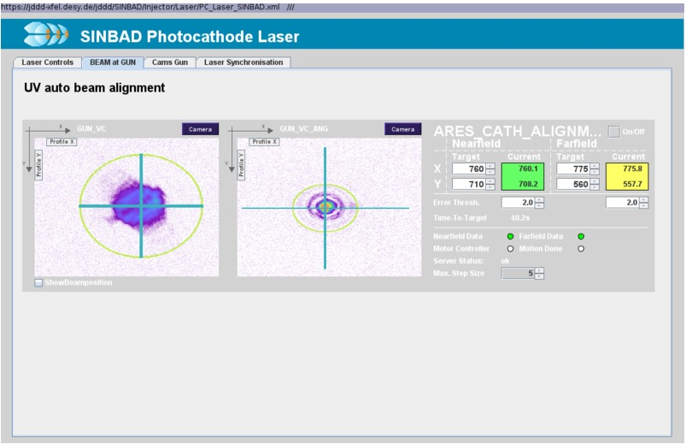
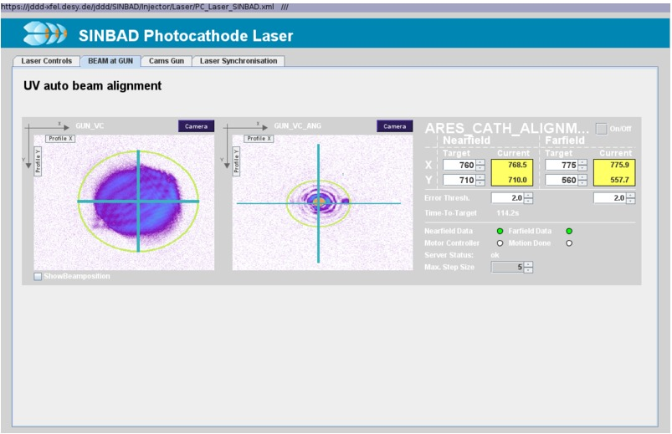
New cathode laser apertures
500um
800um

Slide 5
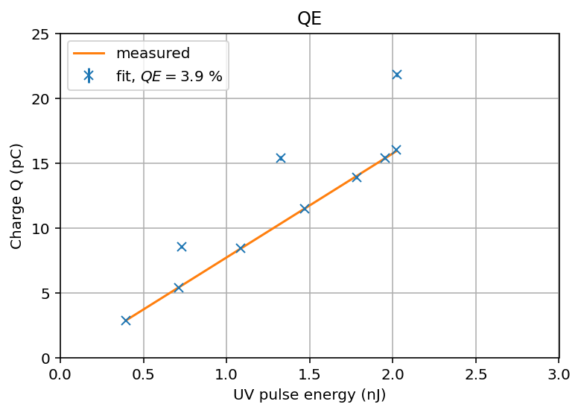
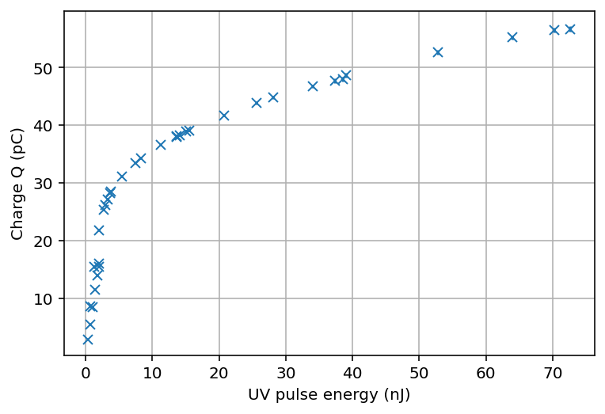
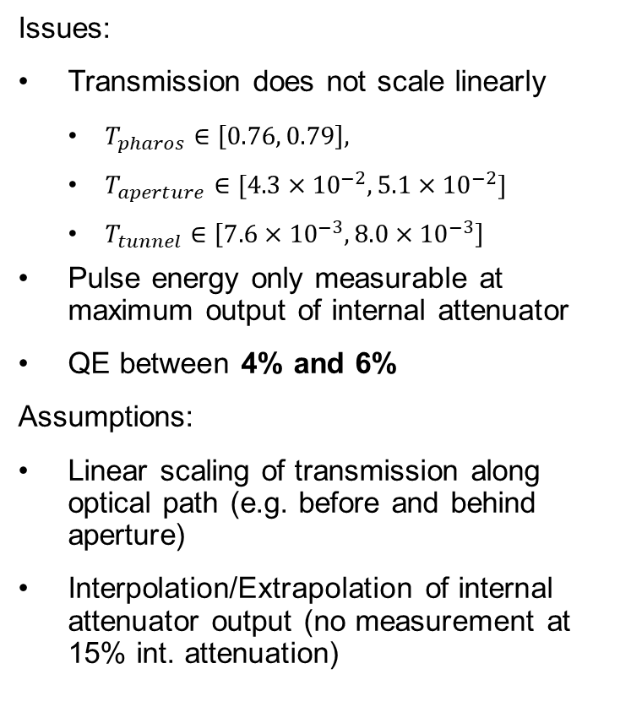
QE measurement
Measurement from 2021.01.15
Issues:
Transmission does not scale linearly
$T_{pharos}∈\left[0.76, 0.79\right],$
$T_{aperture}∈[4.3×{10}^{−2}, 5.1×{10}^{−2}]$
$T_{tunnel}∈\left[7.6×{10}^{−3}, 8.0×{10}^{−3}\right]$
Pulse energy only measurable at maximum output of internal attenuator
QE between 4% and 6%
Assumptions:
Linear scaling of transmission along optical path (e.g. before and behind aperture)
Interpolation/Extrapolation of internal attenuator output (no measurement at 15% int. attenuation)

Slide 6
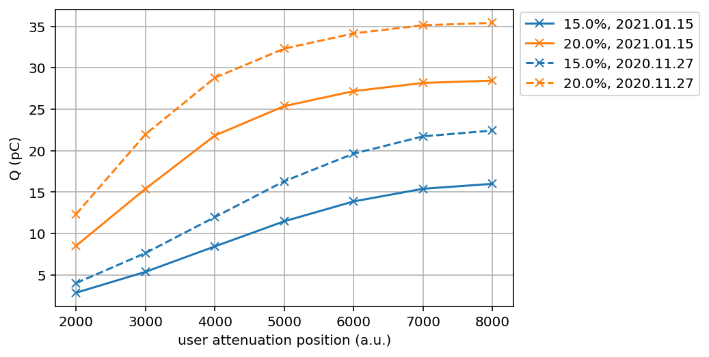
Comparison to last QE measurement
Scaling at 15%: (71 +- 0.4)%
Scaling at 20%: (76 +- 4.8)%

Slide 7
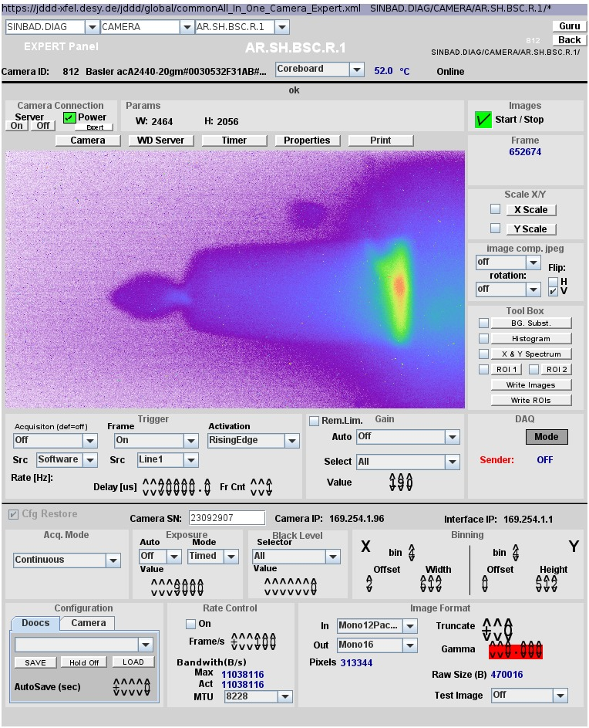
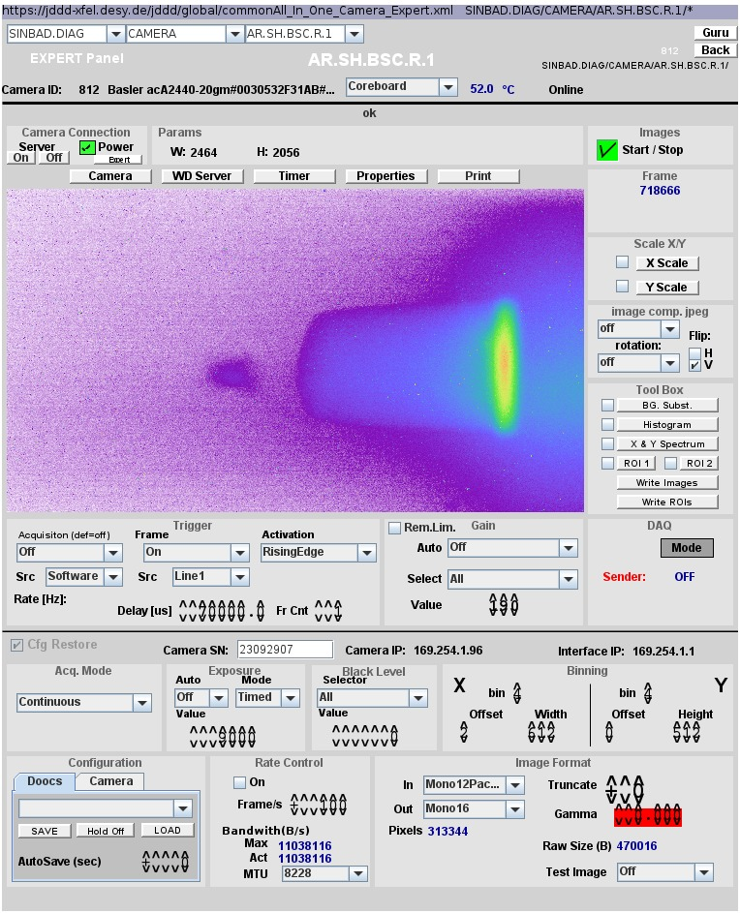
Secondary beam
After spectrometer dipole, for different laser attenuator settings

Slide 8
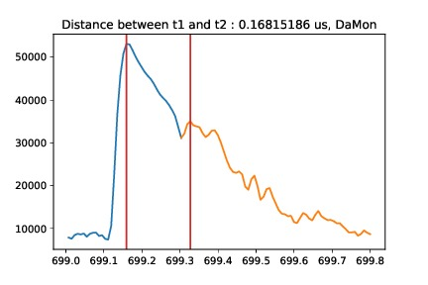
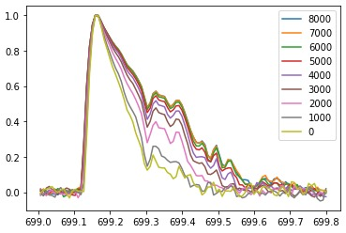
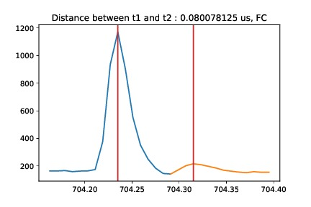
Secondary beam
On Faraday cup an DaMon
DaMon signal over laser att. position

Slide 9
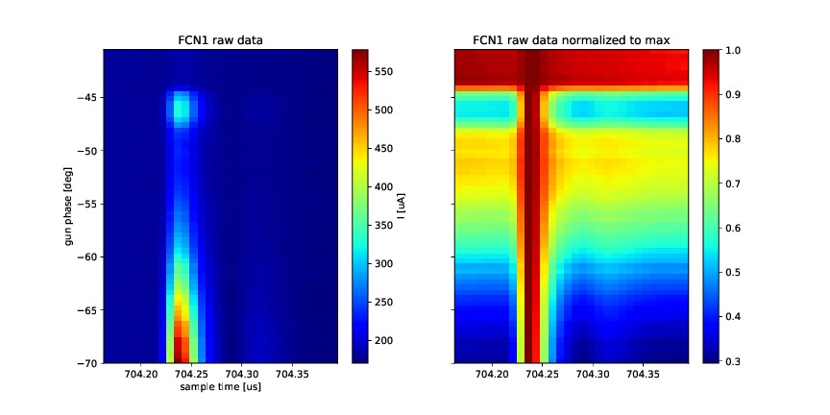
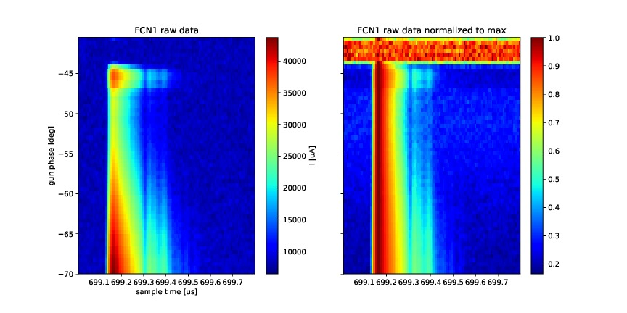
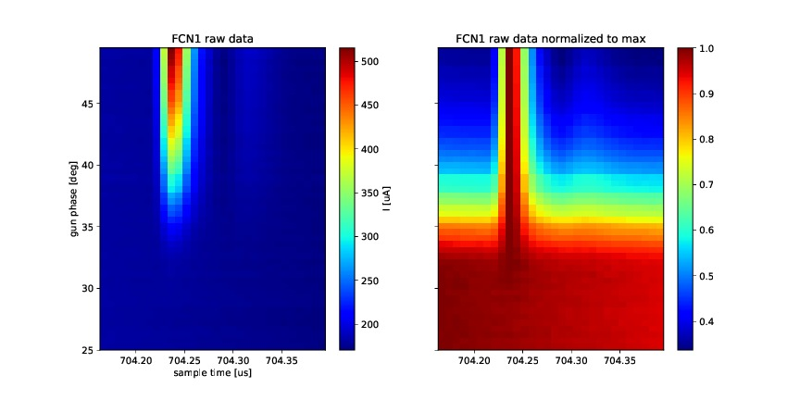
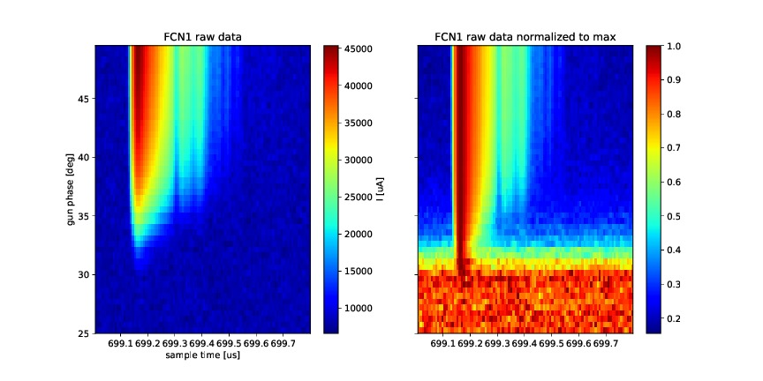
Secondary beam
gun phase scan
FC1
DaMon

Slide 10
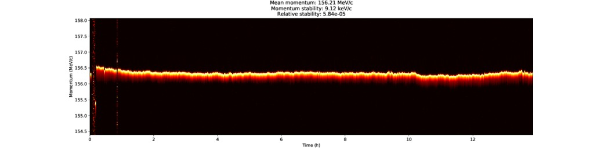
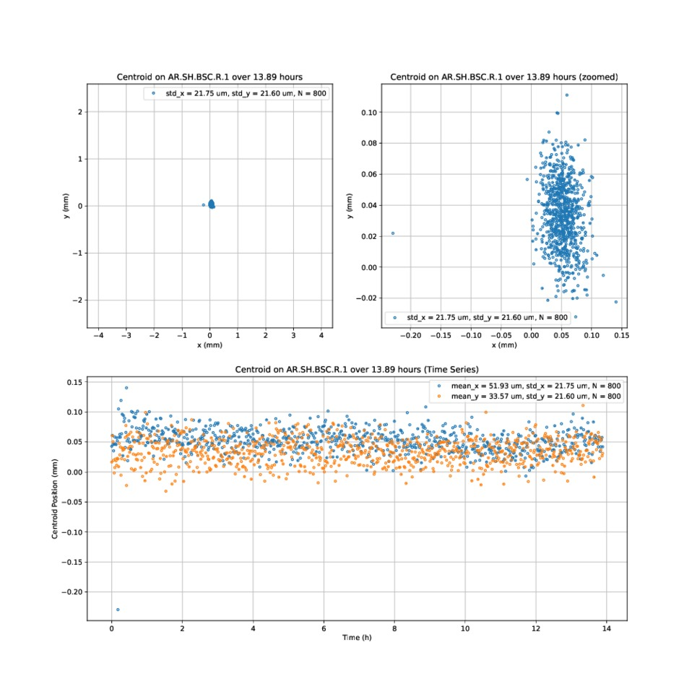
Stability measurements

Slide 11
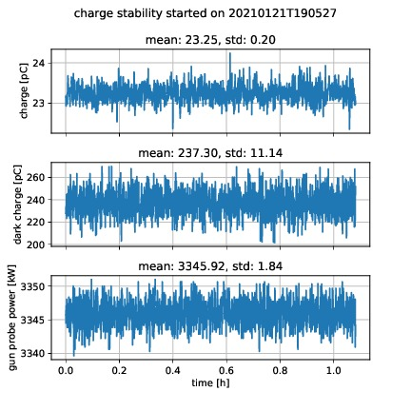
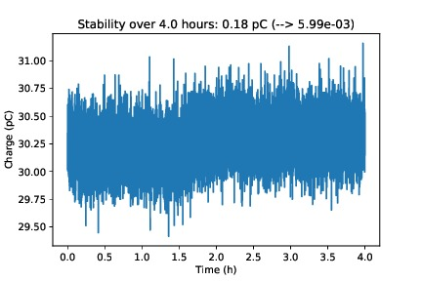
Stability measurement
20.01.2021

Slide 12
Plan for this week
Re-check timing of sec. bunch.
MDI shift (to be clarified)
Emittance measurements
Check alignment of magnets
Velocity bunching studies
Charge stability measurements

Slide 13
Schedule
Week 4
Date | Shiftleader
25.1. | MKK1, MDI, FS-LA
26.1. | Hannes
27.1. | Frank
28.1. | Willi /MDI - shift
29.1. | Thomas

Slide 14
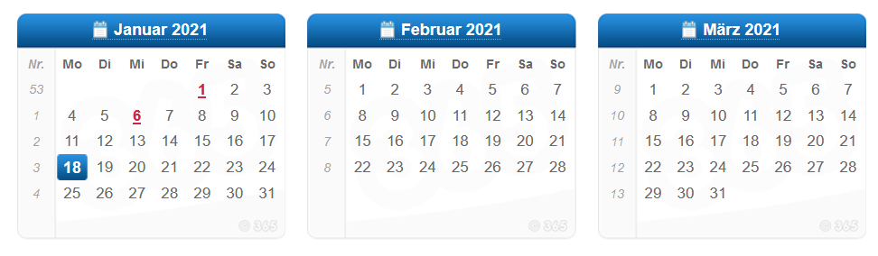
Schedule
shutdown
Beam operation

