Slide 1
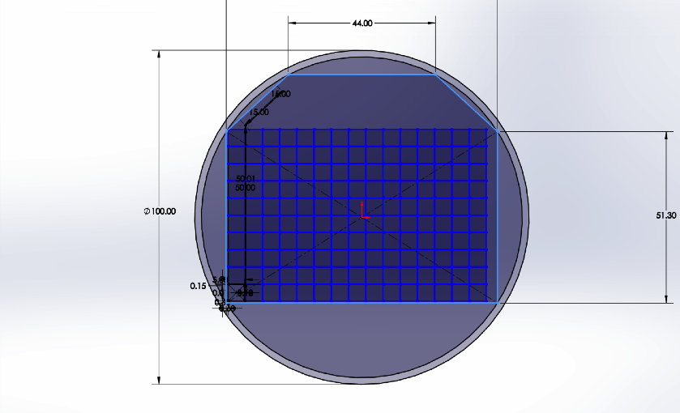
81.14

Slide 2
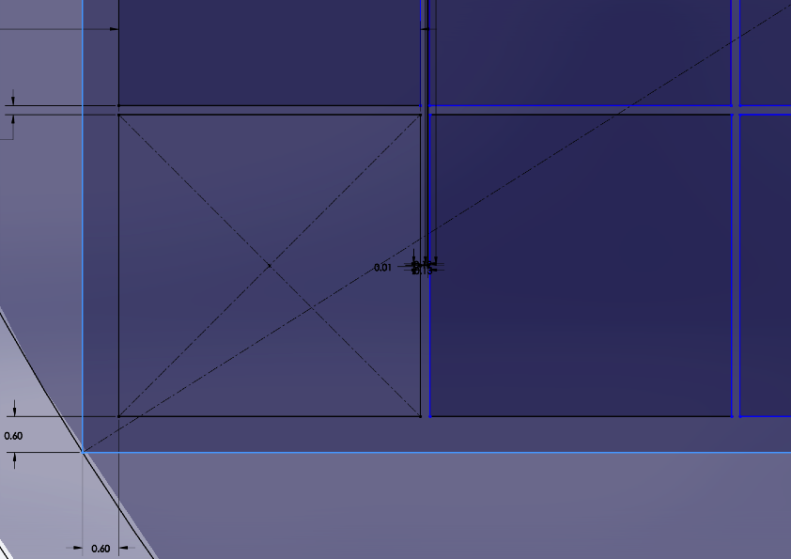

Slide 3
GaAs with or without traces
5 mm pitch :
What with guard ring ?
Distance to the end of the wafer ?
Distance between sensors ?
15x10 array : 750x50 mm2. why not 16x10 ?
Number of sensors : ~ 55 cm/7.5 cm = 7.33 wafers
7 wafers = 52.5 cm
8 wafers = 60 cm
SIZE OF THE TUNGSTEN PLANE IN X ?

Slide 4
GaAs with traces
SIZE OF THE TUNGSTEN PLANE IN Y ?

Slide 5
1.1mm
2mm

Slide 6
