Slide 1
Sapphire procurement status
For the moment we have offers from 3 manufacturers:
China ( 1$/cm² , 100 micron thick), 500$ total
Russia ( 6€/cm², 150 micron thick), 3000€ total
Germany ( 80€/cm², 100 micron thick), 1800€ total
Different sizes (from 1x1 cm² up to 5x6 cm²)
What wafers we purchase? Who will cut them? What size do we need now?
Could we make 50 μm strip pitch for the prototype?

Slide 2
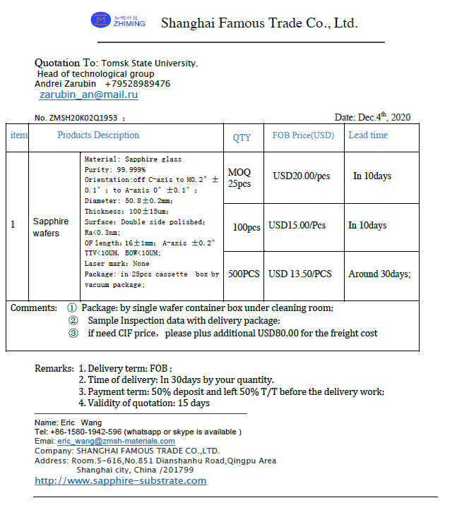
Sapphire glass, purity 99,999% Wafers ø50 mm, thickness 100±15 μm
25 pcs, 20 $/pcs
1$/cm²
~500 $ total

Slide 3
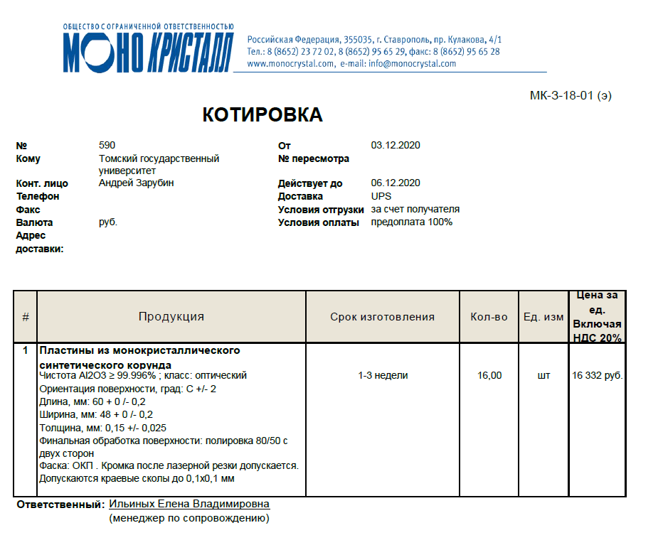
Single crystal sappfire, purity 99,996%, Plates 60×48 mm, thickness 150±25 μm
16 pcs, 16332 ₽/pcs, (180 €/pcs),
6.25 €/cm²
~3000 € total

Slide 4
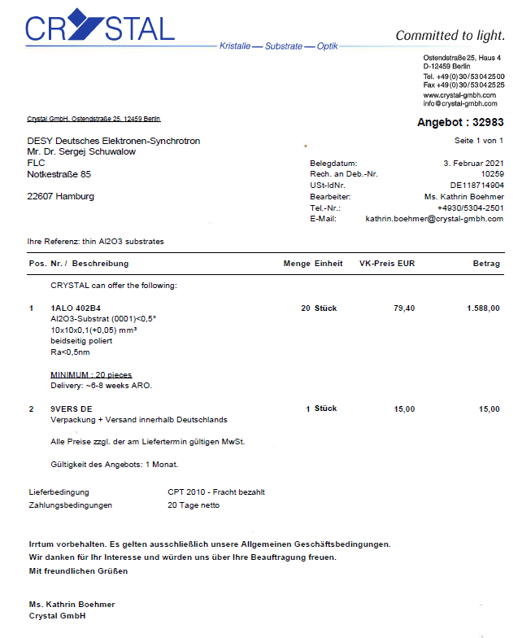
Single crystal sappfire, purity 99,996%, Plates 10×10 mm, thickness 100+50 μm
20 pcs, 79 €/pcs,
79 €/cm²
~1800 € total

Slide 5
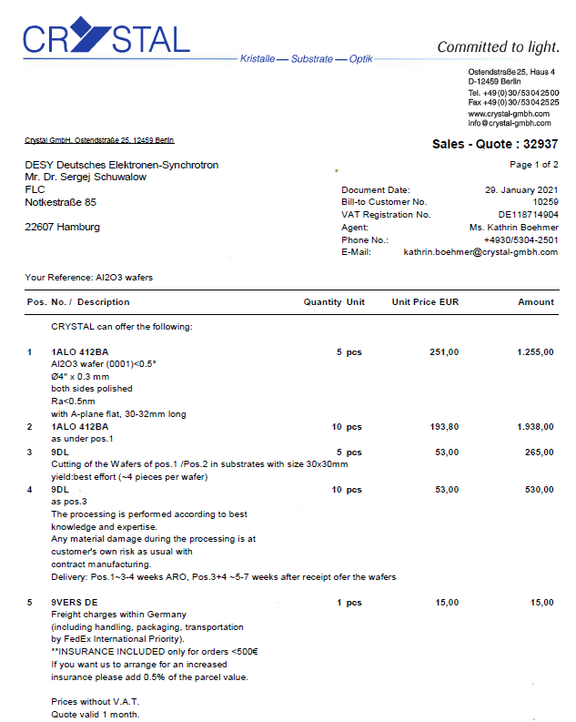
Single crystal sappfire, purity 99,996%, Wafers ø100 mm, thickness 300 μm
10 pcs, 200 €/pcs,
2.5 €/cm²
+cut to 30x30 mm² square plates
~2500 € total

Slide 6
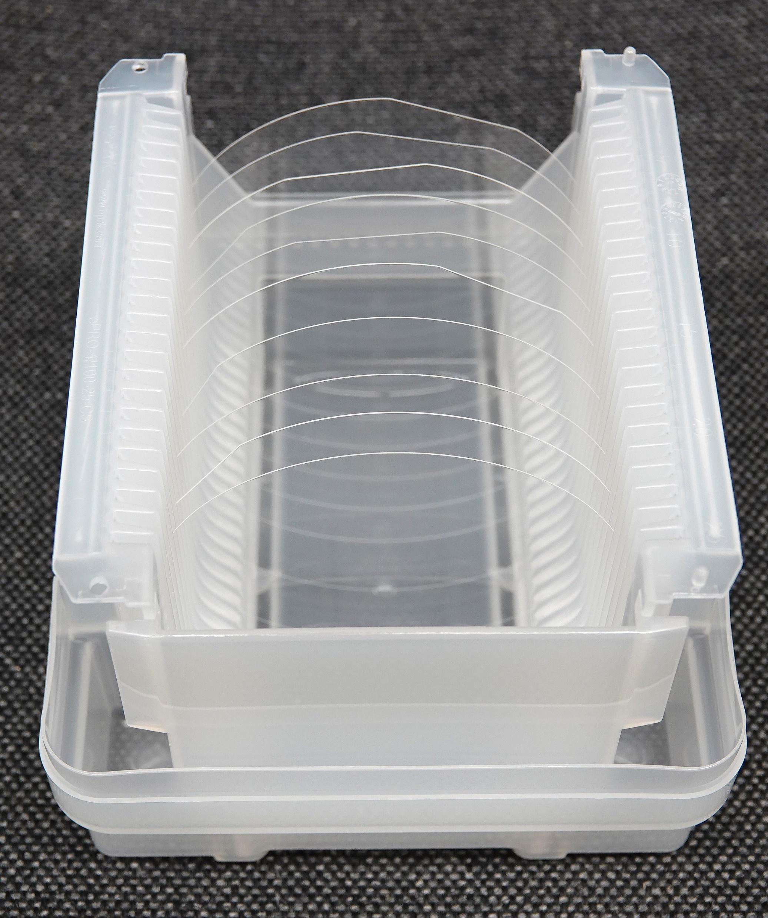
4-inch single crystal
sapphire wafers 0.3 mm thick
~2.5 €/cm²
Producer: Crystal GmbH,
Berlin

