Slide 1
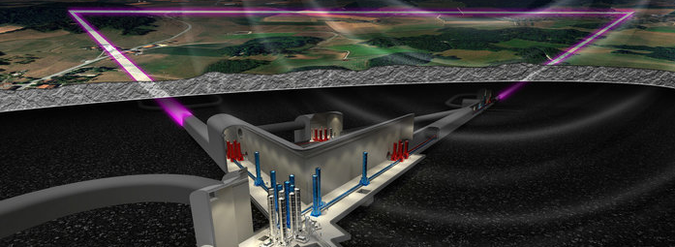
Einstein Telescope
DESY’s potential path into the Einstein Telescope
Joined session APC+PRC
Marek Kowalski
May 4th, 2021

Slide 2
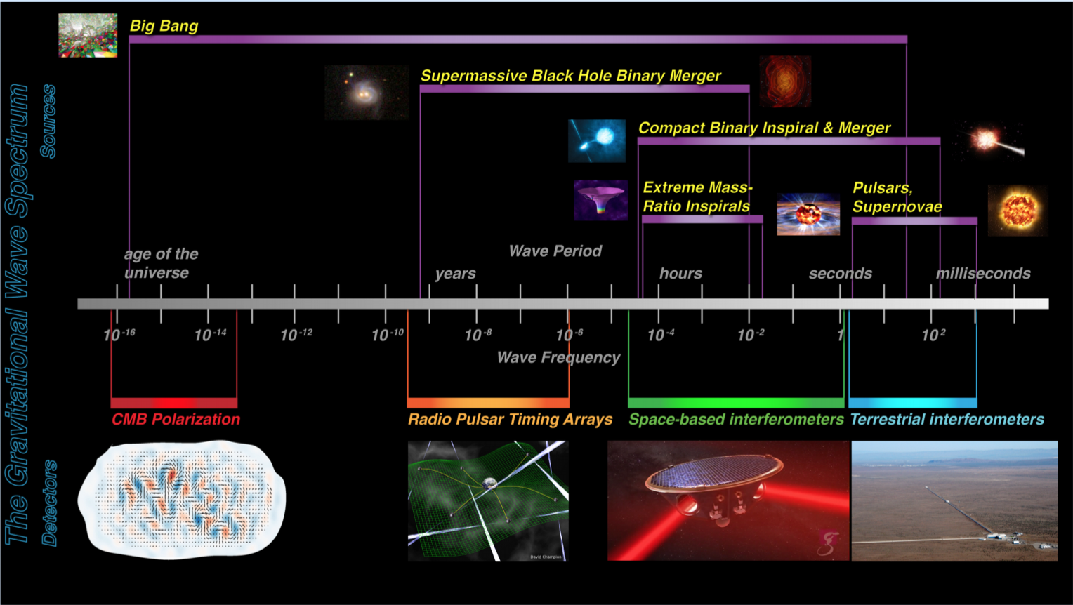
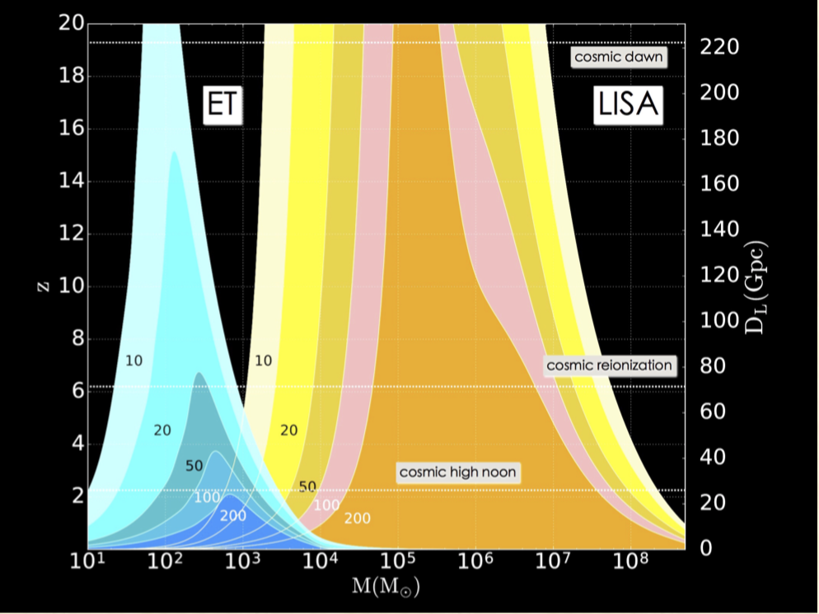
Gravitational Wave Astronomy offers a new and spectacular view deep into the history of our Universe
Courtesy, Achim Stahl, RWTH
The Einstein Telescope
BH-BH coalescene with masses between (20-100) M_{sun} visible up to redshift z ~ 20 (today z ~ 1)
NS-NS binaries with total mass around 3 M_{sun} visible up to z ~ 2-3 (GW170817 was at z ~ 0.01)
Detection rates will be 10⁵ – 10⁶ BH-BH and 7 * 10⁴ NS-NS coalescenes per year

Slide 3
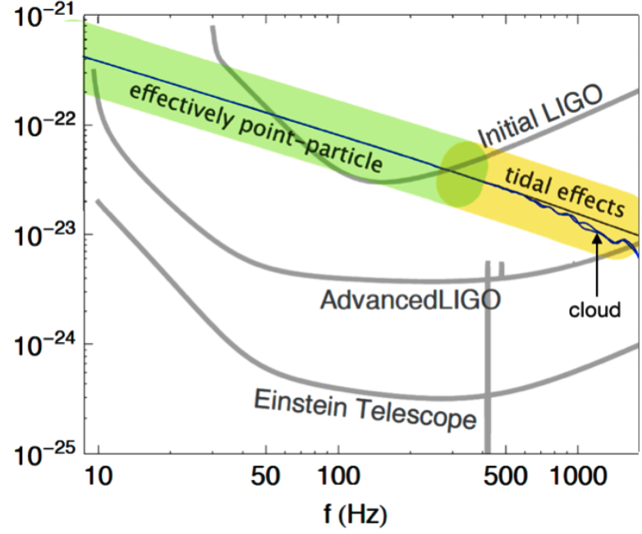
Gravitational Wave Astronomy offers a new and spectacular view deep into the history of our Universe
“precision
frontier”
Courtesy, R. Porto
Courtesy, Achim Stahl, RWTH
The Einstein Telescope
BH-BH coalescene with masses between (20-100) M_{sun} visible up to redshift z ~ 20 (today z ~ 1)
NS-NS binaries with total mass around 3 M_{sun} visible up to z ~ 2-3 (GW170817 was at z ~ 0.01)
Detection rates will be 10⁵ – 10⁶ BH-BH and 7 * 10⁴ NS-NS coalescenes per year

Slide 4
Gravitational Wave Astronomy offers a new and spectacular view deep into the history of our Universe
Astrophysics
  Black holes: origin (stellar vs. primordial), evolution, demography.
  Neutron star properties: interior structure (QCD at ultra-high densities, exotic states of matter), demography.
  Multi-messenger astronomy: nucleosynthesis, physics of jets, role of neutrinos.
  Detection of new astrophysical sources of GWs: core collapse supernovae, isolated neutron stars, stochastic background of astrophysical origin.
  Fundamental physics and cosmology
    The nature of compact objects: near-horizon physics, tests of no-hair theorem, exotic compact objects.
    Dark matter: primordial BHs, axion clouds, dark matter accreting on compact objects.
    Dark energy and modifications of gravity on cosmological scales.
    Stochastic backgrounds of cosmological origin and connections with high-energy physics (inflation, phase transitions, cosmic strings, ...)
Notes:
It will shine light on
the cosmic history of stellar evolution,
the origin (stellar versus primordial), evolution and demographics of black holes,
and the interior structure of neutron stars, with potentially important implications for the fundamental theory of strong interactions at ultra-high densities.
It will
perform exquisite tests of the theory of General Relativity in its strong-gravity regime.
allow to investigate dark matter candidates that cannot be tested by other means
have the potential to elucidate the nature of dark energy
lead to modifications of General Relativity on cosmological scales,
provide an image of the earliest moments after the Big Bang and of physics at correspondingly high-energy scales, through the detection of stochastic GW backgrounds of cosmological origin.

Slide 5
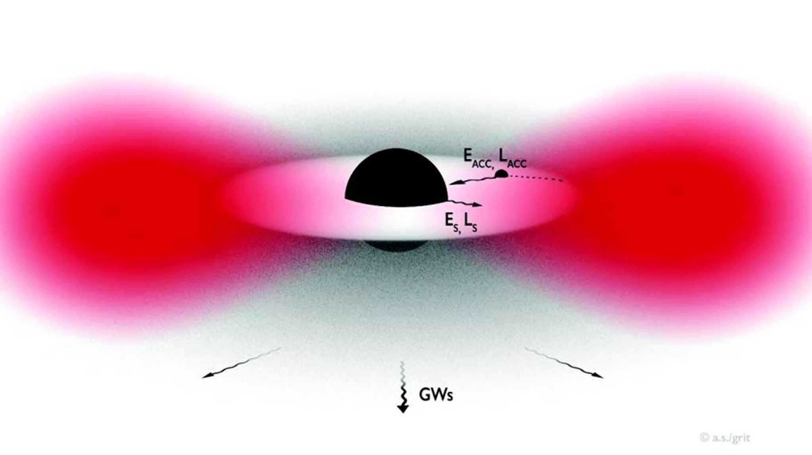
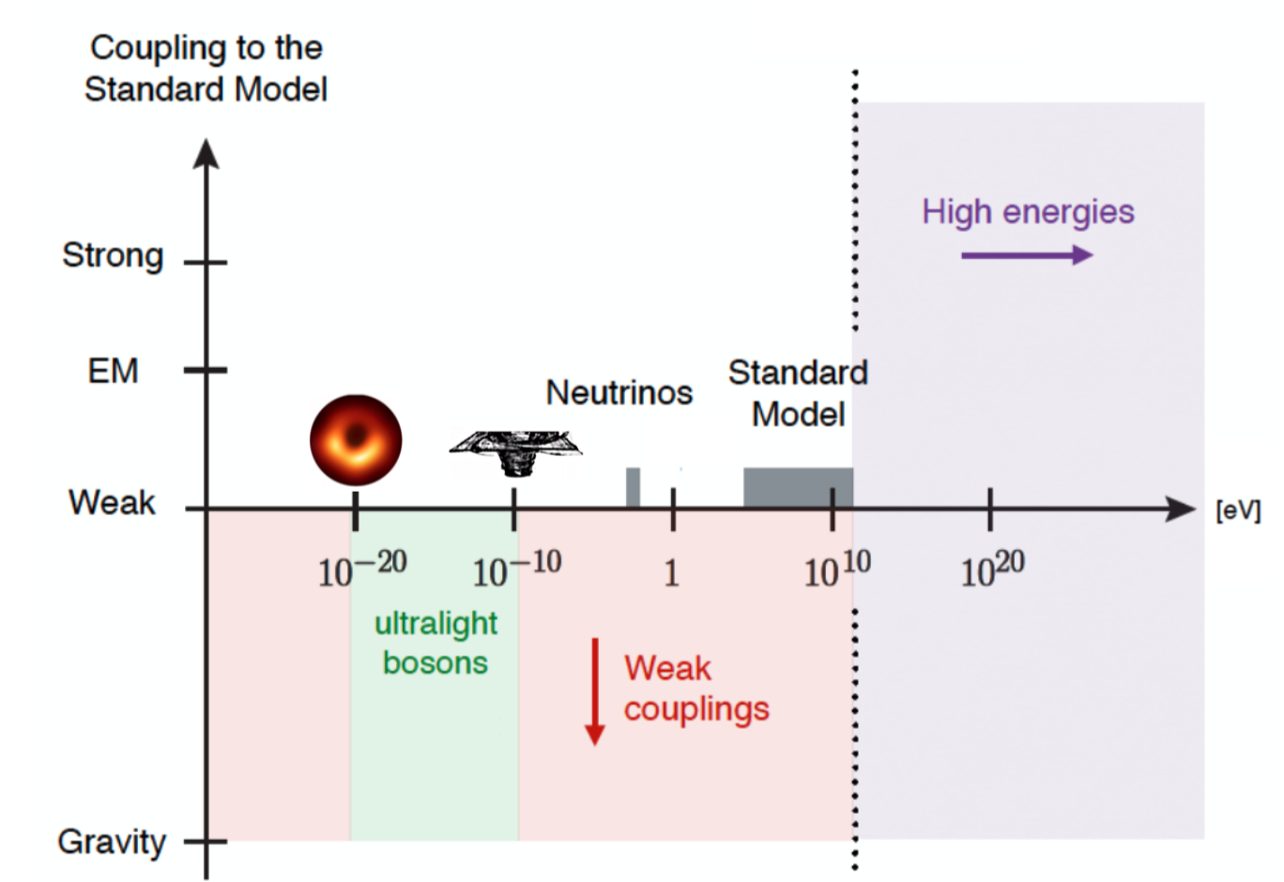
Gravitational Wave Astronomy offers a new and spectacular view deep into the history of our Universe
  Fundamental physics and cosmology
    The nature of compact objects: near-horizon physics, tests of no-hair theorem, exotic compact objects.
    Dark matter: primordial BHs, axion clouds, dark matter accreting on compact objects.
    Dark energy and modifications of gravity on cosmological scales.
    Stochastic backgrounds of cosmological origin and connections with high-energy physics (inflation, phase transitions, cosmic strings, ...)
Gravitational wave instruments will penetrate deeply into uncharted territories, where surprises are bound to await us.
R.Brito et al., Gravitational Waves from Ultralight Bosons, PRL (2017)
Baumann, Porto et al., Gravitational collider physics, (PRD 2020)
Notes:
It will shine light on
the cosmic history of stellar evolution,
the origin (stellar versus primordial), evolution and demographics of black holes,
and the interior structure of neutron stars, with potentially important implications for the fundamental theory of strong interactions at ultra-high densities.
It will
perform exquisite tests of the theory of General Relativity in its strong-gravity regime.
allow to investigate dark matter candidates that cannot be tested by other means
have the potential to elucidate the nature of dark energy
lead to modifications of General Relativity on cosmological scales,
provide an image of the earliest moments after the Big Bang and of physics at correspondingly high-energy scales, through the detection of stochastic GW backgrounds of cosmological origin.

Slide 6

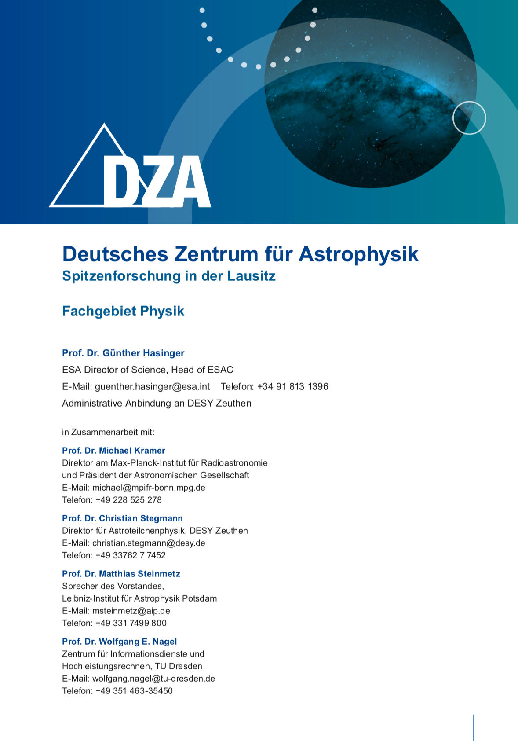
Possible locations of ET
Application for the foundation of the German Centre for Astrophysics as part of a BMBF ideas competition for the foundation of two large-scale research centres in Saxony. Part of the application is to investigate whether Lusatia, 150 km south of Berlin, is suitable as a site for ET.
Two-and-a-half candidate sites

Slide 7
Costs
From the ESFRI application
Full
version
Start
version
Optics
Lasers
Cryogenics
Suspensions
Tunnel
Vacuum
Services
Surface
Lab
Full version
1.74 B€
1.20 B€
Start version: 2025 – 2033
Full version: 2033 – 2040 Germany: 0.6 B€; German participation essential

Slide 8
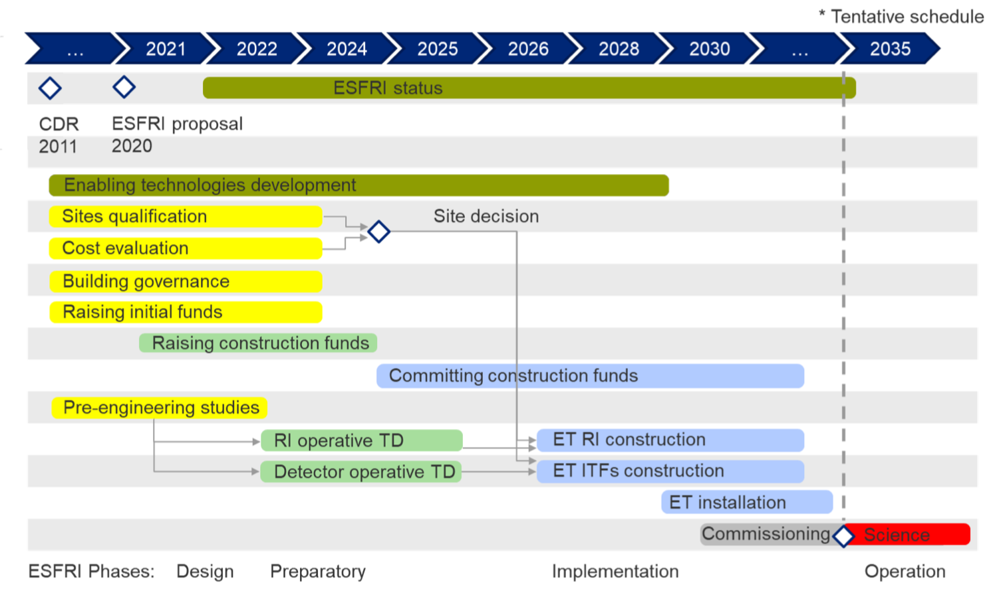
Time Schedule
From the ESFRI application
Construction start 2026, Science from 2034, time schedule appears optimistic
DESY perspective: realistically, ET comes after PETRA IV & LHC HL upgrade and CTA

Slide 9
Situation in Germany: needs a national initiative to organize a participation in the Einstein Telescope
Max Planck Society
  Key player in GW astronomy (AEI, Hannover and Potsdam)
Universities
  Strong interest documented by consortium of 17 partners working on R&D for ET (funded by the BMBF)
BMBF
  Opened collaborative research for GW astronomy
  No support of the ESFRI application (yet), referred to national roadmap process (call expected 2021/2022)
Helmholtz Association
  PoF Evaluation: "Participate in future global initiatives in gravitational wave observations, e.g. the Einstein Telescope"
  Interest by 4 Helmholtz Centers (DESY, KIT, HZDR, FZJ)
DESY
  Wide range of activities in theoretical particle and astroparticle physics related to GW astronomy
  Experimantal cooperation with the Quantum Universe Cluster in Hamburg
  Recent strengthening of multi-messenger astronomy, most visibly through participation in the ULTRASAT project for the follow up of NS-NS mergers
  DESY is establishing an ET-project office, to prepare for a German contribution (T. Berghöfer et al.)
  A DESY Task Group to generate an educated list of DESY expertise and competences in connection to ET
  Task force members: Sasa Bajt, Franz Kärtner, Marek Kowalski (chair), Lutz Lilje, Axel Lindner, Rafael Porto, Geraldine Servant

Slide 10
The Einstein Telescope @ DESY
Opportunities identified by DESY ET Task force
FH AP M FS
Technological Opportunities:
Low-Noise, high-power Lasers
Large Area Optical Mirrors
Interferometric facil. (e.g. ALPSII)
Fiber Optic Networks for Seismic Sensing
Large scale project expertise
Vacuum systems
Cryogenics
Experimental control
Project Management
Scientific opportunities:
Understanding Gravity & Black Holes
Particle Physics beyond the Standard Model.
  Early Universe physics
  Dark Matter
Multimessenger astronomy
  From the formation of elements to entire Galaxies
  Expansion rate of the Universe
R. Porto, GWAT group logo

Slide 11
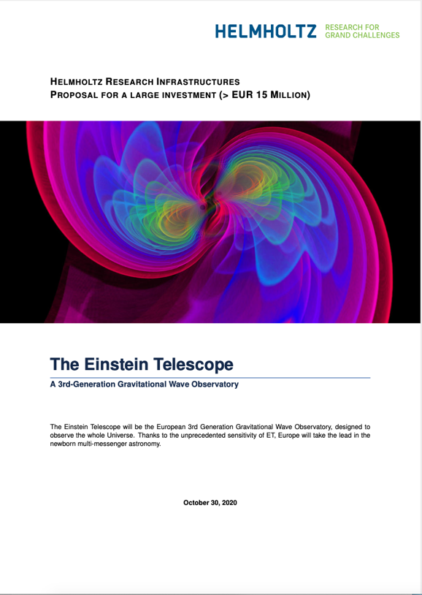

ET pre-proposal for the Helmholtz roadmap
to enable Helmholtz to take a position in time for the application for the national roadmap.
Participating Helmholtz centers: DESY, KIT, HZDR
  Based on ESFRI application and Design Report Update 2020
  Detailed participation of Helmholtz center not fully defined yet
Helmholtz decision
FIS recommendation
Peer review
Priorisation of the Research Area
Centers prepare applications

Slide 12
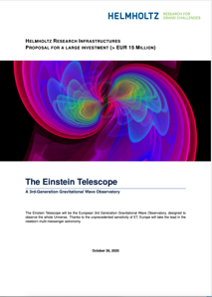
A path of Germany and DESY to the Einstein Telescope
2020 2021 today 2022 2023 2024 >2025
ET timeline
ESFRI proposal
ESFRI process
Site decision
Construction start
German national
time line
Motion of the NRW
Parliament
National roadmap process
Helmholtz FIS roadmap process
Helmholtz time line
Pre-proposal for
Helmholtz FIS
Coordination of the Helmholtz contribution by the centres that have expressed interest (DESY, KIT, HZDR, FZJ)
DESY time line
Implementation of
theoretical GW
astronomy
Implementation of a ET coordination team to support the preparation of the application for the national roadmap
Implementation of a
GW astronomy group
(VIRGO, LIGO, KAGRA → ET)
Take project responsibility for 0.5B€ contribution from Germany

Slide 13
A participation of DESY in the ET project is recommended by advisory committees
PoF Evaluation
  “The recent breakthroughs in gravitational wave astronomy offer the potential for observing the universe through a new window requiring large-scale infrastructures such as the proposed Einstein telescope. Helmholtz is ideally placed to participate in this initiative, which would complete the missing component of its multi-messenger approach.”
  “Participate in future global initiatives in gravitational wave observations, e.g. the Einstein Telescope.”
DESY Astroparticle Physics Committee
  “APC reiterates the recommendation that DESY keeps working towards establishing and reinforcing the DESY gravitational-wave research area, and strongly recommends the involvement of DESY in the realization of the new generation of gravitational wave experiments, such as the Einstein Telescope and to even consider to take a lead position of the project for Germany.”
DESY Scientific Council
  “The SC strongly supports the recommendation to consider participation in future global initiatives concerning gravitational wave astronomy and, in particular, expects DESY to encourage the Helmholtz-Gemeinschaft to take a leading role in developing a strategy for this emergent field.”
  “The SC reiterates that it would appreciate a presentation of a (Helmholtz) strategy for DESY’s experimental program in Gravitational Wave Astronomy within the German context at the next meeting.”

Slide 14
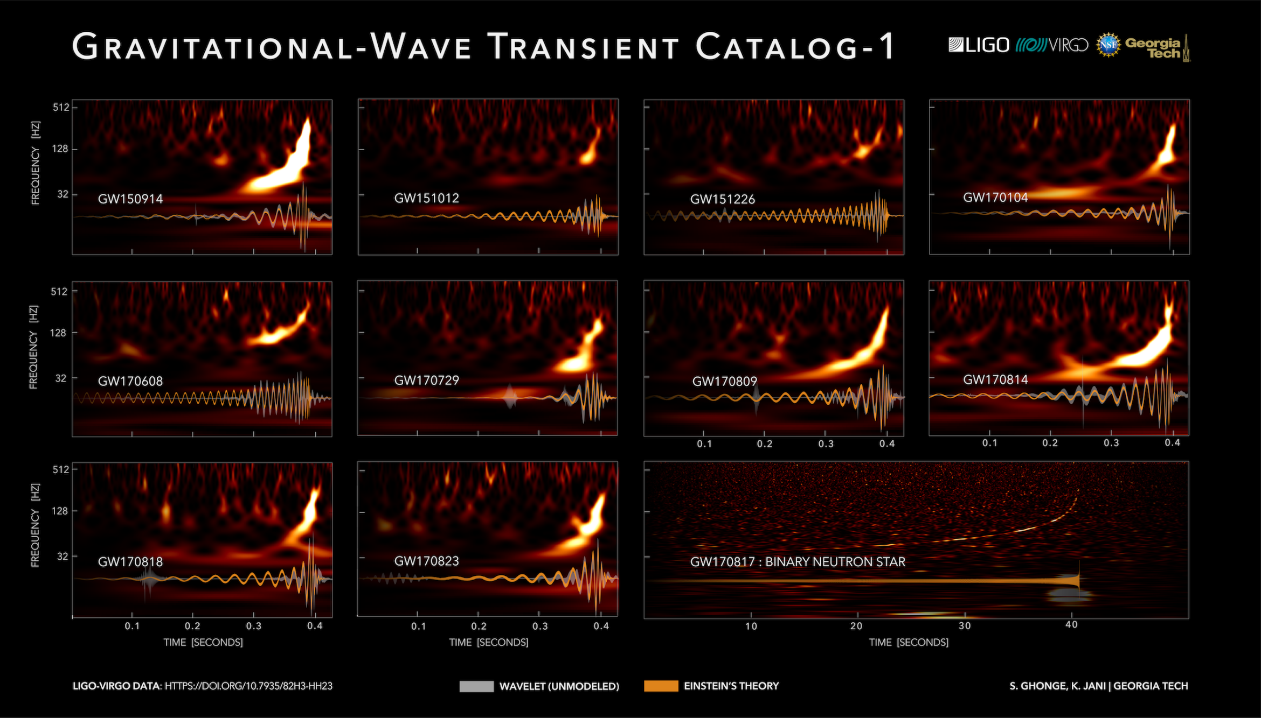
The Einstein Telescope @ DESY
Summary
Gravitational wave astronomy offers DESY a great
scientific and strategic opportunity
DESY can actively participate in and shape one of
the greatest breakthroughs in recent science history
DESY can now enter this field of research and play
a leading role in a major European gravitational
wave astronomy project, the Einstein Telescope.
The Einstein Telescope is an opportunity to bring
together large parts of DESY’s expertise ranging
from accelerators, materials science, laser technology, to particle physics and astroparticle physics in a joint project.
Moreover, the time schedule for the Einstein telescope seems to fit well into DESY's and international plans for future large-scale projects.

Slide 15
Backup

Slide 16
Germany’s role in the Einstein Telescope
GW astronomy is not (yet) based on the three pillars necessary for an adequate participation of Germany
  Max Planck Society (AEI Hannover and Golm) is a key player in the field
  Increasing interest and participation by university groups (15 university groups received funding starting this year for R&D work for a future GW instrument)
  Helmholtz Association (in charge of operating large infrastrutures) is considering a participation
Germany (BMBF) is currently burdened by a number of large-scale facilities for science, which leads to great competition among the planned research infrastructures
  Opened collaborative research for universities for GW astronomy
  No support of the ESFRI application (yet)
  Referred to the national roadmap process (call expected 2021/2022)
The geographical proximity to one of the possible sites of the Einstein Telescope requires an early response from Germany.
There are those who say that ET is difficult to imagine without a significant German participation.
There is strong political pressure from parties in North Rhine-Westphalia towards the BMBF to support ET.

