Slide 1
Random photons
Beate, Feb. 15th 2021

Slide 2
Emulated random photons
Generating two random photons
  Exponentially falling energy distribution
  Flat phi distribution
  Flat R distribution:
    Exit of beam dump: R<=20 cm
    Hit at detector: R<=100 cm
  Polar angle calculated from R values
    Smeared by +-20 mrad (resolution of SplitCal for SHiP)
Cuts applied:
  E>0.5 GeV
  Delta phi<0.1 rad (constrained by granularity, not sure)
  Reconstructed z position for each photon <330 cm
  |Delta z|<50 cm

Slide 3
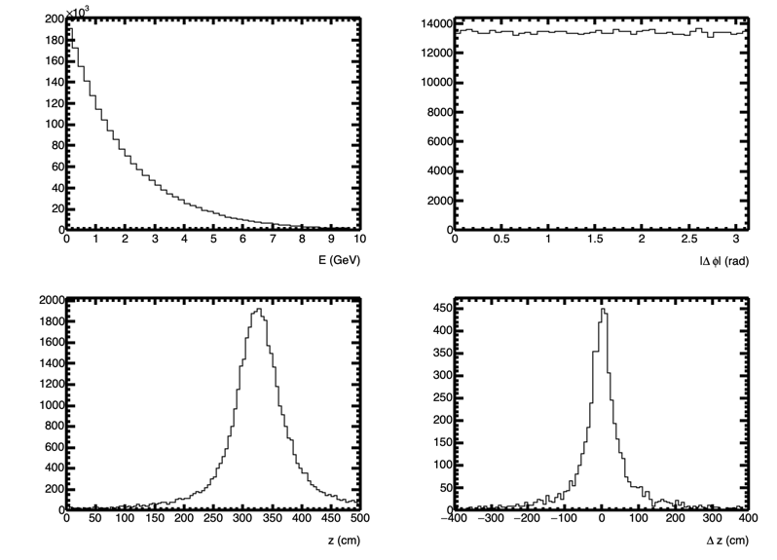
Distributions

Slide 4
Rejection factors
Cut | Fraction of events (%)
E>0.5 GeV | 100
Delta Phi | 3.2
Z<330 | 0.88
Delta z<50 | 0.53
Z<300 | 0.12
So, probably a background rejection factor of ~1000 is possible

Slide 5
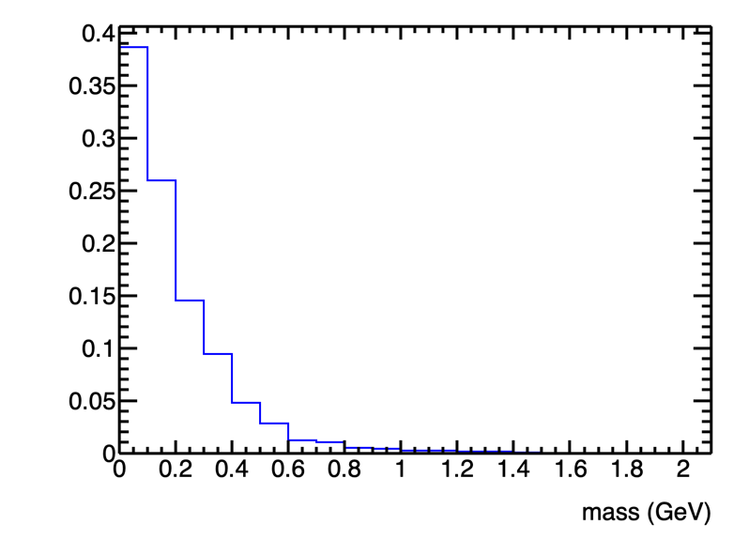
Mass distribution (normalized to unity)

Slide 6
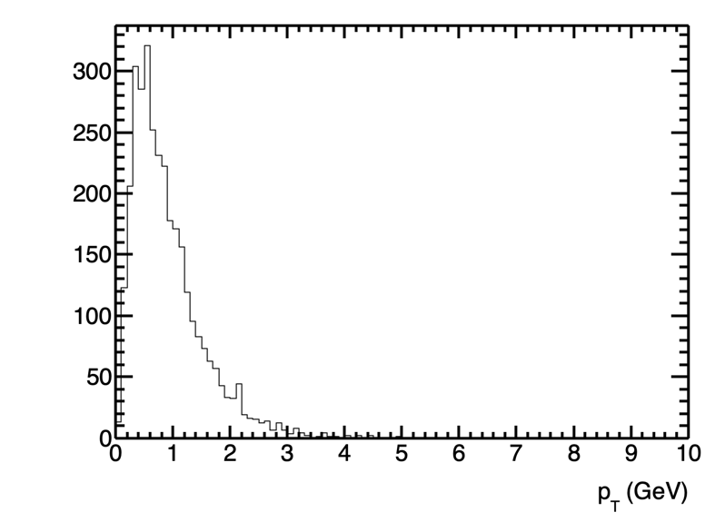
Pt distribution
p_{T} of diphoton system should be zero for signal
For background is random
  Constrained by other cuts
Could provide additional power

Slide 7
Expected number of diphoton events/year
Nb = 10^7 the number of bunches.
Mgg = 0.1 for 10 bins of di-photon invariant mass
Rk = 10^(-3) kinematical cut rejection power (from this analysis).
Assuming a probability of 0.525 photons per bunch the probability to have two photons is p(gg)=0.08. Thus, the number of background events per mass bin in naively: N_bkg = Nb Mgg Rk pgg = 10^7 * 0.1 * 0.001 * 0.08 = 80
Thus, the 2\sigma exclusion limit is N_a = 2\sqrt{N_bkg} = 18 events

