Slide 1
Update on the photon-beam profiler
M. Bruschi, O. Borysov, A. Sbrizzi, S. Schuwalow, A. Tyazhev

Slide 2
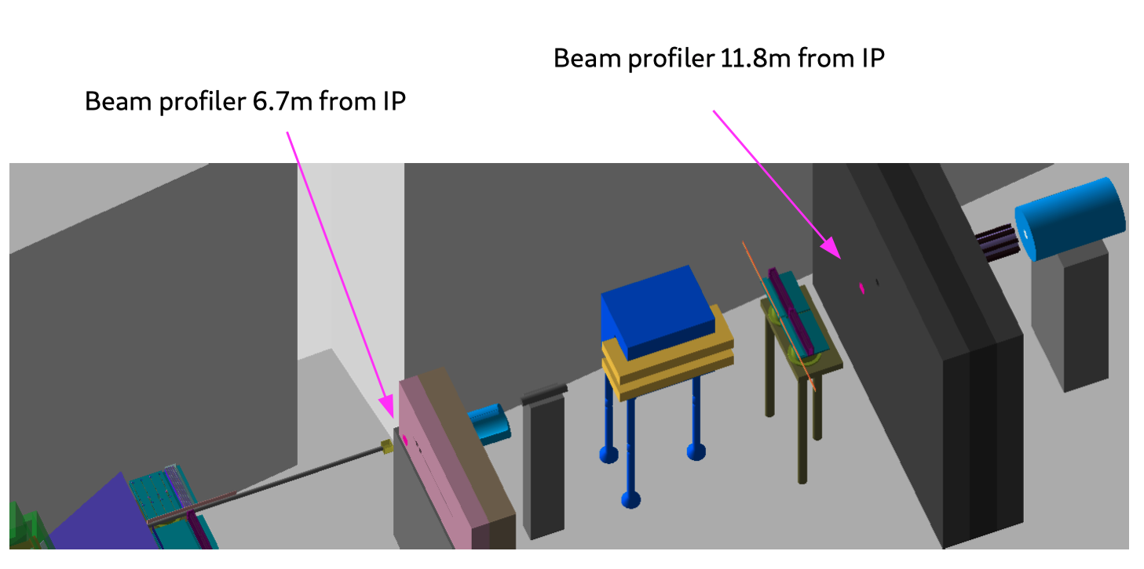
From geometry implemented by Sasha Borysov

Slide 3
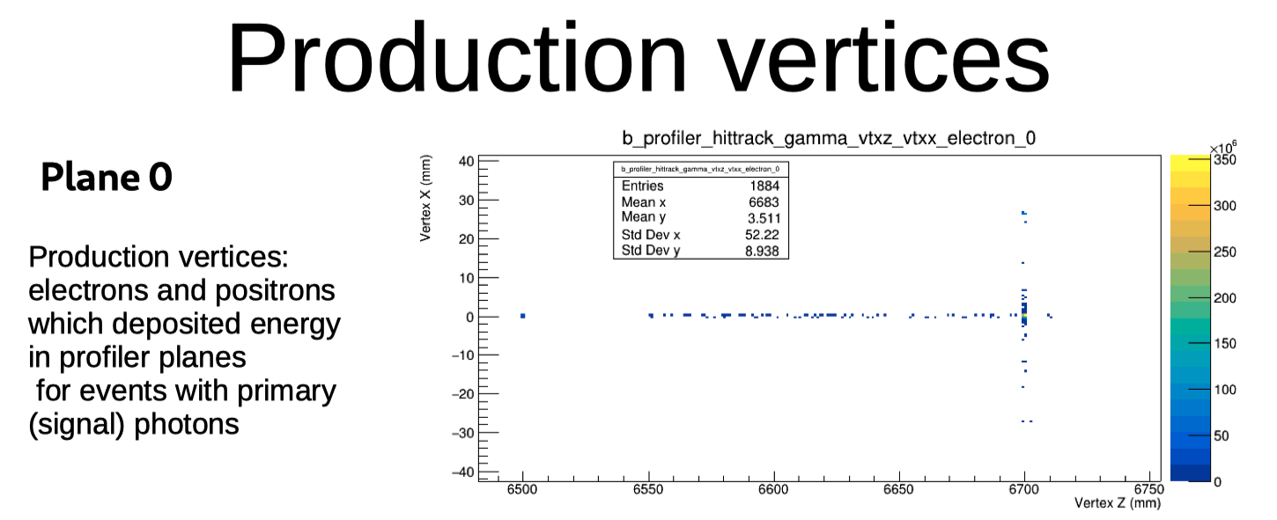
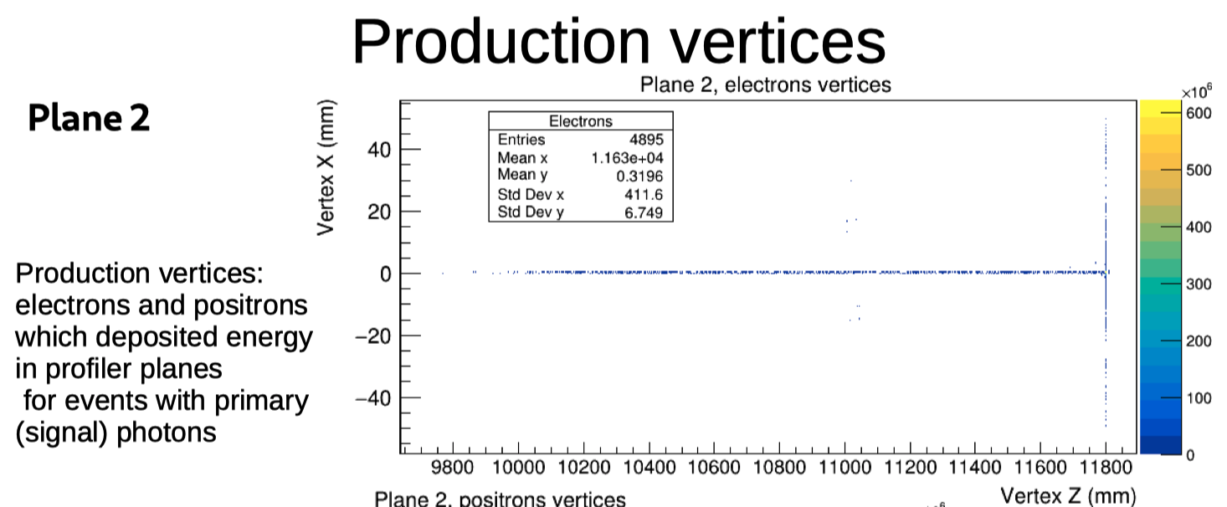
Gammas converting in air
Broaden the profile
Increase the energy released in the detector

Slide 4
Beam widening due to 6m of air spoils significantly the beam profile
Point of attention
Detector Thickness: 0.14% Xo
1m of air : 0.33% Xo

Slide 5
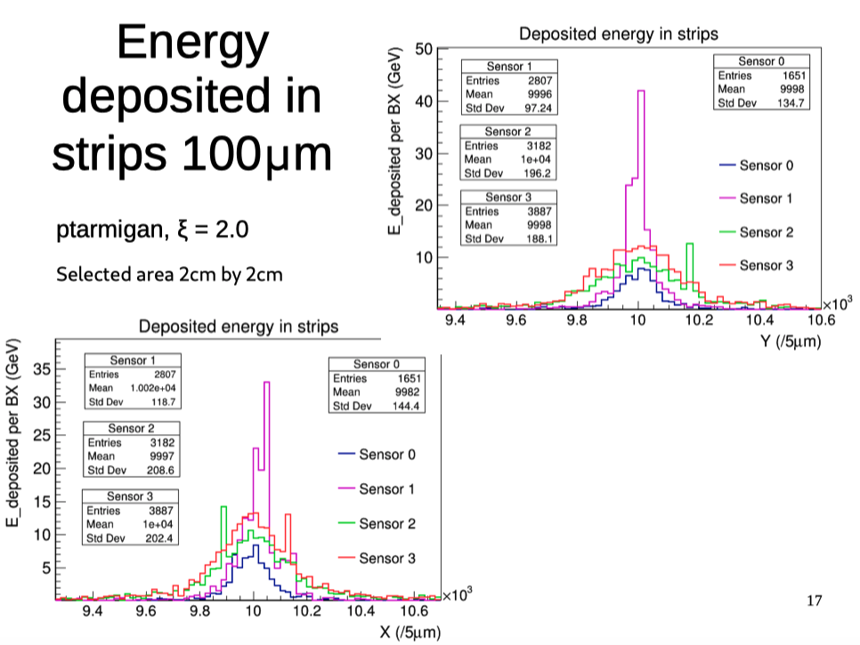
Beam profiles becomes wider in the last two sensors
Angular opening effect
Multiple scattering in air

Slide 6
Present understanding
The first station, just out of the vacuum, seems to be practically at the optimal position
Some further studies are needed to understand the performance and proper location of the second pair of detectors for the photon beam profiler
Only one station at ~12m , just out of the vacuum, is the preferred solution

