Slide 1
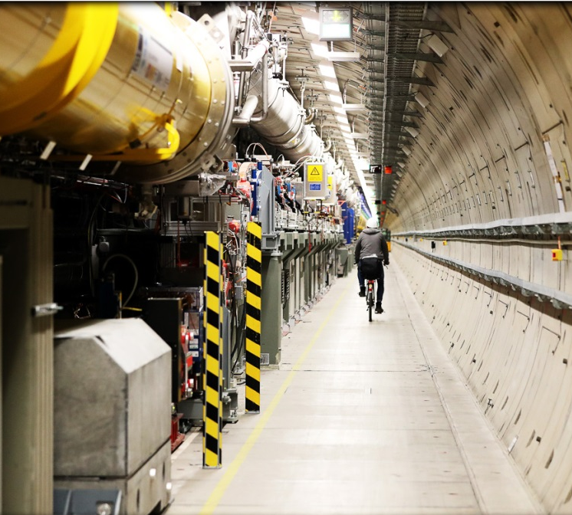
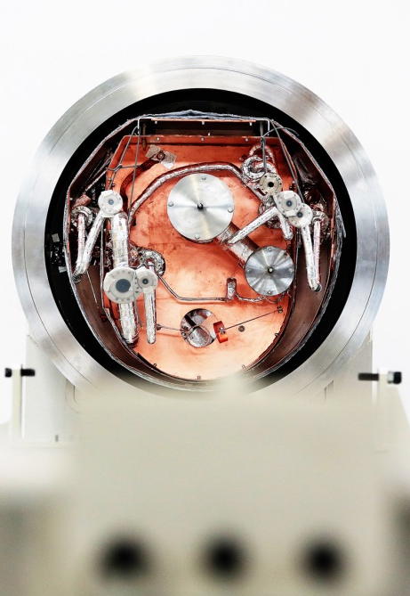
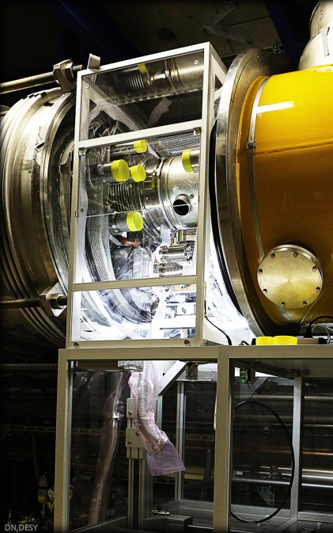
XFEL operator training Start Up Procedure
Matthias Scholz
March 23, 2021

Slide 2
What is the aim of this operator training?
You will learn how to restart the XFEL after a maintenance day.
It is organized such that it can be used as a step by step manual for the control room.

Slide 3
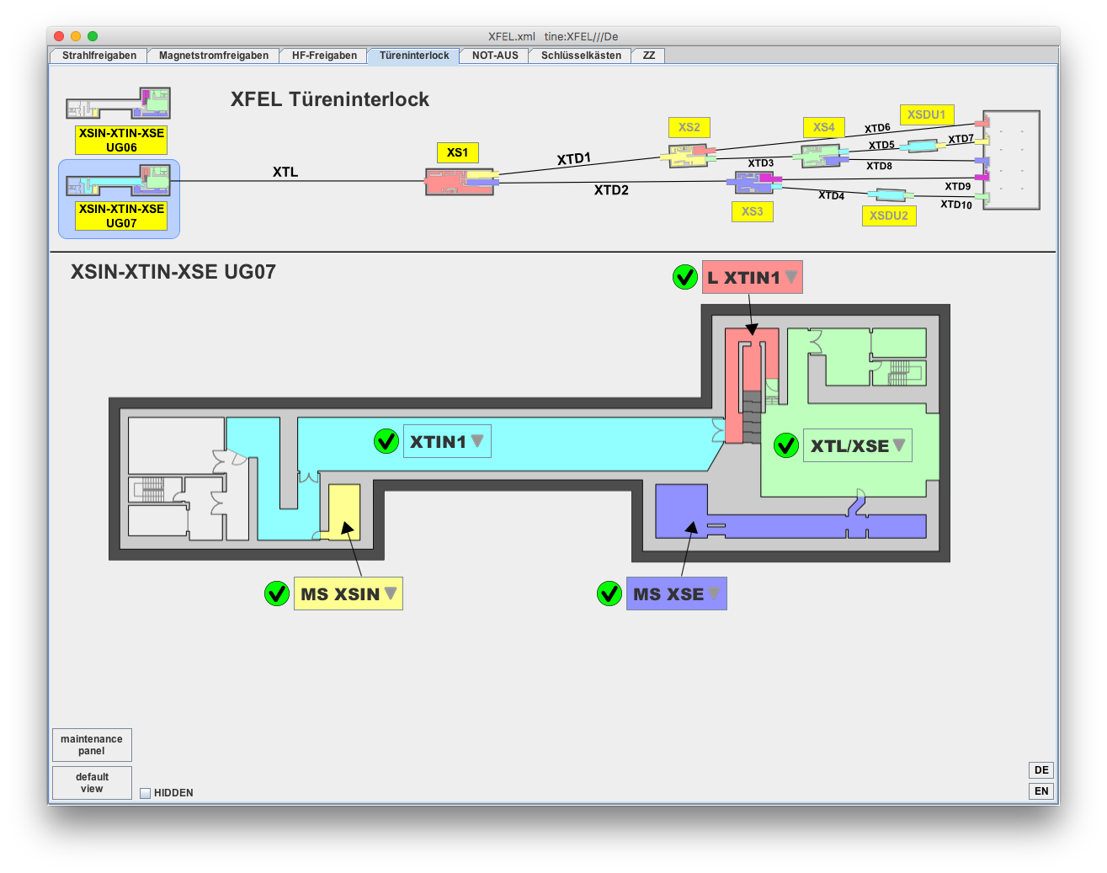
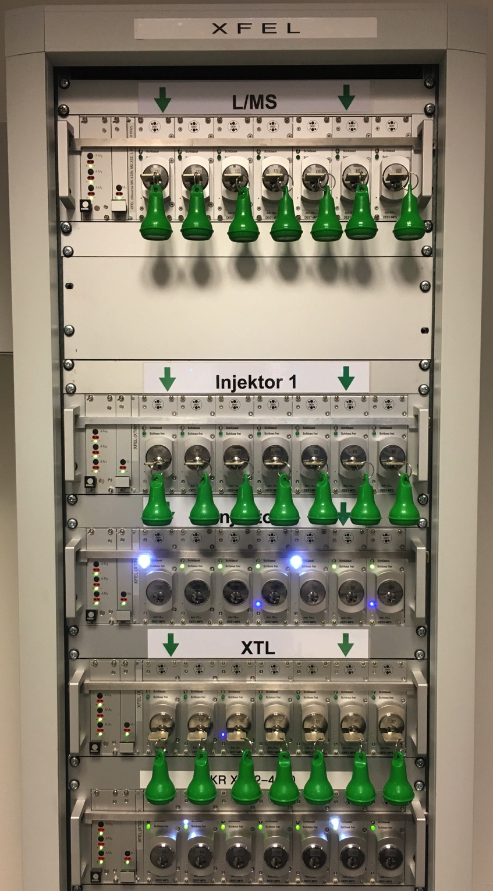
Tunnel search
There are the following interlock areas:
XTIN1, MS XSIN, MS XSE, L XTIN1, L XTIN2
XTL, MS XS1, XTD1, XTD2, XTD4, XTD9, XTD10
XTD1, XTD3/5, XTD6, XTD7, XTD8
Each of these areas has to be searched by at least two trained operators. A further operator can participate as trainee.
You need the following items for the tunnel search:
Safety shoes and helmet
Flashlight and oxy-box
DACHS card and transponder
Tunnel search instruction
Interlock key from BKR
Dosimeters (EPD and personal)
Additional information can be fond on the BKR confluence page:
https://confluence.desy.de/x/utrpBw
BKR interlock keys for
labyrinths and media shafts
(L/MS), Injector 1 and XTL

Slide 4
Assumptions
RF is off.
Magnets are off.
All tunnels are searched.
We want to operate the machine with beam in all beamlines.

Slide 5
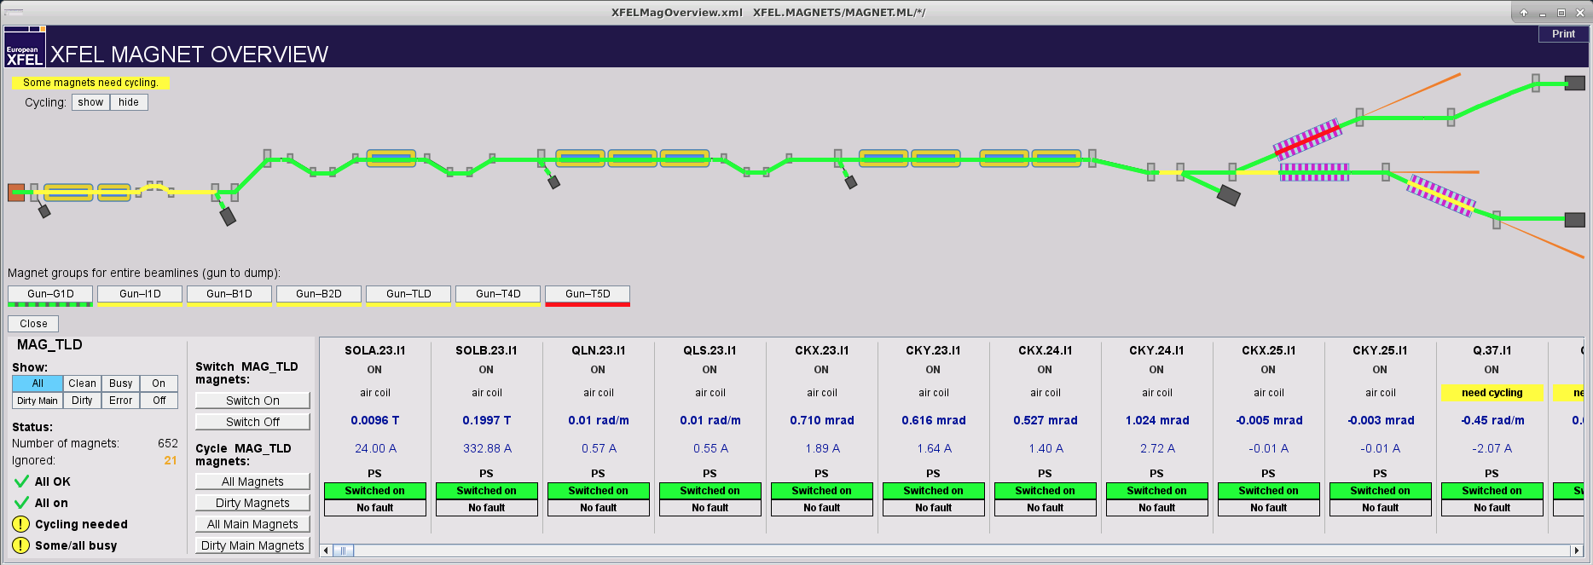
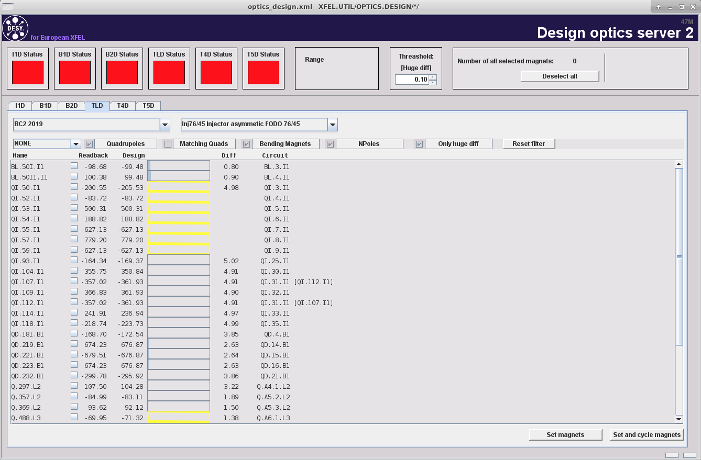
Next steps
Ensure that the injector laser is blocked.
Get magnet current permission in all beamlines.
Talk to the MKK shift crew to un-ground the magnets.
Switch on all magnets via magnet middle layer (using the magnet overview panel).
Load the design kicks to all magnets (see next but one slide).
Get beam permission in all beamlines.
Start the RF-stations via the linac energy manager.
Start the gun via the ramp tool.

Slide 6
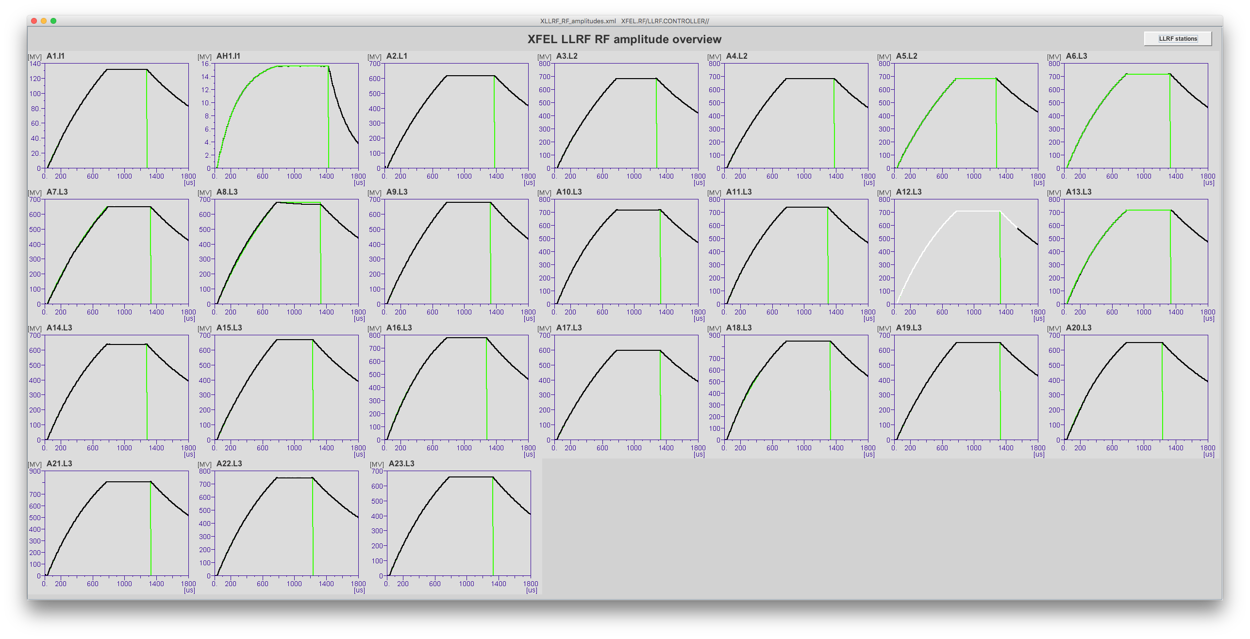
LLRF parameters
Ensure the settings for the RF stations are correct (130, 700, 2400 and e.g. 14000 MeV). At this point of the start up that has to be done relying on the LLRF parameters.
This can be done either on the sum voltage control panel or on the SASE tuning panel.
Check the RF amplitudes using the panel that you can find here: Main Panel, RF, RF Amplitudes
There you can see whether one of the stations runs with open feedback loops or has problems in general.
Check for RF slopes on the amplitudes and phases, check if the stations A1-A5 are running with more than one flattop.
Disable slopes and additional flattops if necessary.

Slide 7
Design beam optics
Open the tool here: Main Panel, Beam Dynamics, Design Kick Server
This server compares the current magnet kick strengths with the design values.
Yellow bars indicate uncycled magnets.
XFEL is always operated with design kicks for all main magnets (except matching quads).
You can select single magnets (or groups) with the check boxes and write the design values to the magnet middle layer server.

Slide 8
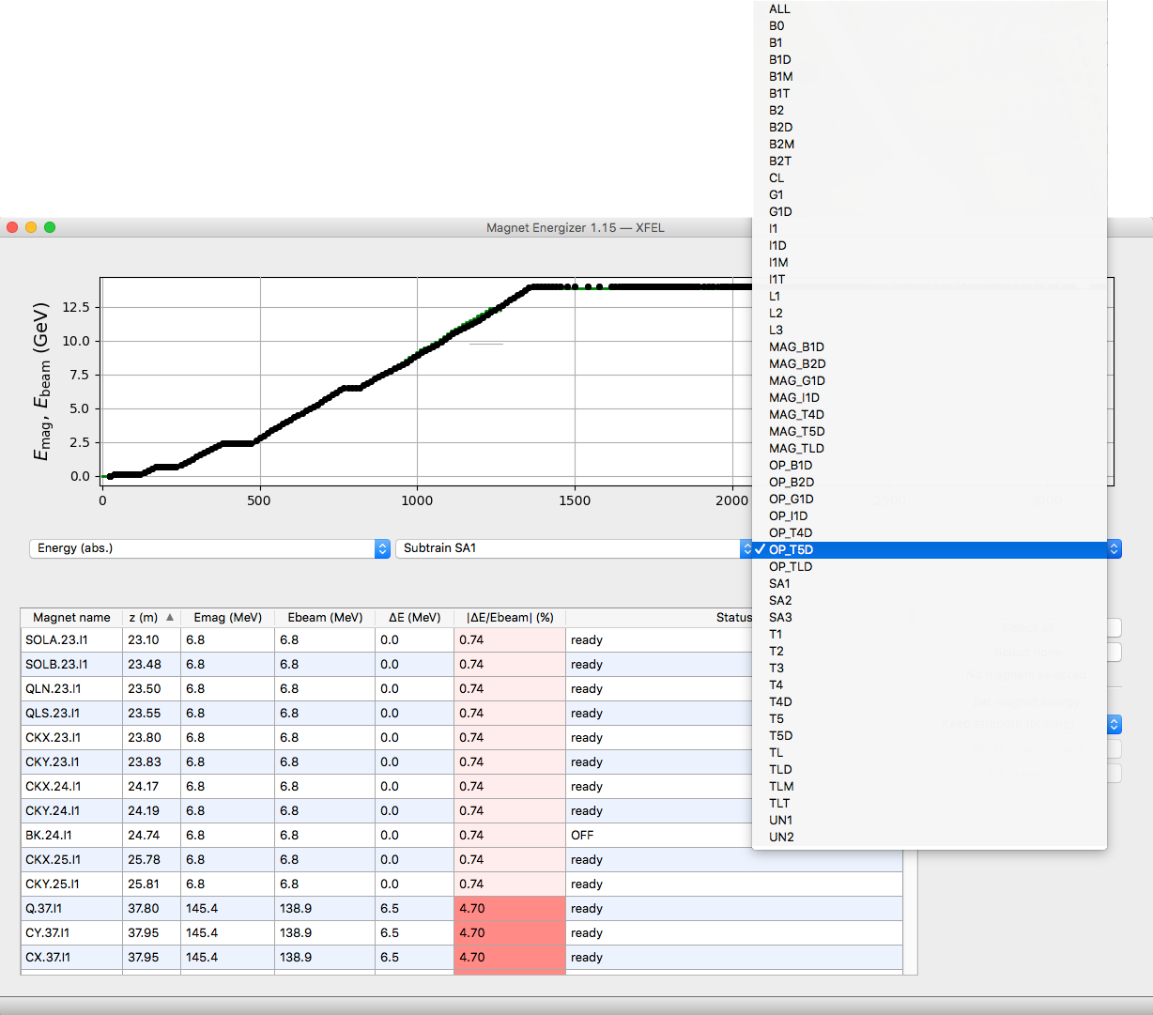
Magnet energizer
The momentum setpoint of the magnets can be easily changed using the magnet energizer.
You can find the energizer here: Main Panel, Magnets, Magnet Energizer
Select the beamline in the third dropdown menu. The beamlines starting with OP_ include all magnets from the gun to the named dump.
The momentum setpoints have to be in agreement with the electron beam energy at each position in the beamline.
If that is not the case, select ‘keep strength (scaling)’ method to correct it.
Use the ‘set to beam energy’ button for all magnets inside the modules (energy steps).
However, the (energy wise) well known parts of the beamline should be set to the exact values -> 130, 700, 2400 and e.g. 14000 MeV.

Slide 9
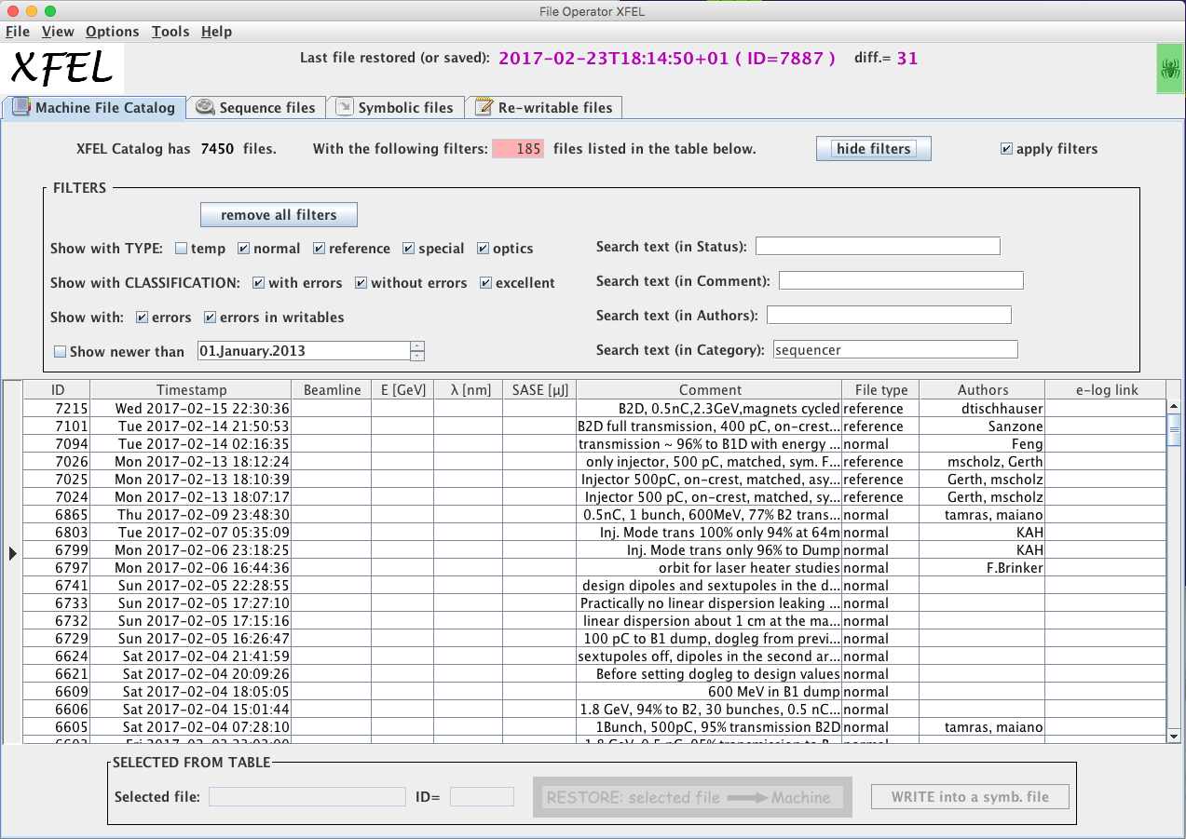
File catalog
It is possible and often helpful to load the corrector configurations from one of the previously saved machine files.
The run coordinator should tell you which file to use.
The provided filters allow to select only single section of the machine.

Slide 10
Magnet overview
Open the magnet overview here: Main Panel, Magnets, Magnet Overview.
Select a beamline (e.g. Gun-T4D) and check for magnets that are still off or in an error state.
Filter only the dirty magnets and cycle all dirty main magnets using the provided button.
Filter the busy magnets (SP and RBV are different). Refresh the filter by clicking on ‘busy’ from time to time. The number of shown magnets should become less and less.
Wait until no magnets are busy any more.
Check one more time for magnets that are off or in an error state.

Slide 11
Vacuum and dumps
Check for closed vacuum valved and open them if you find any.
Ceck the status of all main beam dumps.
Pumps running?
Valves open?

Slide 12
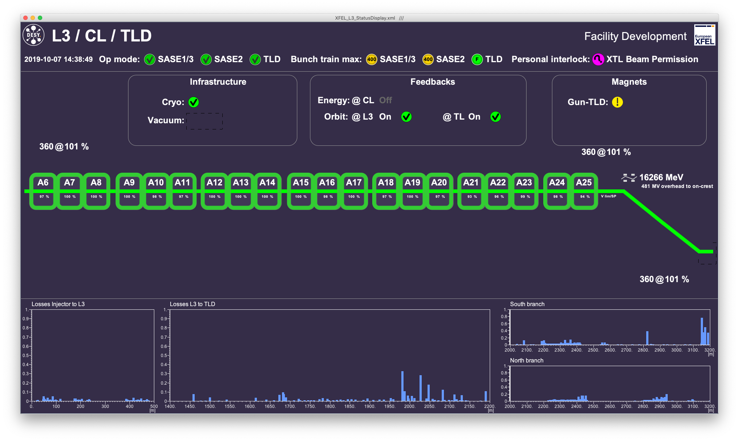
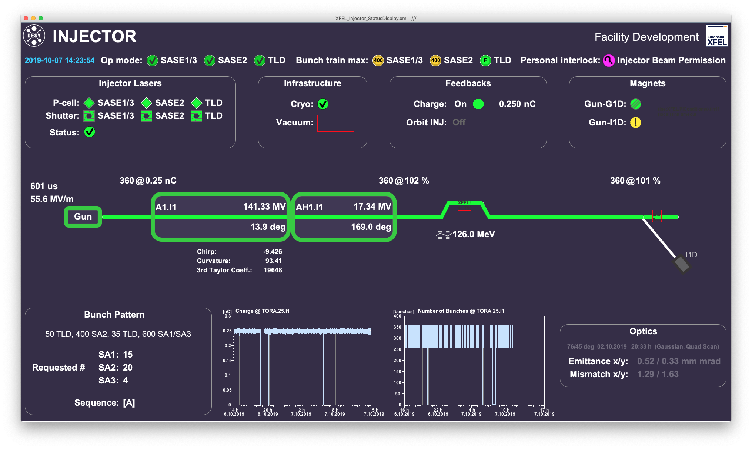
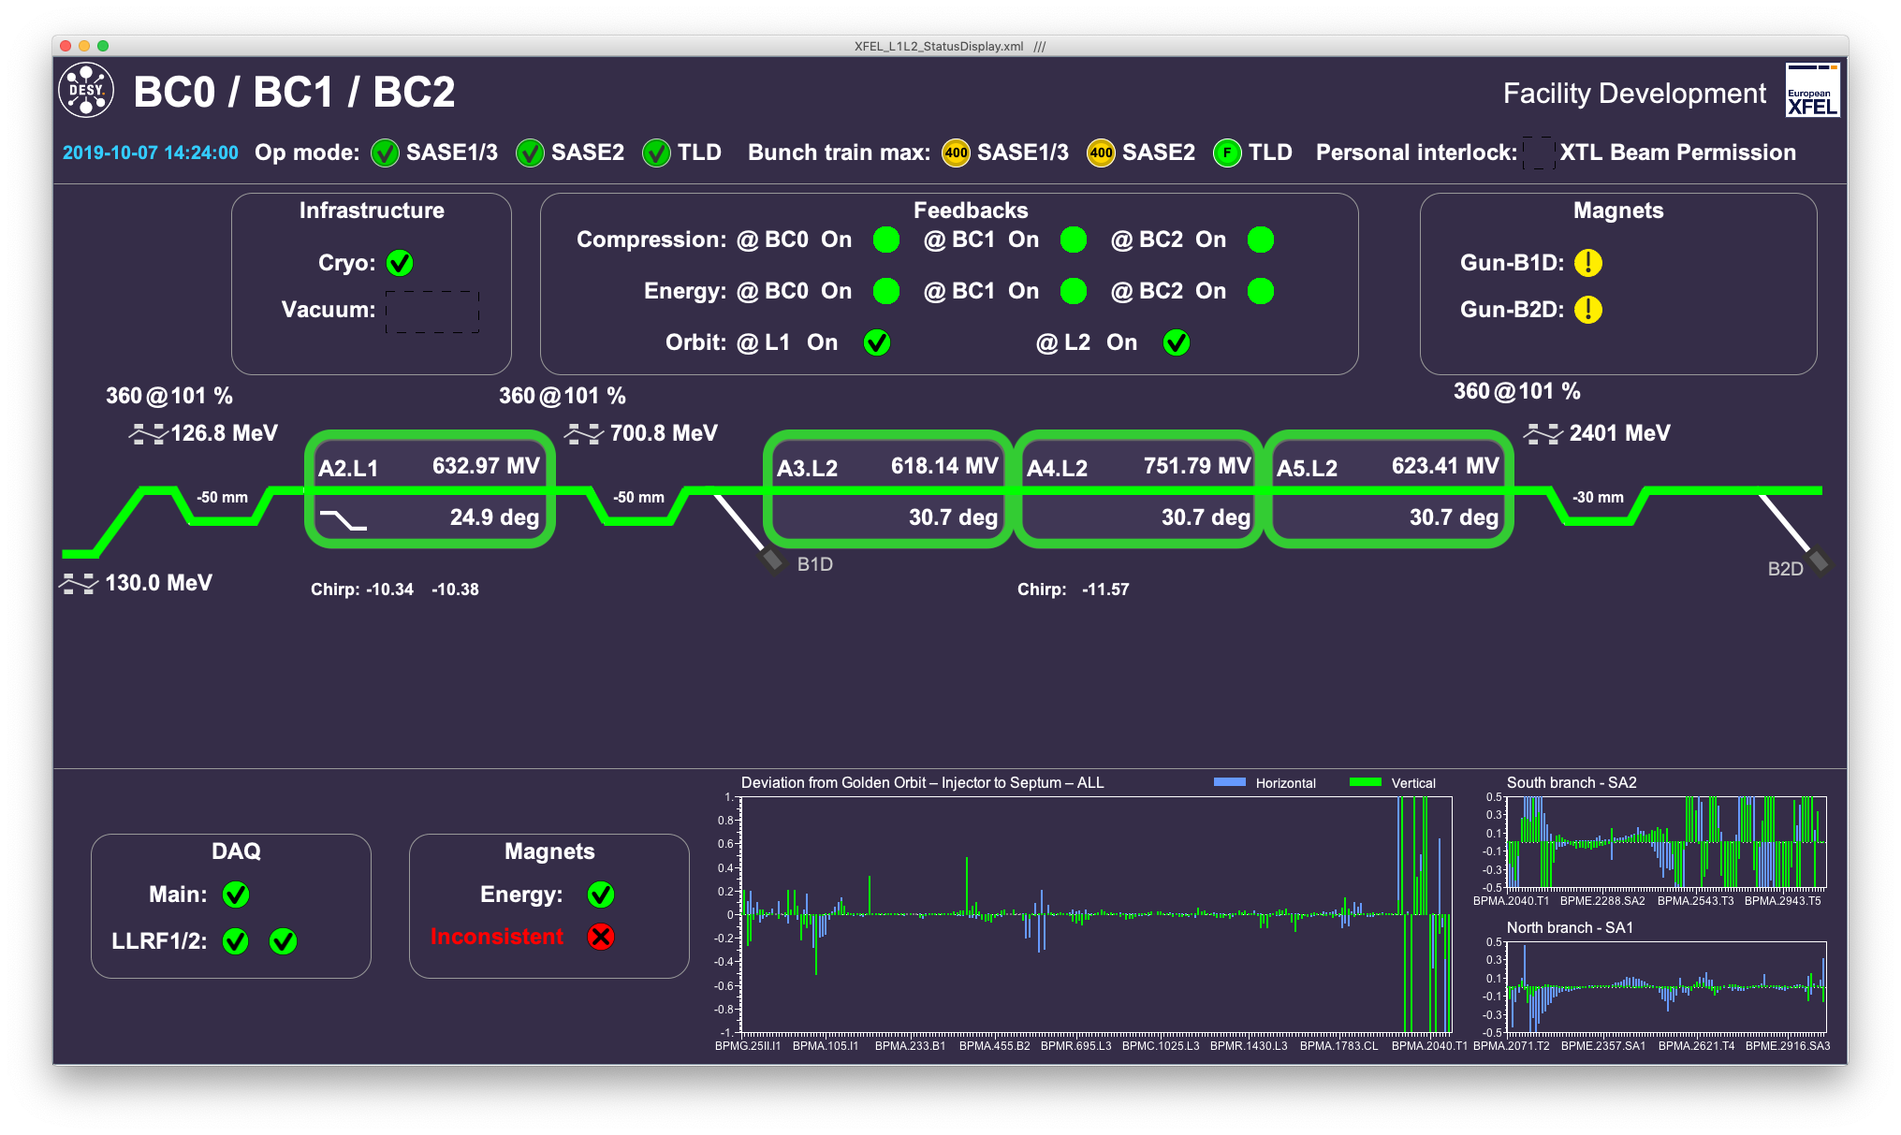
Overview panels
Any error messages from FSMs shown?
Is the laser blocked by the MPS?
Cryo and Vacuum ok?
Feed back status as expected?
Is the DAQ ok?
What is the status of the magnets?
Beam permissions?

Slide 13
Feedbacks off
It is recommended to switch the compression and energy feedbacks off before the first bunches are accelerated.
This should only be necessary for flattop 1 because all other flattops were disabled before.
This prevents that the FB changes heavily the RF parameters in order to reconstruct some old bunch compression monitor read back values.
The feedbacks can be switched off e.g. on the SASE tuning panel.

Slide 14
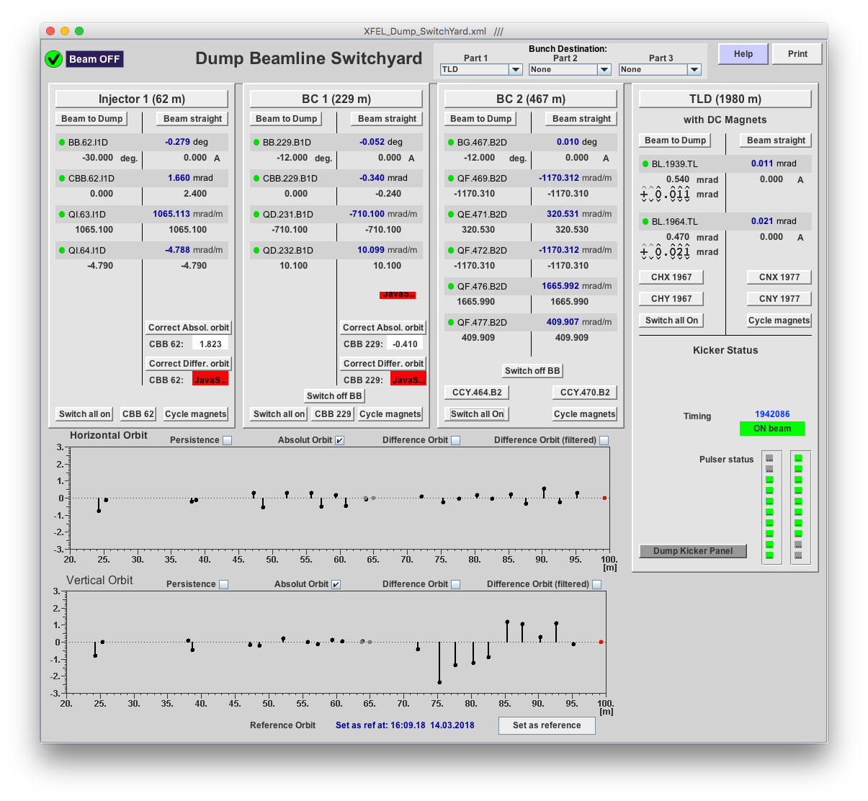
Beam to injector dump I1D
Use the dump switch panel to steer the beam into the I1D dump beamline.
Establish transmission to the dump.
Correct the beam energy until the I1D beam energy measurements shows 130 MeV.

Slide 15
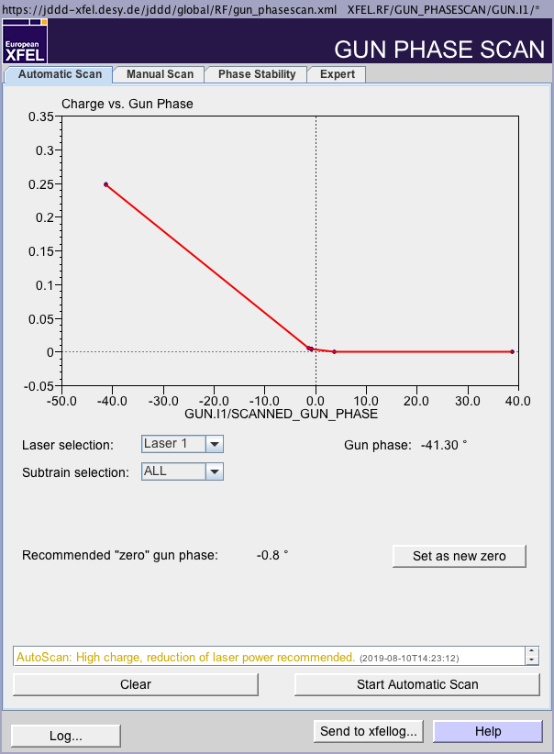
Measure and set gun phase
Set the bunch charge to 100 pC using the charge feedback. Wait a few minutes until the charge is reached.
Measure the gun phase using the provided tool.
The tool can be found here: Main Panel -> Injector -> Gun Phase Scan.
Set the recommended phase as new zero gun phase.
Set the gun phase to -43 degree.

Slide 16
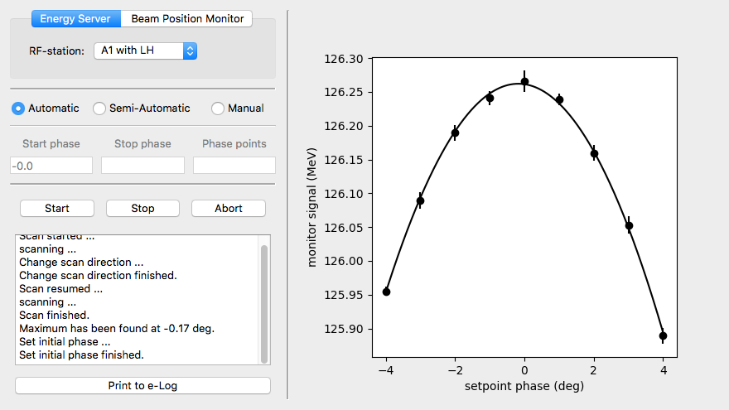
Phase scan of A1 and AH1
Use IntelliPhase (Main Panel, RF, IntelliPhase) to measure and set the on-crest (anti-crest) phase of A1 and AH1.
Set the chirp in the injector to 0.
Curvature and third derivative should be zero.
The sum voltage should be adjusted that the beam energy in I1D is 130 MeV.

Slide 17
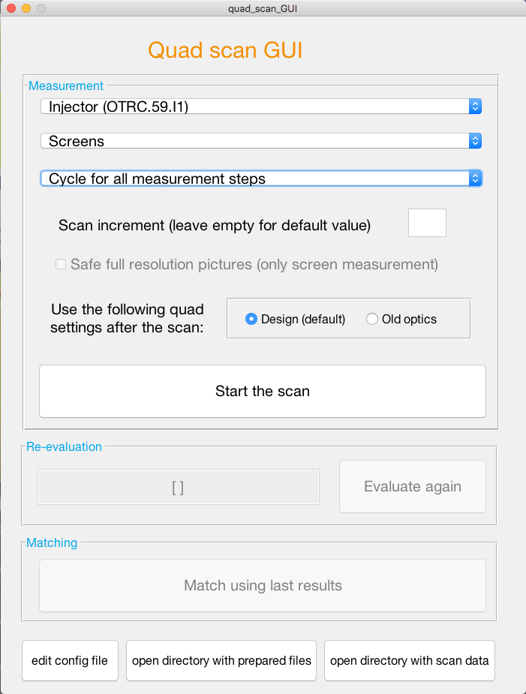
Beam optics measurement and matching in I1
Multi quad scan: Takes more time compared to the four-screen-method but takes also more data and thus delivers slightly more precise results.
You can find the tool here: Main Panel -> Beam Dynamics -> Multi Quad Scan Tool
Select the machine section, the measurement devices (e.g. screens) and the cycling method. Then press the ‘Start the scan’ button.
The matching button becomes available after the scan.

Slide 18
Compression and beam energy settings
Go close to final compression settings. You can do that e.g. on the SASE tuning panel.
Reduce the injector chirp by 1. Curvature and third derivative can be set to the expected final values.
Set also the chirp in L1 and L3 to the final values and reduce them by 1 in order to avoid over compression under all circumstances.
Check that all beam energies have been kept constant. Correct the beam energies if that is not the case. (Since there is no beam yet downstream the injector, you have to rely so far on the beam energies calculated by LLRF).
Correct the orbit in the injector. Changing phase steers the beam. This is the reason why the compression settings should be applied already now.

Slide 19
Ensure that all undulator gaps are open
Open all undulator gaps (as long as there is no access any more to the respective sections of the machine). This should be done for SASE1, 2 and 3!

Slide 20
Beyond the injector
Block the beam.
Use the prepared sequence to join Injector 1 and XTL.
Select the preset for bunches to TLD on the main timing panel.
Check if you can get a single bunch to TLD using the previously loaded corrector settings.
Start without trajectory feedback.
Add the trajectory FB later on
In case you have transmission take a golden orbit.
In case there is no transmission use a settings loaded via the trajectory storage server.
If there is still no transmission to TLD, use the Python (Ocelot) orbit correction tool to correct the orbit up to TLD. Switch off the orbit FB in areas that you want to correct. Use the single shot capability of the tool.
Take a new golden orbit after the correction and switch the orbit FB on.

Slide 21
Beam beyond the B2 section
The IBFB should be switched off.
Establish transmission to TLD using the orbit correction tool. It helps to do that section wise. My typical sections are
400 m - 800 m (warm-cold transmission)
700 m - 1650 m (ends upstream the collimation section, includes the cold-warm transission)
1550 m - 1939 m (ends upstream the BL magnets and KS kickers that steer the beam into TLD)
The L3-part of the beamline can also be corrected using the orbit feedback.
Keep in mind that the electron beam energy downstream L3 might not be correct! That should be your first knob to obtain/improve transmission. Use the beam energy manager for that!
It helps often to set all correctors in TLD to zero and to correct the orbit mainly with only one horizontal and one vertical correction at the beginning of the TLD beamline.

Slide 22
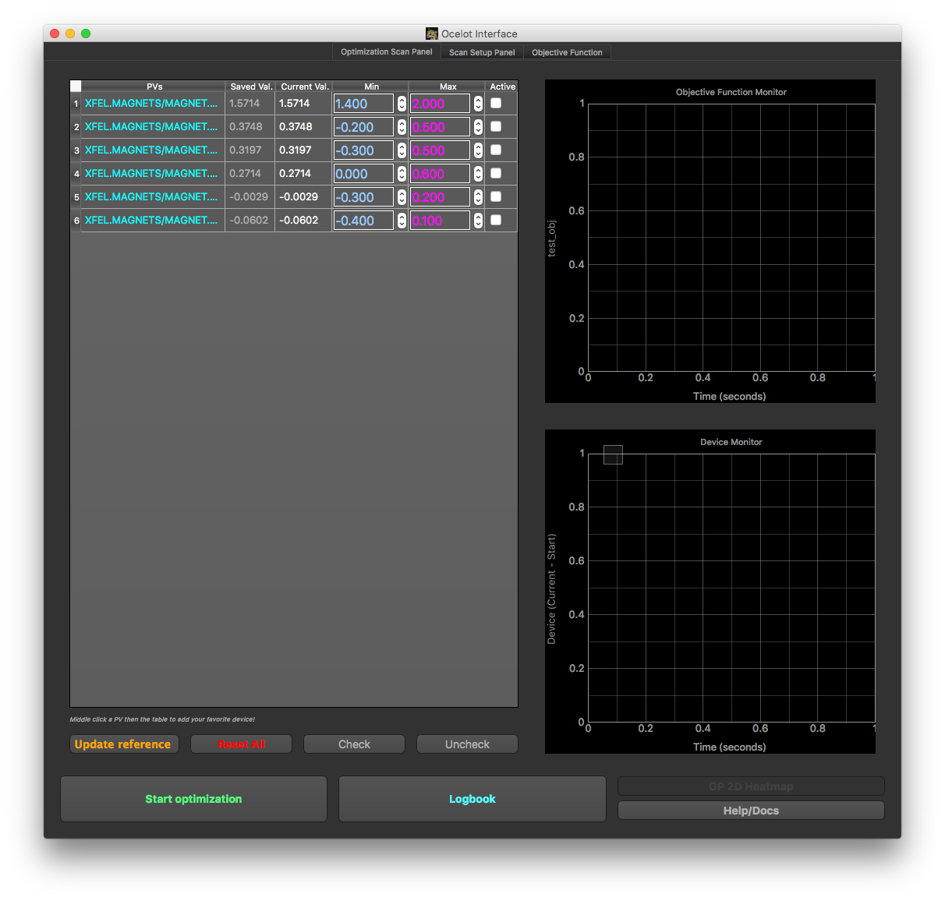
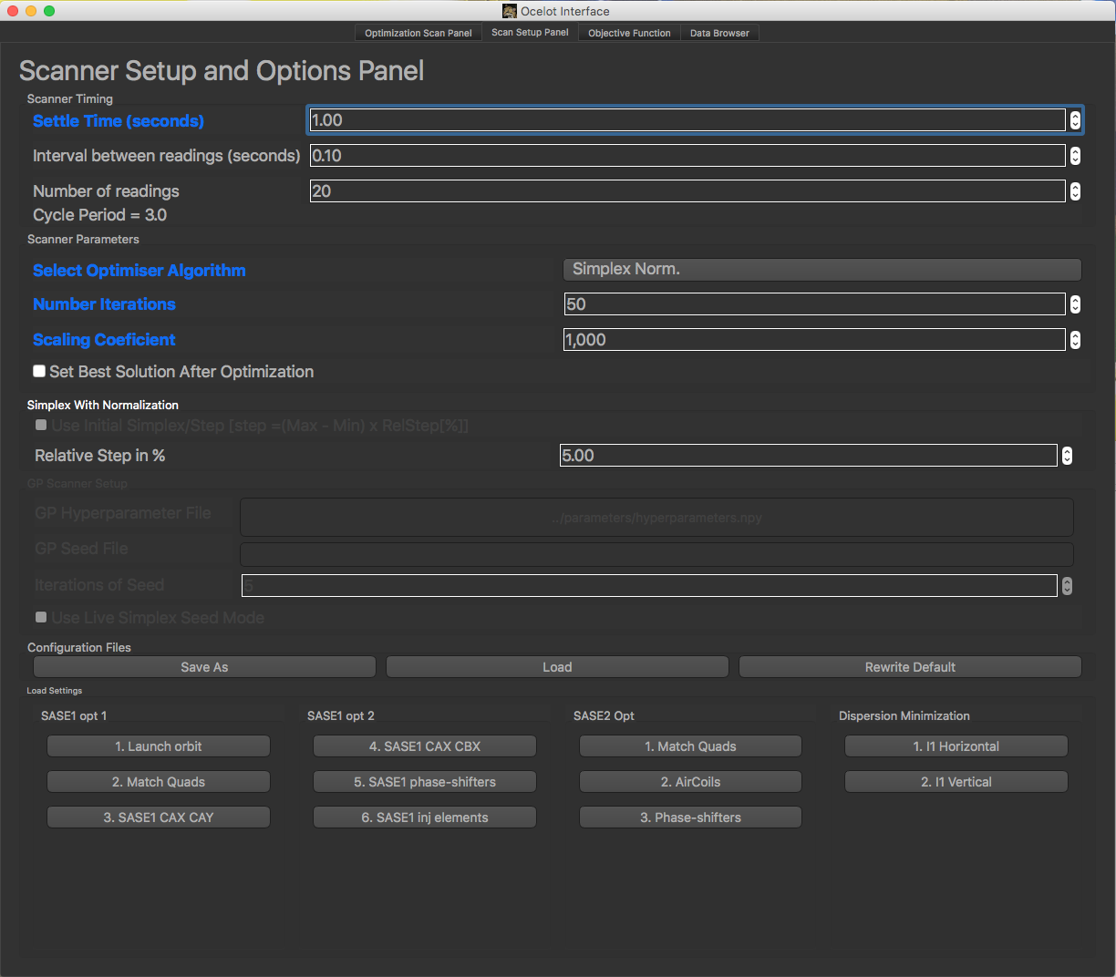
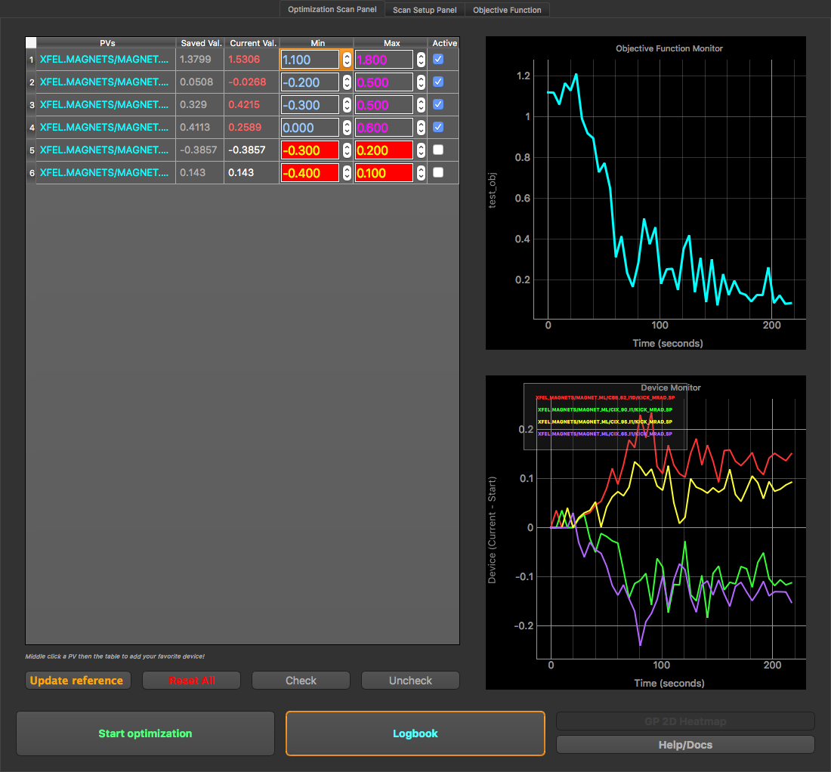
Dispersion correction
The dispersion in the section with 130 MeV can be corrected with the ocelot optimizer.
Open the optimizer here: Main Panel, Tools, Ocelot Optimizer.
Go to the ‘Scan Setup Panel’ and chose ‘I1 Horizontal’ or ‘I1 Vertical’.
Go back to the first tab and select the correctors that should be used.
Adjust the min-max-rage for all selected correctors.
Press ‘Start optimization’

Slide 23
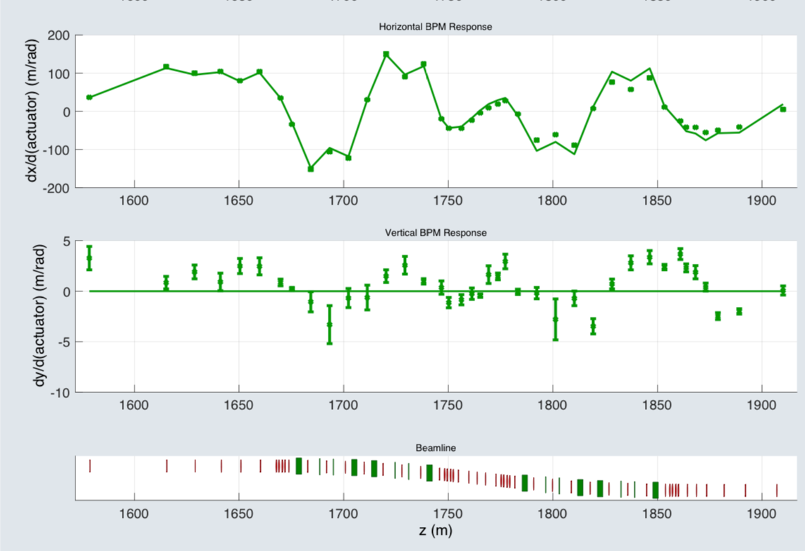
Final beam energy measurement downstream L3
Final electron beam energy determination with trajectory response measurement using the chromatic beam optics in the CL section.
Use the trajectory response measurement tool, corrector CX.1542.L3 and 350 m downstream beamline.
The goal is to find the beam energy with the best agreement between measured and design responses on the kick.
https://ttfinfo.desy.de/XFELelog/show.jsp?dir=/doc/Beam%20Dynamics/Optics&pos=2018-11-13T20:54:48

Slide 24
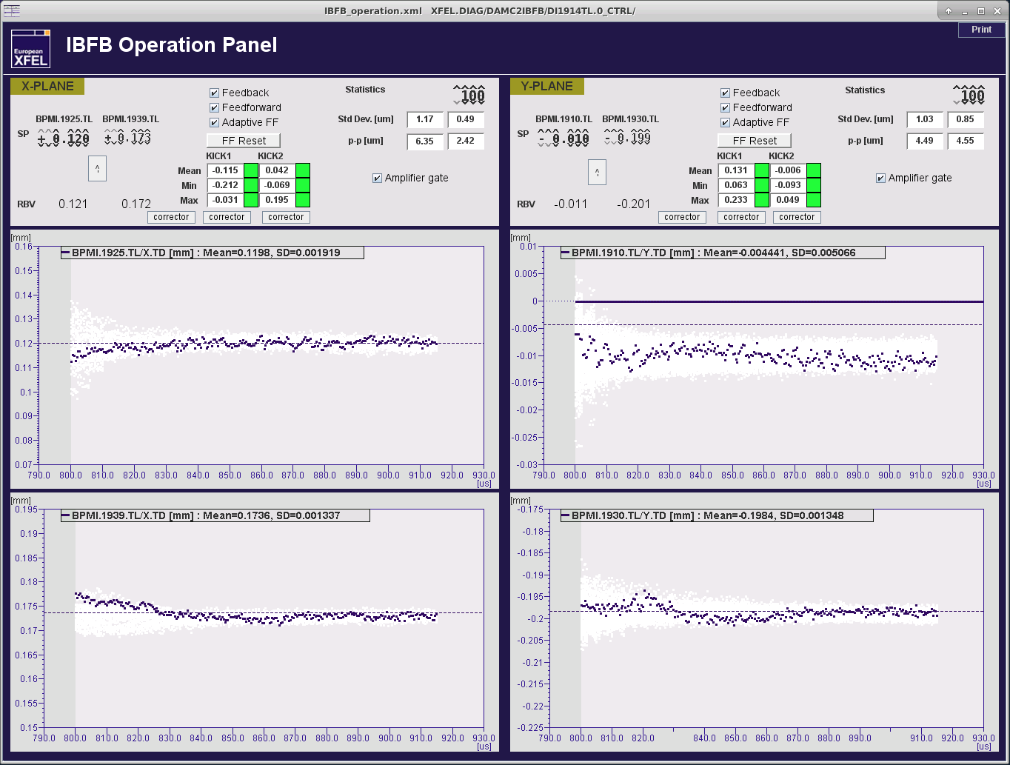
Start IBFB
You can find the IBFB panels (inter alia) here: Main Panel, Feedbacks Automation, IBFB operation
Set the IBFB Set Points by pressing the buttons with the little upwards pointing arrows.
Reset the feed forward (FF) correction tables.
Activate the feedback, the feed forward correction as well as the adaptive FB using the marked buttons.

Slide 25
Beyond TLD
Ensure again that all undulators gaps are open.
Only one bunch for steering through any beamlines.
Switch the orbit feedbacks in SA1-SA3 on (as long as it is to be expected that the used setting is good enough to improve the orbit in the respective section).
As mentioned before, it might help to load corrector settings from a file that worked before. Otherwise it might help to set all correctors to zero and use the orbit correction tool to optimize the transmission.
In any case, there is typically no reason to steer the beam by hand using the cockpit (or whatsoever panel). This should always be done using the orbit correction tool! As long as there are losses in the respective beamline, use the single shot mode of the orbit correction tool! Be patient, it takes a while until the beam gets released!

Slide 26
T4D
Establish transmission to the T4D dump. Do not use the dipole magnets/correctors that are foreseen to substitute the TLD- and SASE2-beamline kickers (TLD -> BL.1939.TL and BL.1964.TL, T5D -> CHY.1997.TL and CHY.2004.TL). Those correctors should be at zero kick (and cycled).
The offsets at the first septum can be in the range of +200 um in horizontal plane and at the second septum around -200 um in the vertical plane. That should make it easier to pass the septa with acceptable losses.
Establish transmission to the T5D dump. The magnets in the TL section should not be used any more in order to keep the transmission to TLD and T4D.
The orbit correction tool does also work in the T5D beamline. Choose the SASE2 section for that purpose and restrict then the range to what you need.

Slide 27
Finally
Assuming there is proper transmission to the dumps and no losses in all beamlines, this is the time to go back to TLD and increase the number of bunches. Check if you can run XFEL with e.g. 300 bunches without problems.
Establish now a bunch pattern as required for the following program.
Find SASE
If there is no clear signal after closing the undulator gaps, use the first FEL imager to search for SASE.
BTW, the BBA orbit should always be good for at least some signal.
Then: SASE tuning using the adaptive feedback, compression, etc. (extra operator training…)

