Slide 1
Clustering
UPDate
04-03-2021

Slide 2
News
Calculated CM of main cluster – per layer – ${CM}_{layer}$
For each layer:
For each pad in a cluster of up to 3 pads:
If distance between pad and ${CM}_{layer}$ $≤$ 2.5 cm:
Attach to main cluster
Else:
Pad was left as a single pad cluster

Slide 3
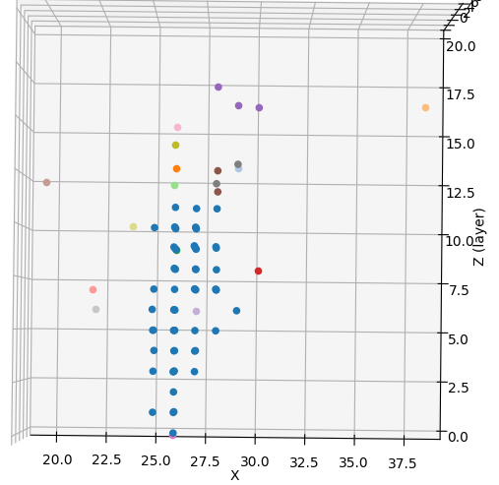
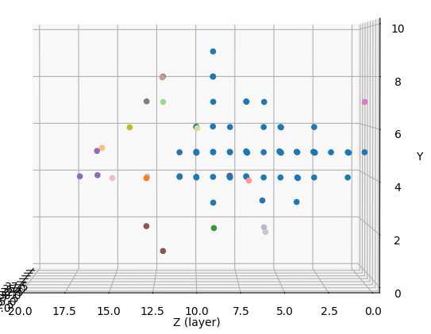
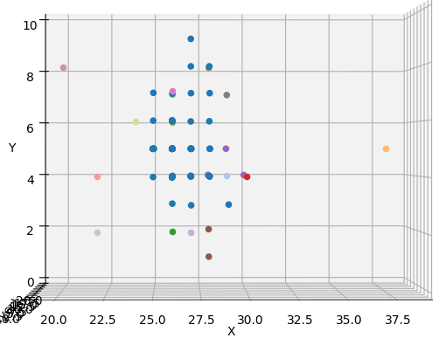
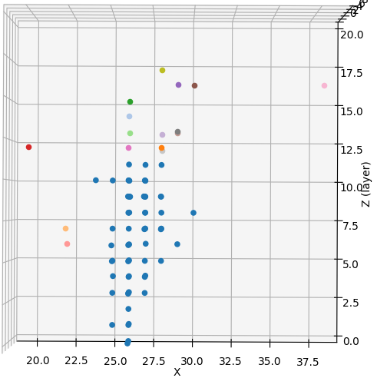
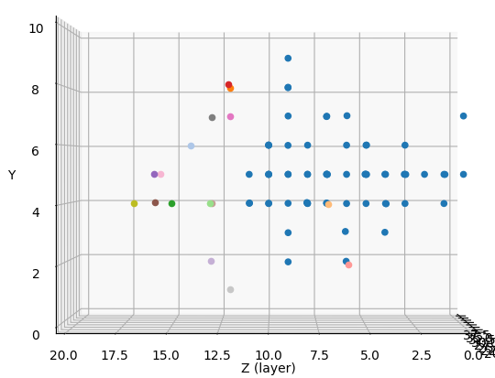
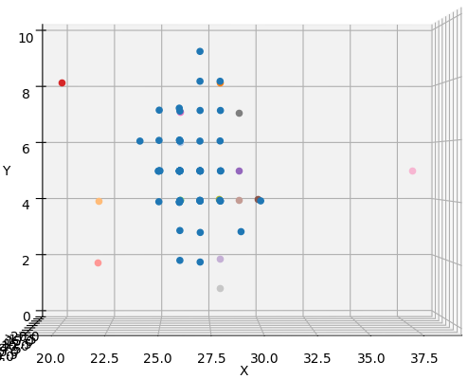
BEFORE
4 GeV
AFTER

Slide 4
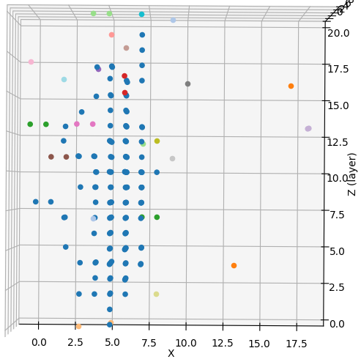
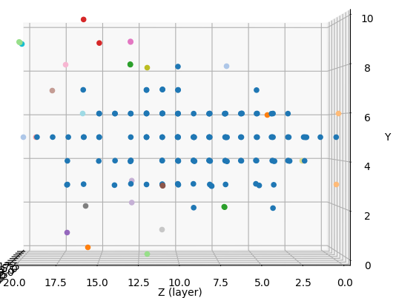
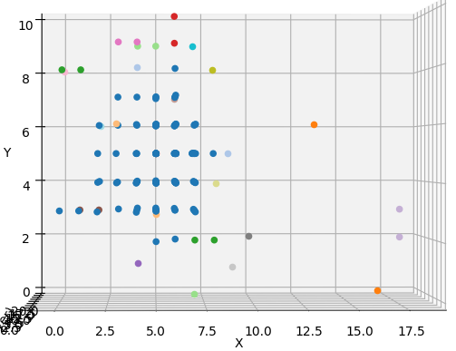
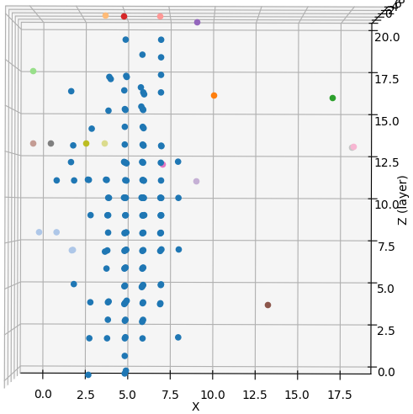
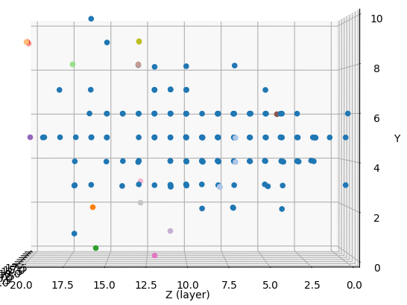
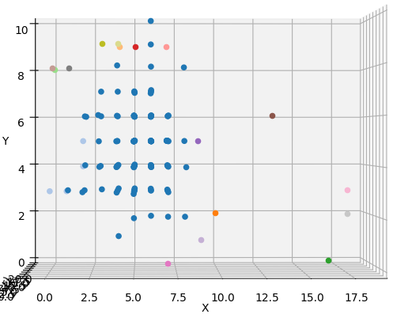
BEFORE
10 GeV
AFTER

Slide 5
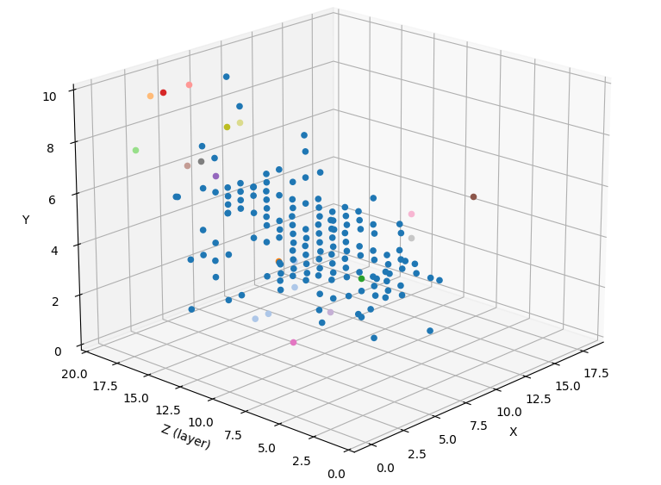
10 GeV
BEFORE
AFTER

Slide 6
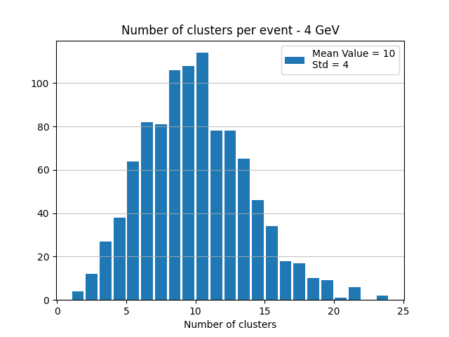
4 GeV
BEFORE
AFTER

Slide 7
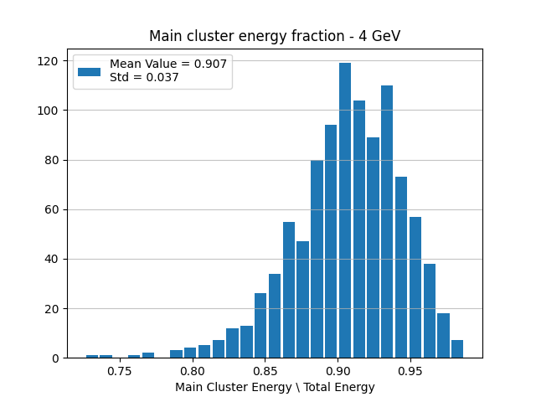
4 GeV
BEFORE
AFTER

Slide 8
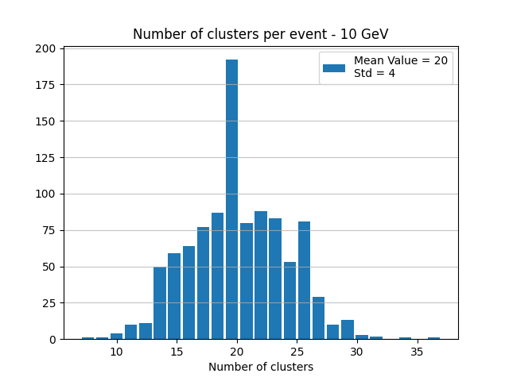
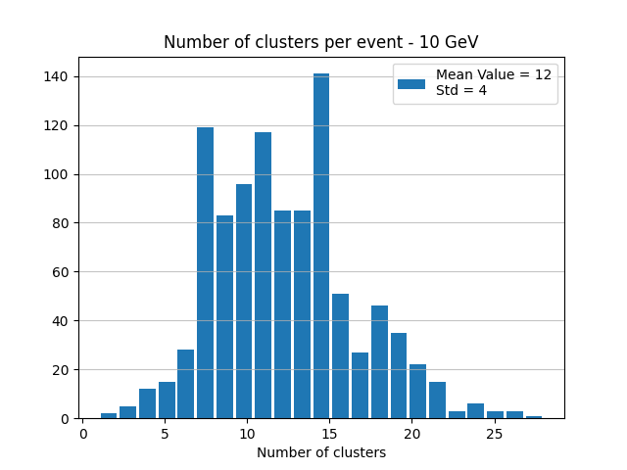
10 GeV
BEFORE
AFTER

Slide 9
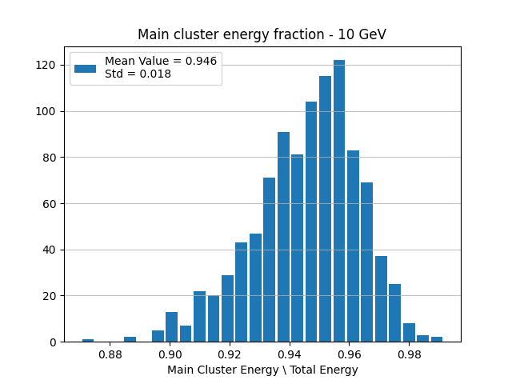
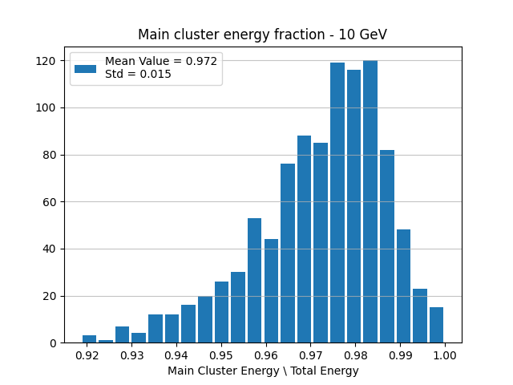
10 GeV
BEFORE
AFTER

Slide 10
Notes
Number of clusters affected by breaking up small clusters to single pads
If necessary, could:
Attach entire small cluster to main (not pad by pad)
Keep far pads in their original cluster
Possible upgrade – broaden search for neighbors In deeper layers
Relevant to big clusters as well (number of pads $≥15$)
See example in next slides

Slide 11
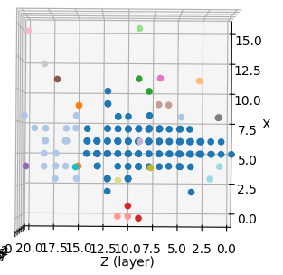
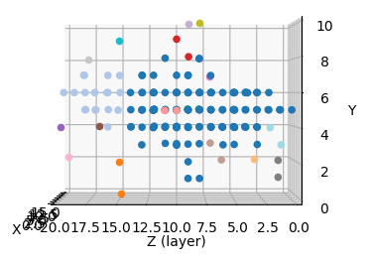
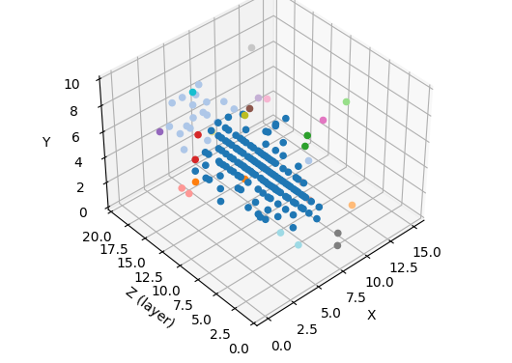
Example #1 – no immediate neighbors – 10 GeV

Slide 12
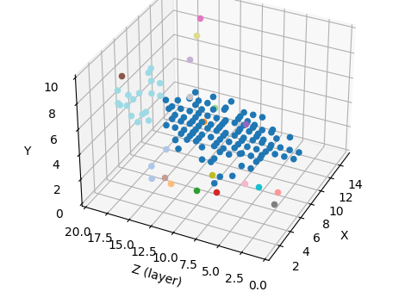
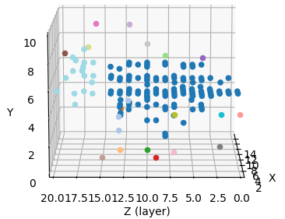
Example #2 – layer separation – 10 GeV

Slide 13
Average Edep per pad
Projected on X-axis
LOG SCALE

Slide 14
LOG SCALE – 2 GeV

Slide 15
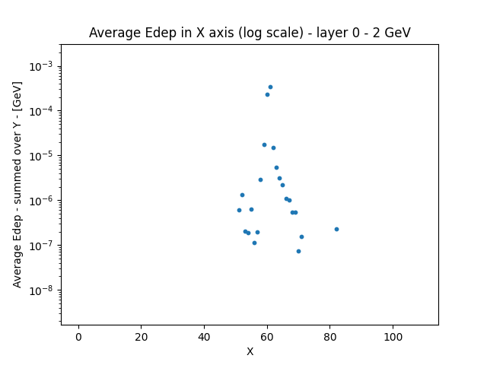

Slide 16
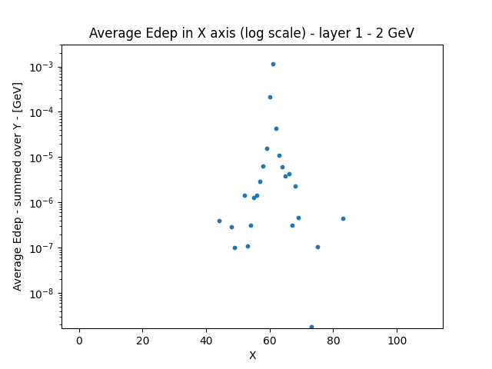

Slide 17
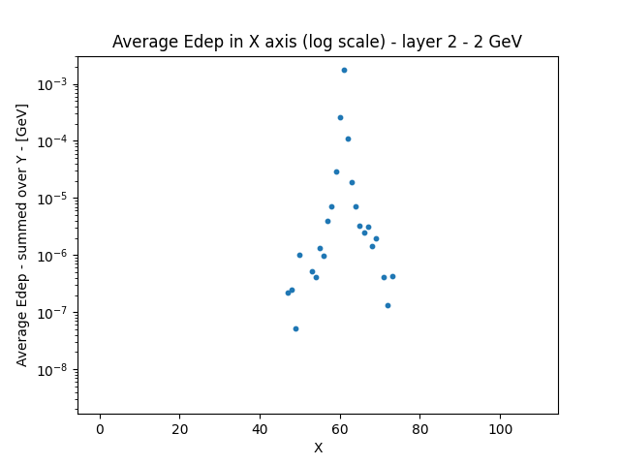

Slide 18
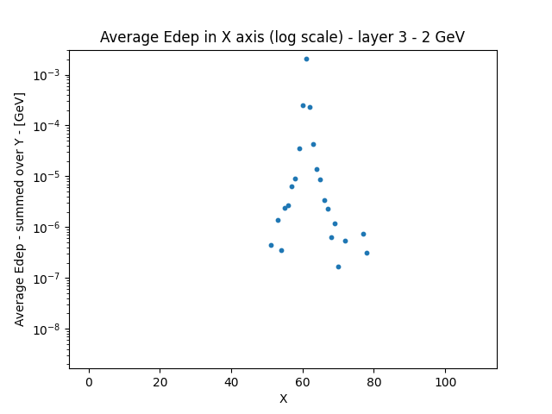

Slide 19
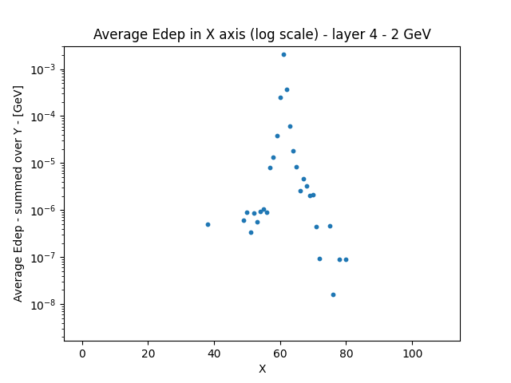

Slide 20
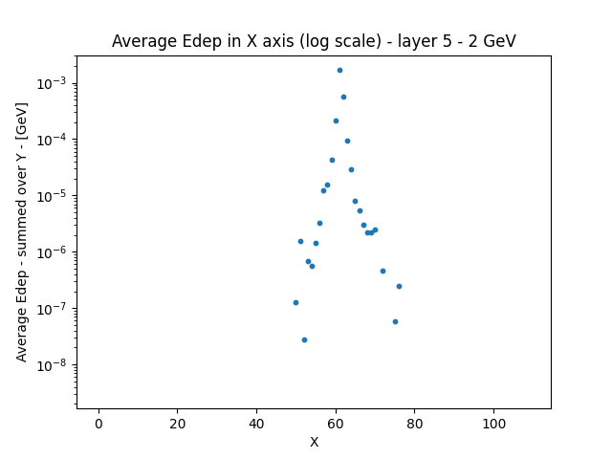

Slide 21
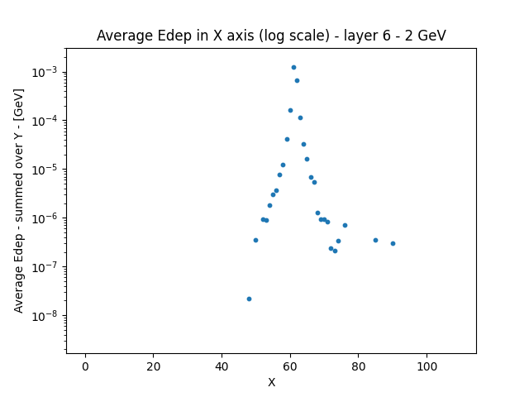

Slide 22
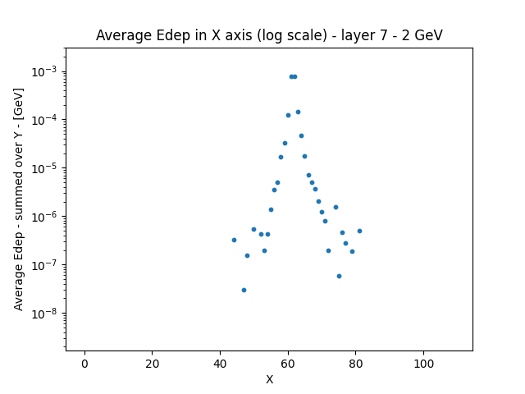

Slide 23
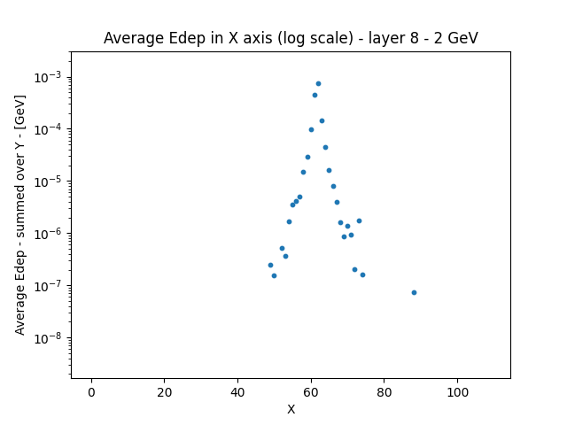

Slide 24
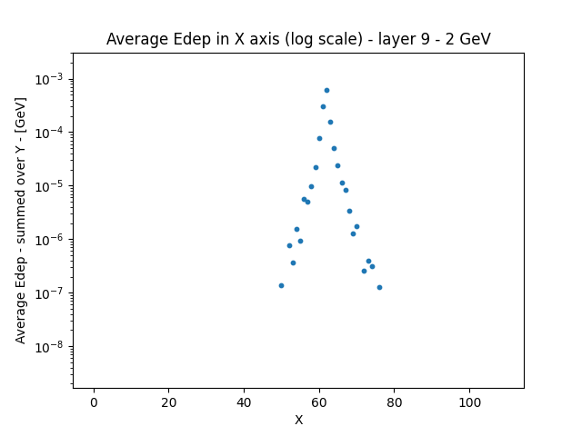

Slide 26
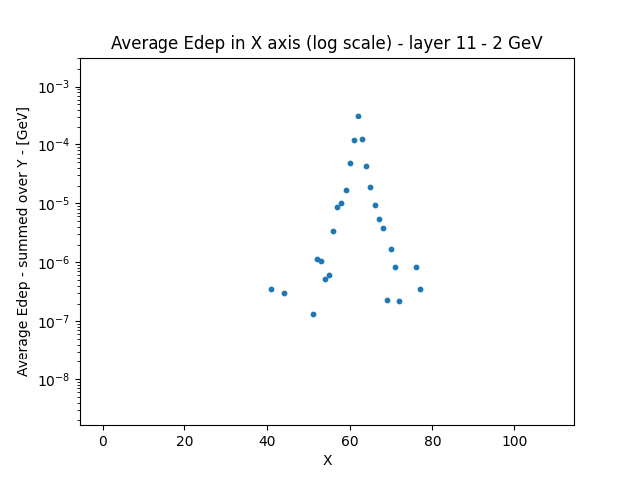

Slide 27
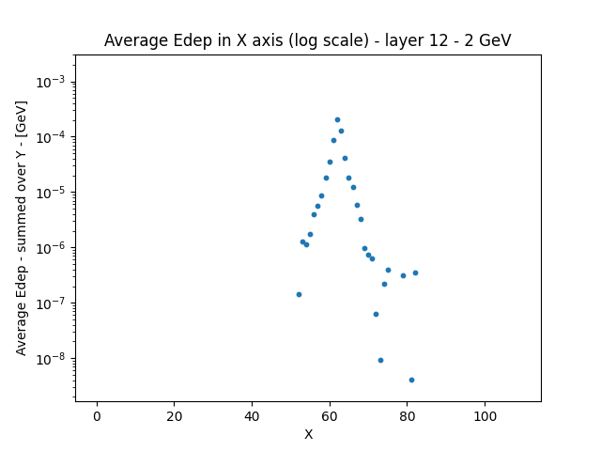

Slide 28
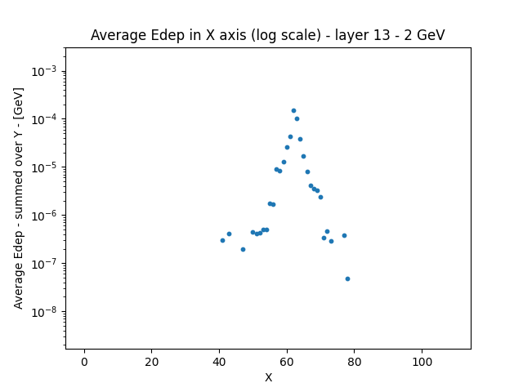

Slide 29
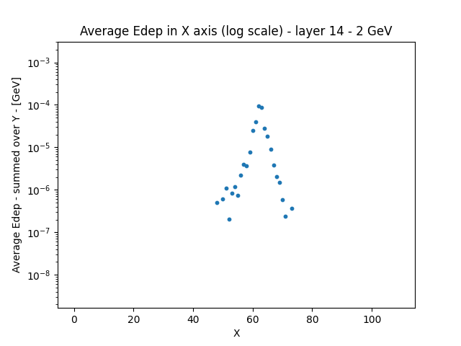

Slide 30
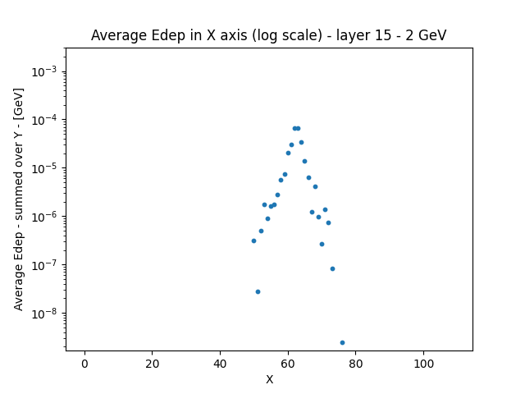

Slide 31
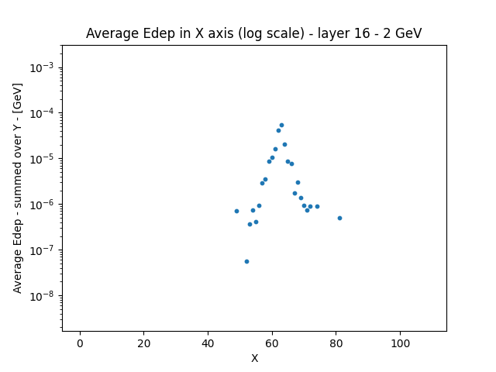

Slide 32
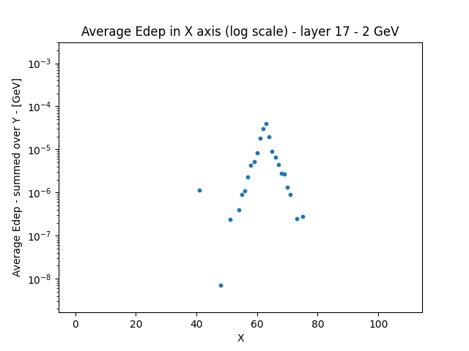

Slide 33
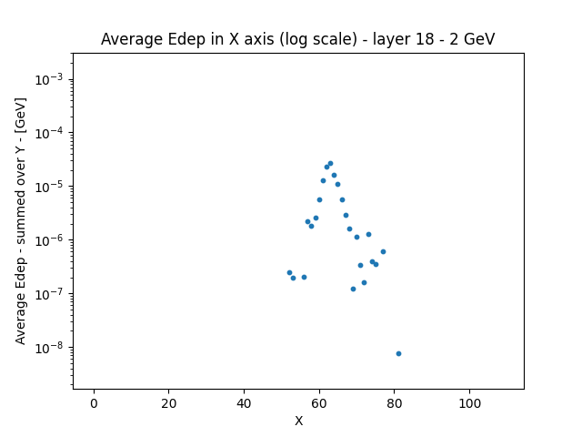

Slide 34
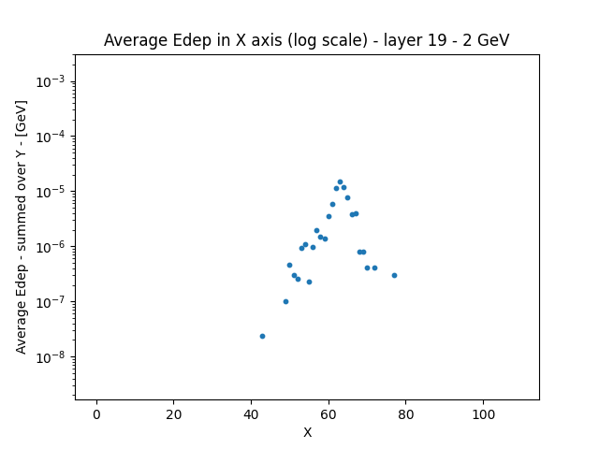

Slide 35
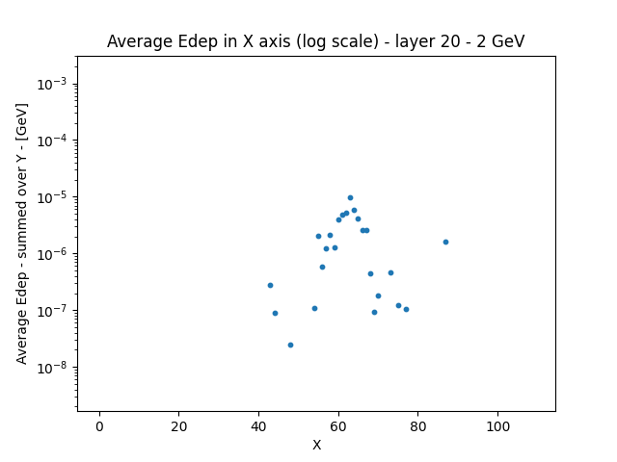

Slide 36
LOG SCALE – 10 GeV

Slide 37
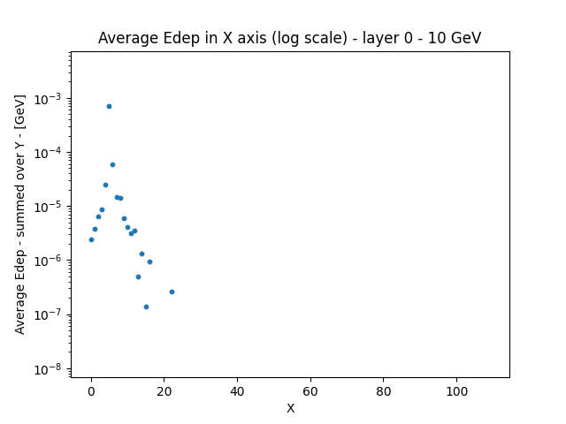

Slide 38
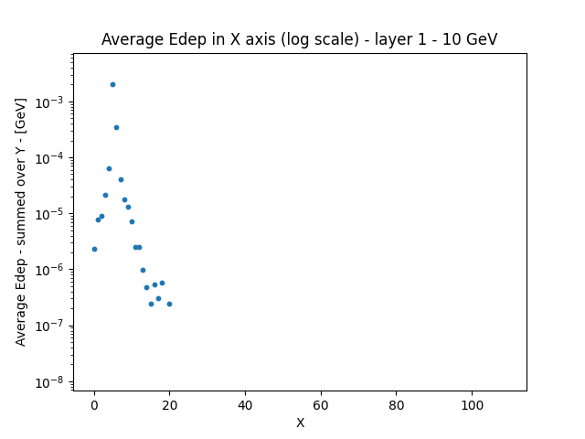

Slide 39
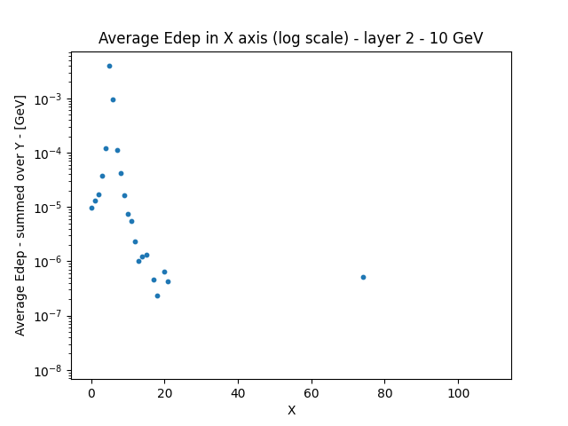

Slide 40
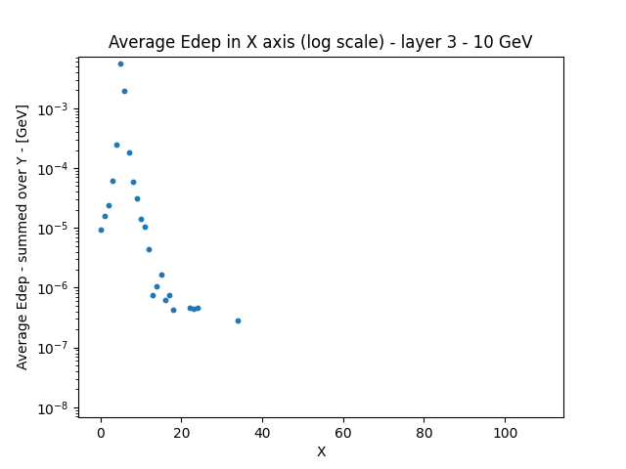

Slide 41
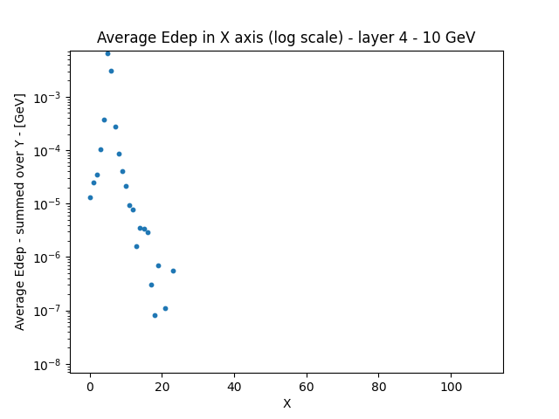

Slide 42
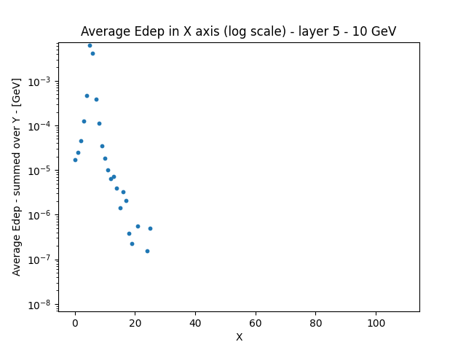

Slide 58
Average Edep per pad
Projected on X-axis
LINEAR SCALE

Slide 61
LINEAR SCALE – 2 GeV

Slide 83
LINEAR SCALE – 10 GeV

Slide 105
Average Edep per layer
2 GeV
5 GeV
10 GeV
13 GeV

Slide 106
Average Edep per pad
LINEAR SCALE

