Slide 1

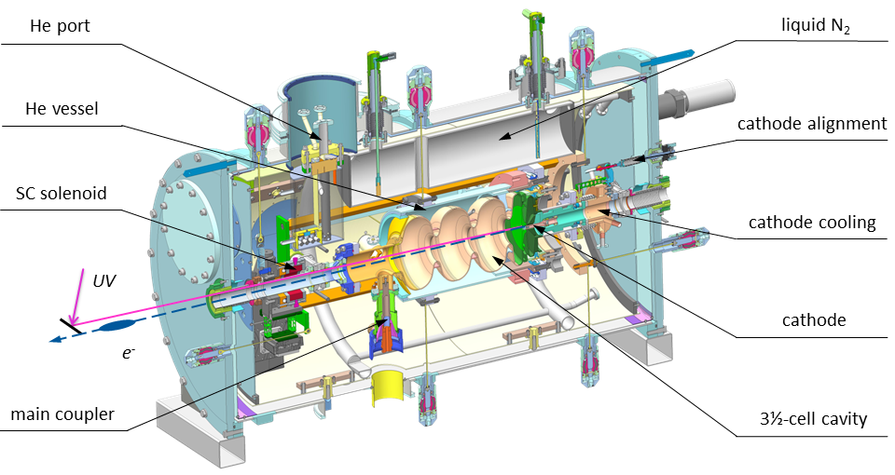
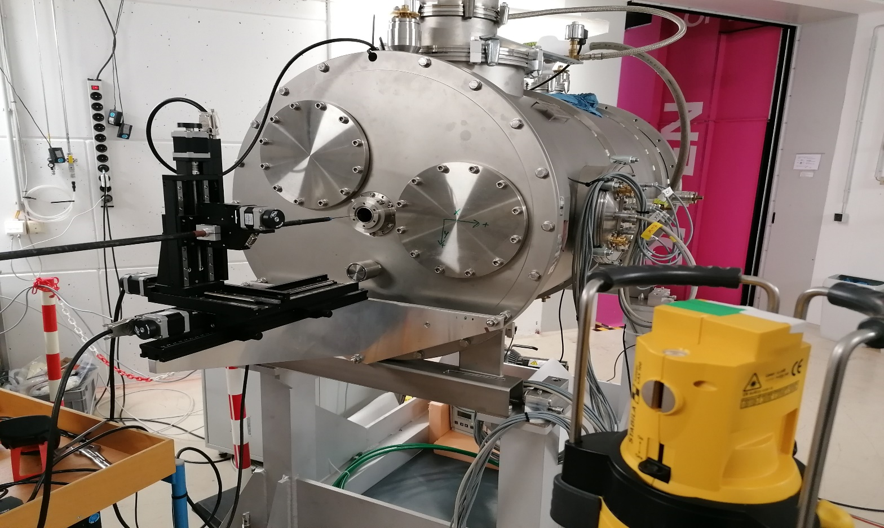
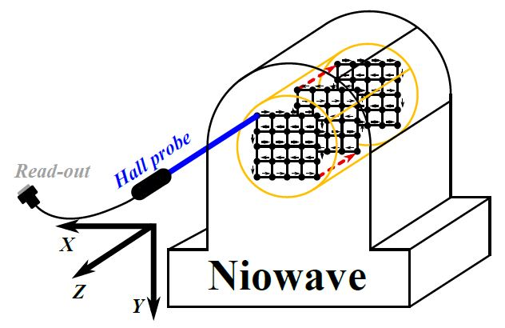
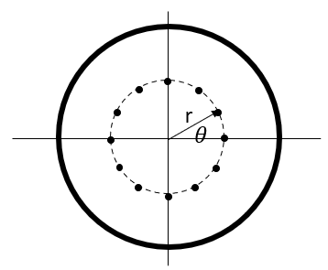
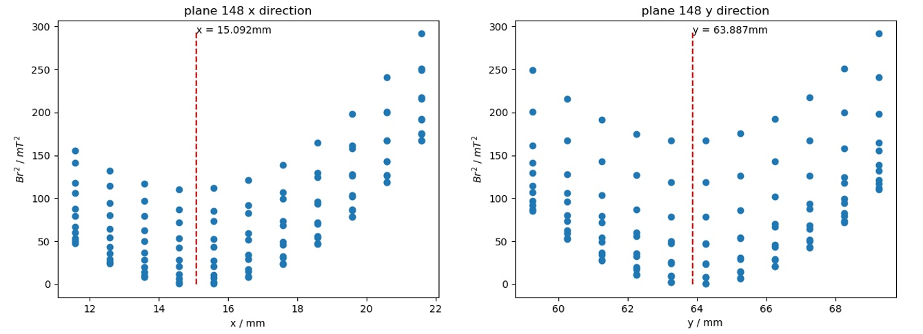
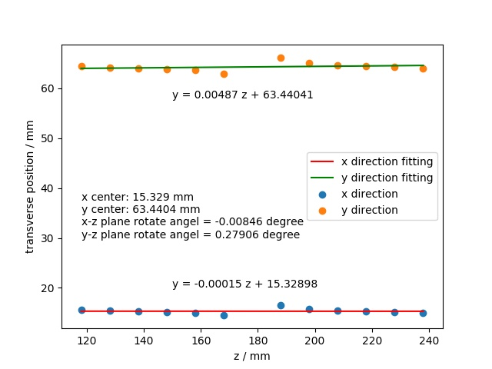
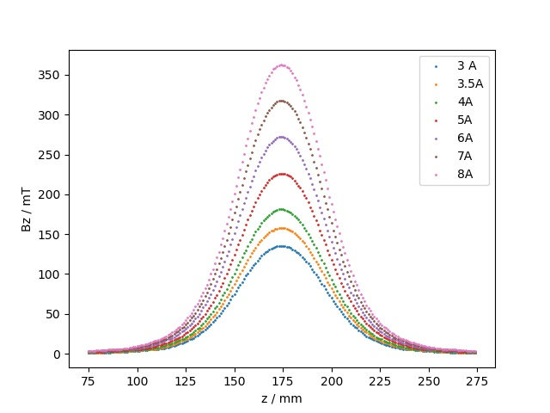
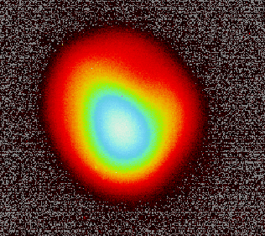
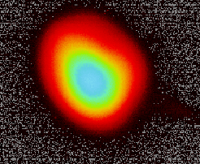
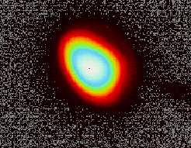
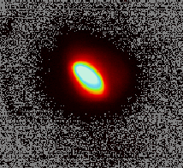
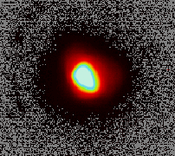
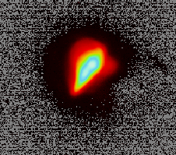
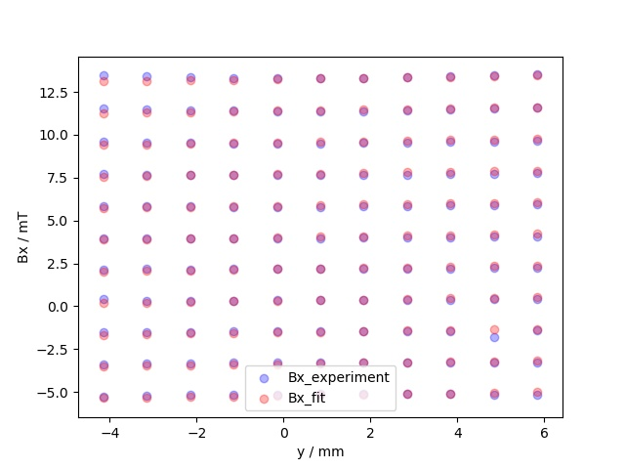
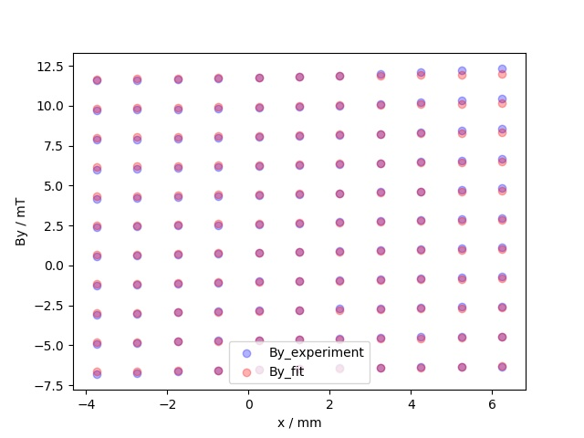
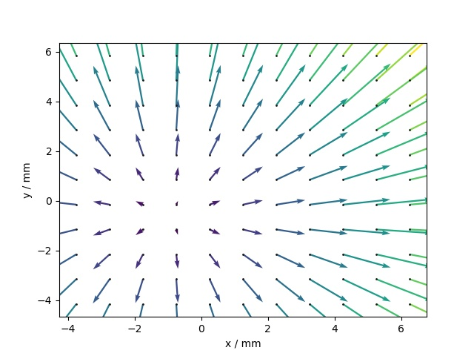
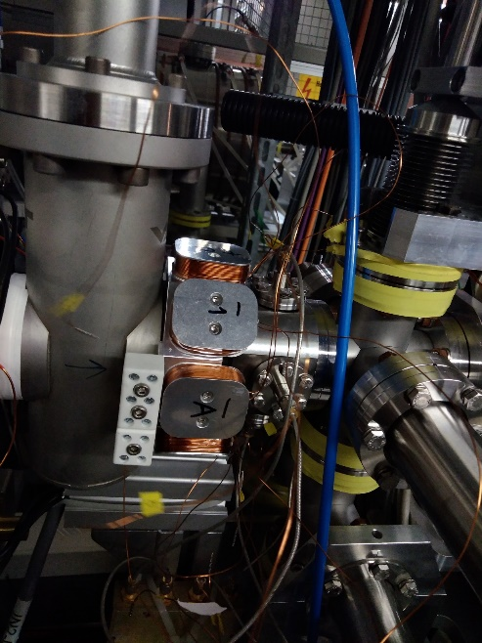
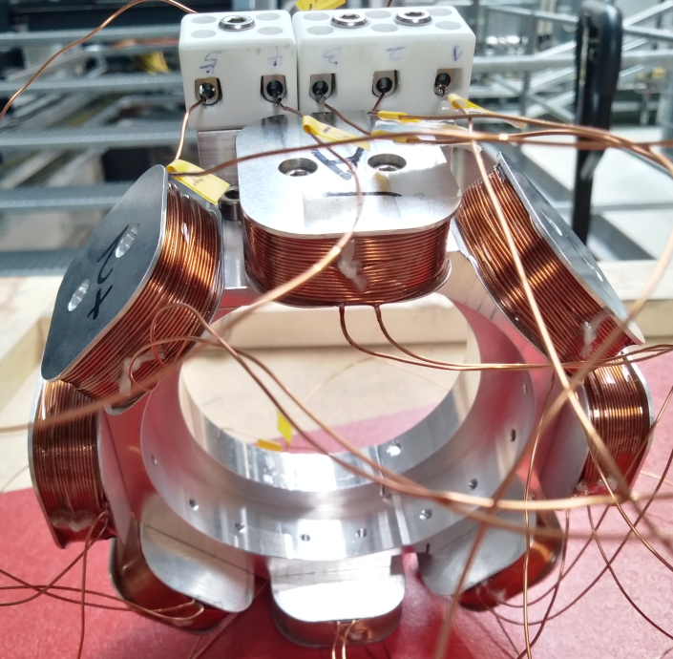
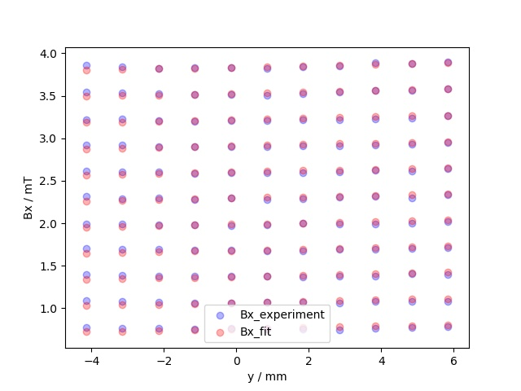
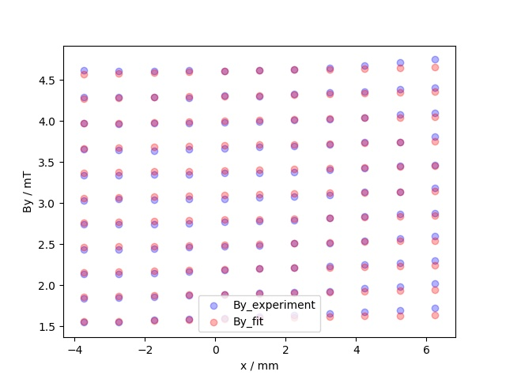
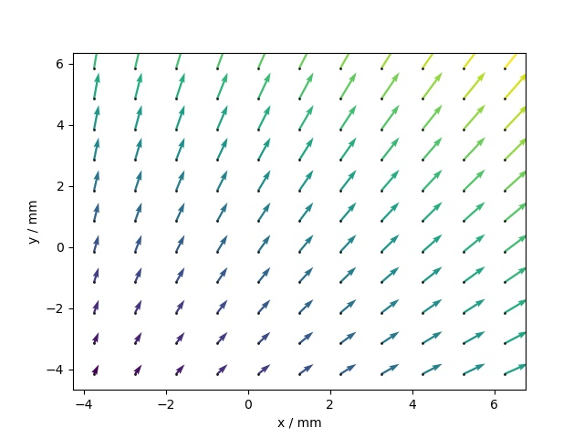
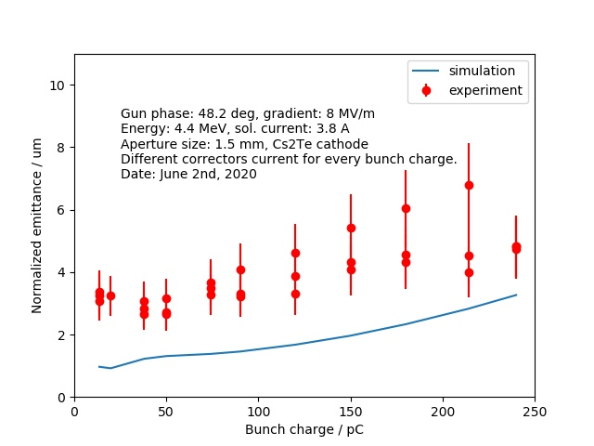
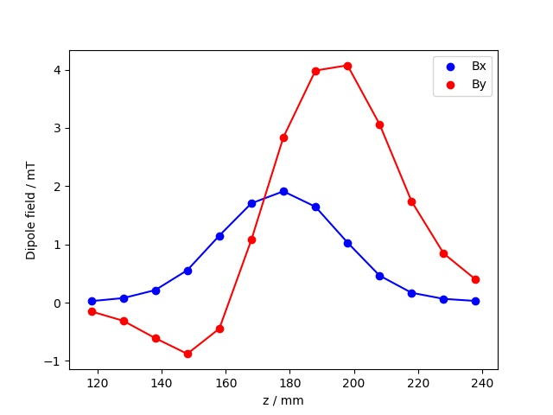
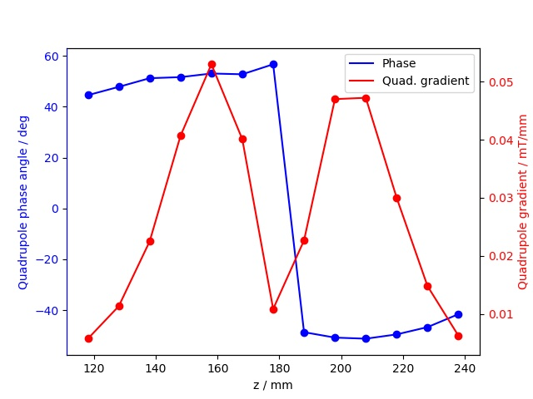
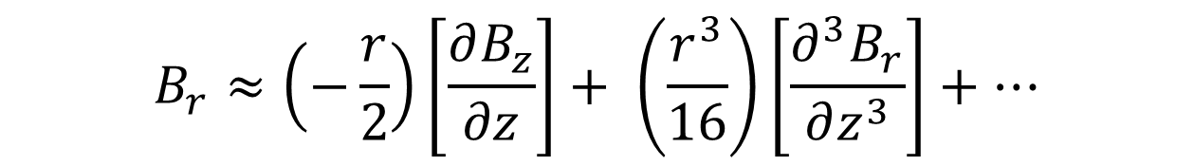
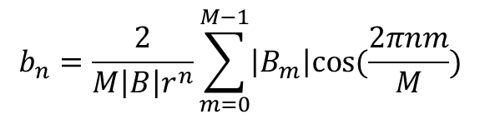
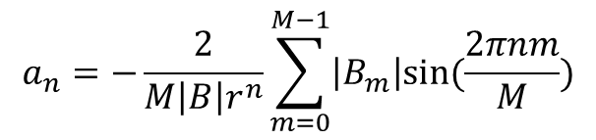


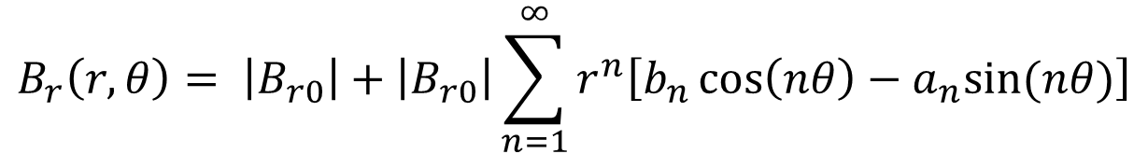

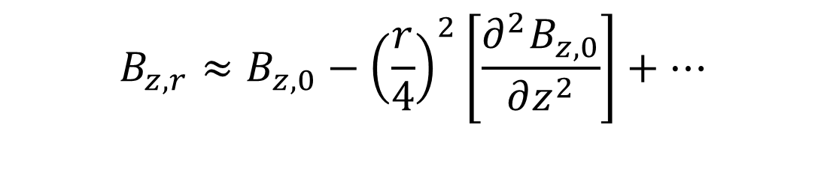

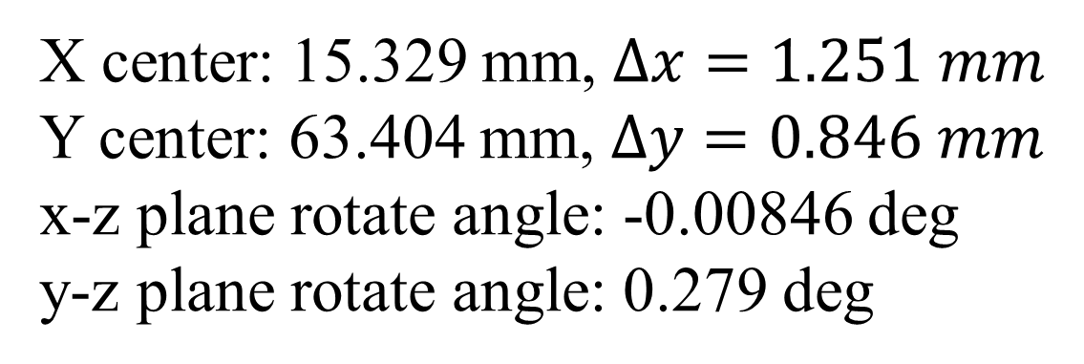


Superconducting solenoid
fields measurement and optimization
S. Ma, A. Aronld, M. Petr, Z. Paul, R. Anton, J. Schaber, J. Teichert, R. Xiang, Institute of Radiation Physics, HZDR, 01328 Dresden, Germany.
H. Qian, Deutsches Elektronen-Synchrotron DESY, Platanenallee 6, 15738 Zeuthen, Germany
Introduction
In order to reduce the projected transverse beam emittance, a solenoid is usually used at normal conducting as well as superconducting radio frequency (SRF) photoinjectors. At the ELBE SRF Gun-II, a superconducting solenoid is located inside the gun´s cryomodule about 0.1 m far from the end of the gun cavity. The aberration of the solenoid field, such as quadrupole component, will influence the beam symmetry and enlarge the projected transverse emittance. To analyze the multipole components of the solenoid field, a simple method is used and works well. The influence of the quadrupole field to emittance is studied and the correctors have been used to cancel this multipole field.
Solenoid magnetic field analysis
Solenoid multipole field analysis
Experiment setup and magnetic field center
Method one
Z
Analyze the solenoid field from Laplace's equation using Fourier series.
X
$$B_{r}\left(r,θ\right)= \left|B_{r0}\right|+\left|B_{r0}\right|\sum_{n=1}^{∞}{r^{n}\left[b_{n}\cos\left(nθ\right)−a_{n}sin⁡(nθ)\right]}$$
Z
$a_{n} and b_{n}$ are the skew and normal 2(n+1)-pole coefficients, respectively.
Y
$$a_{n}=−\frac{2}{M\left|B\right|r^{n}}\sum_{m=0}^{M−1}{\left|B_{m}\right|sin⁡(\frac{2πnm}{M})}$$
$$B_{r}≈\left(−\frac{r}{2}\right)\left[\frac{∂B_{z}}{∂z}\right]+ \left(\frac{r^{3}}{16}\right)\left[\frac{∂^{3}B_{r}}{∂z^{3}}\right]+…$$
$$b_{n}=\frac{2}{M\left|B\right|r^{n}}\sum_{m=0}^{M−1}{\left|B_{m}\right|cos⁡(\frac{2πnm}{M})}$$
Method two
$$B_{r}^{2}≈kr^{2}=k_{r}\left[{(x−x_{0}^{z})}^{2}+{(y−y_{0}^{z})}^{2}\right]$$
Linear fitting using the feature of the field depending on the cartesian coordinate system.
$$B_{z,r}≈B_{z,0}−{\left(\frac{r}{4}\right)}^{2}\left[\frac{∂^{2}B_{z,0}}{∂z^{2}}\right]+…$$
Transverse field
$$\vec{B_{t}}=k_{t}x\hat{e_{x}}+k_{t}y\hat{e_{y}}$$
$$B_{z,r}≈B_{z,0}−k_{z}\left[{(x−x_{0}^{z})}^{2}+{(y−y_{0}^{z})}^{2}\right]$$
Dipole component
$$\vec{B_{b}}=k_{bx}\hat{e_{x}}+k_{by}\hat{e_{x}}$$
$$\vec{B_{n}}=k_{n}y\hat{e_{x}}+k_{n}x\hat{e_{y}}$$
X center: 15.329 mm, $∆x=1.251 mm$
Y center: 63.404 mm, $∆y=0.846 mm$
x-z plane rotate angle: -0.00846 deg
y-z plane rotate angle: 0.279 deg
Normal quadrupole component
$$\vec{B_{s}}=k_{s}x\hat{e_{x}}−k_{s}y\hat{e_{y}}$$
Skew quadrupole component
Horizontal magnetic field
$$B_{x}=\left(k_{t}+k_{s}\right)x+k_{n}y+k_{bx}$$
Vertical magnetic field
$$B_{y}=\left(k_{t}−k_{s}\right)y+k_{n}x+k_{by}$$
Measurement results
Bz in axis x=16.58, y=64.25
Influence to beam profile, projected emittance and correction
0
Solenoid center
z
y
mm
3.0 A
3.3 A
3.6 A
3.9 A
4.0 A
4.2 A
168
178
188
The way to correct the problem is to use a reverse coupled field: a rotated quadrupole field + normal quadrupole field.
Parameters:
- Combination of a normal and a skew quads
- Aluminum frame
- 0.56 mm copper cable
- 140 windings per coil
- Non-magnetic screws
- Q_grad = 0.0117 T/m @ 1A
- Position 0.437 m to solenoid center
z = 168 mm
z = 178 mm
Conclusions
From the measurement results, although the magnetic transverse field multipole components are small comparing to the longitudinal filed, they will destroy the beam symmetry and enlarge beam projected emittance. The correctors can cancel this influence and optimize the beam projected emittance.
Field center in x direction | 15.329 ± 0.0227 mm
Field center in y direction | 63.4404 ± 0.0197 mm
Effective length | 40.33 ± 0.143 mm
Longitudinal field | 45.2267 ± 0.117428 mT/A
Acknowledgement
From the measurement results, the mechanical alignment is well. The second method can analyze the solenoid multipole fields easily and fast. The influence of the magnetic field center is negligible compared with the first method. The quadrupole component is inverse symmetric with the center of field.
We would like to thank the whole ELBE team for their help with this project. Thank Dr. Houjun Qian from PITZ DESY for his helpful discussion and advice. The work was partly supported by China Scholarship Council, and Fluid Institute of physics, China Academy of Engineering Physics.
Reference:
[1] Wiedemann, Helmut. Particle accelerator physics. Springer, 2015.
[2] Anderson, S. G., et al. Physical Review Special Topics-Accelerators and Beams 5.1 (2002): 014201.
[3] Lu, Pengnan. Optimization of an SRF Gun for high bunch charge applications at ELBE. Diss. Saechsische Landesbibliothek-Staats-und Universitaetsbibliothek Dresden, 2017.
[4] Vennekate, Hannes. "Emittance Compensation for SRF Photoinjectors." (2017).
Contact: Shuai Ma, Institute of Radiation Physics, Radiation Source ELBE. Email: s.ma@hzdr.de

