Slide 1
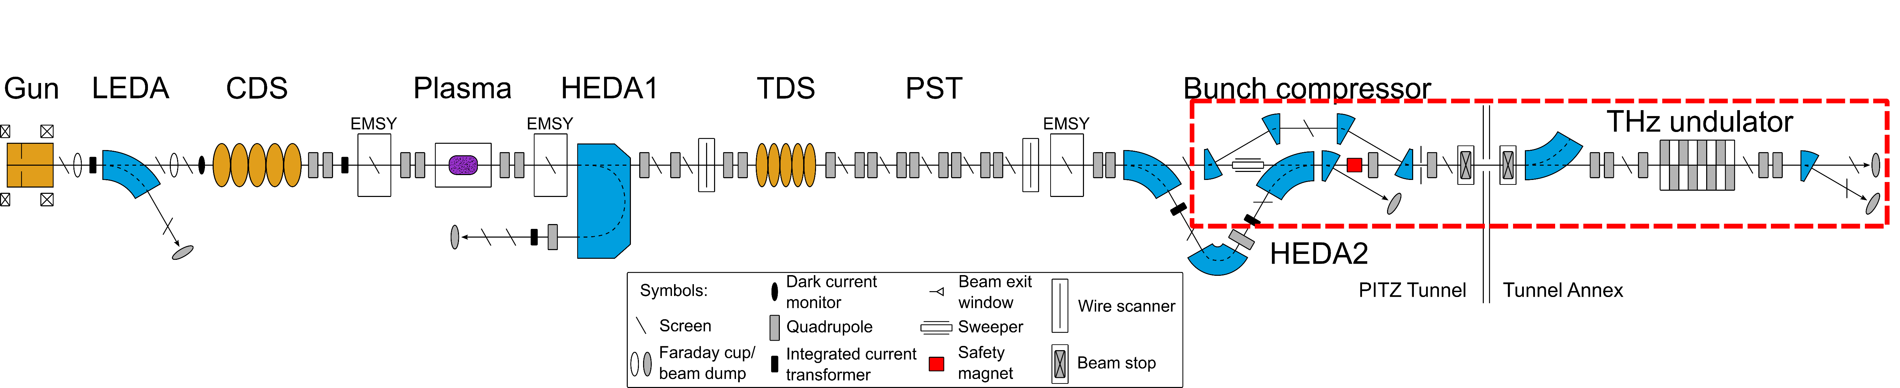
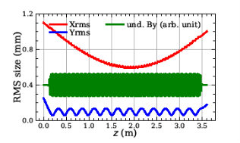
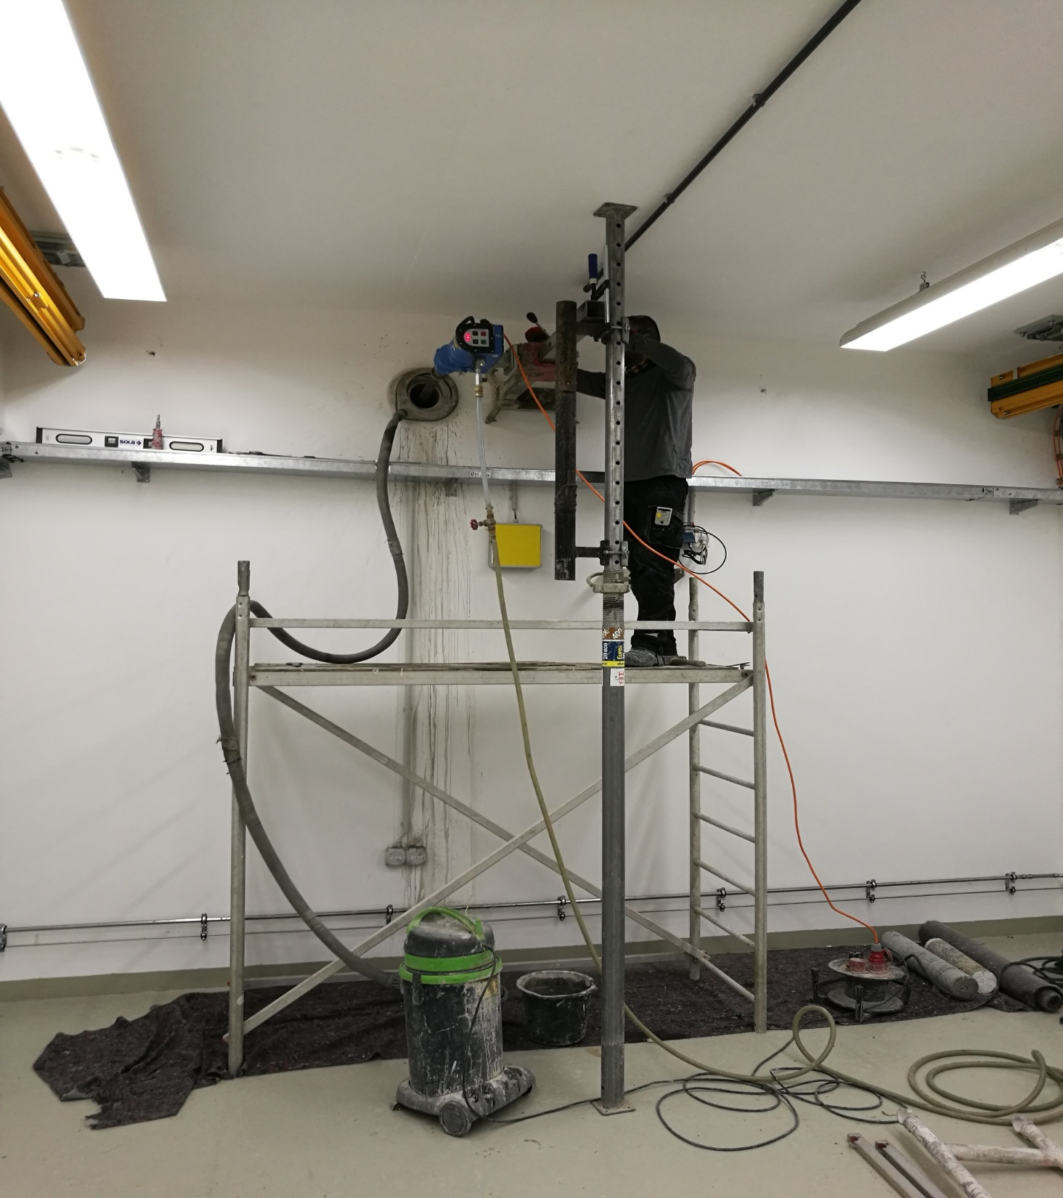
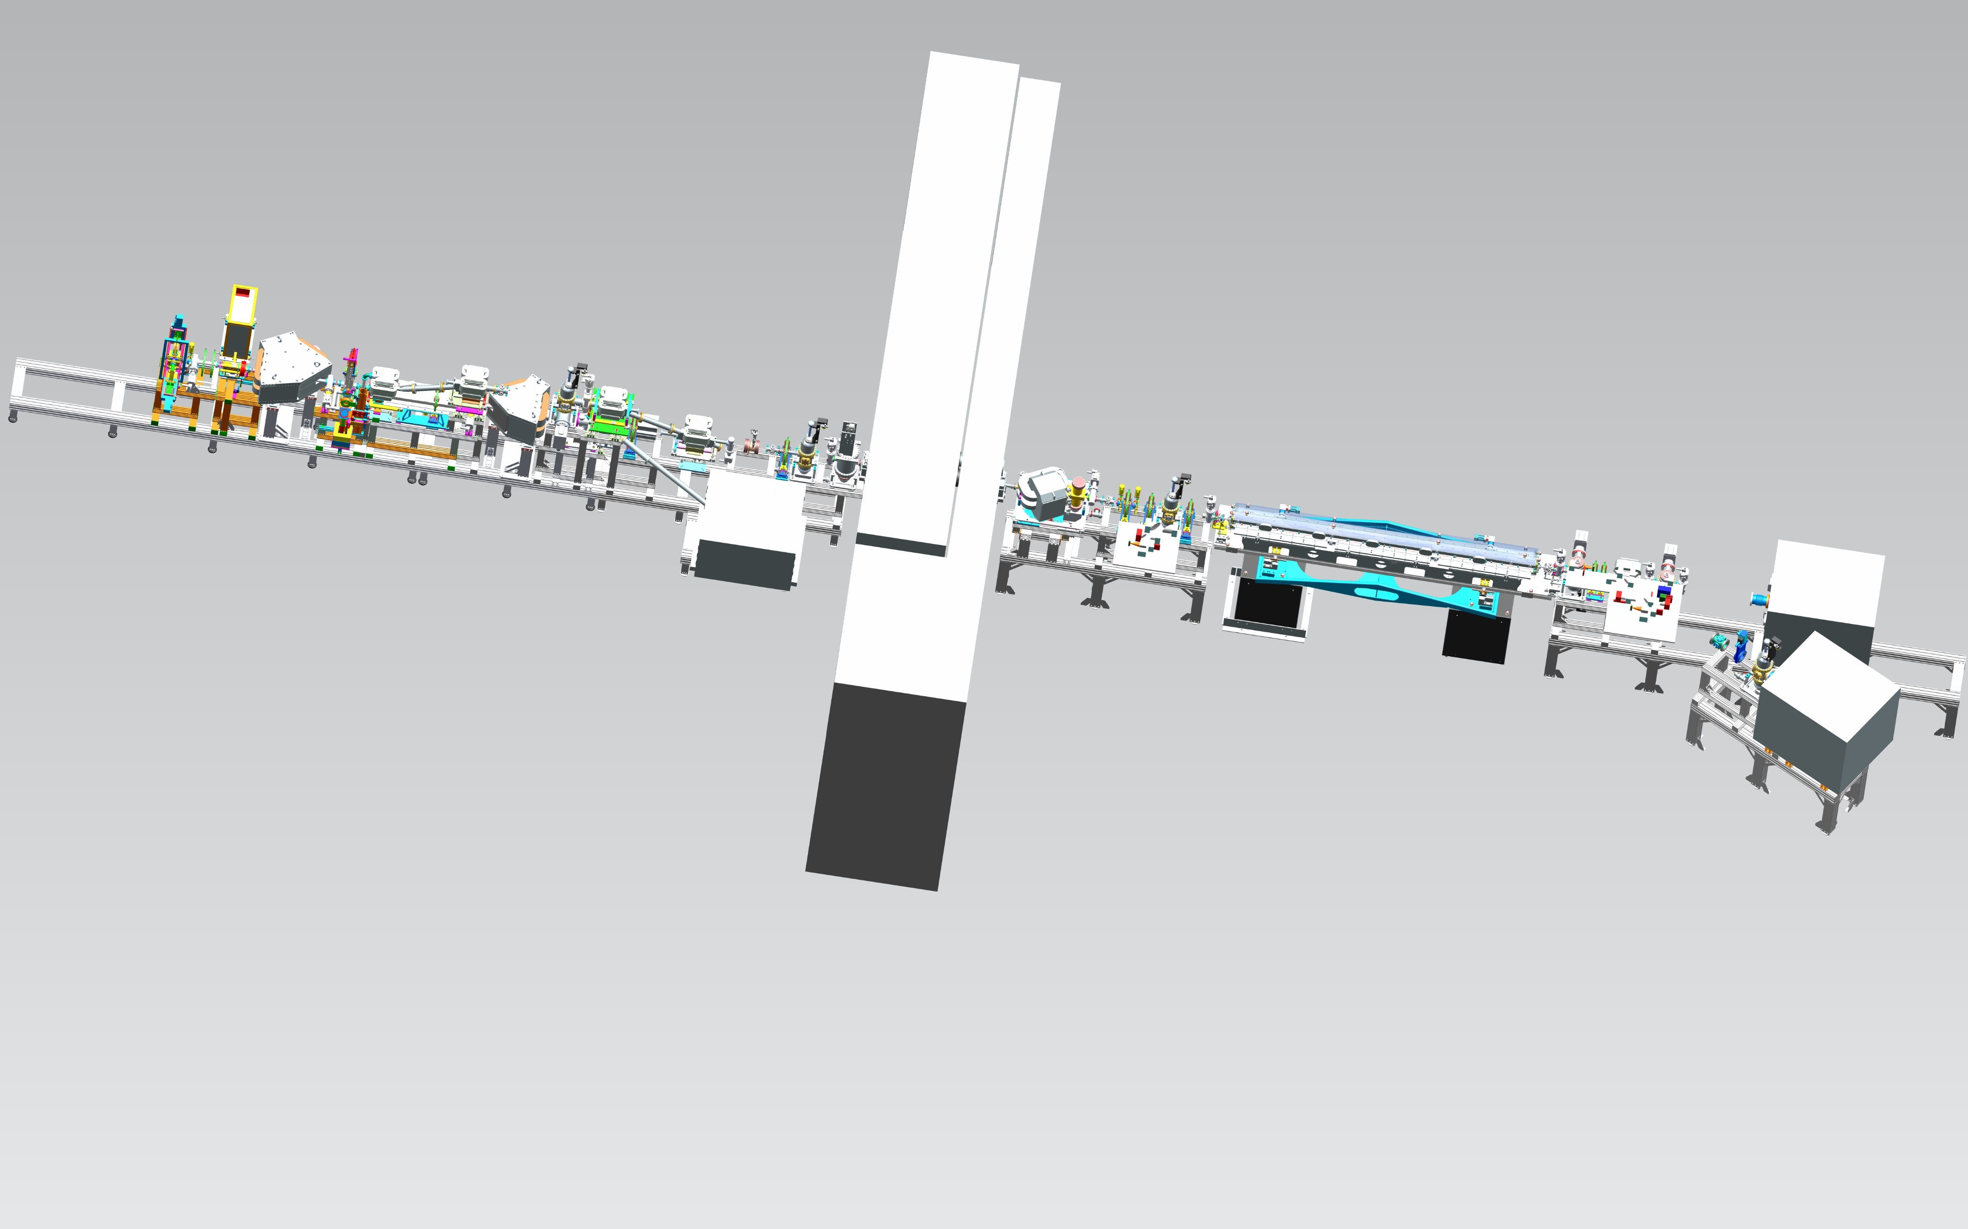
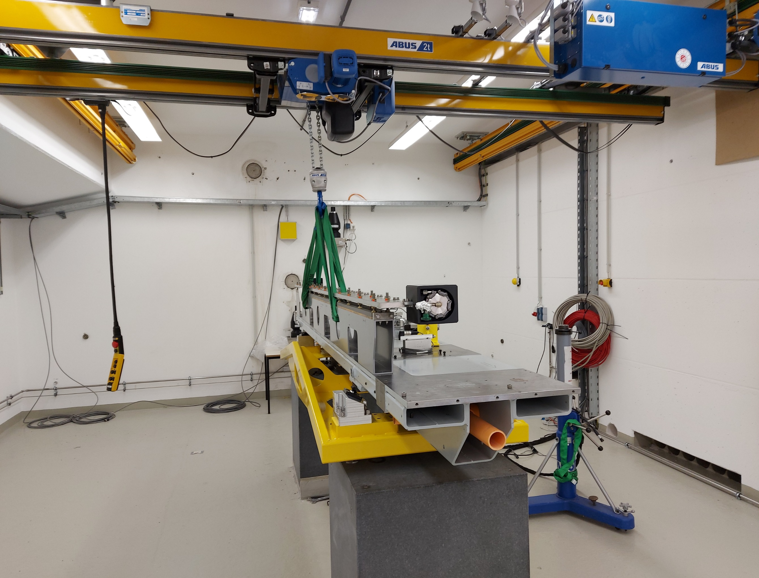
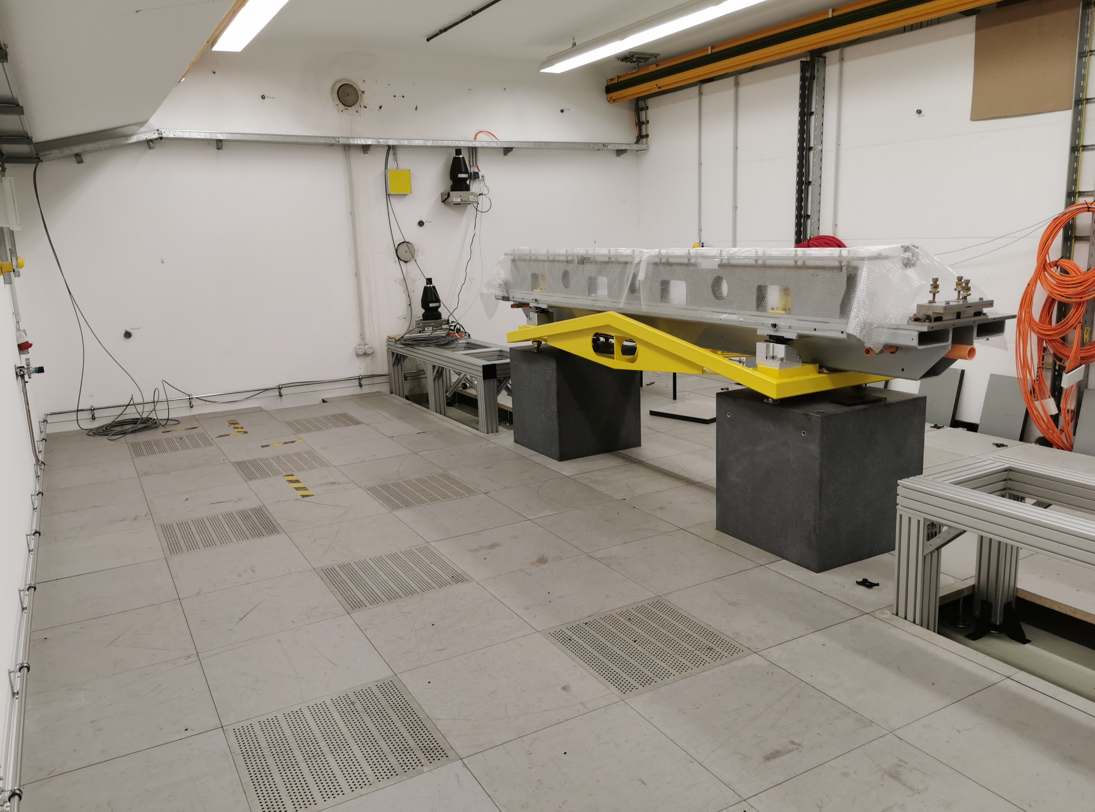
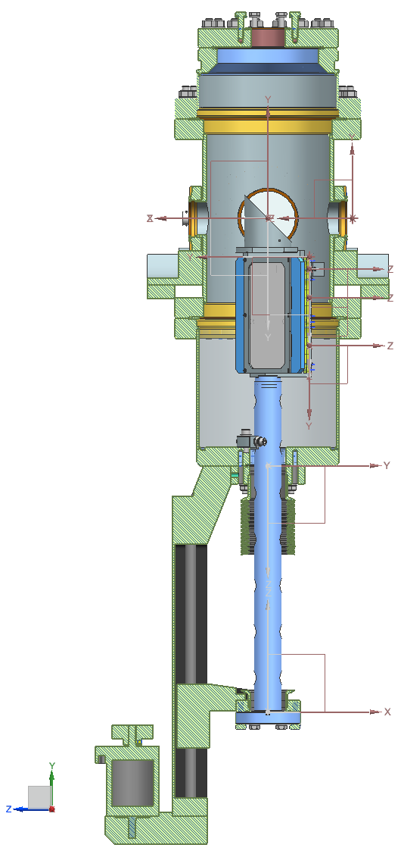
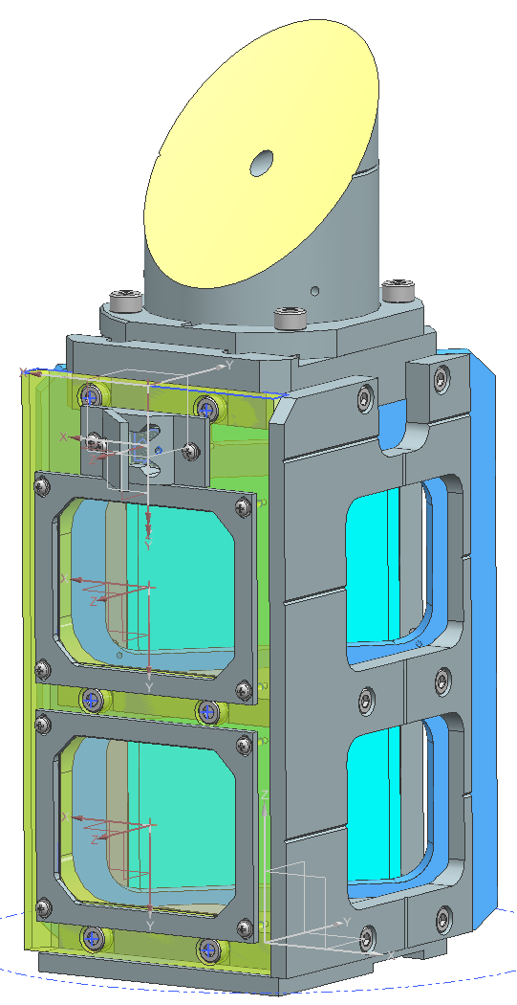



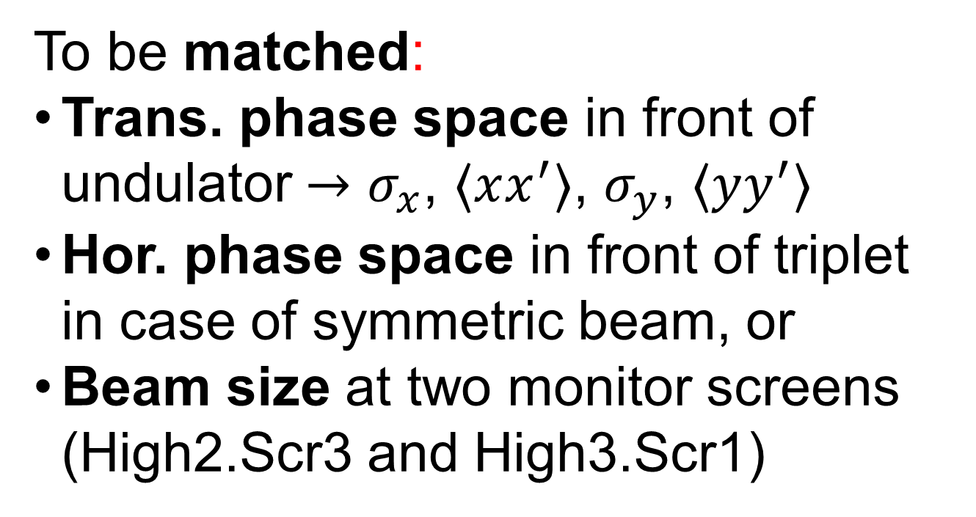
Status of the THz@PITZ Project – the Proof-of-Principle Experiment on a
THz SASE FEL at the PITZ Facility
T. Weilbach, P. Boonpornprasert, G. Georgiev, G. Koss, M. Krasilnikov, X.-K. Li, A. Lueangaramwong, F. Mueller, A. Oppelt,
S. Philipp and F. Stephan DESY, Zeuthen, Germany
MT meeting 2021 part 2
16-18th of June 2021
Schematic Overview of PITZ
Beam Optics Simulations and Measurements
To be matched:
Trans. phase space in front of undulator $→$ $σ_{x}$, $⟨xx^{′}⟩$, $σ_{y}$, $⟨yy^{′}⟩$
Hor. phase space in front of triplet in case of symmetric beam, or
Beam size at two monitor screens (High2.Scr3 and High3.Scr1)
Beam transport to undulator
Beam transport in undulator
Undul.. ent.
Core hole drilling
PITZ Tunnel
Tunnel Annex
Screen stations
Outlook
Preparations of tunnel annex finished
Last heavy construction work done in 06/2021
Production / Ordering of components ongoing
First beam in undulator planed for Q4/2021
e⁻-beam
LCLS-I Undulator
Beam Dump
Bunch compressor
Beam Dump
Matching section
+ first THz diagnostic
(Bunch compression measurements)
2nd THz
diagnostic
THz
Radiation
detectors
Cable
trays
Screen Station Design
Ellipsoidal
THz-mirror
with hole
Test target for camera
alignment
Design of all six screen stations finished
Designed modularly to minimize the number of parts to produce
In vacuum roller bearings for better stiffness at the THz screen
Ellipsoidal mirror in vacuum to focus THz radiation, focus in diamond window to minimize window size (diameter: 20mm)
e⁻
Mirror to look at screens
e⁻
Crane
Additional
in-vacuum roller bearing for higher stiffness
Core holes
YAG and LYSO Screen
Support structures

