Slide 1
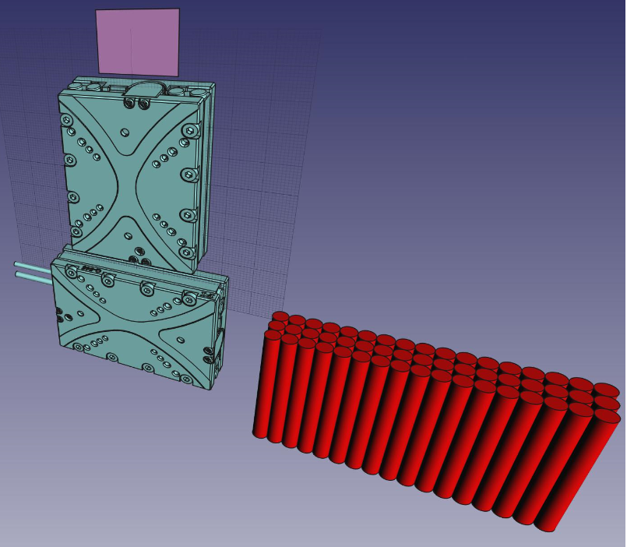
Beam profiler station
Sensor
Piezo motors
Signal cables (Cat5)

Slide 2
Beam profiler station
Sensor
Piezo motors
Signal cables (Cat5)
“SLIM” edition CAT6 cables
(STP shielded, PVC)

Slide 3
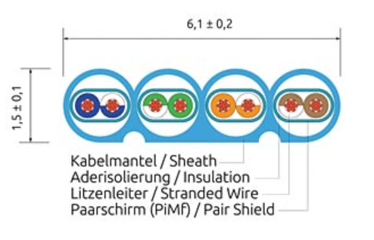
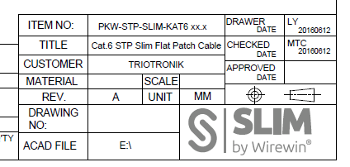
Cat.6 SLIM-Patchkabel, STP(PIMF)
Not halogen-free

Slide 4
To design:
Sensor frame (fixed to upper motor). PCB with two possible orientation (X,Y strips), bond contacts for sensor, HV circuit, 2x100-pin connectors for flex Kapton cables
Intermediate plate (aluminum) for inter-motor connection
Patch panel (fixed to support) 2x100-pin connectors for flexible Kapton cables, HV connection/cable
Protection box (for 2 stations together). Gas (dry air) inlet, beam windows (two) – Kapton 20EN (5 μm thick each)
Connectors for flex cables - SAMTEC 100 pin, two rows, 0.5 mm pitch (0.625 mm)
Find Halogen-free compact signal cables or place front-end electronics right at the station

