Slide 1
The LUXE Beam Profiler positioning
M. Bruschi, N. Cavanagh, U. Dosselli, K. Fleck, M. Morandin, G. Sarri, A. Sbrizzi, S. Schuwalow, A. Tyazhev, M. Zanetti
and A. Zarubin

Slide 3
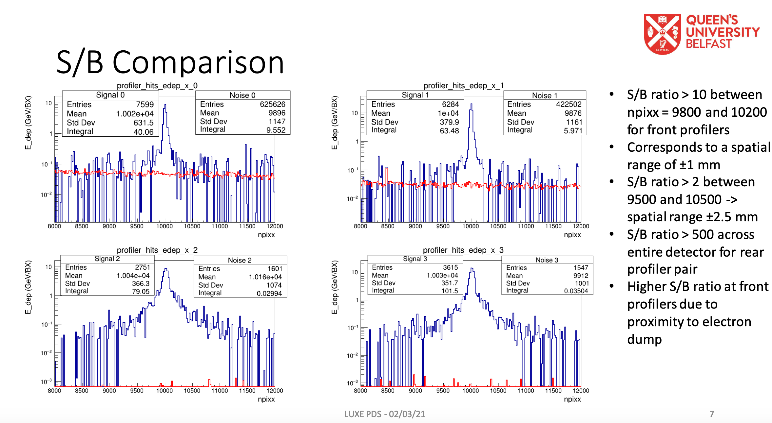
Motivation
To place movable tables in vacuum would be in principle possible
Technical challenging
More expensive
Beam line new #2 is the preferred solution for the GBP
X-Y stations placed just outside the beam pipe
200 um of Kapton, or similar will not spoil significantly the performances
12m distance from the IP will guarantee maximum beam opening
Easier and better profile reconstruction
Less damage from irradiation
GEANT4 simulation has shown that in the rear station impact of the beam background is minimal
More details in the backup slides

Slide 4
Backup

Slide 5
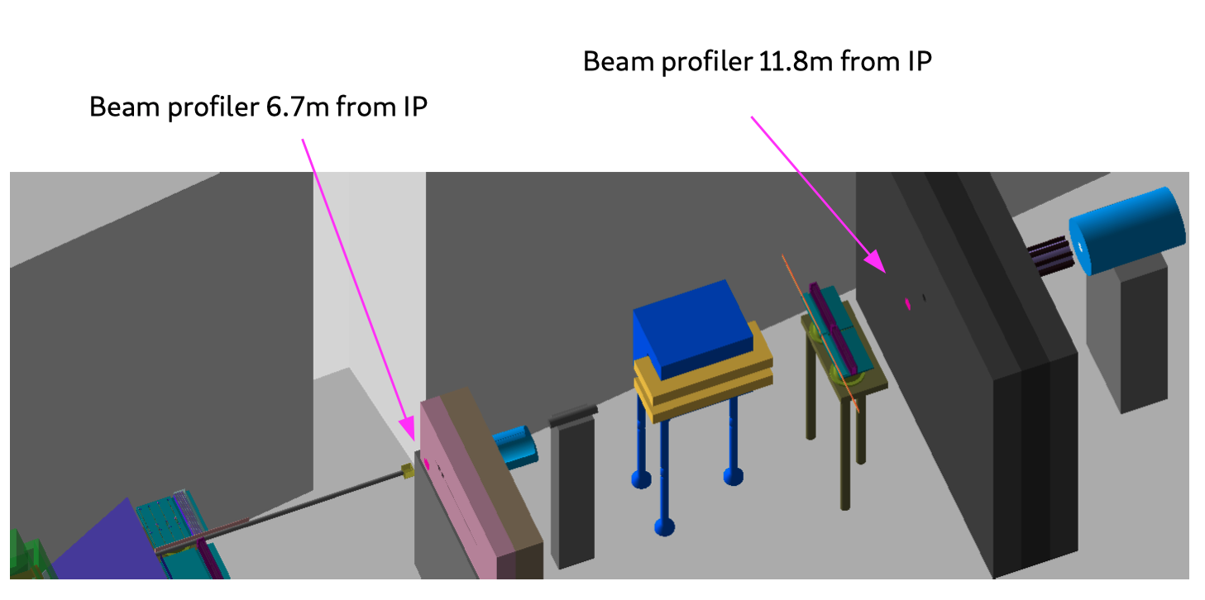
From geometry implemented by Sasha Borysov

Slide 6
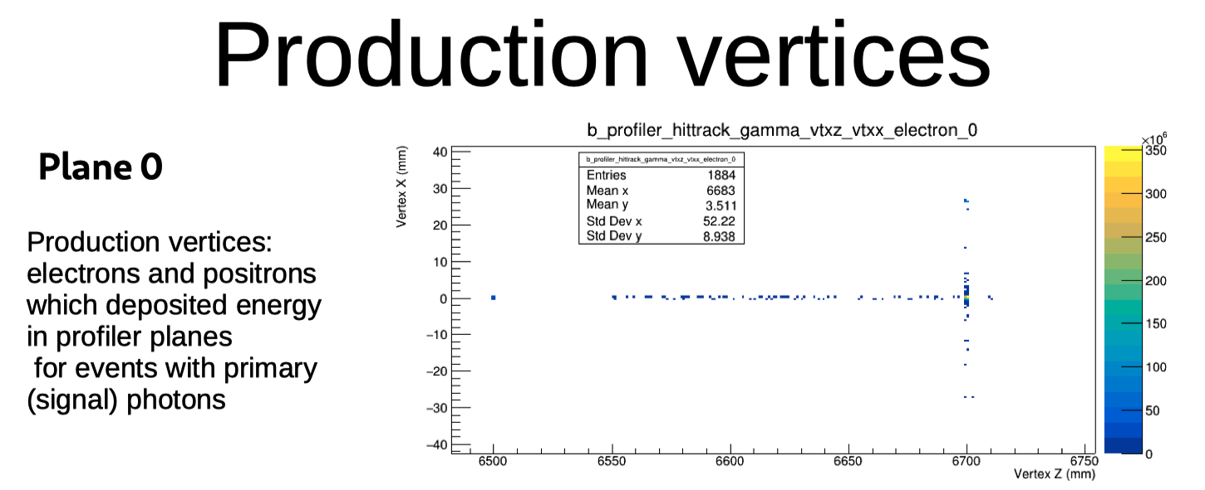
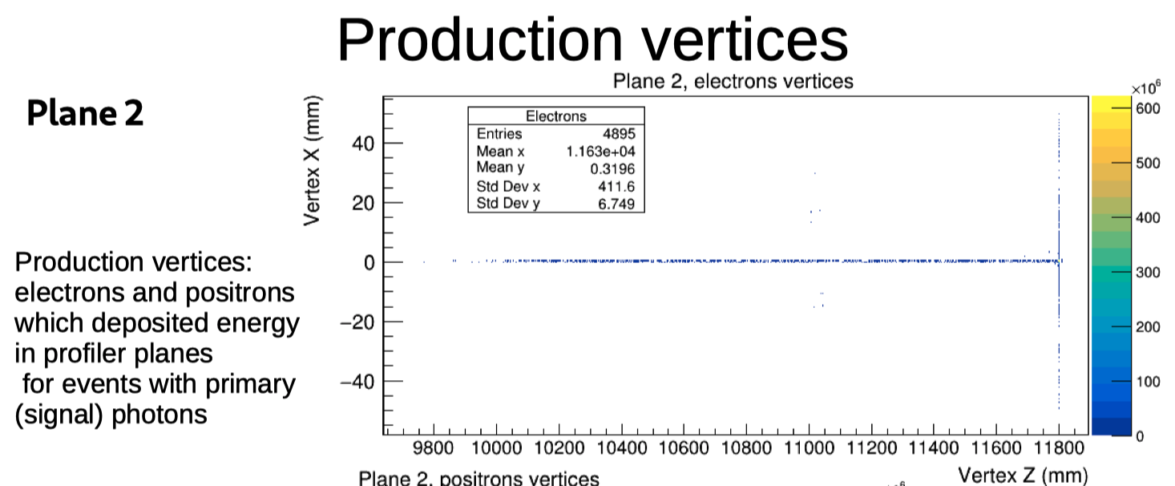
Gammas converting in air
Broaden the profile
Increase the energy released in the detector

Slide 7
Beam widening due to 6m of air spoils significantly the beam profile
Point of attention
Detector Thickness: 0.14% Xo
1m of air : 0.33% Xo

Slide 8
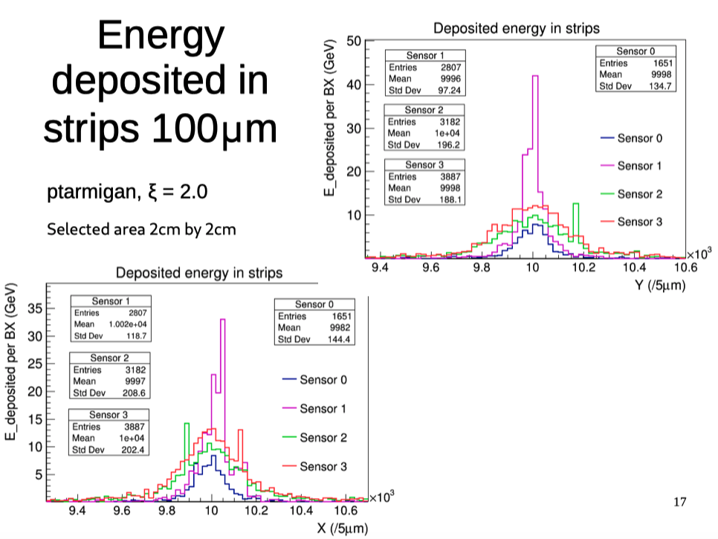
Beam profiles becomes wider in the last two sensors
Angular opening effect
Multiple scattering in air

