Slide 1
HPK Campaign
Frank Hartmann
CEC Meeting Zeuthen 19.05.2010

Slide 2
Tentative Schedule
Initial Test and Campaign description September 2009
We (CMS) started ~monthly meetings in January
  More iterations of measurement definitions
    Finalized and defined by participating institutes themselves
Final design approved by CMS: 02.02.2010
Double Metal design delivered to HPK: 26.03.2010
Start Delivery to CERN: End of June
  6/E : 10 pcs (320 um thick)
  7/E : 44 pcs
  8/M : 36 pcs
  8/E : 12 pcs
  9/M : 24 pcs (2nd AL, N-MCZ)
  Ship sensors to institutes: Beginning of July
Some pieces will be shipped to Warsaw for further diode cutting
First full pre-irradiation measurement (first set): August-September
First Irradiation: End of September!!
…
End of Campaign: End of 2011 = 1.5 y of campaign
We’ll start with the 300um FZ parts, as requested
Not all institutes are ready yet!

Slide 3
HPK Submission
 | substrate type | FZ 200um | MCZ 200um | FZ 100um | epi 100um | epi 75um | FZ 300um | Total
 | & Active Thickness | carrier |  | carrier | carrier | carrier
 | P-on-N Production | 6 | 6 | 6 | 6 | 6 | 6 | 36
 | N-on-P Production p-spray | 6 | 6 | 6 | 6 | 6 | 6 | 36
 | N-on-P Production p-stop | 6 | 6 | 6 | 6 | 6 | 6 | 36
 | 2'nd metal production P-on-N | 6 |  |  |  |  |  | 6
 | 2'nd metal production N-on-P p-stop | 6 |  |  |  |  |  | 6
 | 2'nd metal production N-on-P p-spray | 6 |  |  |  |  |  | 6
 | Total | 36 | 18 | 18 | 18 | 18 | 18 | 126
Many different
technologies
thicknesses
geometries
structures with different objectives
➔ Choice of technology
Only two (times 3) with correct backside light access

Slide 4
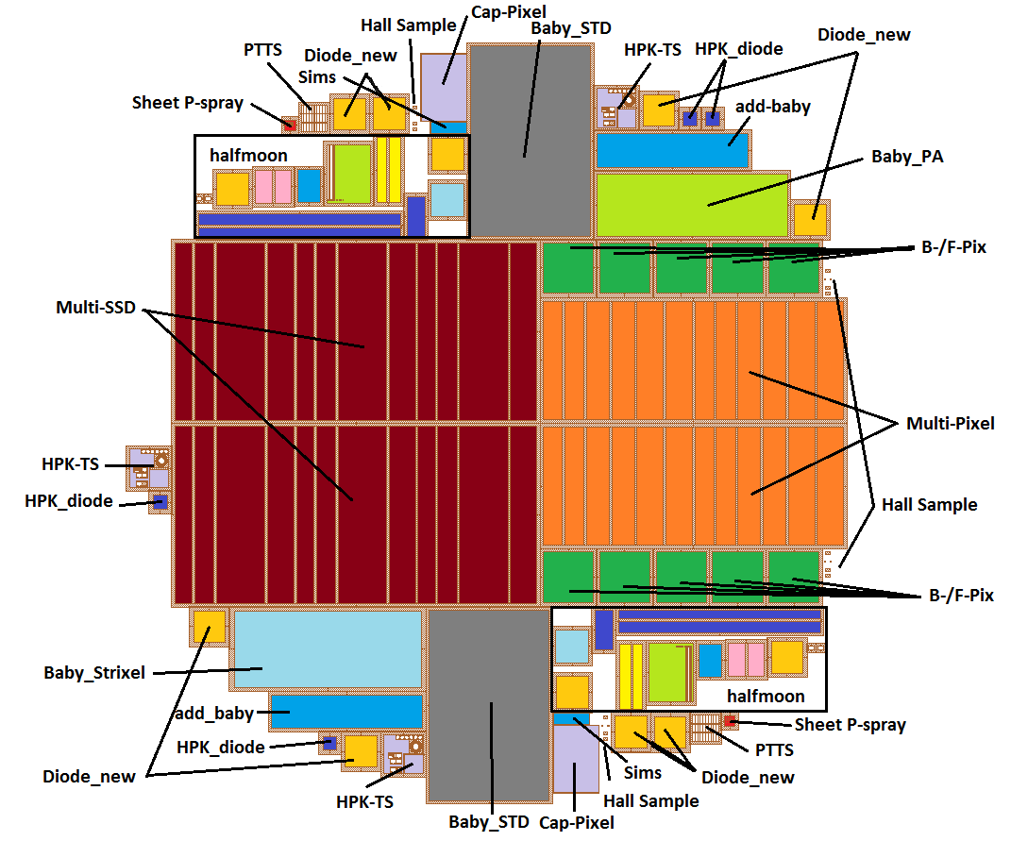
Cutting → Work Packages so far
Structures
Objectives:
more rad. hard planar pixel
Pixel
Multi-geometry strips
Multi-geometry pixel
Baby_std
Baby_PA
Baby_Strixel
Diodes
Test-structures
Add_Baby aka Lorentz angle sensor
Geometry/thickness
Irradiation/annealing
Routing/design
Irradiation/annealing/material
Design/process/surface
Lorentz angle
~ 30 pieces per wafer ➔ 3800 pieces
Diodes to be cut further (backup slides)
All cut pieces come in an individual envelope
Notes:
Pieces times irradiation times annealing times voltage times temperatures

Slide 5
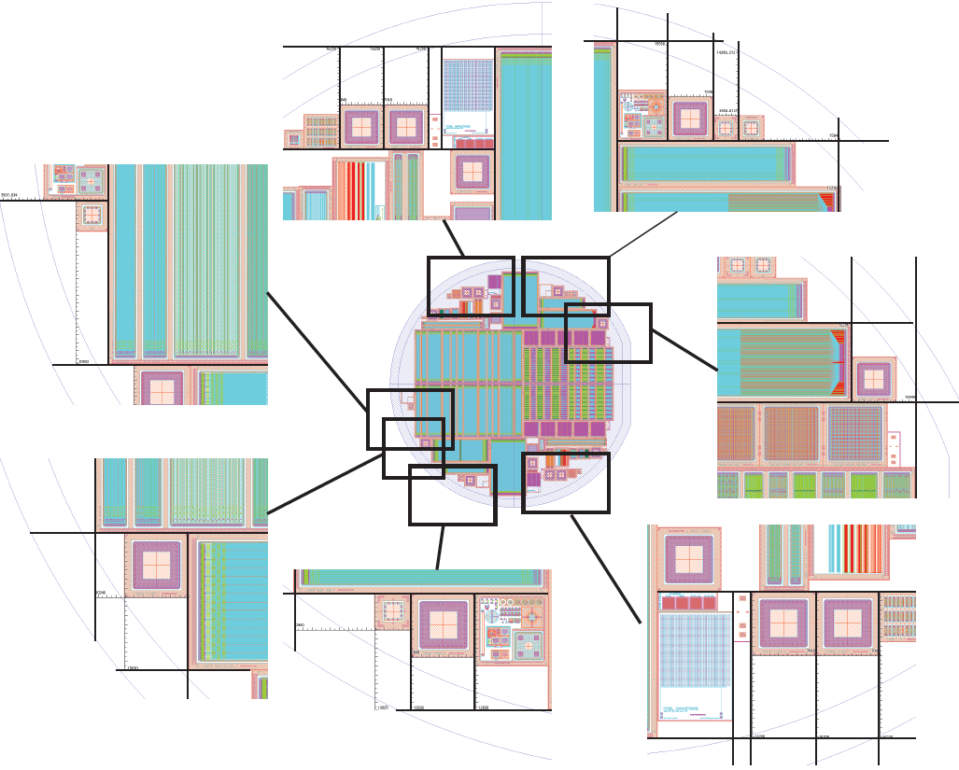
Diode Cutting
2*2 diodes IN TS
8 individual diode_new
4 individual HPK diode
Done in Warsaw ITE

Slide 6
Commitments, so far
 | baby_std | Multi strip | multi pixel | strixel | PA | TS | pixel | Lorentz angle | Diodes | SIMS | TB |  | comments
 | help appreciated |  |  | 80% | 80% | 100% | 100% | 100% | help needed |  | not defined | logistics | 80% for strixel and PA is ok
PSI |  |  |  |  |  |  | 50%
Purdue |  |  |  |  |  |  | 50%
CERN | 20% | 100% | 100% |  |  |  |  |  | xxx%??? |  |  | DB | xxx~30%
Karlsruhe | 50-100% annealing (100% strip) |  |  | 30% | 30% | crossC |  | 100% | 10%
Vienna |  |  |  | crossC | crossC | 100%
HH | annealing study? |  |  |  |  |  | interested |  | xxx% |  |  |  | xxx~30%
Perugia |  |  |  | 50+% | 50+% |  |  |  |  |  |  |  | p-cross calib with LA-sensors????
Louvain |  |  |  |  |  |  |  |  |  |  |  |  | n-irrad cross calib with LA sensors!
FNAL |  | 50% | 50% |  |  |  | interested
Firenze |  | % strip testing |  |  |  |  |  |  |  |  |  |  | also strip measurement on PS, together with CENR
Rochester
Zeuthen
Bari
Brown
Santander
Aachen
Helsinki |  |  |  |  |  |  |  |  |  |  | to do |  | see today
Lyon |  |  |  |  |  |  |  |  |  |  |  | DB
Program well covered, BUT diodes and multi-pixel
Notes:
I don’t see the multi-geometry pixel covered so well

Slide 7
Mixed irradiations I
Mixed radiations with full annealing evaluation
  Neutron fluence a bit adapted
Some intermediate proton/neutron only results
Full material info from diodes
Small subset
Proton
dominated
Neutron
dominated

Slide 8
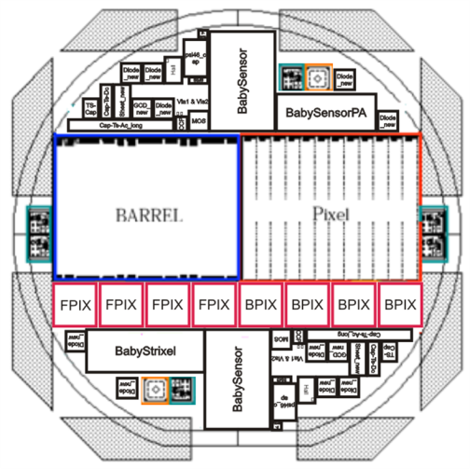
Mixed radiations II
2 diodes out for full long term annealing
Initial measurements
To investigate the pure particle (p & n) dependence
Wafer with both
p- & n- irradiation
p-irrad (KA)
(e.g. 15x10¹⁴)
p-irrad (KA)
(e.g. 15x10¹⁴)
Short annealing
- measuring
Short annealing
- measuring
n-irrad (Ljubljana)
(e.g. 6x10¹⁴)
n-irrad (Ljubljana)
(e.g. 6x10¹⁴)
Full measurement:
Test beam (some)
Long term annealing (many steps, many measurments
To investigate the mixed (p+n) (real) dependence
p- & n- fluences defined by expectation for the different radii (with some adaptations) e.g. 15p+6n equals to situation @ R=15cm
This we will do with 4-5 wafers leaving 1-2 virgins
Some diodes will be irradiated to several additional fluences (p & N & mixed)
Notes:
15p + 6n simulates situation @r=15cm

Slide 9
Mixed Main Set - Big Area
First layer: TS, Baby_std, 2xDiodes
Second layer: Multi-SSD (on ceramic with PA)
Third layer: Multi-Pixel
Inhomogenious irradiation by about 5% !
3. Layer only
2. + 3. Layer
All layers
250mm x 100mm
Notes:
All structures need at the right time, otherwise the irrad cost will explode!

Slide 10
Measurements
All pieces need several different measurements
All pieces come non-irradiated and irradiated
Many will undergo several annealing steps
Most measurements are well defined by the responsible groups

Slide 11
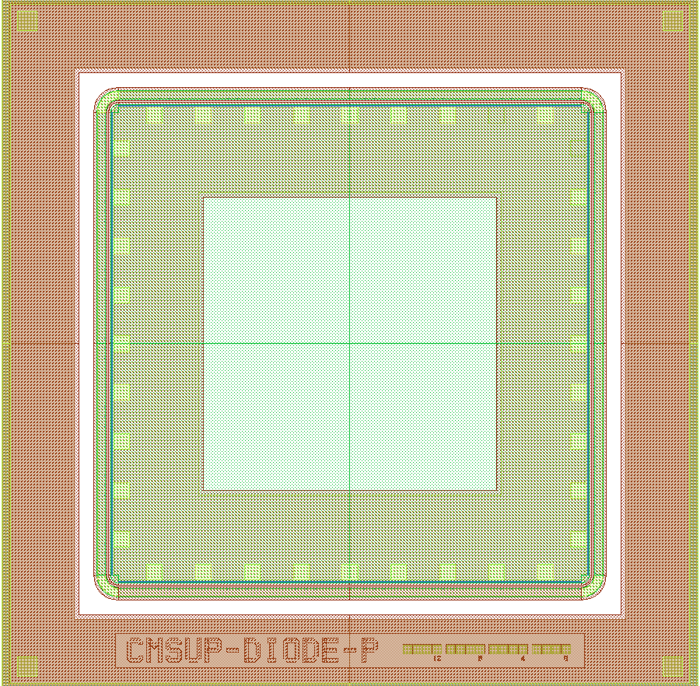
Diodes
Material Study - Info of
  Neutron & Proton irradiation
    Mixed and Pure
  Annealing
Measurements:
  CV/IV
  CCE
  TCT
    Probably only for diodes without carrier
    Hopefully some with edge-TCT
    Difficult or impossible for thin large diodes
  Annealing
7120um
7120um
8 large diodes
4 small diodes
wafer
Help needed
More info:
http://indico.cern.ch/materialDisplay.py?contribId=2&materialId=slides&confId=77900 & http://indico.cern.ch/conferenceDisplay.py?confId=77903
Participating institutes: UHH, CERN, KIT
TCT & CCE calibration not yet done

Slide 12
Sensor baby_std
Sensor behavior with fluence and annealing
CV, IV, strip parameters, CCE
Probe station
Complete strip measurement
CCE (128 strips bonded)
Ramps on 5-10 strips after first irradiation
CCE (128 strips bonded) after first irradiation
Ramps on 5-10 strips after second irradiation
CCE (128 strips bonded) after second irradiation
ALIBAVA
After second irradiation: Sensor bonded to ALIBAVA
Measurement (S/N & IV/CV for several voltages, several temperatures with source and/or laser)
Annealing
Measurement
Annealing
Measurement
Etc.
All steps fully automated in the one setup
  Baby_std: http://indico.cern.ch/materialDisplay.py?contribId=34&sessionId=1&materialId=slides&confId=80949
Participating Institutes: KIT, CERN

Slide 13
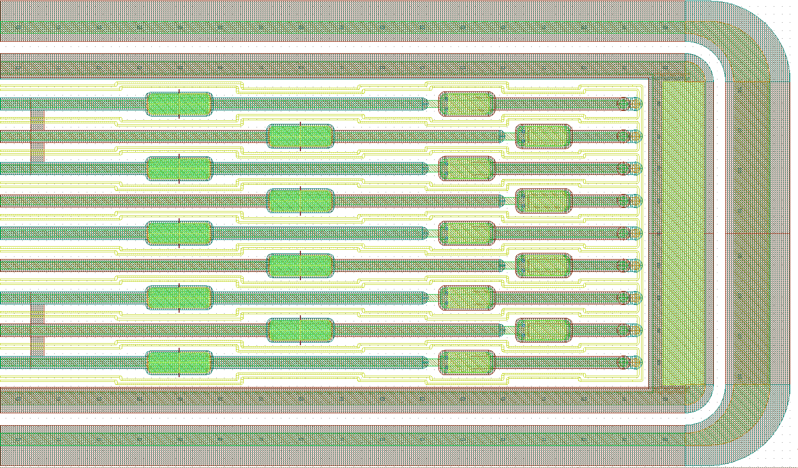
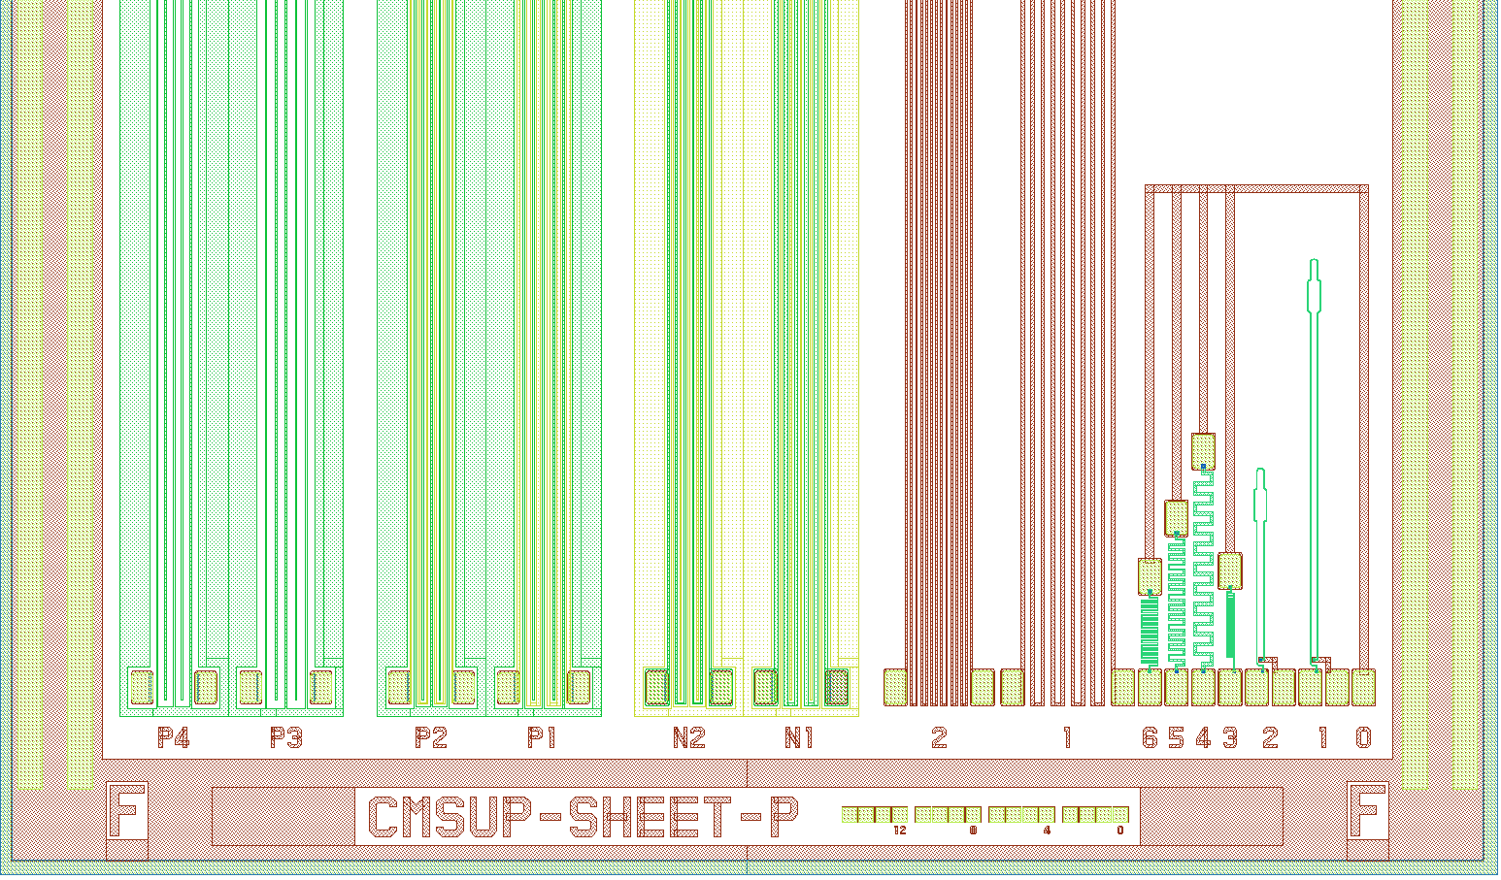
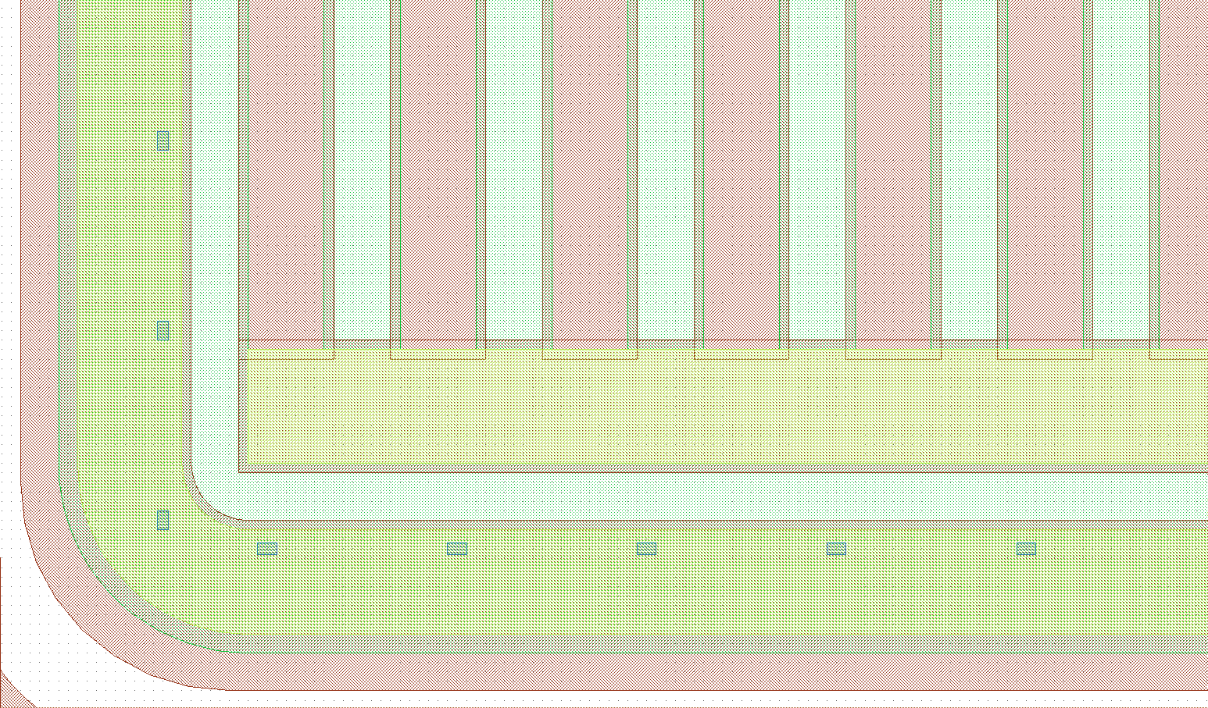
Standard Test Structures
Qualify test structure design for pre- and post irradiation process checking
Check sheet resistances, oxide quality, break down voltages, etc
CAP-TS-AC
Many small different structures
  Sheet, MOS, diode, GDC, TS-CAP, VIA
N+/p+ strip
alu
GCD
TS http://indico.cern.ch/getFile.py/access?contribId=1&sessionId=0&resId=0&materialId=slides&confId=77907
Participating Institutes: HEPHY (crosscheck KIT)

Slide 14
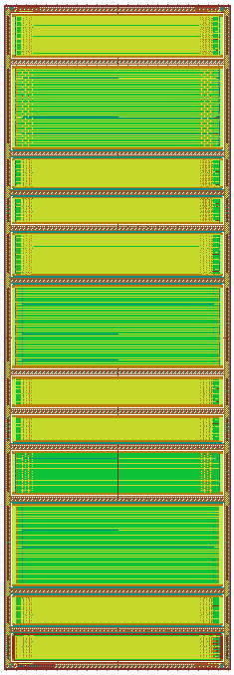
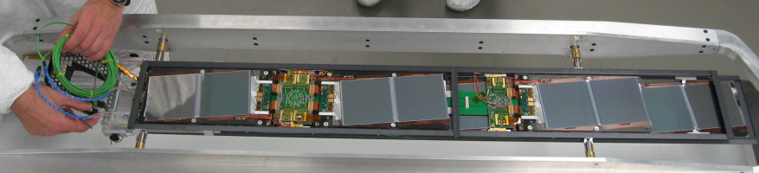
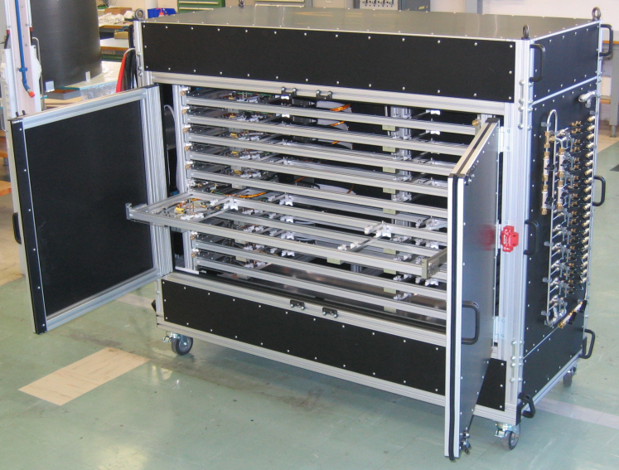
Multi-geometry Strip Sensor
65744,25um x 32792um
12 regions
  Different: pitch, width, ratios
Geometry study
Full irradiation campaign
Inter-strip measurements
  In Vienna box with multiplexer
  Values always vs. voltage ramp
CCE / Resolution with APV readout
  ➔ On CMS RODS ➔ CRACK / x,z table
  Multi-geometry: http://indico.cern.ch/materialDisplay.py?contribId=1&materialId=slides&confId=77900
Participating Institutes: CERN, Florence, FNAL?

Slide 15
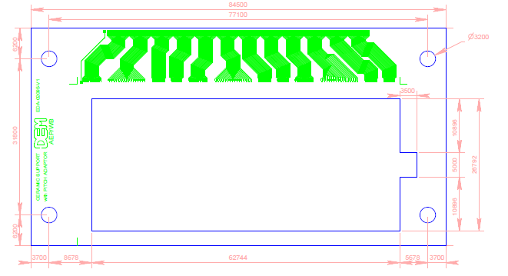
E.g. Multi-geometry strips, electrical
Biasing circuit
12 resistors
clamps
bonds
solder
12×2 cables
Pitch adaptor
To the
instruments
Goes to Vienna Box
31 strips in each group bonded together
for C_{interstrip} measurements
IV/CV
Multi-geomtry strips goes here
Rpoly, CaC, Rinsterstrip on Probestation in Florence
Measure:
Before irradiation
After first irradiation
After second (mixed) irradiation
(possibly additional annealing study)
Goes to irradiation

Slide 16
E.g. Multi-geometry strips S/N & resolution
Similar plans for the multi-geometry long pixels
Biasing circuit
12 resistors
clamps
bonds
solder
12×2 cables
This part can be exchanged with a CMS hybrid:
Signal to Noise, & Resolution
Multi-geomtry strips goes here
Goes to CRACK or x,y-table
(cosmic, source)
Pitch adaptor
Goes to irradiation

Slide 17
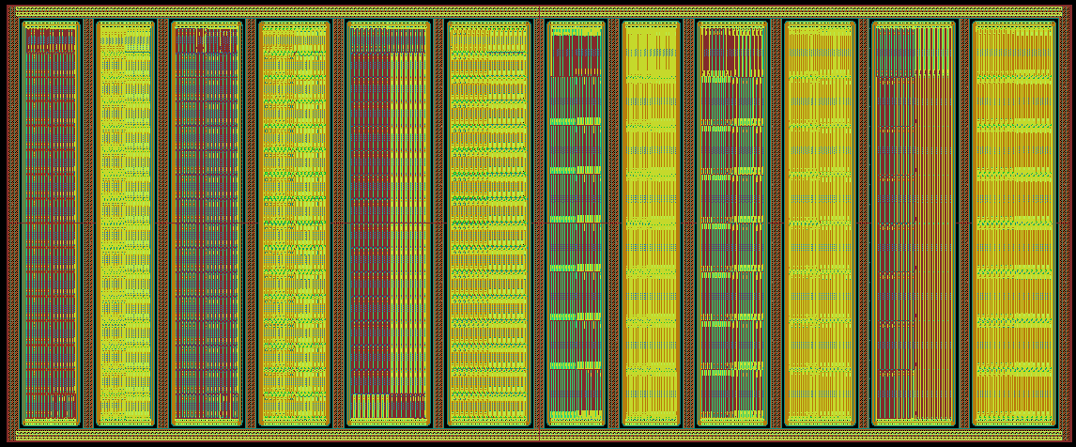
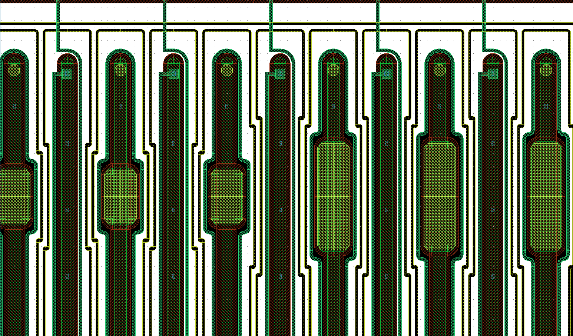
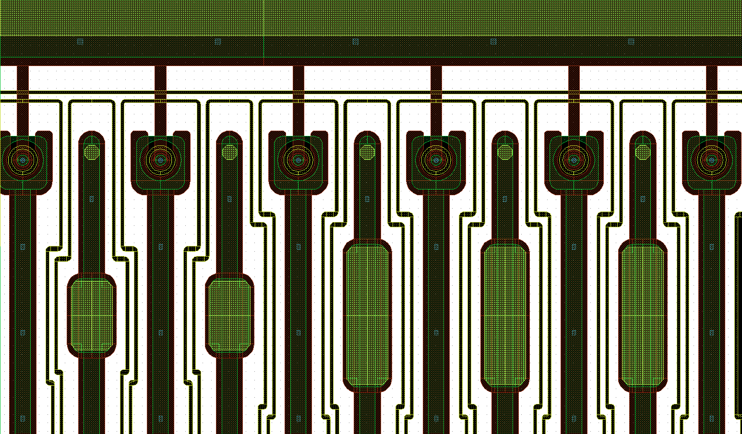
Multi-geometry Long Pixel Sensor
Geometry study for long pixel
Full irradiation campaign
12 regions: 3 ratios w/p, 2 diff. pixel lengths (1.25 mm and 2.5 mm), 2 diff. Bias schemes
Same as multi-geometry strips
  Bonding more complicated
  Inter-pixel parameters, CCE, resolution
  DELAYED!
Discussion started at CERN to establish a second x,y station
Participating Institutes: CERN, FNAL?, ??

Slide 18
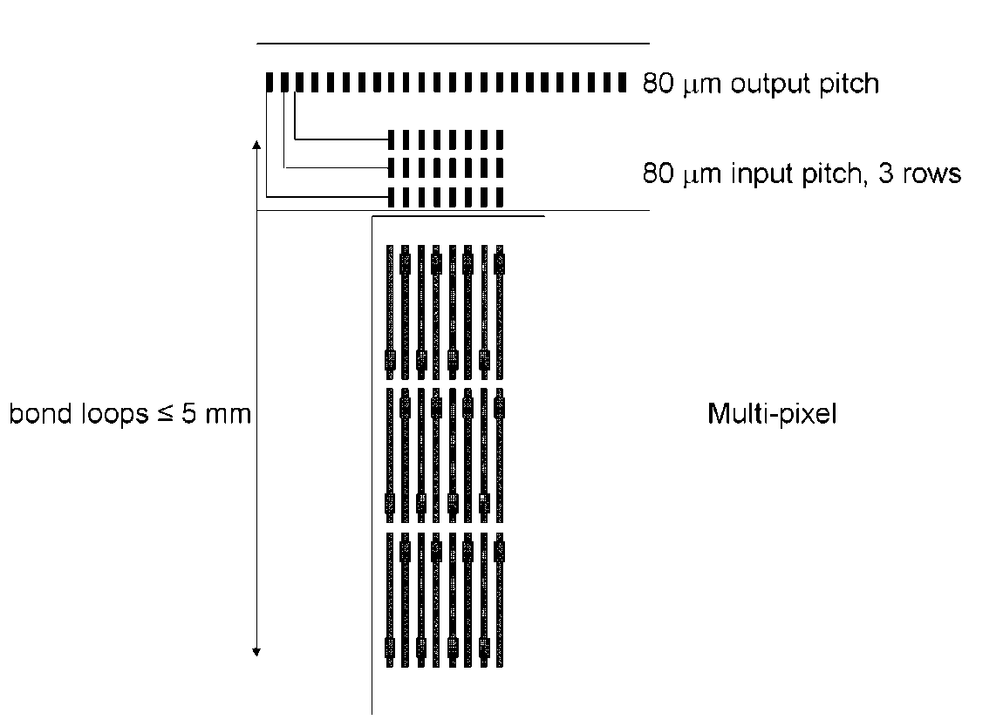
Multi-geometry Long Pixel Sensor
Originally designed only for capacitance measurements
  Relatively easy to do by stitch bonding neighboring pads
  But the capacitance might be too low to measure
Signal measurements make sense only if one can read at least 3 rows
  Bonding at a pitch of 80/3 μm
  With loop length ~ 5 mm
  Bonding only 16 strips
Probably more more pixel measurements
  Rpoly, punch through characteristics
1) Cold box + multiplexer
very challenging
2) Cold box + read out
3) Probe station, cold
➔ Test beam and/or source
Help appreciated
Bonding can be fully done at CERN
Participating Institutes: CERN, FNAL?, ??
Notes:
Readout here CMS, thus ARC or FEC/FED

Slide 19
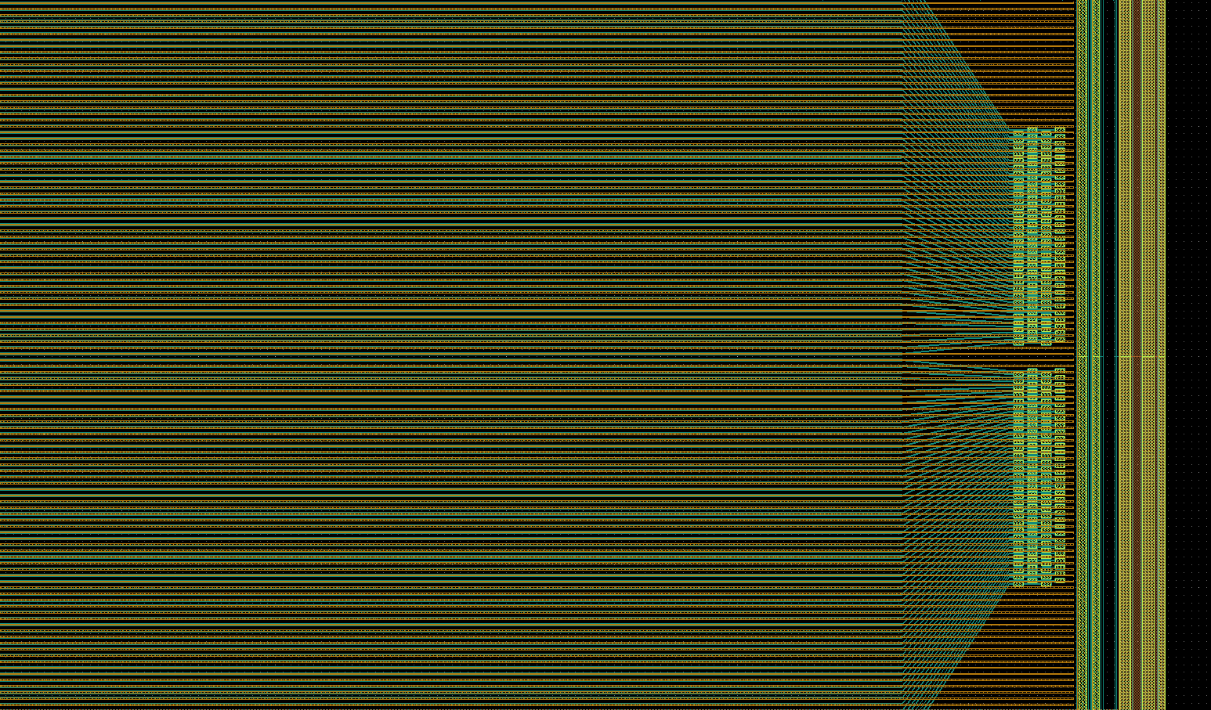
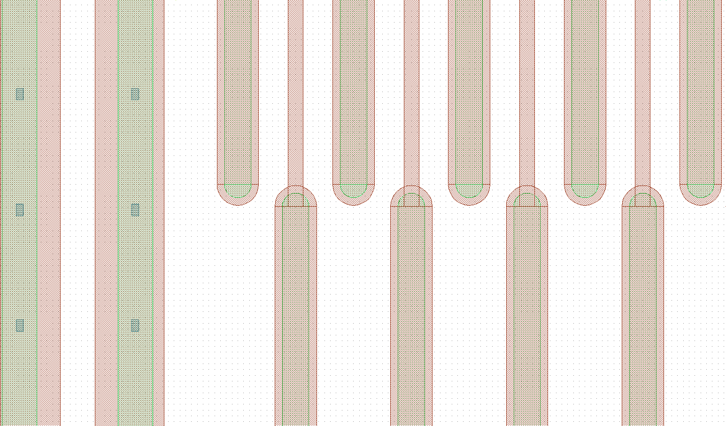
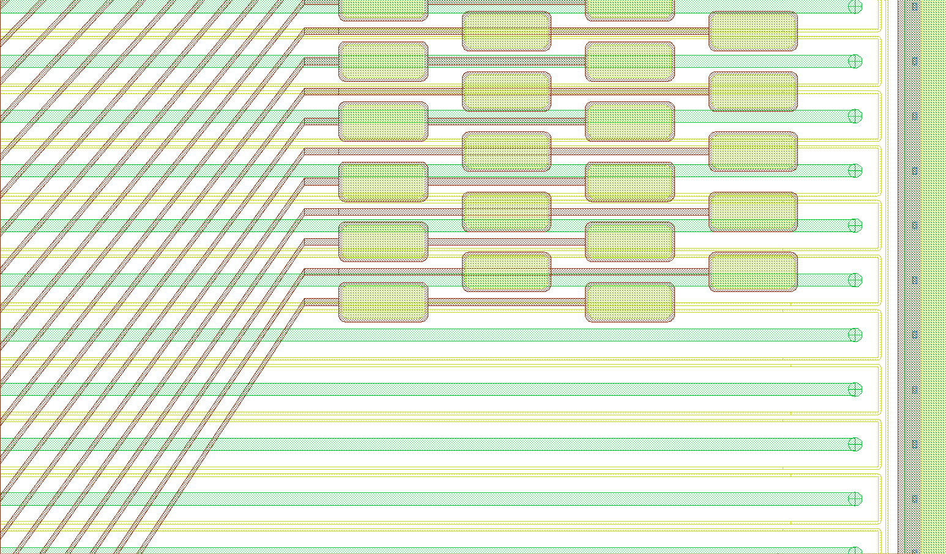
Strixel and Pitch Adapter Sensor
Design qualification
Routing studies
Strip measurements (esp. Cap)
  Ramp after irradiation
Irradiation
CCE, Signal vs. position (laser and source)
Laser and source scan
  Baby_PA & _strixel: http://indico.cern.ch/materialDisplay.py?contribId=7&materialId=slides&confId=77900
Participating Institutes: Perugia, KIT, Vienna

Slide 20
Plans for Baby_PA and Baby_Strixel
Design qualification
Routing studies
Irradiate with lowest and highest fluence:
18 materials => 36 Baby_PA and 36 Baby_Strixel
Probe stations (all 72 sensors):
  Before irradiation: full strip characterization + 10 ramps on strips + iv/cv => 22/ 29 days
  After p-irradiation: 10 ramps on strips + iv/cv => 16 / 16 days
  After n-irradiation: 10 ramps on strips + iv/cv => 16 / 16 days
Bonding:
  Needed three times: before, p-irr, n-irr => assume 1h per sensor ???
Each time 64 strips will be bonded
Laser
Source
Strixel
PA
Before irradiation
P-irradiation
N-irradiation
Before irradiation also for bonding
P-irradiation also for bonding
N-irradiation also for bonding

Slide 21
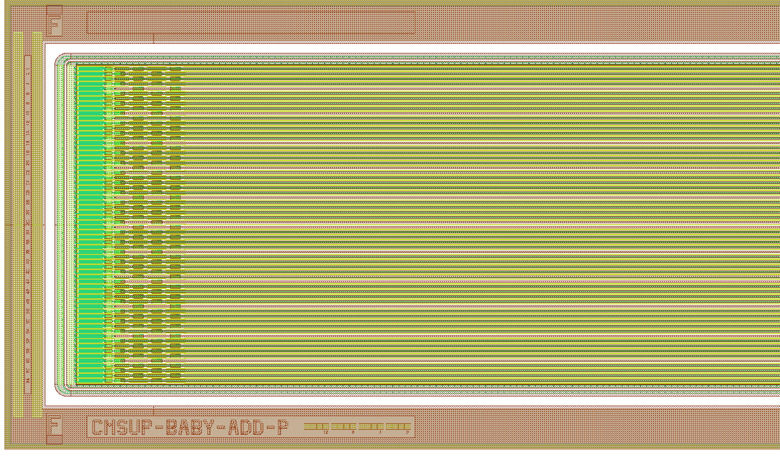
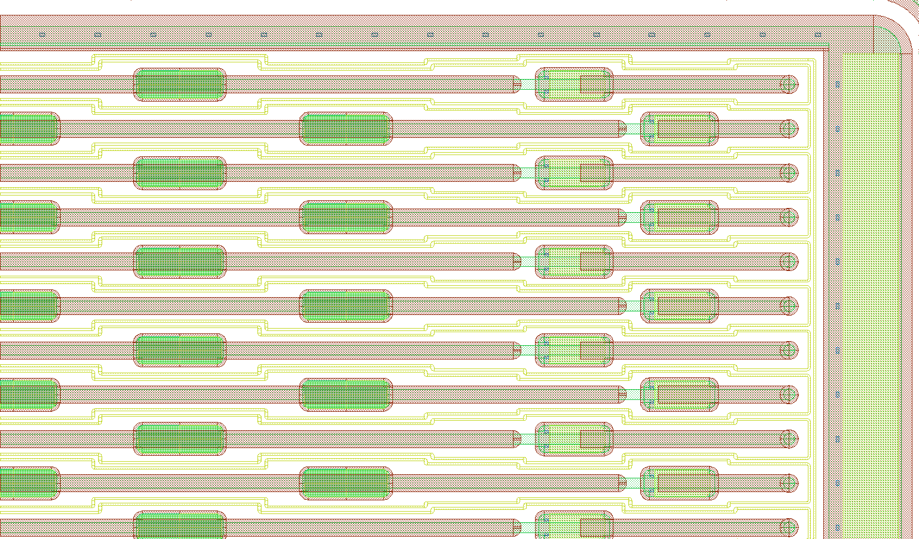
Lorentz Angle Sensor add_baby
Lorentz Angle for different fluences, temperatures, voltages, B-fields
Irradiation cross-calibration
  Neutrons Louvain!!!
  Neutron Vienna???
  Protons Catania???
Lorentz angle
Irrad. cross calibration
Additional minisensor with 64 strips
80um pitch; 18um implant; 31um alu
AC-Pad: 150um x 50um; DC-Pad: 85um x 38um
P-type
Participating Institutes: KIT, Louvain, Perugia?

Slide 22
Lorentz Angle Measurement
Measure displacement for different fields (up to 10 T), temperatures, voltages
Lorentz angle
B
TOP-6APV
4,95cm
1.25cm
1cm
5-6 sensors from same technology irradiated to different fluences on one hybrid
  Lorentzangle: http://indico.cern.ch/conferenceDisplay.py?confId=77903
Participating Institutes: KIT

Slide 23
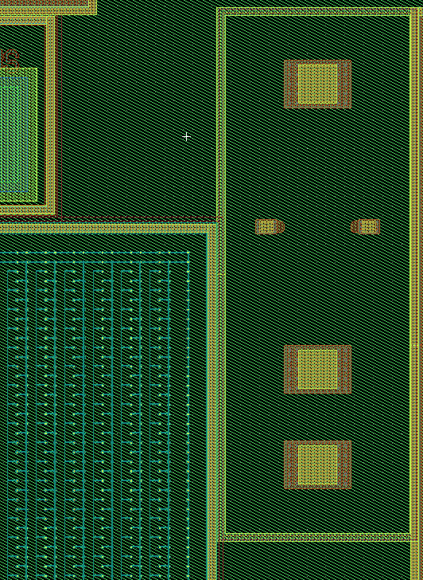
Hall Structure
  Resistivity
  Photoconductivity
  Trapping
  Radiation levels to be defined
Participating Institutes: Vilnius

Slide 24
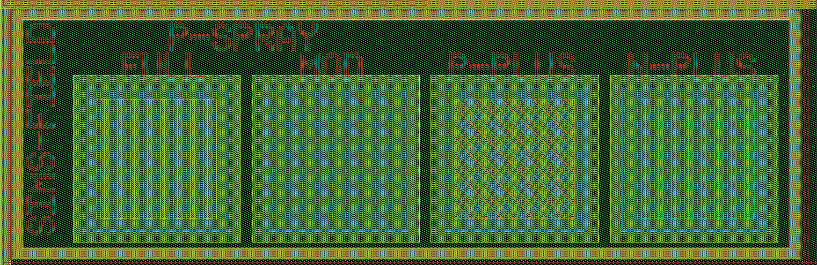
SIMS
Surface characteristics
Participating Institutes: ????

Slide 25
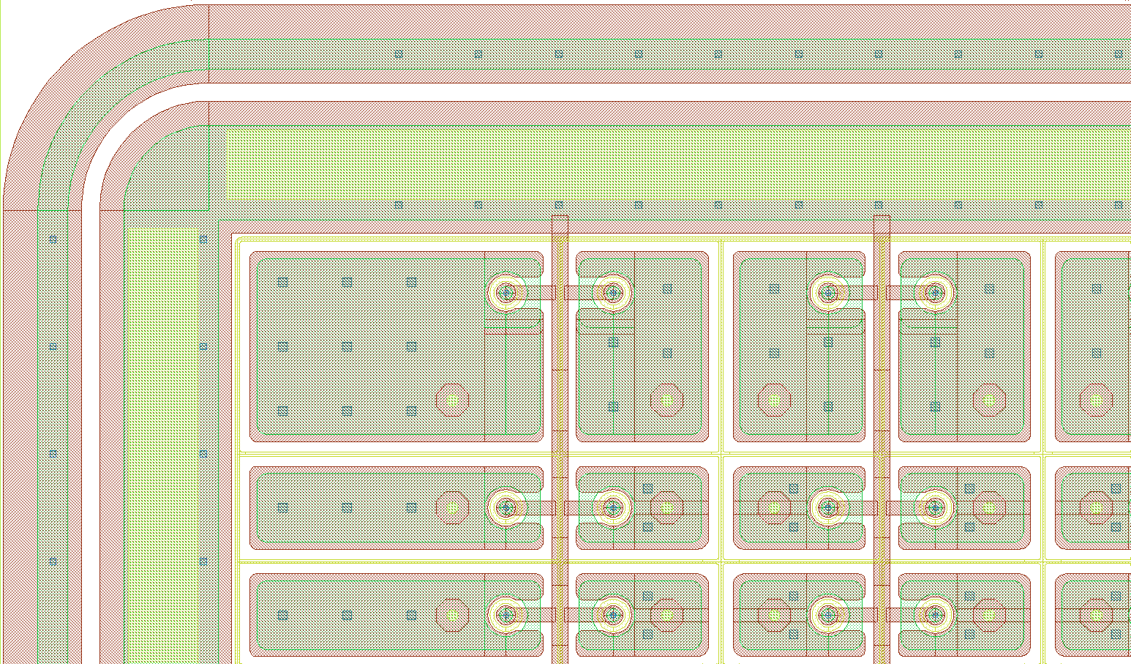
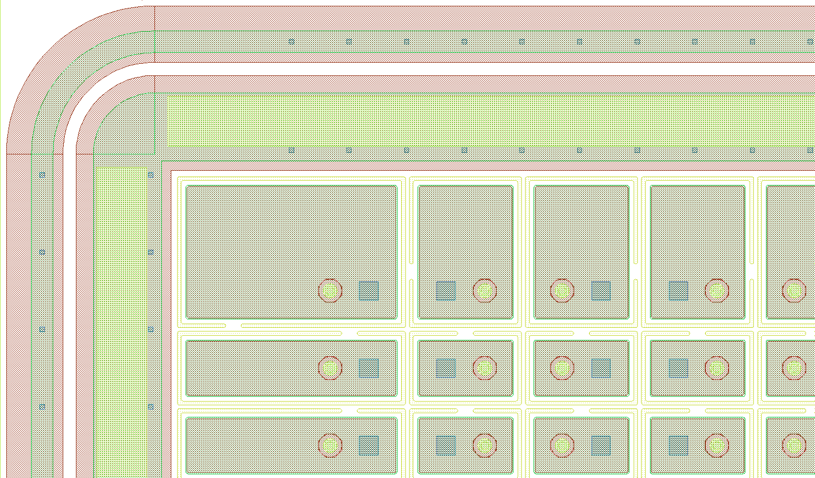
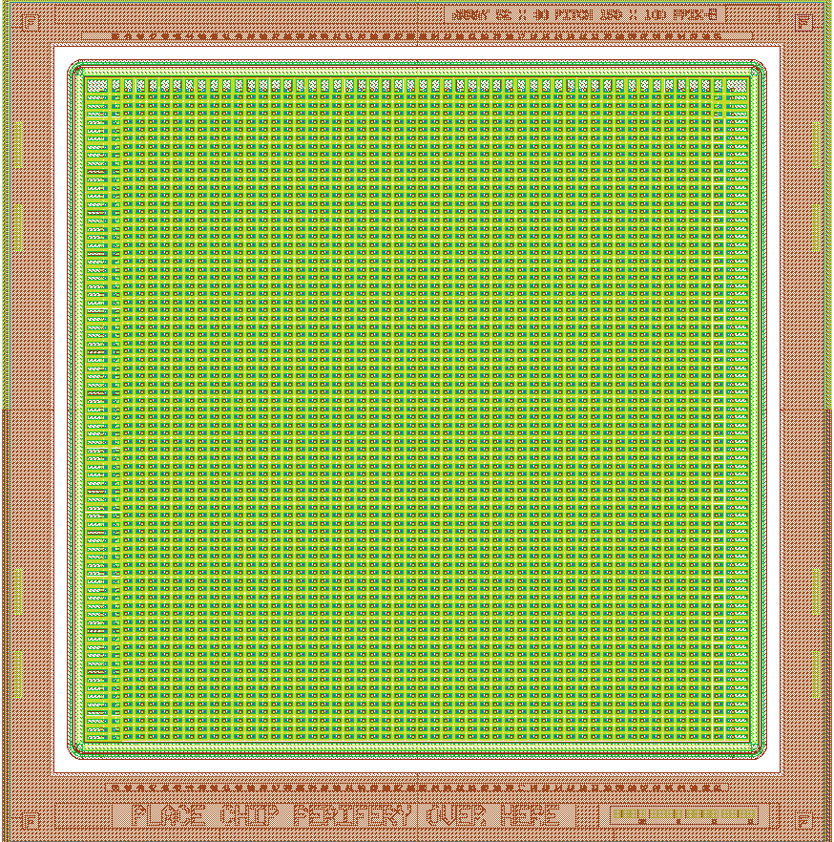
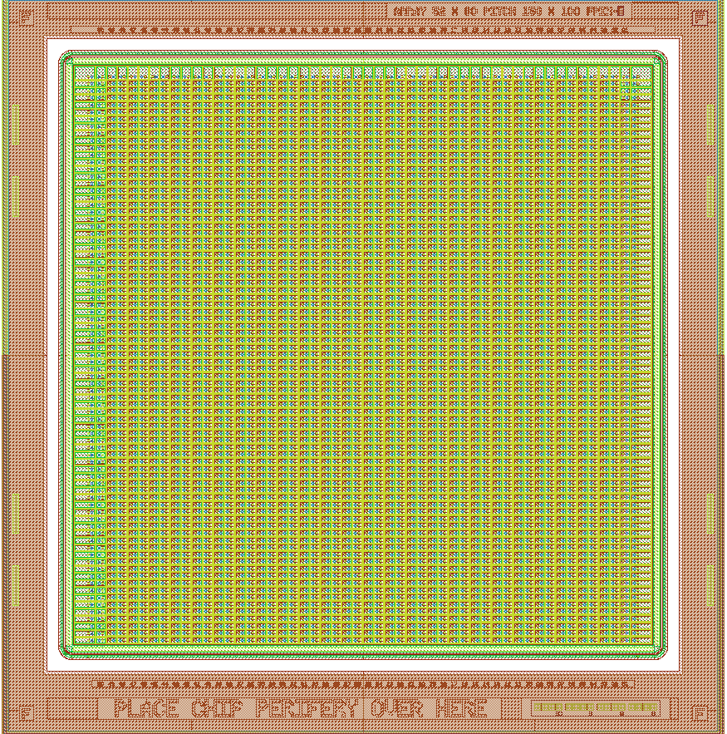
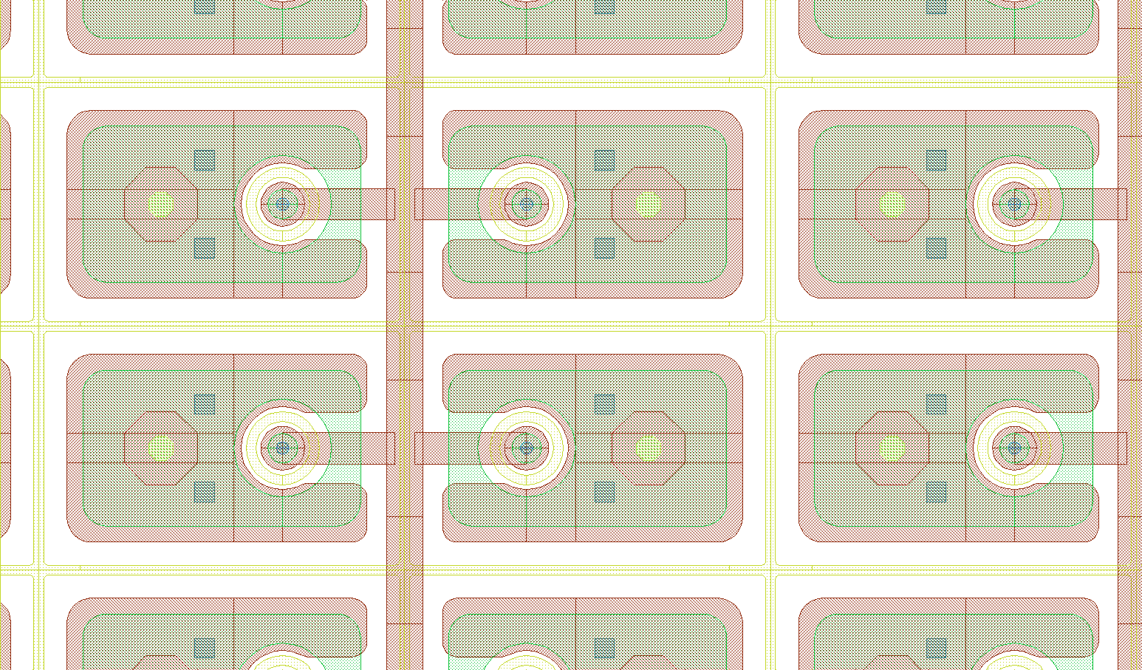
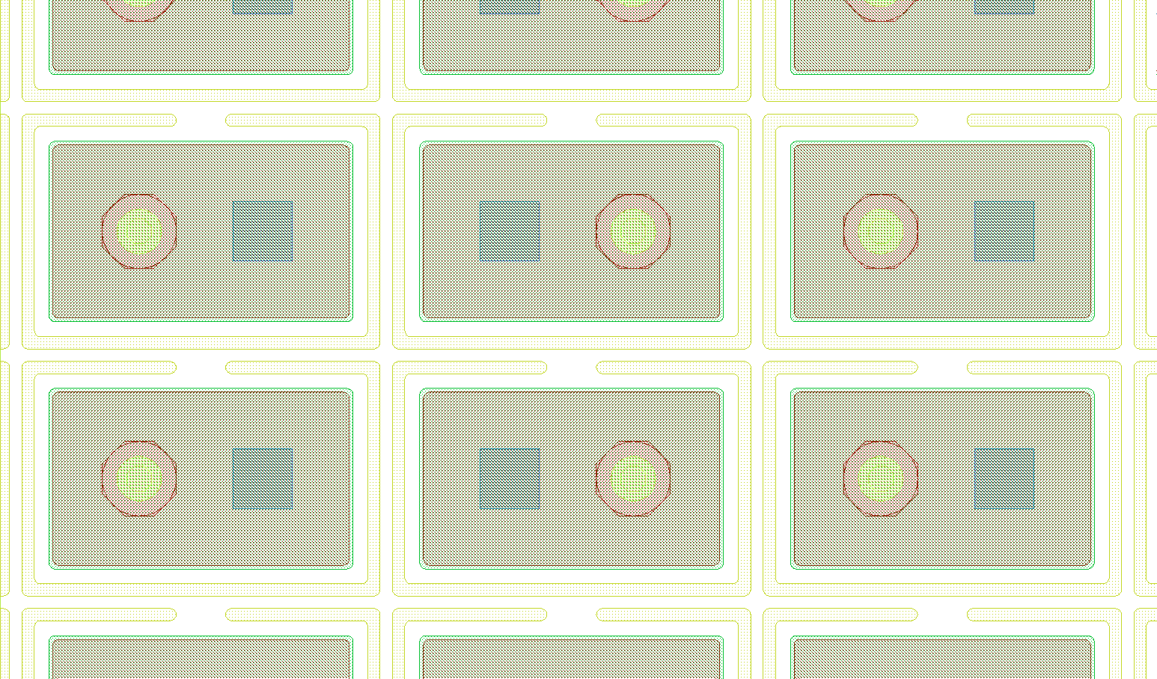
Pixel
Pixels will be bonded to PSI46 RIC chips, then irradiated
  Pixel readout system needed
  CCE
6 structures: BPix A, BPix B, BPix C, BPix D, FPix E, FPix F
Size: 10420um x 10120um
BPix p-type
FPix p-type
Participating Institutes: Participating institutes: PSI, Purdue, +??

Slide 26
Measurement
Descriptions & Definitions
The former descriptions in this talk are not exhaustive:
Combination of
  Initial talk at FNAL: http://indico.cern.ch/sessionDisplay.py?sessionId=7&slotId=0&confId=67916#2009-10-29
  Diodes: http://indico.cern.ch/materialDisplay.py?contribId=2&materialId=slides&confId=77900 & http://indico.cern.ch/conferenceDisplay.py?confId=77903
  Multi-geometry: http://indico.cern.ch/materialDisplay.py?contribId=1&materialId=slides&confId=77900
  Baby_std: http://indico.cern.ch/materialDisplay.py?contribId=34&sessionId=1&materialId=slides&confId=80949
  Baby_PA & _strixel: http://indico.cern.ch/materialDisplay.py?contribId=7&materialId=slides&confId=77900
  Lorentzangle: http://indico.cern.ch/conferenceDisplay.py?confId=77903
  TS & double metal: http://indico.cern.ch/conferenceDisplay.py?confId=77907
Irradiation: http://indico.cern.ch/materialDisplay.py?contribId=34&sessionId=1&materialId=slides&confId=80949 & http://indico.cern.ch/materialDisplay.py?contribId=3&sessionId=3&materialId=slides&confId=76114

Slide 27
Bottlenecks
E.g. a pitch adapter is missing for the Lorentz angle measurement campaign (Help?)
Packages for cut diodes?
The DIODE measurement campaign is not fully covered
  CV/IV (can be done at many places)
  CCE (laser setup needed)
  TCT (not available in many places)
  Rough calculation*:
    12 types * 30 different fluences (10 * (n+p+mixed)) = 360 diodes
      360 * 10 annealing steps = 3600
        3600 * 10 voltages * 3 temperatures = 108000 measurements TIMES X
      Probably all times 2 diodes
The multi-geometry (especially pixel) would profit from help
Logistics
Frames etc. definition for neutron irradiation
Program can be probably be split in two packages:
IV/CV/CCE
TCT
Anybody??
Anybody??
* Numbers can be lowered (as proposed by HH), but that does not change the problem

Slide 28
Proposal Scratch Pads
Mainly from Alex
Scratch pad definition accepted by HPK
Doping | Material |  |  |  | Position |  |  | Wafer
n-type | FZ300 | 1 | 00001 |  | Upper half | 0 |  | 0 | 000
n-type | FZ200 | 2 | 00010 |  | Lower half | 1 |  | 1 | 001
n-type | FZ100 | 3 | 00011 |  |  |  |  | 2 | 010
n-type | MCZ200 | 4 | 00100 |  |  |  |  | 3 | 011
n-type | Epi100 | 5 | 00101 |  |  |  |  | 4 | 100
n-type | Epi50 | 6 | 00110 |  |  |  |  | 5 | 101
p-type p-stop | FZ300 | 7 | 00111 |  |  |  |  | 6 | 110
p-type p-stop | FZ200 | 8 | 01000 |  |  |  |  | 7 | 111
p-type p-stop | FZ100 | 9 | 01001
p-type p-stop | MCZ200 | 10 | 01010
p-type p-stop | Epi100 | 11 | 01011
p-type p-stop | Epi50 | 12 | 01100
p-type p-spray | FZ300 | 13 | 01101
p-type p-spray | FZ200 | 14 | 01110
p-type p-spray | FZ100 | 15 | 01111
p-type p-spray | MCZ200 | 16 | 10000
p-type p-spray | Epi100 | 17 | 10001
p-type p-spray | Epi50 | 18 | 10010
Example: | FZ200 p-type p-spray, wafer 7, upper half: 0000 1110 1000 0111
 | first three pads are always unscratched
Wafer type
Wafer No.
irradiation type
HPK use
Scratched by CMS
Position
(Upper or Lower)

Slide 29
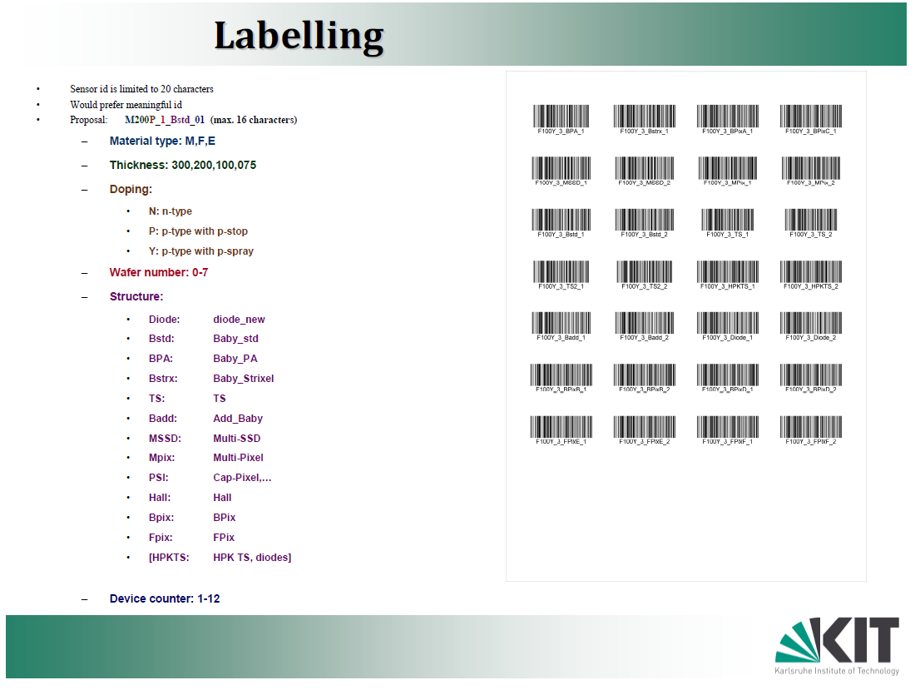
Barcodes

Slide 30
Test Beam(s)
Definitively NOT ORGANIZED yet
  No real plan: WHAT? HOW?
Possible to join parasitically with the SILC TB in September (quite early)
CERN: 5.11-15.11. @SPS
  http://spsschedule.web.cern.ch/SPSschedule/schedules/sps/2010/v100/p6.pdf
  Plan to use SIBT telescope and readout
Fermilab, maybe after November??
I see room for improvement!
Anybody??

Slide 31
Logistics
So far, no person dedicated to do the logistics, this WILL cause some friction
All data should go to a common DB
  Most tables defined
  Expert User: Stefano Mersi, CERN
  More Details, see DB talk
Notes:
Looks like, we have enough hybrids

Slide 32
Conclusion
Wafers coming end of June
  CEC defined a substantial part of the design
Testing Campaign defined
  CEC will lively participate in the testing
CEC sensor deliverables covered by this campaign
  Choice of technology!
  Routing schemes!
    Strixel, PA, double metal
  Standard Test Structures!

Slide 33
Backup

Slide 34
HPK 2009/2010 planning
Option B
Planned studies: (There will be 6 wafers per thickness/technology)
  FPIX/BPIX pixel will be handled differently (~ 50% bumb bonded – irradiated – tested by PSI)
  4-5 MIXED (n+p) radiation (full annealing study); (multi-geometry(s&p), baby, 4 diodes, strixel, PA, test structures)
    Sequence for multi-geometry(s&p), baby, strixel, PA:
      Half of the structure will be p-irradiation – short annealing – measure_A – n-irradiation – short annealing – measure_A – longterm annealing
      Half of the structure will be n-irradiation – short annealing – measure_A – p-irradiation – short annealing – measure_A – longterm annealing
    5cm * is not possible for a full set, only for diodes and may be one ?mini sensor?
      Only for pixel and EPI!!
  Standard iso-thermal annealing study; most diodes (5*8 = 50➔ 2*12 p+2*12 n) of five wafers
    Radiate to 5 additional different fluences 1(n+p), 2.5(n+p), 10(n+p), 15p, 30p (100p for EPI) · 10¹⁴ neq/cm²
      measure_C – anneal - measure_C – anneal … Long term annealing
Measurements A, B, C to be defined; measurement A, B, C different for the different structures
Short annealing = 10 min at 60C or x d @RT; Longterm annealing to be defined
First n then p
Scenario |  |  | mixed
protons | neutron |  | Radius | p | n | neutrons adjust
2.5 | 2.5 |  | 5 | 166.5 | 12 | 12
5 | 5 |  | 10 | 32.9 | 6.6 | 8
10 | 10 | è | 15 | 15 | 6 | 6
15 | 15 |  | 20 | 8.9 | 5.4 | 5
30 |  |  | 40 | 2.6 | 4.8 | 4
 |  |  | ref | 1?? | 1?? | 1??
First p then n
Maybe we can play a bit with these numbers,
especially with n
Option B: easier logistics; do we learn the same? Can we understand scientifically difference between p- & n-irradiation

Slide 35
Structures vs fluence
For Option B
 | initial | 40 cm | 40 cm | 40cm | 20 cm | 20 cm | 20cm | 15cm | 15cm | 15cm | 10cm | 10cm | 10cm | 5cm | 5cm | 5cm | wafer used | remain at 0 | study
~10E14 | 0 | 2.5p | 4 n | 2.5+4n | 9p | 5n | 9p+5n | 15p | 6n | 15p+6n | 33p | 8n | 33+8n |  |  |  | 4
Multi strip & strixel | 6 | 1 | 1 | 2 | 1 | 1 | 2 | 1 | 1 | 2 | 1 | 1 | 2 |  |  |  | 4 | 1 | multi-geometry, radiation
Baby | 6 | 1 | 1 | 2 | 1 | 1 | 2 | 1 | 1 | 2 | 1 | 1 | 2 |  |  |  | 4 | 1 | radiation
TS incl. 1 diode | 6 | 1 | 1 | 2 | 1 | 1 | 2 | 1 | 1 | 2 | 1 | 1 | 2 |  |  |  | 4 | 3 | functionality, process
PA & strixel | 6 | PA | Strixel | both | PA | Strixel | both | PA | Strixel | both | PA | Strixel | both |  |  |  | 4 | 1 | functionality
diodes | 10x6 | 2 | 2 | 2 | 2 | 2 | 2 | 2 | 2 | 2 | 2 | 2 | 2 |  |  |  |  |  | radiation
Pixel | x |  |  |  | ? | ? | 9p+5n | ? | ? | 15p+6n | ? | ? | 33+8n |  |  |  | 3 | many | bumbed before irradiation
EPI multi &strip | 6 |  |  |  | 9p | 5n | 9p+5n | 15p | 6n | 15p+6n | 33p | 8n | 33+8n |  |  |  | 3 | 3 | multi-geometry, radiation
EPI Baby | 6 |  |  |  | 1 | 1 | 2 | 1 | 1 | 2 | 1 | 1 | 2 | 160p | 12n | 166p+12n | 4 | 3 | radiation
EPI TS incl. 1 diode | 6 |  |  |  | 1 | 1 | 2 | 1 | 1 | 2 | 1 | 1 | 2 |  |  |  | 3 | 4 | functionality, process
EPI PA, Strixel | 6 |  |  |  | 1 | 1 | 2 | PA | Strixel | both | PA | Strixel | both |  |  |  | 3 | 4 | functionality
EPI diodes | 10x6 |  |  |  | 2 | 2 | 2+2 | 2 | 2 | 4 | 2 | 2 | 2+2 | 2 | 2 | 2+2 |  |  | radiation
PSI structures | x |  |  |  |  |  |  | ? | ? | ? | ? | ? | ?
Hall | x
remaining "thick" diodes should be additionally subjectedto a SLHC scenario; similar for EPI
in e14 | 1 | 2.5 | 5 | 10 | 15 | 30 |  | total
 | 2n+2p | 2n |  | 2n+2p | 2n | 2p |  | 14
 | TCT, CCE |  | start long term annealing |  |  |  |  |  |  |  | diodes thick(=2*10+4*6) |  |  |  | 36
 |  |  |  |  |  |  |  |  |  |  | in pairs of two |  |  |  | 18

Slide 36
[micron] | Length | Width | #
Multi-Pixel | 54664 | 22452 | 2
Multi-SSD | 65744.25 | 32792 | 2
Baby_std | 35120 | 22620 | 2
Baby_PA | 35120 | 12380 | 1
Baby_Strixel | 35120 | 15120 | 1
Add_Baby | 28120 | 7260 | 2
BPIX-A | 10420 | 10120 | 1
BPIX-B | 10420 | 10120 | 2
BPIX-C | 10420 | 10120 | 1
BPIX-D | 10420 | 10120 | 2
FPIX-E | 10420 | 10120 | 2
FPIX-F | 10420 | 10120 | 2
Diode_New | 7120 | 7120 | 12
Diode_CMS | 7000 | 7000 | 0
CAP-TS-AC | 37120 | 5234
CAP-TS-DC | 12895 | 5454
CCP | 8340 | 4340
GCD_New | 7580 | 7120
MOS_New | 7120 | 7120
Sheet_New | 11690 | 8970
Via1 | 1720 | 1720
Via2 | 1720 | 1720
TS-CAP120 | 7120 | 5312
HKP_TEST
Hall_Sample | 5620 | 2120
Cap-Pixel | 12110 | 8310
Sheet_Pspray | 3120 | 3120
SIMS | 6610 | 2110
PTTS | 5620 | 5620

Slide 37
Calibration campaign
non-irradiated structure
Institute | IV / CV | stripmeasurements | TS
Vienna | successful | successful | successful
Louvain | successful | strange Rpoly | x
Hamburg | successful | successful | successful
DESY Zeuthen | successful | successful | successful
Bari | successful | successful | x
Rochester | successful | missing Cint, Rint, Pinhole; bad Ileak | x
Fiorentino | successful | successful | successful
CERN | successful | successful | some missing structures
Karlsruhe | successful | successful | successful
Santander | successful | Missing Ileak, Pinhole | successful
Fermilab | successful | x | successful

Slide 38
Calibration campaign
irradiated structure
Institute | Structure received | IV / CV | Strips, ramps | TS
Vienna | X | successful | successful | successful
Louvain | X | x | x | x
Hamburg | X | successful | successful | x
DESY Zeuthen |  | x | x | x
Bari | X | x | x | x
Rochester |  | x | x | x
Fiorentino |  | x | x | x
CERN | X | x | x | x
Karlsruhe | X | successful | successful | successful
Santander |  | x | x | x
Fermilab |  | x | x | x

