Slide 1
Status of Calibration Campaign
Karl-Heinz Hoffmann
Institut für Experimentelle Kernphysik
Karlsruhe Institute of Technology
Initial description of the calibration can be found:
http://www-ekp.physik.uni-karlsruhe.de/~hartmann/Calibration_and_final_measurement.3.doc
Karl-Heinz Hoffmann
IEKP, KIT

Slide 2
measurement program:
CMS halfmoon:
CMS mini sensor
Global iv/cv
Stripmeasurements (Rpoly, Rint, CC, Cint, Ileak and Pinhole)
CMS test structures
TS-CAP, Sheet, GCD, CAP-TS-DC, Diode, MOS, CAP-TS-AC
some parameters and settings:
measurement to be done at room temperature (21C) and relative humidity < 30%
frequencies for capacitance measurements:
CV 1kHz, CC 100Hz, Cint 1MHz
all strip measurements at Vbias = 600V
for the non-irradiated
halfmoon
http://www-ekp.physik.uni-karlsruhe.de/~hartmann/Calibration_and_final_measurement.3.doc
Karl-Heinz Hoffmann
IEKP, KIT

Slide 3
measurement program:
CMS halfmoon:
CMS mini sensor
Global iv/cv
Voltage ramps on 10 Strips (Stripmeasurements: Rpoly, Rint, CC, Cint, Ileak and Pinhole)
some parameters and settings:
measurement to be done at room temperature (-20C) and relative humidity ~ 5%
frequencies for capacitance measurements:
CV 1kHz, CC 100Hz, Cint 1MHz
all strip ramps in steps of Vbias = 1-20 in 1 V
20-1000 in 20V
for the irradiated
halfmoon
http://www-ekp.physik.uni-karlsruhe.de/~hartmann/Calibration_and_final_measurement.3.doc
Karl-Heinz Hoffmann
IEKP, KIT

Slide 4
Institutes
institute | contact person | delivered | measurement done | TS-#
Wien | Thomas Bergauer | Irradiated + non-irradiated | Non-irradiated + irradiated | 2, 9
Louvain | Otilia Militaru | Irradiated + non-irradiated | Non-irradiated | 3, 10
Hamburg | Georg Steinbrück | Irradiated + non-irradiated | Irradiated + non-irradiated | 1, 5, 11
DESY Zeuthen | Wolfgang Lange | Non-irradiated | Non-irradiated | 7
Bari | Mauro Depalma | Irradiated + non-irradiated | Non-irradiated | 14
Padova | Andrea Candelori | non-irradiated |  | 12, 13, 16
Rochester | Sergey Korjenevski | Non-irradiated | Non-irradiated | ?
Fiorentino | Raffaello D'Alessandro | Non-irradiated | Non-irradiated | 17
Pisa | Alberto Messineo | Non-irradiated |  | 18
Perdue | Daniela Bortoletto | Non-irradiated |  | ?
CERN | Anna Peisert | Irradiated + Non-irradiated | Non-irradiated | 8
Aachen | Lutz Feld | Non-irradiated |  | 21
Santander | Iván Vila Álvarez | Non-irradiated | Non-irradiated | 22
Fermilab | Simon Kwan | Non-irradiated | Non-irradiated | 23
Karl-Heinz Hoffmann
IEKP, KIT

Slide 5
non-irradiated structure
* stand 1.5.2010
Institute | IV / CV | stripmeasurements | TS
Vienna | successful | successful | successful
Louvain | successful | strange Rpoly | x
Hamburg | successful | successful | successful
DESY Zeuthen | successful | successful | successful
Bari | successful | successful | x
Rochester | successful | missing Cint, Rint, Pinhole; bad Ileak | x
Fiorentino | successful | successful | successful
CERN | successful | successful | some missing structures
Karlsruhe | successful | successful | successful
Santander | successful | Missing Ileak, Pinhole | successful
Fermilab | successful | x | successful
Karl-Heinz Hoffmann
IEKP, KIT

Slide 6
irradiated structure
* stand 1.5.2010
Wien
Institute | IV / CV | ramps | TS
Vienna | successful | successful | successful
Hamburg | successful | successful | x
Karlsruhe | successful | successful | successful
Up to now, three Institutes performed the measurements on irradiated structures, but:
Bari is measuring an irradiated mini
6 irradiated halfmoons are ready to be shipped next week
Karlsruhe
Karl-Heinz Hoffmann
IEKP, KIT

Slide 7
Temperature Calibration
Started Temperature calibration with Hamburg with non-irradiated diode
We will calibrate with irradiated diode
Vienna will join
Other institutes should also join in order to be comparable
Wien
Karlsruhe
Karl-Heinz Hoffmann
IEKP, KIT

Slide 8
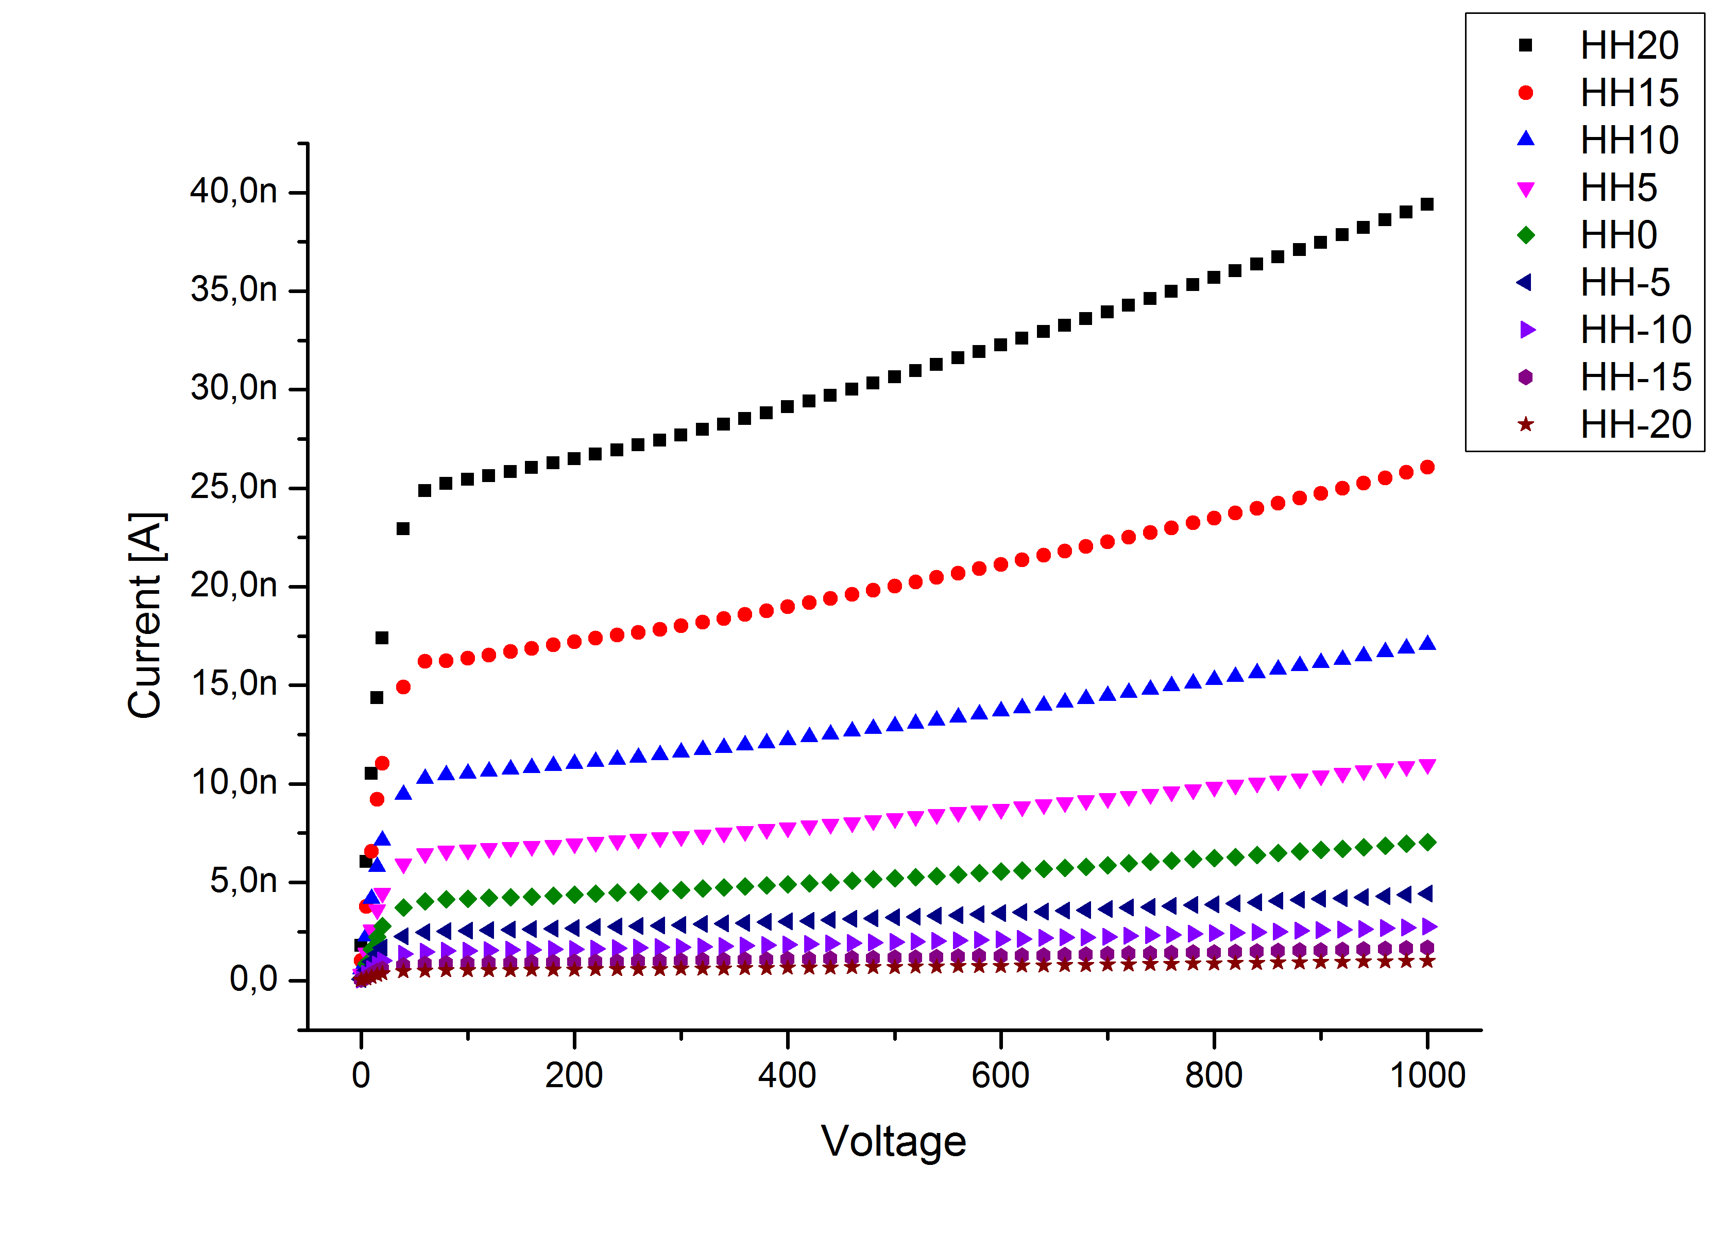
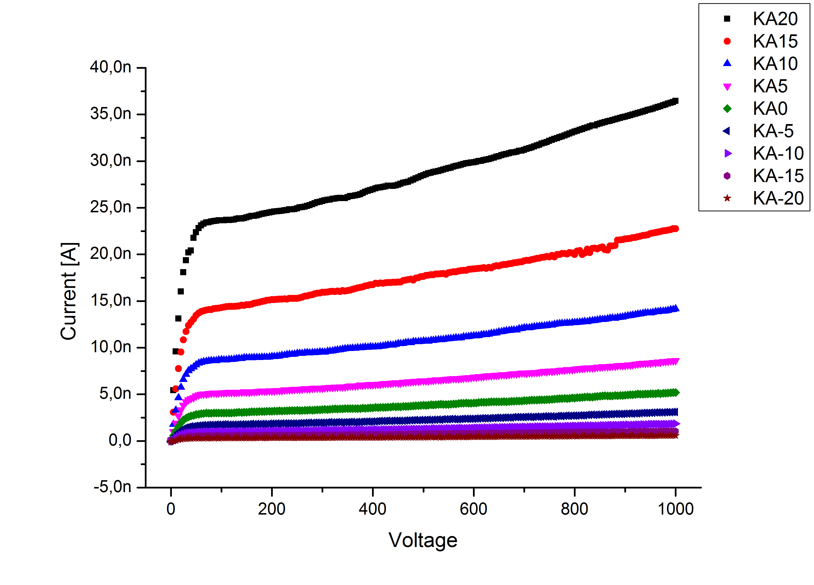
Temperature Calibration
First comparison between HH and KA with a non-irradiated diode
Wien
Karlsruhe
Karl-Heinz Hoffmann
IEKP, KIT

Slide 9
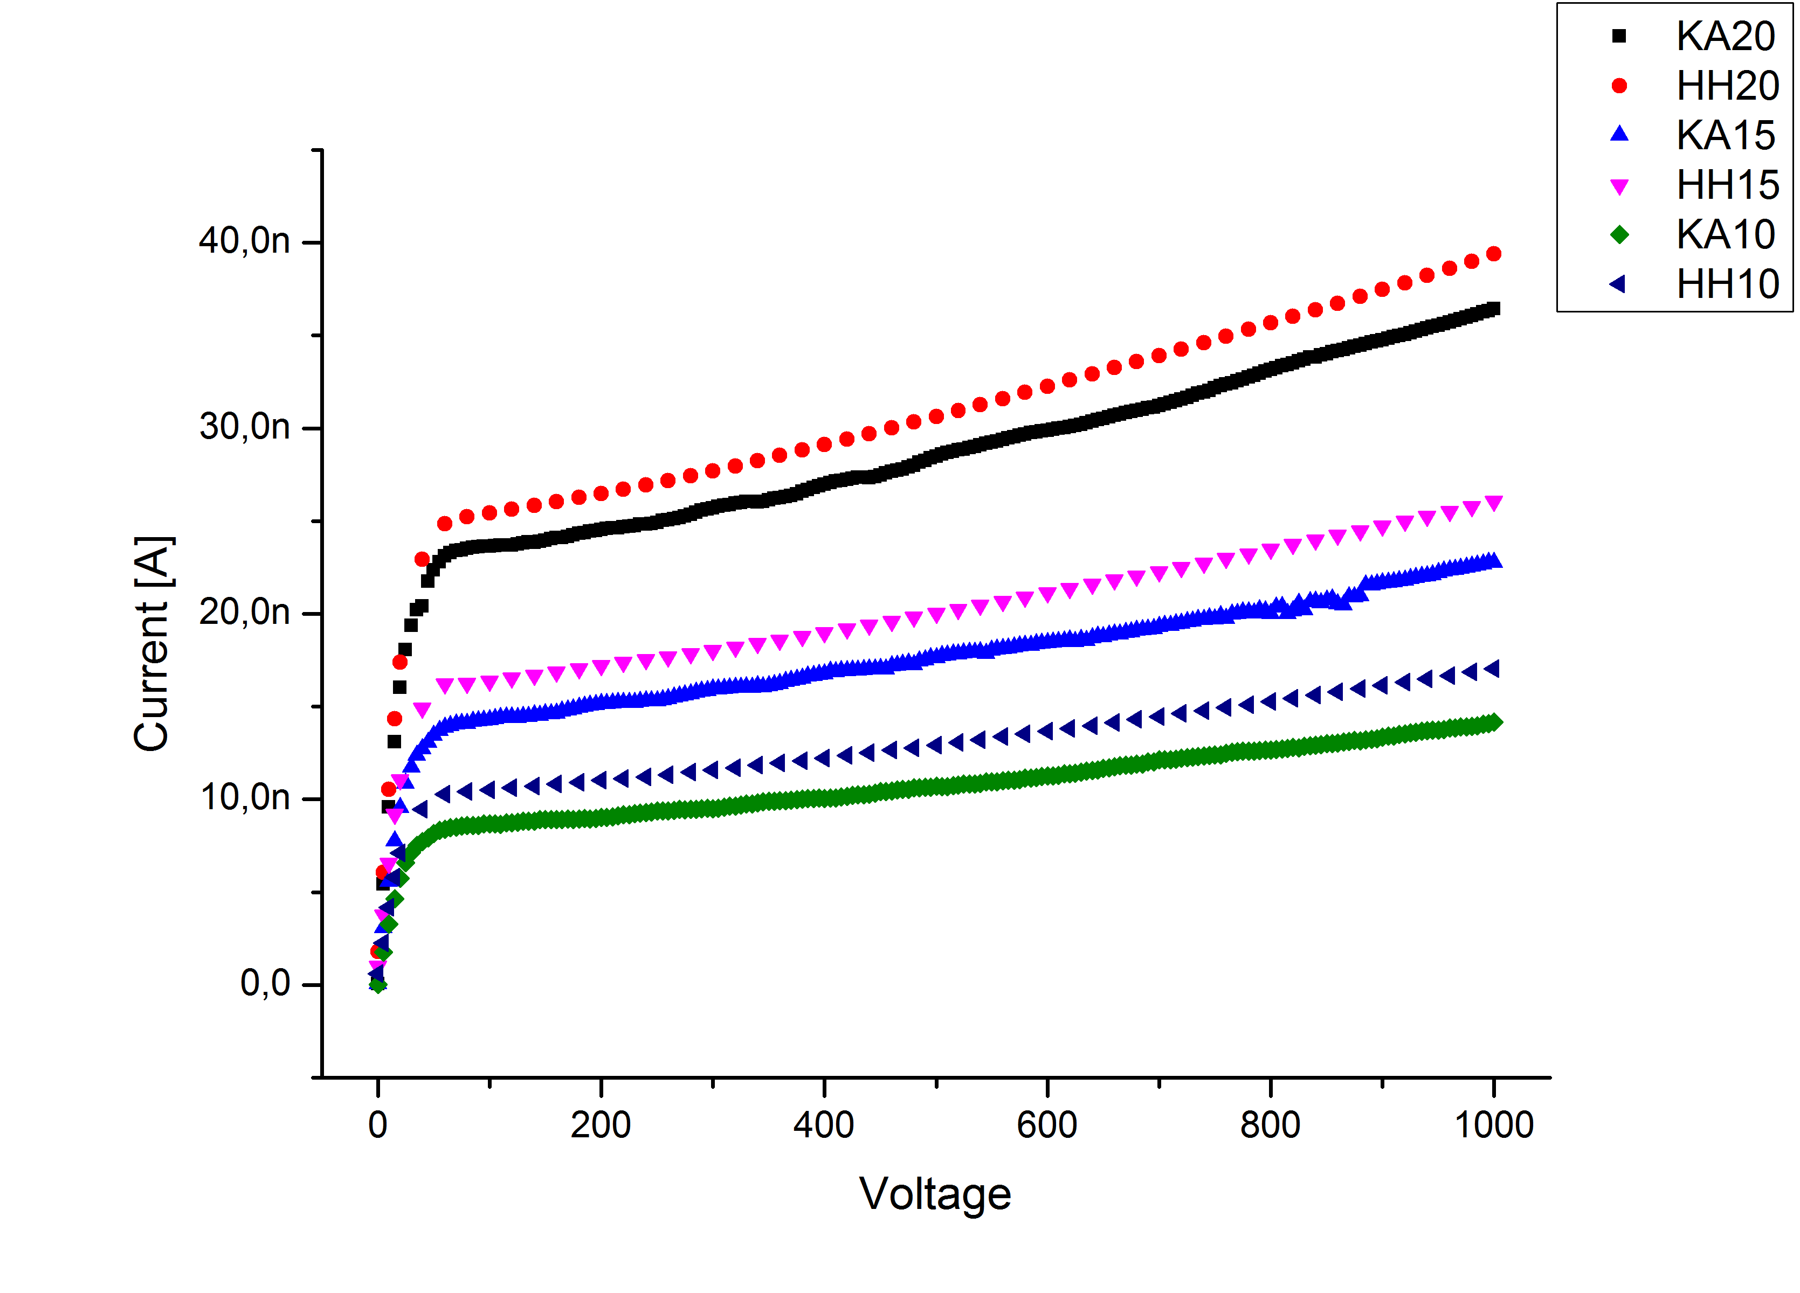
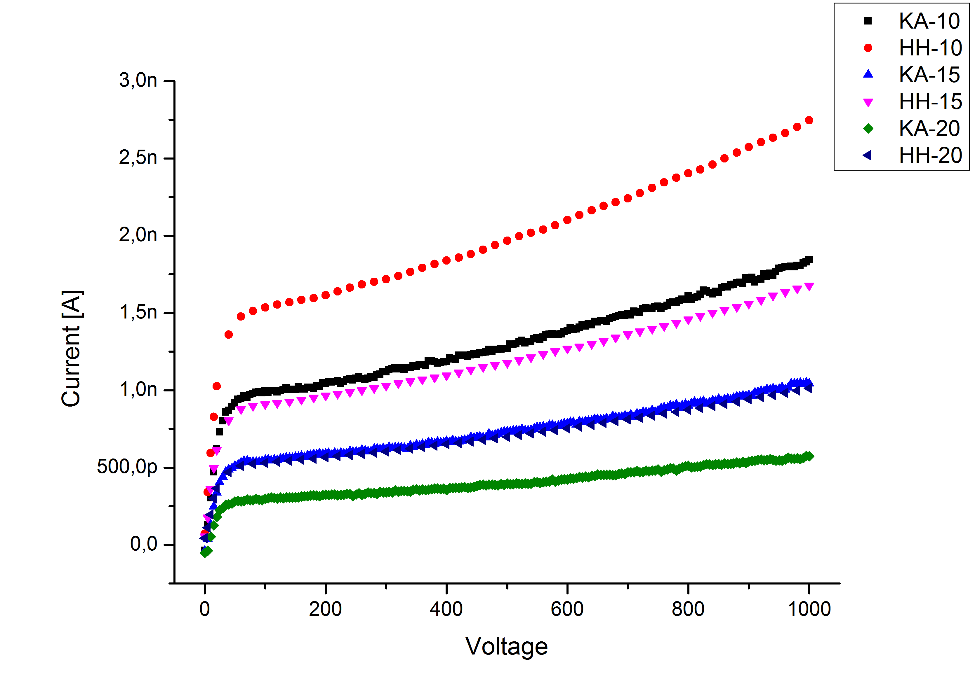
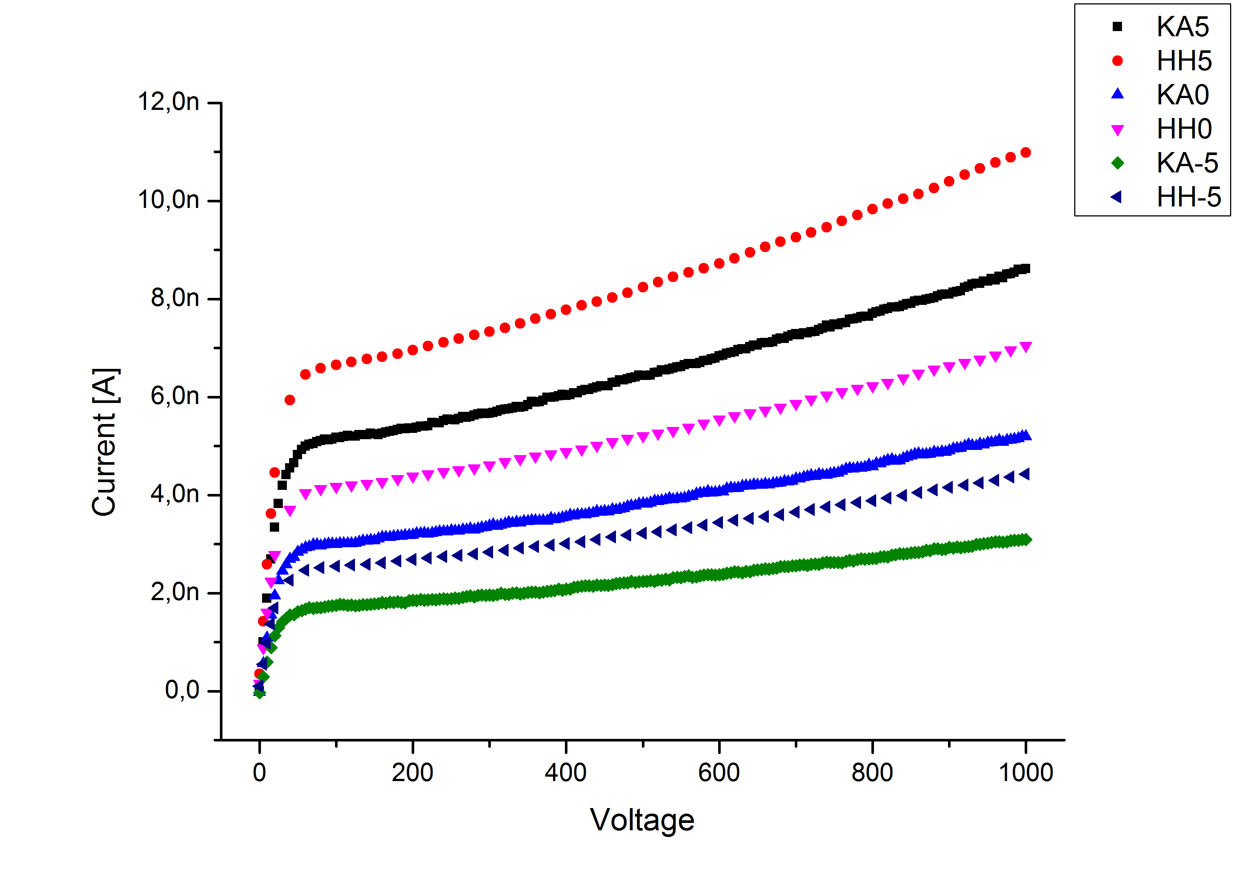
Temperature Calibration
First comparison between HH and KA with a non-irradiated diode
Wien
the bigger
the difference!
the deeper
the temperature …
Our dT is growing
Each step!
Karlsruhe
Karl-Heinz Hoffmann
IEKP, KIT

Slide 10
Temperature Calibration
Wien
A little bit playing with numbers:
Dark Current:
I ~ T² exp(-Eo/kT)
( * with reduced temperatures;
starting with 19°C ending with -25°C )
Temperature | Karlsruhe | Hamburg | I-Prop real | I-Prop *() | Faktor HH | Faktor KA | Faktor KA *
20 | 3,61E-08 | 3,90E-08 | 1,99996E-05 | 1,84104E-05 | 513 | 555 | 510
15 | 2,25E-08 | 2,58E-08 | 1,31473E-05 | 1,15609E-05 | 510 | 583 | 513
10 | 1,40E-08 | 1,69E-08 | 8,52082E-06 | 7,13408E-06 | 505 | 610 | 511
5 | 8,52E-09 | 1,09E-08 | 5,44034E-06 | 4,32167E-06 | 500 | 639 | 507
0 | 5,13E-09 | 6,95E-09 | 3,41916E-06 | 2,56714E-06 | 492 | 666 | 500
-5 | 3,06E-09 | 4,37E-09 | 2,1134E-06 | 1,49351E-06 | 484 | 690 | 487
-10 | 1,81E-09 | 2,71E-09 | 1,28354E-06 | 8,49885E-07 | 474 | 708 | 469
-15 | 1,04E-09 | 1,66E-09 | 7,65179E-07 | 4,72376E-07 | 462 | 739 | 456
-20 | 5,61E-10 | 9,98E-10 | 4,4727E-07 | 2,56047E-07 | 448 | 797 | 456
Karlsruhe
Karl-Heinz Hoffmann
IEKP, KIT

