Slide 1
CO₂ Cooling
for the CMS Tracker
at SLHC
Lutz Feld, Waclaw Karpinski,
Jennifer Merz, Michael Wlochal
RWTH Aachen University, 1. Physikalisches Institut B
18 May 2010 CEC Meeting, DESY Zeuthen

Slide 2
Outline
CO₂ cooling for SLHC
Test System in Aachen
Aims and specifications
Schematic design
Set-up
Pressure drop along detector pipe
Dryout measurements
Conclusion

Slide 3
CO₂ Cooling for SLHC
Evaporative CO₂ cooling system: Dissipate power by evaporating liquid CO₂
Already planned for phase-I pixel upgrade
and phase-II upgrade of whole tracker
Effective cooling: high heat load can be cooled with little flow → Evaporating more effective than heating up a liquid
Lower temperatures are possible → Benefit for silicon sensors
Reduction of material budget: - Low CO₂ density - Little flow - Thin pipes, CO₂ under high pressure
Liquid CO₂ @-20°C:
Heat up to -19°C: 2 J/g
→ Evaporate: 282 J/g
x100

Slide 4
R&D in Aachen
Aims:
Gain experience with a closed recirculating CO₂ system
Determine lowest operating temperature
Find out ideal operating conditions (→ stable system), depending on heat load and CO₂ temperature
Specifications:
Maximum cooling power: 500W
CO₂ temperature in detector: -45°C to +20°C
Precise flow and temperature control
Continuous operation
Safe operation (maximum pressure:100bar)

Slide 5
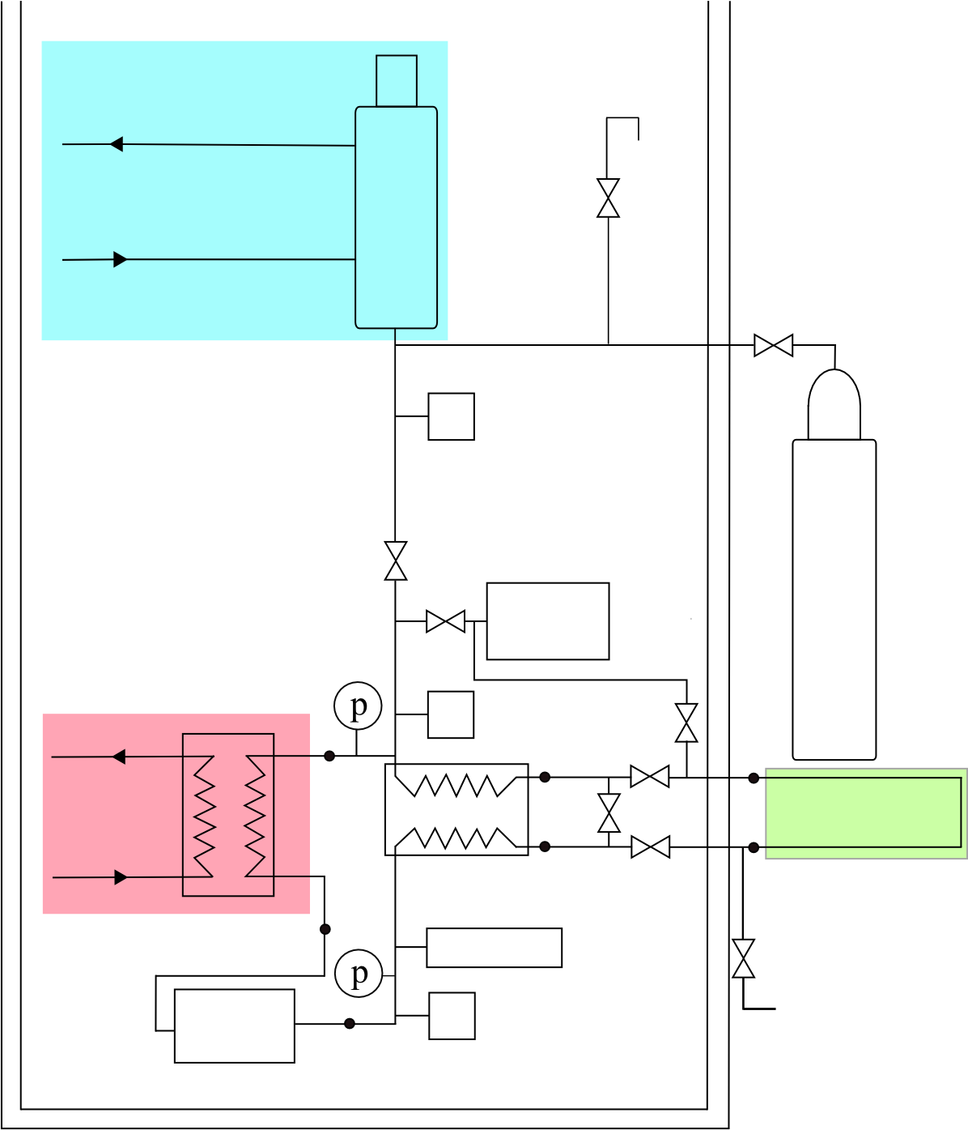
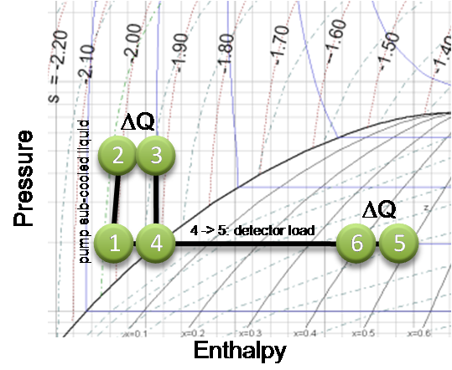
Schematic View of the CO₂ System
Chiller 1: Chiller temperature→ vapour pressure → system temperature
Expansion Vessel:
Saturated mixture of CO₂ liquid and vapour
ΔQ
-45°C
2
3
pressure, bar
ΔQ
1
4
6
5
Enthalpy, kJ/kg
Vacuum-
Pump
CO₂-Bottle
Heat Exchanger :
Dissipation of detector heat load
Subcooling incoming CO₂ (only liquid in pump)
Chiller 2
6
5
3
4
Heat Exchanger :
Warm incoming CO₂ to nominal temperature ( given by chiller 1)
Partial condensation of returning CO₂
-55°C
Detector:
Up to 500 W
heat load
1
Flow meter
CO₂
Pump
2
5

Slide 6
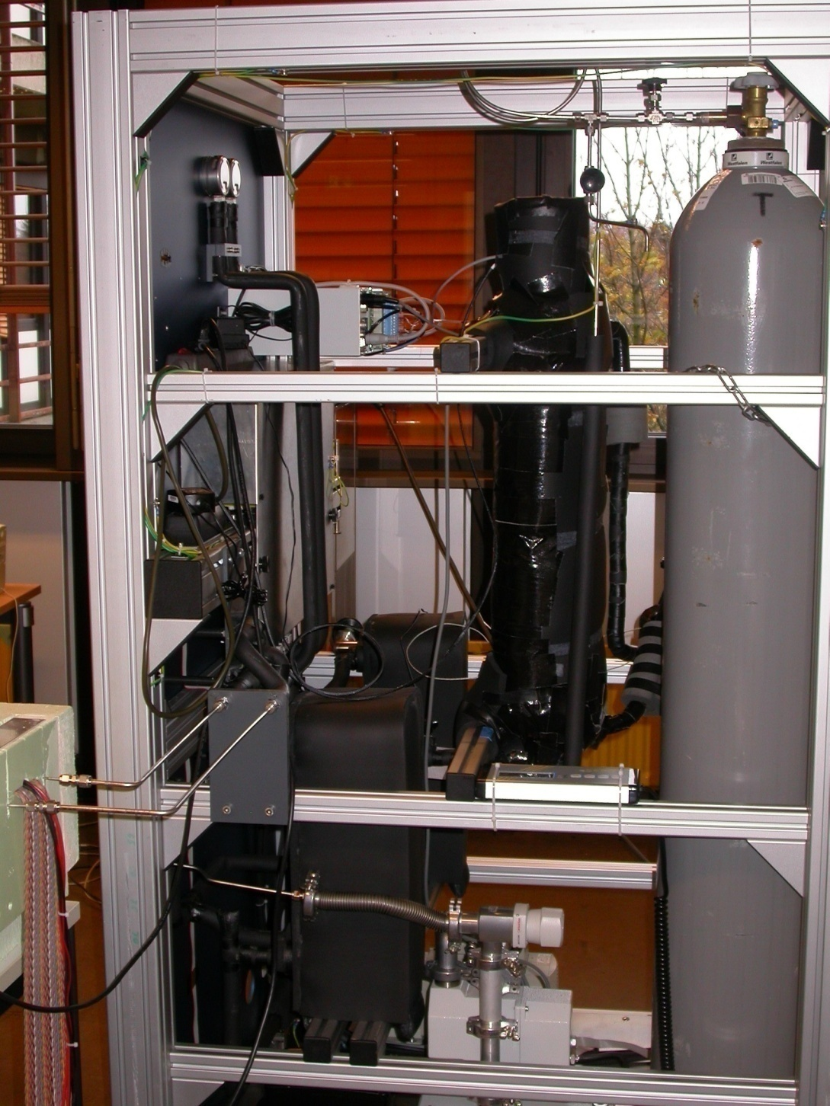
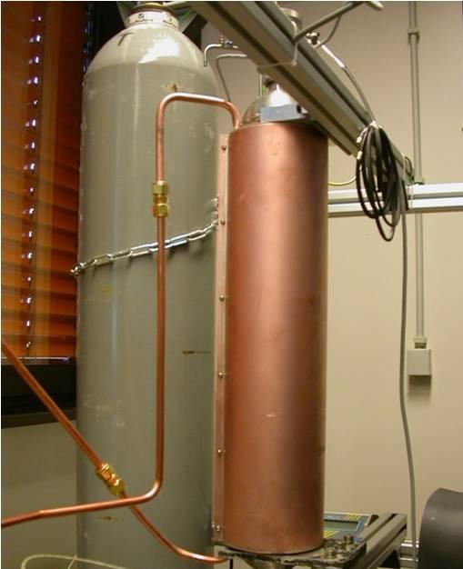
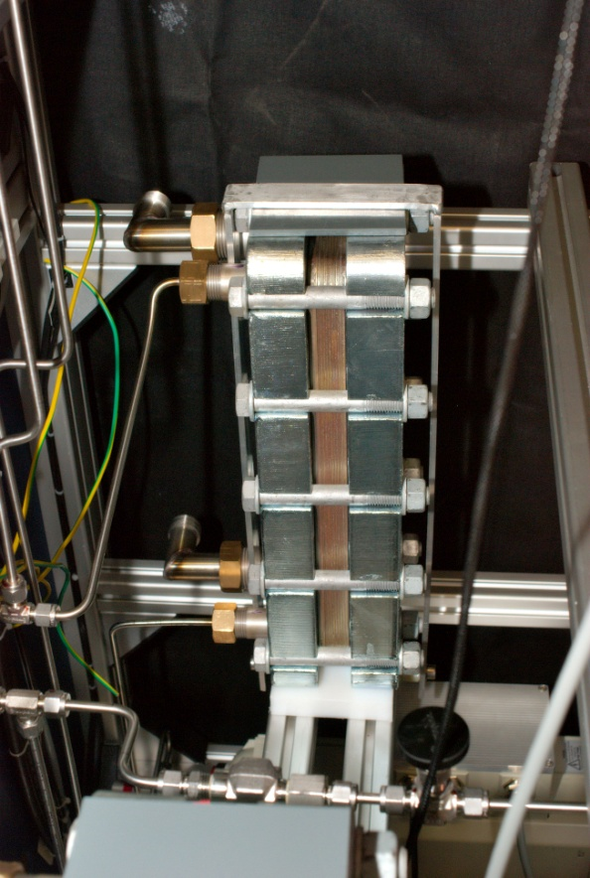
CO₂ Test System (I)
CO2-Bottle
CO2-Flasche
Expansion Vessel
CO₂
Bottle
Detector
Heat Exchanger

Slide 7
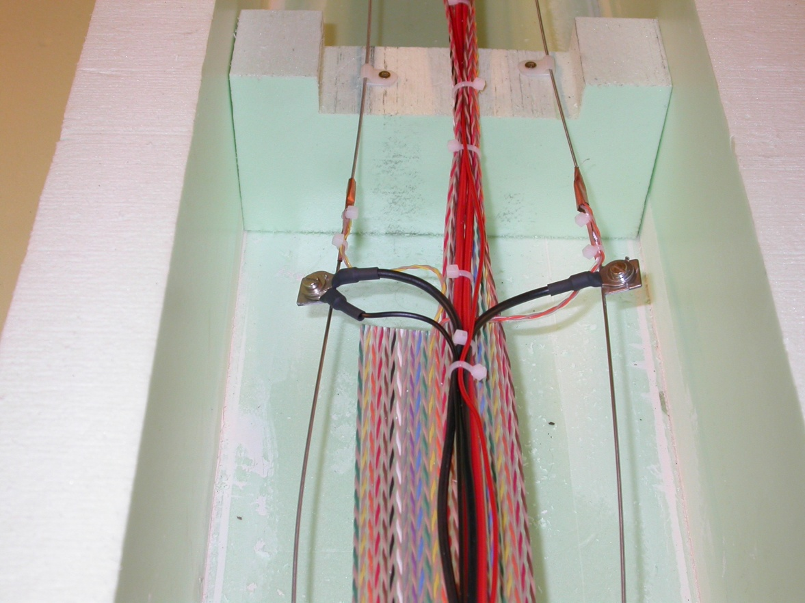
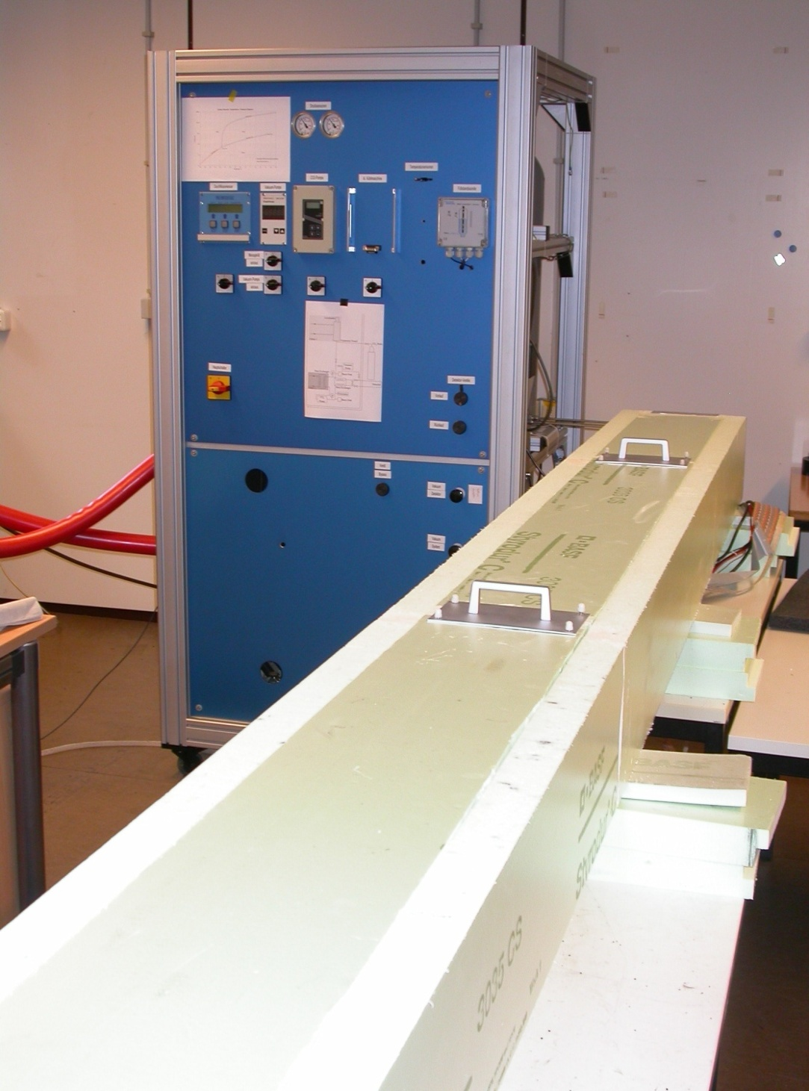
CO₂ Test System (II)
Thermistors
CO2-Bottle
CO2-Flasche
Users
panel
Electrical connections
6m stainless steel pipe, 1.7mm inner diameter
14 Thermistors along the pipe: Measurement of temperature distribution
Simulation of uniform heat load, by current through pipe (→ ohmic losses)
Box for insulation

Slide 8
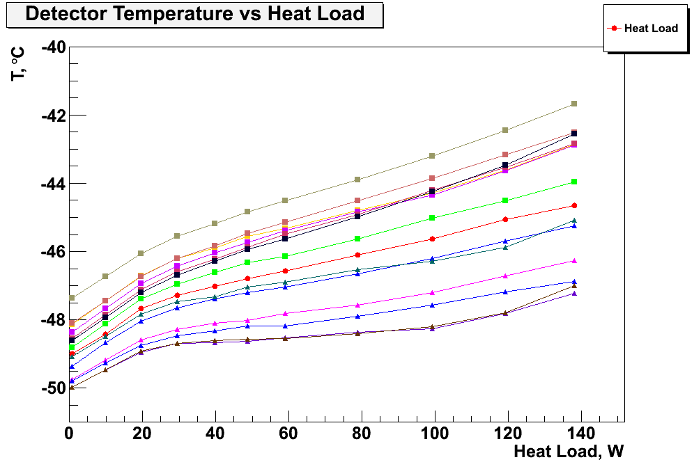
Heat Load at -45°C
14
12
10
8
6
4
2
14 thermistors along pipe
-45°C CO₂ temperature
13
11
9
7
5
3
1
Detector temperature, °C
6m long pipe
1.7mm inner diameter
~ 50 g/min flow
Increase heat load by 140W
Heat Load
Low temperatures can be reached
Constant detector temperature with applied heat load

Slide 9
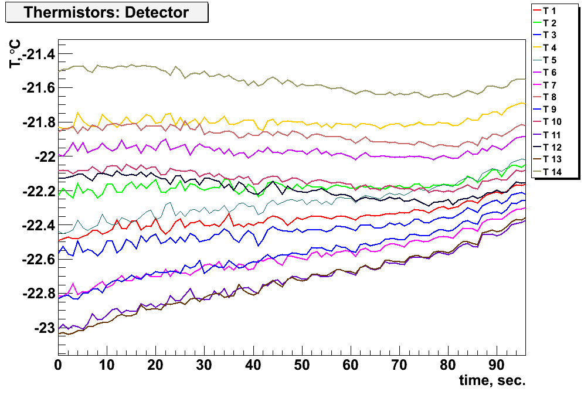
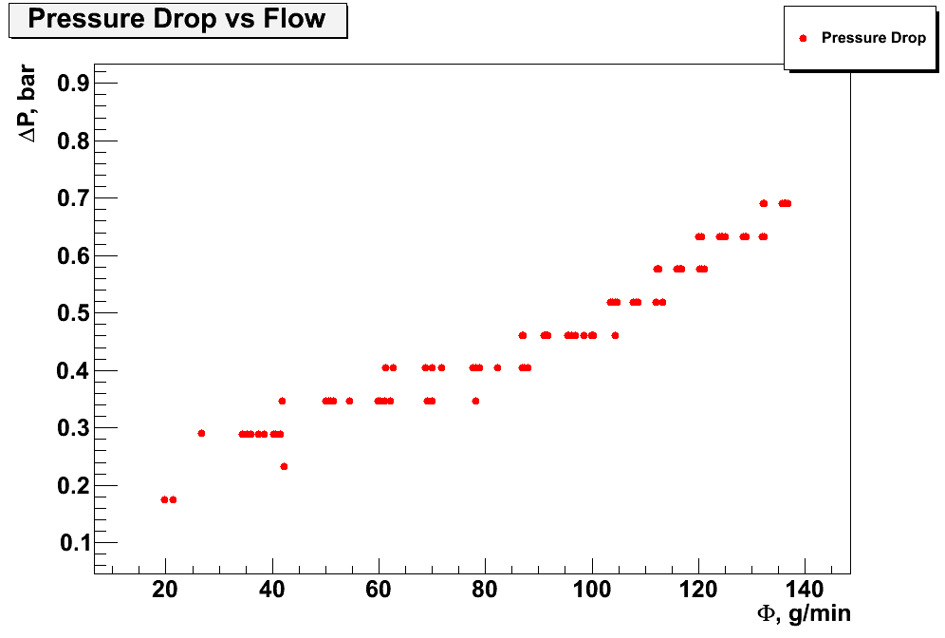
Pressure Drop along Detector Pipe
Temperature distribution over detector pipe
14
12
10
8
6
4
2
14 thermistors along pipe
13
11
9
7
5
3
1
Detector temperature, °C
Determine pressure drop from temperature distribution over detector pipe
No heat load
-20°C CO₂ temperature
No heat load
-20°C CO₂ temperature
Decrease flow
Δp, bar
Time, s
In a 2-phase system: pressure drop = temperature drop
Measurement of pressure gradient important to precisely control detector temperature
Determine Δp between in- and outlet
Flow, g/min

Slide 10
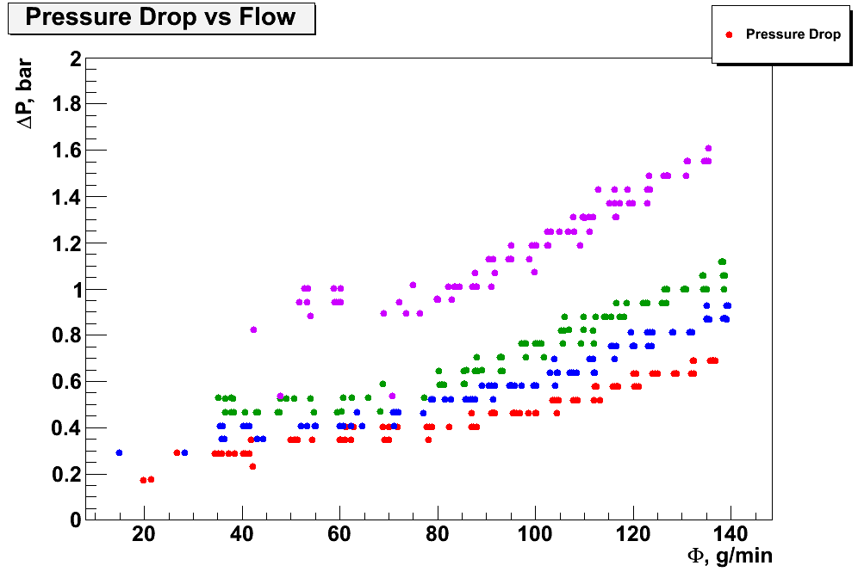
Pressure Drop with Heat Load
Δp, bar
-20°C CO₂ temperature
100 W
50 W
20 W
0 W
Heat load affects pressure drop
The higher the heat load, the higher the pressure drop
Flow, g/min
More investigation on pressure drop needed
Compare measurement with theory models
Improve pressure drop measurement by using dedicated instruments

Slide 11
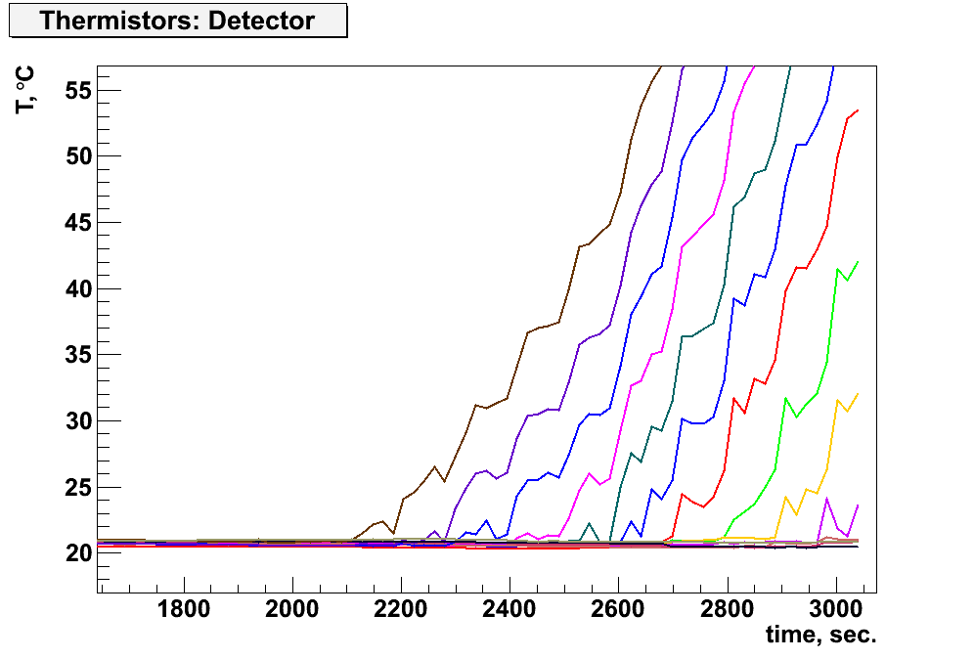
Dryout Measurement
Dryout: pipe walls not in touch with liquid anymore
→ No heat dissipation by evaporating CO₂
Rise in detector temperature
x: vapour quality
x=0
liquid
gas
x=1
Temperature distribution over detector
14
12
10
8
6
4
2
14 thermistors along pipe
Detector temperature, °C
CO₂ temperature: +20°C
13
11
9
7
5
3
1
Keep heat load constant
Decrease flow step by step
Determine where detector temperature rises over nominal value
Decrease flow
Time, s

Slide 12
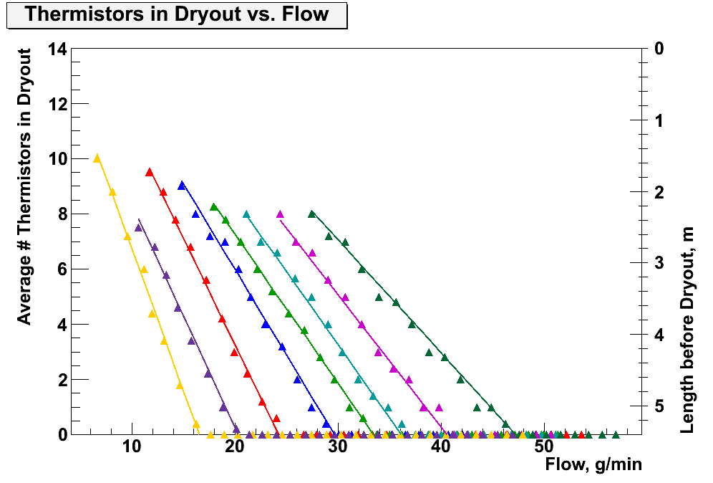
Dryout Measurement @ +20°C
30 W
40 W
50 W
60 W
70 W
80 W
90 W
100 W
CO₂-Temperatur: +20°C
Average No. of Thermistors in Dryout
Length before Dryout, m
Flow, g/min
The higher the heat load, the larger the flow at which dryout is observed

Slide 13
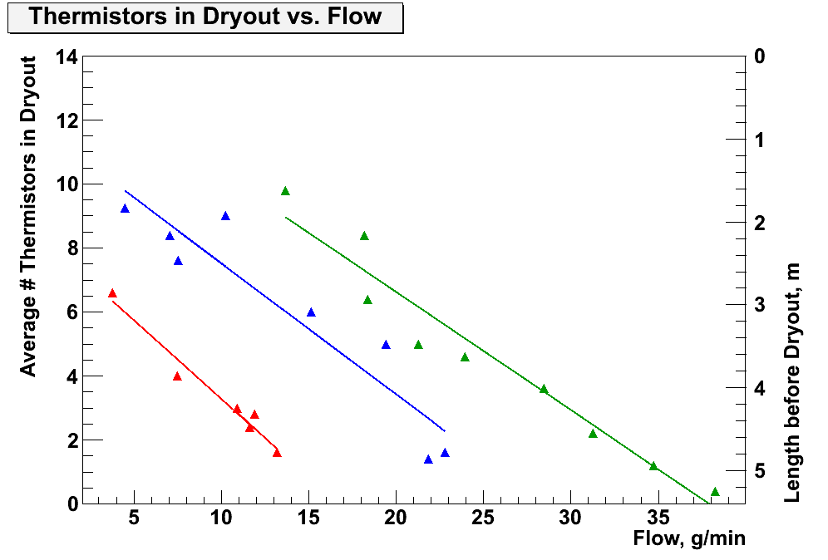
Dryout Measurement @ 0°C
60 W
80 W
100 W
CO₂-Temperatur: 0°C
Average No. of Thermistors in Dryout
Length before Dryout, m
Flow, g/min
At a lower operating temperature: smaller slope, dryout is observed later

Slide 14
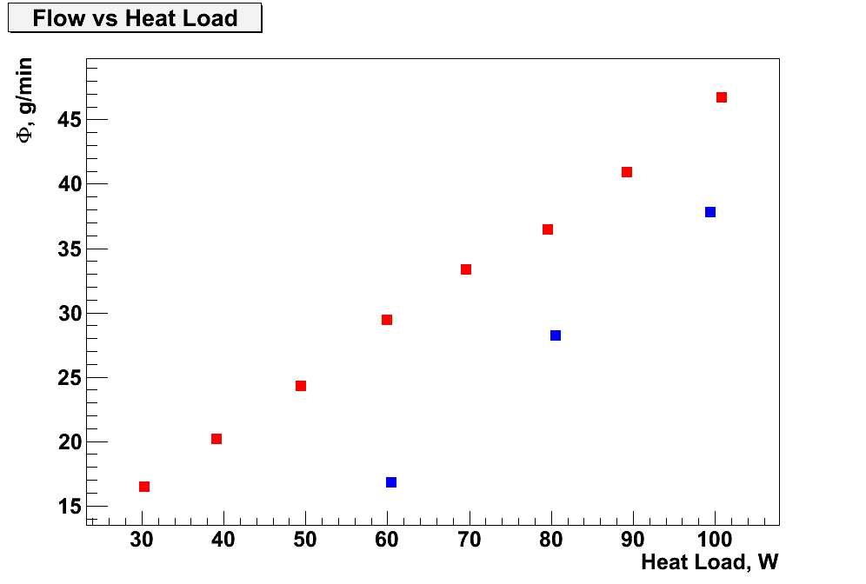
Flow vs. Heat Load
Flow, g/min
CO₂ @ +20°C
CO₂ @ 0°C
Heat Load, W
The higher the heat load, the more flow is needed to dissipate the power
At a lower operating temperature less flow is needed to dissipate certain heat load

Slide 15
Conclusions and Outlook
Evaporative CO₂ cooling system under investigation for phase-I and -II upgrade of the CMS tracker
CO₂ test system in Aachen fully commissioned and operational
First measurements to a temperature of -45°C
Performed measurements on pressure drop and dryout
→ Further analysis and comparison with theory needed
Perform more measurements on pressure and temperature drop along different pipes: vary inner diameter and form/curving
Determine the best cooling contact between heat dissipating devices and cooling system

