Slide 1
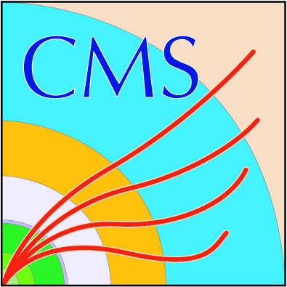
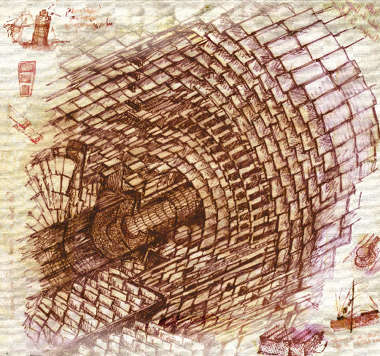
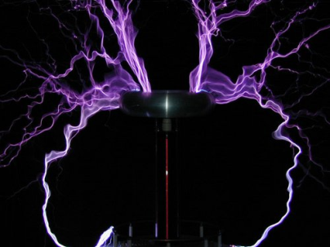
DC-DC Conversion Powering
for the Tracker Upgrades -
A Status Report
L. Feld, R. Jussen, W. Karpinski, K. Klein, J. Sammet
1. Physikalisches Institut B
RWTH Aachen University
CEC Meeting, DESY Zeuthen
May 18th, 2010

Slide 2
Outline
DC-DC conversion
ASIC technology and development (CERN)
Converter development (RWTH Aachen)
Pixel upgrade for phase-1
Tracker upgrade for phase-2
Summary

Slide 3
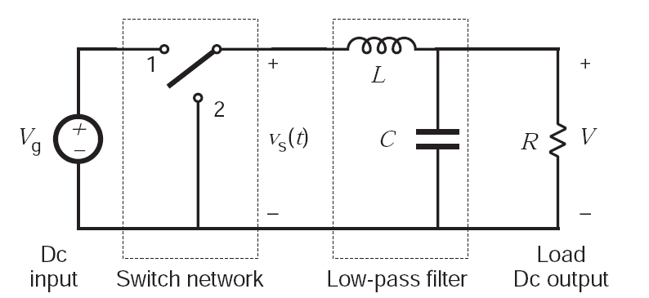
DC-DC Conversion
Tracker needs kWs of power at a low voltage (1.2V) → I = kAmps
P = U x I = (rU) x (I/r) ⇒ supply power at higher voltage, but lower current ⇒ lower Ohmic losses P_{cable} = R_{cable} ⋅ (I/r)² , and less copper in detector volume
DC-DC step-down converters transform V_{in} = rV_{out} to V_{out}, with conversion ratio r
Based on inductors or switched capacitors (“charge pump“)
Focus here on buck converter: simplest inductor-based step-down converter few components, high r, efficiency ~80%, sev. Amps, regulated by feedback loop via PWM
f_{s} = 1-5MHz
⇒ switching noise
Ferrites saturate for B > ~2T
⇒ air-core inductor needed
bulky
radiates
HV-tolerant
semi-conductor
technology needed
radiation-hardness
Efficiency
Material budget
Space constraints

Slide 4
ASIC Technology Evaluation (CERN)
Commercial buck converters are in general not radiation-hard ⇒ custom ASICs
Systematic irradiations of candidate technologies by F. Faccio (CERN) Leakage current, R_{on}, I_{DS} = f(V_{ds}) vs. TID < 350Mrad and fluence < 10¹⁶/cm²
Best candidate: IHP SGB25V GOD 0.25µm SiGe BiCMOS (IHP, Germany)
Back-up: AMIS I3T80 0.35µm (ON Semiconductor, US)
Buck converter ASIC development in both technologies by Stefano Michelis (CERN)
AMIS1 & AMIS2 (available since ~ May 2009)
IHP1 & IHP2 (submitted in Jan. 2010)
Federico Faccio,
CMS/ATLAS Power WG,
at TWEPP-09

Slide 5
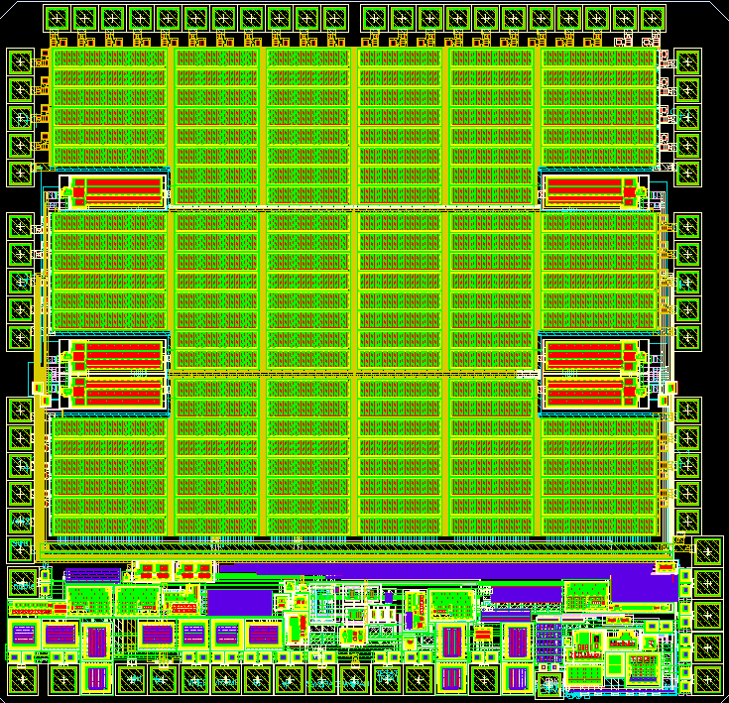
ASIC Development: AMIS2 (CERN)
AMIS2 FEATURES (from data sheet)
VIN and Power Rail Operation from +3.3V to +12V
Internal oscillator fixed at 1Mhz, programmable up to 2.5MHz with external resistor
Internal voltage reference
Programmable delay between gate signals
Integrated feedback loop with bandwidth of 20Khz
Different Vout can be set: 1.2V, 1.8V, 2.5V, 3V, 5V
Lateral HV transistors are used as power switches
Enable pin
St. Michelis, TWEPP-09
switch1
switch2
Irradiation: efficiency vs. TID & fluence; device fully functional up to 300Mrad and 5⋅10¹⁵ p/cm²
Issues: regulation sometimes not working for conversion ratios below 2-3; thermal instability of bandgap reference; no protection features
AMIS2 used by CMS for converter
development, system tests etc.

Slide 6
ASIC Development: IHP2 (CERN)
Most complete prototype up to now - integrated features include:
Linear regulators
Bandgap reference
Overcurrent protection
Improvement in the adaptive logic
Triplication and logic against SEU
Enablers
Efficiency higher than for AMIS2
Schedule:
May-June 2010: testing of first 20 chips
If ok, order of 100 chips
Next submission (IHP3) end of the year
St. Michelis, March 2010
ATLAS/CMS Power WG meeting
IHP2 will be used by CMS for prototyping
- expect to receive chips in summer

Slide 7
Buck Converter Development (Aachen)
Development of low mass, low noise converters with radiation-hard ASICs from CERN for CMS pixels and phase-2 applications
Various converters with AMIS2 ASIC have been made
Vout = 3.3V for pixels
Vout = 1.2V and 2.5V for strip system tests
Version with programmable switching frequency for tests
Large and small chip package
...
Will switch to IHP2 once chips are available (summer)
Prototypes with final ASIC, pre-series and final 1300 converters for pixels
Quality control of production boards
Cost not included in current BMBF funds; estimate being worked out

Slide 8
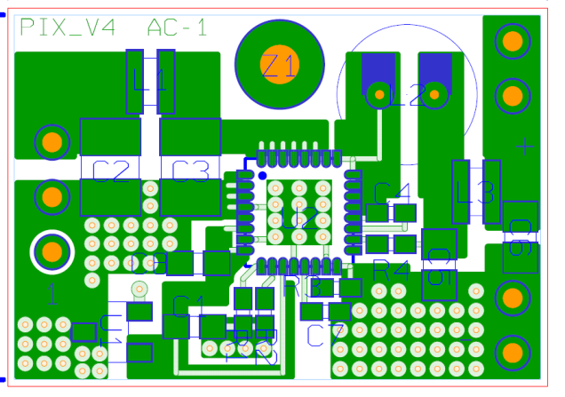
Aachen Converters with AMIS2 ASIC
RWTH AC: development of low mass, low noise converters with rad.-hard ASICs
m = 2.7g
PCB:
2 copper layers a 35μm
FR4 1mm
A = 18mm x 25mm for QFN32
18mm
Chip: AMIS2 by CERN
V_{IN} = 3 - 12V
I_{OUT} < 3A
V_{OUT} = 1.2V, 2.5V or 3.3V
f_{S} ≈ 1.3MHz (V1) or
programmable (V2) betw. 600kHz...4MHz
25mm
Air-core toroid:
Custom-made toroid, ∅ ≈ 6mm,
height = 7mm, L ≈ 600nH, R_{DC} ≈ 80mΩ
Input and output π-filters
L = 12.1nH, C = 22µF
Schematics in back-up slides.

Slide 9
“AC2“ Buck Converter with Enpirion Chip
The “work horse“: buck converter with non-radiation-hard commercial chip
→ used before AMIS2 was available, and still useful for comparison
m = 1.1g
PCB:
2 copper layers a 35μm
FR4, 200µm
V = 2.3cm² x 10mm
m = 1.0g
12mm
Chip: Enpirion EQ5382D
V_{in} = 2.4-5.5V(rec.)/7.0V(max.)
I_{out} ≤ 0.8A
f_{s} ≈ 4MHz
19mm
Air-core inductor:
Custom-made toroid, ∅ ≈ 6mm
L ≈ 600nH
Input/output filters
Snubber to reduce ringing

Slide 10
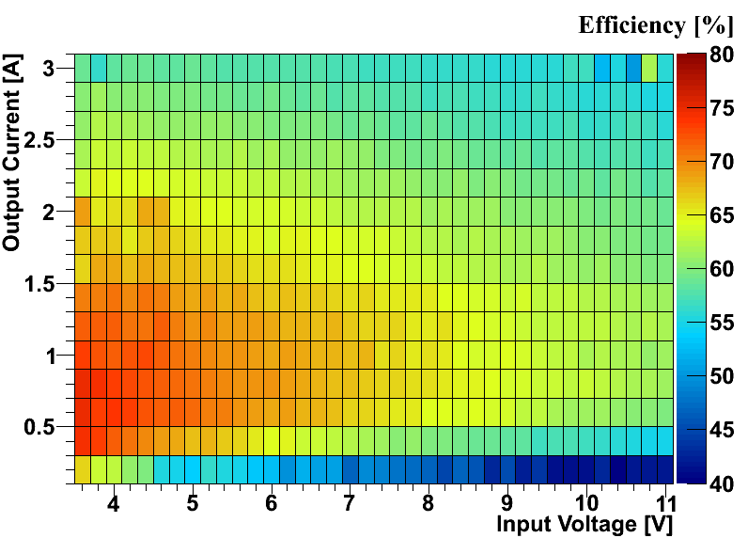
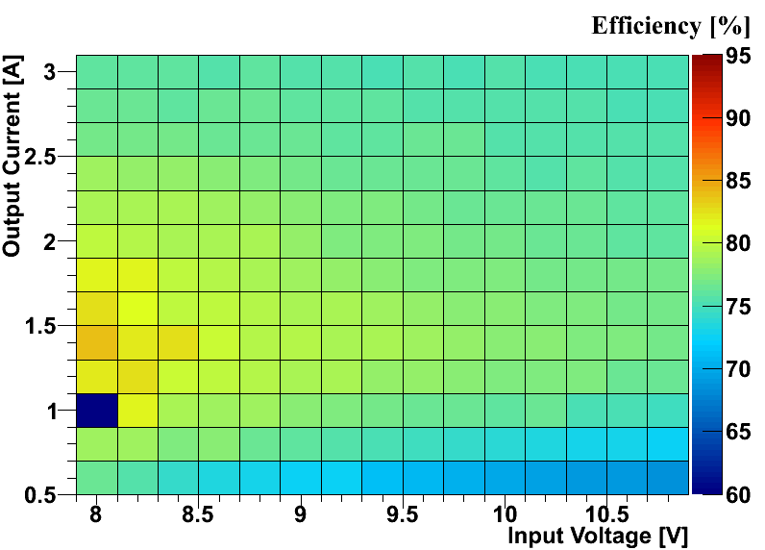
Power Efficiency P_{out}/P_{in}
AMIS2, V_{out} = 1.2V, fs = 1.3MHz
AMIS2, V_{out} = 3.3V, f = 1.3MHz
Phase-2
region
Phase-1
region
Resistive losses (R_{on}, wire bonds, coil ) ~ 1/f_{s}; switching & driving losses ~ f_{s}
Efficiency drops with conversion ratio and current
Phase-1 requirements (I_{out} = 3A, V_{out} = 3.3V, conversion ratio of 2-3): ~ 75% → ok
Phase-2 requirements (I_{out} = 3-5A, V_{out} = 1.2V, conv. ratio = 8-10): ~ 50% → not ok
Further improvements are expected: cooling, flip-chip package, IHP technology ...

Slide 11
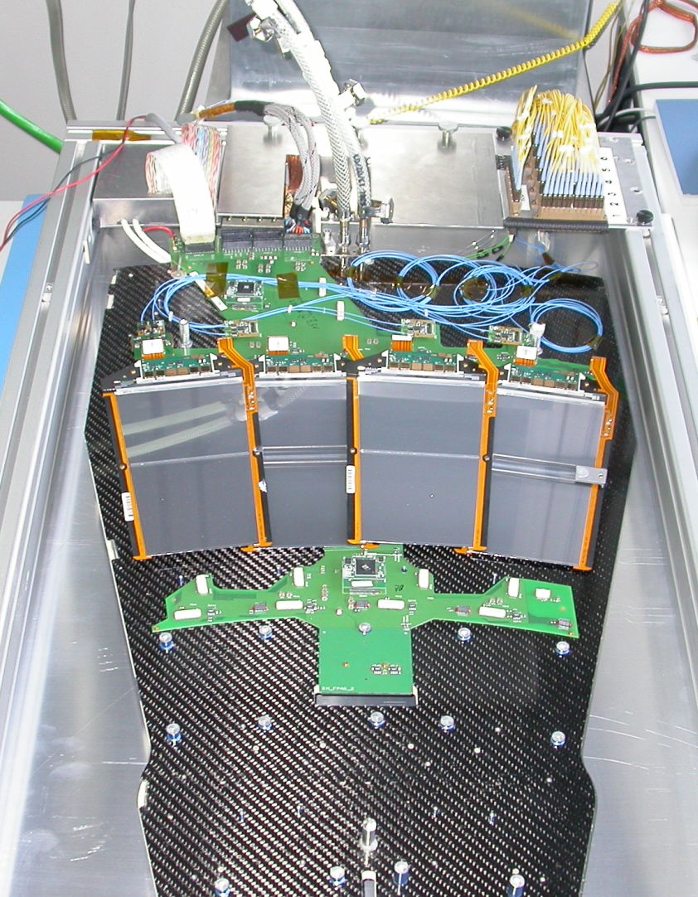
System Test Set-up
SLHC prototype modules not yet available ⇒ existing strip hardware must be used
TEC petal
Ring 6 modules
APV25 :
- τ = 50ns
- 1.25V & 2.50V
- I₂₅₀ = 0.12A, I₁₂₅ = 0.06A
6.4
6.3
6.2
6.1
Motherboard
Two DC-DC converters per module
Integrated via additional adapter
V_{in} from lab power supply

Slide 12
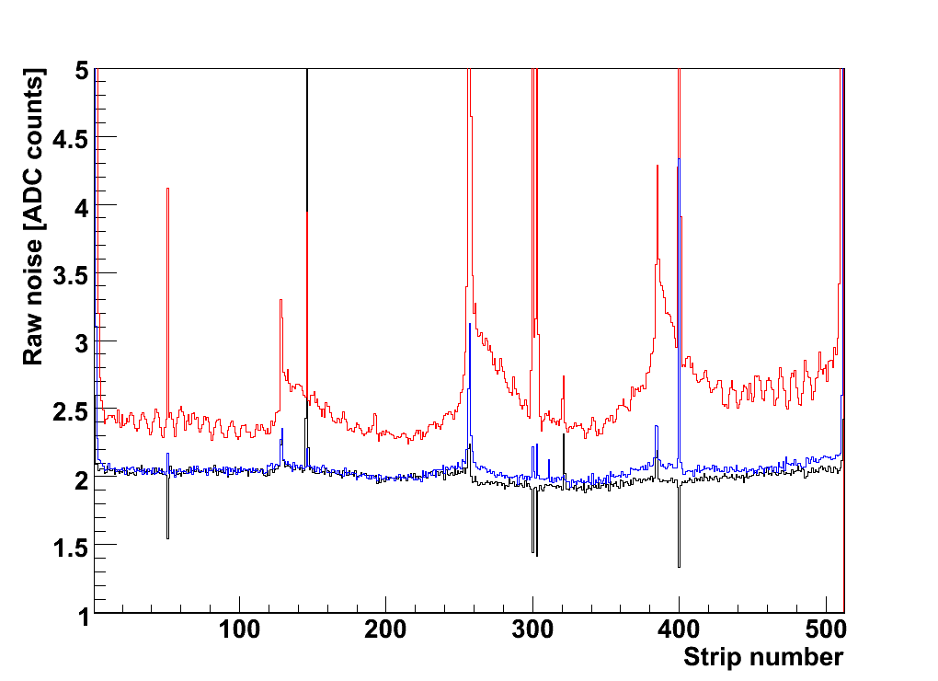
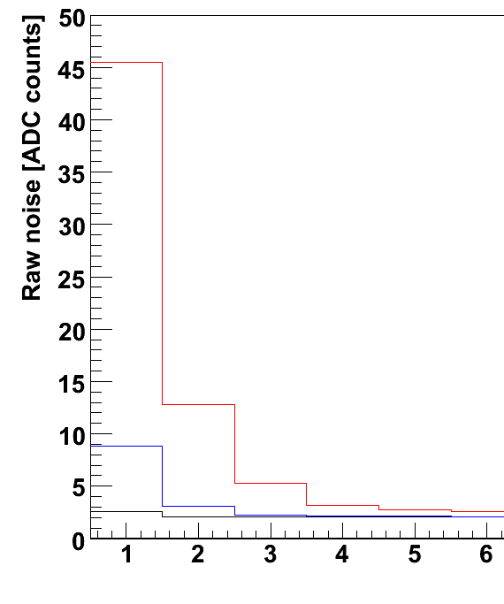
Silicon Strip Module Noise
--- Conventional powering
--- DC-DC converter (AC1, 2008)
--- DC-DC converter (AC2, 2009)
both with Enpirion chip
Zoom onto edge channels
--- Conventional powering
--- DC-DC converter (AC1, 2008)
--- Conventional
powering
--- DC-DC converter
(AC1, 2008)
--- DC-DC converter
(AC2, 2009)
--- Conventional
powering
--- DC-DC converter
(AC1, 2008)
Conventional
powering
Observations:
Conductive Differential Mode noise indeed increases module noise, visible mainly on edge strips due to on-chip common mode subtraction in APV25 (details in back-up)
Magnetic radiation from inductor creates “wings“
Some aspects are special to todays CMS modules (e.g. transistor of pre-amp referenced to 1.25V → high sensitivity to ripple on 1.25V)
K. Klein et al., TWEPP-08 & -09

Slide 13
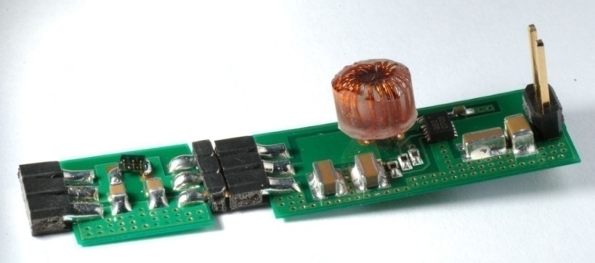
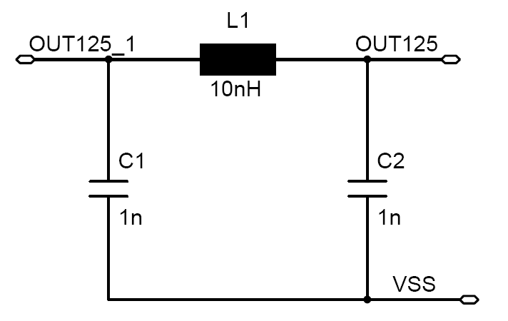
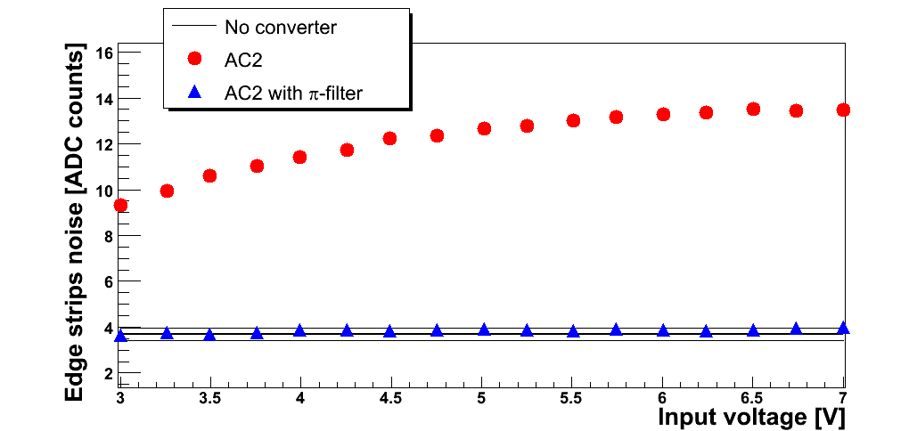
Conductive Noise Filters
Passive π-filters
e.g. L1 = 2.55nH (R_{DC} ≤ 5mΩ)
C = 2.2µF ⇒ f_{cut} ≈ 3MHz
Efficiency loss < 1%
Enpirion converter
With commercial chip and pi-filter we observe no significant extra noise for r ≤ 5

Slide 14
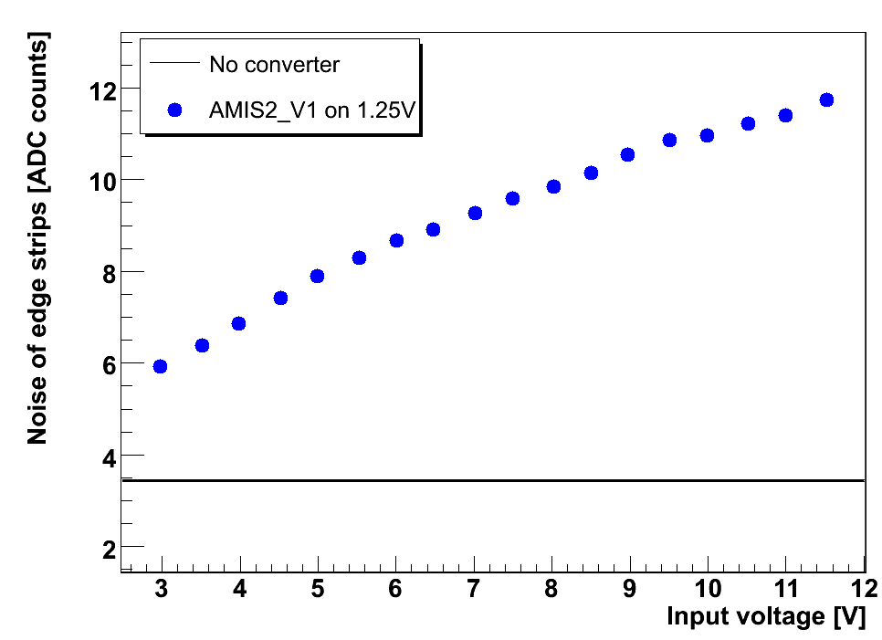
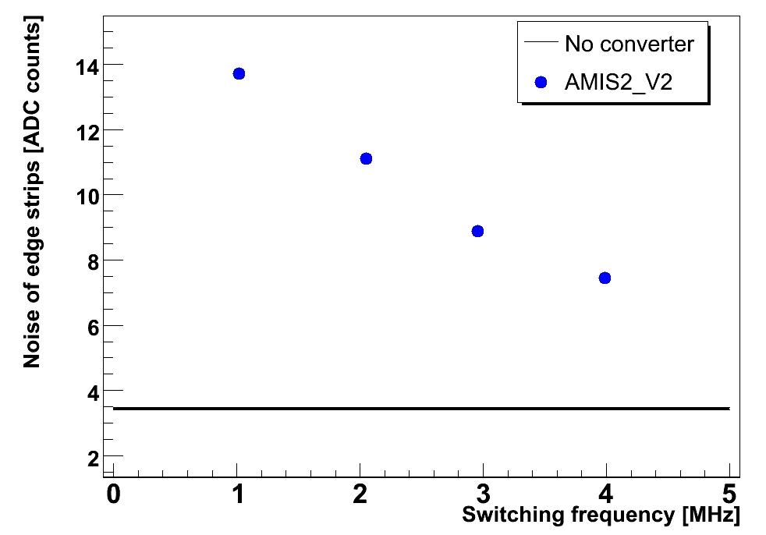
AMIS2 Noise Behaviour
Noise of prototypes has been studied in system test with current strip modules
⇒ Significant conductive and magnetic noise effects
⇒ Noise increases with conversion ratio
⇒ Noise increases for lower switching frequency (as required for efficiency)

Slide 15
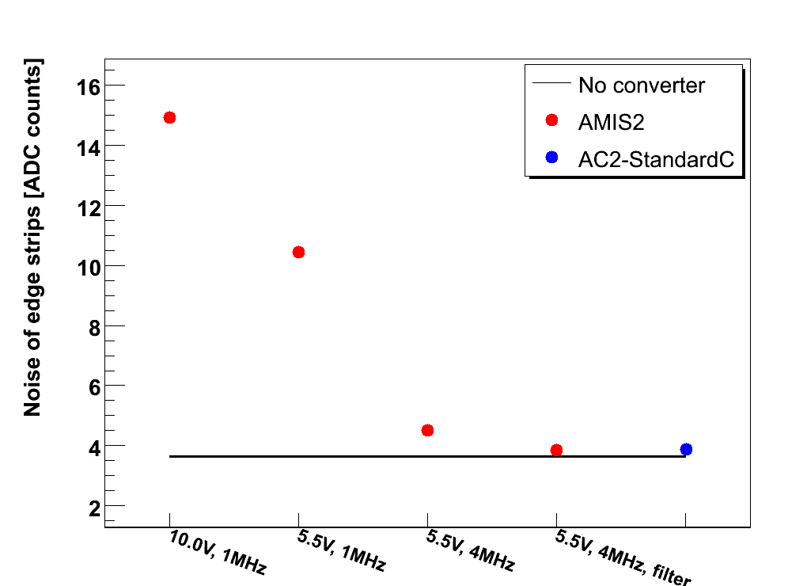
AMIS2 Noise Behaviour
With commercial
converter
5.5V, 4MHz,
external noise filter
AMIS2 board adds no extra noise for conversion ratio of 2-3, 4MHz and external pi-filter – just as Enpirion converter!
On-board pi-filters work not as well as external pi-filters
Further R&D required

Slide 16
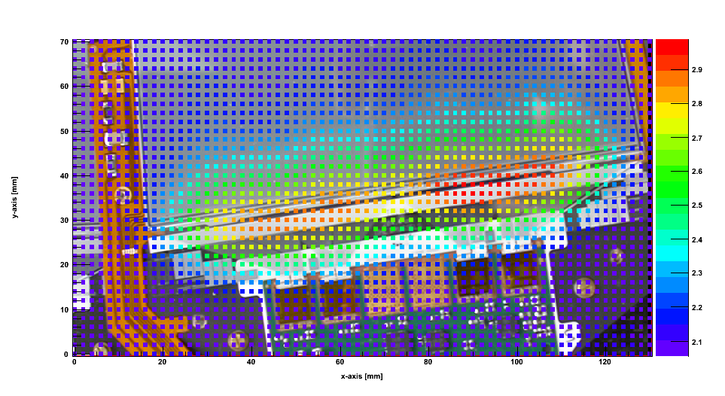
Study of Coupling Mechanisms
Small B-field probe operated from sinus-wave generator
Scanning table set-up to move B-field emitter across strip module
Most sensitive region: pitch adapter!
Theory: B_{z} couples into loops formed by pairs of strips (closed via capacitive coupling to backplane)
Mean module noise [ADC counts]

Slide 17
DC-DC Converters for Pixels at Phase-1
Number of ROCs increases: BPIX: 11 520 → 19 456; FPIX: 4 320 → 10 756 → More readout chips per cable and per power supply
Multi-service cables cannot be exchanged
Supplied by CAEN A4603 power supply modules
Want to keep power supplies, if possible (perhaps with light modifications)
FPIX: might cope without DC-DC converters (cables for 3rd disk already installed)
BPIX:
Increase of heat load in cable channels by a factor of 3
Required power cannot be delivered by todays’ power supplies
Decision in June 09 to go for buck converters, located on far end of supply tube
Low conversion ratio (~ 2:1) to be compatible with voltage specification of PS

Slide 18
Modularity
PSI46 ROC needs two supply voltages: V_{ana} ≈ 1.5V and V_{dig} ≈ 2.5V
A4603
4-5 converters
DC-DC
analog
4 barrel modules
per converter
PSU
V_{ana}
MS cable
4-5 converters
DC-DC
digital
4 barrel modules
per converter
V_{dig}
PSU
FPIX: 2 blades per DC-DC converter

Slide 19
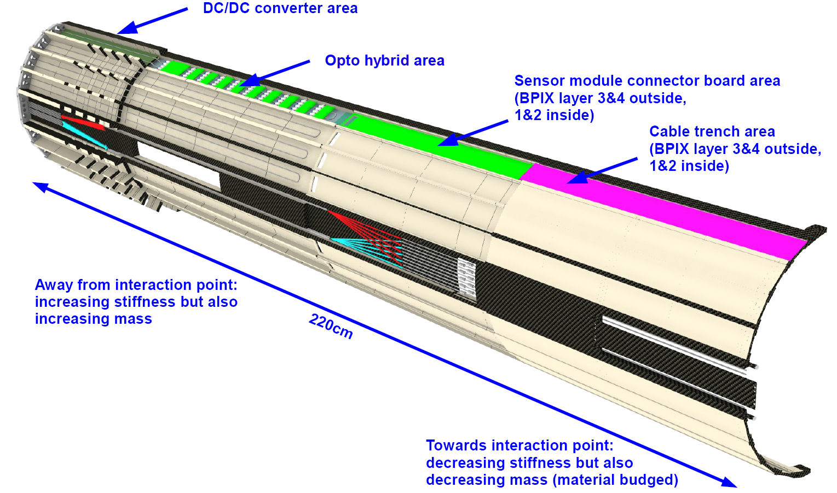
Integration onto Supply Tube
Silvan Streuli, 28/10/2009
PCB with DC-DC converters at far end
Cooled by CO₂ cooling loops
Mock-up in preparation at RWTH AC

Slide 20
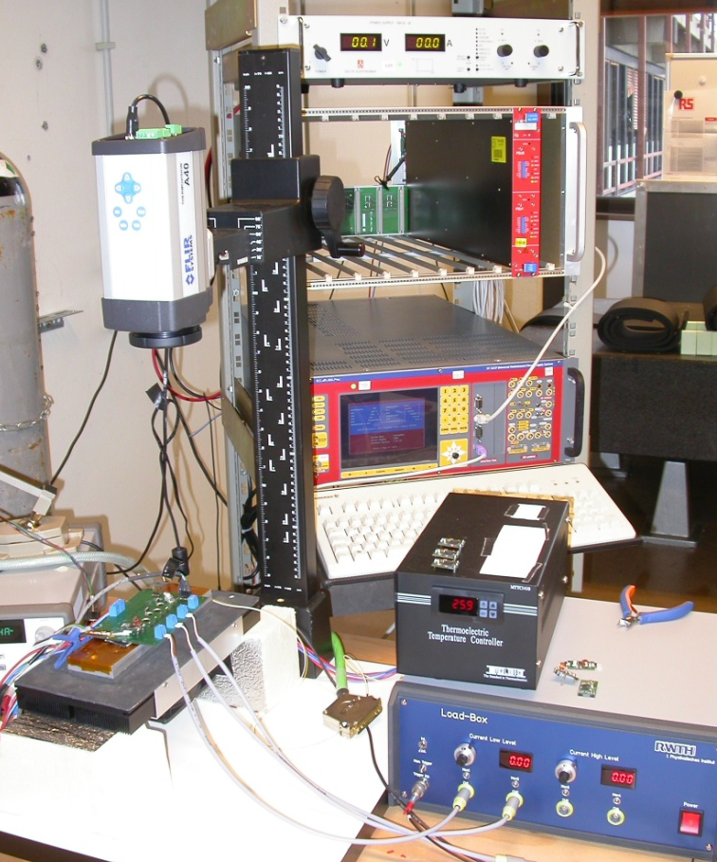
System Aspects
Operation with 40m long cables and A4603 CAEN power supplies
Remote sensing of CAEN power supplies at input of DC-DC converters
Stability of V_{out} during fast load variations on digital line
Digital activity lower during orbit gaps (3µs)
I_{dig} = 2.7A → 1.9A for L = 2⋅10³⁴/cm²/s
Changes within one to few bunch crossings
Noise sensitivity of PSI46 - should be low due to linear regulators on chip
System tests & simulations started at FNAL and RWTH Aachen
IR camera
48V
A4603
SY
Peltier +
controller
PCB with
4 converters
Loadbox

Slide 21
“Specs“ for Pixel DC-DC Converters (I)
Numbers are still subject to changes.
Converter type: Inductor-based non-isolated step-down converter, probably of buck-type, integrated on a separate PCB.
Conversion ratio V_{in}/V_{out}: 2 - 3
Output voltage V_{out}: V_{ana} = 2.3V V_{dig} = 3.5V
Input voltage V_{in} (for 1:2): V_{ana} = 4.6V V_{dig} = 7.0V
Output current I_{out}: < 2.8A (in some detector regions up to 4.9A)
Switching frequency: 1 - 2 MHz Low frequency to maximize the efficiency.
Efficiency: ≈ 80%

Slide 22
“Specs“ for Pixel DC-DC Converters (II)
Dissipated power: 2-3W per converter for 80% efficiency. → Active cooling has to be foreseen.
Dimensions of PCB: Length = 3.2cm, width = 2cm, height <1.4cm
Small piggy-board with board-to-board connectors
Material budget / weight: Since these converters are at z = 2.0-2.3m and r ~ 19cm they are absolutely outside of the tracking region and therefore uncritical in mass and material budget. The only concern is the use of material with little activation.
Output voltage ripple: Since the PSI46 ROC has rather fast on-chip regulators, the requirements for ripple are very relaxed.
Radiation environment: 19cm radius, z = 2.3m, 700fb⁻¹, safety factor = 2: Fast hadrons fluence: 6-7 x 10¹⁴ /cm² Dose: 200kGy
Specific requirements: Behaviour for very fast load variations due to orbit gaps. Stability of operation together with long pixel cables and the CAEN A4603 power supply modules.

Slide 23
DC-DC Converters for Phase-2
Outer Tracker for tracking plus track trigger layers
Requirements are driven by stacked layers for track trigger
Quantity | Requirement | Comments
Radiation level | Fast hadron fluence: ~9x10¹⁵/cm²; Dose: ~1.3MGy | For R > 20cm, z < 3m, 5000fb⁻¹, safety factor of 2
Output voltage | V_{ana} = 1.2V V_{dig} = 0.9V | Assuming 130 or 90nm (+ V_{opto} = 2.5V, 1.5V)
Output current | 3-5A | → 2 converters per double module
Conversion ratio | Up to 10:1, depends on proposal | Max. current in cable channels 15kA Assuming ~100kW & 80% efficiency
Efficiency | 70-80% | Losses need to be cooled
Conductive noise (DM, ripple) | Depends on PSRR of the ROC (still to be studied) | Can be filtered
Common mode noise | ? As low as possible... | Notoriously hard to control
Radiated noise (magnetic near field) | Ideally none – converter close to module | Minimize with distance, shielding, module design
Material budget | Critical since installed at low R | Expect 1-2g per converter
Real estate | No space on FE-hybrid | 2-4cm² per converter must be found
Much more demanding application!

Slide 24
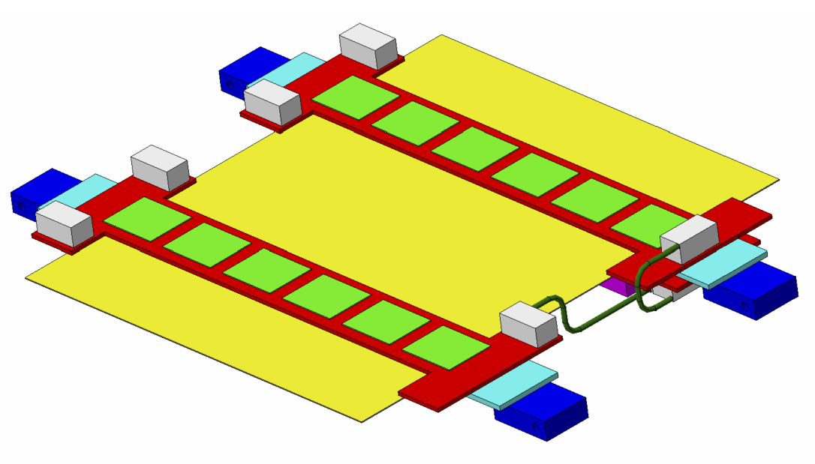
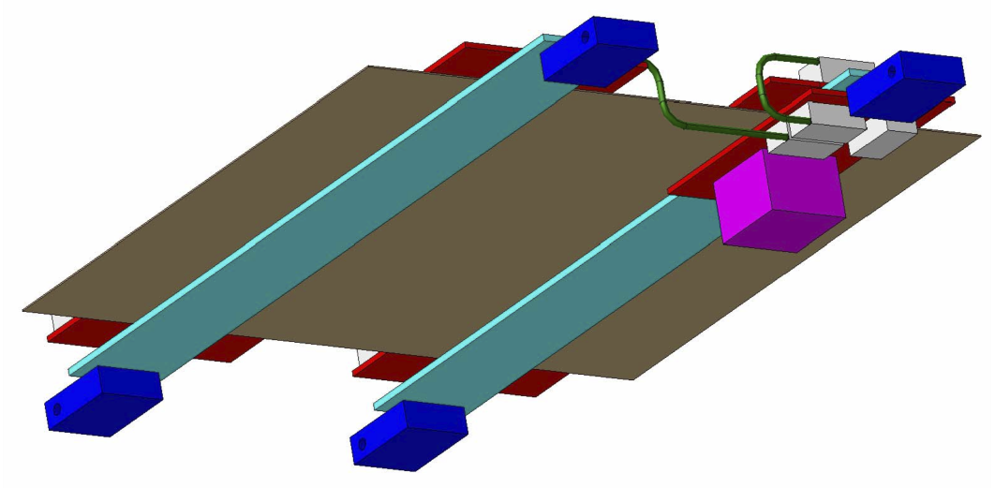
DC-DC Converters for Outer Tracker
Power requirements: 1.5W per module
Idea: 1.2V delivered by buck converter; required conversion ratio ~ 4
Space is tight – various ideas:
move into 3rd dimension
integrate into support structure
Waiting for CBC and module prototypes
Top
Bottom
sensor
CBC
DC-DC
converter
cooling block
TPG strips
hybrid

Slide 25
Double Stacks for Track Trigger
Converters could be integrated into support structure:
no space on hybrid required
larger distance → less magnetic field
easier shielding (e.g. by existing Carbon Fibre structures)
much easier cooling
Kapton bus needed anyway for GBT and by-pass capacitors
decoupling of module & converter R&D, QA etc.
Marvin Johnson,
CMS Upgrade WS, 2009
Per 100cm² double-module:
⇒ 2 PCBs a ≈ 4cm² ~ ok
100cm²
20cm
A lot of space also inside beam

Slide 26
Summary
CERN group has identified ASIC technology and developed several chip prototypes
Final chip to be delivered by 2011 - end of this CERN R&D project
Low noise converters with commercial chips developed at RWTH
AMIS2 boards have similar performance for same operating parameters
Pixel application (considered easy) is our priority
Hope to have final chip and converter in 2011
Production in 2012
Phase-2 application is more demanding, further R&D required to improve efficiency and noise

Slide 27
Back-up Slides

Slide 28
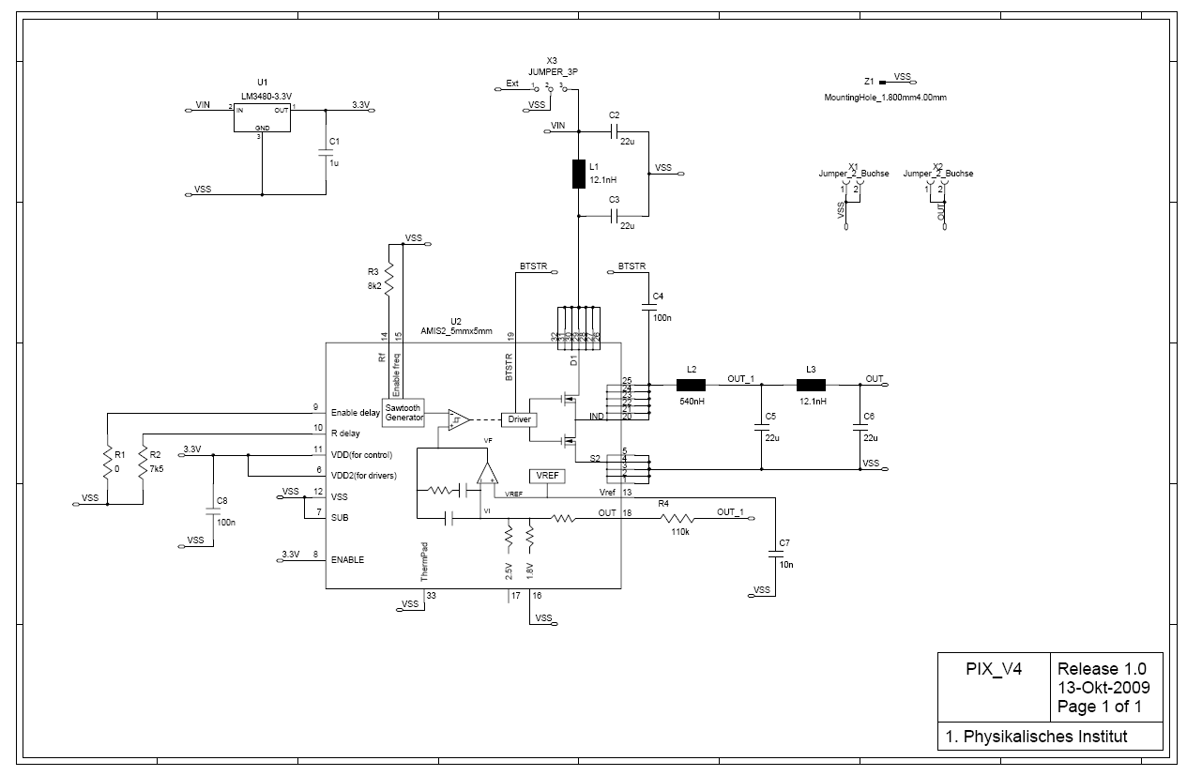
AC_AMIS2 Schematics (PIX_V4)
W. Karpinski, I. Özen (RWTH Aachen)

Slide 29
On-Chip Common Mode Subtraction
128 APV inverter stages powered from 2.5V via common resistor (historical reasons) ⇒ mean common mode (CM) of all 128 channels is effectively subtracted on-chip
Works fine for regular channels which see mean CM
CM appears on open channels which see less CM than regular channels
CM imperfectly subtracted for channels with increased noise, i.e. edge channels
pre-amplifier
inverter
V250
V250
R (external)
V125
strip
v_{CM}
v_{IN}+v_{CM}
v_{OUT} = -v_{IN}
VSS
Node is common to all 128 inverters in chip

Slide 30
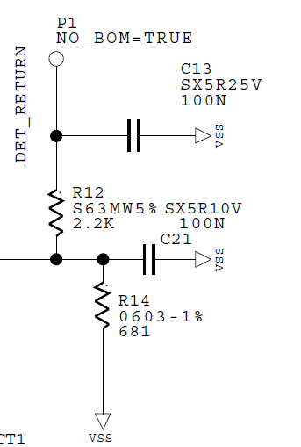
Module Edge Strips
APV25 pre-amplifier
V250
V125
strip
bias ring
VSS=GND
[Mark Raymond]
Edge strips are capacitively coupled to bias ring
Bias ring is AC coupled to ground
Pre-amplifier is referenced to 1.25V
If V125 is noisy, pre-amp reference voltage fluctuates against input
This leads to increased noise on edge channels
[Hybrid]

Slide 31
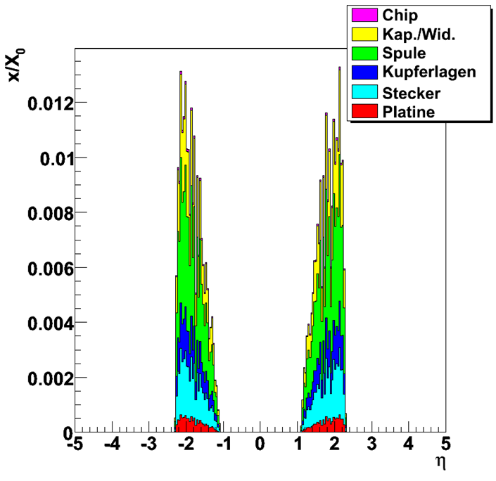
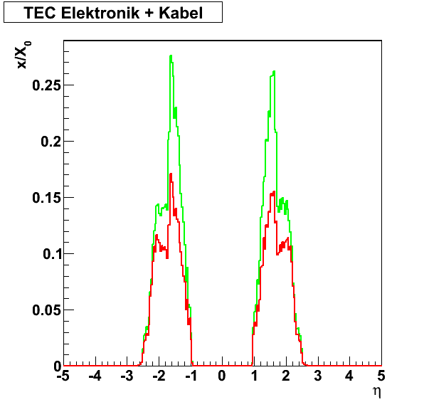
Material Budget (MB)
Motivation for new powering schemes is to save material inside the tracker
Detailed study of Enpirion-converter, 1 per Tracker End Cap module, located on FE-hybrid
Assumptions: 80% efficiency, r = 8, Iout = 2A per module, Uout = 1.2V
Simulation of current tracker layout with CMS software based on GEANT4
⇒ Converter adds 10% of strip module, but still saves 30% in electronics & cables
MB of End Cap buck converters
Chip
C‘s & R‘s
Toroid
Copper layers
Connector
FR4 of PCB
MB of electronics & cables
Without DC-DC
With DC-DC
- 30.9%

Slide 32
Load Variation during Orbit Gaps
Enpirion 5336QI
AMIS2
Iout
Vout
150mV
~ 300mV
Vin
Trigger
Load variation clearly visible with EN chip
Inacceptable large U_{out} variation for AMIS2
Can be damped with additional caps at the converter output → mass, space
Work in progress...

