Slide 1
Clustering
UPDate
11-03-2021

Slide 2
News
Before:
Each pad in a small cluster was considered separately.
After:
Small clusters were added if any pad was within Moliere radius.
Numbers are slightly better:
Average number of cluster – decreased by 2
Average energy fraction of main cluster – increased by 0.002
Updated histograms in next slides

Slide 3
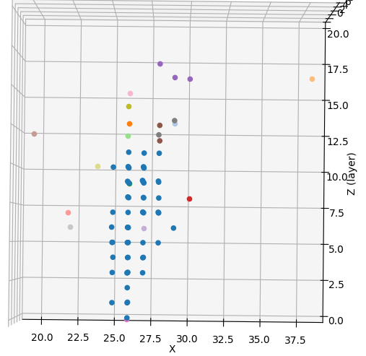
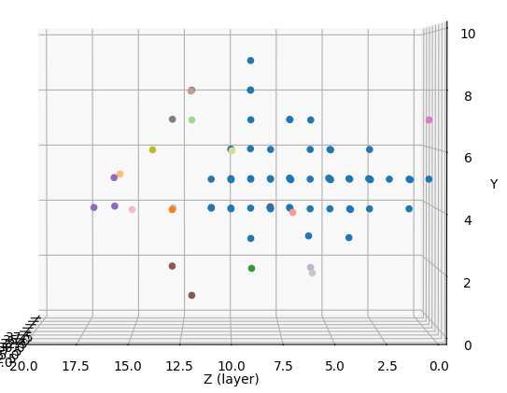
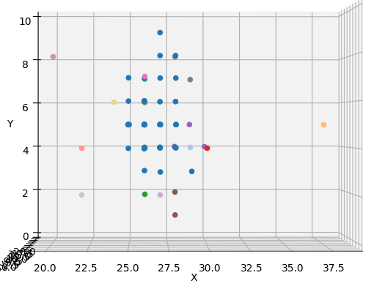
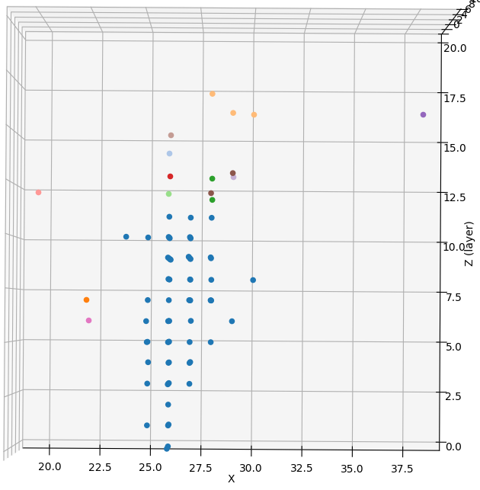
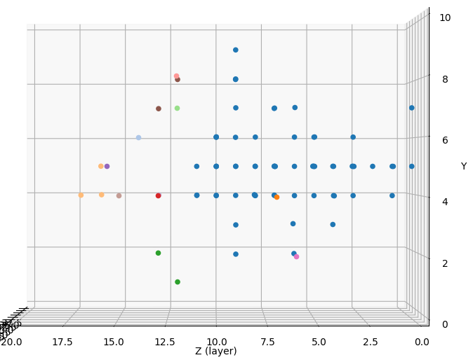
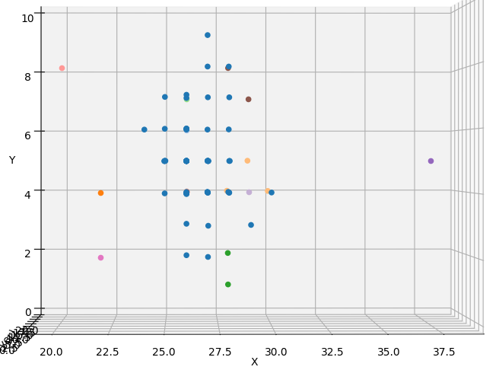
UPDATED
BEFORE CONNECTION
4 GeV
AFTER CONNECTION

Slide 4
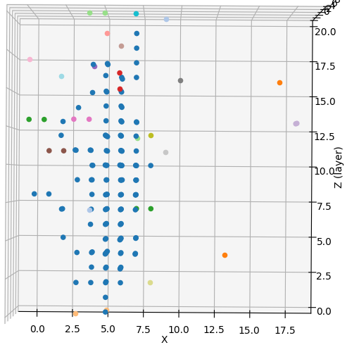
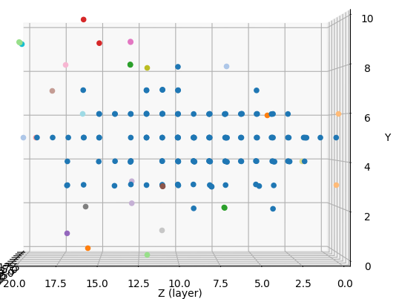
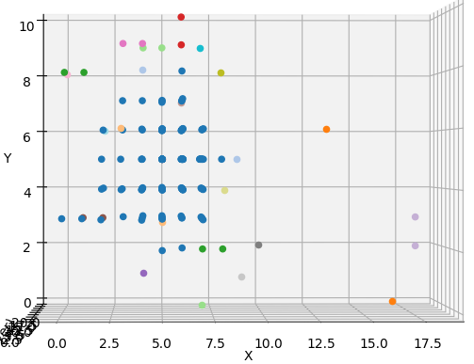
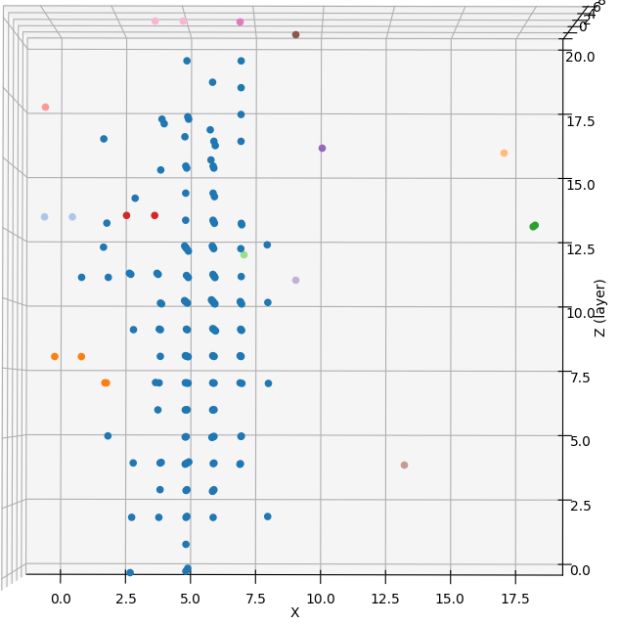
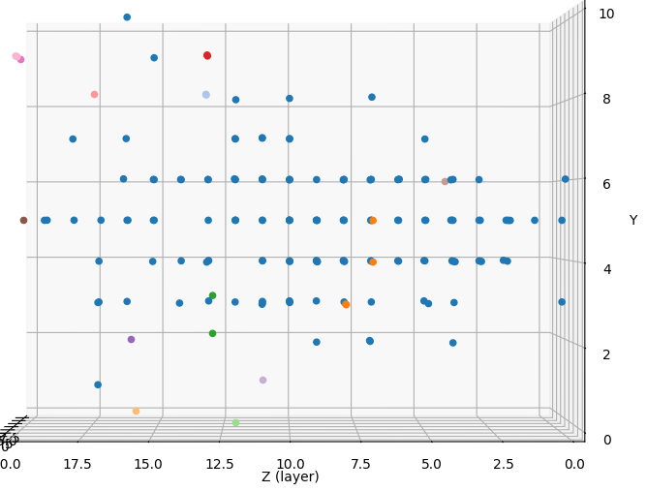
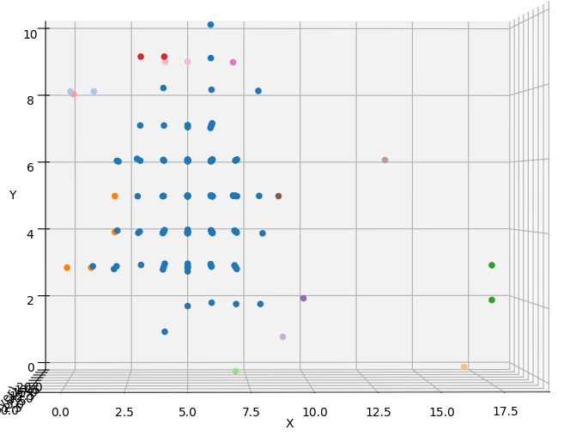
UPDATED
BEFORE CONNECTION
10 GeV
AFTER CONNECTION

Slide 5
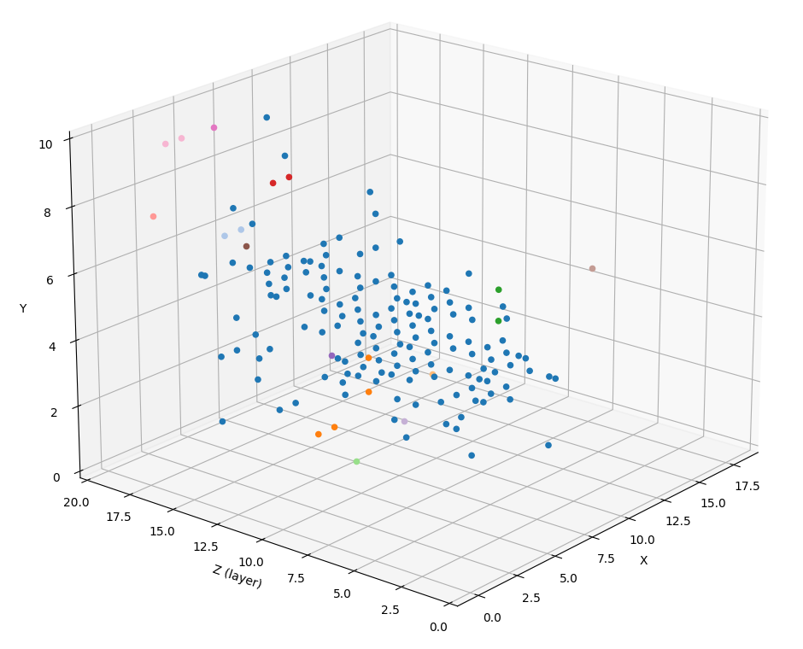
10 GeV UPDATED
UPDATED

Slide 6
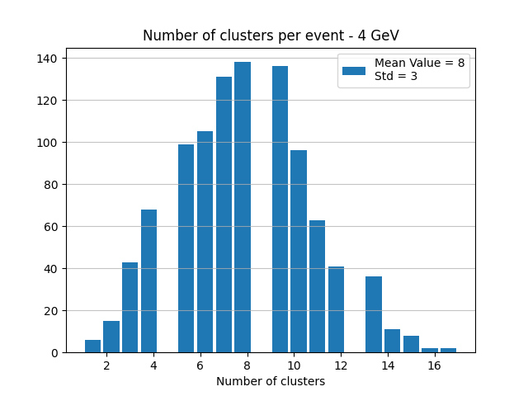
4 GeV
UPDATED
BEFORE CONNECTION
AFTER CONNECTION

Slide 7
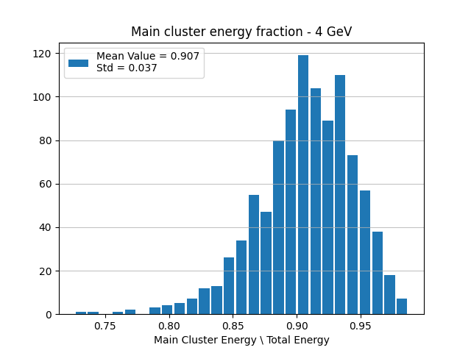
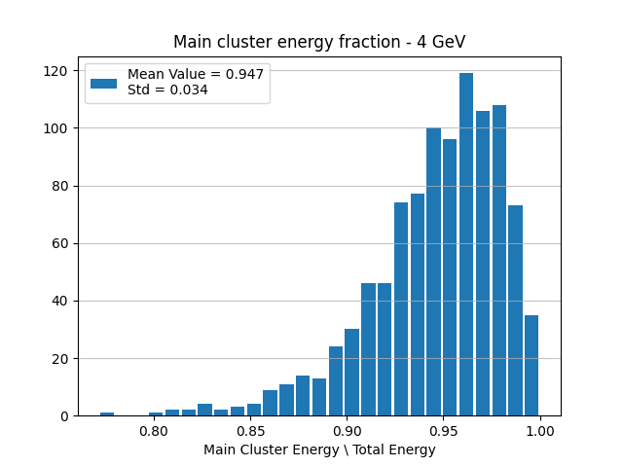
4 GeV
UPDATED
BEFORE CONNECTION
AFTER CONNECTION

Slide 8
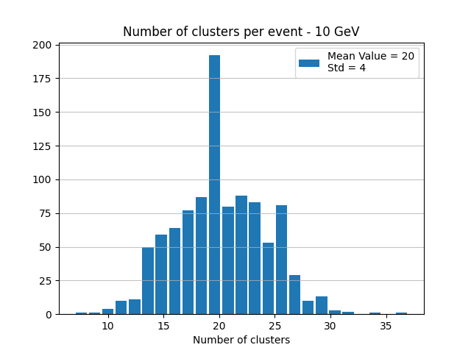
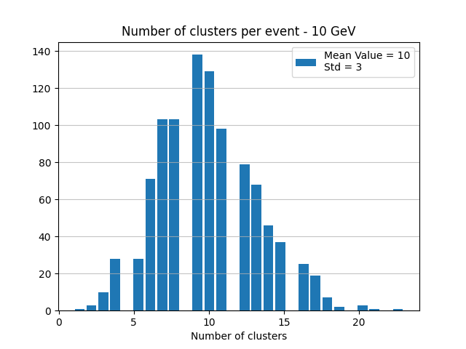
10 GeV
UPDATED
BEFORE CONNECTION
AFTER CONNECTION

Slide 9
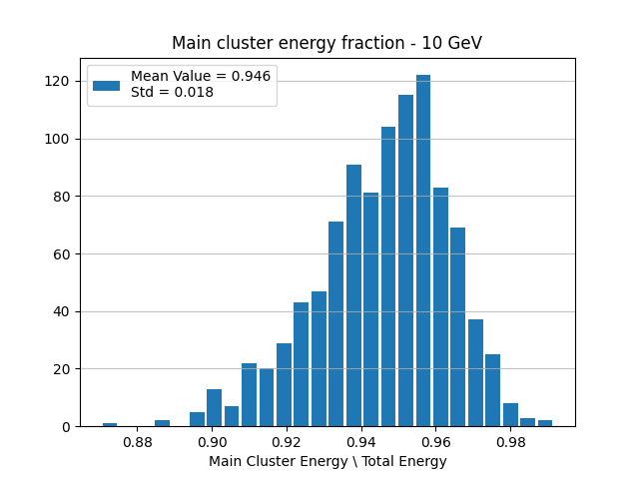
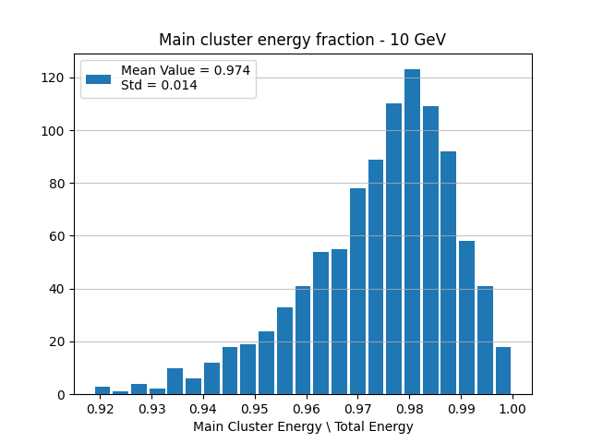
10 GeV
UPDATED
BEFORE CONNECTION
AFTER CONNECTION

Slide 10
Affect of radius on clustering
Increased the radius around the main cluster gradually.
Results are improving very slowly.
Not necessarily the solution to the large number of clusters.

Slide 11
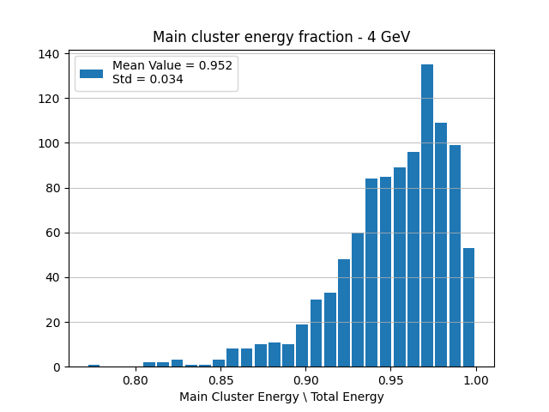
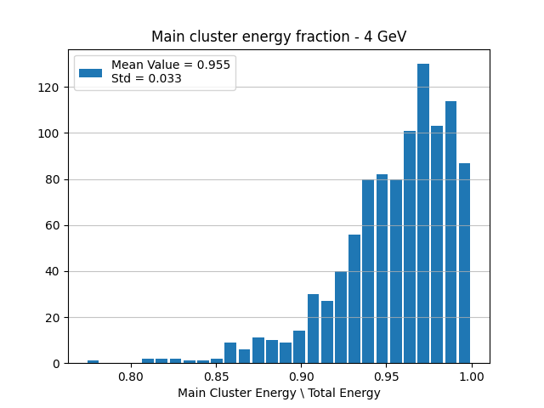
4 GeV – Main cluster energy fraction
2.5 cm
2.8 cm
3.1 cm

Slide 12
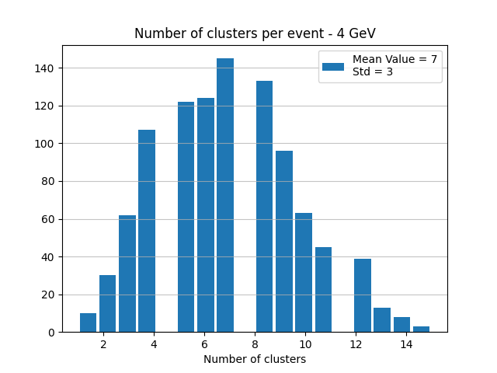
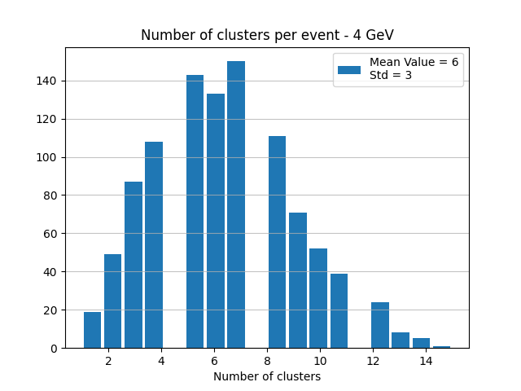
4 GeV – Number of clusters
2.5 cm
2.8 cm
3.1 cm

Slide 13
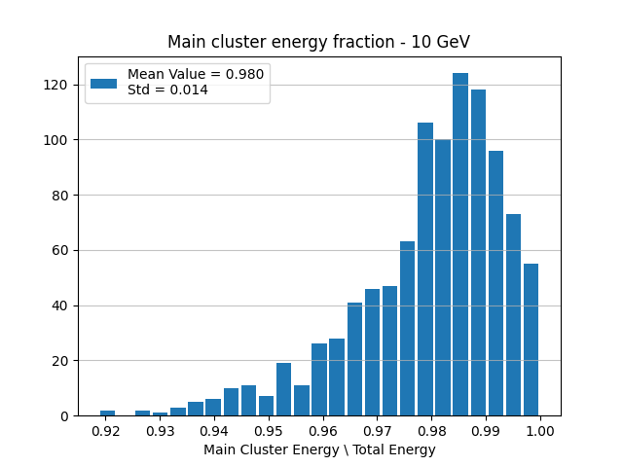
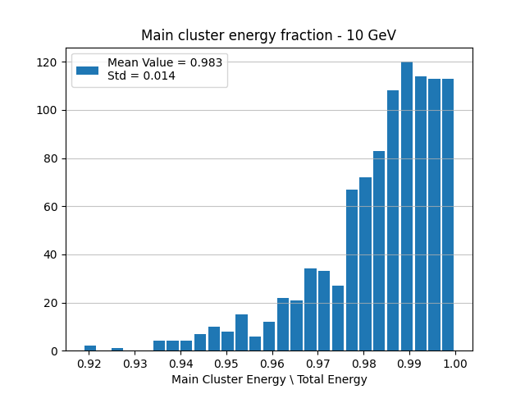
10 GeV – Main cluster energy fraction
2.5 cm
2.8 cm
3.1 cm

Slide 14
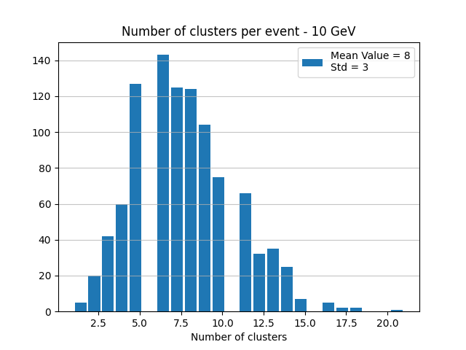
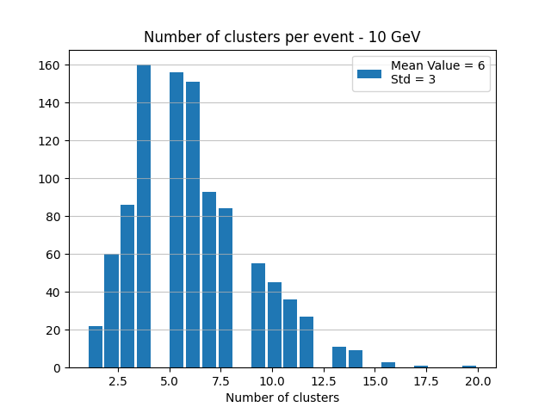
10 GeV – Number of clusters
2.5 cm
2.8 cm
3.1 cm

Slide 15
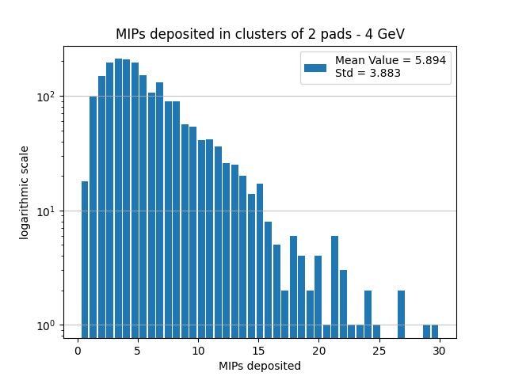
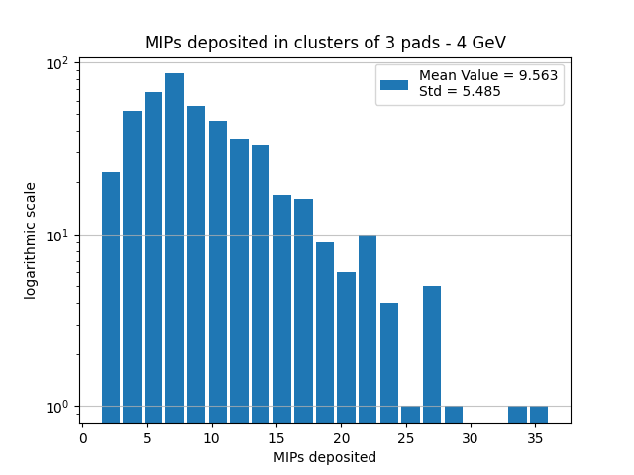
4 GeV – MIPs by cluster size
1 pad
2 pad
3 pad

Slide 16
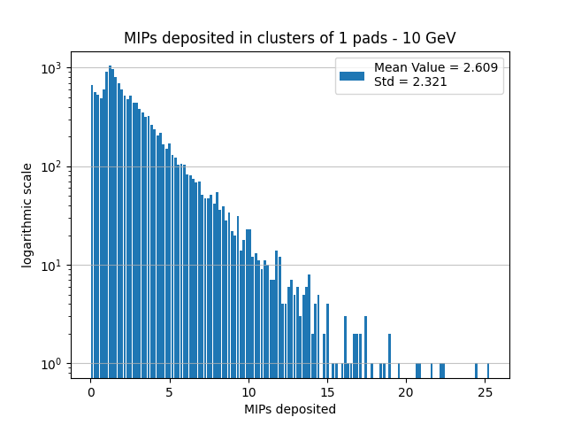
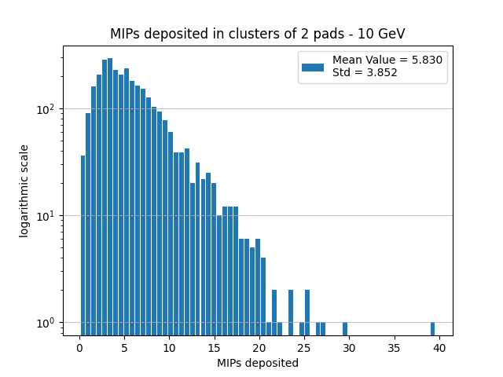
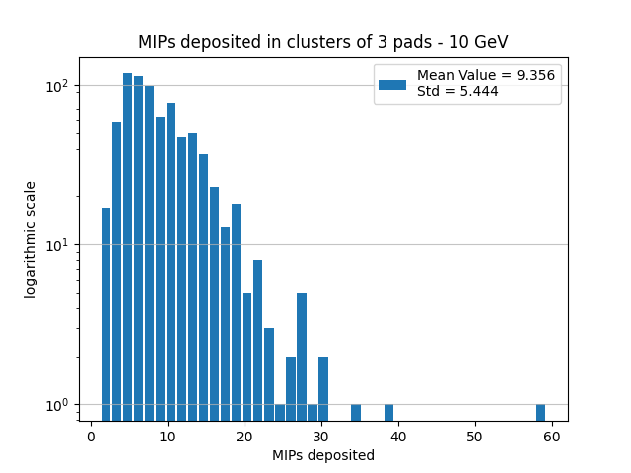
10 GeV – MIPs by cluster size
1 pad
2 pad
3 pad

Slide 17
And the result? (for now)
What is left outside the main cluster, after we attach small clusters within radius of 2.5 cm?
In next slides:
Distributions of energy and MIPs deposited in satellite clusters, after the final clustering.

Slide 18
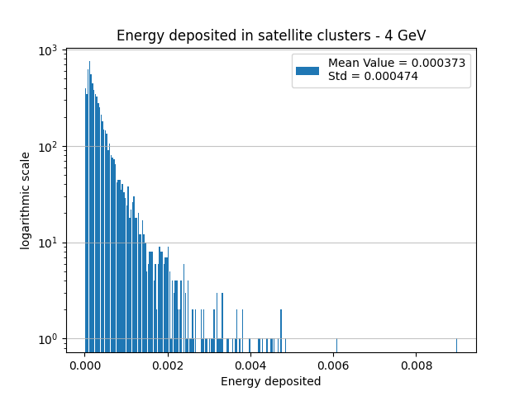
4 GeV – Edep in satellite clusters

Slide 19
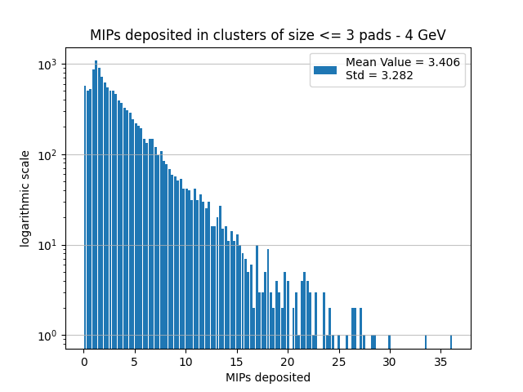
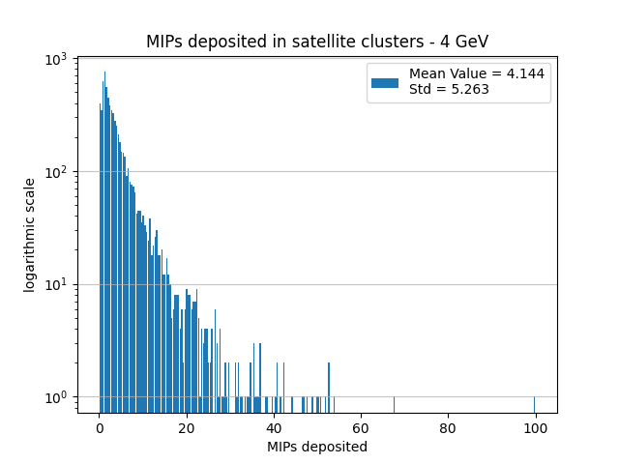
4 GeV – MIPs in satellite clusters
<= 3 pads
All satellites

Slide 20
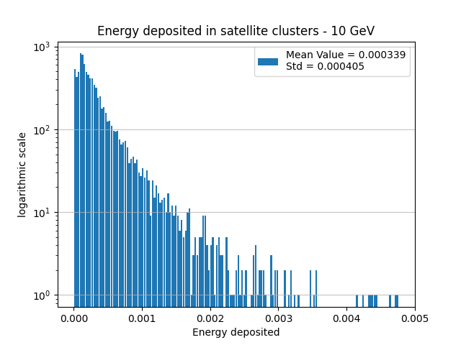
10 GeV – Edep in satellite clusters

Slide 21
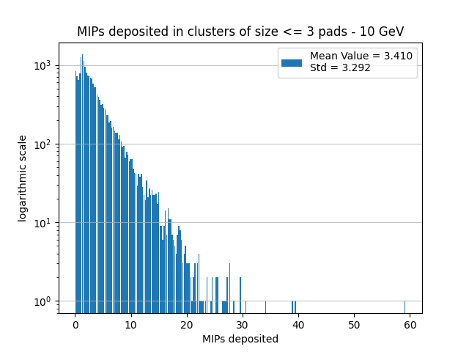
10 GeV – MIPs in satellite clusters
<= 3 pads
All satellites

Slide 22
To do
Apply a looser criteria for the in-depth clustering.
(Discussed previously).

